Slide 1





Simultaneous OptimiSation of Multiple-Effect Evaporation Systems and Heat Exchanger Network
Elvis Ahmetović^{a,*}, Midhat Suljkanovićª, Zdravko Kravanja^{b}, François Maréchal^{c}, Nidret Ibrićª, Maziar Kermani^{c}, Miloš Bogataj^{b}, Lidija Čuček^{b}
ªUniversity of Tuzla, Faculty of Technology, Univerzitetska 8, 75000 Tuzla, Bosnia and Herzegovina
^{b}University of Maribor, Faculty of Chemistry and Chemical Engineering, Smetanova 17, 2000 Maribor, Slovenia
^{c}EPFL/ Industrial Processes & Energy Systems Engineering Group (IPESE), Valais Wallis, 1951 Sion, Switzerland
20th Conference on Process Integration, Modelling and Optimisation for Energy Saving and Pollution Reduction (PRES'17), August 21-24, Tianjin, China

Slide 2
Presentation outline
INTRODUCTION
SHORT OVERVIEW OF RESEARCH PROBLEMS
PROBLEM STATEMENT
SUPERSTRUCTURE
MODELLING AND SOLUTION APPROACH
CASE STUDY
CONCLUSIONS

Slide 3
Introduction to evaporation
What is evaporation?
One of the most energy-intensive unit operations
Industrial applications
Concentrating the various feed systems such as milk, fruit and vegetable juices, black liquor in pulp and paper industry, salt water for food grade salt production
Producing freshwater within desalination processes
Wastewater treatment processes
How to reduce energy consumption?
Multiple Effect Evaporation (MEE)
Mechanical/Thermal Vapour Compression (MVC/TVC)
Feed stream preheating (energy from condensates, vapours or other process streams)
Heat integration of Multiple Effect Evaporation Systems (MEES) with the background process

Slide 4
SHORT OVERVIEW of RESEARCH PROBLEMS
Analysis and steady-state simulation (Stewart and Beveridge, 1977)
Design (Nishitani and Kunugita, 1979) and Optimisation of steam economy (Verma et al., 2016) for various flow-patterns with and without pre-heating (Kaya and Sarac, 2007)
Optimisation of the number of effects minimising the total annualised cost and maximising the net present value (Simpson et al., 2008)
Multiple Effect Evaporation system with Thermal Vapour Compression (TVC) –solar assisted (Sharan and Bandyopadhyay 2017)
Multiple Effect Evaporation system with Mechanical Vapour Compression (MVC) (Onishy et al. 2017)
Stewart G., Beveridge G.S.G., 1977, Steady-State Cascade Simulation in Multiple Effect Evaporation, Computers & Chemical Engineering, 1, 3-9.
Nishitani H., Kunugita E., 1979, The Optimal Flow-Pattern of Multiple Effect Evaporator Systems, Computers & Chemical Engineering, 3, 261-268.
Verma O.P., Mohammed T.H., Mangal S., Manik G., 2016, Optimization of Steam Economy and Consumption of Heptad’s Effect Evaporator System in Kraft Recovery Process, International Journal of System Assurance Engineering and Management, 1-20.
Kaya D., Sarac I.H., 2007, Mathematical Modeling of Multiple-Effect Evaporators and Energy Economy, Energy, 32, 1536-1542.
Simpson R., Almonacid S., López D., Abakarov A., 2008, Optimum Design and Operating Conditions of Multiple Effect Evaporators: Tomato Paste, Journal of Food Engineering, 89, 488-497.
Sharan P., Bandyopadhyay S., 2017, Solar Assisted Multiple-Effect Evaporator, Journal of Cleaner Production, 142, Part 4, 2340-2351.
Onishi V.C., Carrero-Parreño A., Reyes-Labarta J.A., Ruiz-Femenia R., Salcedo-Díaz R., Fraga E.S., Caballero J.A., 2017, Shale Gas Flowback Water Desalination: Single vs Multiple-Effect Evaporation with Vapor Recompression Cycle and Thermal Integration, Desalination, 404, 230-248.

Slide 5
SHORT OVERVIEW of RESEARCH PROBLEMS
Heat integration of evaporation system with streams inside and outside the evaporation system minimising the utility consumption (Hillenbrand & Westerberg, 1988)
Xiao & Smith (2001) studied evaporators integrated with the background process and TVC
Sharan and Bandyopadhyay (2015) developed an analytical methodology to show that energy can be saved if the systems are integrated properly
Sharan and Bandyopadhyay (2016) selected appropriate temperatures of evaporator effects in order to minimize energy consumption in the overall process
Walmsley (2016) addressed total site heat integration method for evaporation systems including MVC (process-process, process-utility integration)
Hillenbrand J.B., Westerberg A.W., 1988, The Synthesis of Multiple-Effect Evaporator Systems Using Minimum Utility Insights-I. A Cascaded Heat Representation, Computers & Chemical Engineering, 12, 611-624.
Sharan P., Bandyopadhyay S., 2015, Integration of Multiple Effect Evaporators with Background Process, Chemical Engineering Transactions, 45, 1591-1596.
Sharan P., Bandyopadhyay S., 2016, Energy Integration of Multiple Effect Evaporators with Background Process and Appropriate Temperature Selection, Industrial & Engineering Chemistry Research, 55, 1630-1641.
Walmsley T.G., 2016, A Total Site Heat Integration design method for integrated evaporation systems including vapour recompression, Journal of Cleaner Production, 136, 111-118.

Slide 6
GOALS
Develop superstructure for Multiple Effect Evaporation Systems (MEES)
Develop mathematical model for simultaneous optimisation and heat integration of combined MEES and Heat Exchanger Networks (HENs)
Solve model with the objective function minimising total annualised cost of the overall system
Find optimum network parameters (flow rates, concentrations, temperatures)
Optimum design parameters (evaporator areas, heat exchanger areas, flash vessel volumes)
Explore heat integration opportunities between hot and cold streams within the overall system

Slide 7
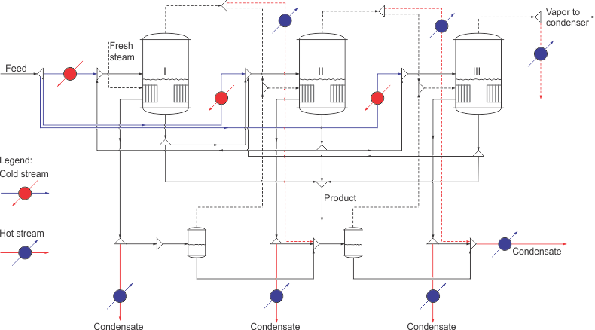
PROBLEM STATEMENT
Given:
a set of evaporators including flash vessels,
a set of hot and cold streams from the background process
flow-rate, solids’ concentration, and temperature of feed stream, and a desired concentration of solids within a concentrated product
temperature of fresh steam
Exchanger Minimum Approach Temperature (EMAT)
a residence time of condensate within flash vessels.
Determine:
An optimal network design minimising total annualised cost including operating (hot and cold utility)
and investment costs (evaporators, heat exchangers and flash vessels).

Slide 8
MEE SUPERSTRUCTURE
Evaporators:
Number of units
Feed splitter:
Series and parallel feed
Evaporator mixer and splitter:
Forward, backward or parallel operation
Flash vessels:
Cascade condensate flashing
Steam generation using hot condensates
Condensate and steam splitters:
Multiple use of steam/condensate
Condensate for flashing or heat integration
Steam for evaporators or heat integration
Fig.1 Supersturcture of MEE

Slide 9
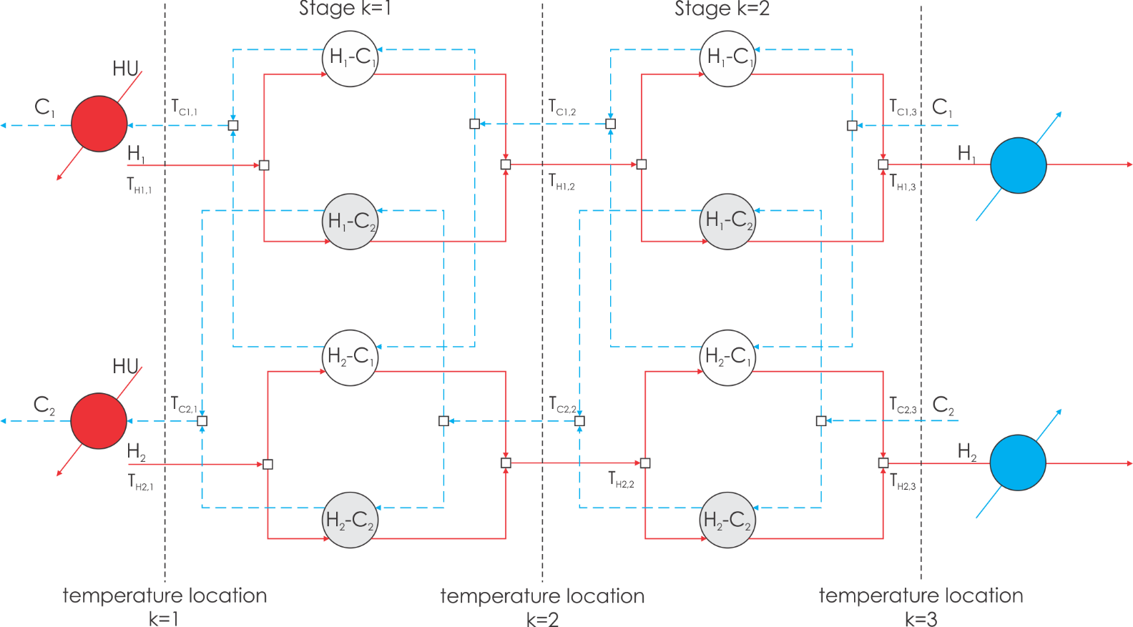
HEN SUPERSTRUCTURE (*Yee and Grossmann, 1990)
Enables heat integration of hot and cold streams within and outside MEE
Objective function of the HEN model minimises operating cost of utilities and heat exchangers investment
Hot streams:
Hot condensates, secondary vapours
Hot process streams
Cold streams:
Cold feed streams
Cold process streams
Fig.2 HEN supersturcture
*Yee, T.F., Grossmann, I.E., 1990. Simultaneous optimization models for heat integration—II. Heat exchanger network synthesis. Comput. Chem. Eng. 14, 1165–1184. doi:10.1016/0098-1354(90)85010-8

Slide 10
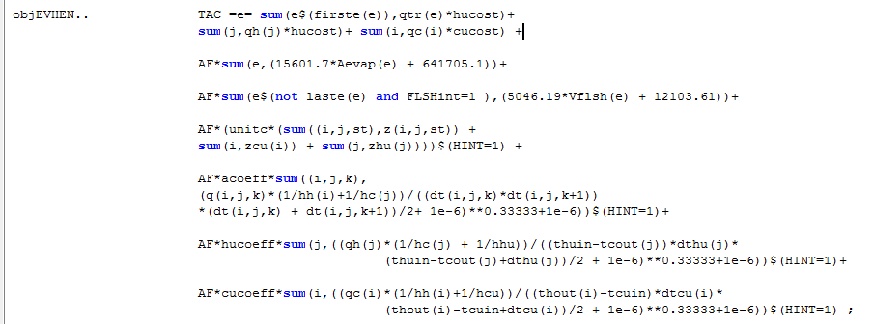
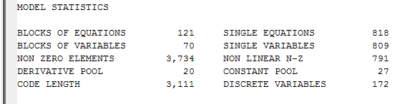
MODELLING AND SOLUTION APPROACH
Mixed-Integer Nonlinear Programming (MINLP) model of combined MEES (M1)-HEN (M2) was formulated
The objective function minimises total annualised cost (TAC) of the overall network subject to equality and non-equality constraints related to MEES and HEN networks
The model was implemented and solved in General Algebraic Modelling System (GAMS 24.7.3)

Slide 11
SOLUTION STRATEGY
Step 1: Solve NLP model (M1) of non-integrated MEES
NLP solver: BARON
Step 2: Solve MINLP model (M1+M2) of combined MEES-HEN networks
MINLP solver: SBB
Initialisation

Slide 12
CASE STUDY (Milk concentration plant)
Feed stream: 2.5 kg/s of milk with 10 % Total Solids (TS) at 30°C
Product stream: 40 % TS
The minimum temperature within the last evaporation effect is set to be 40 °C
Number of evaporation stages is 3
Surface areas of evaporators are equal
Two process streams are available within the background process
Hot process stream (heat capacity flow-rate 10 kW/°C, 82 → 50 °C)
Cold process stream (heat capacity flow-rate 5 kW/°C, 20 → 40 °C).
Table 1: Data for case study
Parameter | Value
Cooling water inlet and outlet temperatures, °C | 10 and 20
Hot utility (fresh steam) temperature, °C | 85
Hot utility cost, $/(kW∙y) | 382
Cold utility cost, $/(kW∙y) | 189
Fixed cost for heat exchangers, $ | 117,014
Area cost coefficient for heat exchangers, $/m² | 1055
Fixed cost for flash tanks, $ | 12,103
Volume cost coefficient for flash tanks, $/m³ | 5046
Fixed cost for evaporators, $ | 641,705
Area cost coefficient for evaporators, $/m² | 15,601
Individual heat transfer coefficients for process streams, water and utilities, kW/(m²∙K) | 1
Specific heat capacity of condensates, kJ/(kg∙°C) | 4.2179
Retention time of condensate within the flash tanks, min | 5
Plant operating hours, h | 8,000
Interest rate, % | 8
Equipment lifetime, y | 10
Minimum allowed exchange temperature (°C) | 10

Slide 13
CASE STUDY (Results)
Table 2: Results of optimisation and heat integration of different flow-patterns of triple-effect evaporation system
without and with flash vessels
Parameter | Forward feed | Backward feed | Parallel feed
Fresh steam consumption, kg/s | 0.604 0.591* | 0.671 0.646* | 0.627 0.605*
Evaporator investment, $ | 4,735,642 4,738,067* | 4,908,466 4,904,963* | 5,361,180 5,377,758*
HEN investment, $ | 420,494 441,292* | 274,142 281,634* | 516,734 521,659*
Flash vessels investment, $ | - 27,905* | - 30,050* | - 29,781*
Annualised investment, $/y | 768,416 776,036* | 772,361 777,434* | 875,983 883,625*
Operating cost, $/y | 528,147 516,012* | 586,485 564,555* | 547,682 528,972*
Total annualised cost, $/y | 1,296,563 1,292,048* | 1,358,846 1,341,989* | 1,423,665 1,412,598*
*The results including flash vessels
Without integration with
the background process
1,351,262 $/y
With integration with the
background process
1,292,048 $/y
4.4 % reduction in TAC

Slide 14
CASE STUDY (Optimum number of evaporation effects)
Table 3: Results of optimisation for different number of evaporation effects for forward feed flow-pattern
Number of evaporators | Operating cost, $/y | Investment cost, $/y | Total annualised cost, $/y
1 | 1,603,103 | 309,579 | 1,912,682
2 | 783,495 | 542,069 | 1,325,564
3 | 516,012 | 776,036 | 1,292,048
4 | 416,760 | 1,007,525 | 1,424,285

Slide 15
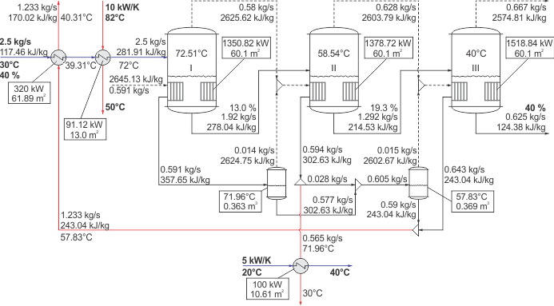
CASE STUDY (Optimum design-forward feed)
Temperatures in the
evaporators are optimised
Fig.3 Optimal design of heat-integrated multiple-effect evaporation system with the background
process hot and cold streams

Slide 16
Conclusions
A simultaneous optimisation and heat integration approach of MEES and HEN is presented
A typical MEE superstructure is extended to include flash vessels for improving energy efficiency within the overall system
Heat integration of MEE system hot and cold streams is enabled together with the background process hot/cold streams to improve heat recovery in the system
The MINLP model is developed and applied to a case study of milk concentration plant for analysing different flow-patterns of MEES and finding optimium number of evaporators
For the cosidered case study
The forward feed flow-pattern had the lowest minimum total annualised cost compared to the backward and the parallel feed flow-patterns
The optimum number of evaporation stages was found to be three
Future improvements include extension of the existing generic model including also MVC and TVC

Slide 17







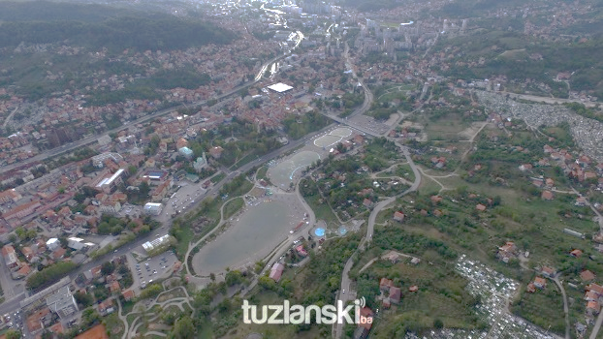
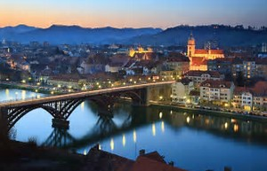
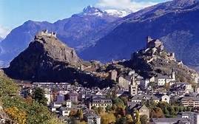
ACKNOWLEDGEMENTS
Elvis Ahmetović
Midhat Suljkanović
Nidret Ibrić
Zdravko Kravanja
Lidija Čuček
Miloš Bogataj
François Maréchal
Maziar Kermani
The authors are grateful to the Swiss National Science Foundation (SNSF) and the Swiss Agency for Development and
Cooperation (SDC) for providing financial support within the SCOPES 2013‒2016 (Scientific Co-operation between Eastern
Europe and Switzerland) joint research project (CAPE‒EWWR: IZ73Z0_152622/1), and Federal Ministry of Education
and Science, Bosnia and Herzegovina (Agreement Number: 01-8294/16; 05-39-3032-2/16).

