Slide 1
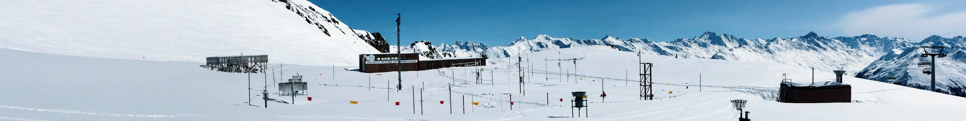





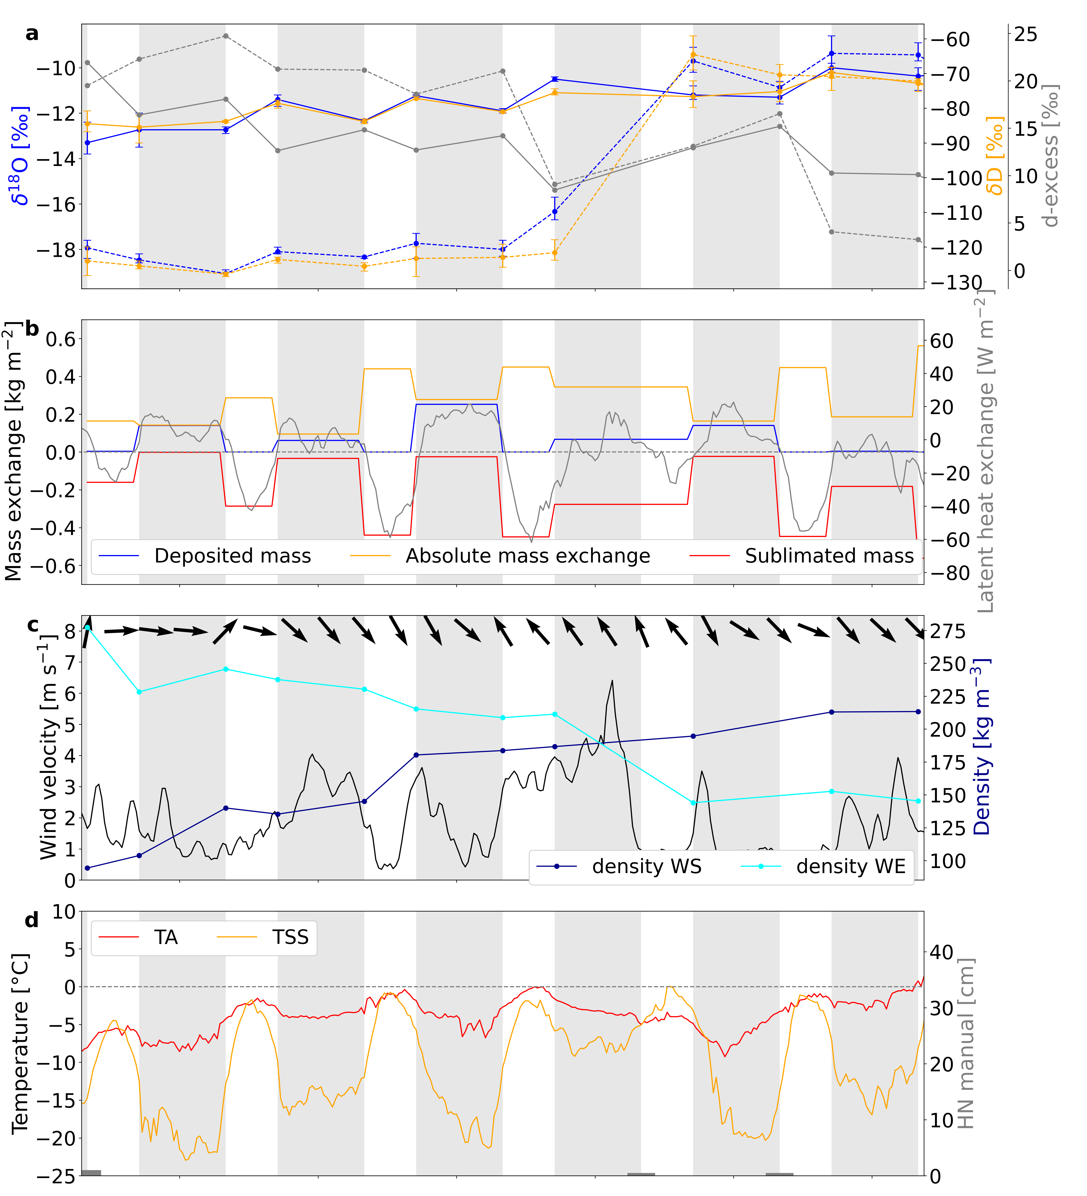
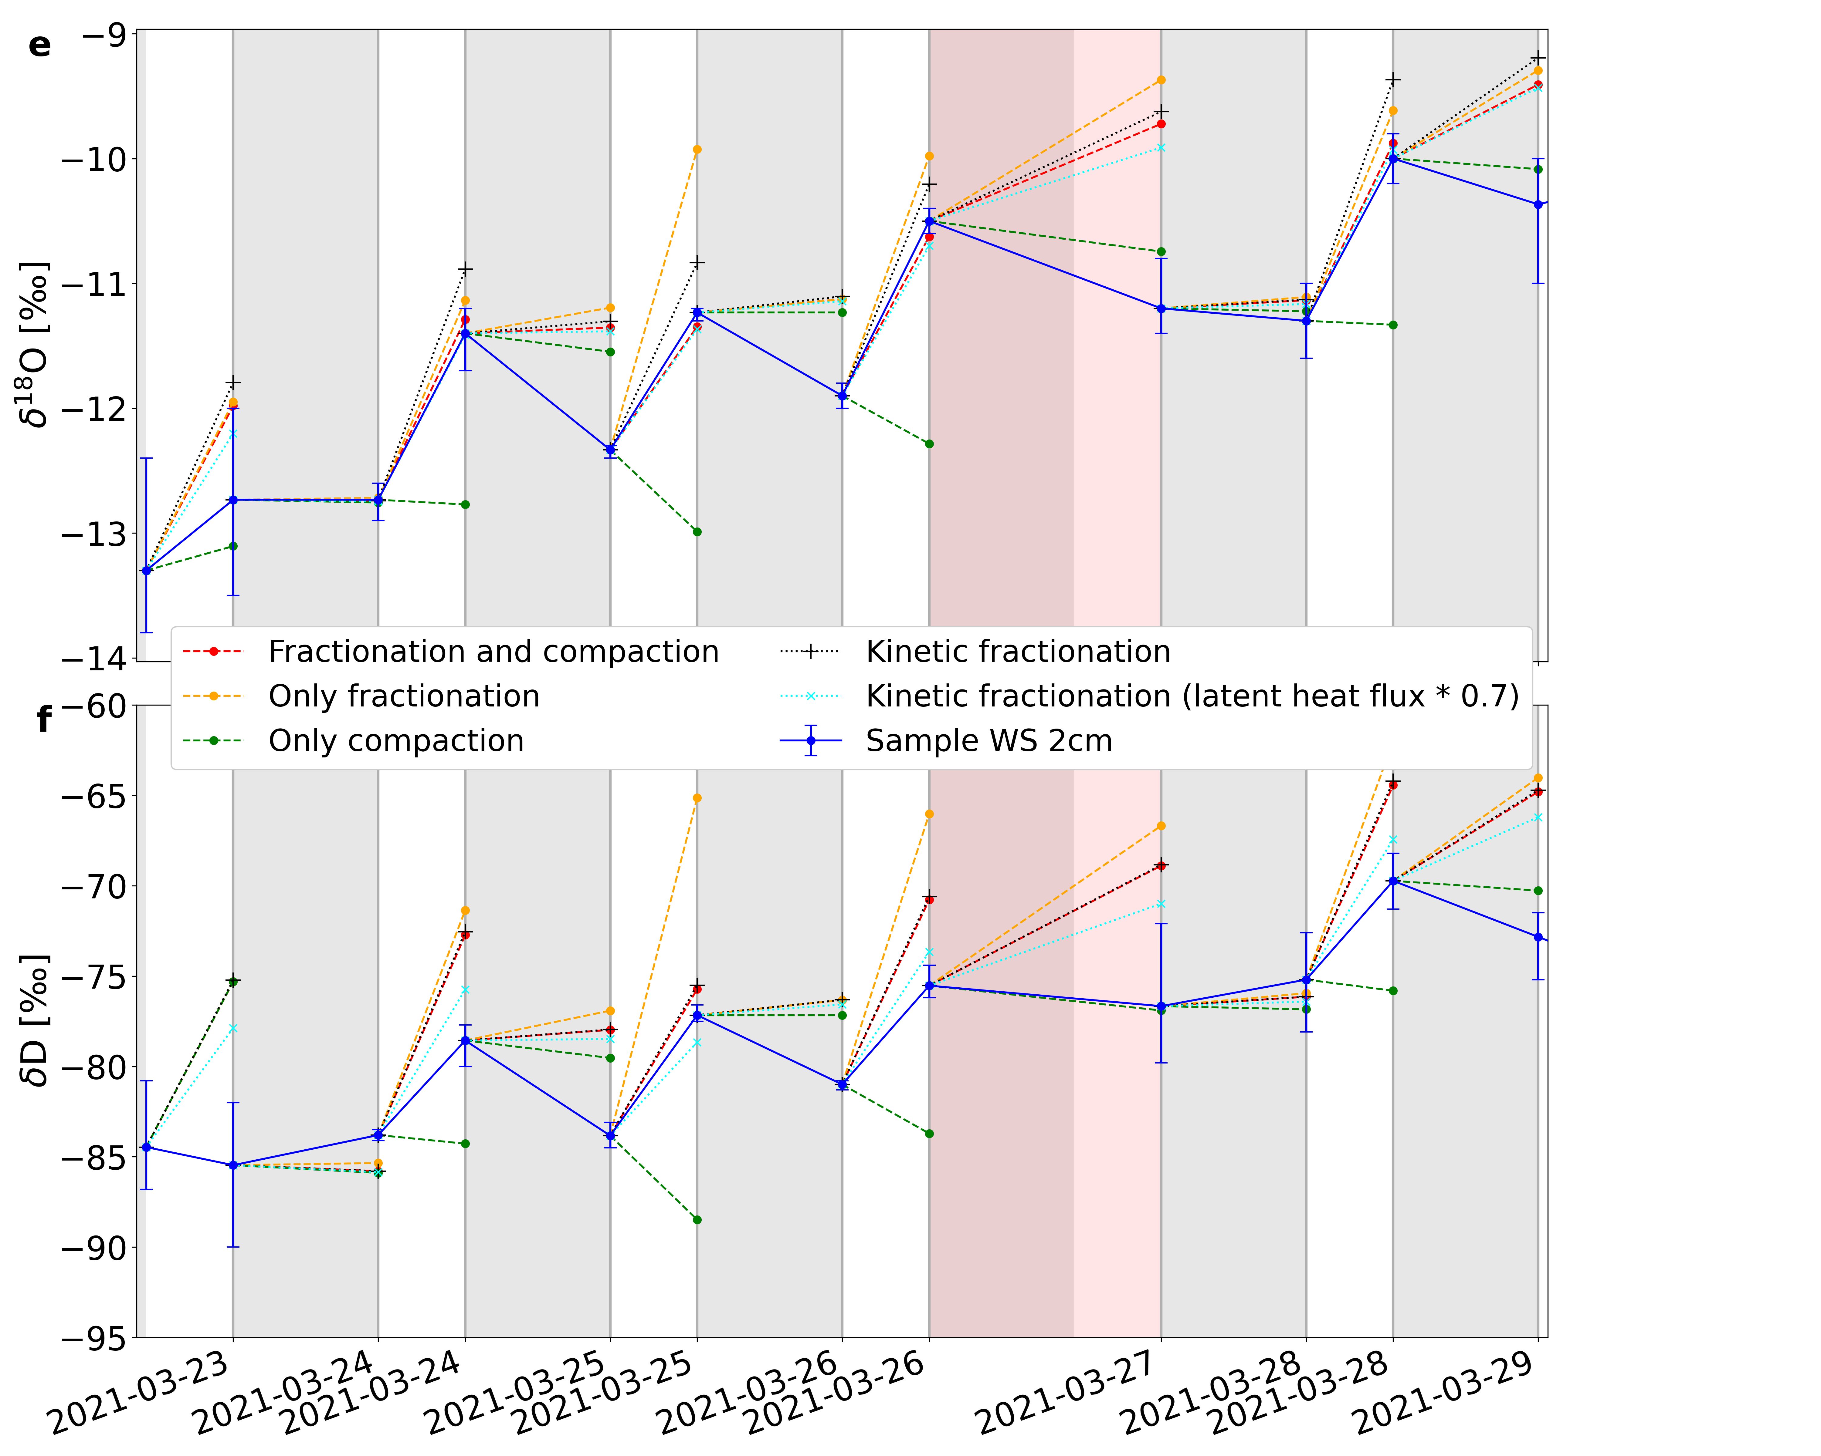

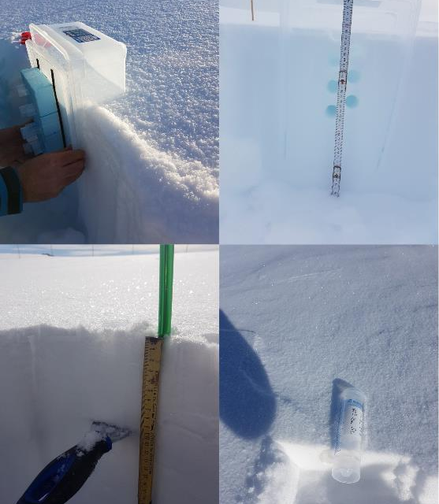
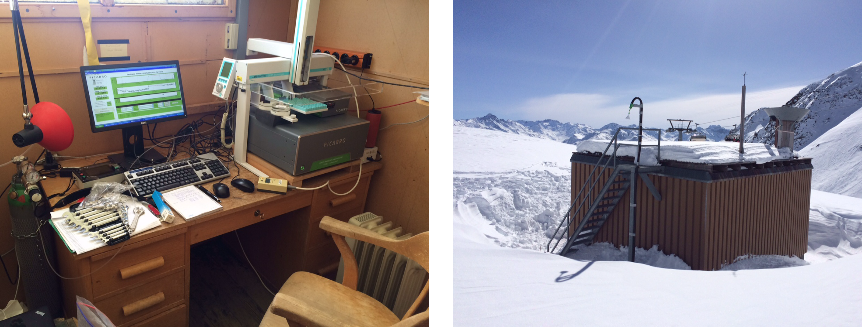


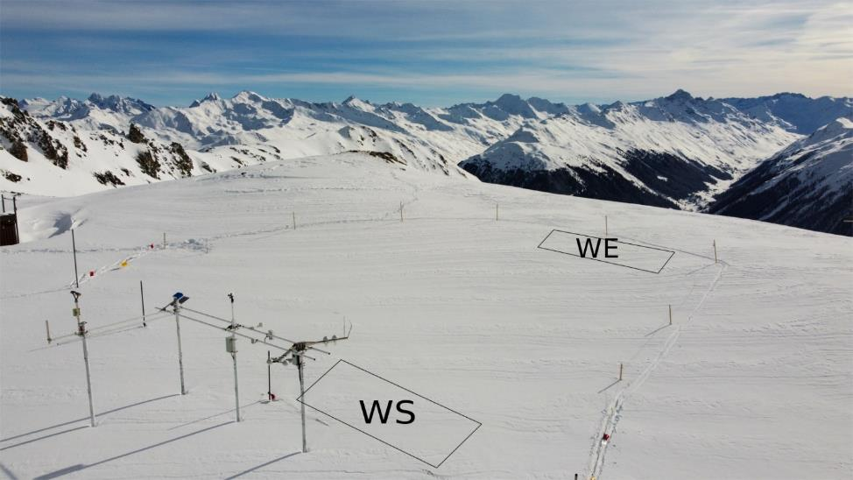
Post-depositional processes affecting stable water isotopes
in Alpine snow
Y. Sadowski^{1,2}, J. Trachsel¹, F. Aemisegger³, L. Bianchi¹, A. Eichler⁴, M. Lehning^{1,2}, M. Schneebeli¹
¹ WSL-Institute for Snow and Avalanche Research SLF; ² School of Architecture, Civil and Environmental Engineering, EPFL;
³ Institute for Atmospheric and Climate Science, ETH Zürich; ⁴ Laboratory of Environmental Chemistry, Paul Scherrer Institute,
Key Points
Results
A) Snow surface
In several campaigns, processes affecting the snow isotopic composition before, during, and after a snowfall were studied on the Weissfluhjoch, Switzerland between 2017 and 2022.
Snow surface: Diurnal cycles in the isotopic signal were observed during periods with important latent heat exchange.
This cycle is only visible in the top few centimeters and the isotopic signal is well preserved deeper in the snowpack.
A
Fig. 3
Panel a: snow surface isotopic composition on the Weissfluhjoch (solid lines for the WS site and dashed lines for the WE site).
Panels b to d: Overview of the meteorological conditions.
Panels e and f: model results.
Processes Overview
Diurnal cycles in the isotopic signal were observed during periods with strong latent heat exchange. Deposition results in a reduction of δ¹⁸O and δD and a d-excess increase while sublimation has the opposite effect.
Modeling compaction and equilibrium fractionation during sublimation gives good results for δ¹⁸O but overestimates δD. Accounting for kinetic fractionation overesti-mates the enrichment due to sublimation but gives a better H₂¹⁸O/HDO ratio.
D
B
A
C
Fig 1: The isotopic signal in the snow is strongly influenced by the trajectory of the cloud and the temperature (see companion poster 33: Recording frontal passages with the stable water isotope signal of seasonal Alpine snow). Once on the ground, the snow isotopic signal is further modified by the wind and vapor exchange with the atmosphere and the surrounding snow layers.
D
B
Wind
Field Campaigns
The snowpack isotopic signal is strongly influenced by snow redistribution. The impact becomes evident in the difference in snow height between the two close-by sites (167 cm on WE and 251 cm on WS). In addition, wind enhances vapor exchange and snow compaction, making the distinction between individual effects difficult.
Different campaign were carried out at the test site Weissfluhjoch (WFJ) in the Swiss Alps (2536 m a.s.l.) between 2017 and 2022.
  2017 Jan-Jun: surface profile (w), full profile (m)
  2020 Jan: Surface (d), surface profile (w)
  2020 Dec, 2021 Mar: Surface (2x d), surf. profile
  2022 Mar: Surface (2x d), surface profile ( 2nd d)
  Feb-May 2017 & Mar 2022, incl. daily calibration
  2017 to 2020, without calibration
  Picarro Analyzer (WS-CRDS, L2130-I)
  Inlet: 4 m above ground, heated tube to analyzer
C
B) Snow profile
δ¹⁸O Snow
δ¹⁸O Air
Fig. 4: Records of δ¹⁸O in five snowpits at WFJ Davos 2017
The first three snowpits, Jan (black), Feb (red) and Mar (blue), were taken in cold conditions, Apr (green) was partially melted. The snowpack was completely soaked when the last profile was taken in Jun (violet).
High variability in the profile (13‰).
Cold winter: signal was conserved (Jan, Feb, March).
Dry snow metamorphism plays minor role at this scale (slight smoothing).
April: smoothing of about 4‰ (no water flow - pendular system)
June: profile was shifted by up to 9‰ towards less negative values.
However, the general signal of the profile is maintained.
Fig 2: Left: Sampling snow surface and snow profile with PP tubes. Right: WFJ test site with small hut and Picarro installation, and different areas (Wind-exposed WE (stronger sublimation but wind-induced snow redistribution); Wind-sheltered WS (more preserved and homogenous snow surface )
References
Trachsel, J. (2019). Microscale Distribution of Environmental Proxies in Snow, PhD Thesis no 26360, ETH Zürich.
Sadowski, Y. (2021). The effect of sublimation on snow isotopic composition, Master Thesis, EPF Lausanne.
Bianchi, L. (2022, in prep). How postdepositional processes alter the surface snow isotopic composition, Master Thesis, POLI Milano.

