Slide 1

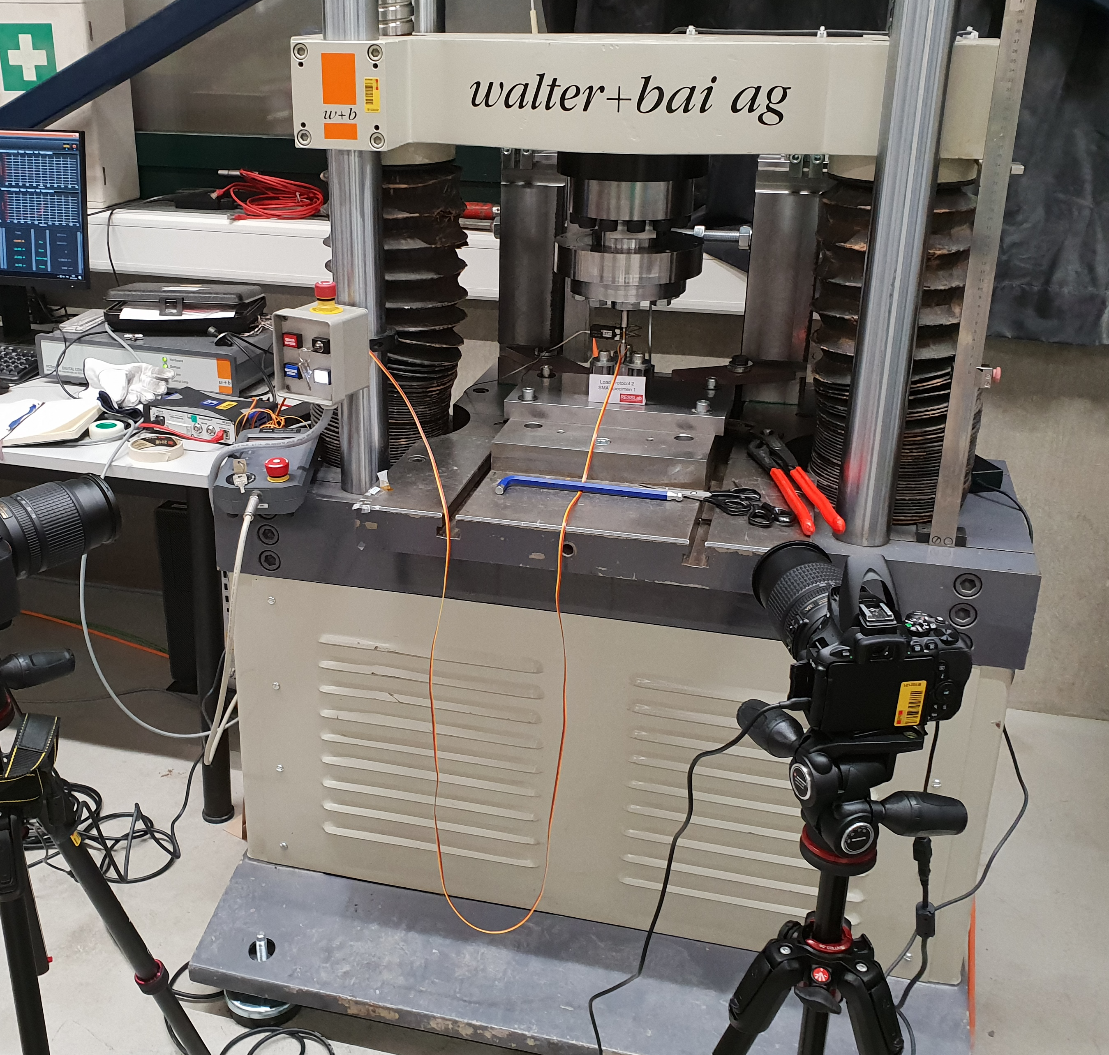
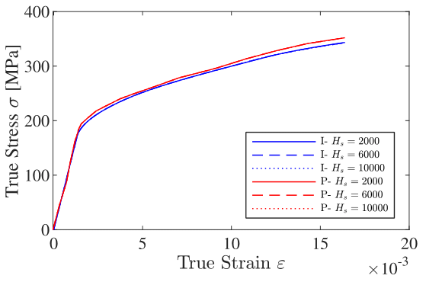
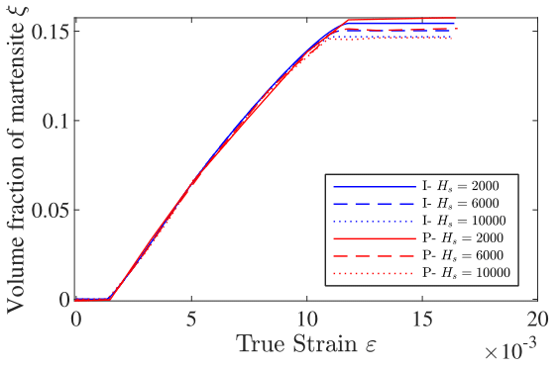
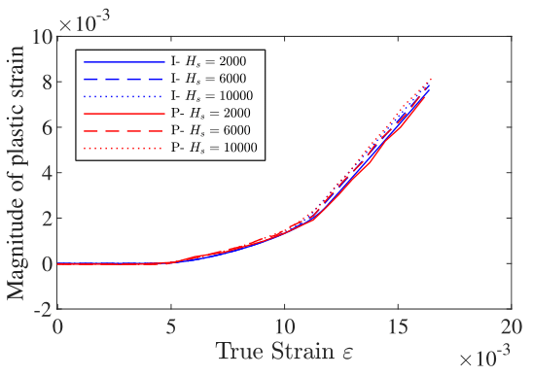
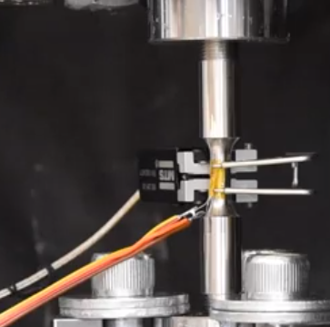
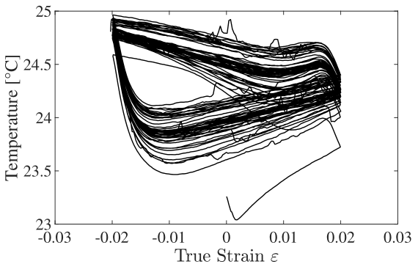
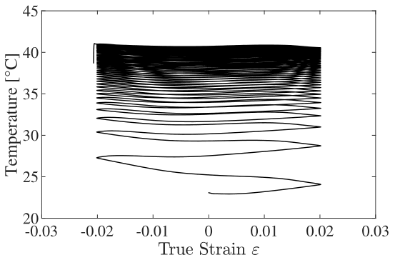
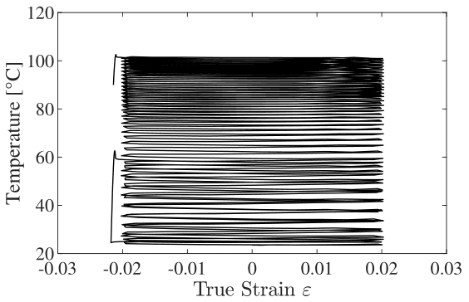
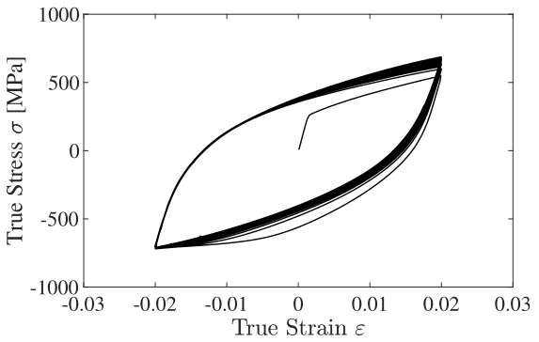
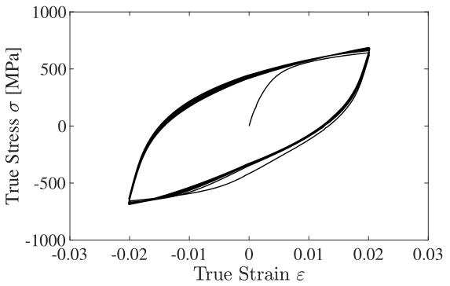
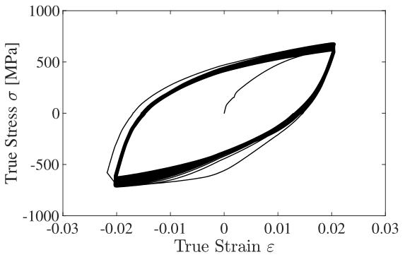
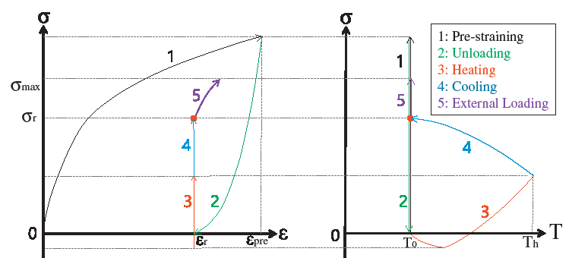
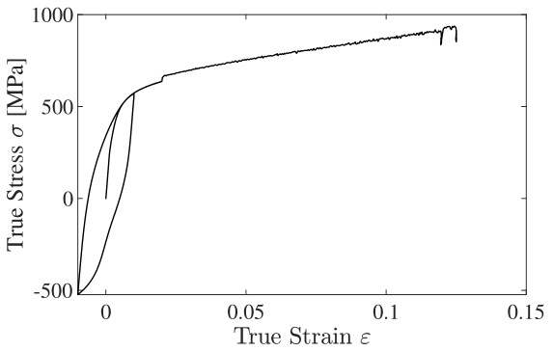
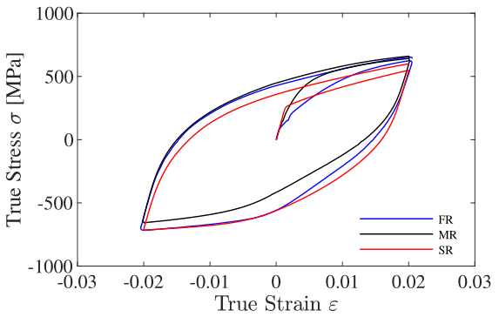
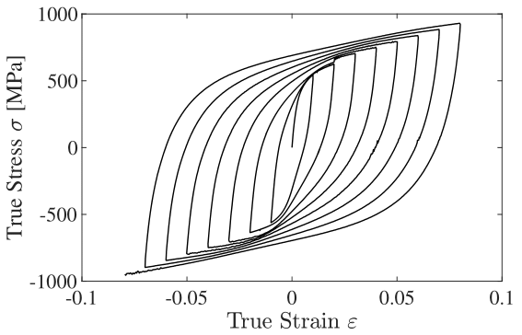
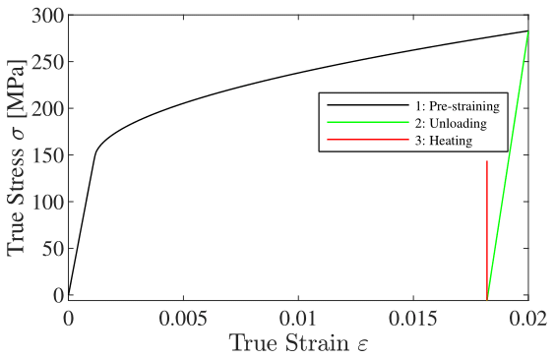
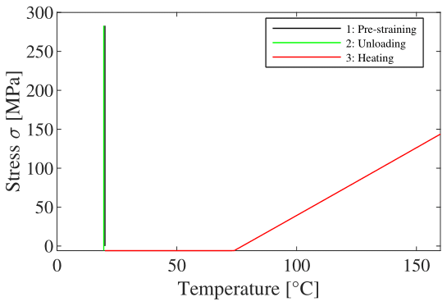
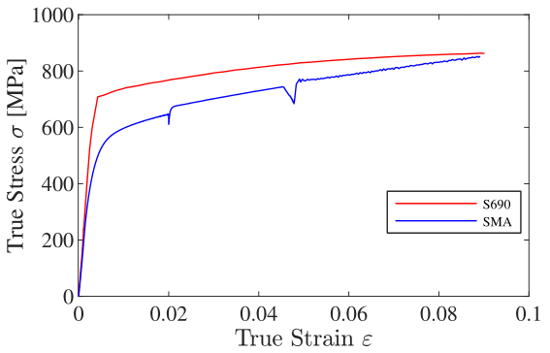
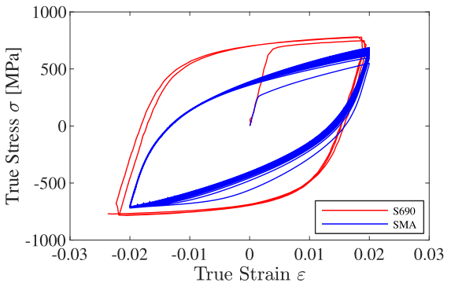
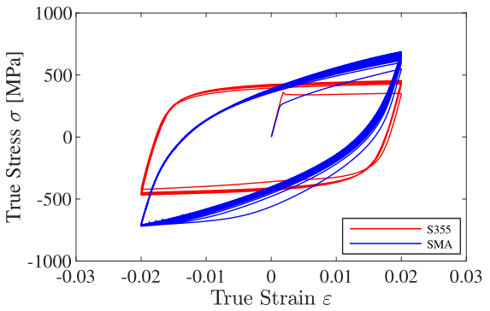
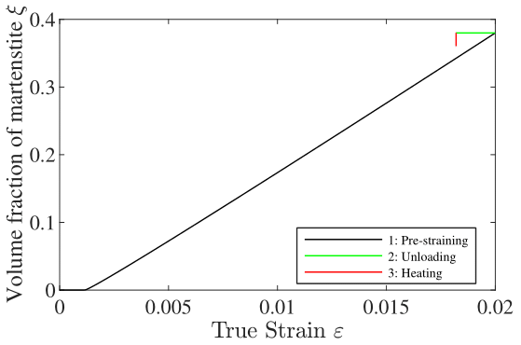







Experimental Behavior and Nonlinear Modeling of iron-based Shape Memory
Alloys (SMAs) under Inelastic Cyclic Straining
Heredia Diego (Master’s student)
Resilient Steel Structures Laboratory (RESSLab), Swiss Federal Institute of Technology, Lausanne (EPFL)
1. Objectives
3. State-of-art material model
- Conduct an experimental campaign in order to characterize the behavior of Fe-SMAs under cyclic tension/compression straining
  Literature is lacking information on the specificities of Fe-SMAs under cyclic tension/compression straining.
  Tests on Fe-SMAs involving high compressive strains and high strain rates have never been conducted before.
- Implement a state-of-art material model for Fe-SMAs to represent the behavior of such alloys under monotonic tensile loading
  Establish the fundamental equations used in the model that will be used as a starting point to integrate cyclic loading effects.
- Extend the implemented material model to account for cyclic loading
  A constitutive model that can represent all relevant deformation mechanism active in Fe-SMAs is essential to develop and analyze dissipation devices with this material.
Cissé et al. (2017) constitutive model for monotonic tensile loading of Fe-SMAs
  Loading functions:
  $F_{m}^{tr}=\frac{G_{ma}}{6}σ_{eq}^{2}+\frac{κ_{ma}}{2}σ_{eq}^{2}+σ:\left({\overline{ε}}_{tr}−{\overline{ε}}_{pl}\right)−ζ_{m}\left(T−M_{s}^{0}\right)+(λ_{1}−λ_{2})$
  $−H_{v}\left({\overline{ε}}_{tr}:ε^{tr}\right){\left(ε^{tr}:ε^{tr}\right)}_{}^{\frac{n_{v}−1}{2}}−H_{pv}δ_{pv}\left({\overline{ε}}_{tr}:ε^{pl}\right){\left[\left(ε^{tr}:ε^{pl}\right)δ_{pv}\right]}_{}^{n_{pv}} −σ_{m}^{tr}ε_{L}+H_{s}p^{2}$
  $F_{a}^{tr}=−\frac{G_{ma}}{6}σ_{eq}^{2}−\frac{κ_{ma}}{2}σ_{eq}^{2}−σ:\left({\overline{ε}}_{tr}−{\overline{ε}}_{pl}\right)+ζ_{a}\left(T−A_{s}^{0}\right)−(λ_{1}−λ_{2})$
  $+H_{v}\left({\overline{ε}}_{tr}:ε^{tr}\right){\left(ε^{tr}:ε^{tr}\right)}_{}^{\frac{n_{v}−1}{2}}+H_{pv}δ_{pv}\left({\overline{ε}}_{tr}:ε^{pl}\right){\left[\left(ε^{tr}:ε^{pl}\right)δ_{pv}\right]}_{}^{n_{pv}}−σ_{a}^{tr}ε_{L}+H_{x}ξ$
  $F_{a}^{pl}=\left(1−ξ\right)\left[σ−H_{p}{\left(ε^{pl}:ε^{pl}\right)}_{}^{\frac{n_{p}−1}{2}}ε^{pl}−H_{pv}δ_{pv}{\left[\left(ε^{tr}:ε^{pl}\right)δ_{pv}\right]}_{}^{n_{pv}}ε^{tr}\right]:N^{pl}−\left\langle σ_{a}^{pl}−βT\right\rangle$
  Results at T=45°C, phase change and plasticity are coupled:
2. Experimental campaign
MTS extensometer
Round bar coupon
PT100
Stress-strain for different H_{s}
Evolution of ξ with H_{s}
Evolution of p with H_{s}
Detailed view of the specimen
4.Extendend model for cyclic loading
Experimental setup
Loading functions:
  ${\tilde{F}}_{m}^{tr}=\frac{G_{ma}}{6}σ_{eq}^{2}+\frac{κ_{ma}}{2}σ_{eq}^{2}+σ:|{\overline{ε}}_{tr}−{\overline{ε}}_{pl}|−ζ_{m}\left(T−M_{s}^{0}\right)+(λ_{1}−λ_{2})$
  $−H_{v}\left|{\overline{ε}}_{tr}:ε^{tr}\right|{\left[{\left(E_{eq}^{tr}\right)}^{2}\right]}_{}^{\frac{n_{v}−1}{2}}−H_{pv}δ_{pv}\left({\overline{ε}}_{tr}:ε^{pl}\right){\left[{\left(E_{eq}^{trp}\right)}^{2}\right]}_{}^{n_{pv}} −σ_{m}^{tr}ε_{L}+H_{s}p^{2}$
  $−\frac{1}{1+e^{kε}}H_{v}^{∗}|{\overline{ε}}_{tr}:ε^{tr}|{[\frac{3}{2}{\left(E_{eq}^{tr}\right)}^{2}]}_{}^{\frac{n_{v}^{∗}−1}{2}}$
  ${\tilde{F}}_{a}^{tr}=−\frac{G_{ma}}{6}σ_{eq}^{2}−\frac{κ_{ma}}{2}σ_{eq}^{2}−σ:|{\overline{ε}}_{tr}−{\overline{ε}}_{pl}|+ζ_{a}\left(T−A_{s}^{0}\right)−(λ_{1}−λ_{2})$
  $+H_{v}|{\overline{ε}}_{tr}:ε^{tr}|{[{\left(E_{eq}^{tr}\right)}^{2}]}_{}^{\frac{n_{v}−1}{2}}+H_{pv}δ_{pv}\left({\overline{ε}}_{tr}:ε^{pl}\right){[{\left(E_{eq}^{trp}\right)}^{2}]}_{}^{n_{pv}}−σ_{a}^{tr}ε_{L}+H_{x}ξ$
  ${\tilde{F}}_{a}^{pl}=\left(1−ξ\right)\left[σ−H_{pv}δ_{pv}{[\frac{3}{2}{\left(E_{eq}^{trp}\right)}^{2}]}_{}^{n_{pv}}ε^{tr}\right]:N^{pl}−\frac{3}{2}H_{p}\left(1−ξ\right)P{\left[\frac{3}{2}P^{2}\right]}^{\frac{n_{p}−1}{2}}−\left\langle σ_{a}^{pl}−βT\right\rangle$
Thermomechanical loading representative of those used to prestress concrete
Temperature at the surface of the specimen
Temperature-strain LP5_SR
(0.03 %/sec)
Temperature-strain LP5_MR
(0.8 %/sec)
Temperature-strain LP5_FR
(8 %/sec)
Hardening is strain rate and/or temperature dependent
50 MPa
50 MPa
Stress-strain LP5_SR
(0.03 %/sec)
Stress-strain LP5_MR
(0.8 %/sec)
50 MPa
Stress-strain LP5_FR
(8 %/sec)
Stress-strain response in compression is characterized by three distinct slopes at low strain
Stress-strain and stress-temperature of the thermomechanical loading, from Ghafoori et al. (2017)
1
3
2
Stress-strain LP2
Stress-strain LP5 (first cycle)
Stress-strain LP7
Comparison with structural steels
Stress-strain
Stress-temperature
$$E_{Fe−SMA}=28.3 MPa$$
$$E_{S690}=42.4 MPa$$
$$E_{S355}=26.2 MPa$$
Stress-strain LP1
(S690QL and Fe-SMA)
Stress-strain LP5_SR
(S690QL and Fe-SMA)
Stress-strain LP5_SR
(S355J2 and Fe-SMA)
Evolution of ξ
  The maximum tensile strength of the Fe-SMA is similar to the one of a S690QL steel.
  The potential for energy dissipation trough inelastic straining of the Fe-SMA is similar to the one of a S355J2 steel and 1.5 times smaller than the one of a S690QL steel.
Acknowledgments
Prof. Dr. Dimitrios G. Lignos
Dr. Albano de Castro e Sousa
Alexander Hartloper

