Slide 1
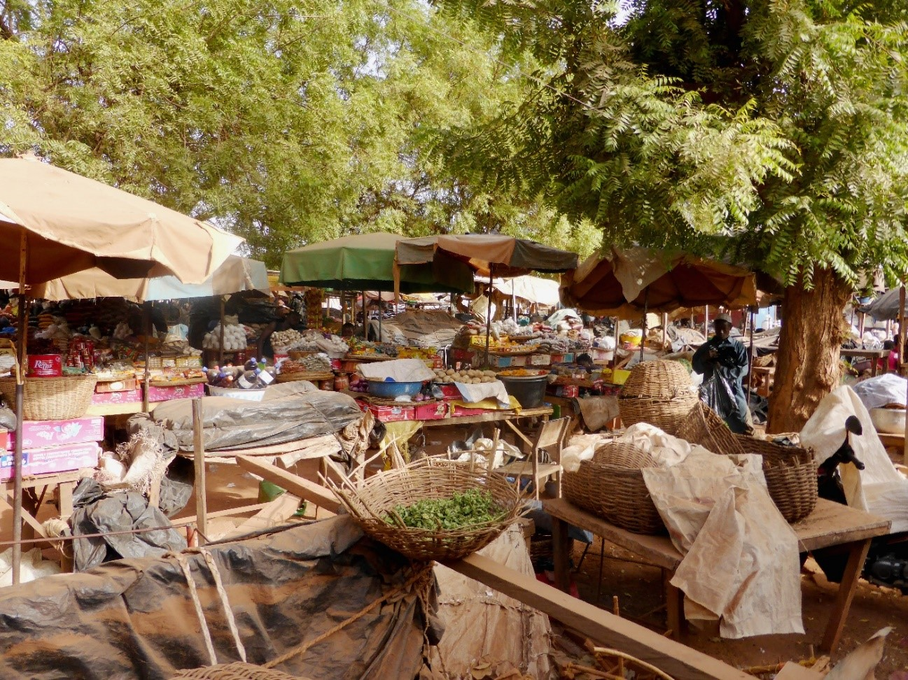

Alternative Urban Planning for Poor Cities in Africa
Prof. Jean-Claude Bolay,
Director of CODEV, EPFL, Lausanne, Switzerland
20th Conference on Urban Development and Planning
WASET, New York, October 8-9, 2018

Slide 2
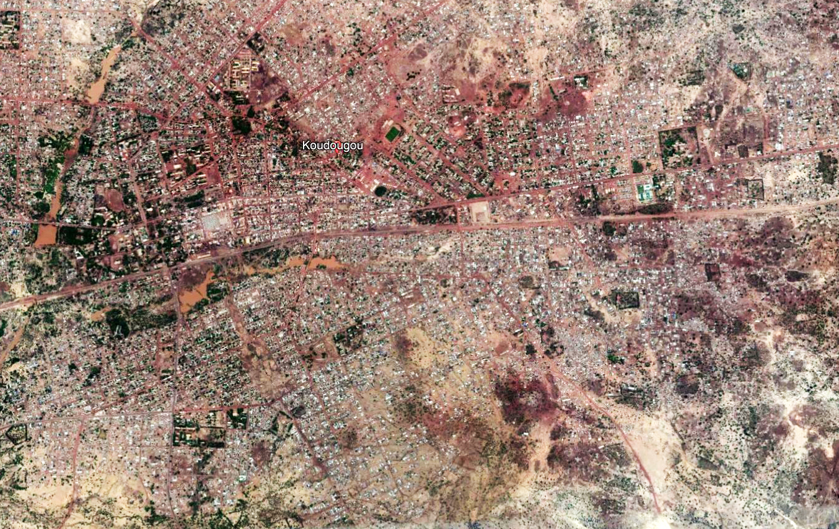
Urban growth
Urban planning was not created to tackle such issues
An examination of the implementation of real cases of urban planning should lead us to review its precepts, methods and applications, based on social, economic and environmental realities
90% of urban growth will, now and in the future, transform developing and emerging countries in the South (Asia and Africa)

Slide 3
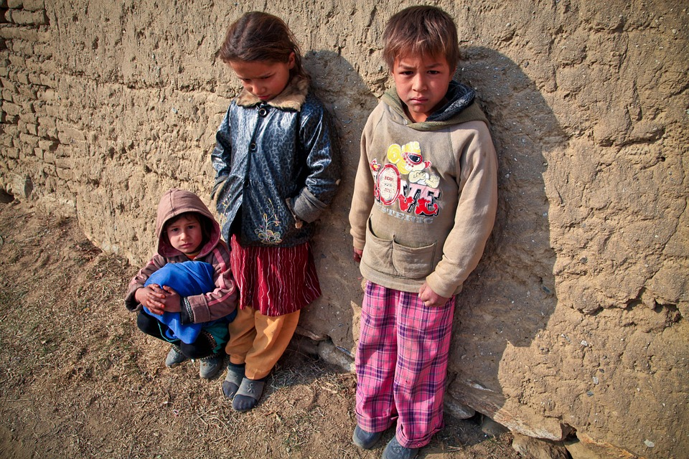
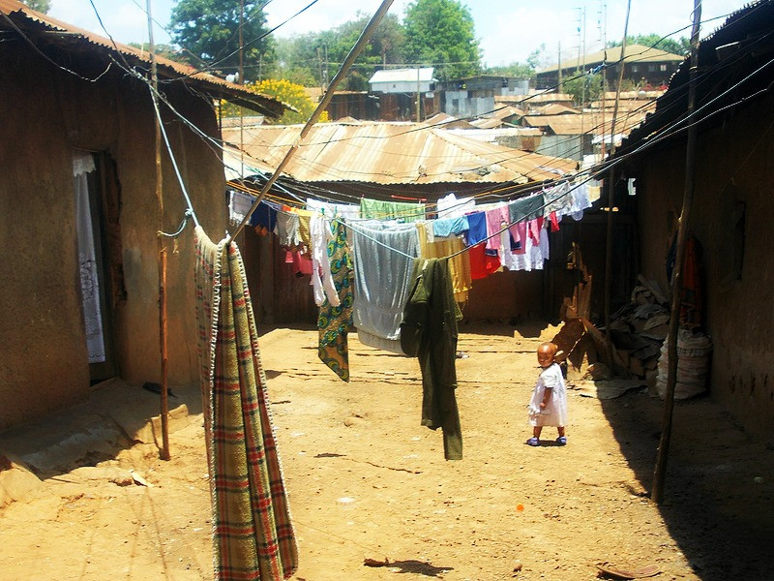
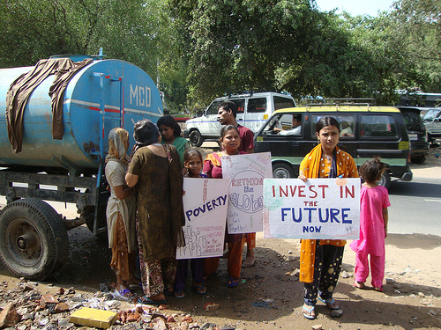
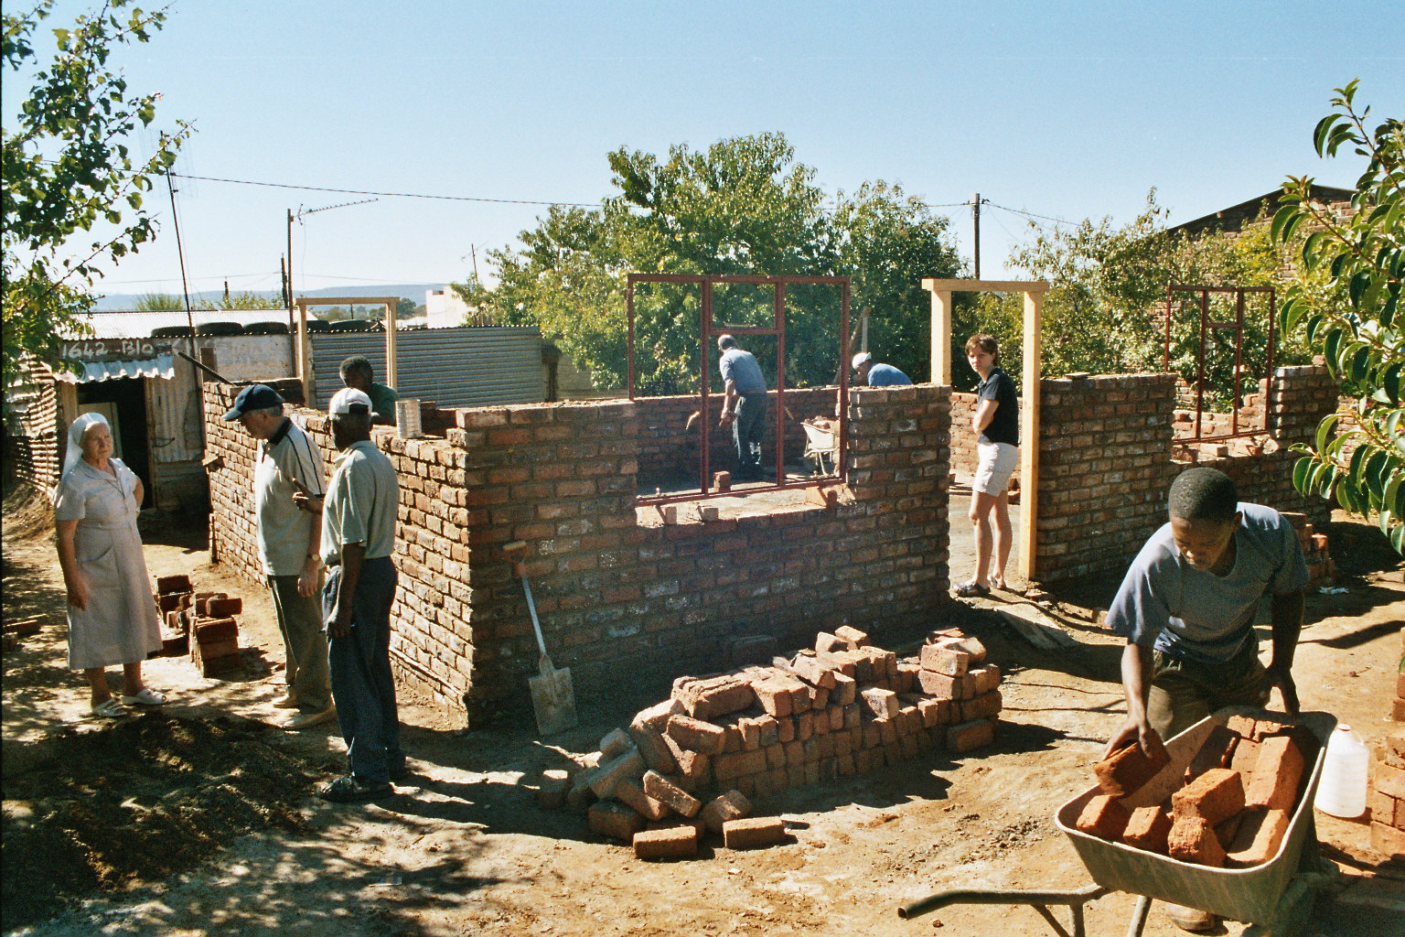
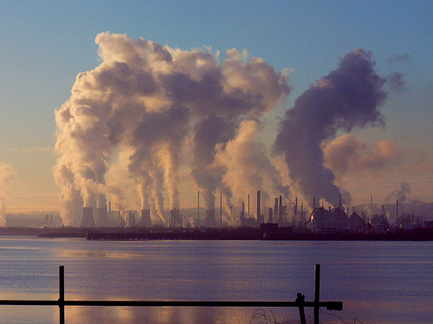
Main urban issues to be resolved
Poverty
Precariousness
Access to services and facilities
Informality and housing
Contamination and climate change
50% - 80% of urban inhabitants in Africa are poor.
Worldwide, around 1 billion urban inhabitants live in slums. This number will double in the next 30 years.
The poor pay more to gain access to basic services in neighborhoods without amenities.
66% of jobs in African cities are informal, and the majority of houses are self-built.
Natural resources such as water, air and soil, are highly contaminated through urban activities.

Slide 4
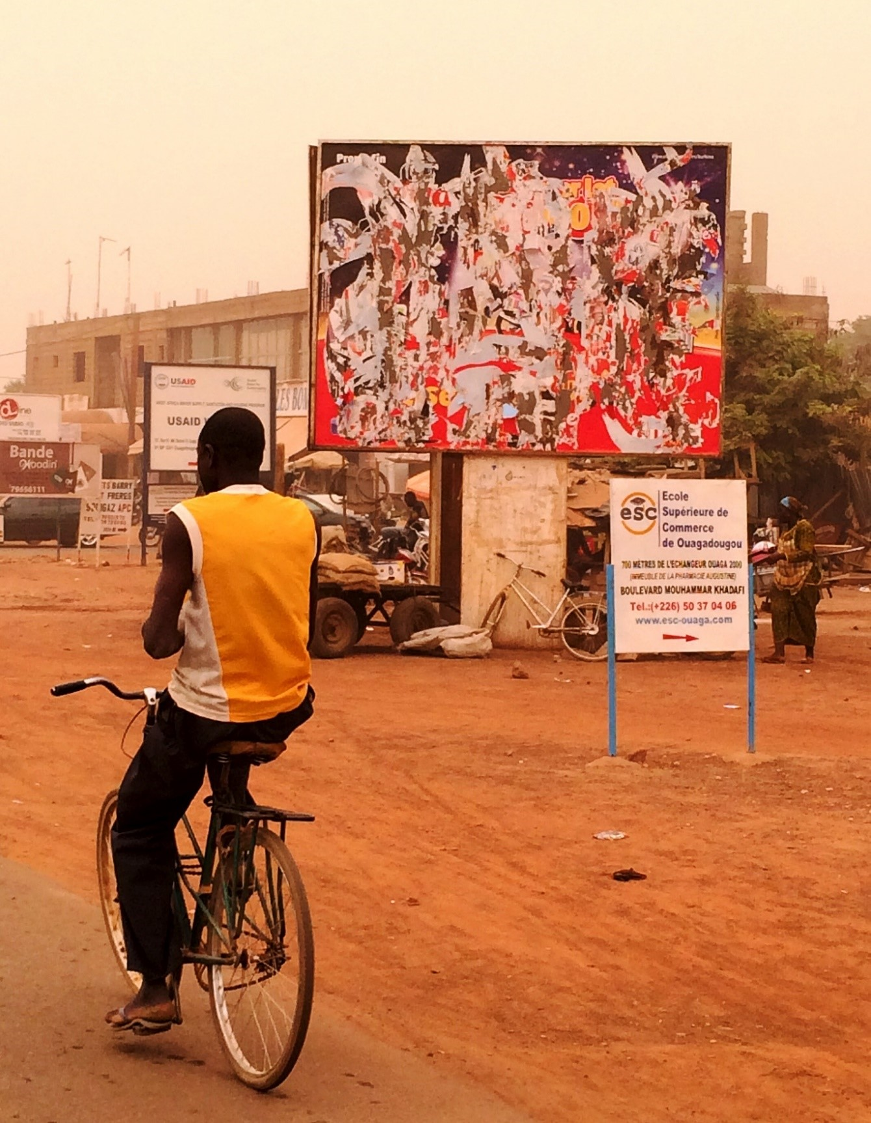
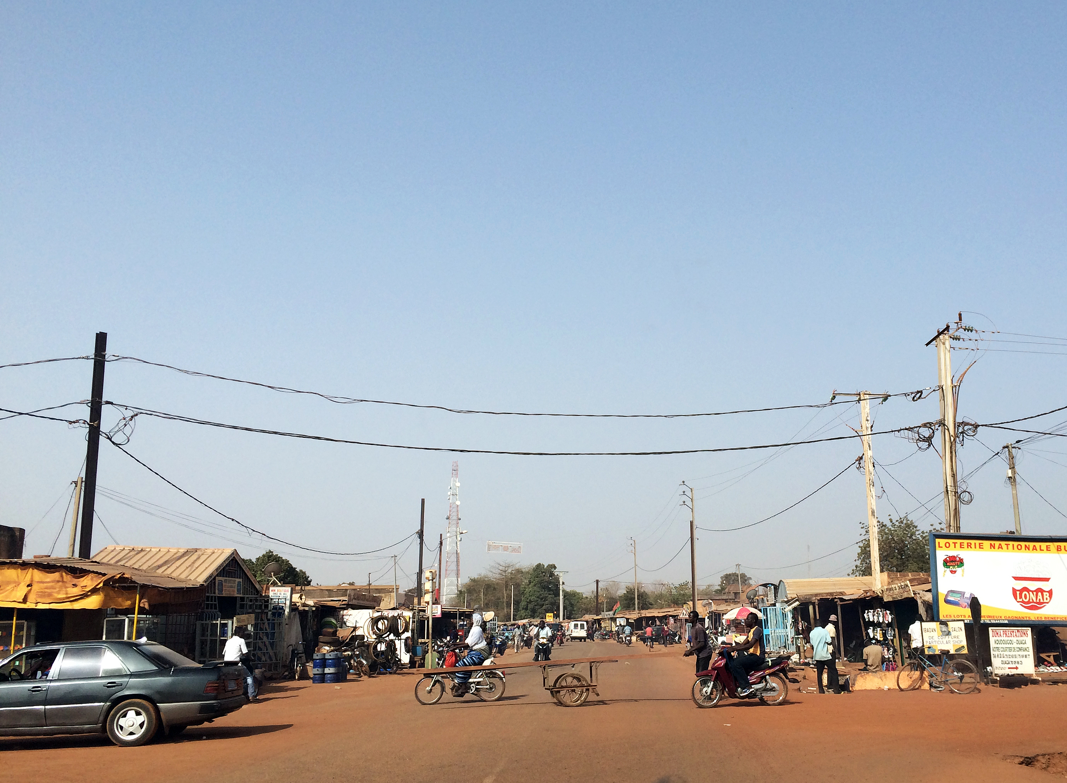
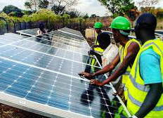
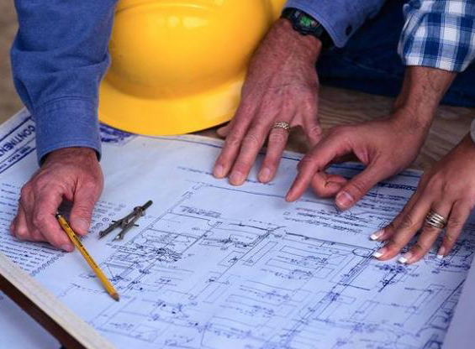
Changing the mindset: does alternative planning exist?
Diagnosis of the city (as a society)
Basic dimensions of urban planning
Towards a realistic proposal
Collect data, information and perceptions about the city (technical, material, financial, human)
Organize information at territorial, environmental, social and economic levels (sustainability)
Design planning that includes a definition of priorities and an implementation that takes into account financial and human resources

Slide 5
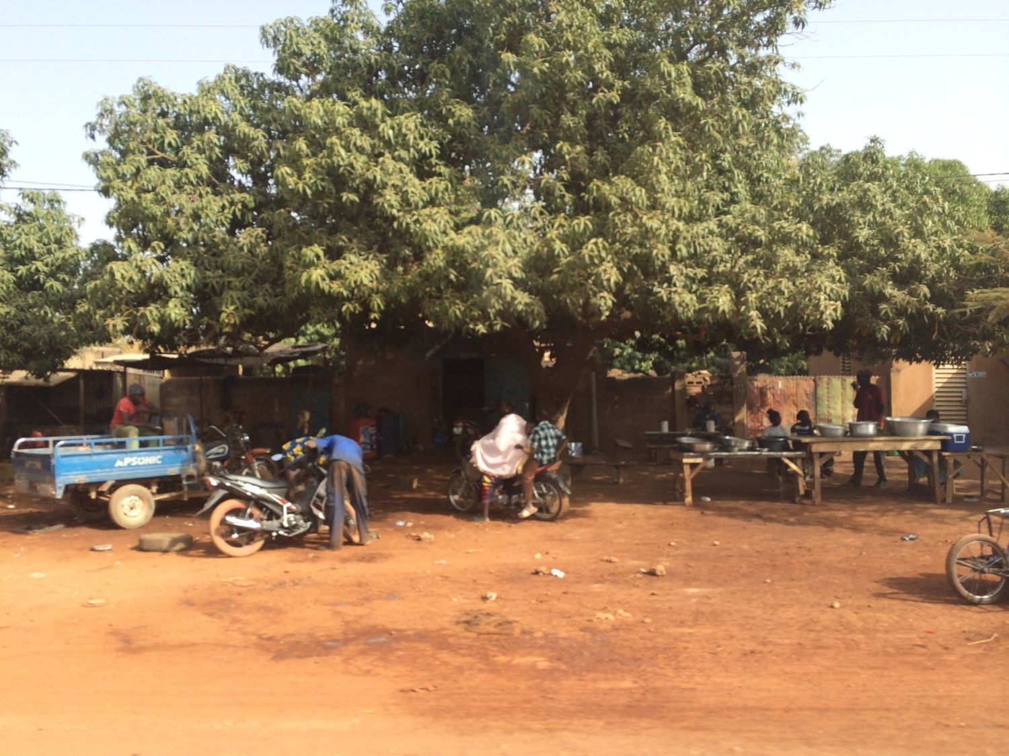



Koudougou, intermediate city in Burkina Faso
3rd city in Burkina Faso
272 km², ~100,000 urban dwellers, 86% of people work in agriculture
Main urban investments
All financed by international cooperation funds (central market, bus station, sanitation, vocational training)
Resources
In 2014: annual budget of 686,350 Euros, 85% used to cover operating costs. 120,000 Euros were allocated to main urban investments.
Trade center for the whole rural region.
Few resources and dependence on external support.

Slide 6
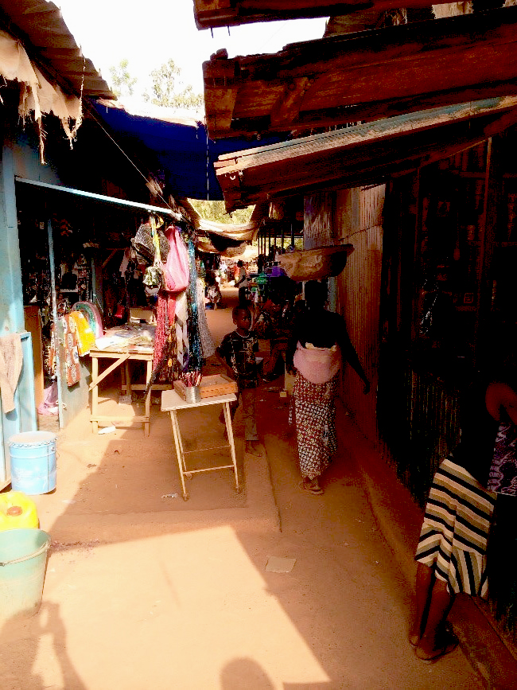
Urban planning in Koudougou: they tried and failed
Several planning exercises were drawn up: a master plan in 2002, a strategic sanitation plan in 2005, a communal development plan in 2006, and a regional development pole in 2011.
None have been implemented !
Why ?

Slide 7


A fundamental contradiction
Resources
Investments
The advantage of the different plans drafted in Koudougou in the last 15 years is that they give a comprehensive picture of the investments that must be made in order to improve the situation in the municipality
The plans’ great weakness is that they are not executed because they are out of step with the financial means and the human resources competencies of the municipal administration
At best, the plan becomes an object of urban marketing and communication with donors

Slide 8
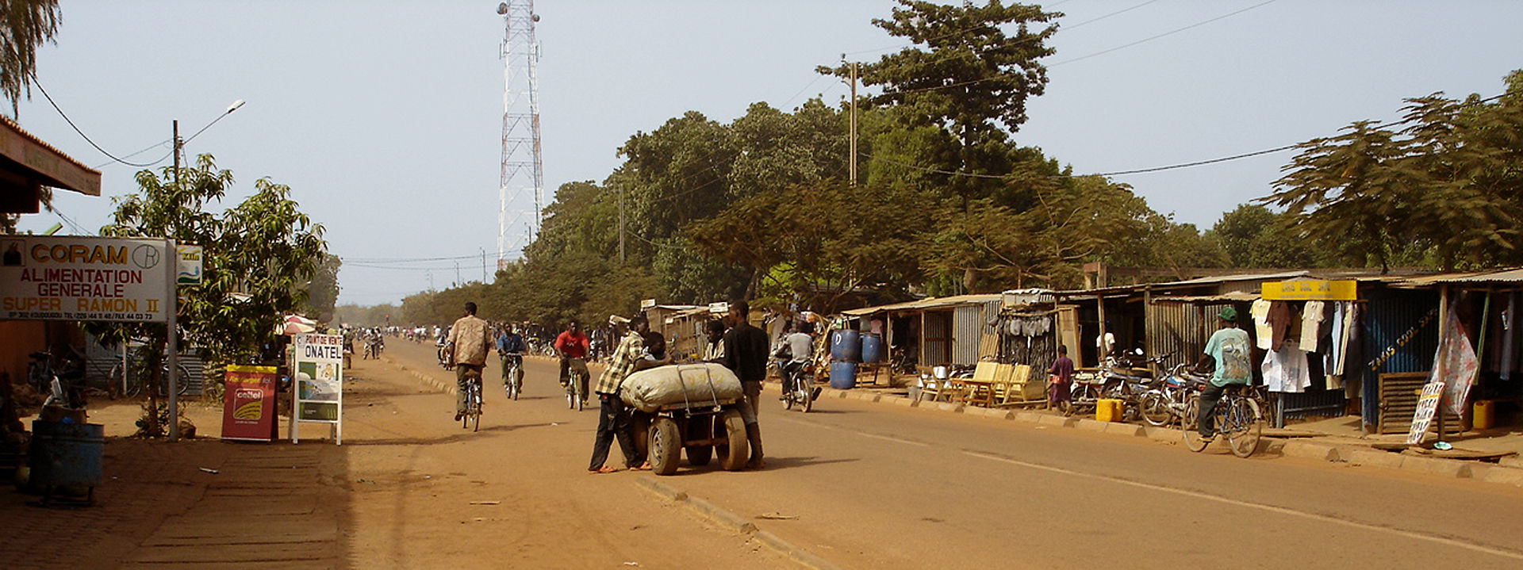
Lessons learned from Koudougou
Efficiency
Funding
Models
Policies
Dialogue with population and stakeholders
Strengthen local skills
Identify and use more sustainable sources of funding (trade taxes, property and real estate taxes)
Remove the urban and regional development schemes that were designed for other environments
Avoid symbolic « gestures » and demonstrations of power
Act for the long term, ignoring political agendas

Slide 9
Synthesis
The key elements of innovation are:
Smaller-sized cities remain neglected and almost invariably face a multitude of glaring needs
Planning in African cities must not mean the blind reproduction of standards and rules defined for and implemented in Western countries, but must meet the local population’s needs and demands
Planning is an opportunity to think about the future, with the goal of fighting poverty and investing in equipment that has a sustainable impact on the living conditions of the poor
An overall coherence guides the specific actions in the short, medium and long term
From participatory diagnosis to
multi-dimensional urban planning

Slide 10
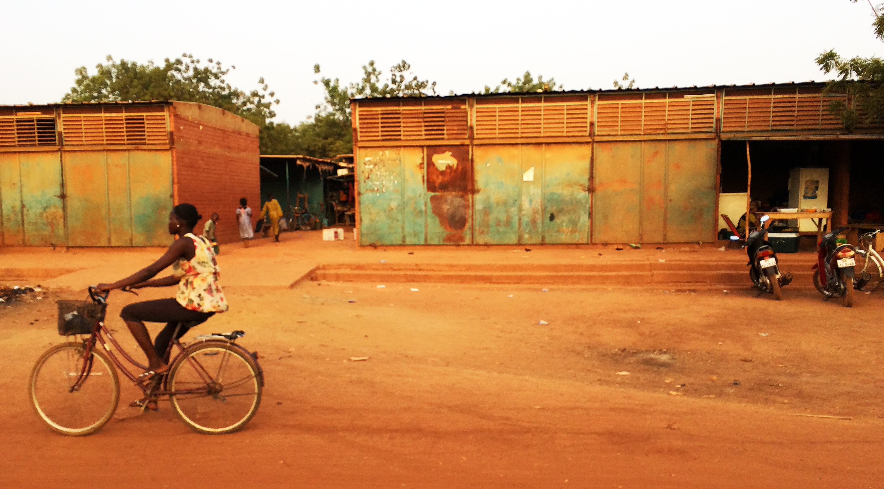





Thank you for your attention
Jean-Claude Bolay
+41 79 570 21 48
Jean-claude.bolay@epfl.ch
www.cooperation.epfl.ch

