Slide 1




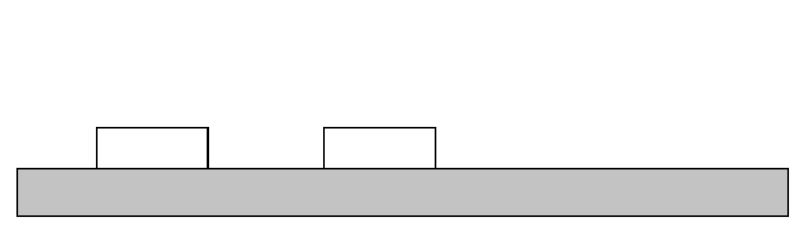
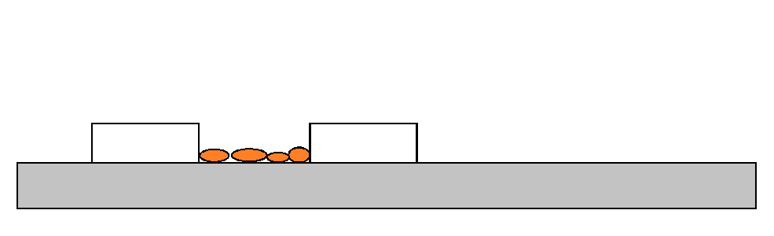
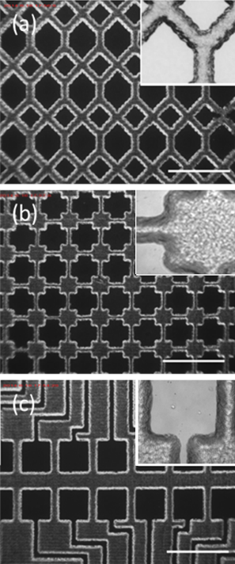
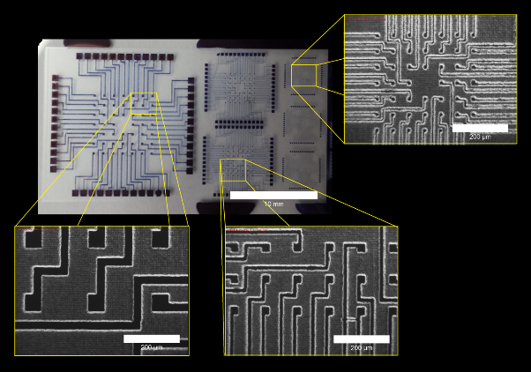
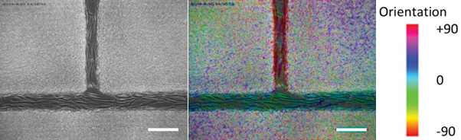
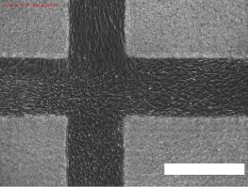
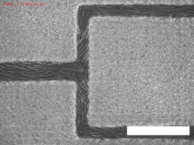
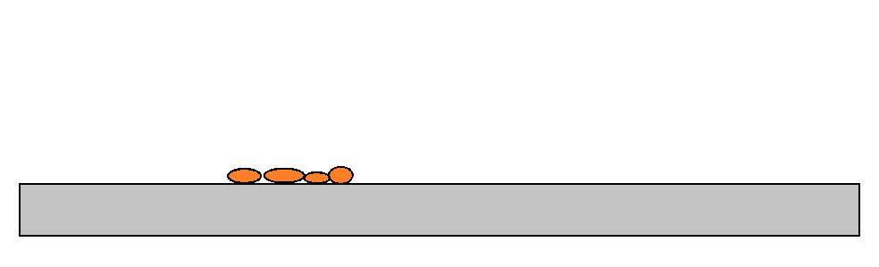
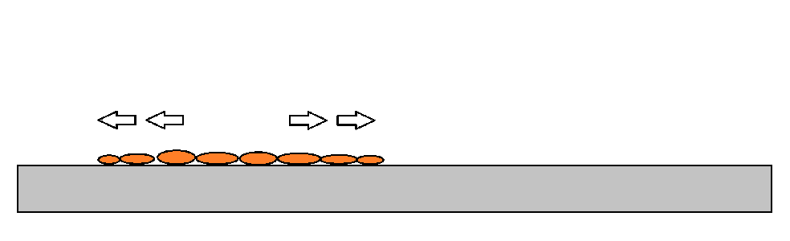
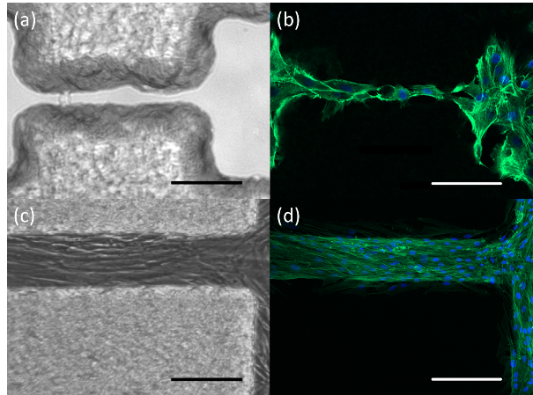
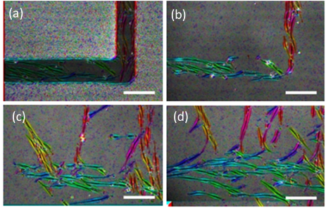
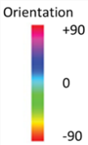


Printing wax to create scaffolds for
tissue engineering applications
Christopher Tse^{1,2)} , Patrick Smith¹⁾, Jürgen Brugger²⁾
1) Laboratory of Applied Inkjet Printing, University of Sheffield, UK 2) Laboratory of Integrated Systems, EPFL, Switzerland
Abstract
In a space of 2–3 hours, the desired pattern could be created with computer assisted design, printed and have cells seeded onto the scaffold, which could reduce the cycle time of prototyping micropattern designs. Human dermal fibroblasts and RN22 Schwann cells were seen to proliferate within the fabricated patterns and survive for more than 7 days. Additionally, the wax constructs could be readily removed from the substrate at any stage after cell seeding with the cells continuing to proliferate. Thus, we report on a simple but novel approach for the controlled physical positioning of live cells by wax inkjet printing, suitable for cell proliferation studies ¹
Methodology
Using a Jetlab 4 printer with a heated reservoir of 70°C, wax was printed onto a glass substrate with the user’s design
2) Cells were seeded onto the substrate and allowed to proliferate for several days until confluent
1)
Inkjet printed wax
2)
Seeded cells
Substrate
a)
d)
a)
b)
b)
c)
d)
c)
a –c) Light microscope images of printed wax designs, with magnified images shown in the small frame. Scale bar = 200 µm; d) Light microscope image of circuit design created with wax (Scale bar = 10mm) with expanded images to show resolution of the print (Scale bar = 200 µm) ²
Light microscope images of cells proliferating in wax patterned environments; a) a wax pattern where fibroblasts are proliferating and orientating along the channel after 2 days in culture. Channel widths are 40 µm and 60 µm (scale bar = 100 µm); b) the same picture after processing with OrientationJ to highlight the alignment of cells within the channel; c+d) more examples of cell proliferation in wax channels after 3 days in culture (scale bar = 200µm) ²
3) Wax was removed through physical detachment with a scalpel, leaving the cells in place
4) Cells proliferate over time across the substrate and their movement can be analysed.
3)
Remove paraffin wax
4)
Cells proliferate over time
a)
b)
Light microscopy (a+c) and confocal micrograph images (b+d) of Schwann cells confined within paraffin wax compartments, differentiated and aligned. Confocal images stained for actin (green; phalloidin-FITC) and nuclei (blue; DAPI) (scale bar a-b = 100 µm, c-d = 200 µm); (a) printed paraffin wax on glass; (b) 2 days of Schwann cells cultured on wax structures and with the wax removed; (c+d) Schwann cells differentiated and remained orientated and within the confines of the wax structures after 7 days. Channel widths averaged 30 µm (i.e. the confines of the wax)
a)
b)
Micrographs having being processed with OrientationJ to highlight the alignment of cells. (a) fibroblasts aligning within wax structures, (b) immediately after wax removal, (c) 24 hours and (d) 48 hrs after wax removal taken in the same sample region of interest.
Scale bar = 50 µm
c)
d)
c)
d)
Summary
Paraffin wax can act as a physical barrier during cell proliferation without detrimental effect, and can create designs with resolutions down to 10μm
Seeded cells orientate themselves parallel to the orientation of the wax as they become confluent
Cells proliferated normally after wax removal, and proliferated from a highly arranged pattern, to a disordered culture environment in 48 hours
Pockets of cells were able to proliferate quicker than others, and it was suspected that this was due to more cell-to-cell interactions with one another that enhanced proliferation
1. Zhang, Y., Tse, C., Rouholamin, D. & Smith, P. Scaffolds for tissue engineering produced by inkjet printing. Open Eng. 2, (2012).
2. Tse, C. C. W. et al. Utilising Inkjet Printed Paraffin Wax for Cell Patterning Applications. Int. J. Bioprinting 2, (2016).
Scan this QR code to send an email to me
christopher.tse@epfl.ch

