Slide 1
Programmation Interactive par l’Exemple
Interactive Programming by Example
Mikaël Mayer
Prof Pierre Dillenbourg, président du jury
Prof Viktor Kuncak, directeur de thèse
Prof Martin Odersky, rapporteur
Prof Martin Vechev, rapporteur
Prof Ravi Chugh, rapporteur
Thèse présentée publiquement à l’EPFL ce jeudi 28 septembre 2017

Slide 2
"Your wish is my command"
« Vos désirs sont mes ordres »

Slide 3
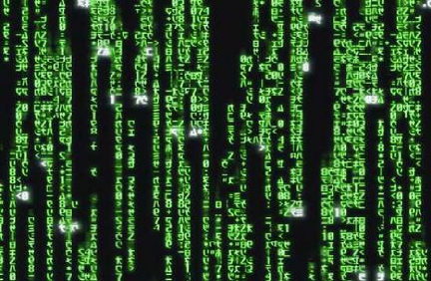
Programmation
Compilation is extensively verified and can be trusted. Same for the verification and synthesis processes. This thesis focuses on correctly translating wishes to specifications.
Programming translates wishes to commands. Two shortcuts: Programming languages (with compilers) and Specifications (with Verification, Synthesis)
Spécifications
Cette
thèse
01101
Compilateur
Souhaits
Vérification
Synthèse
Commandes
Langages de
programmation
Notes:
Wishes = Desires, Will, Thoughts
Commands = Binary programs

Slide 4
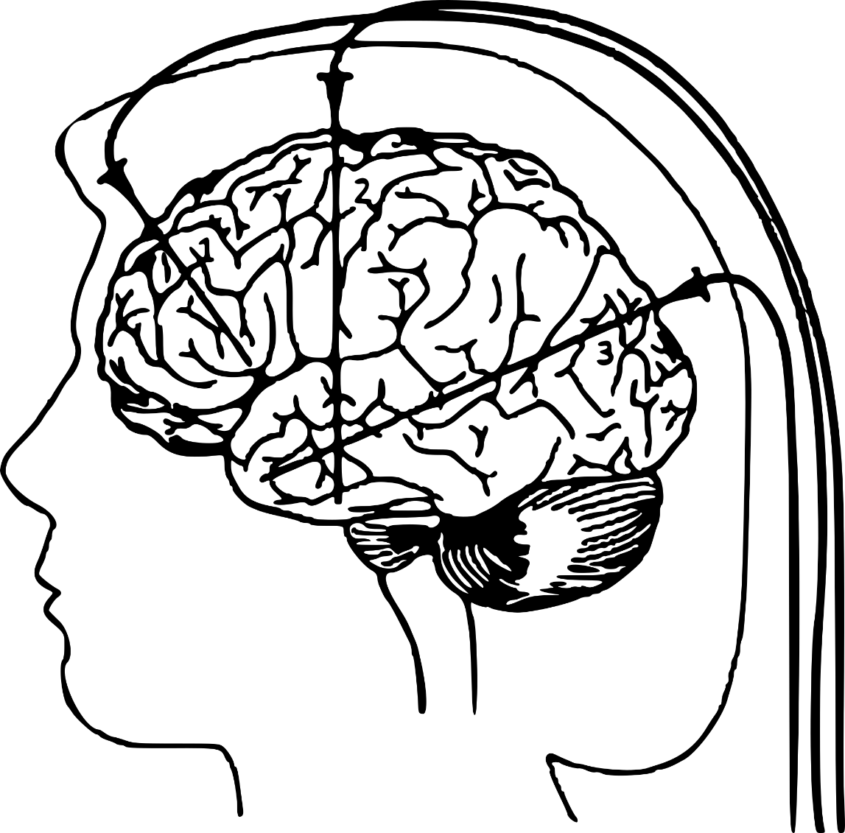
This thesis is not a neuroscience experiment that recovers specifications after reading the brain.
We were not allowed to do so. And we don’t know how to do so either.
Souhaits
Spécifications

Slide 5
Programmation par l’Exemple
Let’s take an example: specifications can also be examples. If we constrain the computer to use a certain type of programs, it can find almost all the programs that work.
How can we make sure that the program is correct? To bring trust to the user, we can provide feedback. Three kinds of feedback, from simple to complex: Output, Program, Specification
After choosing the best program according to some rules of the thumb, the resulting program is consistent with the examples, and can process other unseen inputs
Mme. Cic
Mme. Cic
Leo Da Vinc
Leo Da Vinc
Mikael Mayer
Mikael Mayer
Mikael Mayer
MM
Programme
MM
LV
MC
Leo Da Vinc
LV, LDV, LD, DV, LDa V ?
Retour
Spécification
Programme
Sortie
Notes:
Comment mettre en œuvre ces retours?
Lequel de ces trois retours peut donner plus de confiance à l’utilisateur?

Slide 6
Feuille de route
We identified that the first works are more practical and the last one more theoretical. Although the first works are more social than autistic, the last works are more fundamental contributions.
Roadmap: 1. Program android games with the finger. 2. Rename a million file without coding. 3. Extract table from text using the mouse. 4. How to ask precise questions.
Pong Designer: Programmer des jeux android avec ☺
StriSynth: Renommer des millions de fichiers avec ⌨
FlashProg: Extraire un tableau d’un texte avec 🖰
Prosy: Comment poser des questions précises
+ de pratique
+ social
+ organique
+ de théorie
+ autiste
+ fondamental

Slide 7
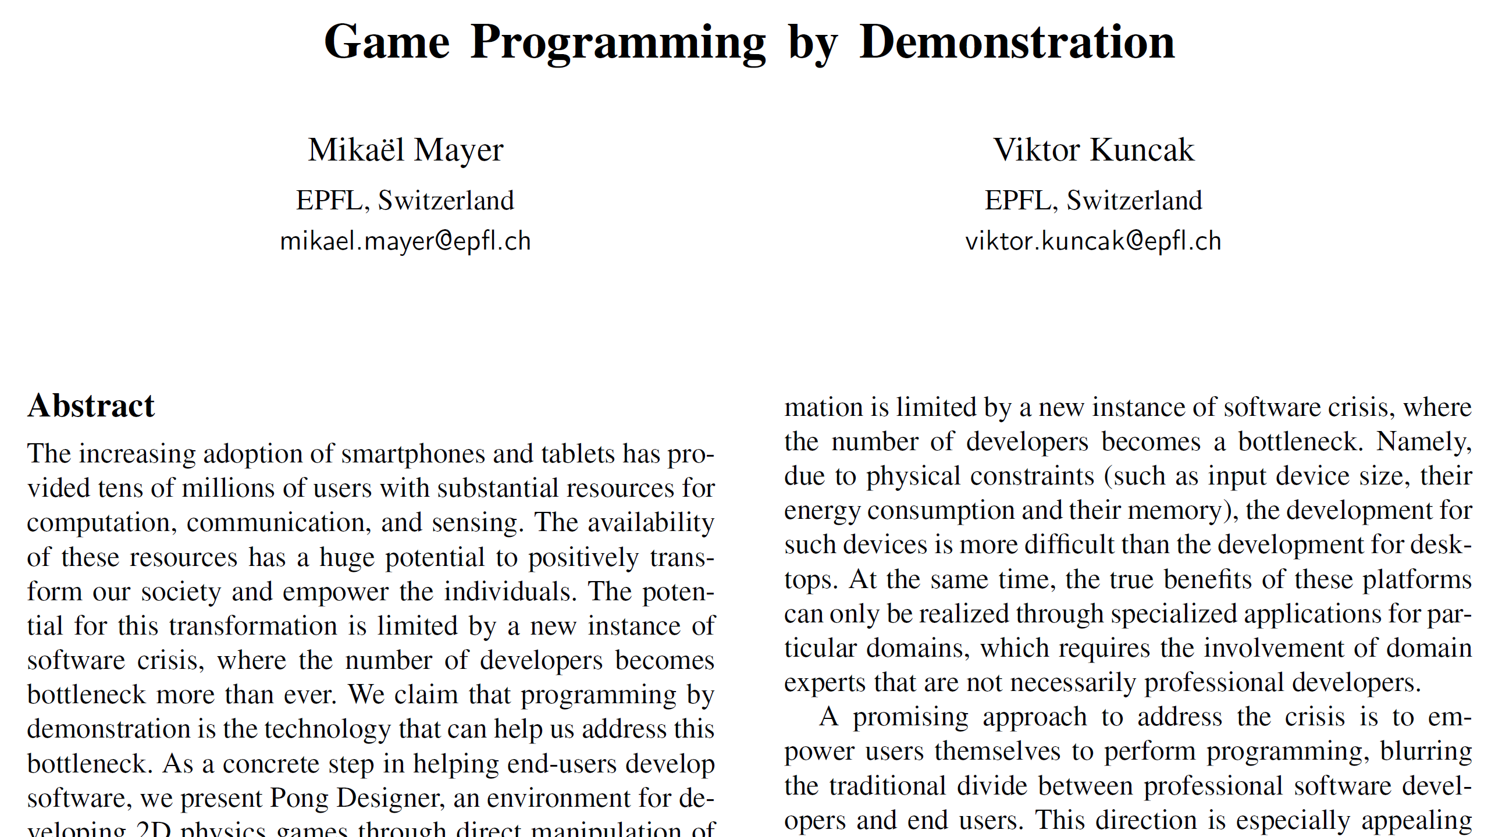
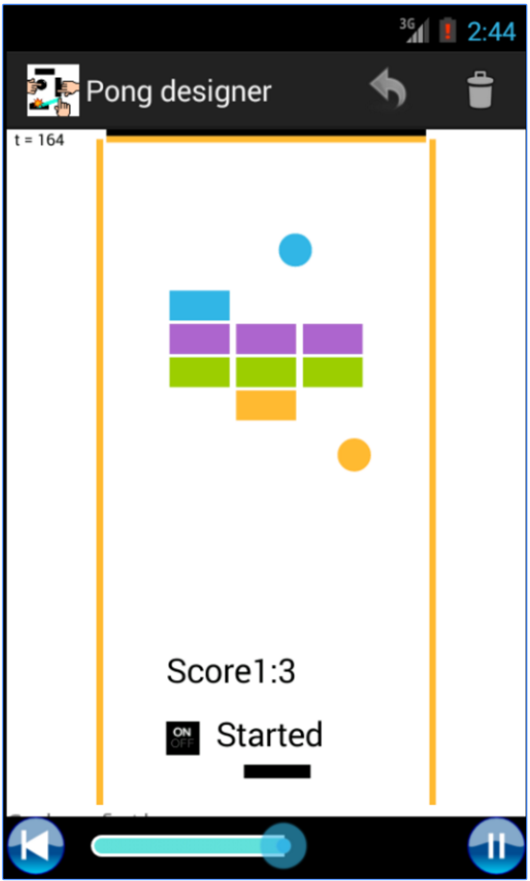
Pong Designer: Programmer des jeux android avec ☺
Pong Designer: Program android games with the finger

Slide 9
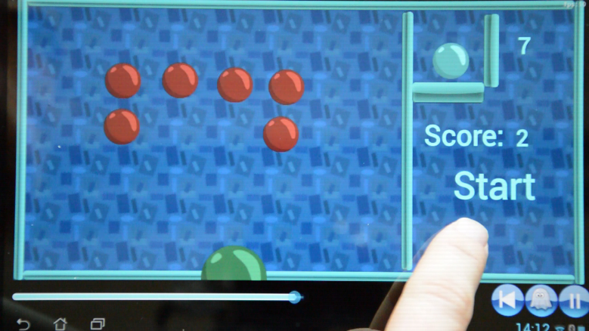
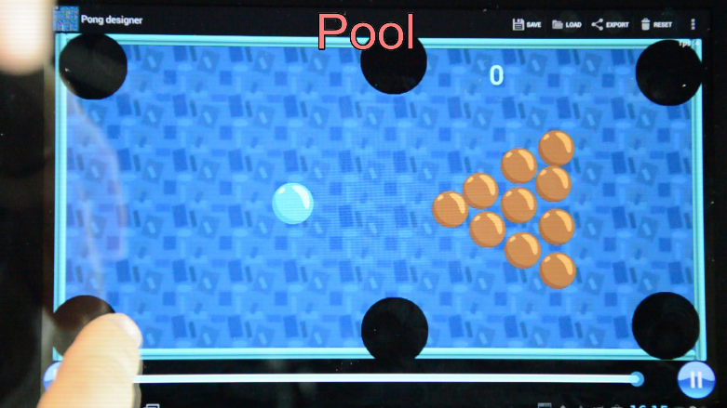
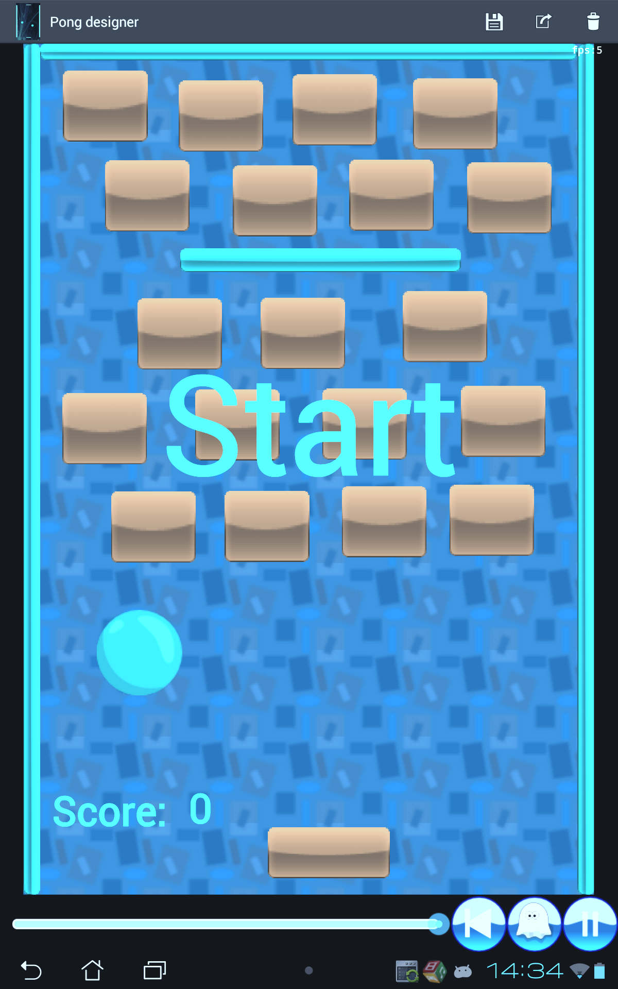
Possibilités infinies
Endless possibilities: We programmed pong games, brick breakers, pacman, space invaders, pool, tilting maze, platform games…
Jeu de Pong
Casse-Brique
Pacman
Space invaders
Billard
Labyrinthe
Mario 2D…
Notes:
Add a video here for 5 minutes of demonstration. Compilation of some existing videos.
Interesting things:
Many possibilities: Counter-increments: from 0 to 1. Pause when there are several positions. In the video.
Few words before the video start.
Remark when zoom out.
Pause the video, and explain
Other captures such as the tilting maze, space invaders, firing balls to the wall.

Slide 10
Toutes les 1/30èmes de seconde:
Every 1/30 of a second, the program takes the previous state and the events, and produces the next state of the game. How do we learn this program by demonstration?
?
Programme

Slide 11
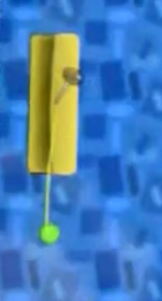
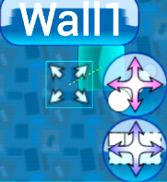
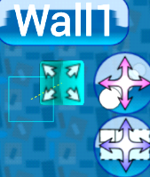
Protocole
The demonstration protocol is first to pause the game, to come back for at most 5 seconds, and to select a "trigger" event (finger movment, number change, out-of-screen).
After confirming the event, we can change the state of the game as it could be before the event, and as it should be after the event. We can change numbers, texts, colors, velocities, positions…
Revenir en arrière, sélectionner un événement.
Modifier l’état avant et après l’événement.
Etat du jeu avant Etat après
Modifier nombres, textes, couleurs, vitesses, positions,,,
Notes:
Good thing about changing the graphical environment is that everything is visible.
You see the events: Collision, finger movement, etc.
You can change the previous or the state after.
How does it map to rules?

Slide 12
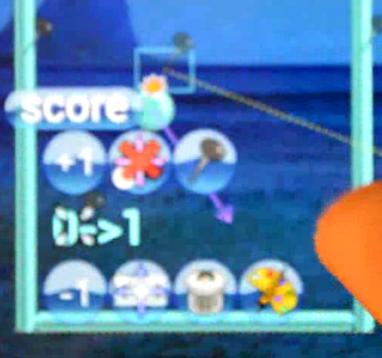
Assimilation des règles
In our model, we allow the user to e.g. demonstrate that after a collision, by removing the block and augmenting a socre, the computer can find a program. This program can be modified.
Sélectionner une collision balle/bloc
Enlever le bloc
Augmenter un nombre « score »
Notes:
Arrows to switch among guessed expressions.

Slide 13
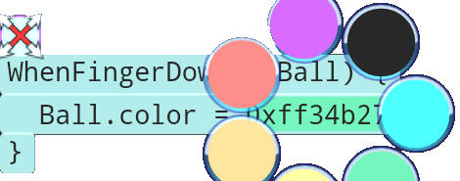
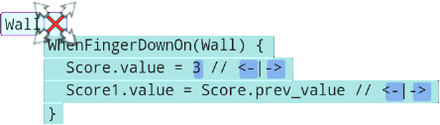
Code interactif
We can choose different colors, different position assignations, or different integers, directly in the game because the rules are visible.
On peut choisir d’autres nombres et variantes
Couleurs
Positions
Entiers

Slide 14
By comparing values before and after, we can produce code snippets. Relative repositioning, absolute repositioning, or copy another object’s position.
Si position_{après} ≠ position_{avant}, voici le code:
position ← position + {position_{après}- position_{avant}}
position ← position_{après}
position ← position(objet)
Clarification: Changer le code ou + d’exemples
Example: Fibonnaci
Example: Syracuse
Example: Primes listing
Example: Minsky Machine
Notes:
Main part: How to do better
If the color change, we add a line concerning .color
If the text changes, consider all expressions that could create this text.
Future: better language based on user tasks.
TODO : Set of examples, find coefficients.
TODO : New slides to infer

Slide 15
Accepting new examples
Fibonacci through examples:
Fibonacci 1, 1, 2
Fibonacci 1, 2, 3
Fibonacci 2, 3, 5
Fibonacci 3, 5, 8
Notes:
If the color change, we add a line concerning .color
If the text changes, consider all expressions that could create this text.

Slide 16
Syracuse sequence
Clock as a ball
Demonstrate n/2, n*3, n*3+1
Test on n%2 to copy either n/2 or 3n+1
Demonstrate appending number to “seq:”
Notes:
TODO : Add screenshot of rules.

Slide 17
Primes listing
2 balls
One to increment the test, the other to increment the quotient
Demonstrate remainder with (11, 3) => 2
Output if quotient greater than half
Stop if remainder=0
Notes:
TODO: Running video.

Slide 18
Minsky Machine
Clock as a ball transferring the PC to read memory.
Memory on a counter
A rule-per-integer-value increases or decreases registers and set up new conditional program counters
Integers testing if registers are zero
Override program counter

Slide 19
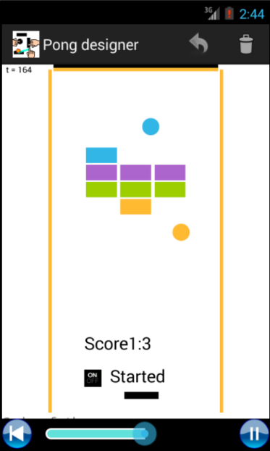
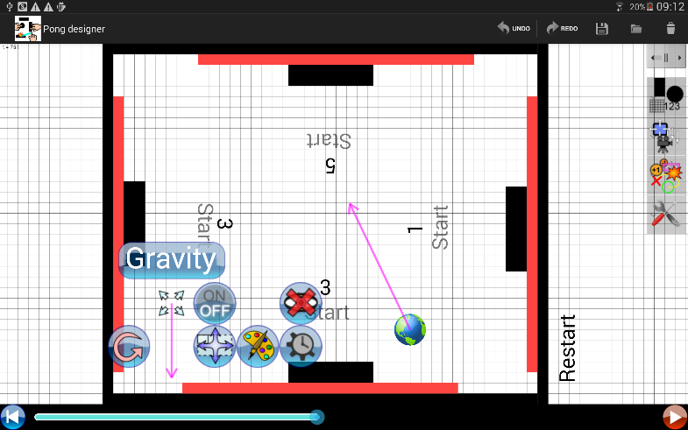
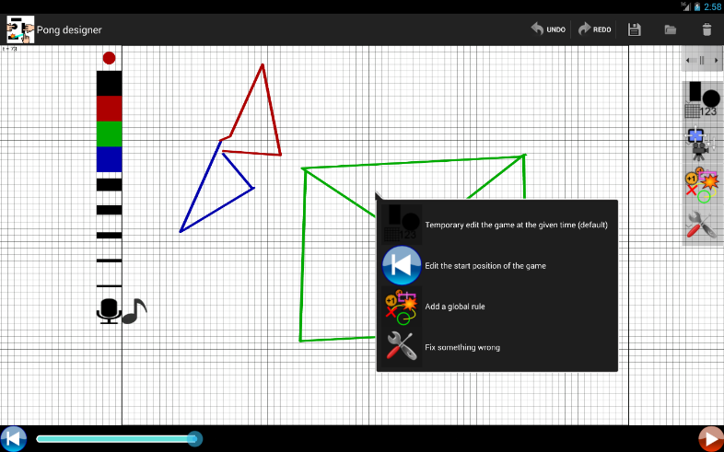
Disponible en ligne
The version 2.0 of this game engine is online for Android only. It features drawing, recording, text-to-speech, gravity, categories, friction, elasticity, … You can share the games you create.
lara.epfl.ch/w/pong
bit.ly/pongdesigner
Version 2.0 avec dessin, enregistrement, texte-vers-audio, gravité, catégories, friction, élasticité…
Notes:
Some words about the implementation

Slide 20
Épilogue – Pong Designer
Unfortunately, it was not widely adopted. Non-experts would e.g. forget to select the event before demonstrating effects. Experts are frustrated because of lack of hand programming
To sum up, as a feedback, we give the output feedback (play the game!), we provide the program in paraphrased version in 2.0, but we do not ask questions (specification feedback)
Encore trop proche de la programmation
Impossible de programmer soi-même.
Tous les moteurs de jeu ont des restrictions !
Retour sortie: Il suffit de jouer !
Retour programme: Code paraphrasé
Retour spécification: Aucun

Slide 21
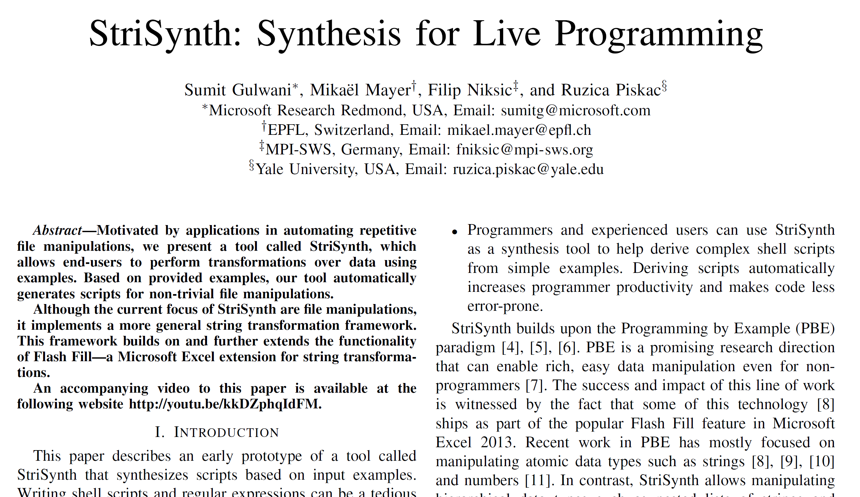
2. StriSynth: Renommer des millions de fichiers avec ⌨
StriSynth: Rename millions of files with the keyboard, without coding

Slide 22
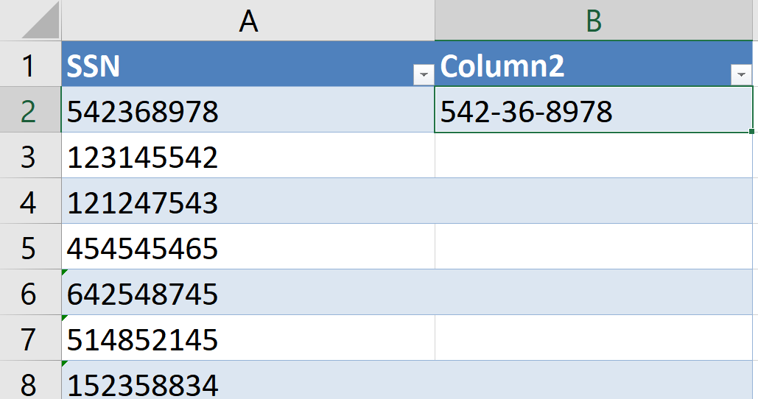
In Excel 2013, Flash Fill enables you to auto-complete when it can guess the transformation (press CTRL+E, or just continue to enter the reformatted data)

Slide 23
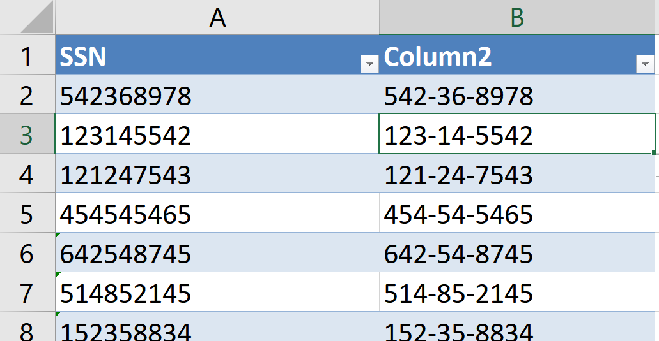
It can for example insert dashes at specific positions

Slide 24
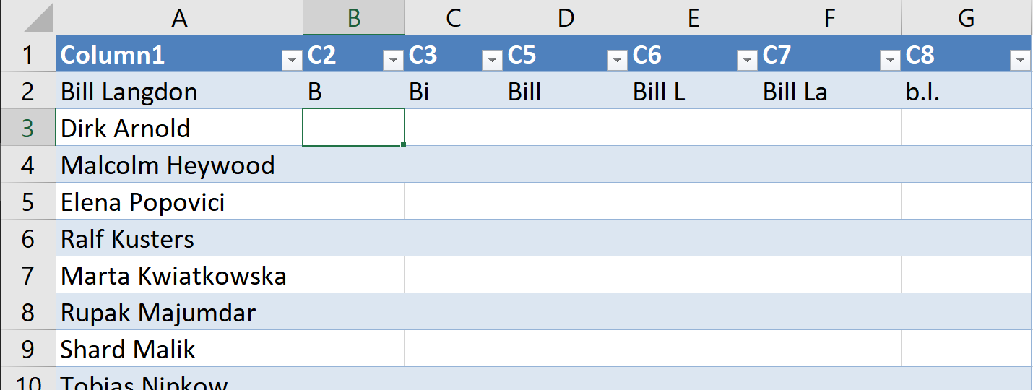
It can do much more, like extracting the first capital letter, the first two letters, the first word, everything up to the second capital letter, the first seven letters, or lowercase initials.

Slide 25
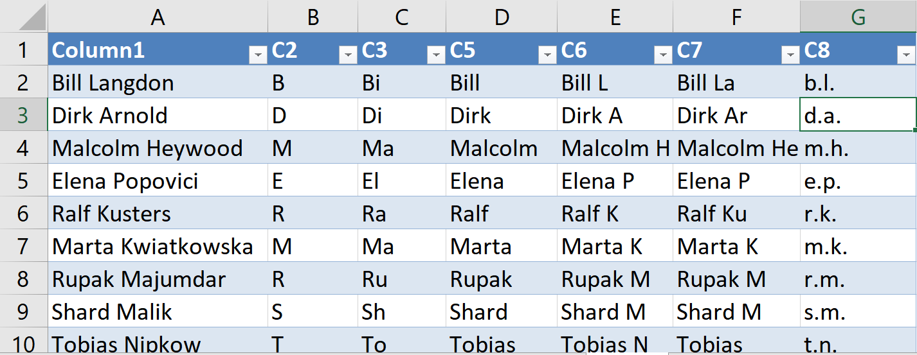
It can do much more, like extracting the first capital letter, the first two letters, the first word, everything up to the second capital letter, the first seven letters, or lowercase initials.

Slide 26
StriSynth en action
First, we extended these algorithms to support numbers and process files. Here I rename the first file and the third one, exchanging words, inserting a prefix EPFL2014_ and a 2 digit counter.

Slide 27
Extension pour Windows
Note that we provide output feedback (how other files would be renamed) and program feedback (in a human-readable way)
Nouveauté : Compteurs, transformations de nombres
Nouveauté : Programmes humainement lisibles

Slide 28
Ligne de commande StriSynth
We developed a command-line tool to learn more complex transformations (transform, reduce, split, filter, partition), which we can compose to create complex scripts using only examples.
2017/Batman_begins_HD_DIVX.avi
Batman begins [2017].avi
Transforme
Batman.avi Spiderman.mp4 Films: Batman, Spiderman, …
Réduit
A supprimer: Film_nul.avi, L’île.mp4 Film_nul.avi L’île.mp4 …
Étend
Cours.pdf math.pdf math.xls
Filtre
Oui
Oui
Non
Erwin_tahiti Mik_tahiti Erwin_nz
Erwin_tahiti Mik_tahiti Erwin_nz
Partition

Slide 29
Imagine you have a comma-separated list of files you saw. You would show how to split the list, filter out files (e.g. those in HD), and then create a command for each of them that delete them.
Déjà vus: Batman_begins_HD.avi, Presto.avi, Spiderman_HD.avi, …
Étend
Filtre
Transforme
Transforme
Transforme
Réduit
del Batman_begins_HD.avi del Spiderman_HD.avi

Slide 30
Etude utilisateur
We did a User Study, where we ask a bunch of PowerShell experts to perform three tasks in both our tool and PowerShell, and we then asked what they would prefer for 11 other tasks.
StriSynth versus PowerShell.
Experts en PowerShell
3 tâches à accomplir dans les deux environments.
Préférence pour 11 autres tâches.

Slide 31
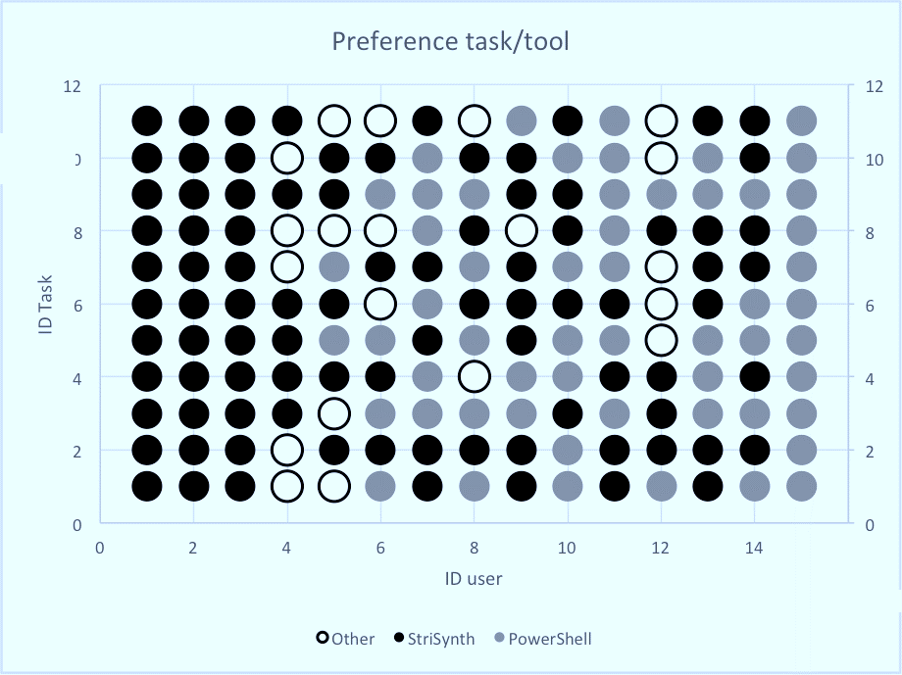
Each user marked his preferences vertically. One line is one task. Black dots meant that the (vertical) user would have preferred StriSynth over PS, blue the contrary, white other.

Slide 32
Épilogue – StriSynth
As a result, my father asked me to rename 40 files on Dropbox for him. I remember that I created a copy of these files, in case the computer renamed them badly.
This idea was awesome, we could produce reusable scripts and programs. We did little effort to present output feedback, more for program feedback, but no questioning (specification)
Une idée géniale, scripts réutilisables
Retour sortie : Un peu
Retour programme : Paraphrasé
Retour spécification: Aucun
Difficile à avoir confiance au système

Slide 33
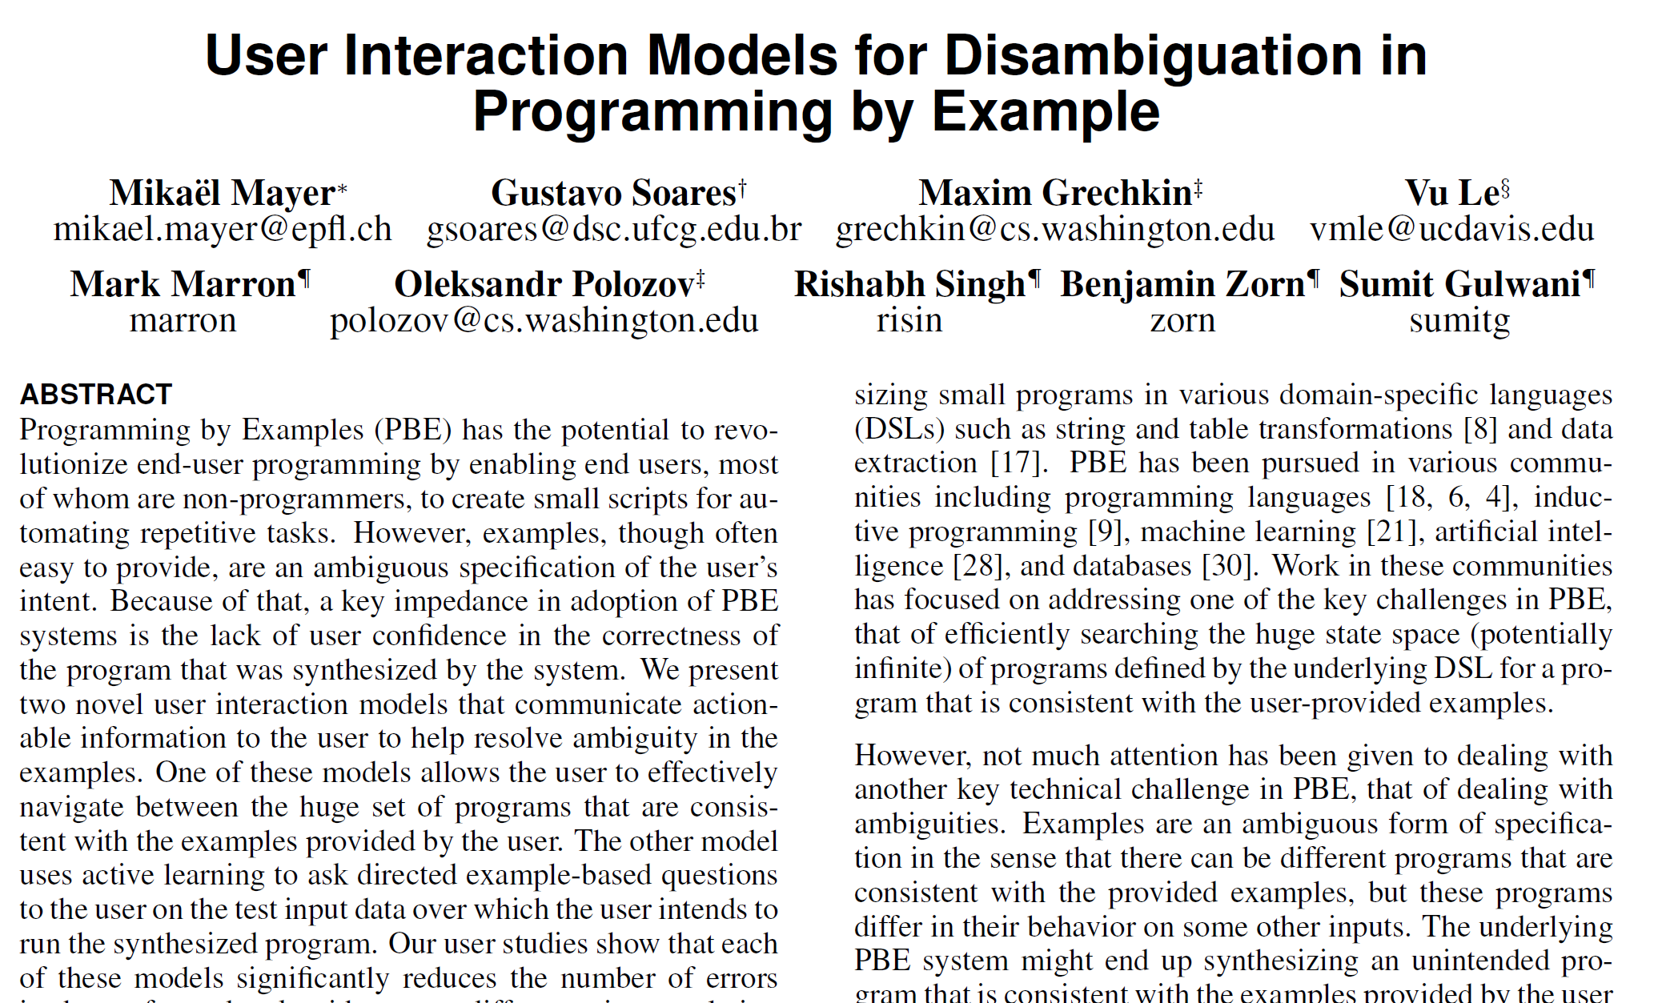
3. FlashProg: Extraire un tableau d’un texte avec 🖰
FlashProg: Extract a table out of a text using the mouse

Slide 34
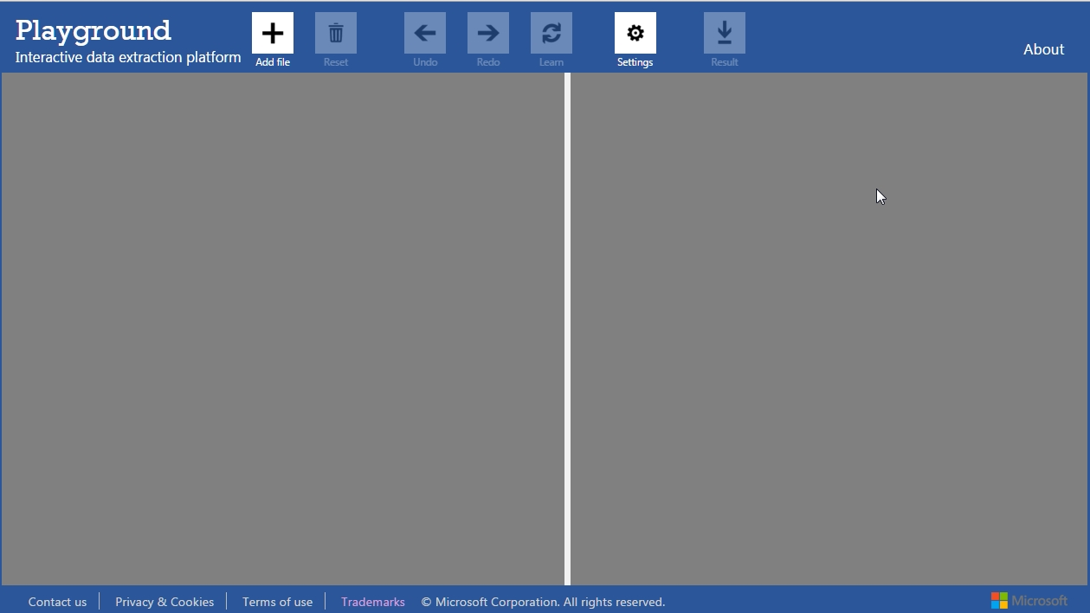
This is the interface of Microsoft Prose, in which we can perform extraction operations. We first load a text, and select the portions that we want to extract.

Slide 35
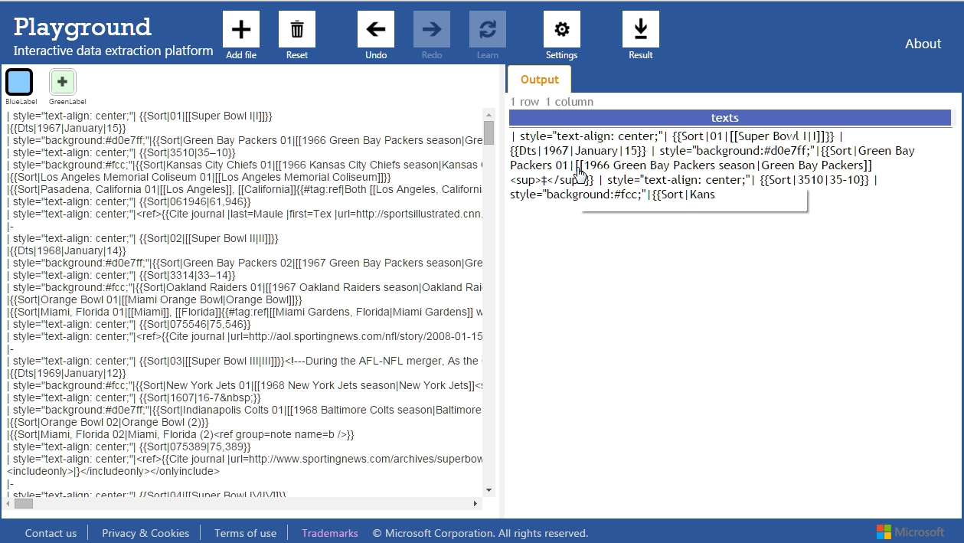
This is the interface of Microsoft Prose, in which we can perform extraction operations. We first load a text, and select the portions that we want to extract.

Slide 36
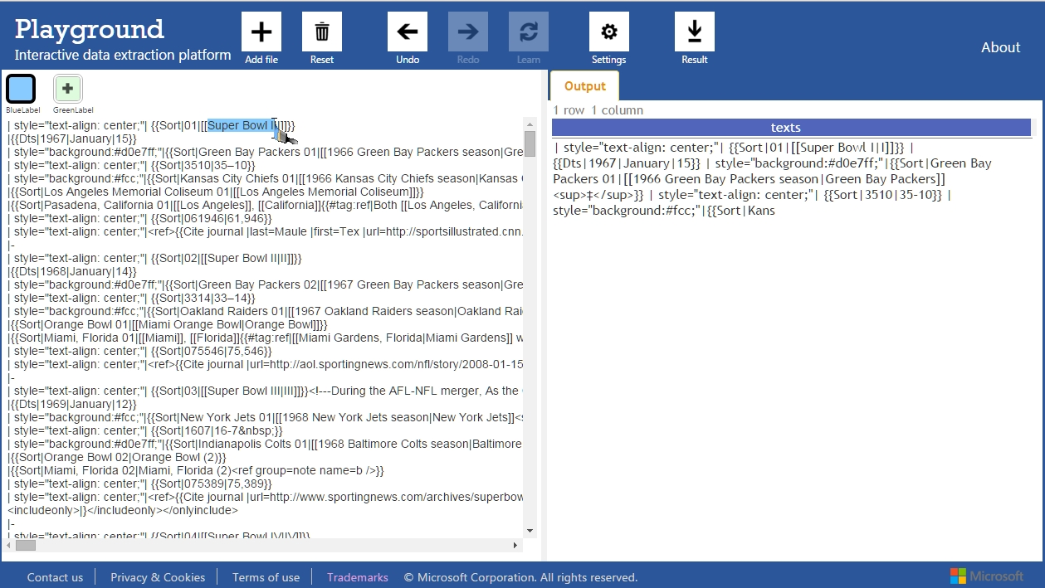
This is the interface of Microsoft Prose, in which we can perform extraction operations. We first load a text, and select the portions that we want to extract.

Slide 37
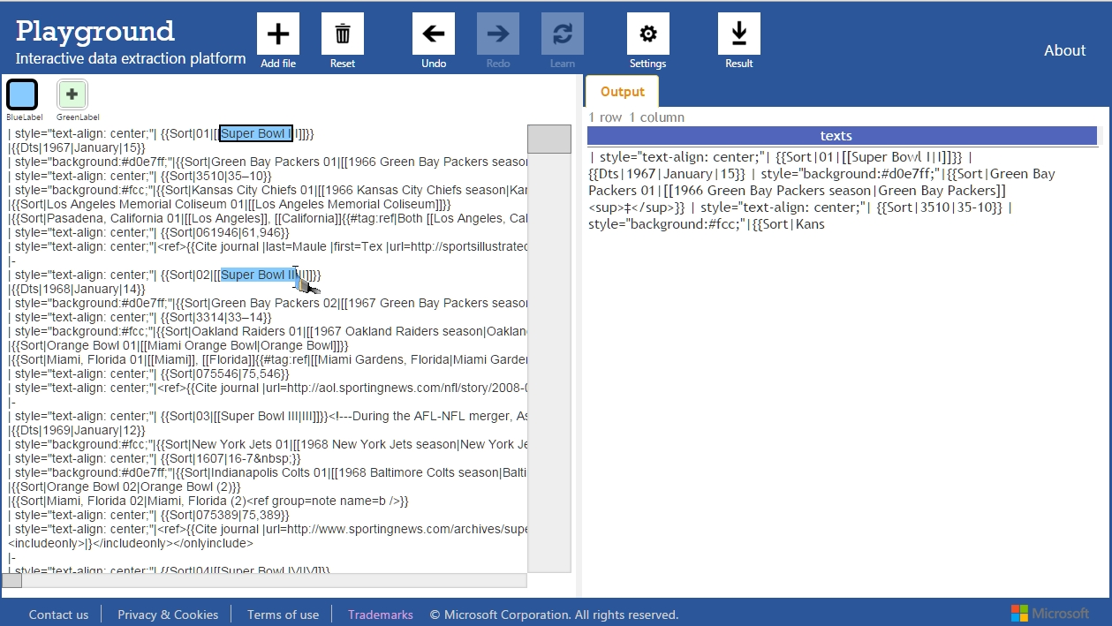
This is the interface of Microsoft Prose, in which we can perform extraction operations. We first load a text, and select the portions that we want to extract.

Slide 38
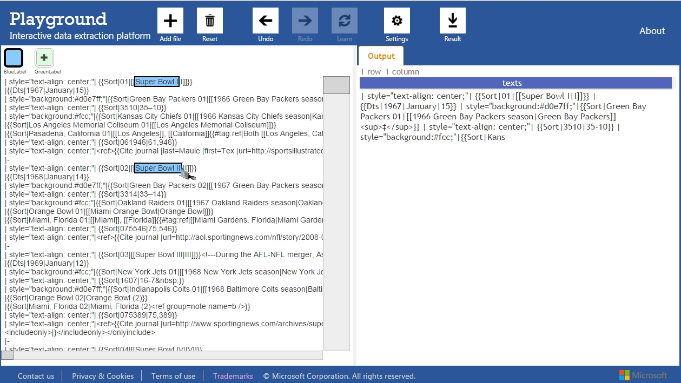
This is the interface of Microsoft Prose, in which we can perform extraction operations. We first load a text, and select the portions that we want to extract.

Slide 39
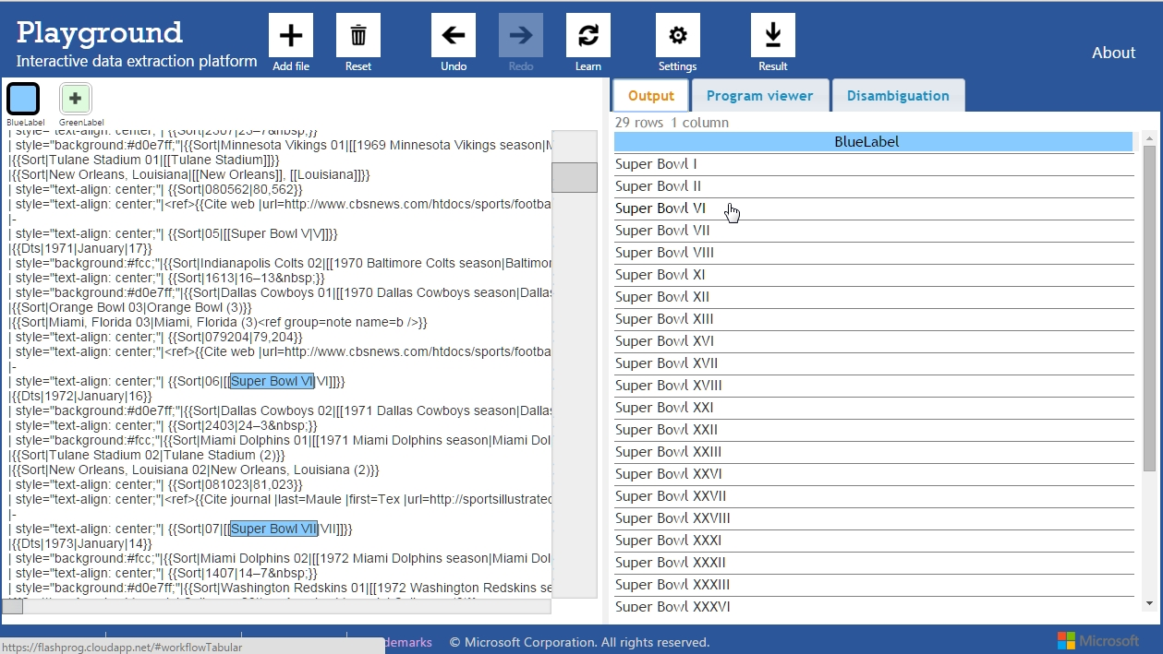
It learns a program that generalizes the set of start/end positions using regular expressions and finishes extracting them from the text. However, it can fail. Here it missed Super Bowl III to V
Super Bowl III, IV, V ne sont pas là

Slide 40
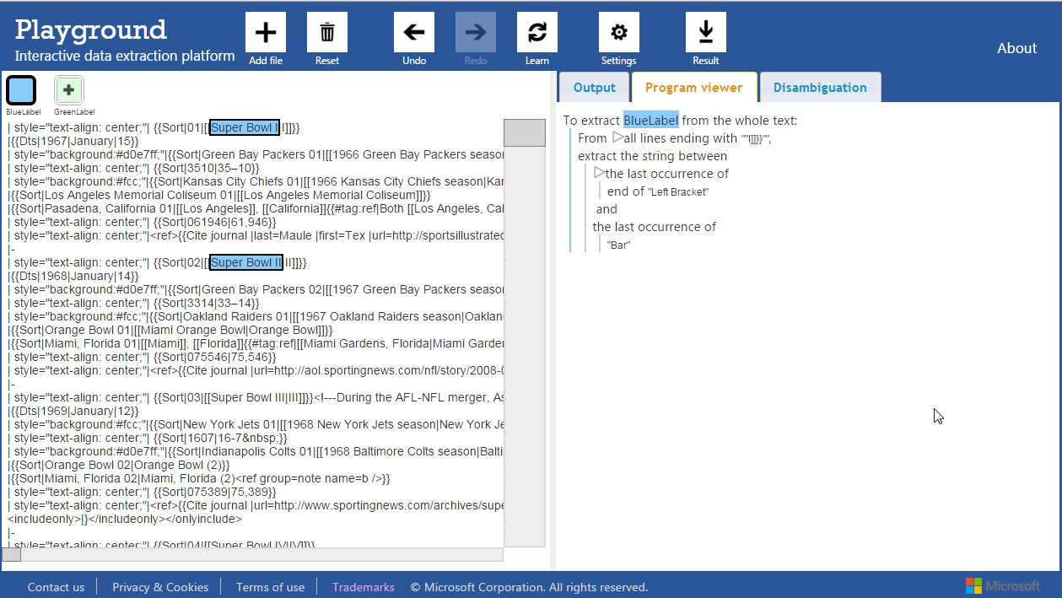
We designed a program view that display the program in an interactive way. Hovering it with the mouse, it highlights its structure. Regular expressions highlight the text.

Slide 41
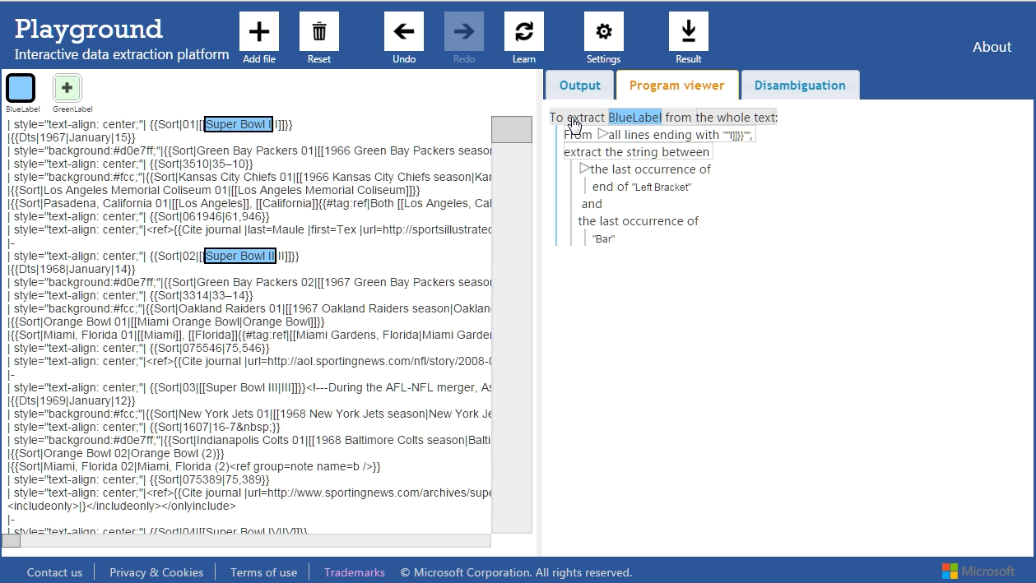
We designed a program view that display the program in an interactive way. Hovering it with the mouse, it highlights its structure. Regular expressions highlight the text.

Slide 42
We designed a program view that display the program in an interactive way. Hovering it with the mouse, it highlights its structure. Regular expressions highlight the text.

Slide 43
Using this information, we understand that the third occurrence of Super Bowl was not selected because lines were extracted based on the end of the line, which differ the third time.
Il y avait un commentaire HTML <!-- qui fait que la ligne ne terminait pas pareil qu’avant

Slide 44
We can highlight manually the missing occurrence to fix that problem indirectly.

Slide 45
We can highlight manually the missing occurrence to fix that problem indirectly.

Slide 46
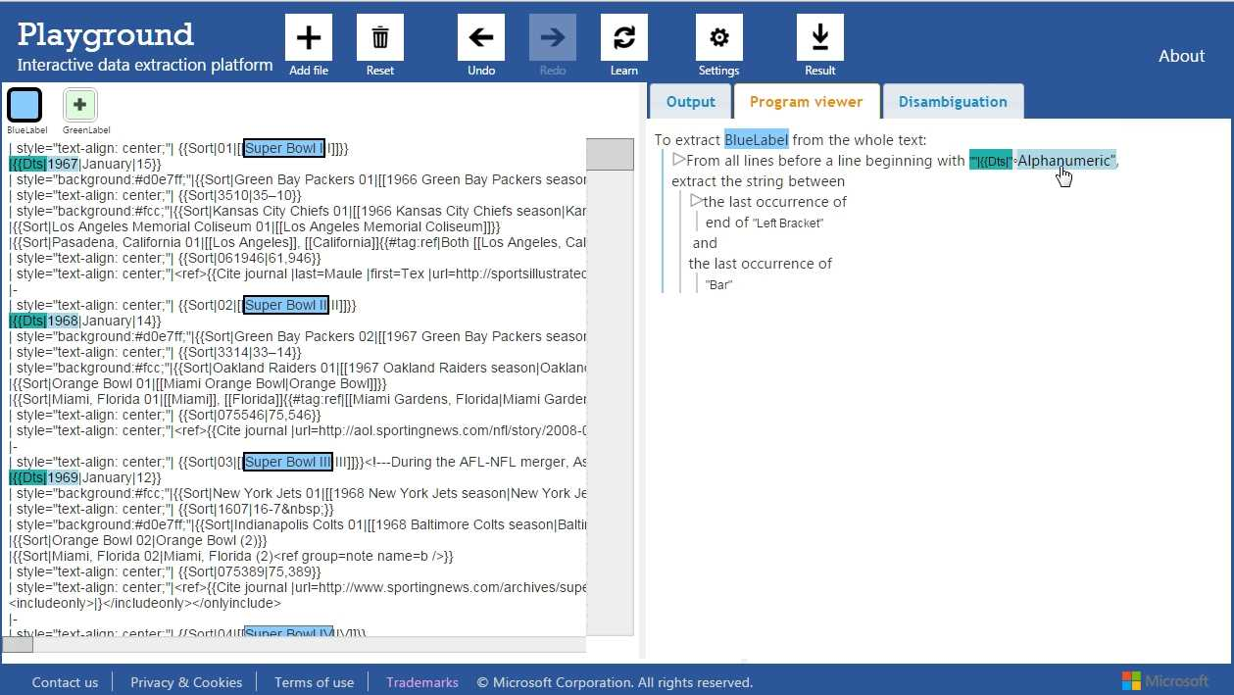
The computer finds another program that, this time, depend on the next line. It might be more secure. At least if we look at the output, it extracted everything correctly.

Slide 47
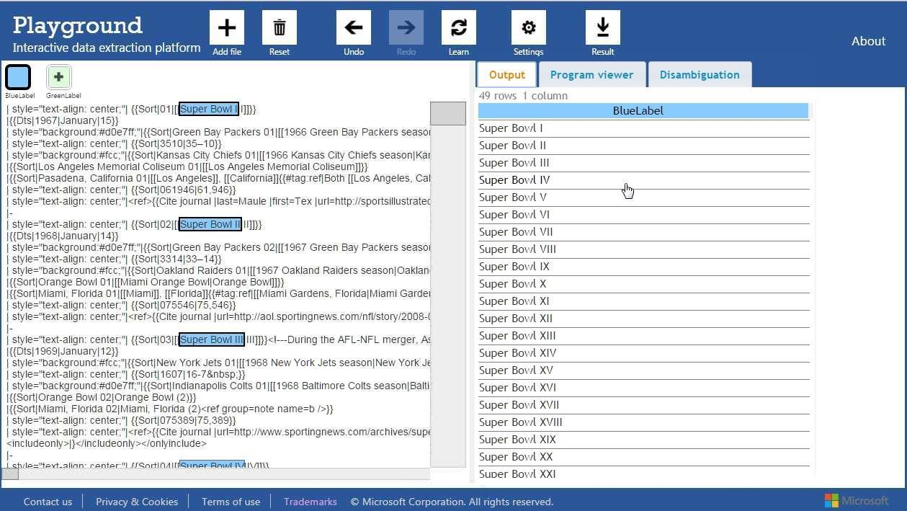
The computer finds another program that, this time, depend on the next line. It might be more secure. At least if we look at the output, it extracted everything correctly.

Slide 48
Let’s come back to the time when we were stuck with the wrong program. This time, we select the faulty program, and the computer proposes alternatives. Hovering them displays differences
Il y avait un commentaire HTML <!-- qui fait que la ligne ne terminait pas pareil qu’avant

Slide 49
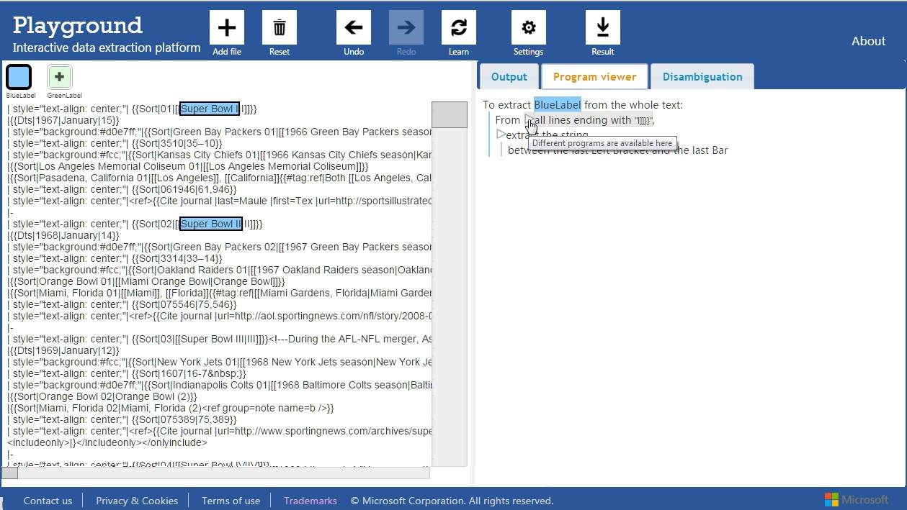
Let’s come back to the time when we were stuck with the wrong program. This time, we select the faulty program, and the computer proposes alternatives. Hovering them displays differences

Slide 50
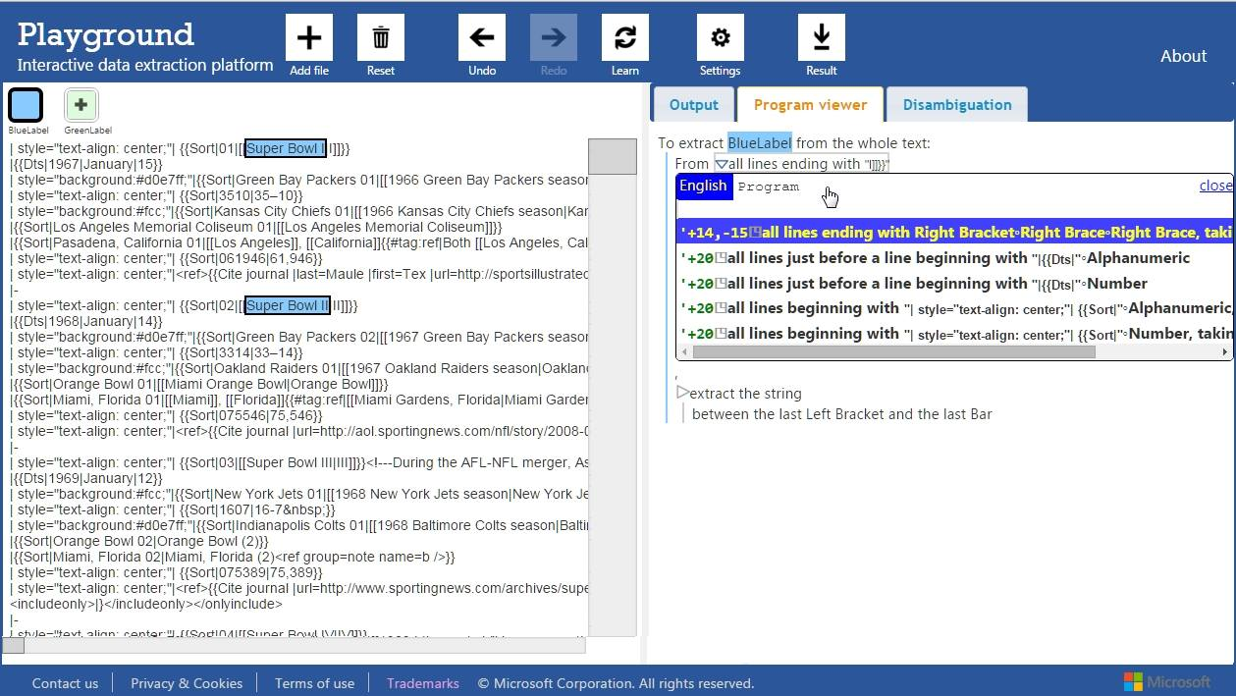
Let’s come back to the time when we were stuck with the wrong program. This time, we select the faulty program, and the computer proposes alternatives. Hovering them displays differences

Slide 51
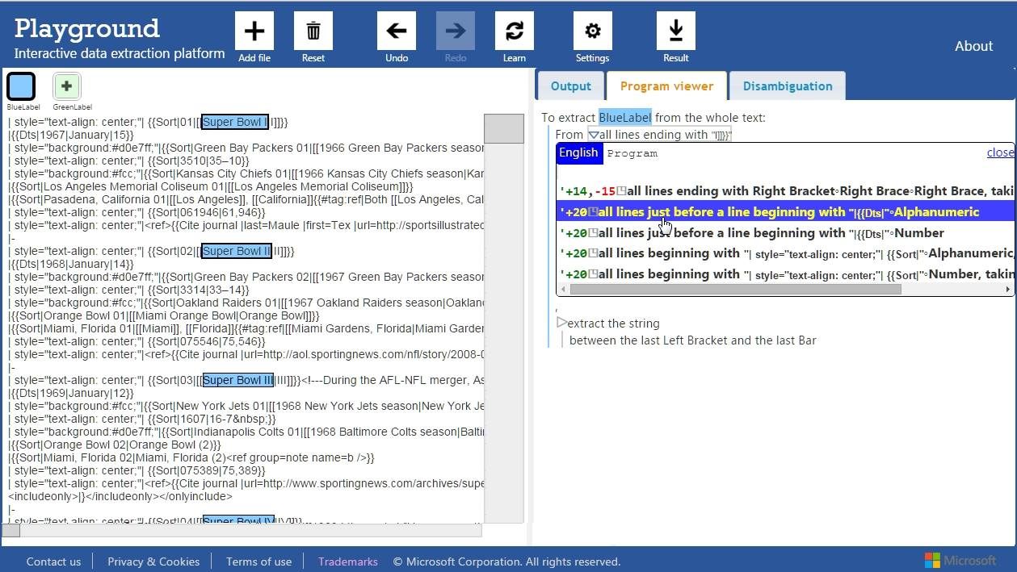
Let’s come back to the time when we were stuck with the wrong program. This time, we select the faulty program, and the computer proposes alternatives. Hovering them displays differences

Slide 52
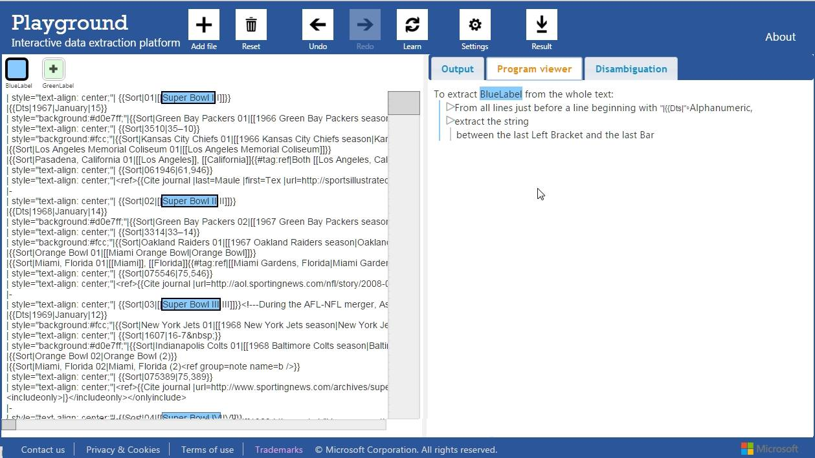
After clicking on one of them, we add the first discrepancy as an example, as if the user had highlighted the text himself. But it took only two imprecise clicks, much better than before.

Slide 53
After clicking on one of them, we add the first discrepancy as an example, as if the user had highlighted the text himself. But it took only two imprecise clicks, much better than before.

Slide 54
We even automated this process further by automatically comparing programs, and only asking about the differences in highlights, not the programs themselves.
Il y avait un commentaire HTML <!-- qui fait que la ligne ne terminait pas pareil qu’avant

Slide 55
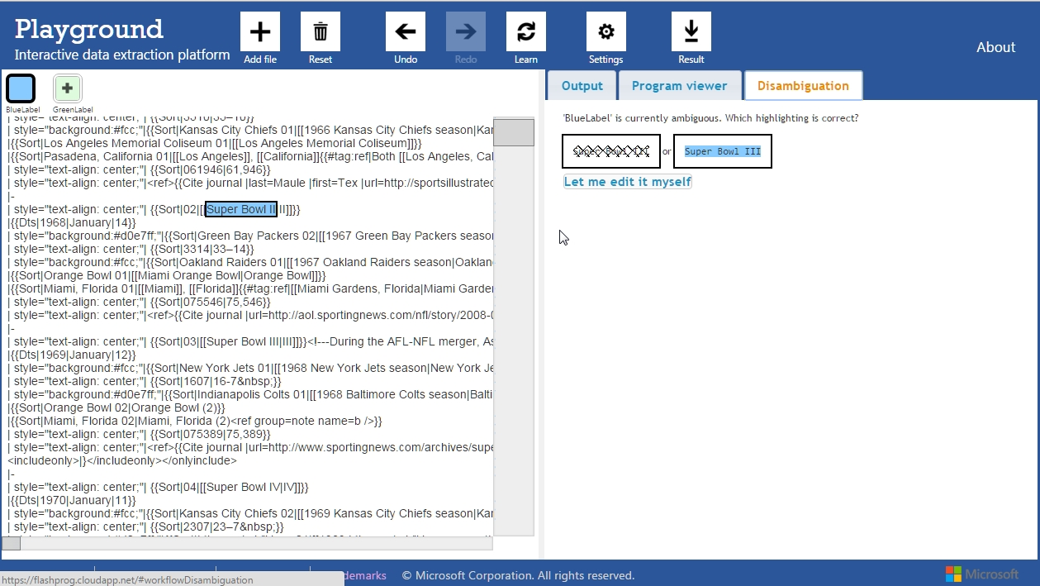
We even automated this process further by automatically comparing programs, and only asking about the differences in highlights, not the programs themselves.

Slide 56
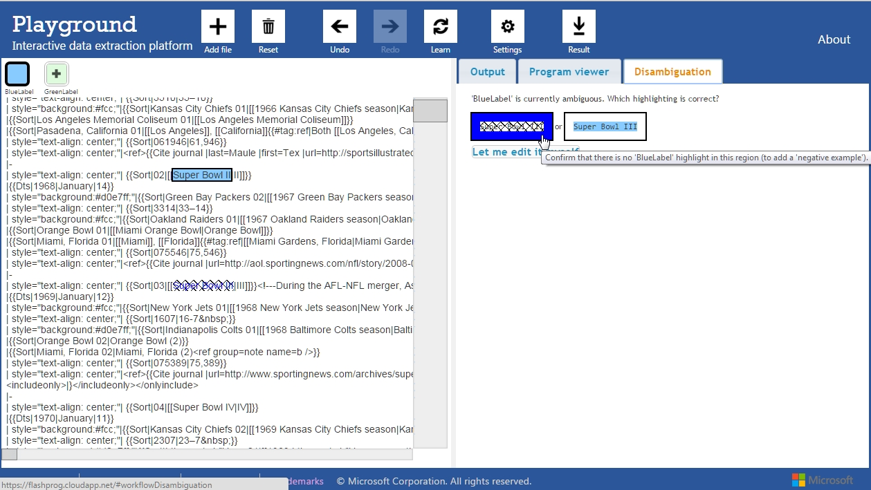
Highlighting answers highlights them in the text, so the user can compare and choose wisely.

Slide 57
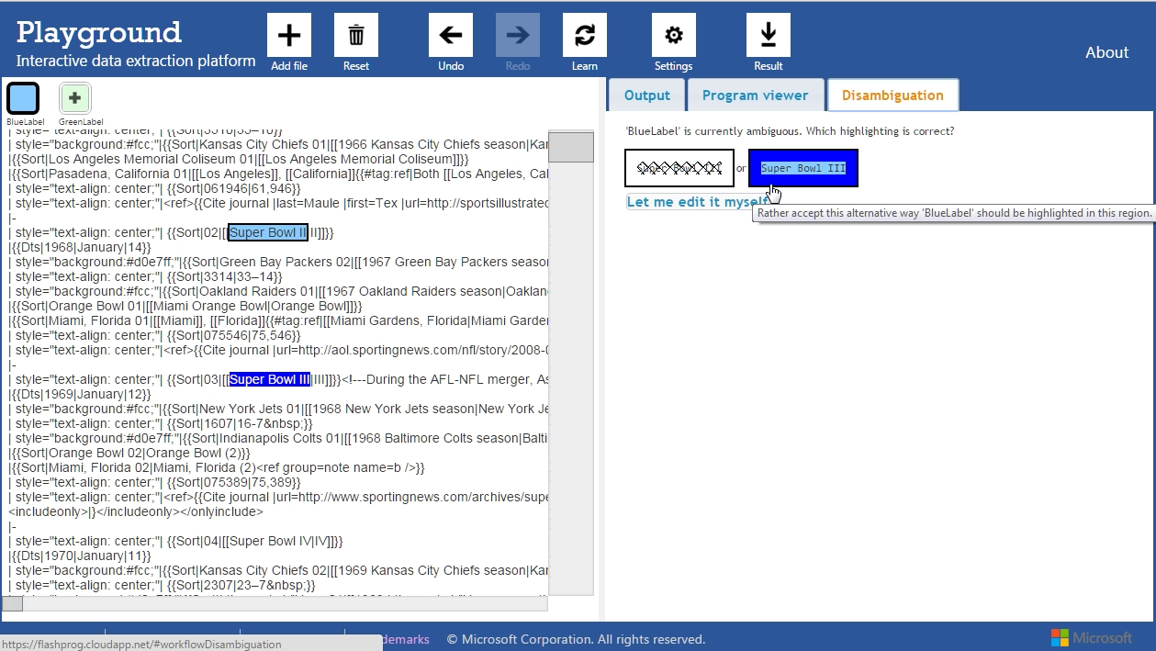
Highlighting answers highlights them in the text, so the user can compare and choose wisely.

Slide 58
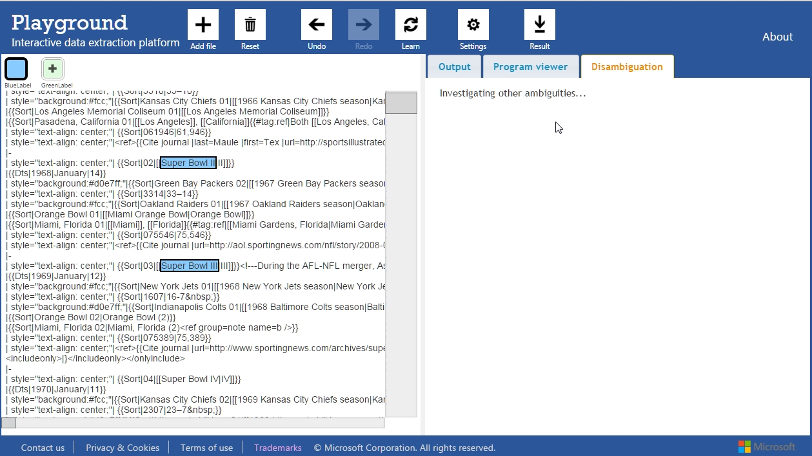
After clicking, the computer looks for other discrepancies. We will see more of them later.

Slide 59
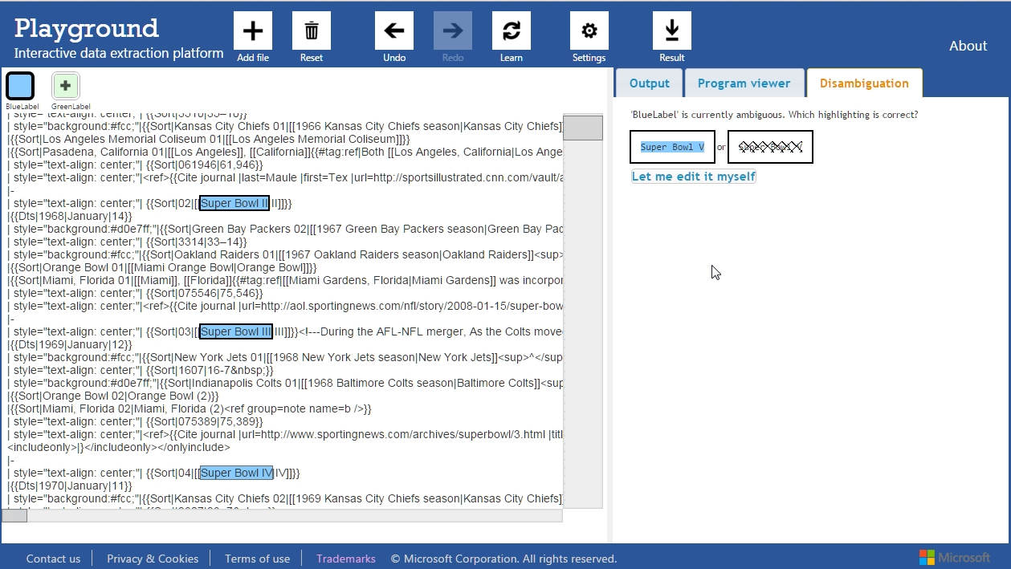

Slide 60
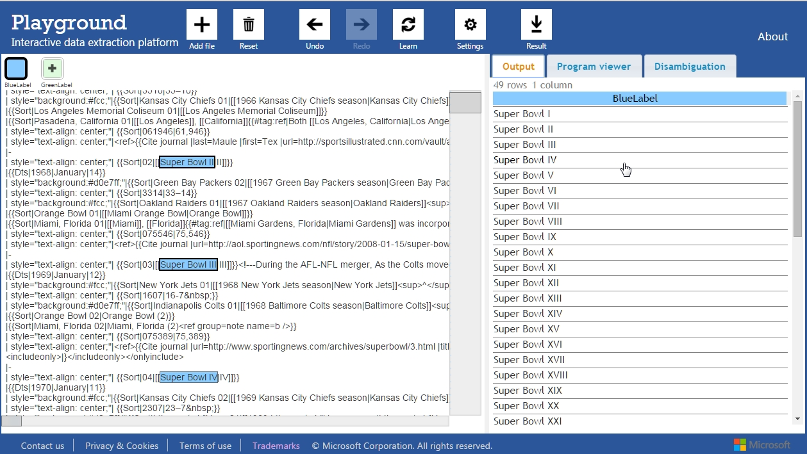

Slide 61
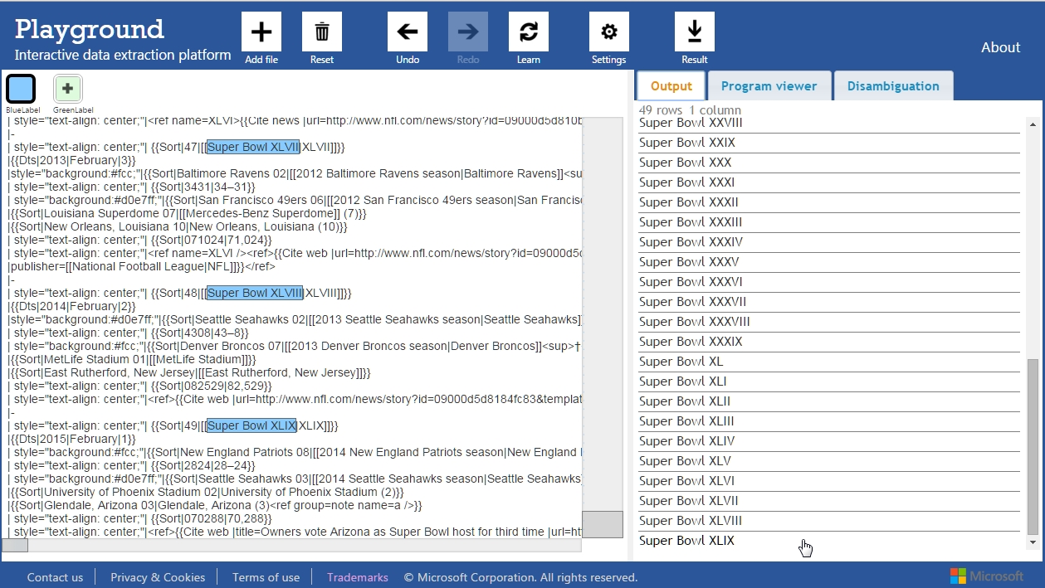

Slide 62
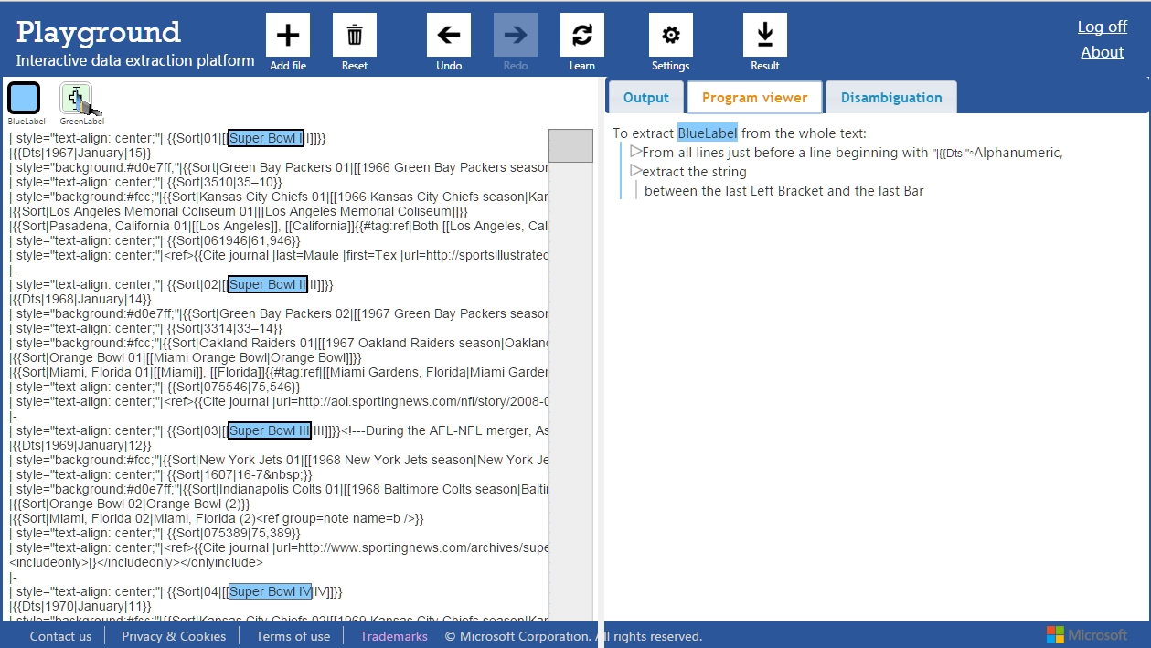
Now let’s extract the winning teams out of these superbowls games. For that we select a new label, a green one, and highlight three examples of winning teams.

Slide 63
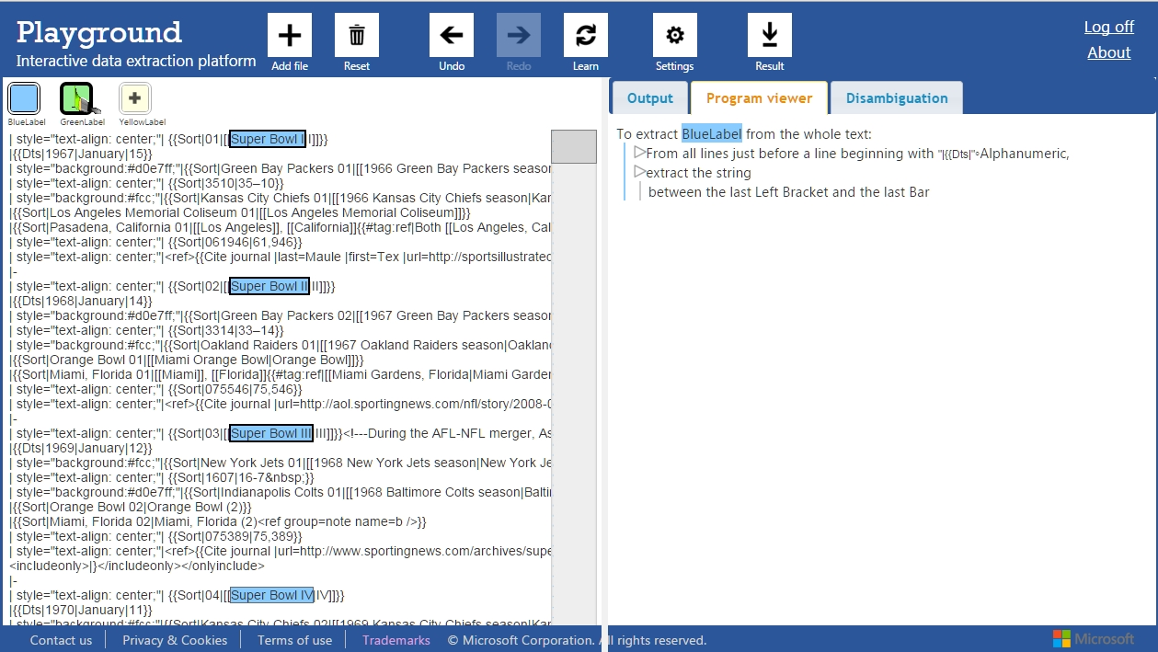
Now let’s extract the winning teams out of these superbowls games. For that we select a new label, a green one, and highlight three examples of winning teams.

Slide 64
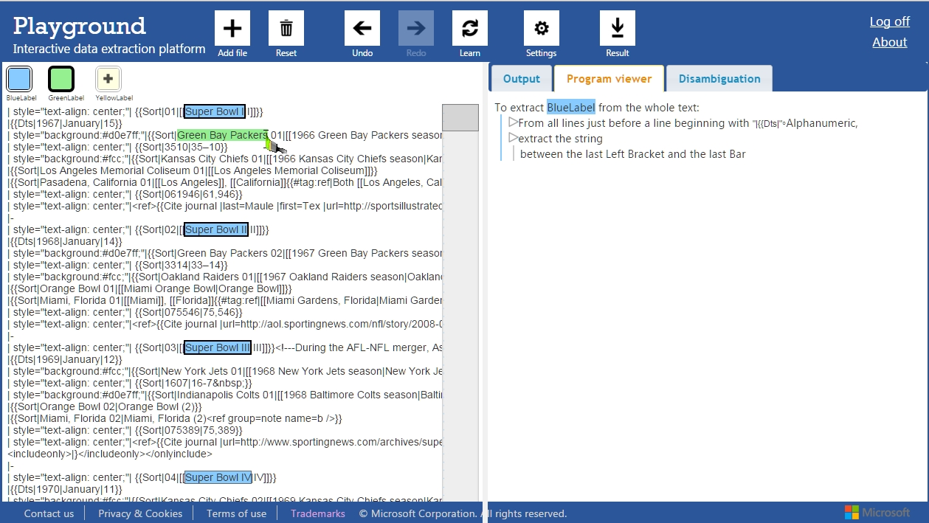
Now let’s extract the winning teams out of these superbowls games. For that we select a new label, a green one, and highlight three examples of winning teams.

Slide 65
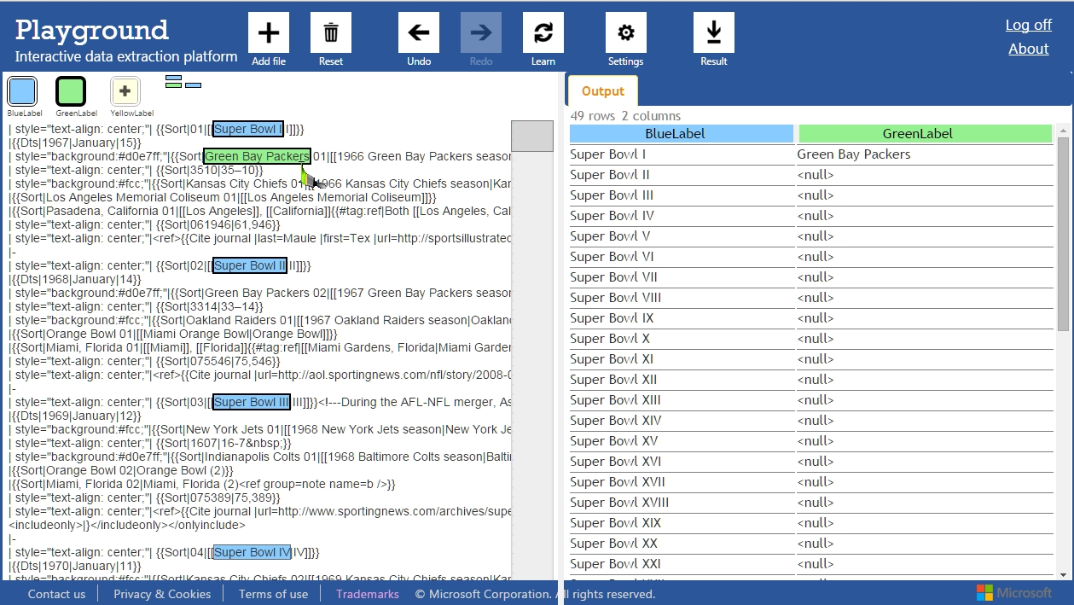
Now let’s extract the winning teams out of these superbowls games. For that we select a new label, a green one, and highlight three examples of winning teams.

Slide 66
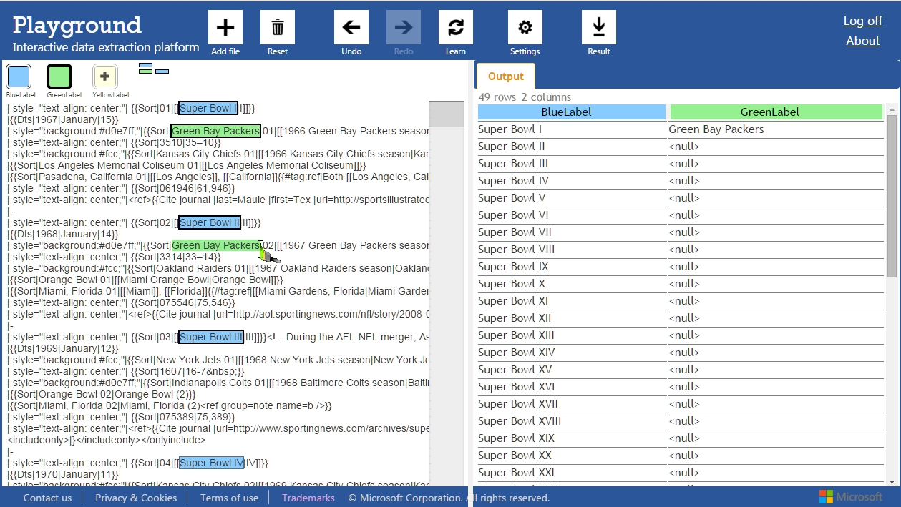
Now let’s extract the winning teams out of these superbowls games. For that we select a new label, a green one, and highlight three examples of winning teams.

Slide 67
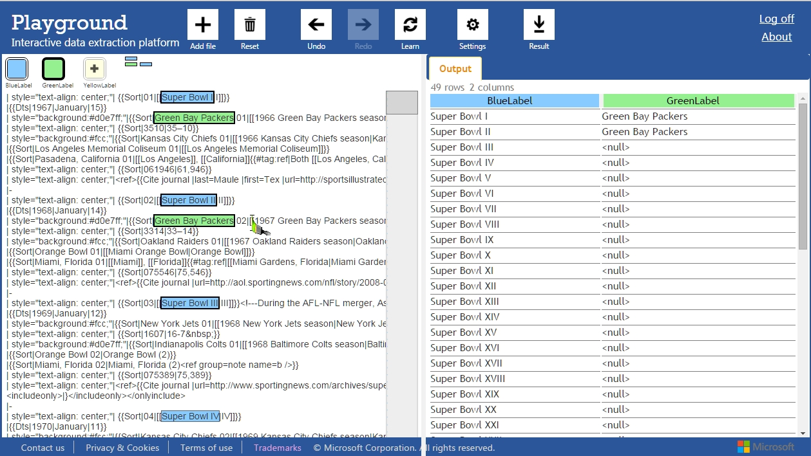
Now let’s extract the winning teams out of these superbowls games. For that we select a new label, a green one, and highlight three examples of winning teams.

Slide 68
Now let’s extract the winning teams out of these superbowls games. For that we select a new label, a green one, and highlight three examples of winning teams.

Slide 69
Now let’s extract the winning teams out of these superbowls games. For that we select a new label, a green one, and highlight three examples of winning teams.

Slide 70
After learning, the output seems correct. Investigating the program would not give us much of a clue. However, there is an error in the output. It is very hard to spot.

Slide 71
After learning, the output seems correct. Investigating the program would not give us much of a clue. However, there is an error in the output. It is very hard to spot.

Slide 72
By going to the Disambiguation view, alias Conversational Clarification, we can answer the question. The team name had a number in it, and the programs extracts until the first number.

Slide 73
By going to the Disambiguation view, alias Conversational Clarification, we can answer the question. The team name had a number in it, and the programs extracts until the first number.

Slide 74
After answering this question, it asks for another ambiguity. This time it got it right, but still ask for confirmation. The program would reveal that the dot in the name is the cause of conflict.

Slide 75
After answering this question, it asks for another ambiguity. This time it got it right, but still ask for confirmation. The program would reveal that the dot in the name is the cause of conflict.

Slide 76
We also have one more ambiguity for the blue label. Since I, II, III, IV in roman letters start with I, it was unsure if it should extract the V or not. We can confirm that it is correct by clicking.

Slide 77
We also have one more ambiguity for the blue label. Since I, II, III, IV in roman letters start with I, it was unsure if it should extract the V or not. We can confirm that it is correct by clicking.

Slide 78
We also have one more ambiguity for the blue label. Since I, II, III, IV in roman letters start with I, it was unsure if it should extract the V or not. We can confirm that it is correct by clicking.

Slide 79
We also have one more ambiguity for the blue label. Since I, II, III, IV in roman letters start with I, it was unsure if it should extract the V or not. We can confirm that it is correct by clicking.
(Paraphrasing explanation skipped)

Slide 80
Paraphrasing challenges
T. Lau, 2009:
Get rid of arcane instructions (“The char 1”)
Char(n) → “The {:0.charNum}” charNum: [{regex: "^1$", result: "beginning“}, {regex: "^(\d+)$", result: “{:1.ordinal} char“}],
Char(1) →“The beginning”
Char(2) → “The second char”
Char(-3) → “The third char from the end”

Slide 81
Paraphrasing challenges
Higher-level description:
PosPair(Pos(Line(1), 1), Pos(Line(1),-1))
“extract the string between (the (beginning) of (second line)) and (the (end) of (second line)))”
PosPair(Pos(?L, 1), Pos(?L, -1)) when {:0:L}={:1:L}
➔ “extract the {:L}”
“extract the (second line)”
Notes:
Rules can be added by the DSL’s designer

Slide 82
Clarification conversationelle
Our strongest feature seems to be the conversational clarification. This works the following. Instead of generating only one program, the computer actually generates many variants.
Name: Mikael
Name: Marion
Name: McLeo
Prog
Programme
Notes:
Program are black boxes, here colored boxes.

Slide 83
Clarification conversationelle
Then we compare the outputs of these programs on the original data, and present the discrepancies. This may lead to many questions. From the user’s aspect, this is a black box.
Nom :Mikael
Nom :Marion
Nom :McLeo
Nom :Mikael
Nom :Marion
Nom :McFly
McLeo
ou
McLeo
ou
McLeo
Nom :Mikael
Nom :Marion
Nom :McFly
ou perso?
Trouver et lancer les programmes
Comparer les sorties au 1er
Poser des questions cliquables
Boîte noire
Notes:
Test set/Training set do not have equivalent here. We perform learning on whole text. The input examples are 2 pairs of positions. The engine wants to extend this list.

Slide 84
Conversation increases confidence in the result « In the last task, I did not have conversational clarification… I missed it so much » « It always helped me to find the right matching »
« the program was quite understandable but it was not clear how to modify the program » Over 13 users who tested the program, 9 did not even try to modify it.
Over 29 participants, we obtained three results. Using program navigation or conversational clarification reduces the number of errors. People find conversations more useful than program.
Sur 29 participants…
1.
L’utilisation du programme ou des questions réduit le nombre d’erreurs au final
2.
3.
Les gens trouvent la conversation plus utile que le programme
Clarification conversationelle: 5.4 / 7
Vue du programme: 4.2 / 7
“Le program était assez comprehensible mais ce n’était pas clair comment modifier le programme”
Sur 13 utilisateurs qui ont apprécié le programme, 9 n’ont même pas essayé de le modifier
La conversation augmente la confiance en le résultat final
W = 181.5, p = 0.07
“Dans la dernière tâche, je n’avais pas la conversation comme option, ça m’a trop manqué”
“[la conversation] m’a toujours aidé à trouver la sélection correcte”
Notes:
within-subject study

Slide 85
Épilogue – FlashProg
You … laid the foundation of the FlashProg demo site that we continue to use even today to find opportunities for our team! Once again, thanks a lot for all your contributions.“ Sumit Gulwani
We developed extensions to deal with webpages and pivoting tables in spreadsheet
The output feedback was total here, we display all the result. We provide strong visualizations of the program, and for the first time, we implemented the specification feedback (conversation)
Extensions avec les pages web et les feuilles excel
“Tu es celui qui, avec Gustavo, a fondé le site web de la démo de FlashProg, que nous continuons à utiliser encore aujourd’hui pour trouver des opportunités pour notre équipe ! Encore une fois, merci beaucoup pour toutes tes contributions” Sumit Gulwani
Retour Sortie : Total
Retour Programme : Code et paraphrasé
Retour Spécification : Implémenté pour la première fois

Slide 86
4. Prosy: Comment poser des questions précises
Prosy: How to ask precise questions

Slide 87
Once upon a time…

Slide 88
Someone invented simple sandwich machines, configurable by merchants. For 1 coin, you get one sandwich. For each additional coin, the machine would add sandwiches above and below
Dessus:
Milieu:
Dessous:
Sandwich à 4€
Sandwich à 2€
Sandwich à 3€
Sandwich à 1€

Slide 89
But the merchants started to fight against each other, because as soon as a merchant configured the machine, it became automatically patented and should not be copied.

Slide 90
For example, this is the first case that was ruled by the court. After opening the machines, the judge discovered that the second machine copied the first and therefore violated the patent.
Dessus:
Milieu:
Dessous:
Dessus:
Milieu:
Dessous:

Slide 91
Same machines, patent violation !
Mêmes machines, violation !

Slide 92
The second case was not so obvious. After opening the machines, the judge decided that because the second machines produced the same sandwiches anyway, it was a patent violation.
Dessus:
Milieu:
Dessous:
Dessus:
Milieu:
Dessous:

Slide 93
Same productions, patent violation !
Mêmes productions, violation !

Slide 94
Later, the green merchant found out that the blue merchant’s machine was producing the same sandwiches for one coin, and for two coins. He could not open it without the judge though.

Slide 95
After opening the machines, the judge realized that the two configurations were not the same. And actually, with three coins, it would produce a different sandwich.
Dessus:
Milieu:
Dessous:
Dessus:
Milieu:
Dessous:

Slide 96
Indeed, the green machine always produced bread/chocolate on the top, whereas the blue machine produced two breads on the top. No patent violation.

Slide 97
The judge decided that, before coming to court, merchant had to test the other’s machine with at least up to three coins. Enough? This thesis proves that three coins are sufficient.
Jusqu’à trois pièces !

Slide 98
But one day, the machines got an upgrade and could accept another type of coin. More customization of sandwiches thus !
Dessus:
Milieu:
Dessous:
Mais un jour….

Slide 99
And the war continued with the following case

Slide 100
The green merchant had spent every combination of one, two and three coins in the blue machine, and all the sandwiches were equal. Therefore, he went to court.

Slide 101
The judge ordered to open the machines
? Ouvrez les machines

Slide 102
They were almost all the same, except at two places
Dessus:
Milieu:
Dessous:
Dessus:
Milieu:
Dessous:

Slide 103
And it did not take long to figure out a combination of coins which would not give the same sandwiches on both machines. There were no patent violation.

Slide 104
The judge therefore ordered that people test all coins combinations up to four pieces. But this is a lot ! Isn’t there a better way to compare machines based on the sandwiches they produce?
Jusqu’à quatre pièces !

Slide 105
Épilogue – Prosy
Before, the best available algorithm was in O(n^6) questions to find out if there was equality or not. We found a better one in O(n^3) questions and, with interaction, it becomes linear.
Avant:
(types de pièces)⁶ questions
Cette thèse (théorème de Mayer-Hamza)
(types de pièces)³ questions
3x(types de pièces) questions si interaction
Retour sortie: Aucun
Retour programme: Pas besoin mais oui
Retour spécification: Complet
Notes:
On ne teste pas la machine en dehors des questions.

Slide 106
Overall Discussion
Pong Designer did not give a lot of interactivity from the conversational point of view. On the other side, Prosy provided complete conversation to disambiguate.

Slide 107
Dans le futur…
In the future, PD for Doodle recorders; Integrate StriSynth into OS; FlashProg’s interaction into more tools; less but bigger questions for Prosy. And dual interfaces program/interaction.
Pong Designer: Créateur de petites vidéos ?
StriSynth: Intégration dans Windows et autres.
FlashProg: Interaction dans davantage d’outils!
Prosy: Moins de questions, mais plus grosses?
Interfaces duales programme/interaction.

Slide 108
Conclusions finales
Final conclusions: Good interaction is about showing the program and asking clarification questions. We proved that Interactive PBE is more trustful, powerful, and less prone to errors.
Qu’est-ce une interaction efficace:
Programmer avec le doigt ?
Accepter davantage d’exemples ?
Afficher le programme ?
Poser des questions ?
Avec l’interaction, la Programmation par l’Exemple :
Est plus digne de confiance
Permet de faire moins d’erreurs
Réduit le nombre d’exemples à fournir
Pas sûr
Pas sûr
Oui
OUI

Slide 109
Remerciements - Thanks
Martin Odersky, Martin Vechev, Ravi Chugh, Pierre Dillenbourg, Philippe Suter, Eva Darulova, Giuliano Losa, Regis Blanc, Etienne Kneuss, Manos Koukoutos, Georg Schmid, Romain Edelmann, Daniel Lupei, Romain Rütschi, Ted Hart, Lomig Mégard, Thomas Dupriez, Elric Milet, Gustavo Soares, Alexander Polozov, Maxim Grechkin, Ravichandran Madhavan, Jad Hamza, Ruzica Piskac, Mark Santolucito, Rishabh Singh, Filip Niksic, Mark Marron, Benjamin Zorn, Vu Le, Yvette Gallais, Sylvie Jankow, Fabien Salvi, Holly Cogliati-Bauereis, Sumit Gulwani, Annick Wagner, et tous ceux qui lisent ça jusqu’au bout, etc.

