Slide 1



Estimation of Organic and Elemental Carbon using FT-IR absorbance spectra from PTFE filters
Matteo Reggente
Giulia Ruggeri
Satoshi Takahama
Swiss Federal Institute of Technology Lausanne
Ann Dillner
University of California, Davis

Slide 2
Nutshell

Slide 3
Nutshell
What:
  Alternative approach to measure OC and EC
Why:
  OC and EC are major components of atmospheric PM.
  Typically OC and EC are measured using thermal optical methods (quartz filters).
    destructive and relatively expensive
Aim:
  Reduce the operating costs of large air quality monitoring networks.
  Fourier transform infrared spectra (FT-IR) of ambient PTFE filters
Contributions:
  Accurate predictions
  Anticipation of the prediction error
Nutshell
1

Slide 4
Methods

Slide 5

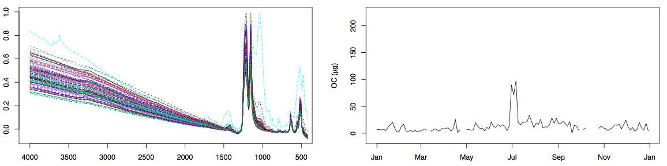
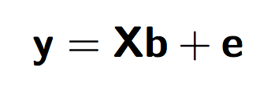
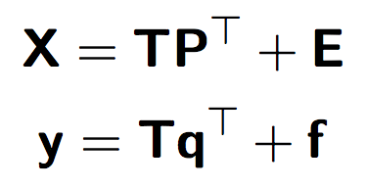
Methods
Alternative Approach: PTFE filters + FT-IR + PLS regression
Calibration: Partial Least Square (PLS) regression
The problem for infrared spectra is
underdetermined: few hundred samples × few thousand wavenumbers
multicollinear: serial correlation of absorbances across wavenumbers
Methods
1/2
Notes:
PLS: bilinear decomposition of both X (spectra matrix) and y (response variable vector) onto orthogonal bases.
The two sets of factors are related through a series of weights (columns of W) used to reconstruct factor scores T and regression coefficients b.
Training and selection: number of factors selected by evaluating against a validation set:

Slide 6
Methods
Ambient Samples: IMPROVE network
More than 3000 collocated ambient samples:
PTFE filters and FT-IR spectra
Quartz filters and TOR
2011: 6 + 1 sites; 794 samples
Dillner and Takahama, Atmos. Meas. Tech., 2015a (OC)
Dillner and Takahama, Atmos. Meas. Tech., 2015b (EC)
2013: 6 + 11 sites; 2239 samples
Reggente, Dillner and Takahama submitted AMTD, 2015
Methods
2/2

Slide 7
Results

Slide 8
Results – Test 2011
Dillner A. M. and Takahama S., AMT, 2015
Dillner A. M. and Takahama S., AMT, 2015
Results
1/9

Slide 9
Results – Test 2013, Sites present in the calibration
Dillner A. M. and Takahama S., AMT, 2015
Dillner A. M. and Takahama S., AMT, 2015
Reggente et al., submitted AMT, 2015
Results
2/9

Slide 10
Results – Test 2013 Addl, NOT present in the calibration
Dillner A. M. and Takahama S., AMT, 2015
Dillner A. M. and Takahama S., AMT, 2015
Reggente et al., submitted AMT, 2015
Results
3/9

Slide 11
Results – OC – Test 2013 Addl, NOT present in the calibration
Can we improve it?
Anticipation of the prediction error
Discrimination between “acceptable” and “unacceptable” predictions
Mahalanobis distance in the feature space (Factor scores of PLS)
Results
4/9

Slide 12
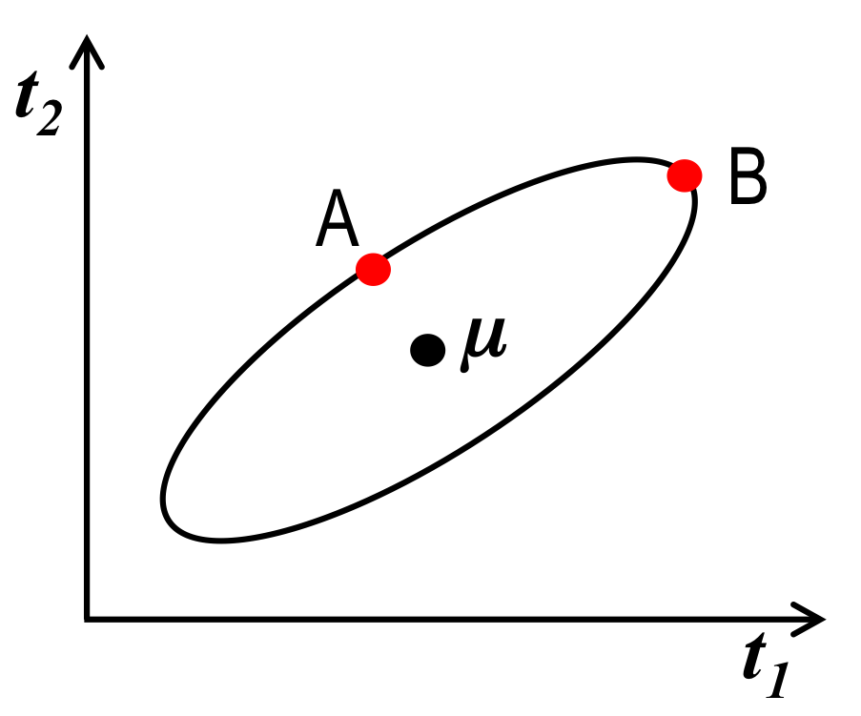
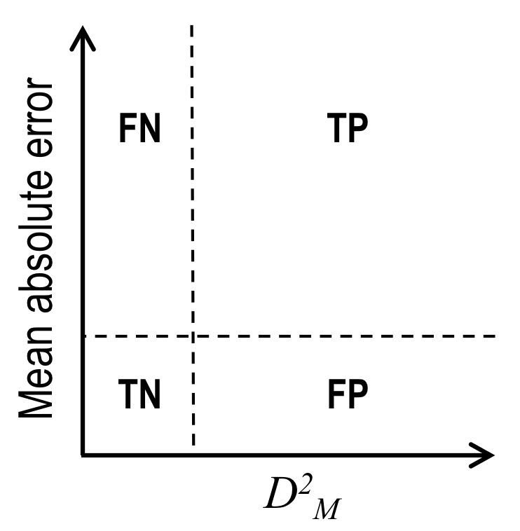
Anticipating prediction error by Mahalanobis distance
Mahalanobis distance (D_{M}) is the N-D generalization of the standard normal probit.
We calculate multivariate distribution parameters from PLS scores T of the calibration spectra.
New spectra are projected into this space and D_{M}² calculated with respect to the calibration spectra without knowledge of OC, EC concentrations
We evaluate our ability to anticipate prediction errors of OC, EC in 4 quadrants:
  TP – true positive
  TN – true negative
  FP – false positive
  FN – false negative
Results
5/9

Slide 13
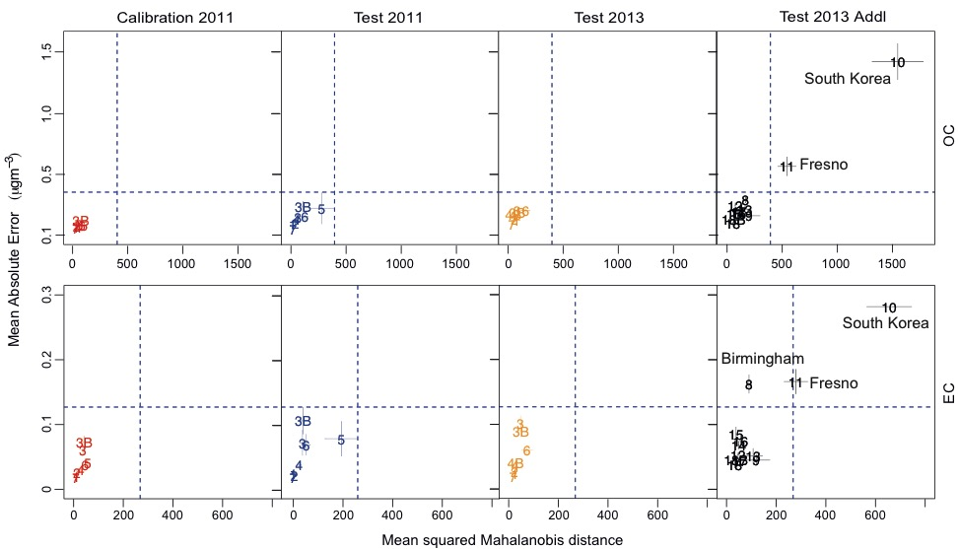
Results – Anticipating Prediction Error
Results
6/9

Slide 14
OC - Reducing Prediction Error
High Mahalanobis distance sites removed
Recalibration leads to lower errors
Results
7/9

Slide 15
EC - Reducing Prediction Error
High Mahalanobis distance sites removed
Recalibration leads to lower errors
Removing improves
R² from 0.66 to 0.84
Results
8/9

Slide 16




Sparse calibration models – TOR EC example
Strategy:
Use a reduced set of wavenumbers (<10% of original)
Associate wavenumbers with absorption bands
Why are we able to predict TOR EC with FT-IR?
Teflon filter
N-H bend in amides
ester C-O-C stretch
C-C-N, C-N-C bend in amines
benzene ring stretch
Results
9/9

Slide 17
Conclusions

Slide 18
Conclusions
Calibrations can predict OC and EC within TOR precision for sites for which we have calibration samples, and many additional sites
Spectral features allow us to anticipate the prediction error for OC and EC (in most cases) and this can guide us in strategic sample collection and calibration
  room for improving false negative for EC
Sparse methods help us understand what bonds are responsible for our predictions
  aromatic, ester, amide groups common for OC, EC
  carbonyls, alkanes additionally identified for OC
  different vibrational modes for same bonds or functional groups are used
Conclusions
1

Slide 19
Acknowledgements
Swiss National Science Foundation (200021_143298)
EPFL Founding
IMPROVE program (National Park Service cooperative agreement P++AC91045)
Acknowledgements
1

Slide 20
Estimation of Organic and Elemental Carbon using FT-IR absorbance spectra from PTFE filters
Thank you

Slide 21
Supplementary Material

Slide 22
Results – OC – Rural Site
Results
12/17

Slide 23
Results – OC – Anticipation Prediction Error
Individual sample, Calibration 2011
Results
13/17

Slide 24
Results – OC – Anticipation Prediction Error
Individual sample, Test 2011
Results
14/17

Slide 25
Results – OC – Anticipation Prediction Error
Individual sample, Test 2013
Results
15/17

Slide 26
Results – OC – Anticipation Prediction Error
Individual sample, Test 2013 Addl
Results
16/17

Slide 27
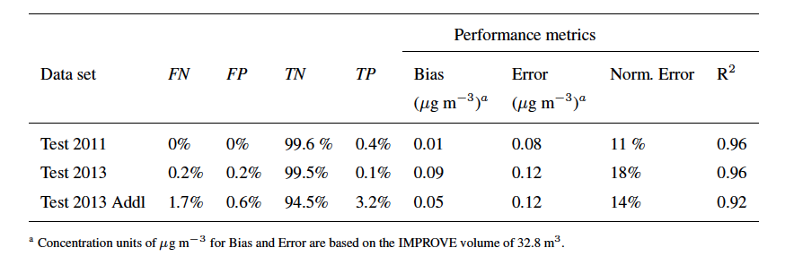
Results – OC – Anticipation Prediction Error
Individual sample, Performance
Results
17/17

Slide 28
Results – EC – Rural Site
Results
6/11

Slide 29
Results – EC – Anticipation Prediction Error
Individual sample, Calibration 2011
Results
7/11

Slide 30
Results – EC – Anticipation Prediction Error
Individual sample, Test 2011
Results
8/11

Slide 31
Results – EC – Anticipation Prediction Error
Individual sample, Test 2013
Results
9/11

Slide 32
Results – EC – Anticipation Prediction Error
Individual sample, Test 2013 Addl
Results
10/11

Slide 33
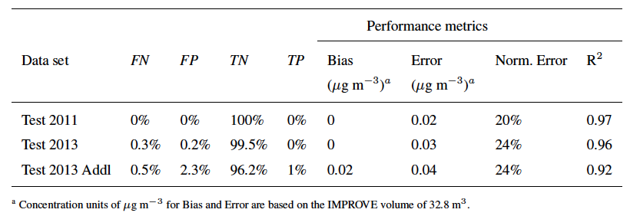
Results – EC – Anticipation Prediction Error
Individual sample, Performance
Results
11/11

