Slide 1




The (Co-)Location Sharing Game
The 19th Privacy Enhancing Technologies Symposium
July 16 – 20, 2019, Stockholm, Sweden
A.-M. Olteanu M. Humbert K. Huguenin J.-P. Hubaux

Slide 2
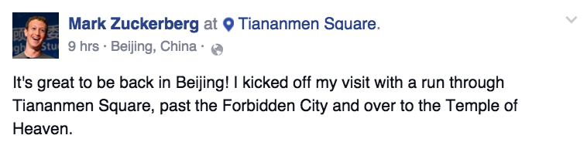
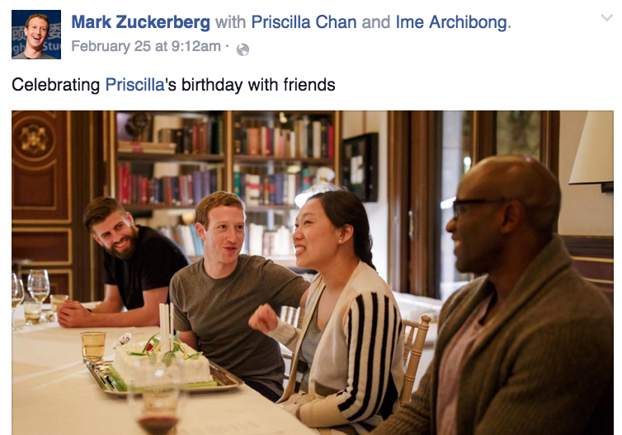
(Co-)Location Information Is Widespread
Declared on Online Social Networks (OSN)
Inferable
  IP address
  Photos
    Geotagged
    Face recognition software + metadata
  Mobile devices behind NAT
  Neighboring Bluetooth devices

Slide 3
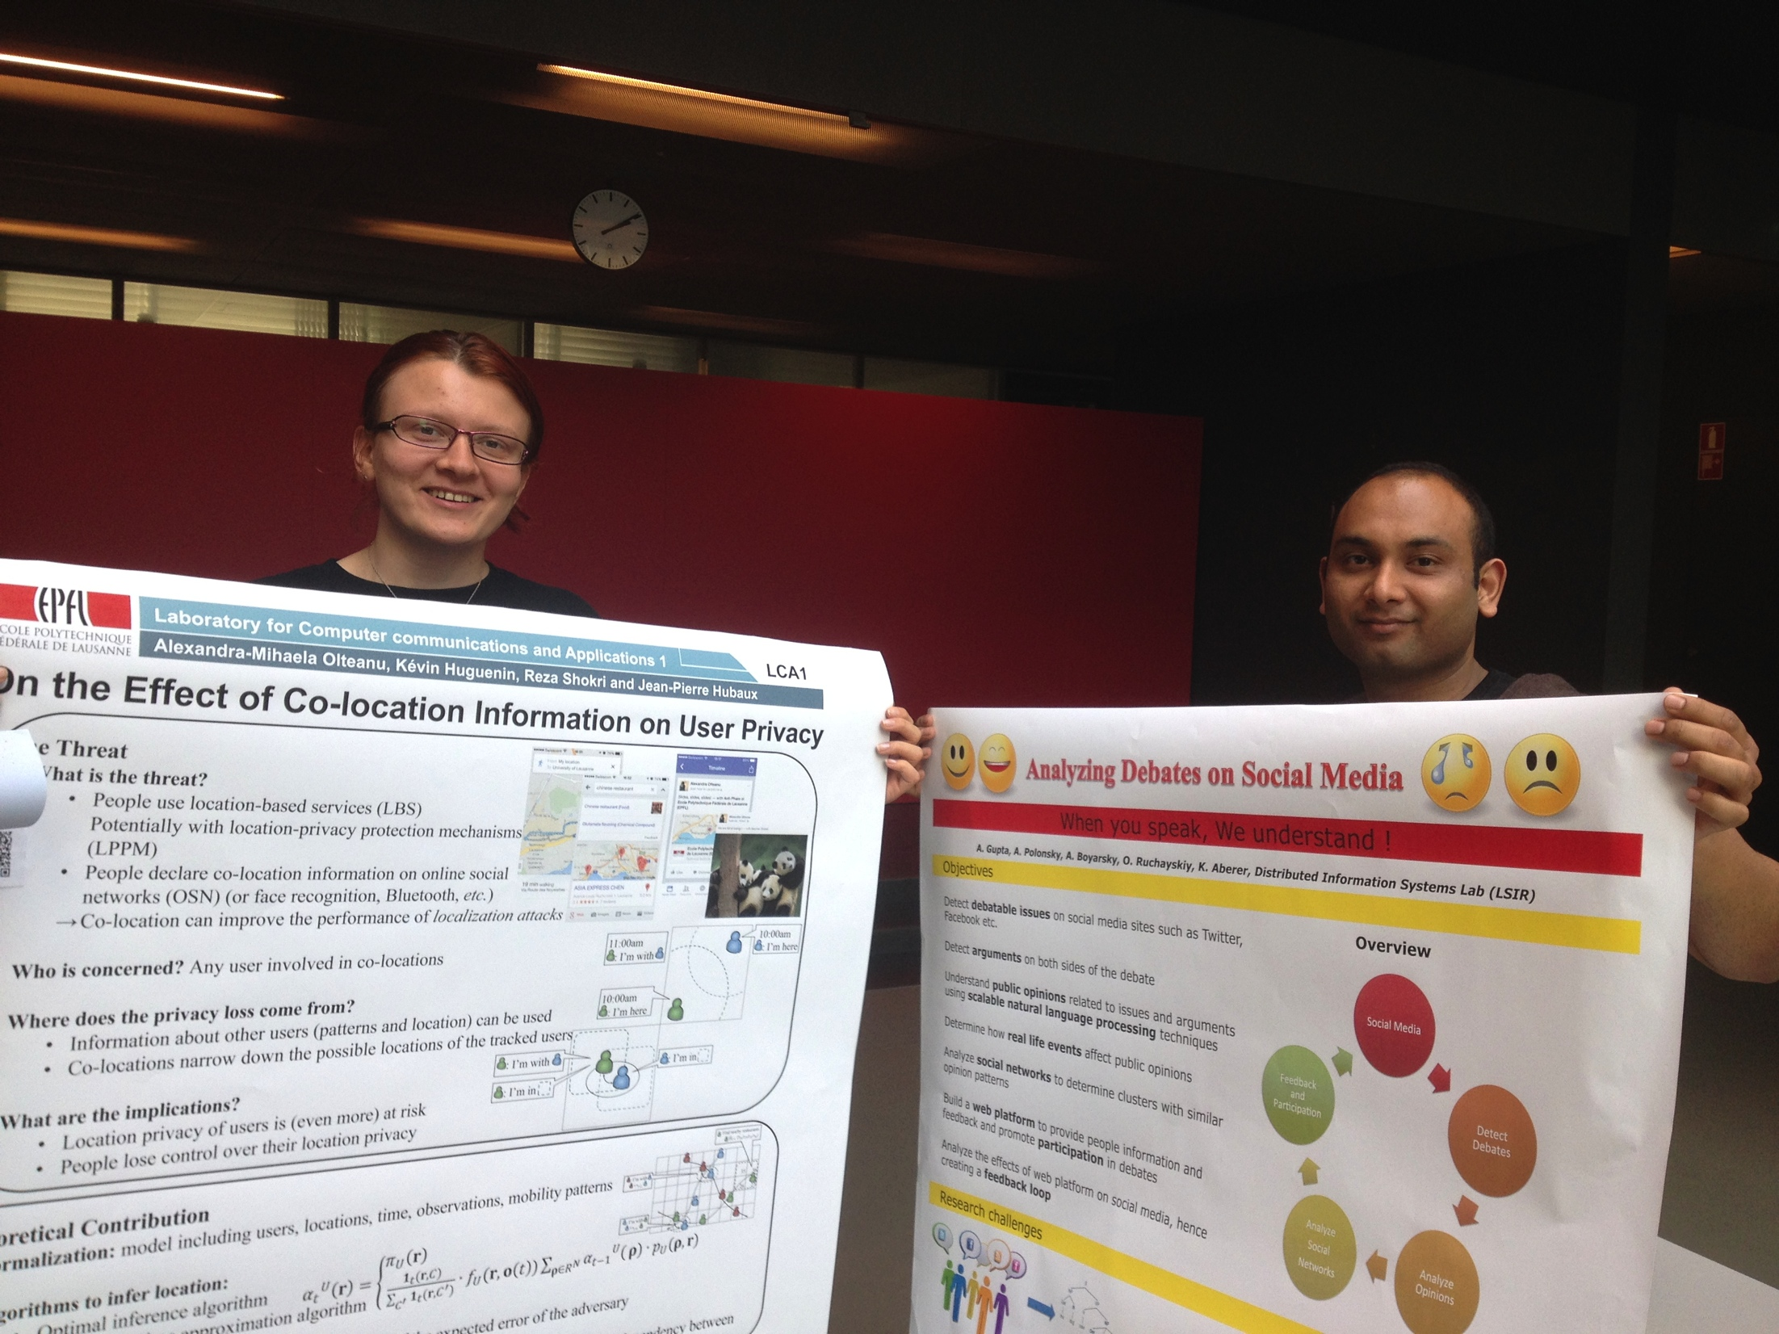

(Co-)Location Information Is Widespread
Declared on Online Social Networks (OSN)
Inferable
  IP address
  Photos
    Geotagged
    Face recognition software + metadata
  Mobile devices behind NAT
  Neighboring Bluetooth devices
Picture shot on DD/MM/YYYY (EXIF metadata)

Slide 4
Privacy Risks
(Co-)Location data …
  … is sensitive for users
    Infer location at arbitrary time instants
    Infer users’ private attributes
      Social ties, interests, personal locations (e.g., home and workplace), identity
    Discrimination, blackmail, stalking, physical assault, robbery, identity theft, etc.
  … can be monetized by service providers
  e.g., through targeted advertising

Slide 5
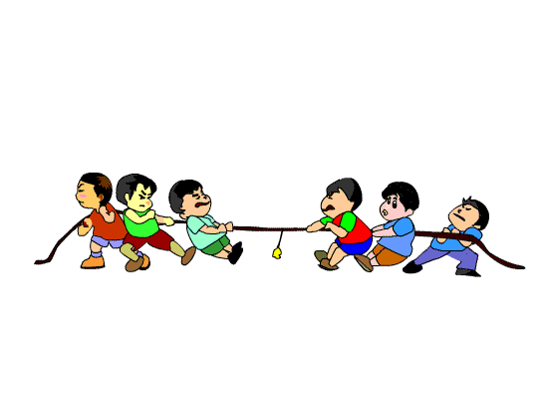
The Problem
Locations and co-locations reported by users on OSN have conflicting effects for the users and for their friends
  Privacy risks vs. social benefits
  Control is limited
    With respect to the service provider
    The uploader of the data is the sole decision maker
Users’ preferences regarding benefits and privacy are unknown
Users’ interactions are complex to understand and predict
Conflicts of interests arise
Our goal:
  Quantify such users’ preferences
  Analyze users’ strategic behaviors and extract insights
Privacy adversaries
Privacy adversaries

Slide 6
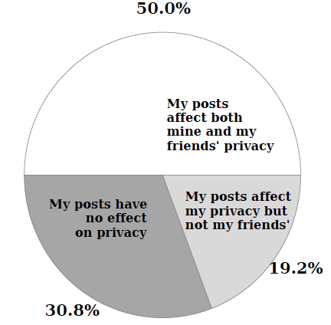
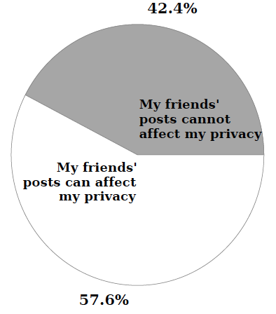
User Survey
MTurk Survey: 250 active Facebook users
  Evaluate users’ awareness
Awareness about own posts Awareness about friends’ posts

Slide 7
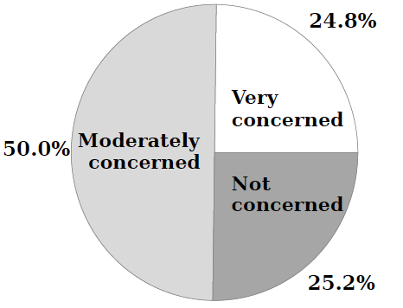
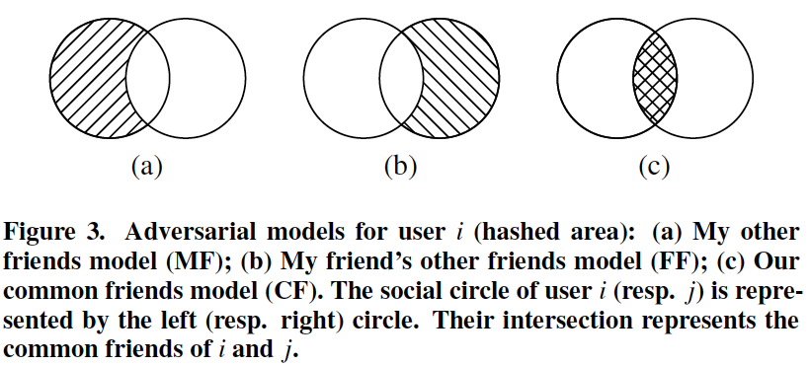

User Survey
MTurk Survey: 250 active Facebook users
  Evaluate users’ awareness and concerns
Common Friends
My Friends
Friend’s Friends
Service Provider
Concern about location privacy Concern about adversaries

Slide 8
User Survey
MTurk Survey: 250 active Facebook users
  Evaluate users’ awareness and concerns
  Quantify users’ preference factors using conjoint analysis
    location vs. co-location information (f_{lc})

Slide 9
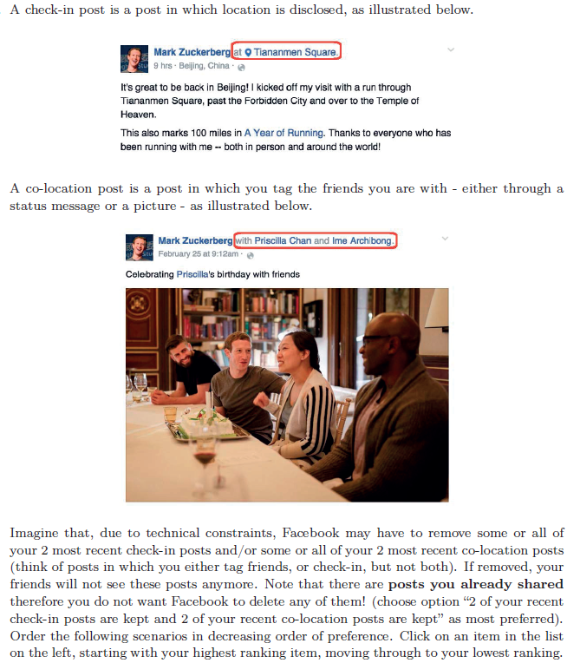
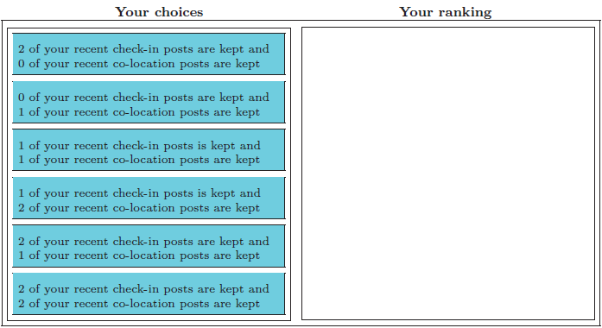
User Survey
An example question used to quantify f_{lc}

Slide 10
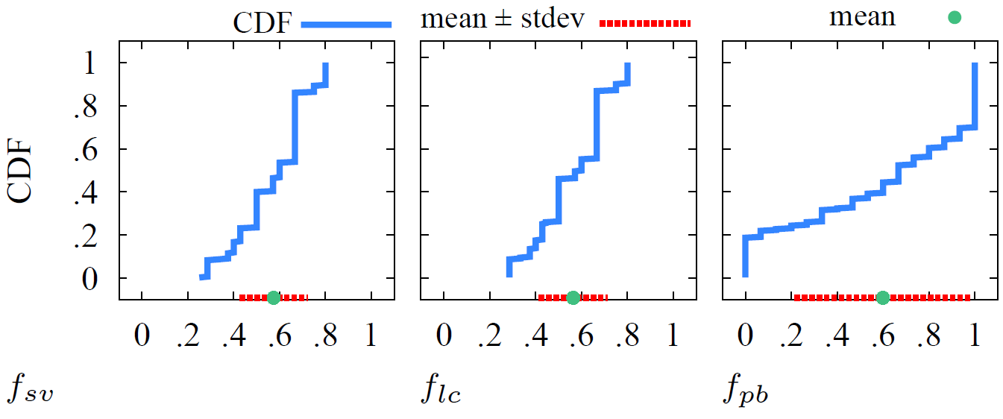

User Survey
MTurk Survey: 250 active Facebook users
  Evaluate users’ awareness and concerns
  Quantify users’ preference factors using conjoint analysis
    location vs. co-location information (f_{lc})
    sharing vs. viewing information (f_{sv})
    privacy vs. social benefits of sharing (f_{pb})
Users’ preferences are very diverse …

Slide 11
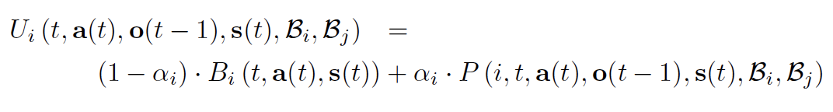
Game Theoretical Framework
Assumptions
  Two players, i and j (OSN friends)
  T time instants
  Perfect and complete information, non-cooperative extensive-form game at each time instant
  “Myopic” players (only concerned about their current utility)
Strategies
  "Share location", "Share co-location", "Share both”, "Share nothing"
Utility of player i, at time t, for some strategy profile s(t)
Adversary’s knowledge of players’ mobility profiles
Highly parametrized !
Information players have shared prior to t
Privacy for i
Actual locations of players at t
Social benefits for i
Preference of privacy vs. benefits for i

Slide 12
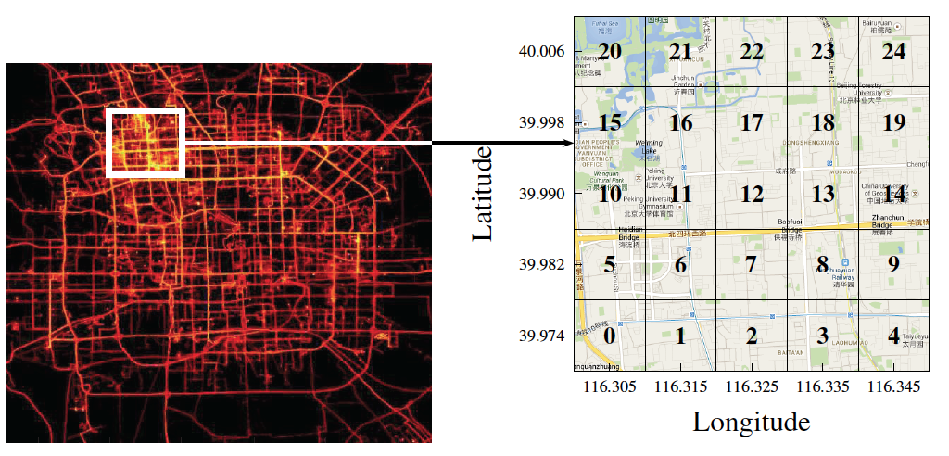
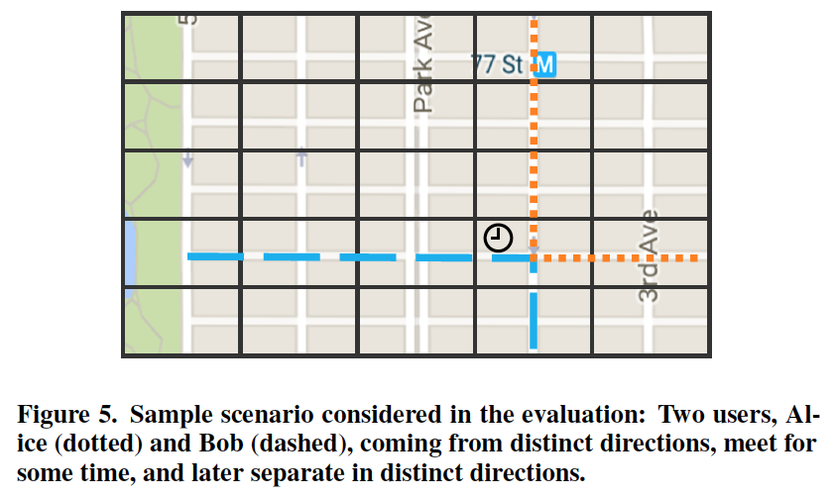
Evaluation
Data-driven numerical simulations of the game in various scenarios and settings
Parameters derived from the real preference factor values (f_{sv,} f_{lc,} f_{pb})
Privacy evaluated as location privacy [1]
Canonical meeting scenario
GeoLife GPS trajectory dataset by MSR Asia enriched with synthetic co-locations
[1] Olteanu et al. Quantifying Interdependent Privacy Risks with Location Data. IEEE TMC 2017

Slide 13
Lessons Learned
    Interactions are highly complex and the driving factors of users’ decisions are …
      both of the users’ preferences
      the considered adversary

Slide 14
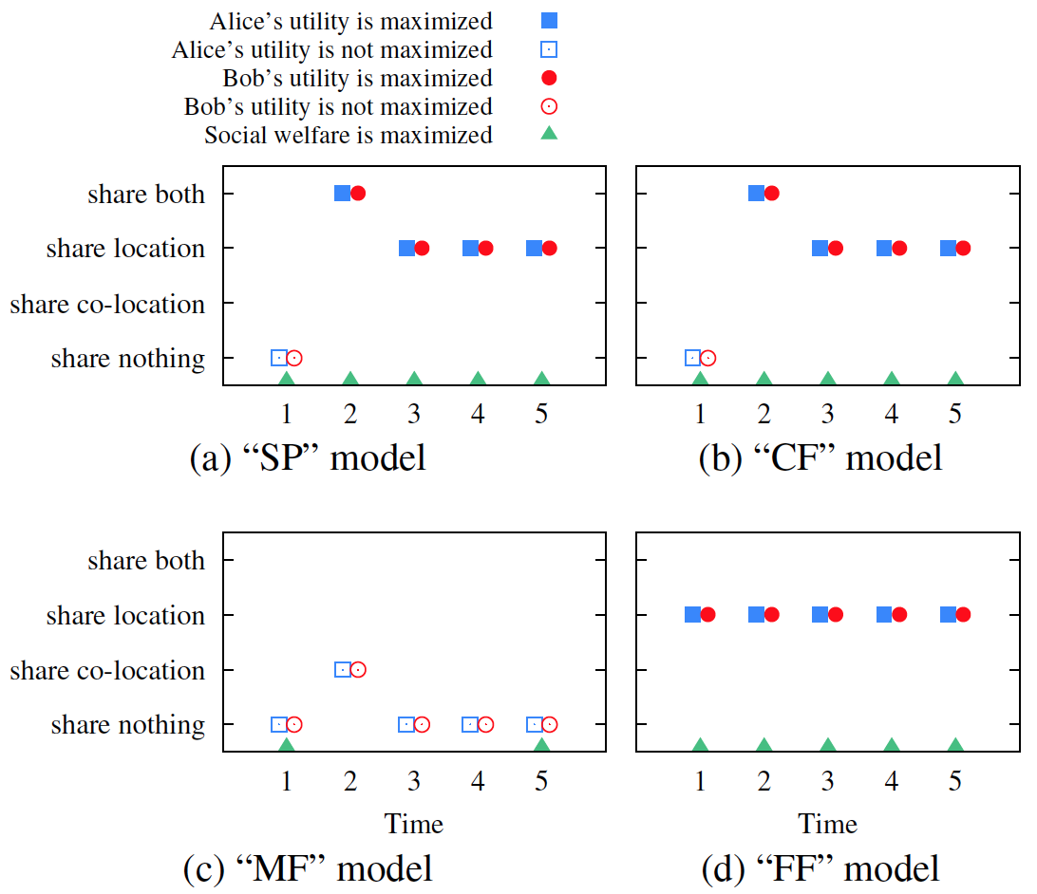
Effect of the Adversary
Players’ equilibria decisions in the canonical setting
mean values for f_{sv,} f_{lc,} f_{pb}

Slide 15
Lessons Learned
    Interactions are highly complex and the driving factors of users’ decisions are …
      both of the users’ preferences
      the considered adversary
      the actual location and co-location data

Slide 16
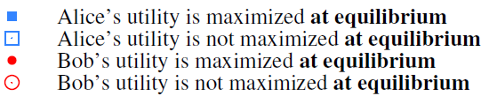
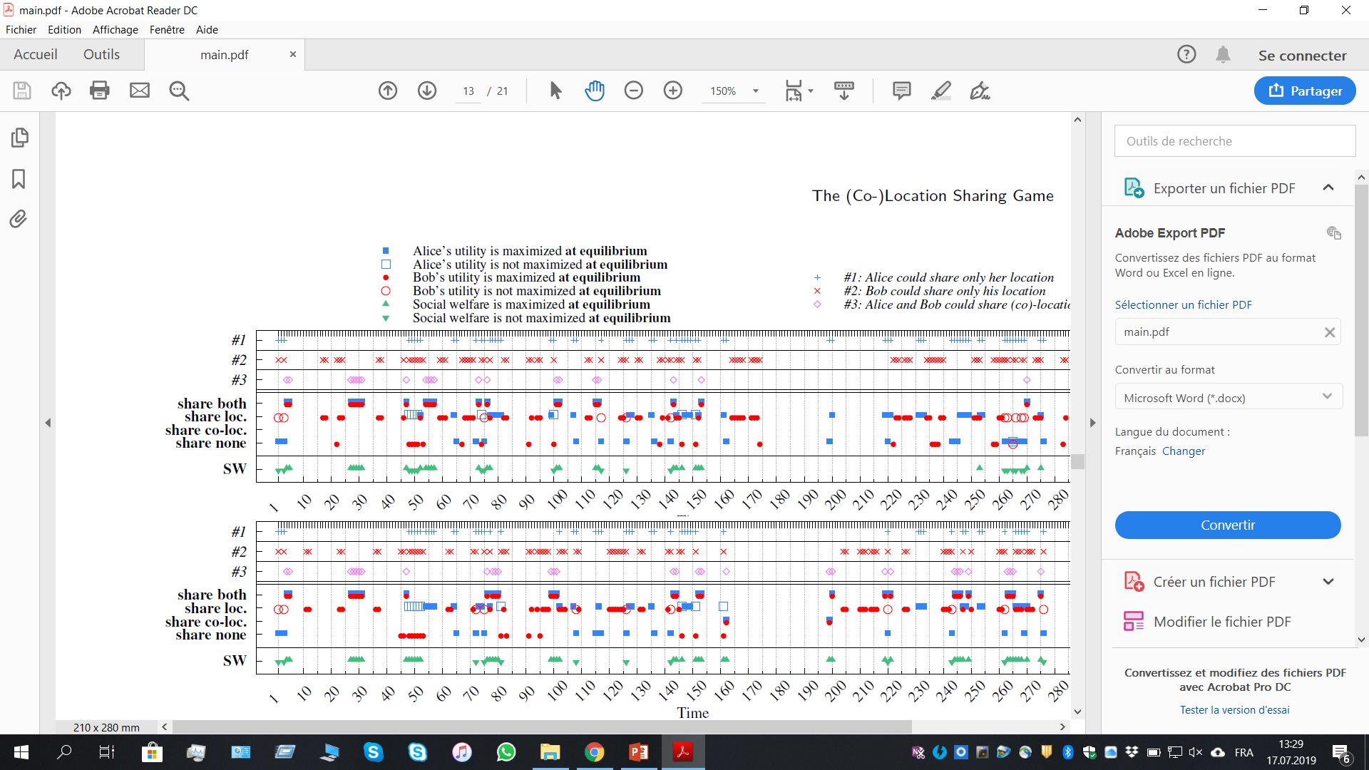
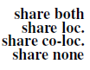
Effect of the (Co-)Location Data
Only Bob’s trace is different, yet both Alice and Bob act differently !
Alice and Bob are co-located 7% of the times
Alice and Bob are co-located 10% of the times
Players’ equilibria decisions for 2 pairs of GeoLife traces
“CF” model, mean values for f_{sv,} f_{lc,} f_{pb}

Slide 17

Conclusions
    Users can influence their friends’ decisions
  Vicious circle effect: A user is forced into sharing because he knows the friend likes to share
Sharing co-locations leads to oversharing co-locations and locations
  could exploit this fact!
The level of privacy one enjoys and, consequently, her sharing decisions depend not only on her own behavior, but also on others’ behavior
    Take-away: Accurate mechanisms must be set in place to increase users’ awareness, grant more control, and assist their decision making

Slide 18
Future Work
Extend the model to include
  User altruism
  Future considerations
  (Co-)Location obfuscation
  Fake (co-)locations
  A combination of privacy adversaries
  N users
  Incomplete information
Quantify more preference factors

