Slide 1
Experimental assessment of active electroacoustic absorbers for broadband room modes damping
Dr. Hervé Lissek, Dr. Sami Karkar, Etienne Rivet (EPFL)
Dr. Véronique Adam, Torje Thorse, Quentin Berthet (Goldmund)
Prof. Antoine Pittet, David Strobino (HEPIA)
Alain Roux, Christian Martin (PSI Audio)

Slide 2
Outline
Context: room modes in the low-frequency range
Presentation of the Electroacoustic Absorber prototype
Experimental assessment: modal damping in rooms

Slide 3
Context

Slide 4
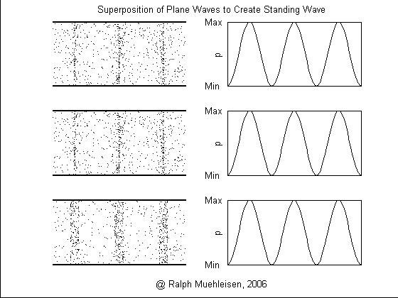
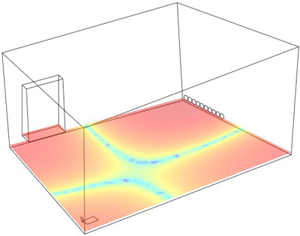
Context
Room modes characterization: standing waves
  ➔ uneven spatial distribution of sound energy

Slide 5
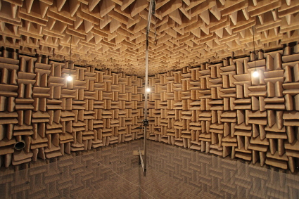
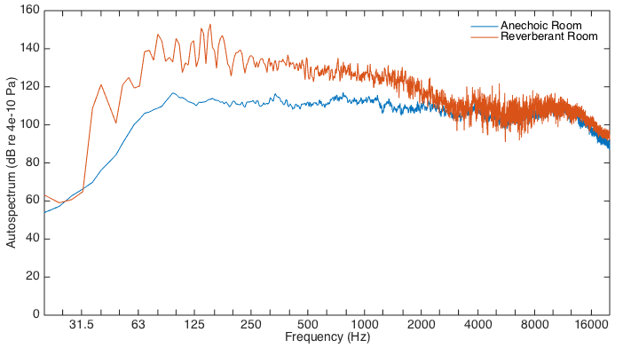
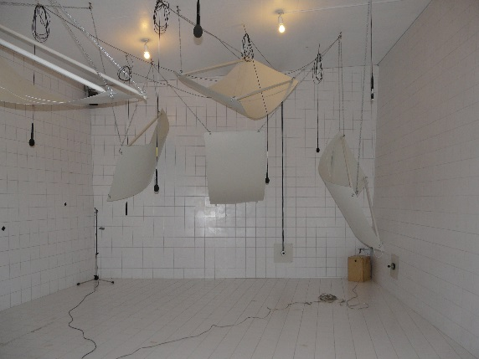
Context
Room modes characterization: frequency response
  dominated by strong peaks (resonances) and dips (anti-resonances)

Slide 6
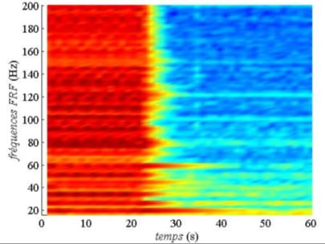
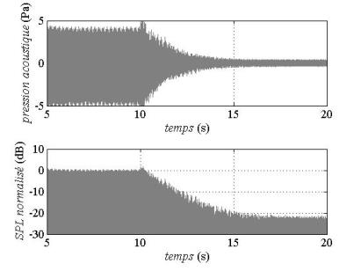
Context
Room modes characterization: modal decay time
  ➔ sustain at the various resonance frequencies once the source stops
  ➔ definition of MT₆₀ (see RT₆₀) – may strongly vary with frequency

Slide 7
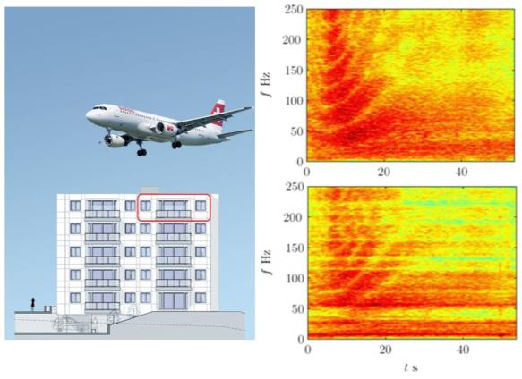
Problem(s)
Low-frequency noise issue

Slide 8
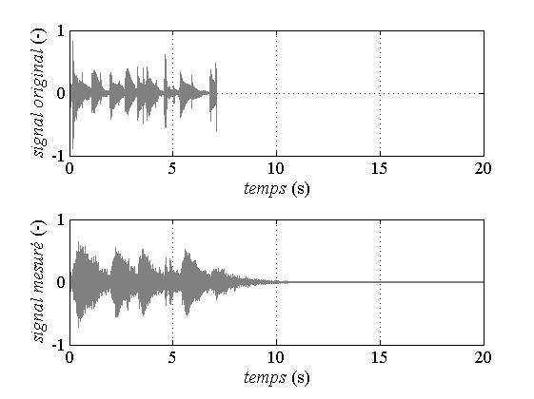

Problem(s)
Music rendering issue in the low-frequency range

Slide 9
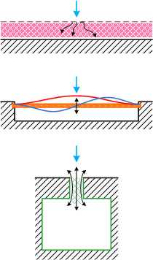
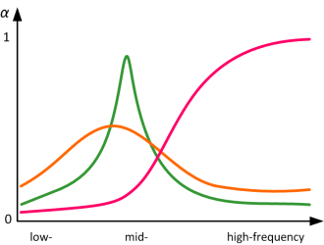
Problem(s)
State of the art sound absorbers
➔totally inefficient in the LF range (see λ/4 rule)
Porous materials
absorption
BF
Panel absorbers
Helmholtz resonators

Slide 10
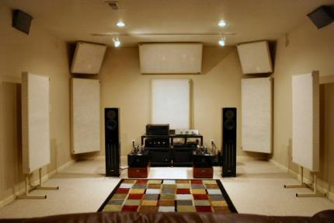
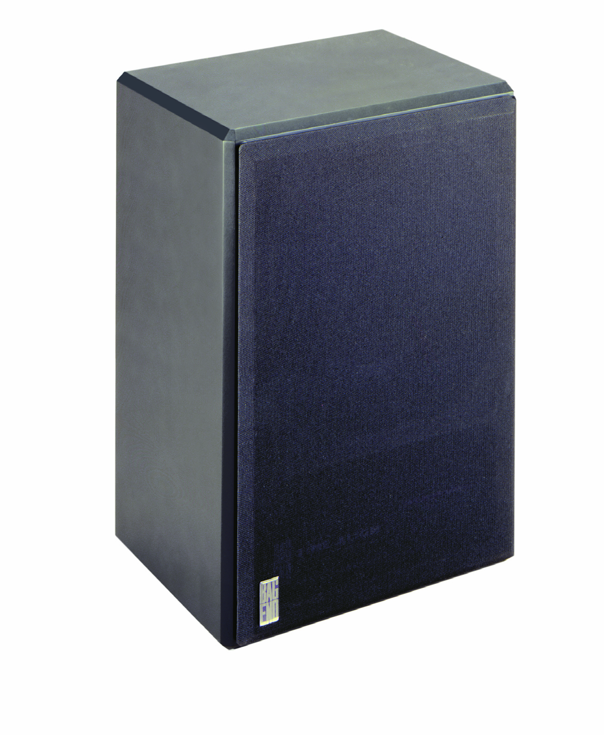
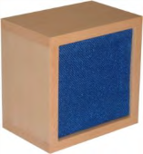
Problem(s)
State of the art sound absorbers
➔bass-traps (membrane absorbers)
Efficient LF narrow-band (1 resonance frequency) sound absorbers
➔e-traps (active bass traps)
Efficient on 2 (adjustable) resonance frequencies
E-trap

Slide 11
Electroacoustic Absorbers

Slide 12

Electroacoustic absorbers
Development of an active sound absorption solution with α>0.83 along the range [20 - 200Hz]
Based on actuated membranes (loudspeakers) used as a membrane absorbers
Evaluation in reverberant conditions, focusing on low-frequency sound «equalization»
H. Lissek, R. Boulandet, and R. Fleury, “Electroacoustic absorbers: bridging the gap between shunt loudspeakers and active sound absorption”, J. Acoust. Soc. Am., 129(5), 2968-2978, (2011).

Slide 13
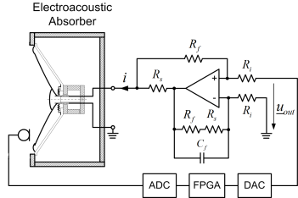
Electroacoustic absorbers
v
p_{t}
Parameter | Description | Value | Unit
M_{ms} | Moving mass | 14.7 | g
R_{ms} | Mechanical resistance | 1.31 | N.s.m⁻¹
C_{ms} | Mechanical compliance | 242.3 | mm.N⁻¹
S_{d} | Membrane surface | 151 | cm²
Bl | Force factor | 6.85 | N.A⁻¹
V_{b} | Cabinet volume | 10 | dm³
ρ | Air mass density | 1.2 | kg/m³
c | Sound celerity in air | 344 | m.s⁻¹

Slide 14
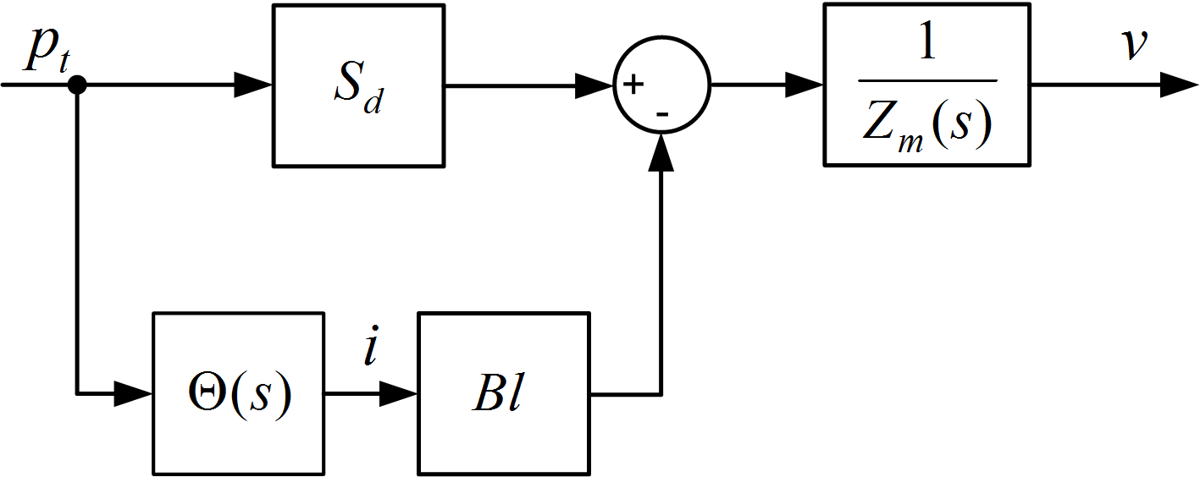
Electroacoustic absorbers
v
p_{t}
A desired acoustic impedance Z_{at} can be assigned by identifying the controller transfer function:

Slide 15
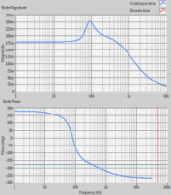
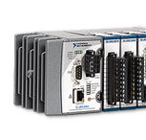
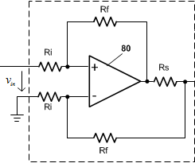
Electroacoustic absorbers
Implementation in the prototype
Voltage-driven current amplifier
CompactRIO® real-time controller

Slide 16
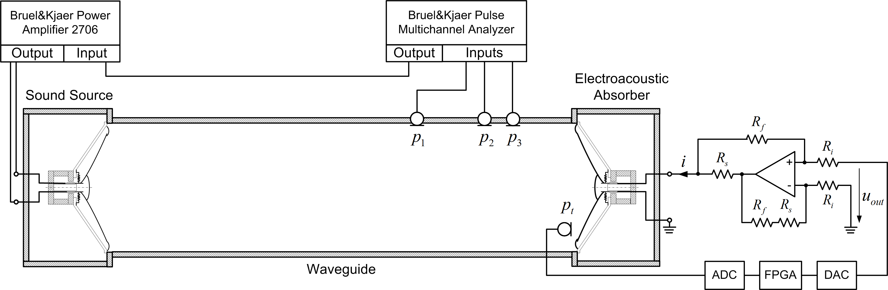
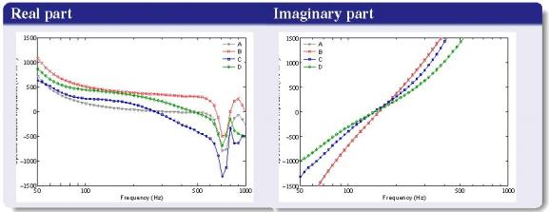
Electroacoustic absorbers
ISO 10534-2 : acoustic impedance measurement technique
Acoustic impedance
Absorption coefficient

Slide 17
Experimental validation of room modes damping

Slide 18
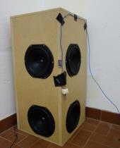
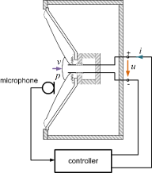
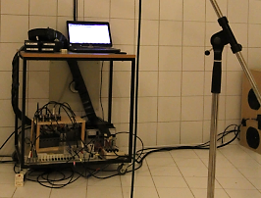
Experimental assessment
4x4 electroacoustic absorbers prototypes
(total surface = 16x151 cm² = 0.24 m²)
In a reverberant chamber of 226.9 m²
➔ evaluation of room modal damping

Slide 19
Experimental assessment
Frequency response without and with absorbers
  ➔ identify individual room modes
  ➔ assess damping performance on peaks and dips amplitudes
Modal decay times without and with absorbers
  ➔ assess damping performance in the time domain
Recording of music rendering, without and with absorbers
  ➔ listen to the effect on music rendering
Recording of kick drum, without and with absorbers
  ➔ listen to the effect on acoustic music playing

Slide 20
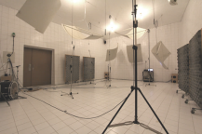
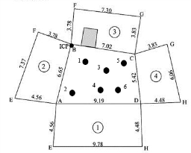



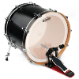
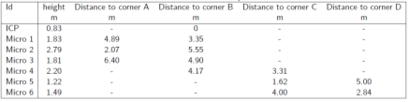
Experimental setup
Hardware
Facility (reverberant chamber, V=215.6 m³, S=226.9 m²)
Recorders/analyzers
  B&K Pulse (frequency responses)
    frequency resolution: 31.5 mHz
  M-Audio M-Track 8 soundcard (recordings)
Microphones
Sources
4 electroacoustic absorbers
at the 4 room corners
Supplementary
panel absorber
  PCB 130D20
  (frequency responses)
  Beyerdynamic M101 N
  (recordings)
7 microphone positions
  Subwoofer
  Kick drum
  (Pearl Export)

Slide 21
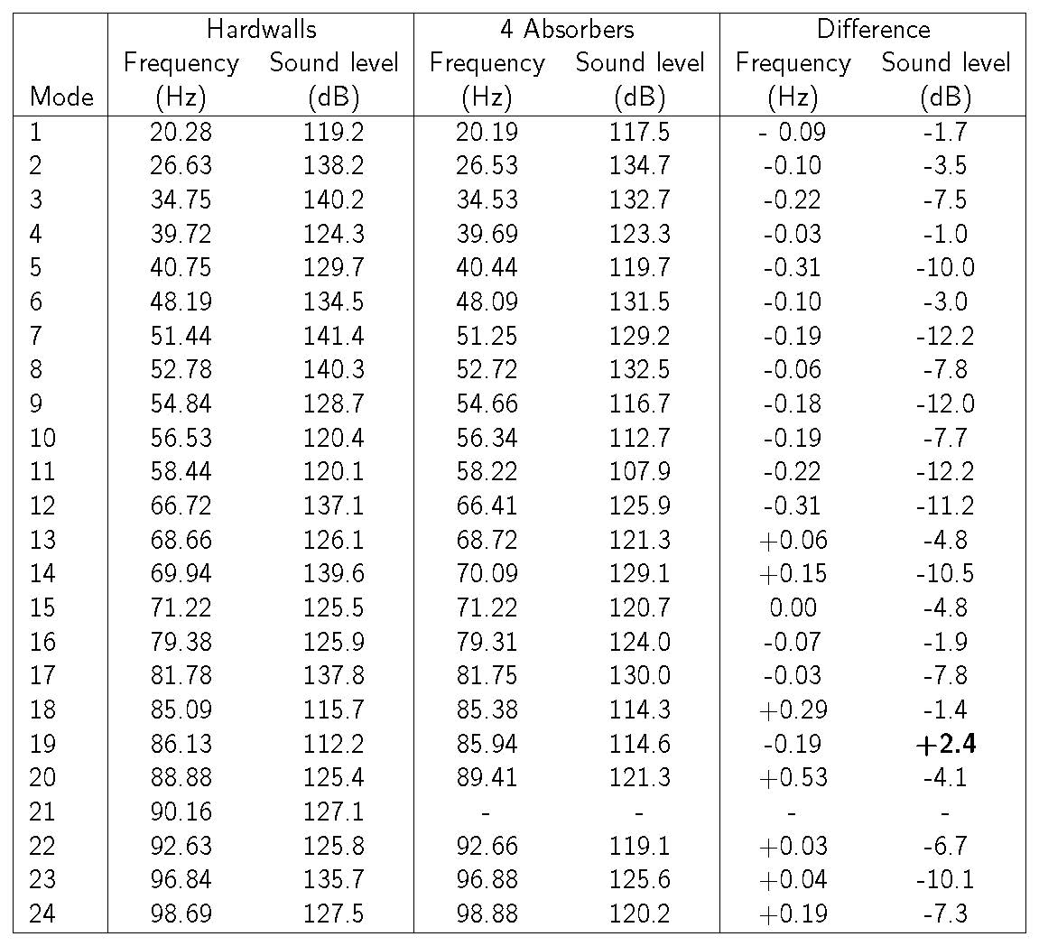
1. Frequency response
(blue: «Hardwalls», red: «Absorbers»)

Slide 22
1. Frequency response
Modal damping (dB)

Slide 23
2. Modal decay time
Mode 8 – waveforms
(hardwalls : 52.78 Hz - absorbers : 52.72 Hz)
Mode 8 - echograms
(hardwalls : 52.78 Hz - absorbers : 52.72 Hz)

Slide 24
2. Modal decay time
1/6MT₁₀
1/3MT₂₀
1/2MT₃₀

Slide 25
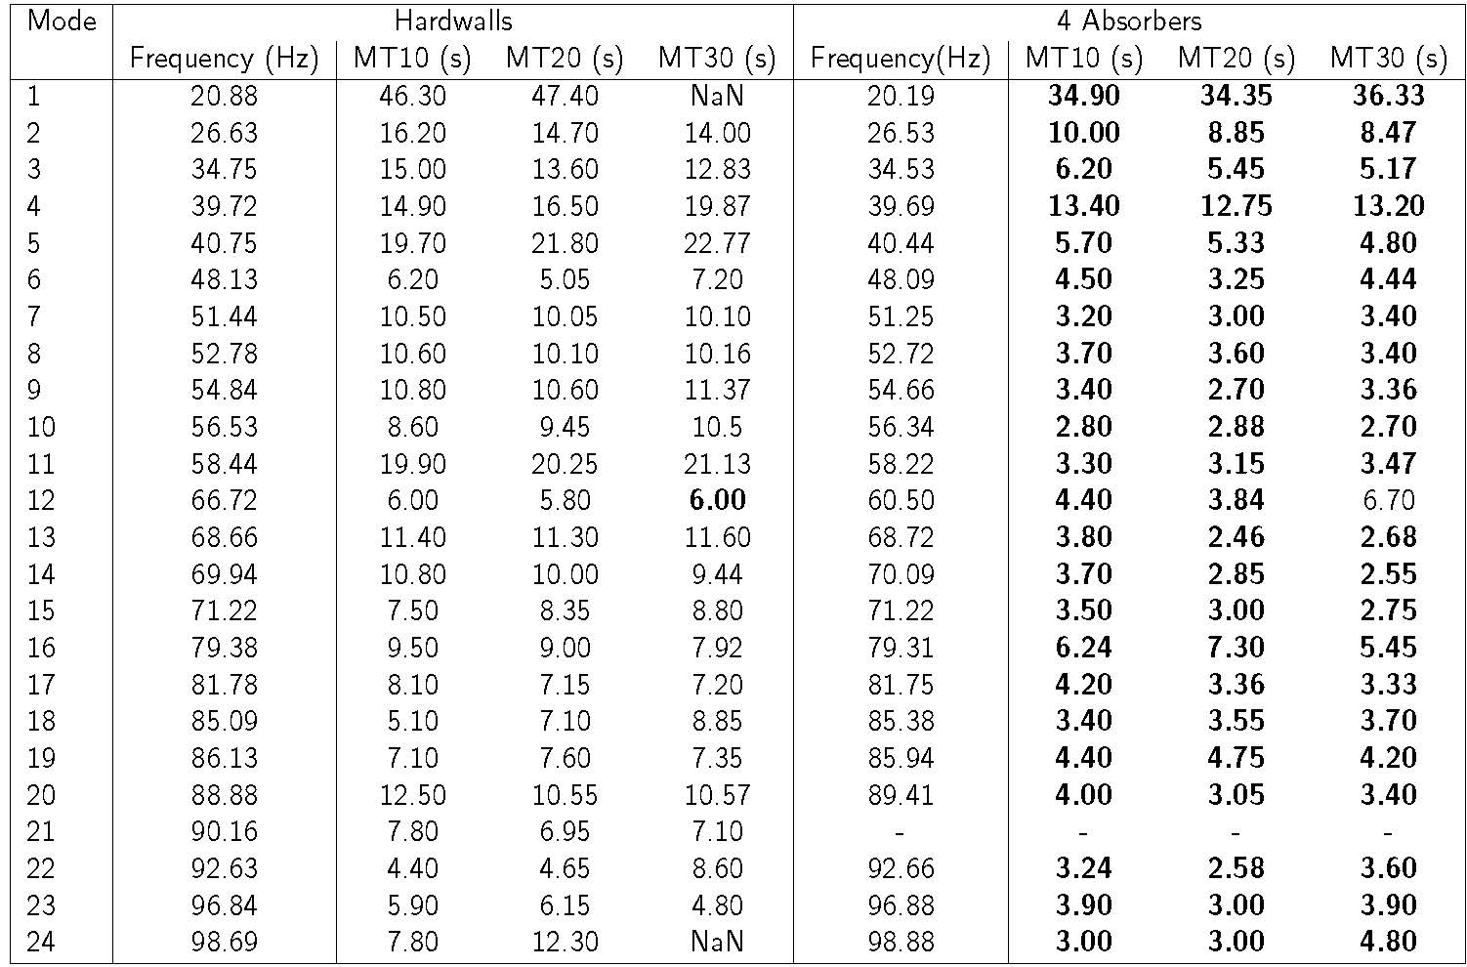
2. Modal decay time

Slide 26
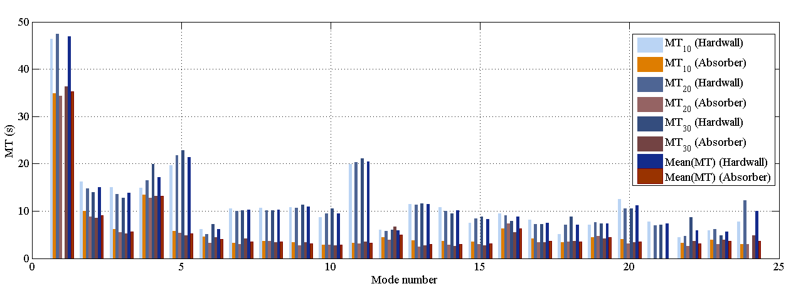
2. Modal decay time

Slide 27
3. Music rendering
Peggy Lee «Fever»
White Stripes «7 nation army»
What’s this tune?
What’s this tune?

Slide 28
4. Kick drum
Waveforms
Echograms

Slide 29
Conclusions and perspectives
4 electroacoustic absorbers prototypes achieve efficient room mode damping in the reverberant chamber
  Max damping: 12.2 dB @ 58 Hz,
  Global damping: 8 dB over [20 – 100 Hz],
  Max modal decay time reduction: 85% @ 58 Hz
  (from 20 s down to 3 s),
for a total absorber surface representing only 0.1% of the whole room walls surface

Slide 30
Conclusions and perspectives
The objective performances are still to be evaluated in a more conventional listening room
Subjective assessments should also be undertaken (to be done in the coming weeks)

Slide 31





Thank you for your attention
This work has been supported by the Swiss Commission for Technology and Innovation (CTI), under the project INTERACTS, agreement number: 14220.1 PFNM-NM.
e-mail: herve.lissek@epfl.ch

