Slide 1
Effects of plasma shaping on MHD and electron heat conductivity; impact on alpha electron heating
O. Sauter for the TCV team
Ecole Polytechnique Fédérale de Lausanne (EPFL)
Centre de Recherches en Physiques des Plasmas (CRPP)
Lausanne, Switzerland

Slide 2
Outline
Introduction
Elongation and triangularity on internal kink
Shape effects on ELMs
Triangularity effects on transport
Negative triangularity for DEMO?

Slide 3
Introduction
This is a short and rapid survey of some published TCV results related to the effects of plasma shape
Studies on sawteeth => effects of shape on internal kink / core MHD stability
Studies on ELMs => effects of shape on edge stability
Studies on transport => effects of shape on micro-stab.
Full list of references given at end of the talk

Slide 4
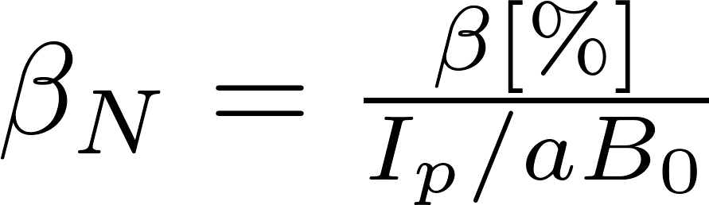
Reminder: β_{N} limit and elongation
β
A. Turnbull et al, Nucl. Fus. 28 (1988) 1381
β_{N}*I_{p}
q₉₅=2
I_{p}
F. Hofmann et al, PRL 81 (1998) 2918
Troyon limit:
TCV design: β_{N} decreases for κ>2.5 before q₉₅=2
TCV results: β_{N} does decreases for κ>2.2 before q₉₅=2

Slide 5
Sawteeth and plasma shape
κ and δ do not penetrate so much into plasma center
yet, large effects of shape on sawteeth
Reimerdes et al, PPCF 42 (2000) 629: Effect of triangular and elongated plasma shape on the sawtooth stability
Same shape dependence: Mercier, ideal internal kink, sawtooth period

Slide 6
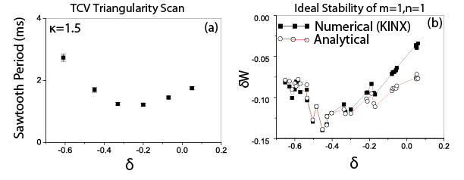
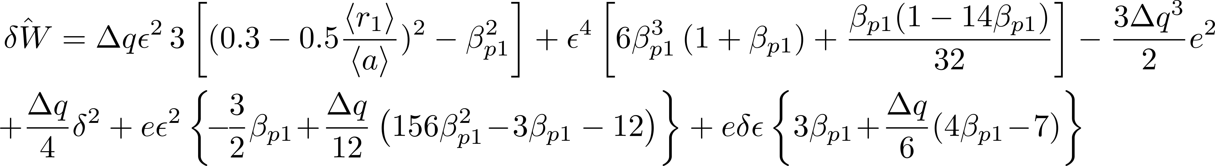
Ideal Internal Kink Mode
Analytical expression used [Graves PPCF (2005), Martynov PPCF (2005)]:

Slide 7
Sawteeth «disappear» at high elongation
Can avoid sawteeth by:
Full stabilization (lengthen sawtooth period -> ∞)
Full destabilization (shorten ST period -> 0)
Reimerdes et al, PPCF 48 (2006) 1621: Sawtooth behaviour in highly elongated
TCV plasmas

Slide 8
«continuous sawteeth» = nonlinear sat. MHD
3D displacement of nonlinar saturated MHD can be predicted
helical core of «hybrid» type plasmas ~ new 3D equilibrium
Graves et al, PPCF 55 (2013) 014005: Magnetohydrodynamic helical structures in nominally axisymmetric low-shear tokamak plasmas

Slide 9
n=1 growth rate well known from ideal MHD
At high κ, small shear:
γ and τ_{ST} have same dependence on δ
Best fits of γ(n=1) do not need δ in the formulas
κ decreases rapidly towards center at high δ => main effect of δ on internal kink through effective value of κ₁
Martynov et al, PPCF 47 (2005) 1743: The stability of the ideal internal kink mode in realistic tokamak geometry

Slide 10
ELMs at negative δ
Significant effect of δ on ELM frequency observed in TCV ohmic H-modes
Pochelon et al, PFR 7 (2012) 2502148: Recent TCV Results – Innovative Plasma Shaping to Improve Plasma Properties and Insight

Slide 11
ELMs at negative δ: main effect on high n
No «2nd stability» effects
More unstable
Smaller ELMs
Medvedev et al, NF (2015): Negative triangularity tokamak: stability limits and
perspectives as fusion energy system

Slide 12
Transport: better e⁻ confinement at negative δ
Same profiles at half the power !
Factor 2 confinement improvement
Camenen et al, NF 47 (2007) 510: Impact of plasma triangularity and collisionality on electron heat transport in TCV L-mode plasmas

Slide 13
Transport: better e⁻ confinement at negative δ
Camenen et al, NF 47 (2007) 510: Impact of plasma triangularity and collisionality on electron heat transport in TCV L-mode plasmas

Slide 14
Nonlinear gyrokinetic simulations at δ<0
Ratio of χ_{e} between positive over negative δ can be explained outside ρ=0.7
Clear difference in the core
Marinoni et al, NF 51 (2009) 055016: The effect of plasma triangularity on turbulent transport: modeling TCV experiments by linear and non-linear gyrokinetic simulations

Slide 15
On core stiffness and edge non-stiffness
From data
From educated fit
Can better relate with gyrokinetic simulations
Can better extract main parameters’ variations
Linear with ρ_{v} in edge region
Gradient increasing with Ip (P, n_{el}, …)
Sauter et al, PoP 21 (2014) 055906: On the non-stiffness of edge transport in
L-mode tokamak plasmas

Slide 16
Role of edge for δ effects on transport
Same input power with positive and negative δ with good radial resolution
Almost whole profile self-similar…except edge (next VG)
Sauter et al, PoP 21 (2014) 055906: On the non-stiffness of edge transport in
L-mode tokamak plasmas

Slide 17
Role of edge for δ effects on transport
T_{e}(ρ_{v}=0.8) increases with negative δ because of increased gradient in edge region 0.8-1.0
Consistent with previous simulations (Marinoni et al)
Sauter et al, PoP 21 (2014) 055906: On the non-stiffness of edge transport in
L-mode tokamak plasmas

Slide 18
Role of δ revisited with gyrokinetic
No change in core
δ<0 better at outer radii
Less stiff near edge
Linear critical gradients seem to play a role
Need global runs
Flux tube GENE
Merlo et al, PPCF (2015): Investigating profile stiffness and critical gradients
in shaped TCV using local gyrokinetic simulations of turbulent transport

Slide 19
Ion transport also stiff even in ohmic
T_{i} versus I_{p} scan. Same R/L_{Ti} across radii and I_{p}, scales with n_{el}
Ti(0.8) increases with Ip similar to Te. Same with P_{EC} scan
Thus with strong electron heating, expect same behaviour
Expect same behaviour with shaping as Te
Merle et al, IAEA (2014)

Slide 20
Negative delta, an option for DEMO
Design with heat flux handling as main priority (instead of core transport/stability)
Large gain with «R» for divertor, large gain for pumping
Potential gain from controlled ELMs, transport
Kikuchi et al, 1st International e-Conference on Energies (2014)

Slide 21
References
Turnbull et al NF 28 (1988) 1379, Current and beta limitations for the TCV tokamak
Hofmann et al, PRL 81 (1998) 2918, Exp. and Theor. Stab. Limits of High κ Tokamak Plasmas
Reimerdes et al, PPCF 42 (2000) 629: Effect of triangular and elongated plasma shape on the ST stability
Graves et al PPCF 47 (2005) B121, Sawtooth control in fusion plasmas
Martynov et al, PPCF 47 (2005) 1743: stability of the ideal internal kink in realistic tokamak geometry
Reimerdes et al, PPCF 48 (2006) 1621: Sawtooth behaviour in highly elongated TCV plasmas
Graves et al, PPCF 55 (2013) 014005: Magnetohydrodynamic helical structures in nominally axisymmetric low-shear tokamak plasmas
Camenen et al, NF 47 (2007) 510: Impact of plasma triangularity and collisionality on electron heat transport in TCV L-mode plasmas
Marinoni et al, NF 51 (2009) 055016: The effect of plasma triangularity on turbulent transport: modeling TCV experiments by linear and non-linear gyrokinetic simulations
Pochelon et al, PFR 7 (2012) 2502148: Recent TCV Results – Innovative Plasma Shaping to Improve Plasma Properties and Insight
Sauter et al, PoP 21 (2014) 055906: On the non-stiffness of edge transport in
L-mode tokamak plasmas
Merle et al, IAEA (2014), EX/P3-55, From Edge Non-Stiffness to Improved IN-Mode: a New Perspective on Global Tokamak Radial Transport
Merlo et al, PPCF (2015) May: Investigating profile stiffness and critical gradients in shaped TCV using local gyrokinetic simulations of turbulent transport
Medvedev et al, NF (2015): Negative triangularity tokamak: stability limits and perspectives as fusion energy system
Kikuchi et al, 1st International e-Conference on Energies (2014)

Slide 22
Back-up

Slide 23
Role of edge for δ effects on transport
T_{e} and n_{e} edge gradient increase with I_{p}, P, n_{el}, δ<0
Sauter et al, PoP 21 (2014) 055906: On the non-stiffness of edge transport in
L-mode tokamak plasmas

