Slide 1

2012 CERN-ECFA-NuPECC Workshop on the LHeC
14-15 June 2012
Chavannes-de-Bogis, Switzerland
LHeC Final Focus System
Jose L. Abelleira, PhD candidate
CERN, EPFL
Thanks to: H. Garcia, R. Tomas, F. Zimmermann

Slide 2
Contents
Round optics. e⁻ FFS optics I: triplet
Flat optics:
  e⁻ FFS optics II: Doublet, local chromatic correction
  e⁻ FFS optics III: Doublet, traditional chromatic correction
Introduced in the talk Interaction Region by R. Tomas (this workshop)

Slide 3
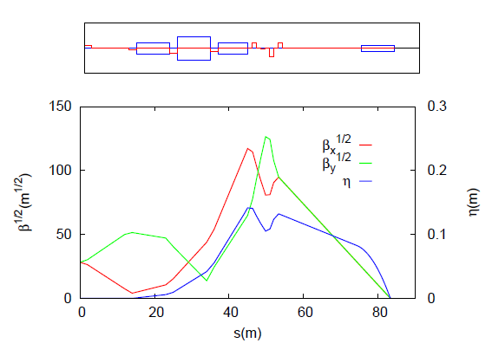
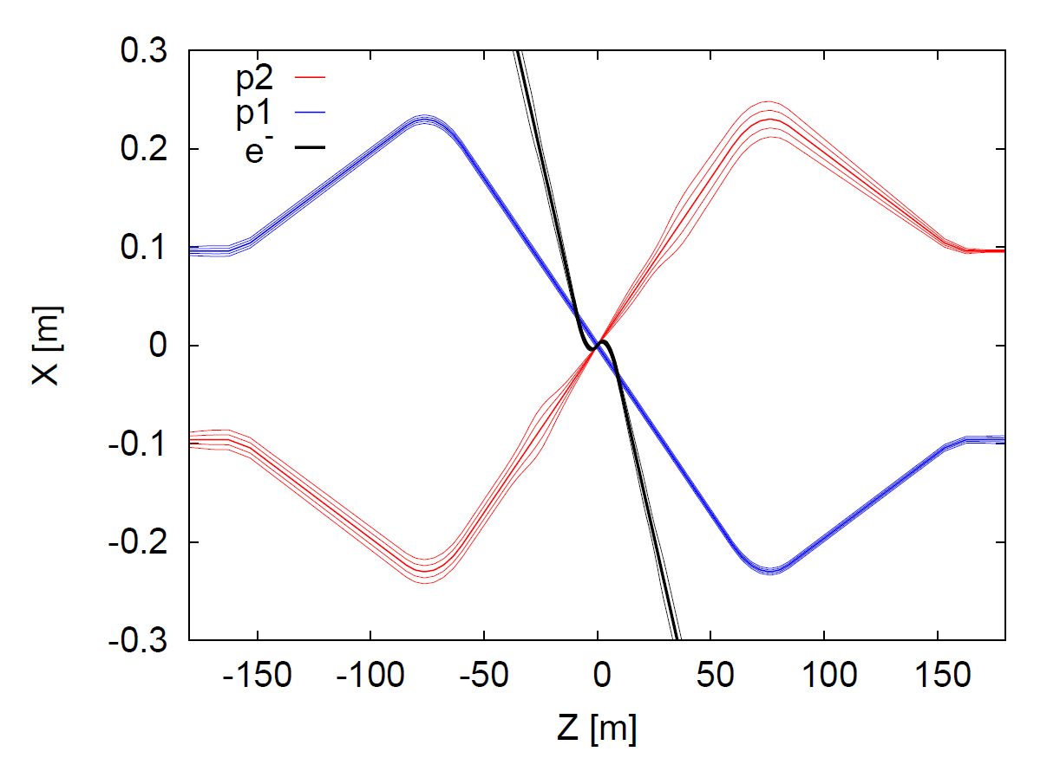
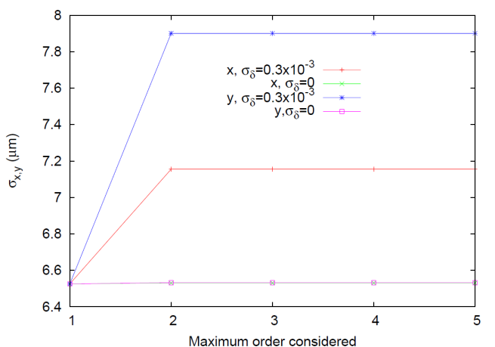
e⁻ FFS optics I: triplet
IP
β∗_{x,y} = 0.1 m.
No chromatic correction
Bending magnets to compensate the dispersion created by the last dipole
Beam size by order computed with MAPCLASS
R. Tomas, CERN AB-Note-2006-017 (ABP) (2006).
Chromatic aberration

Slide 4
Flat beam optics
Chromatic correction
4 Sextupoles to correct chromaticity in pairs
  1st pair: correction in X. β_{x}>> β_{y}
  2nd pair: correction in Y. β_{x}<< β_{y}
Separation of β-functions
β∗_{x} =0.2 m.
β∗_{y} = 0.05 m.
Different β* to separate β-functions
β∗_{x,y} = 0.1 m.
Each of the sextupoles of the pair must be spaced Δμ_{x,y}= π
2 arrangements
  Traditional, dedicated section
  Compact, Local chromatic correction
  P. Raimondi and A. Seryi, Phys. Rev. Lett. 86, 3779 (2001).

Slide 5
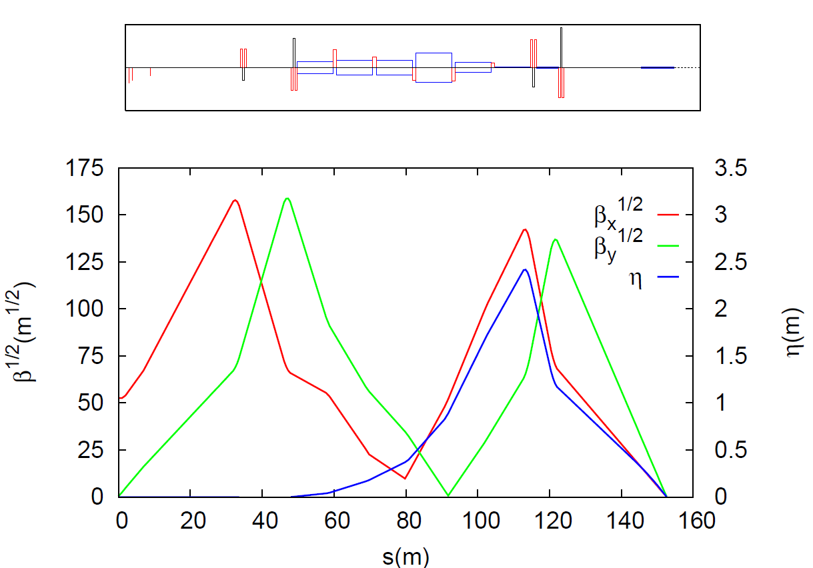
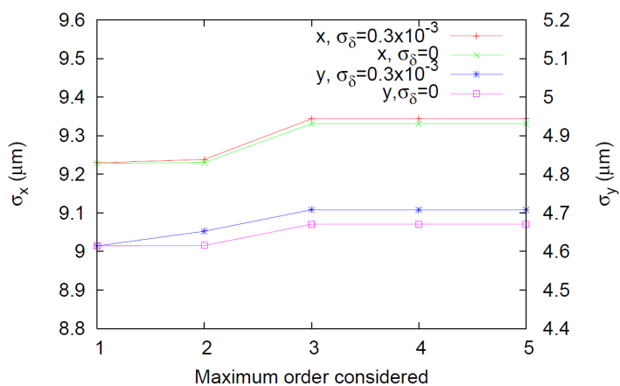
e⁻ FFS optics II: local chrom. corr.
Dipole
Quadrupole
Sextupole
β∗_{x} =0.2 m.
β∗_{y} = 0.05 m.
IP
Length : 150 m
SR power of 83 kW
Beam size by order

Slide 6
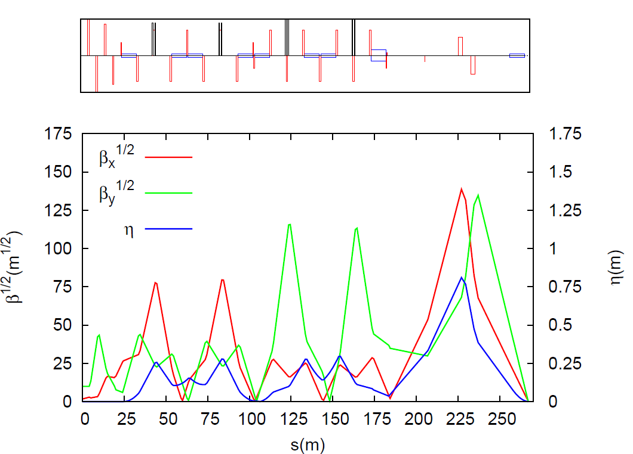
e⁻ FFS optics III: Traditional
Dipole
Quadrupole
Sextupole
β∗_{x} = 0.2 m.
β∗_{y} = 0.05 m.
IP
CCX
CCY
Length : 267 m (too long)
Modular construction:
Chromaticity compensated two dedicated sections.
Separated optics with strictly defined functions that makes the system relatively simple to design.
Chromaticity is not locally corrected.
SR power of 39 kW

Slide 7
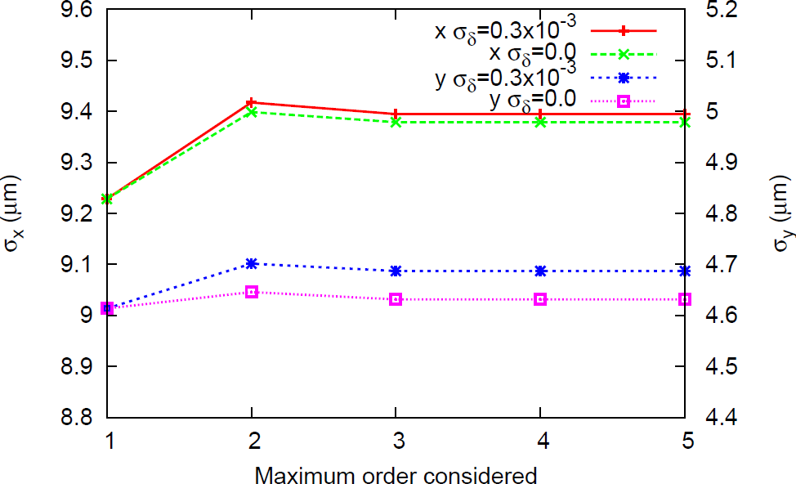
e⁻ FFS optics III: Traditional
Beam size by order
Geometric aberration

Slide 8
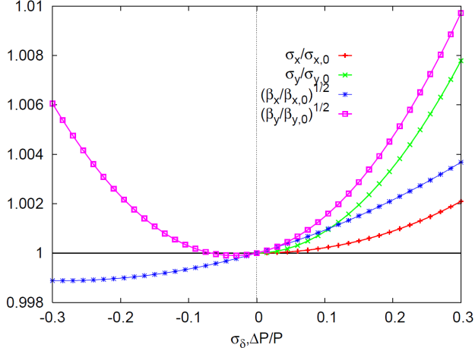
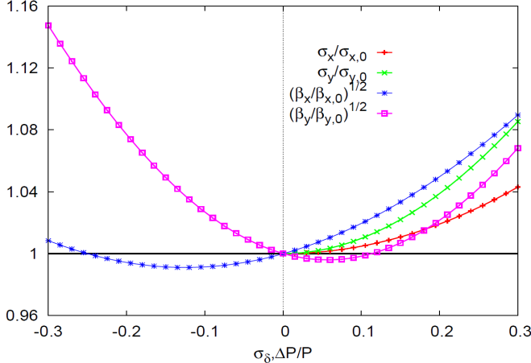
Flat beams comparative
Bandwidth
e⁻ FFS optics II e⁻ FFS optics III: Traditional
Much wider bandwidth for the local chromatic option →
more stable for energy variations

Slide 9



Flat beams comparative
Momentum spread σ_{δ} = 0.3 × 10⁻³ without synchrotron radiation evaluated by tracking with PLACET
 | σ_{x} [μm] | σ_{y} [μm]
Local | 9.34 | 4.69
Traditional | 9.75 | 4.97
 | σ_{y} [μm] w/o SR | σ_{x} [μm] W SR | σ_{x} [μm] Expected*
Local | 9.41 | 22.24 | 22.33
traditional | 10.15 | 12.84 | 13.63
Synchrotron radiation effects due to emittance dilution in the horizontal plane.
*
$∆\left({σ_{x}^{}}_{}^{∗}/{β_{x}^{}}_{}^{∗}\right)$=4.13x${10}^{−11}m^{2}{{GeV}^{−5}E}^{5}I$
$$I=\int_{0}^{L}{\frac{H(s)}{\left|{ρ(s)}_{}^{3}\right|}}\cos^{2}{φ\left(s\right)ds}$$
$H$ = $\frac{{{D^{2}}_{x}^{}+({D^{′}}_{x}^{}β_{x}^{}+D_{x}^{}α_{x}^{})}^{2}}{β_{x}}$
M. Sands, SLAC/AP-047 (1985).

Slide 10
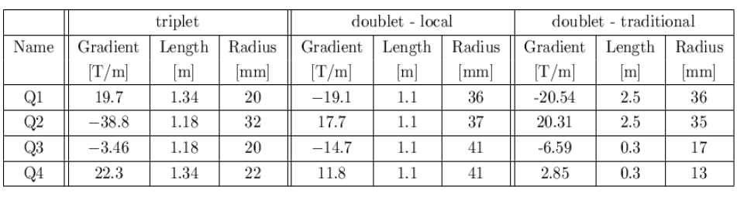
Magnet comparison

Slide 11
Conclusions
A chromatic correction needs high dispersion regions in the sextupoles that introduce SR and emittance growth
Restriction in length
Restriction in L*
Three different solutions have been studied and presented

Slide 12
Conclusions
Three different e- FFS optics
 | Main advantages | Main disadvantages | Future
optics I: Triplet | Simple and short | Chromaticity not corrected
optics II: Doublet, local chromatic correction | Short | Large emittance growth from synchrotron radiation | H-function optimization
optics III: Doublet, traditional modular chromatic correction | Chromaticity corrected with low emittance growth | Too Long? | If there is enough space

Slide 13
References
J.L. Abelleira, N. Bernard, S. Russenschuck, R. Tomas, F. Zimmermann; Proc. IPAC’11 San Sebastian, p. 2796.
J.L. Abelleira, H. Garcia, R. Tomas, F. Zimmermann; IPAC’12 New Orleans

Slide 14
Thank you for
your attention

