Slide 1


Flat-beam IR optics
Joint Snowmass-EUCARD/AccNet-HiLumi LHC meeting
Frontier capabilities for Hadron colliders
CERN, 22th February 2013
José L. Abelleira, PhD candidate EPFL, CERN BE-ABP
Supervised by F. Zimmermann, CERN Beams dep.
Thanks to: O.Domínguez. S Russenchuck, D.Shatilov, M. Zobov

Slide 2
Contents
Crab-waists collisions concept
Flat beam optics for LHC
CW for HE-LHC
  Parameters
  Time evolution
Conclusions

Slide 3
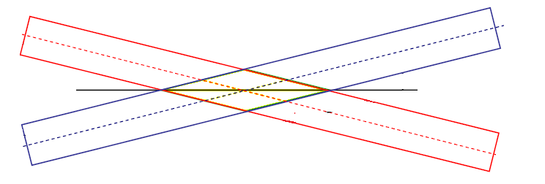


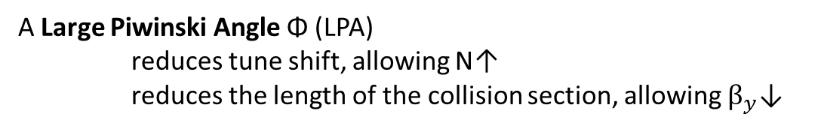

Crab-waist collisions (I)
An important limitation in hadron machines is beam-beam tune shift
A Large Piwinski Angle Φ (LPA)
reduces tune shift, allowing N↑
reduces the length of the collision section, allowing $β_{y}$↓
More luminosity
Length of the Collision section
With Head-on collisions or small φ
$$l_{OA}≈σ_{z}$$
But in LPA regime
$l_{OA}≈\frac{2σ_{x}}{θ}$
!
For LHC
$\frac{2σ_{z}}{θ}≈$ 1cm

Slide 4
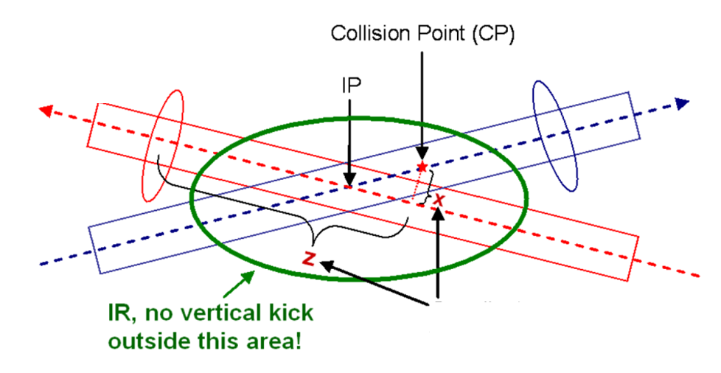
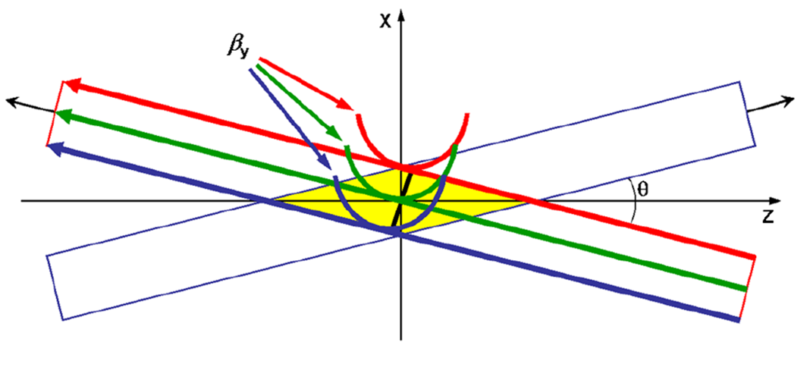
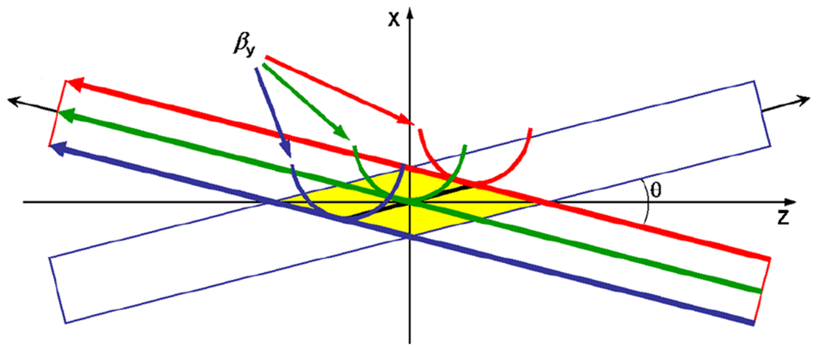
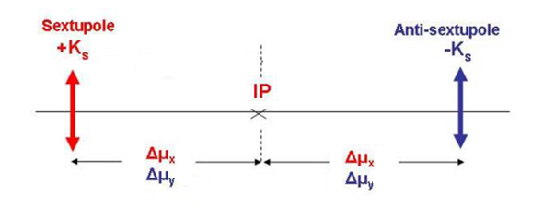



Crab-waist collisions (II)
On the other hand, a LPA induces strong X-Y resonances
Suppressed by crab-waist scheme
P.Raimondi, D.Shatilov,
M. Zobov
Normal collision scheme
Crab-waist collision scheme
Condition for cw collisions
2 sextupoles spaced from the IP
$${Δμ}_{x}≈πm$$
σ_{x}*/σ_{y}*≥10
β_{x}*/β_{y}*≥100
$${ε }_{x}={ε }_{y}$$
${Δμ}_{y}≈\frac{π}{2}$(2n+1)
Suitable for lepton machines
More challenging for hadron colliders

Slide 5
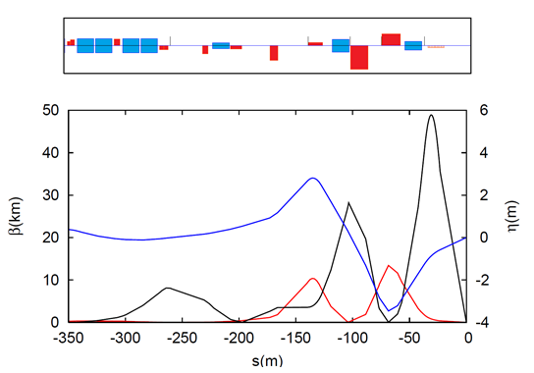
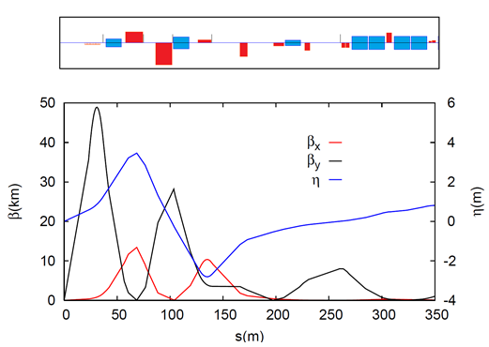
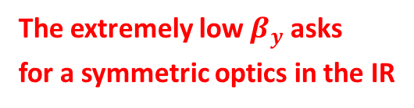
Flat beam optics for LHC
β_{x}*=1.5 m
β_{y}*=1.5 cm
Phase advance from IP
Local chromatic correction in both planes + crab-waist collisions
 | Δμ_{x} | Δμ_{y}
sext1
sext2
sext3
sext4
sext5
π/2
π/2
π/2
π/2
Chromatic correction
CRAB-WAIST SEXTUPOLE
3π/2
3π/2
sext1
sext3
3π/2
3π/2
2π
5π/2
sext2
sext4
sext5
Separation magnets
The extremely low $β_{y}$ asks
for a symmetric optics in the IR

Slide 6

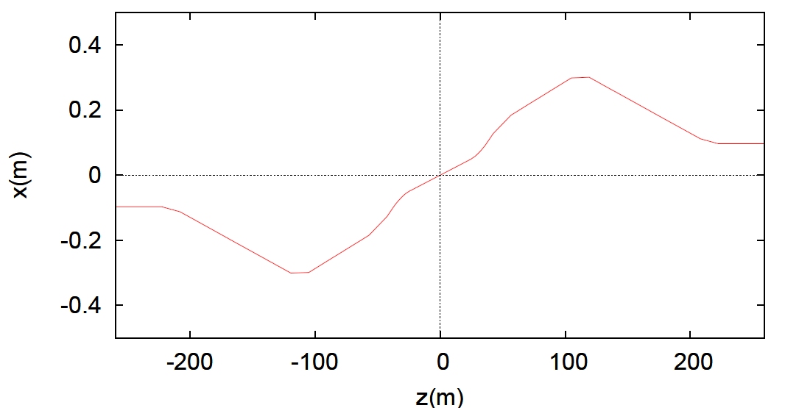

Flat beam optics for LHC
15σ_{y}
Reference orbit
45 mm
$$θ=4mrad$$
15σ_{x}
Minimum required according to beam-beam simulations.
σ_{x/} σ_{y}=10

Slide 7
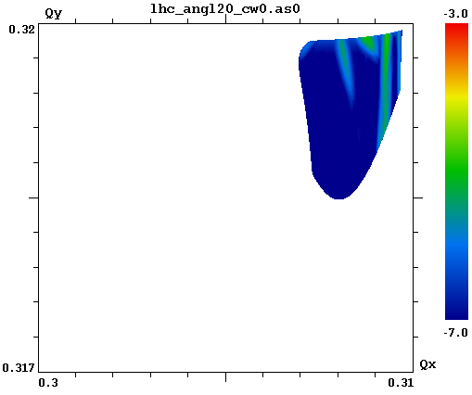
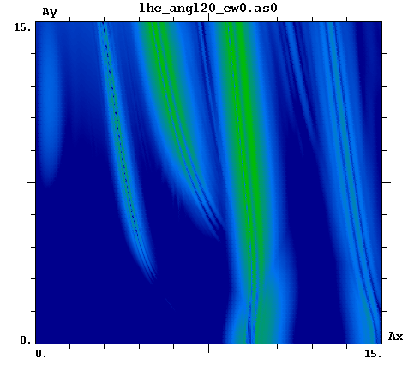
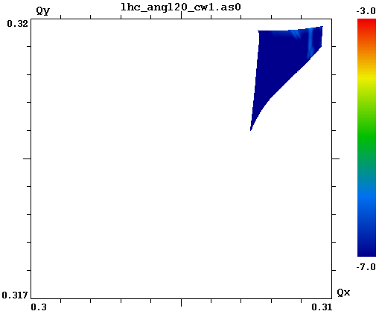
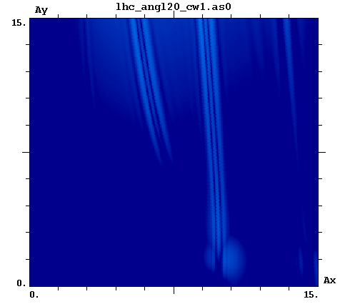


Crab-waist simulations
CW = 0.5
CW = 0
Resonances
Frequency Map Analysis (FMA)
Effective for the beam-beam resonance suppression.
Plot shown for θ_{c} = 1.5 mrad
Dmitry Shatilov
Mikhail Zobov

Slide 8
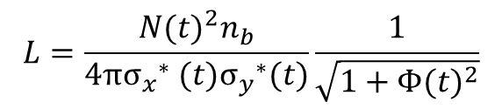
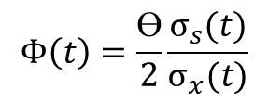
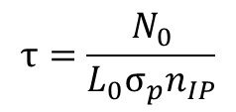
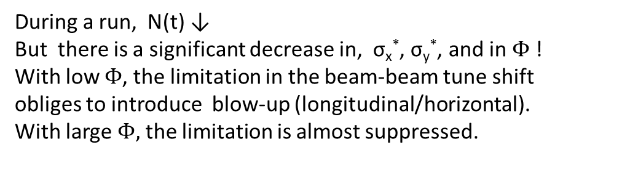
Luminosity evolution
$$L=\frac{{N(t)}^{2}n_{b}}{4π{σ_{x}}^{∗} (t){σ_{y}}^{∗}(t)}\frac{1}{\sqrt{1+{Φ(t)}^{2}}}$$
$$Φ\left(t\right)=\frac{ϴ}{2}\frac{σ_{s}(t)}{σ_{x}(t)}$$
During a run, N(t) ↓
But there is a significant decrease in, σ_{x}*, σ_{y}*, and in $Φ$ !
With low $Φ$, the limitation in the beam-beam tune shift
obliges to introduce blow-up (longitudinal/horizontal).
With large $Φ,$ the limitation is almost suppressed.
↘we just have to adjust the parameters to have SR damping as a compensator for the burn off
Beam lifetime due to burn off
  Higher L_{INT}
$$τ=\frac{N_{0}}{L_{0}σ_{p}n_{IP}}$$
LPA allows a bigger $N_{0}$for the same $L_{0.}$ Contribution to $L_{int}$

Slide 9
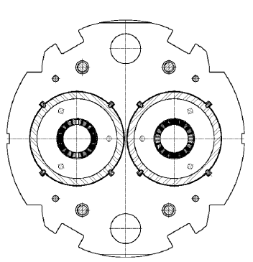
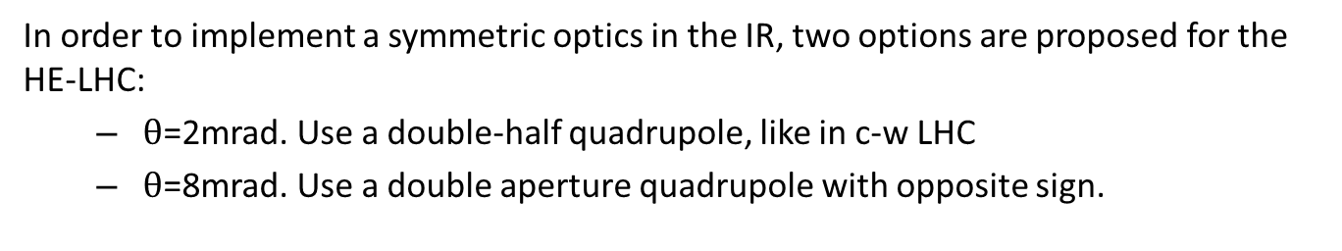
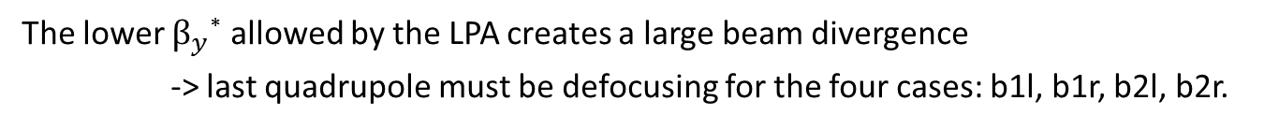
Symmetric optics
The lower $β_{y}$* allowed by the LPA creates a large beam divergence
-> last quadrupole must be defocusing for the four cases: b1l, b1r, b2l, b2r.
IR optics is symmetric. Two options
  Match the sym. IR optics to the antisymetric arc optics.
  Design a symmetric optics in the arcs.
N
S
S
N
N
S
S
N
N
S
S
N
In order to implement a symmetric optics in the IR, two options are proposed for the HE-LHC:
  $θ$=2mrad. Use a double-half quadrupole, like in c-w LHC
  $θ$=8mrad. Use a double aperture quadrupole with opposite sign.

Slide 10
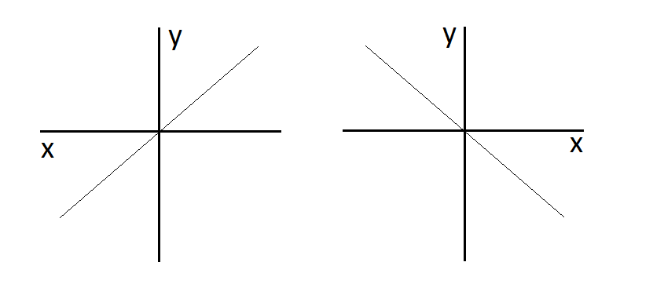
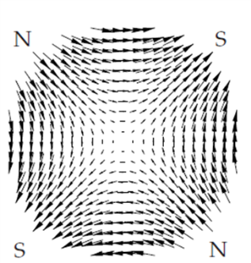
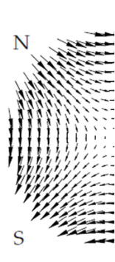
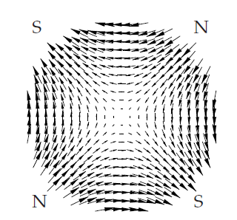
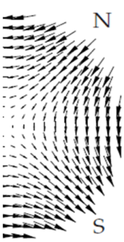
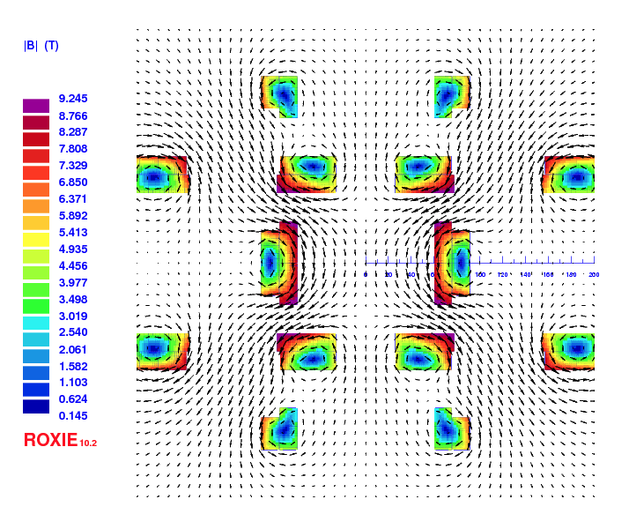
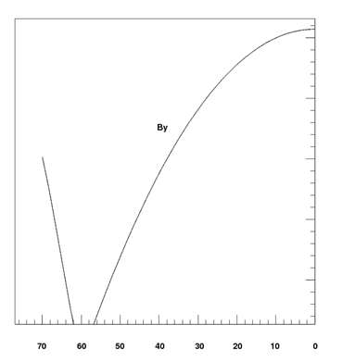
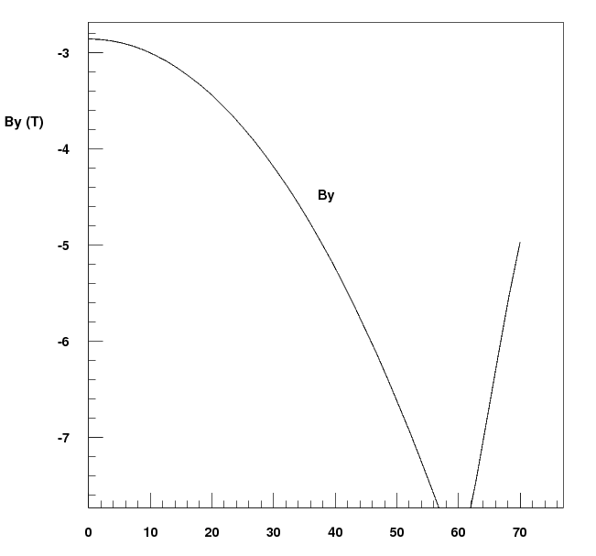
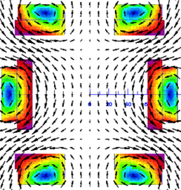

Last quadrupole. $θ$=2 mrad
proposed for c-w LHC as a solution to have diff pol quadrupoles for the 2 beams in a same aperture
B_{y}(x)
Double half
quadrupole
g=115 T/m
B₀=-5.8 T
S. Russenchuck

Slide 11
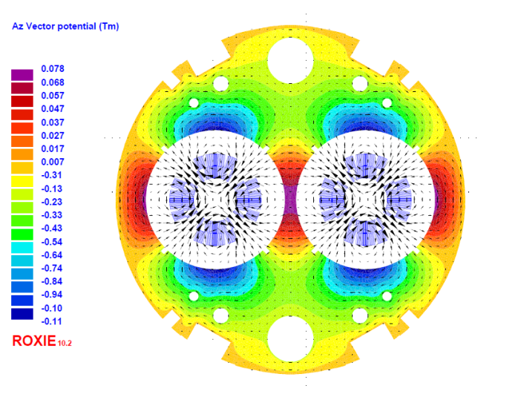
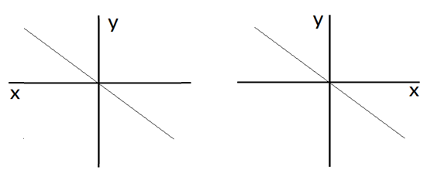
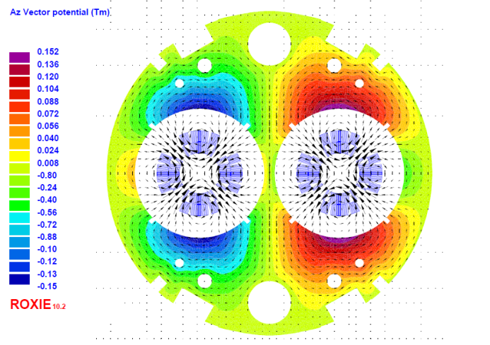

Last quadrupole. $θ$=8 mrad
Double aperture magnets with same polarity (as in LHC arc quadrupoles)
Gradient : 220 T/m
Double aperture magnets with same polarity for c-w HE-LHC
B_{y}(x)
Gradient : 219 T/m
18.4 cm
S. Russenchuck

Slide 12
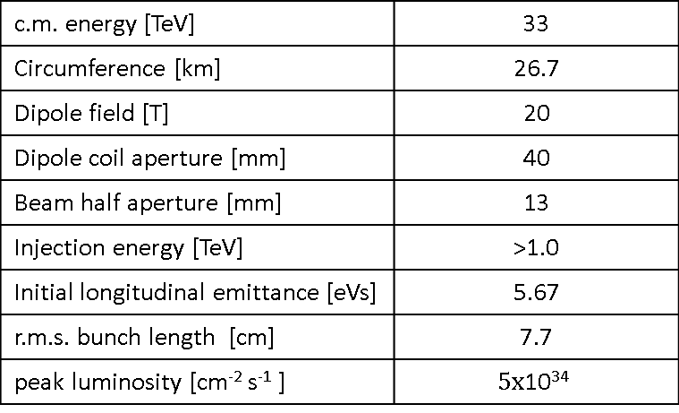
Parameters (I)
c.m. energy [TeV] | 33
Circumference [km] | 26.7
Dipole field [T] | 20
Dipole coil aperture [mm] | 40
Beam half aperture [mm] | 13
Injection energy [TeV] | >1.0
Initial longitudinal emittance [eVs] | 5.67
r.m.s. bunch length [cm] | 7.7
peak luminosity [cm⁻² s⁻¹ ] | $$5\text{x}\text{10}\text{34}$$
O. Domínguez.
HE-LHC/VHE-LHC parameters,
time evolutions & integrated luminosities. This workshop
The initial beam size has been chosen to allow c-w from the beginning of a run
σ_{x}*/σ_{y}*=10
Due to the fast emittance shrink
Initial luminosity ≠ peak luminosity

Slide 13
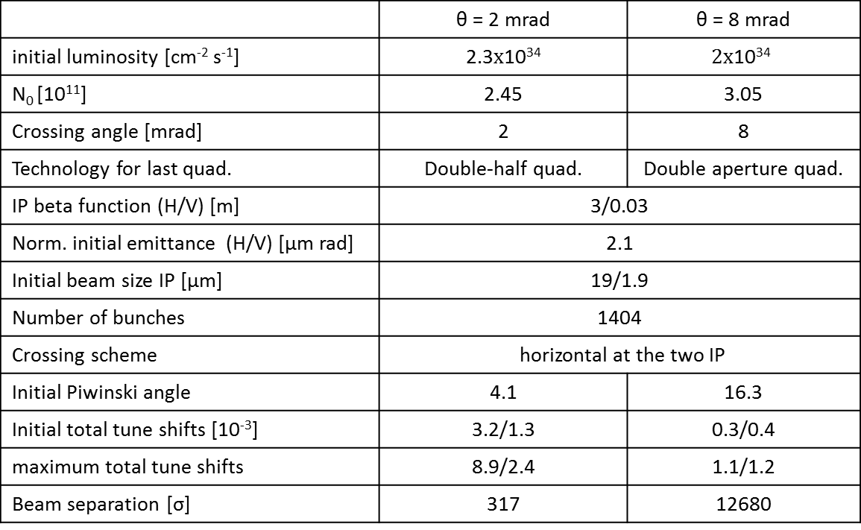
Parameters (II)
 | θ = 2 mrad | θ = 8 mrad
initial luminosity [cm⁻² s⁻¹] | 2.3$\text{x}\text{10}\text{3}\text{4}$ | $$2\text{x}\text{10}\text{34}$$
N₀ [10¹¹] | 2.45 | 3.05
Crossing angle [mrad] | 2 | 8
Technology for last quad. | Double-half quad. | Double aperture quad.
IP beta function (H/V) [m] | 3/0.03
Norm. initial emittance (H/V) [μm rad] | 2.1
Initial beam size IP [μm] | 19/1.9
Number of bunches | 1404
Crossing scheme | horizontal at the two IP
Initial Piwinski angle | 4.1 | 16.3
Initial total tune shifts [10⁻³] | 3.2/1.3 | 0.3/0.4
maximum total tune shifts | 8.9/2.4 | 1.1/1.2
Beam separation [σ] | 317 | 12680
O. Domínguez.

Slide 14
Parameters (III)
 | θ = 2 mrad | θ = 8 mrad
Long. SR emittance damping time [h] | 1.01
Transverse SR emittance damping time [h] | 2.02
Initial horizontal IBS emittance rise time [h] | 37.51 | 21.1
Initial vertical IBS emittance rise time [h] | 72.02 | 42.2
Initial longitudinal IBS rise time [h] | 72.45 | 40.7
Beam intensity lifetime [h] | 14.6 | 29.9
Optimum run time [h] | 6 | 8.5
Opt. av. Int. luminosity/day [fb⁻¹] | 1.63 | 1.93
O. Domínguez.

Slide 15
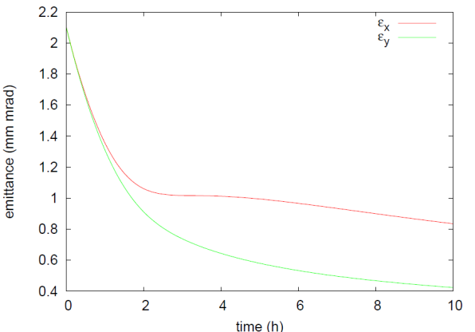
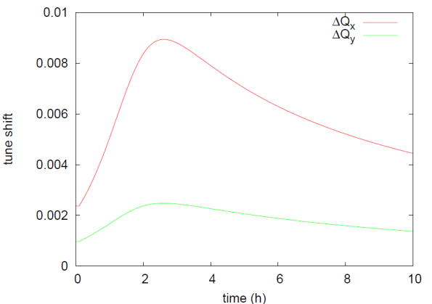
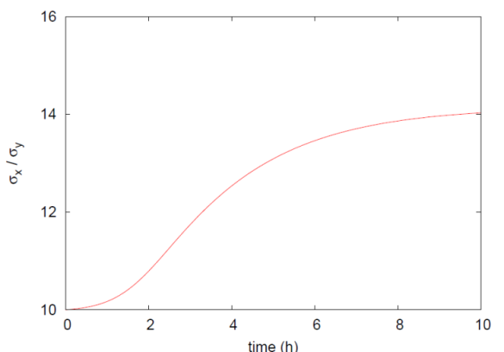
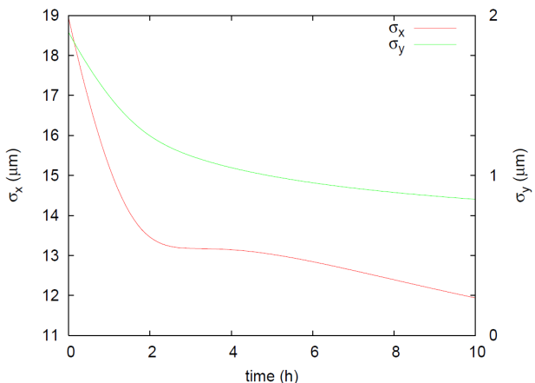
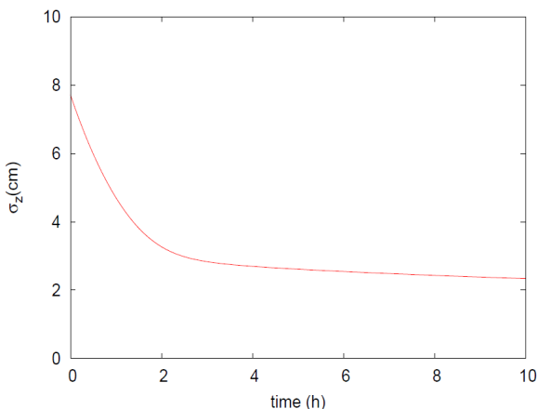
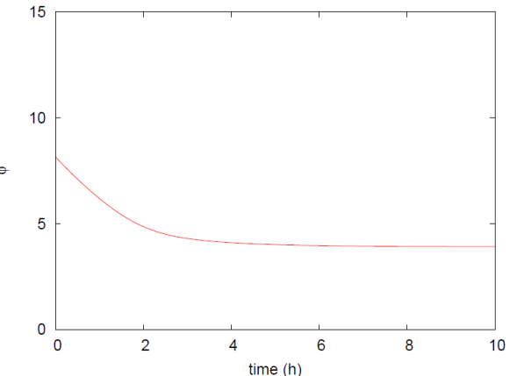

Time evolution. $θ$=2 mrad
Far below 0.01
C-w condition
emittance
Total tune shifts
Beam size ratio
Transverse beam sizes
Long. Beam size
Piwinski angle
Luminosity
O. Domínguez.

Slide 16
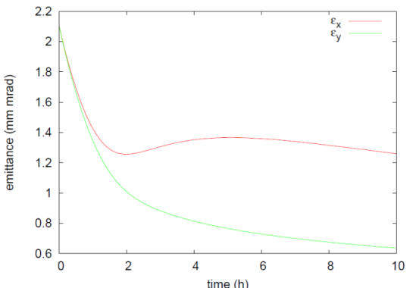
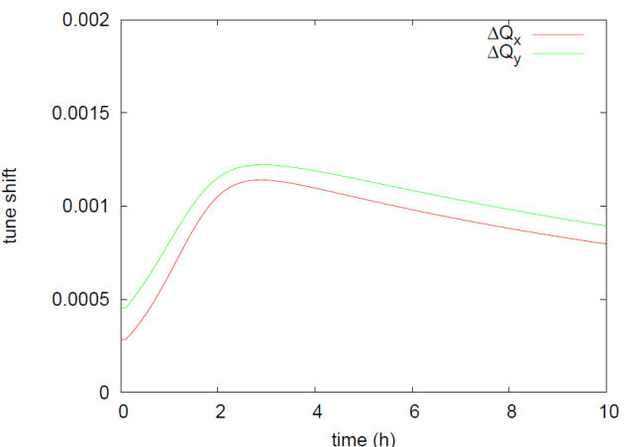
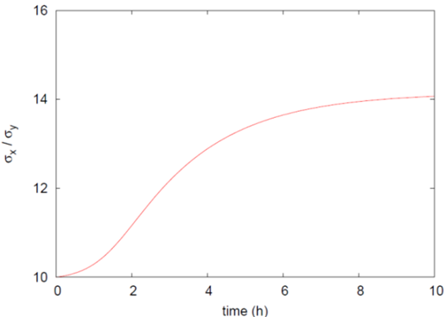
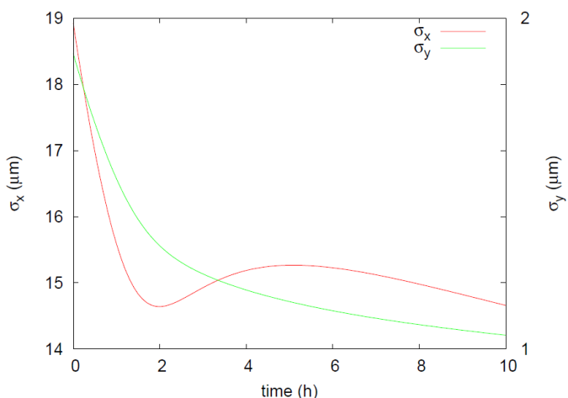
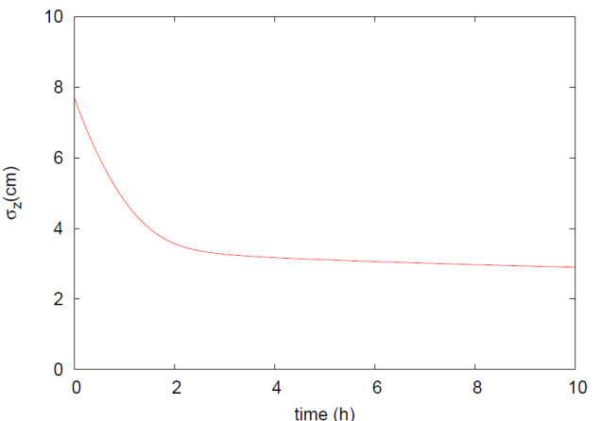
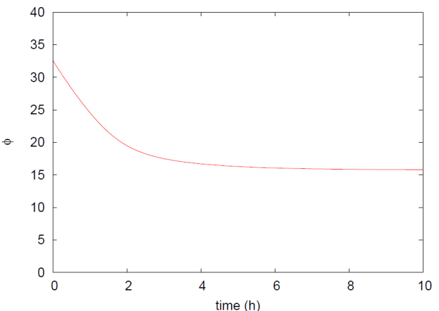

Time evolution. $θ$=8 mrad
Even far below 0.01
emittance
Total tune shifts
Beam size ratio
Transverse beam sizes
Long. Beam size
Piwinski angle
Luminosity
O. Domínguez.

Slide 17
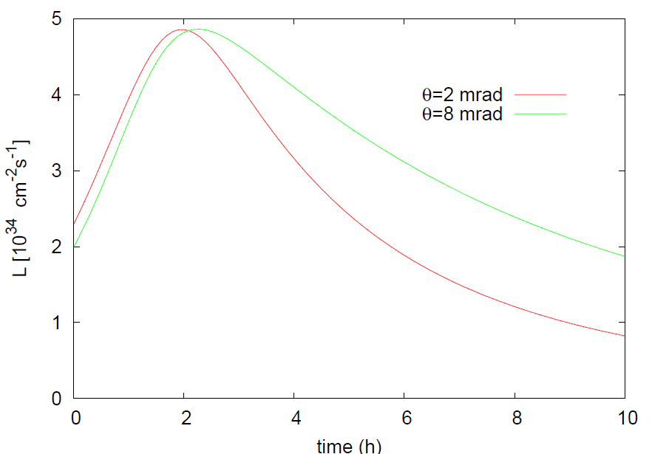
Luminosity evolution
O. Domínguez.

Slide 18
Conclusions
An extremely-flat beam optics (β_{y}*/β_{y}*=100) is conceptual possible for LHC and HELHC
  Large Piwinski angle, to reduce the collision area and allow for a lower β_{y}*
  Local chromatic correction
  Possibility to have crab waist collisions that can increase luminosity and suppress resonances
  Can accept higher brightness.
With crab-waist collisions there is no tune shift limitation: no need for emittance blow up.
  LPA allows for a higher brightness: increases beam lifetime
  SR damping for the three planes increases luminosity
  Significant increase in Lint

Slide 19
Thank you…
…For your attention

