Slide 1
Transport regimes for fast ions in TORPEX toroidal magnetized plasmas
Ivo Furno
F. Avino, A. Bovet, A. Fasoli
K. Gustafson, P. Ricci
Centre de Recherches en Physique des Plasmas, Switzerland
H. Boehmer, W. Heidbrink, S. Zhou
University of California Irvine, USA
13th IAEA Technical Meeting on Energetic Particles
in Magnetic Confinement Systems, Beijing, 2013

Slide 2
Outline
  Motivations
  The TORPEX device and the diagnostics
  ideal interchange turbulence
  fast ions source and detector
Experimental measurements
  fast ion transport: energy dependence
Theoretical framework
  Fluid simulations
Comparison simulations – experiments
Transport regimes for fast ions
Outlook and conclusions

Slide 3
Outline
  Motivations
  The TORPEX device and the diagnostics
  ideal interchange turbulence
  fast ions source and detector
Experimental measurements
  fast ion transport: energy dependence
Theoretical framework
  Fluid simulations
Comparison simulations – experiments
Transport regimes for fast ions
Outlook and conclusions

Slide 4
Why study fast ion transport by turbulence in simple devices?
Fast particles and turbulence are pervasive in Nature and laboratory:
in magnetic fusion devices: α-particles and beam-ion confinement are important for ITER and next step devices.
Basic plasma physics devices allow simpler investigations:
many details of turbulence and fast ions are directly measured
key experimental physics parameters can be varied systematically
direct comparison with numerical simulations ➔ code validation

Slide 5
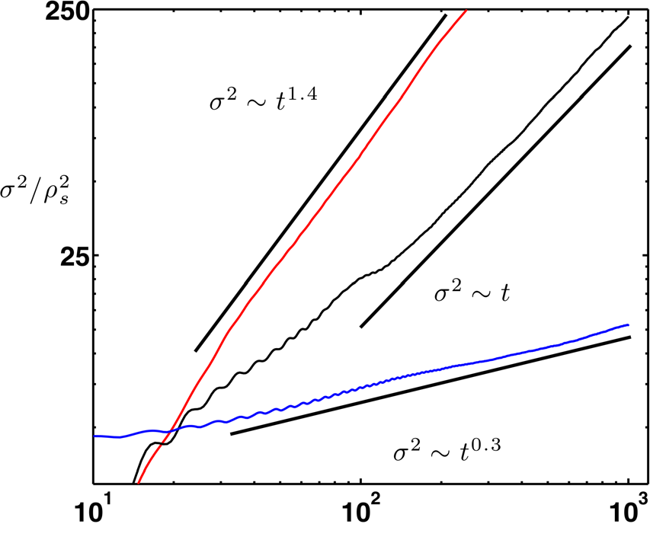
A definition of transport regimes
Spreading in time of the particle positions to extract an exponent:
γ > 1 “super-diffusive”
variance
Diffusive ➔ σ²=Dt¹
Are all these regimes accessible to fast ions?
Which key elements determine the regime?
γ < 1 “sub-diffusive”
time
K. Gustafson et al, PoP 2012

Slide 6
Outline
  Motivations
  The TORPEX device and the diagnostics
  ideal interchange turbulence
  fast ions source and detector
Experimental measurements
  fast ion transport: energy dependence
Theoretical framework
  Fluid simulations
  Transport regimes for fast ions
Comparison simulations – experiments
Outlook and conclusions

Slide 7
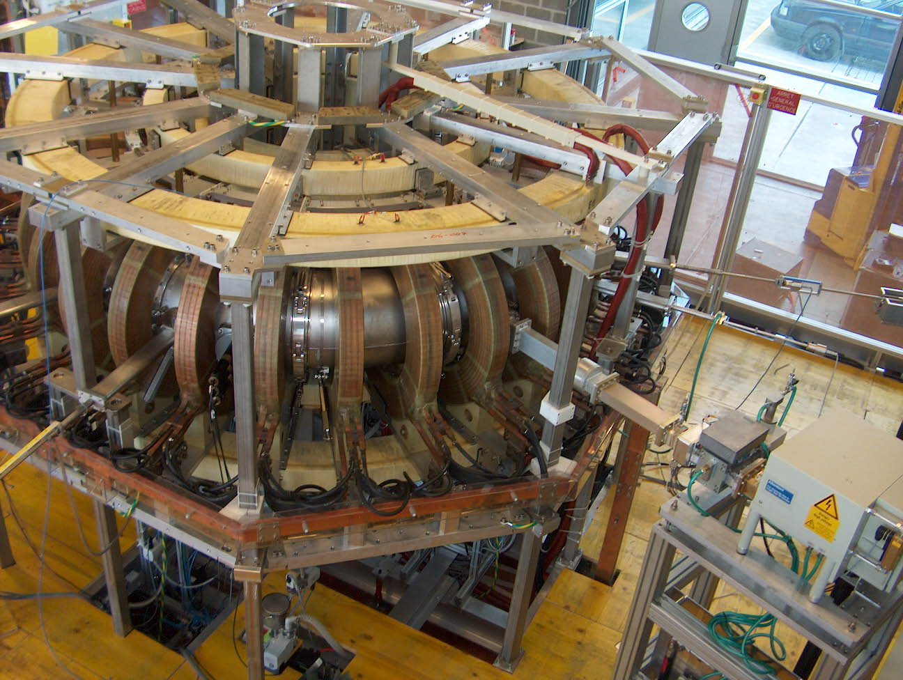
TORPEX (TORoidal Plasma EXperiment) at CRPP
major radius = 1m, minor radius = 20cm
4 vertical field coils
Magnetron
for plasma
production
28 toroidal field coils

Slide 8
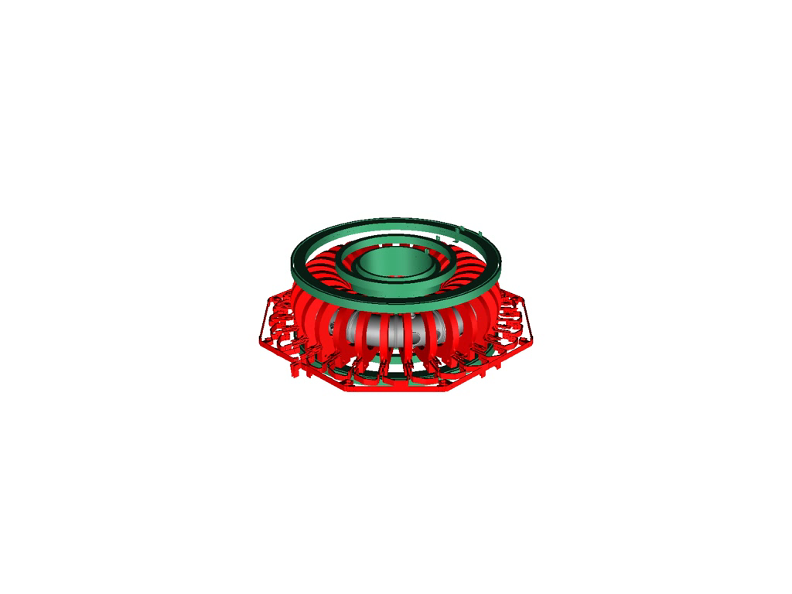
TORPEX and the simple magnetized torus (SMT)

Slide 9
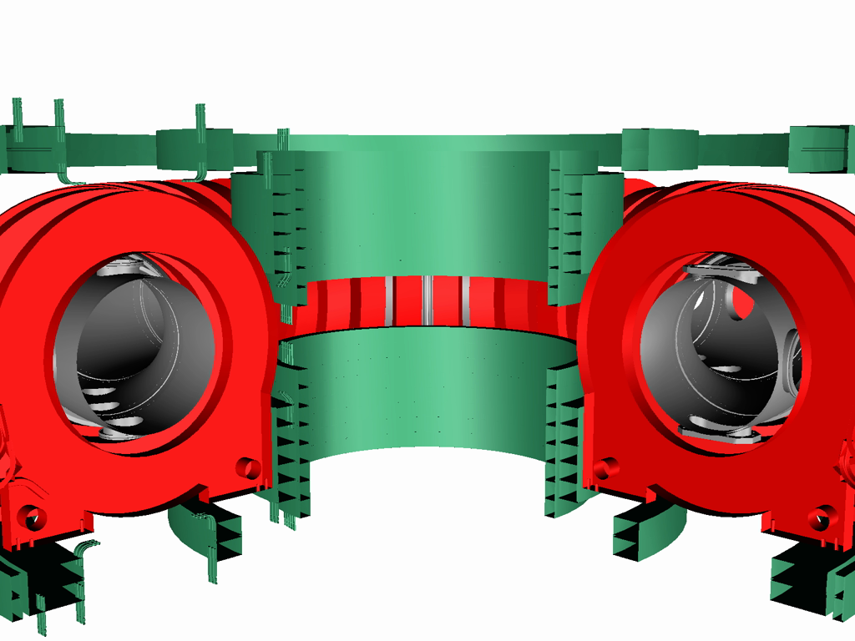
TORPEX and the simple magnetized torus (SMT)
Toroidal coils
B_{t}~800Gauss

Slide 10
TORPEX and the simple magnetized torus (SMT)
Vertical coils
Toroidal coils
B_{v}~10Gauss
B_{t}~800Gauss

Slide 11
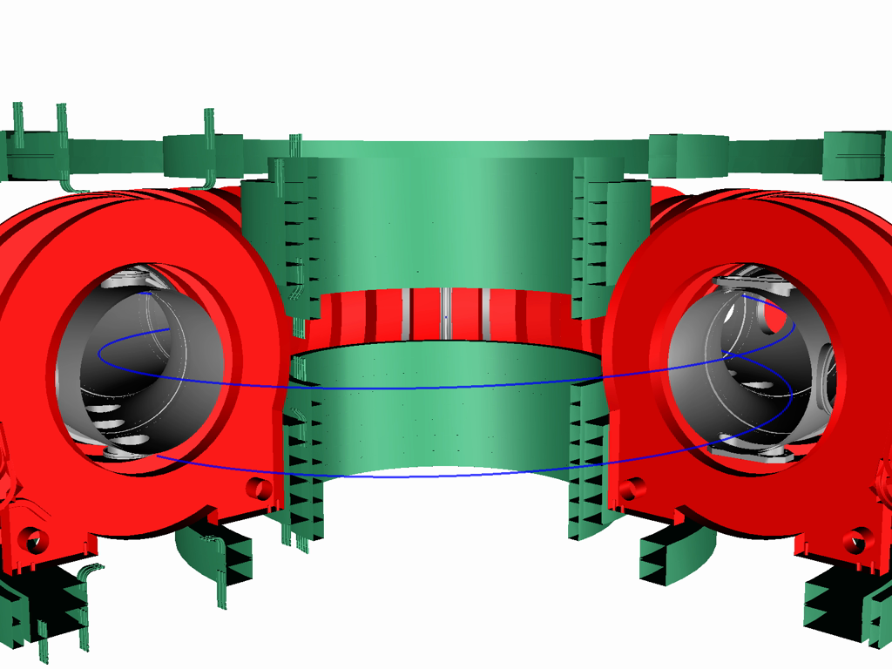
TORPEX and the simple magnetized torus (SMT)
Helical field lines winding N times around the torus
B and curvature ➔ interchange drive
Open field lines

Slide 12
At low N, SMTs are dominated by field-aligned turbulence
Drift
Interchange drive not
effective
Resistive Interchange
N~2 ➔ k|| =0, ideal interchange turb.
T_{e}~5-10eV, T_{i}<<T_{e}
n_{e}~3x10¹⁶m⁻³
Ideal Interchange
k|| =0
inverse pressure gradient
P. Ricci and B. Rogers, PRL 2010
Notes:
12

Slide 13
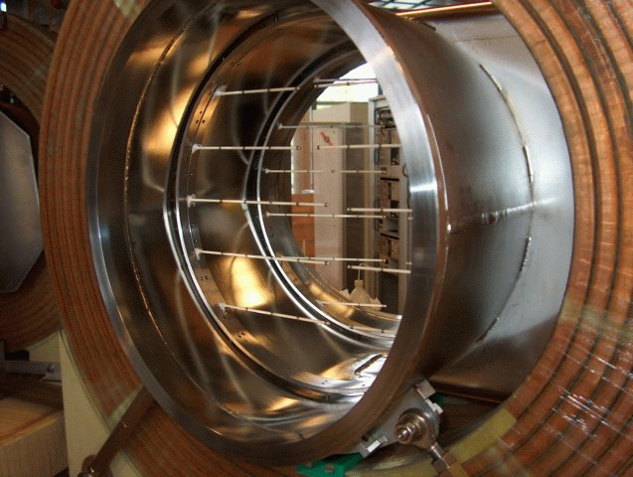
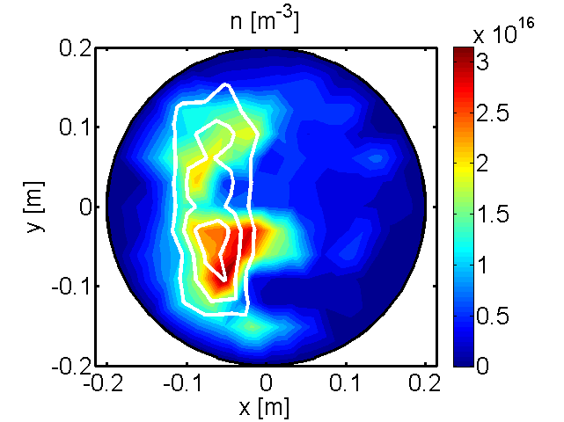
Ideal interchange turbulence: waves and blobs
Interchange wave
Blob region
High field side
Low field side
I. Furno et al., PRL 2008, 2011; C. Theiler et al., PRL 2009, 2012

Slide 14
Ideal interchange regime: waves and blobs
High field side
Low field side

Slide 15
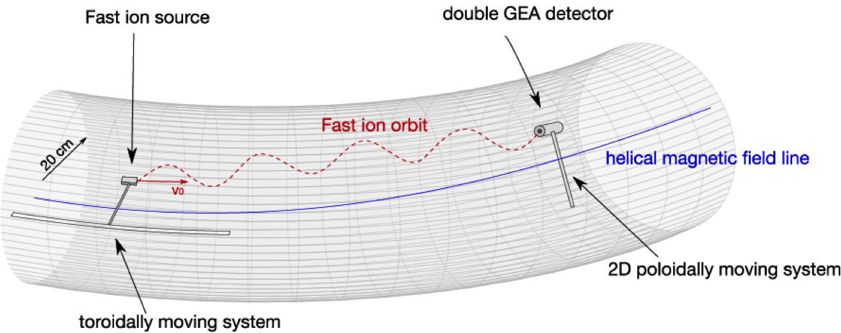
Source + GEA ➔ 3D fast ion profiles

Slide 16
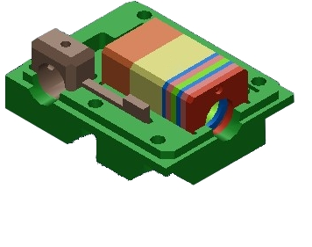
Miniaturized ₆Li⁺ ion source – Collaboration with UCI
Heating wires (30W)
Extract. grid
Acc. grid
Emitter
1 cm
Tungsten body
BN casing
Alumino-silicate coating
₆Li doping
Thermo-ionic effect (~1200º)
Ion current ~ 10μA
Compact, vacuum and plasma safe BN casing
Double grid accelerating scheme
Geometry optimized for small beam divergence
Extraction voltage: ~10V–1kV ➔ E _{fast ion} =10eV-1keV

Slide 17
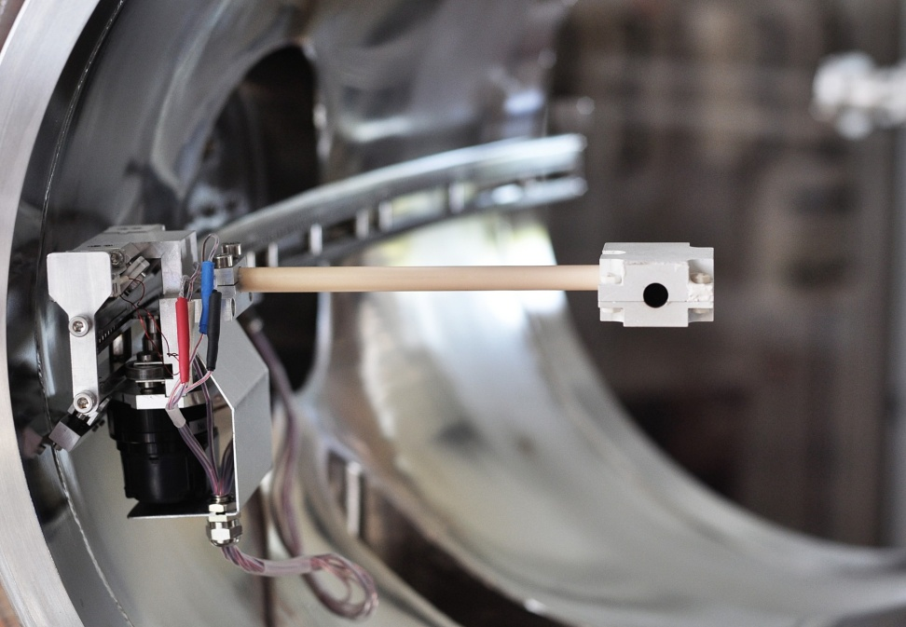
The source is installed on a toroidally moving system
TORPEX
vacuum vessel
36mm
Toroidal moving
system
Fast ion source ➔ quasi-parallel injection (~5 deg), spreading ~10 deg

Slide 18
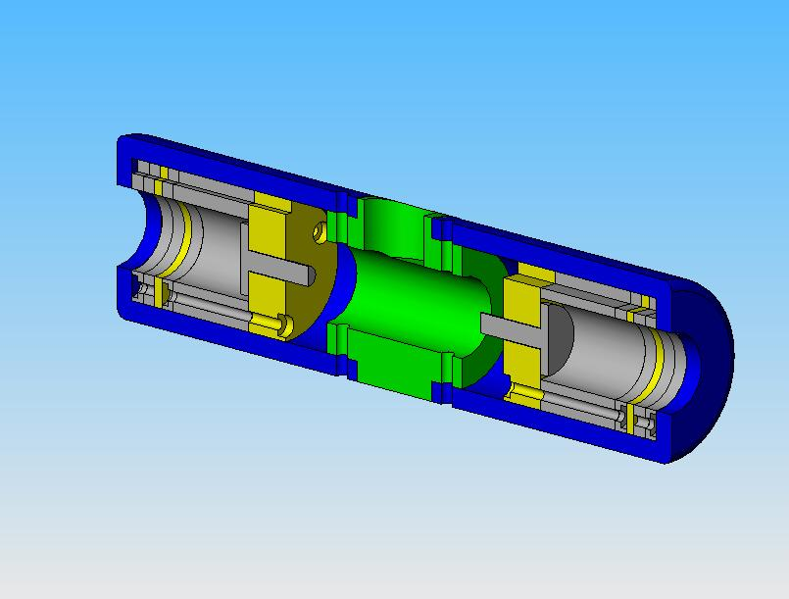
The fast ion detector: double gridded-energy analyzer
Second grid – electron rejection
Collector – ion selector
8 mm
Fast ion beam
First grid
G. Plyuschev et al., RSI 2006

Slide 19
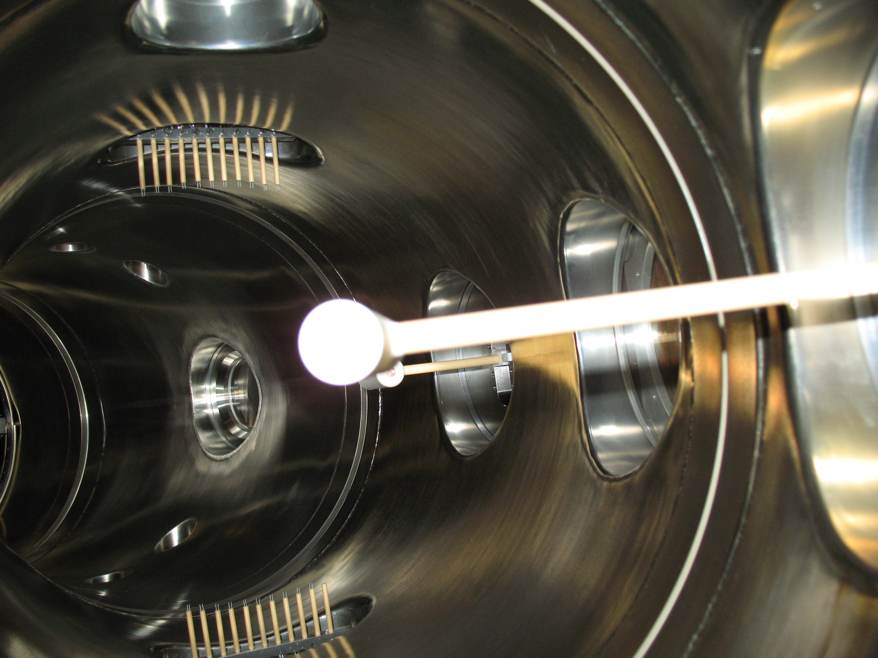
A 2D movable system allows poloidal measurements
poloidal
TORPEX
vacuum vessel
radial
GEA detector

Slide 20
A 2D movable system allows poloidal measurements
y
TORPEX
vacuum vessel
x
GEA detector

Slide 21
Synchronous detection for small signals
Generate a CW plasma
Source ON
Small fast ion
current < 1μA
Synchronous detection
Large SN ratio over 10s
Source OFF
time
A. Bovet et al., submitted to PPCF

Slide 22
Outline
  Motivations
  The TORPEX device and the diagnostics
  ideal interchange turbulence
  fast ions source and detector
Experimental measurements
  fast ion transport: energy dependence
Theoretical framework
  Fluid simulations
Comparison simulations – experiments
Transport regimes for fast ions
Outlook and conclusions

Slide 23
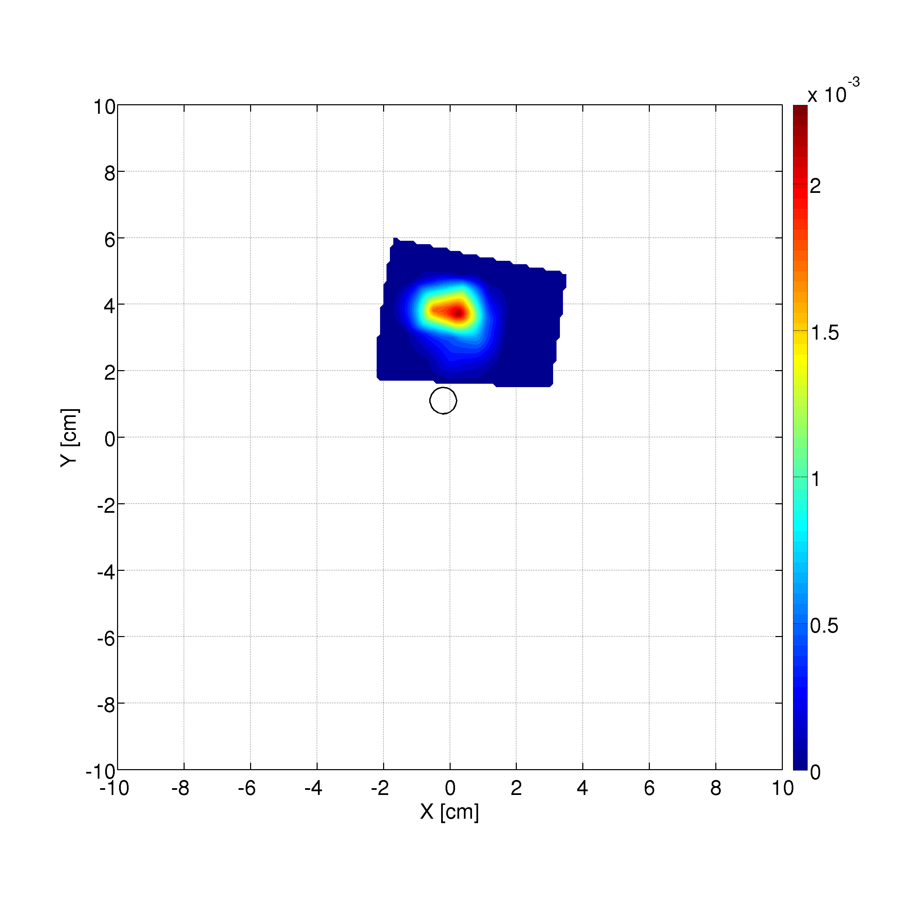
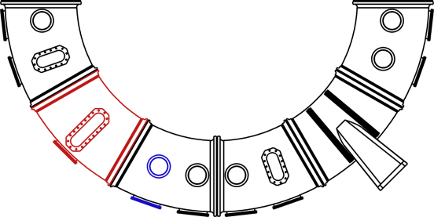
Measurements at two fast ion energies
E = 70 eV
E/T_{e} ≈ 46
Fast ion injection location
detector
Distance from the source = 0.2 m
source

Slide 24
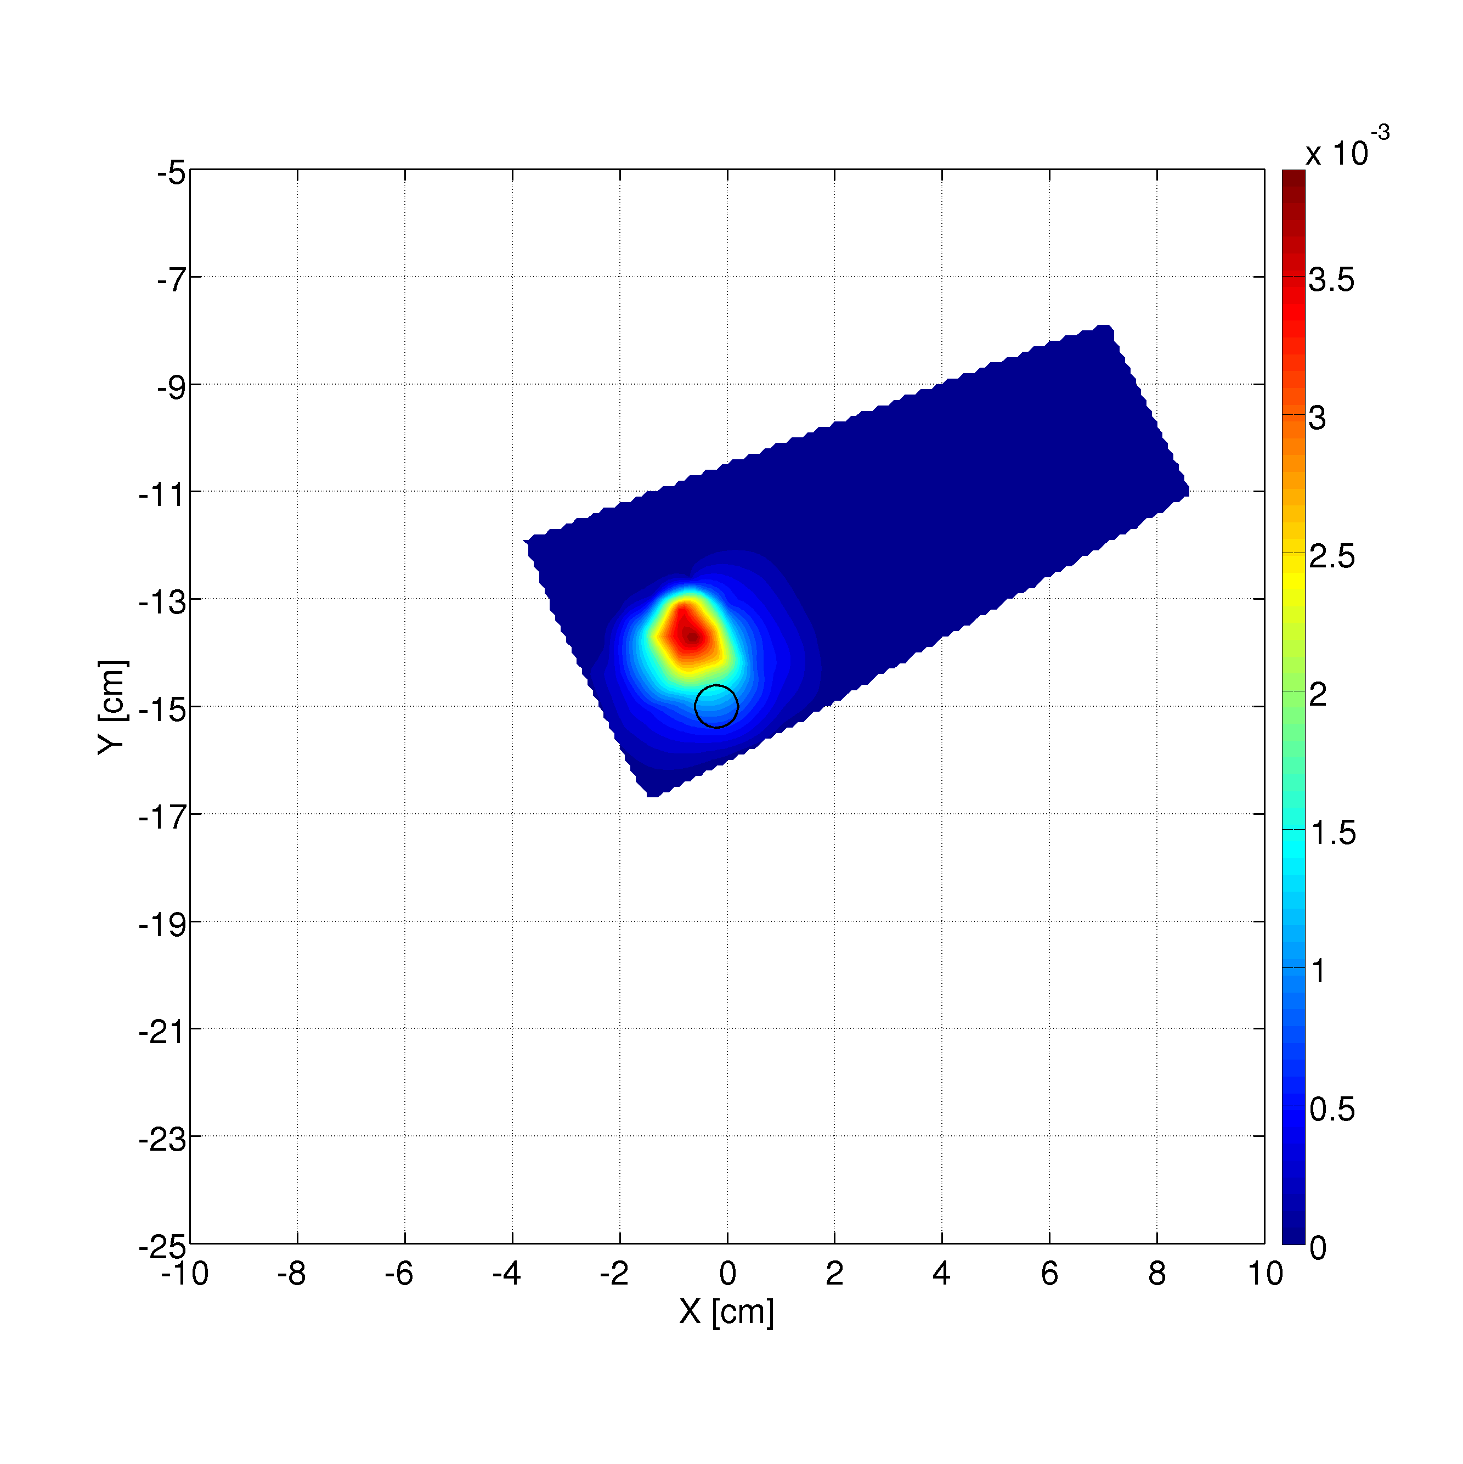
Measurements at two fast ion energies
E = 70 eV
E = 30 eV
E/T_{e} ≈ 46
E/T_{e} ≈ 20
Fast ion injection location
detector
Distance from the source = 0.2 m
source

Slide 25
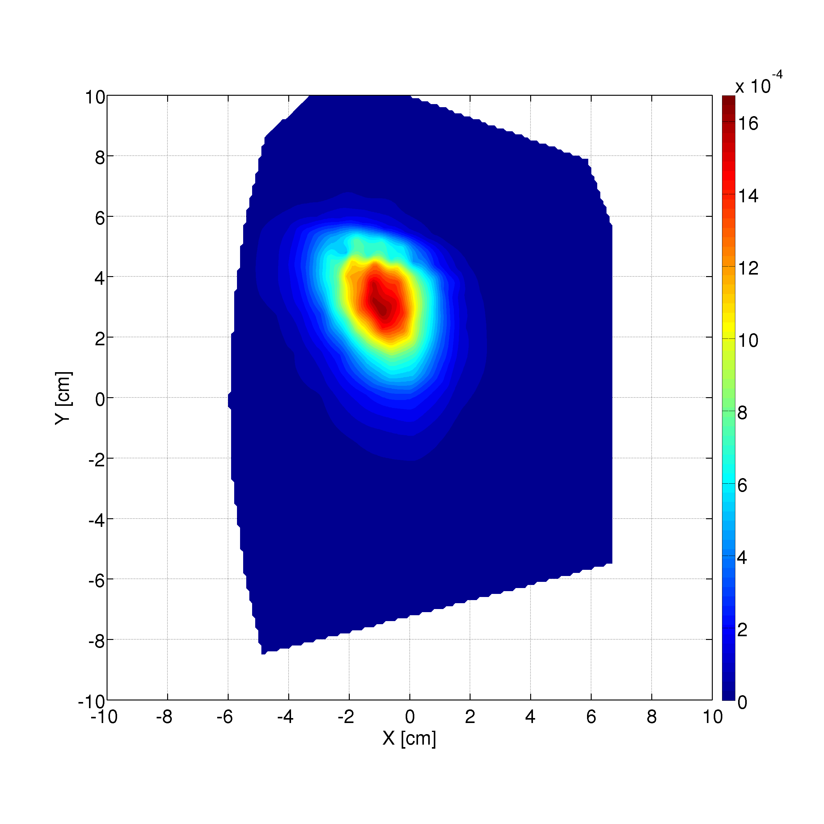
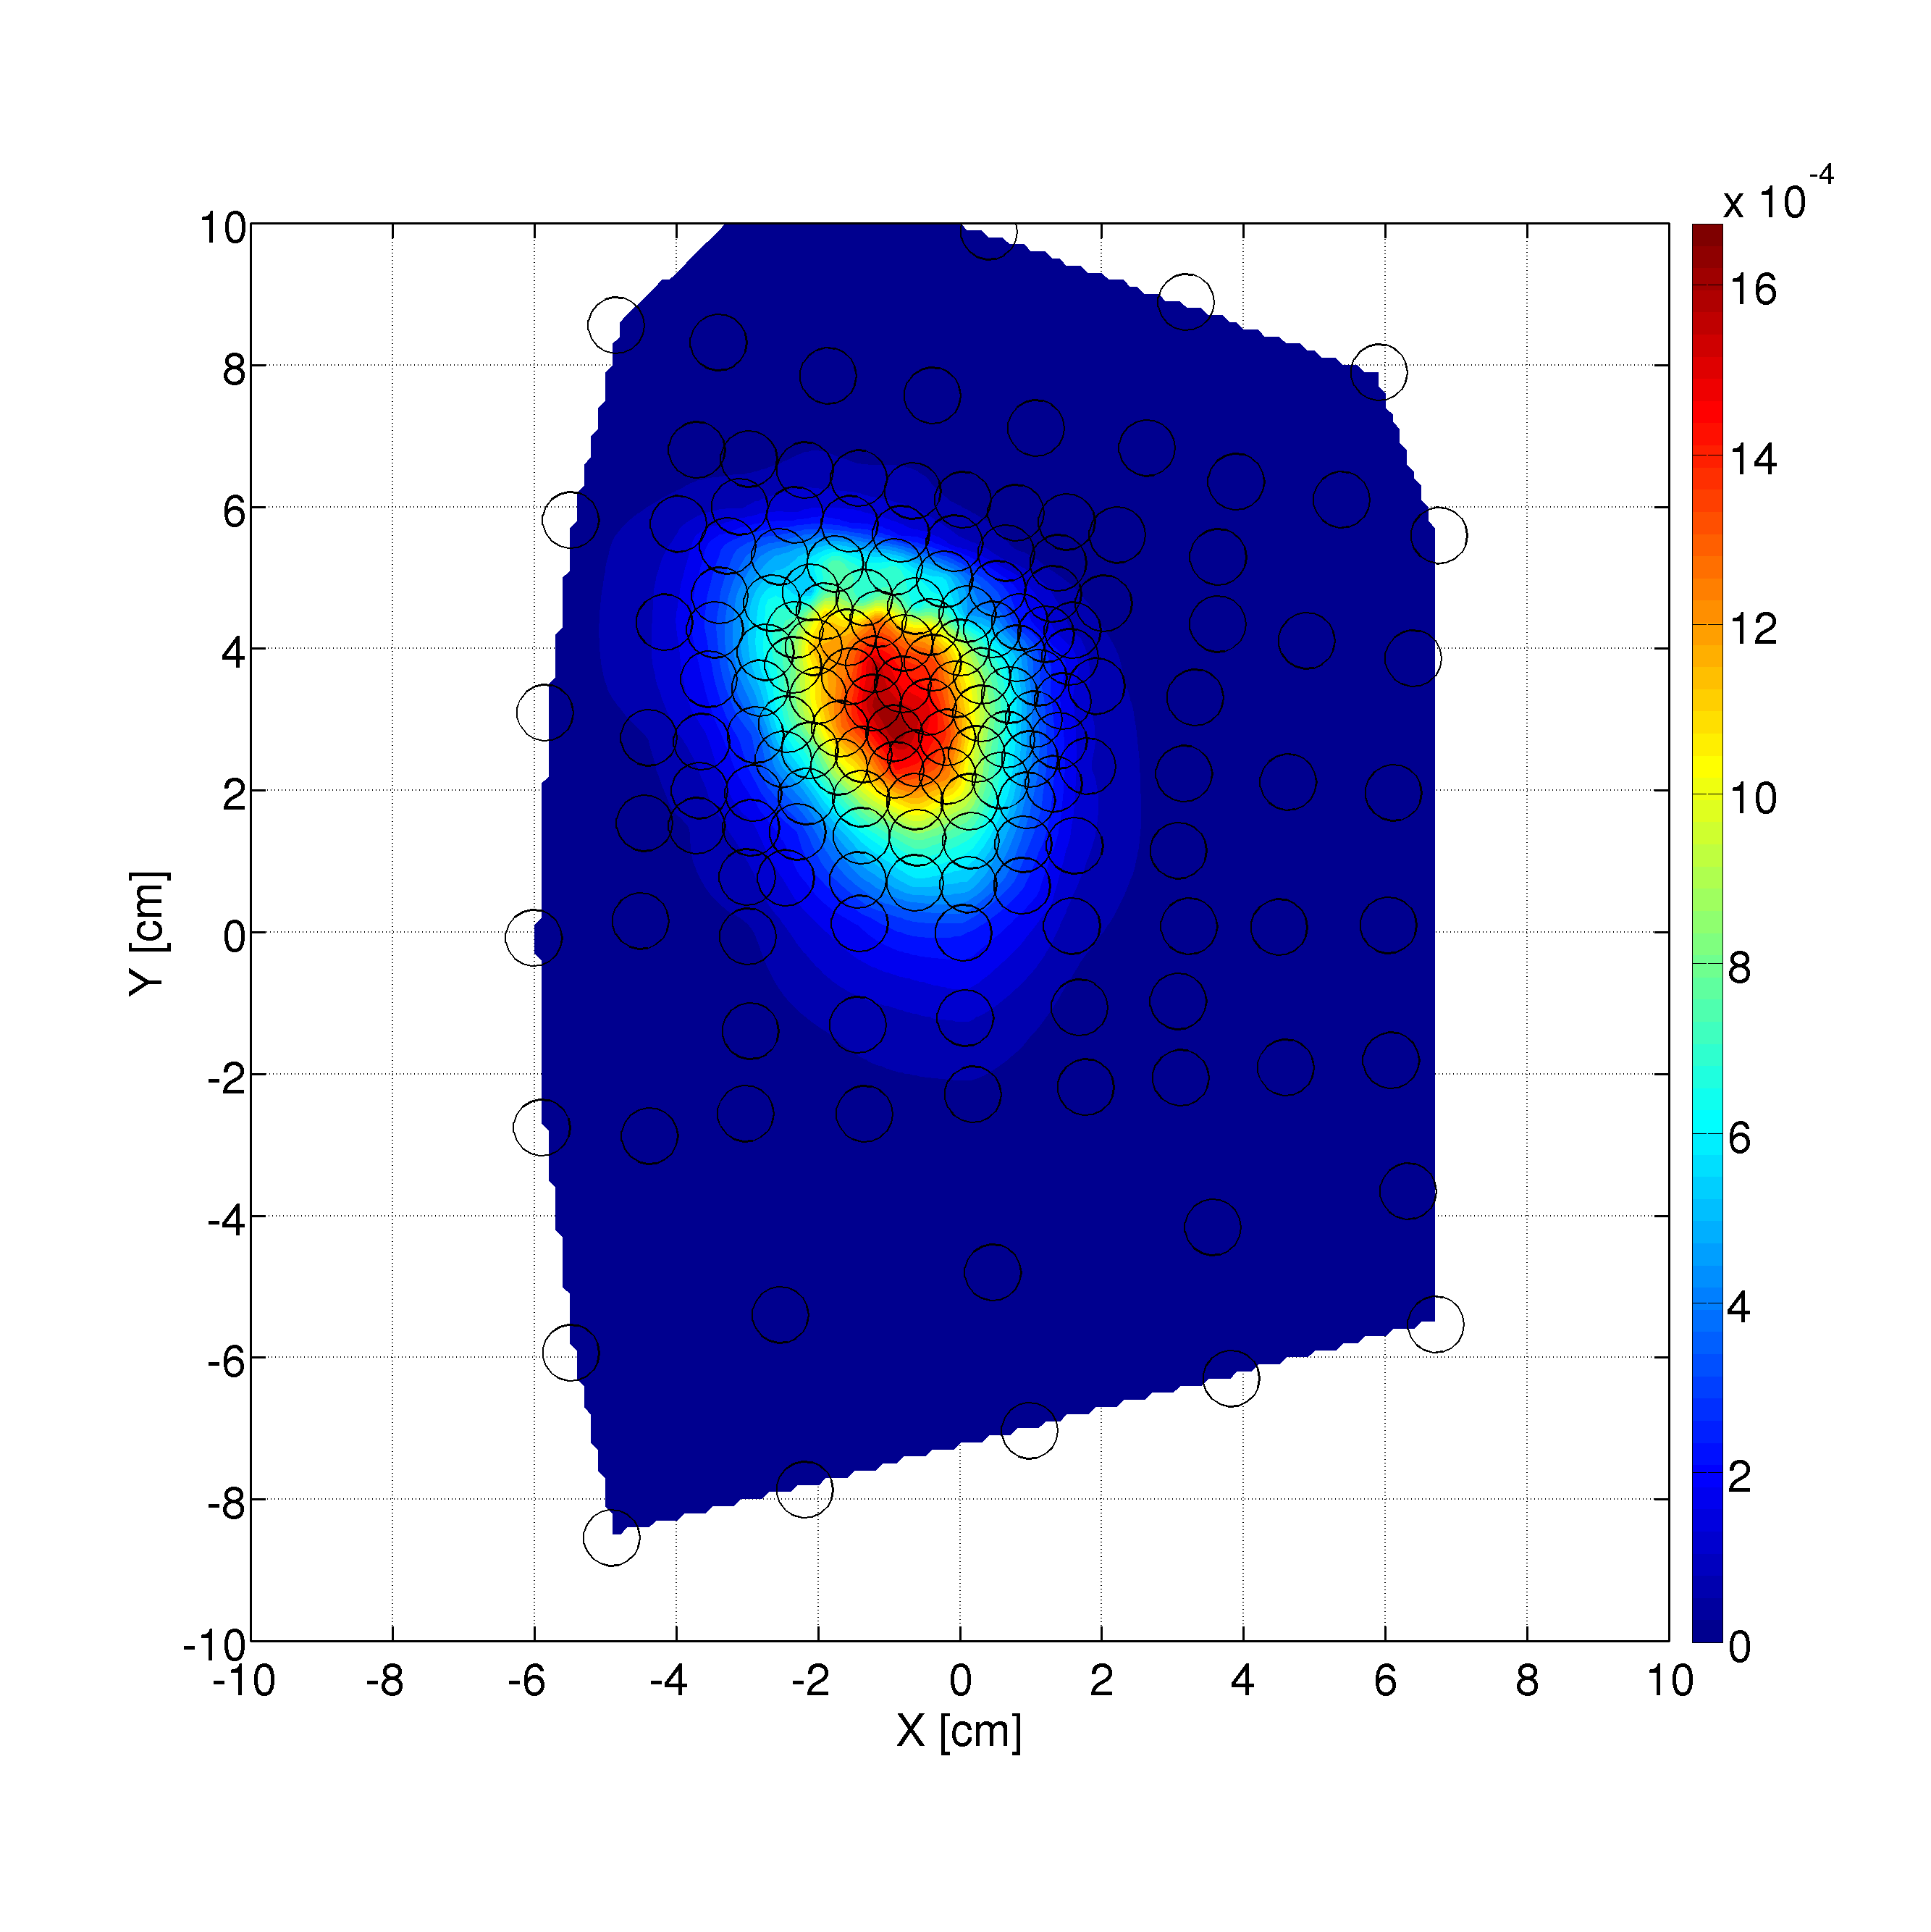
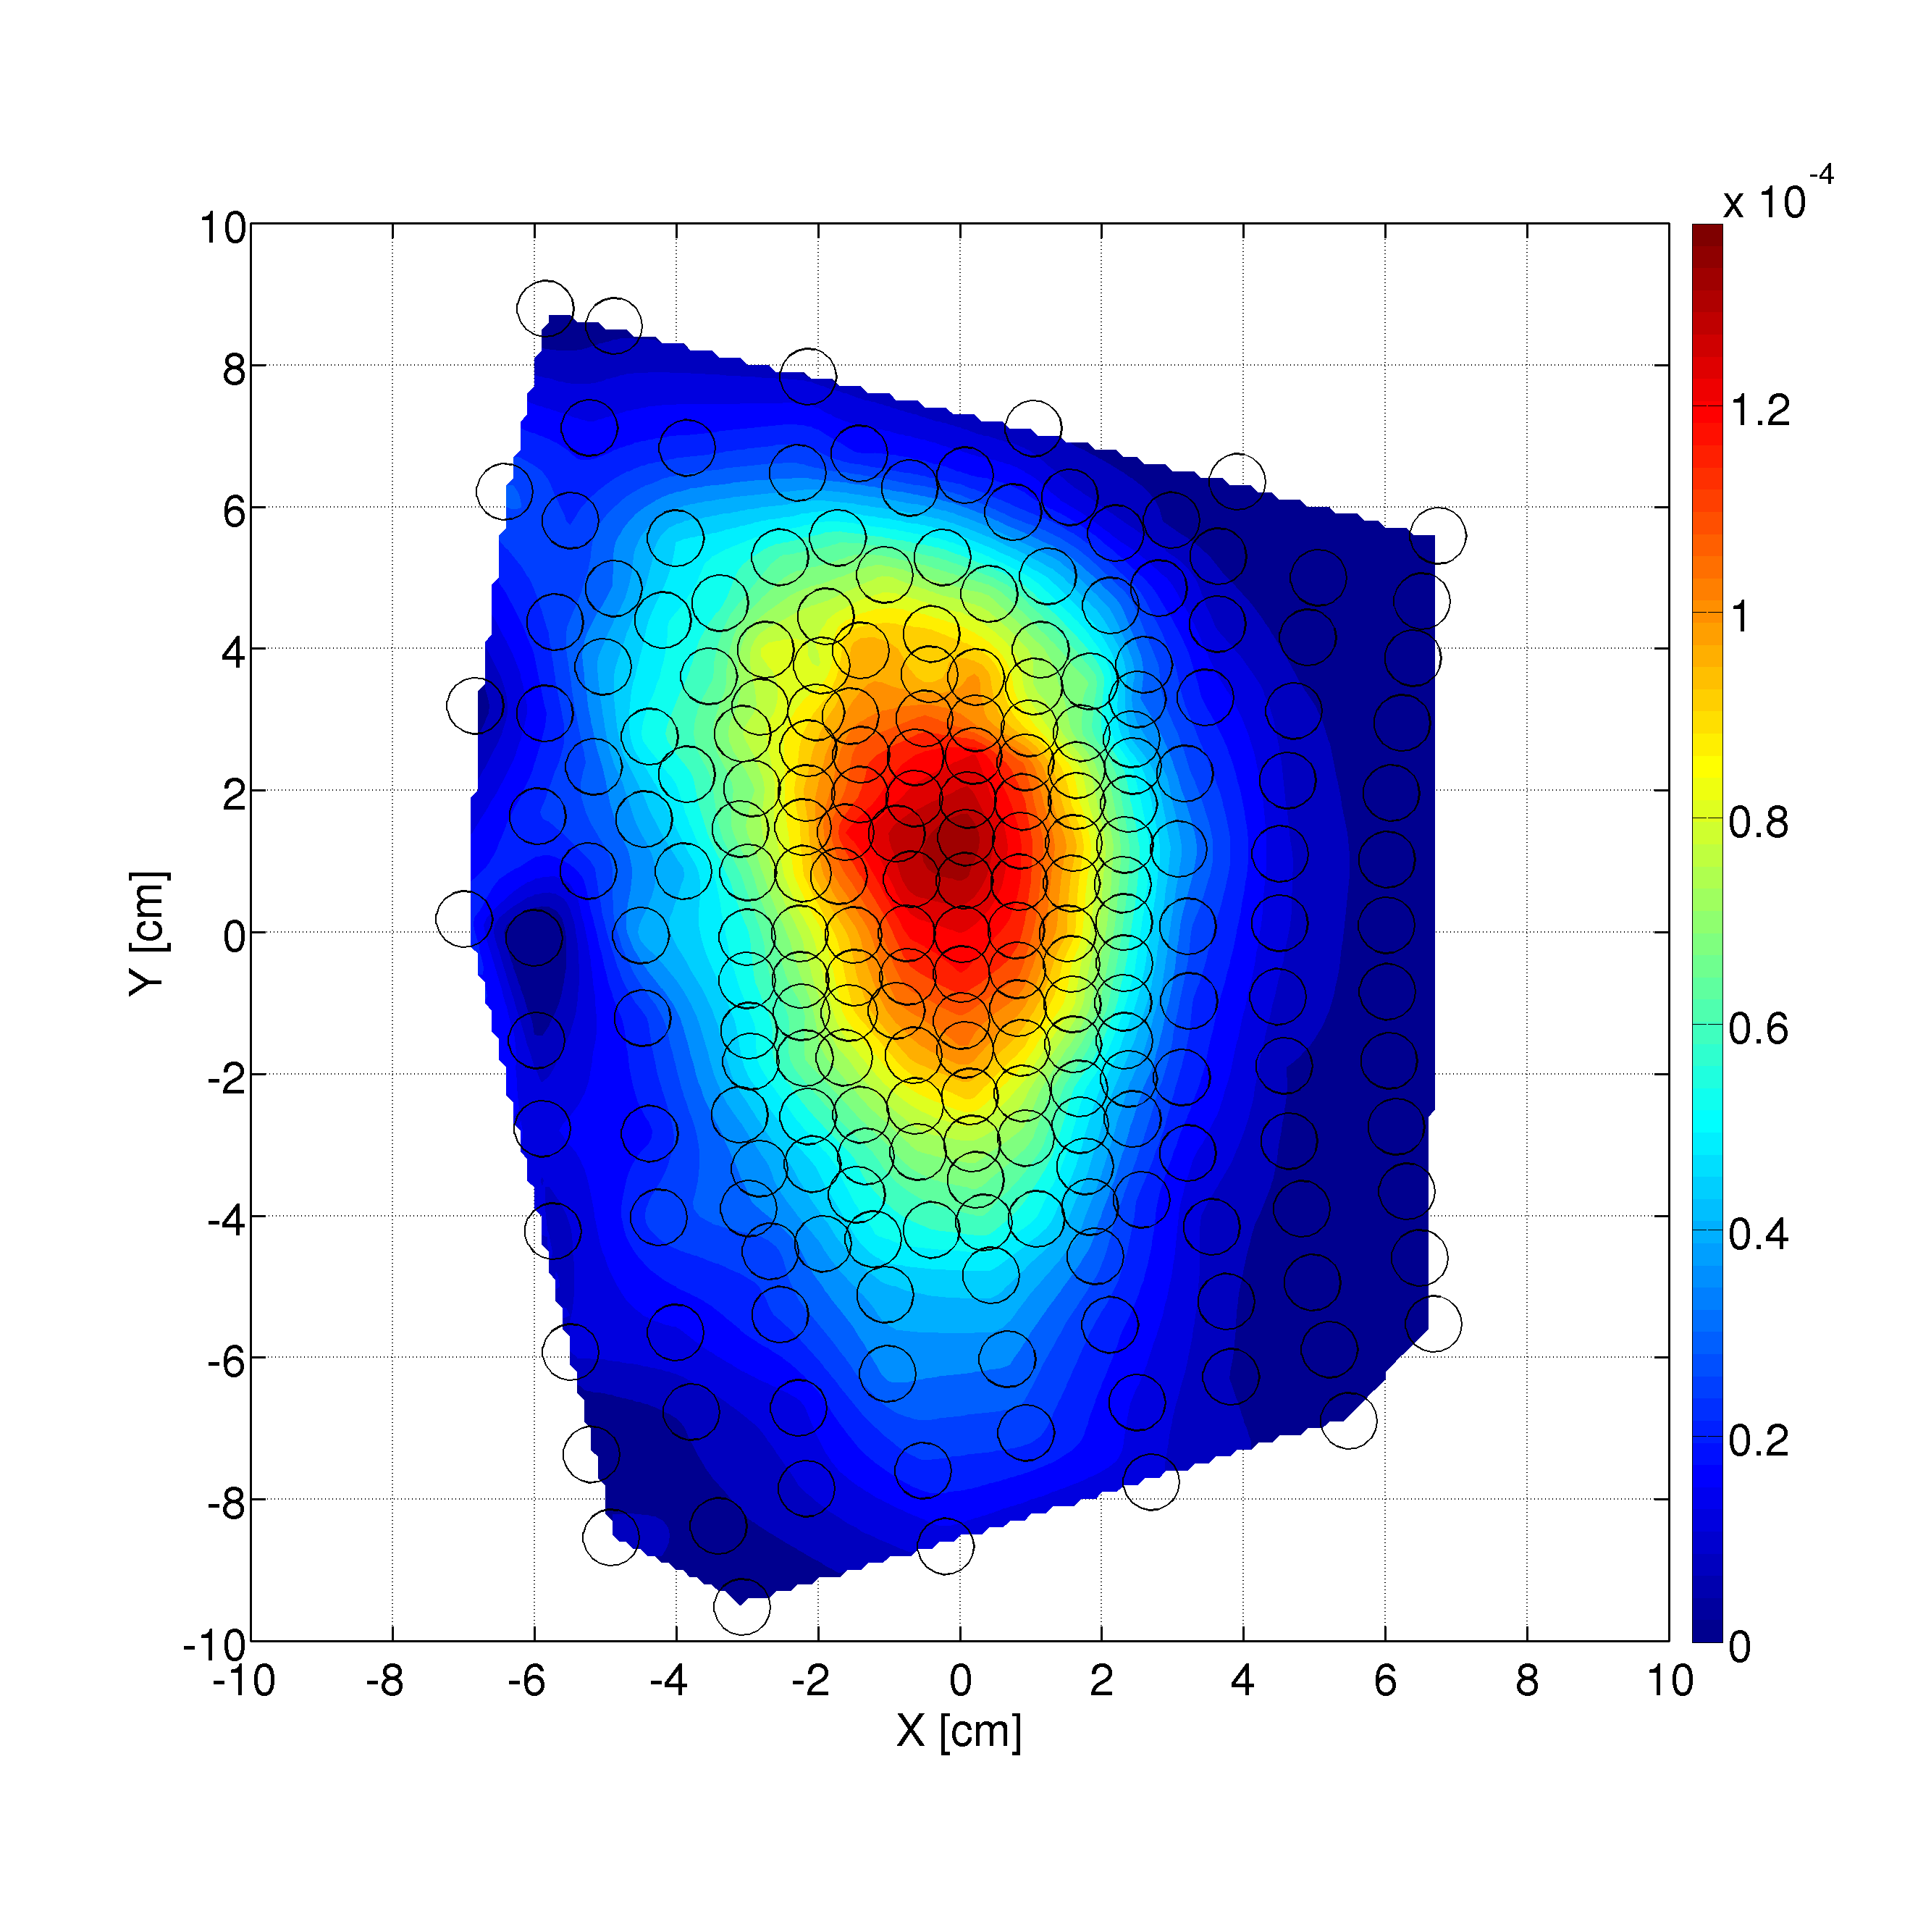
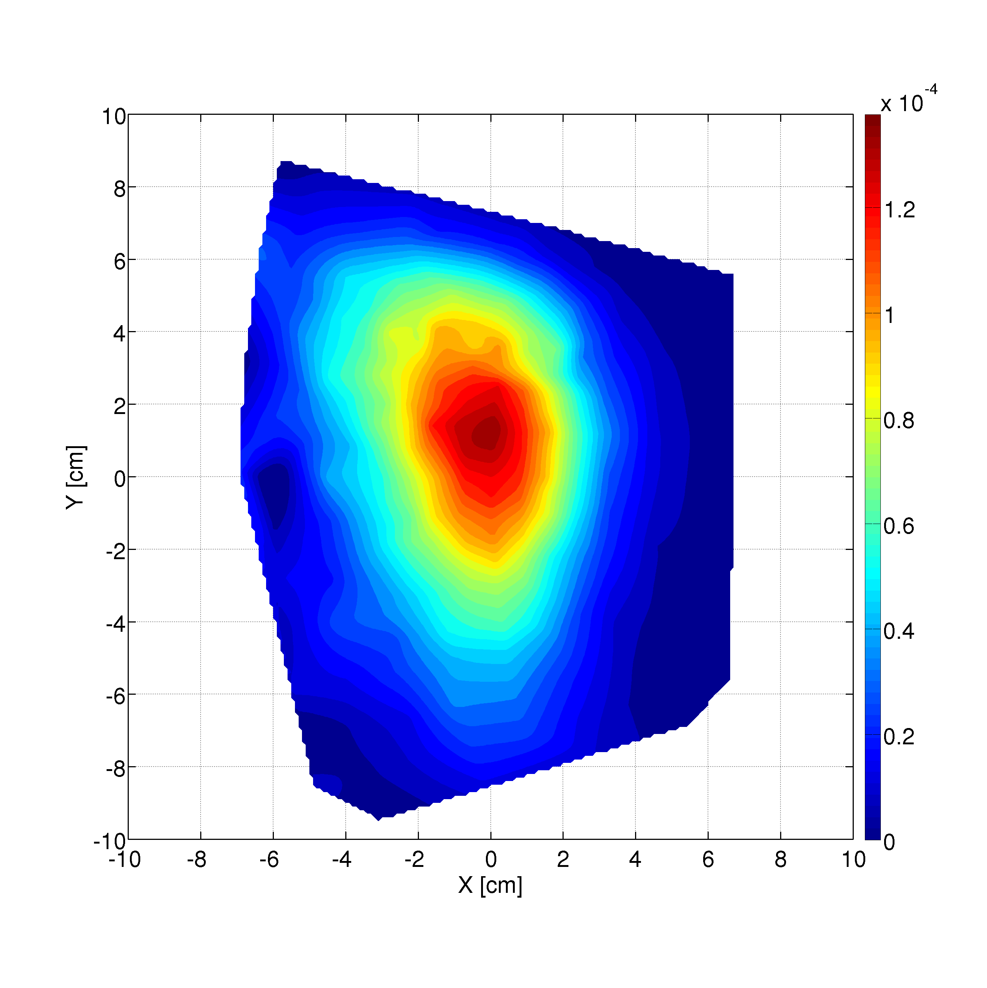
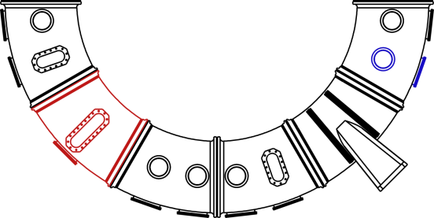
Measurements are performed at two energies
E = 70 eV
E = 30 eV
E/T_{e} ≈ 46
E/T_{e} ≈ 20
detector
Distance from the source = 2.2 m
source

Slide 26
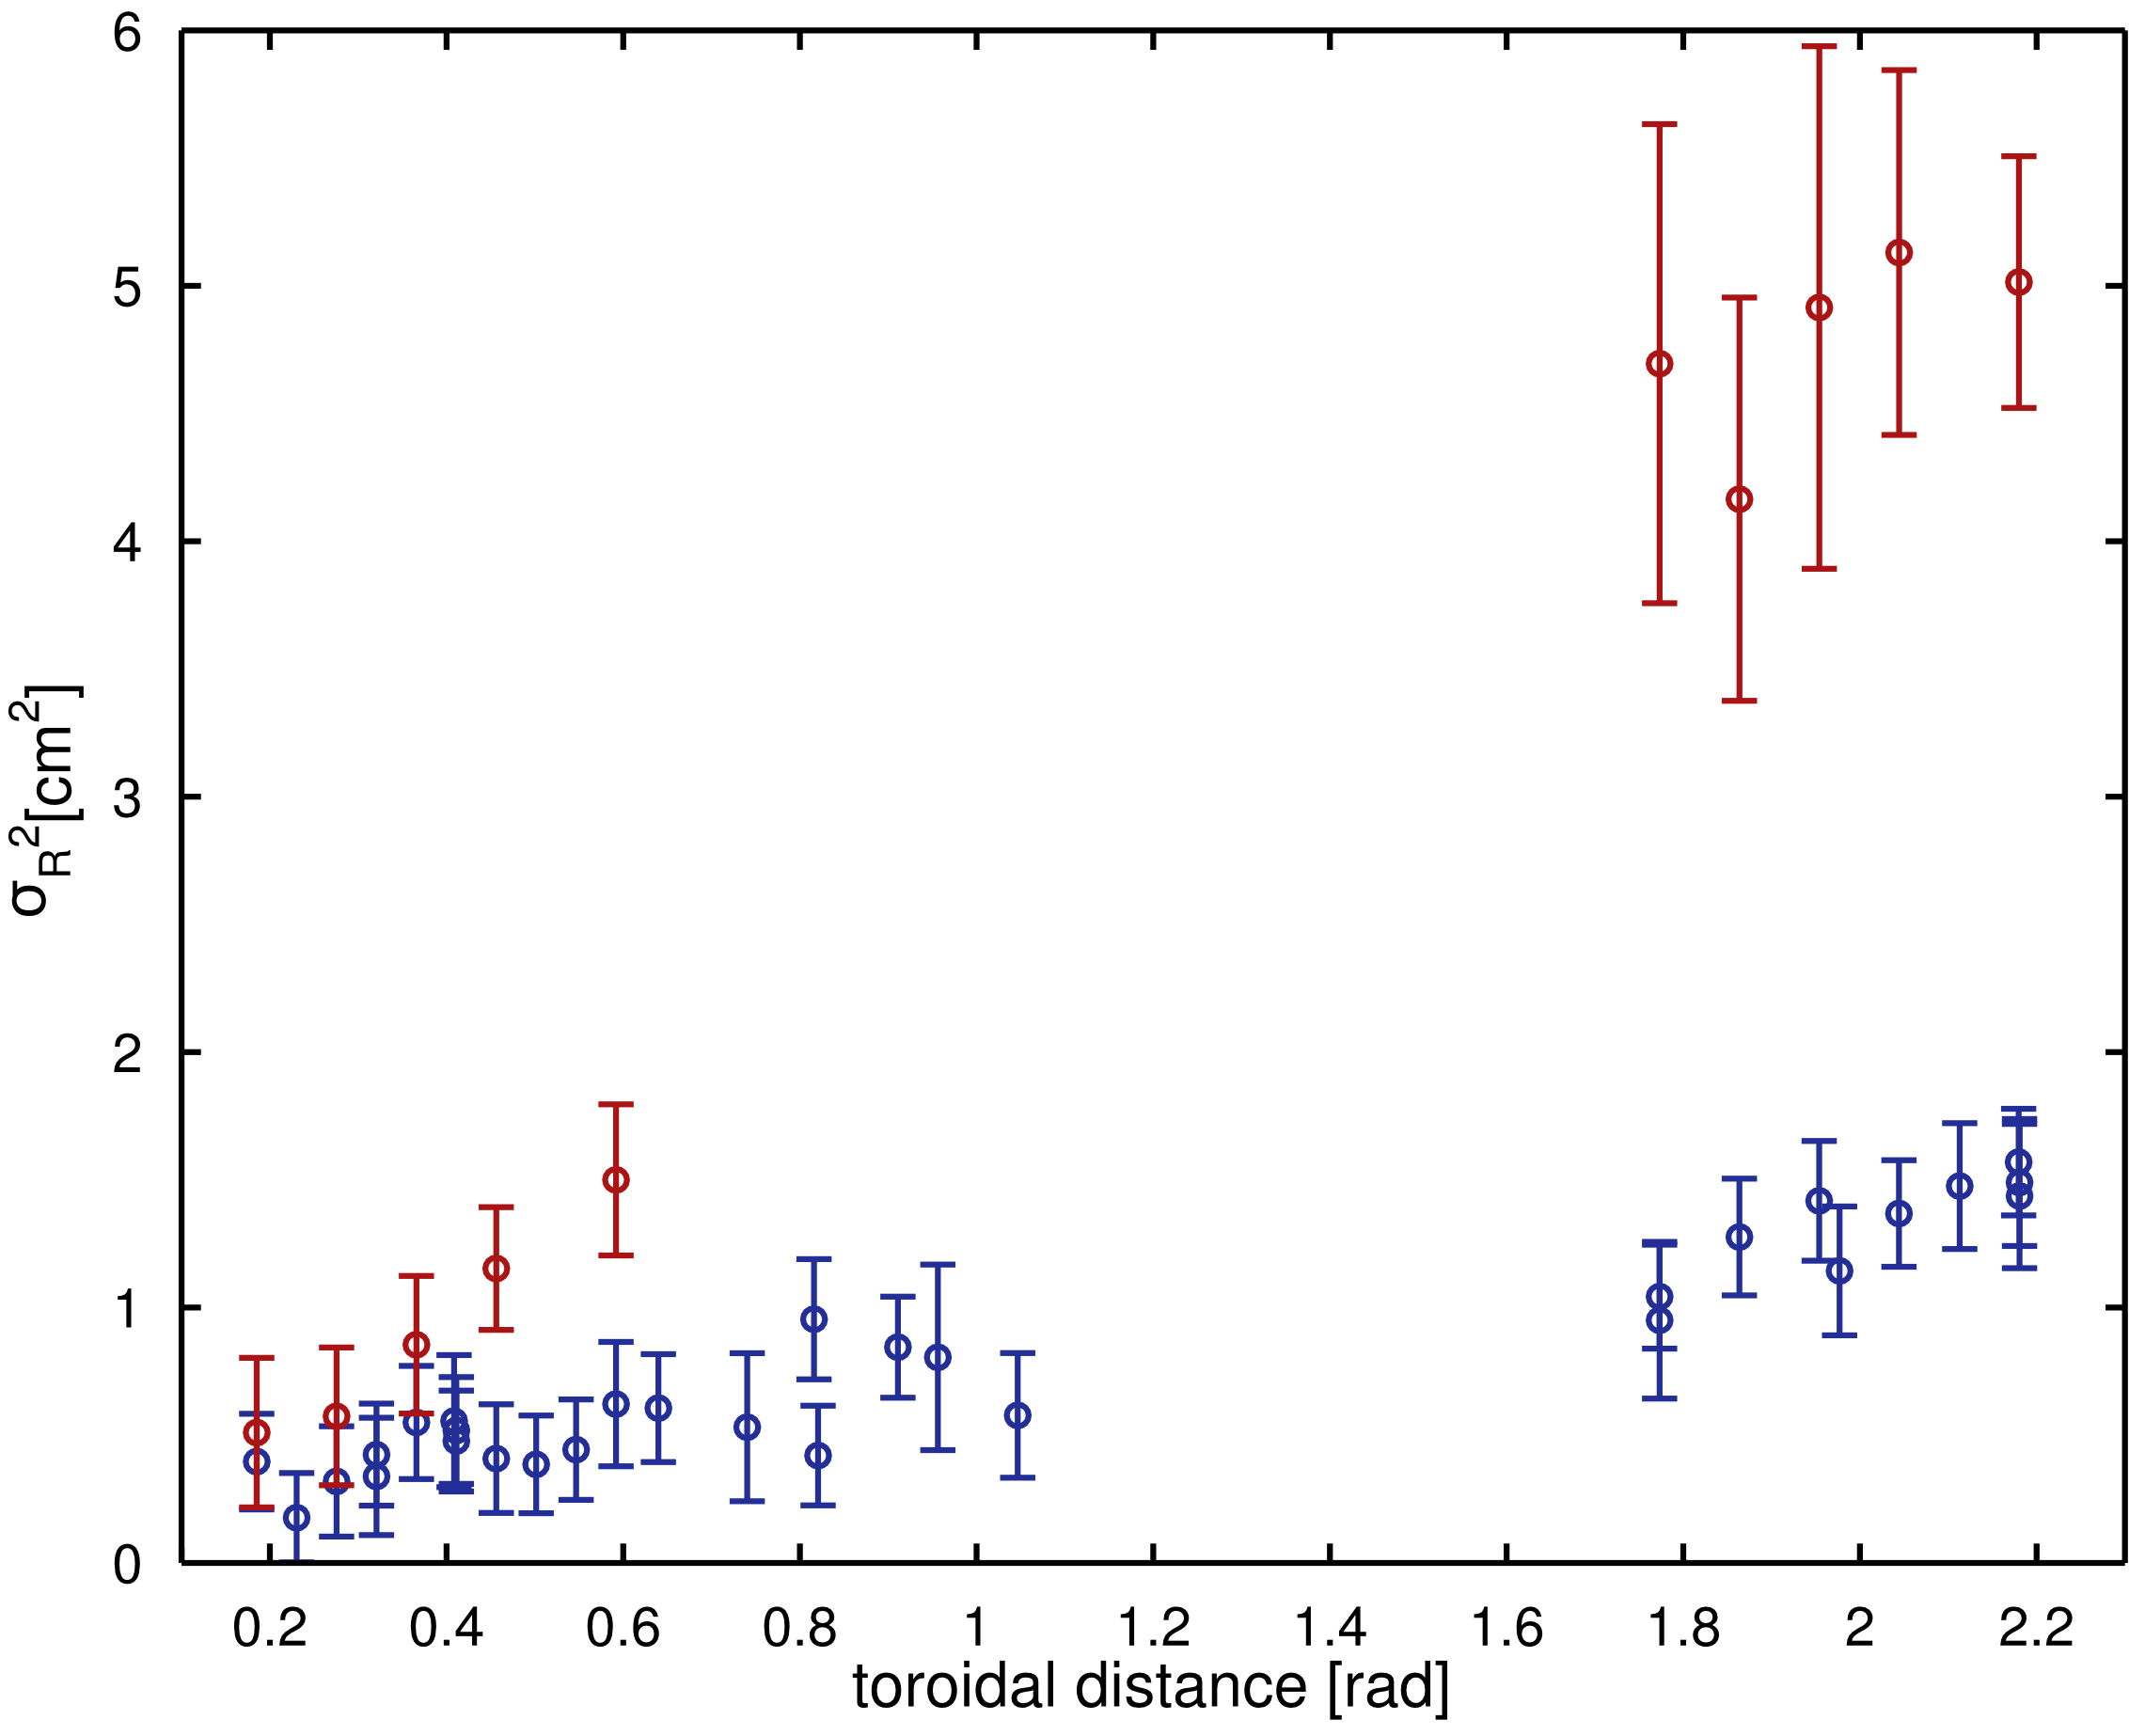
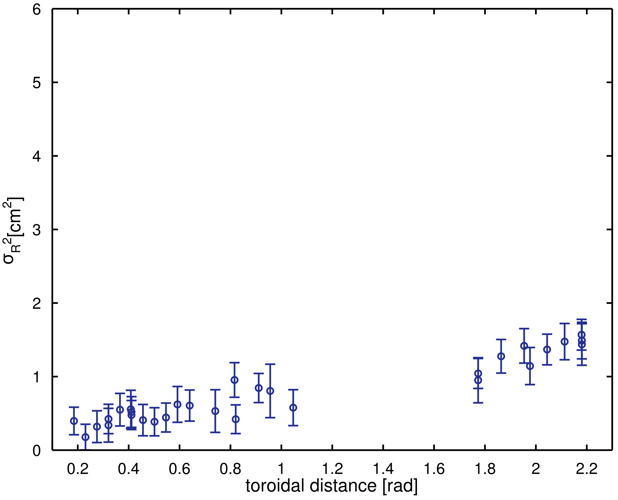
Different radial spreadings are observed for the two energies
Exp. E = 70 eV
Exp. E = 30 eV
Radial variance of the beam

Slide 27
Outline
  Motivations
  The TORPEX device and the diagnostics
  ideal interchange turbulence
  fast ions source and detector
Experimental measurements
  fast ion transport: energy dependence
Theoretical framework
  Fluid simulations
Comparison simulations – experiments
Transport regimes for fast ions
Outlook and conclusions

Slide 28
The Global Braginskii Solver (GBS) code models TORPEX plasmas
Collisional
Plasma
ρ_{i} << L, β << 1
ω << Ω_{ci}
Electrostatic
Drift-reduced Braginskii equations
Braginskii model
Parallel dynamics
Convection
Diffusion
Magnetic curvature
Source
+ similar equations for T_{e}, Ω (vorticity= )
+ parallel momentum balance for V_{||e}, V_{||i}
3D global, full code, however it is used in the 2D version since k//=0
P. Ricci et al., PoP 2009, 2011

Slide 29
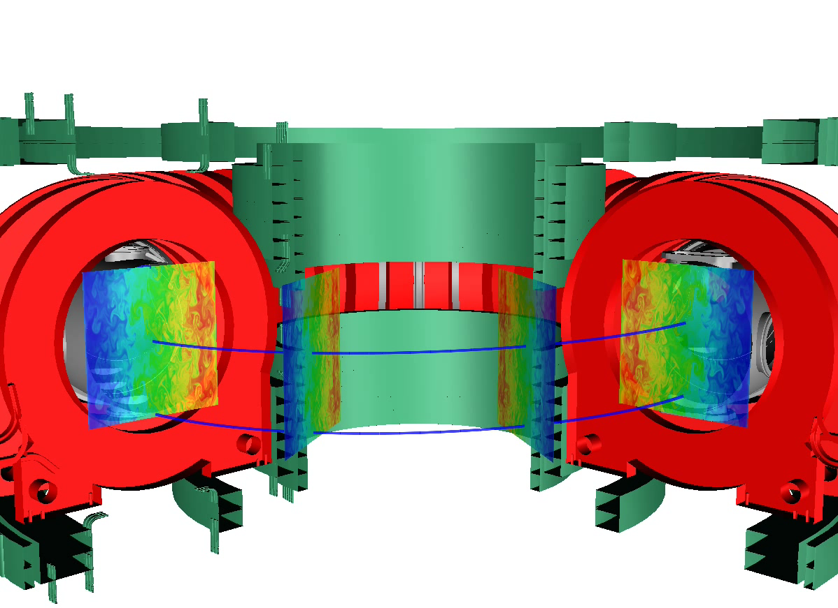
3D turbulent fields are constructed from 2D simulations
Fast ions (~10⁵ particles) are injected in the turbulent electric field.
Trajectories are computed by solving the full equation of motion

Slide 30
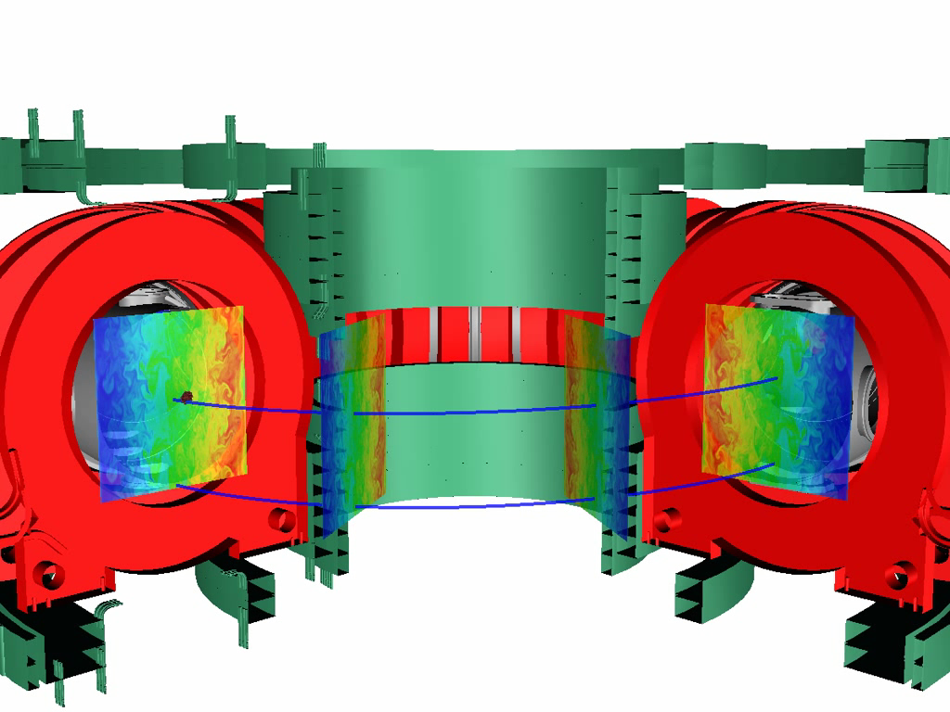
Full time dynamics of the fast ions is obtained
K. Gustafson et al, Phys. Plasmas (2012)

Slide 31
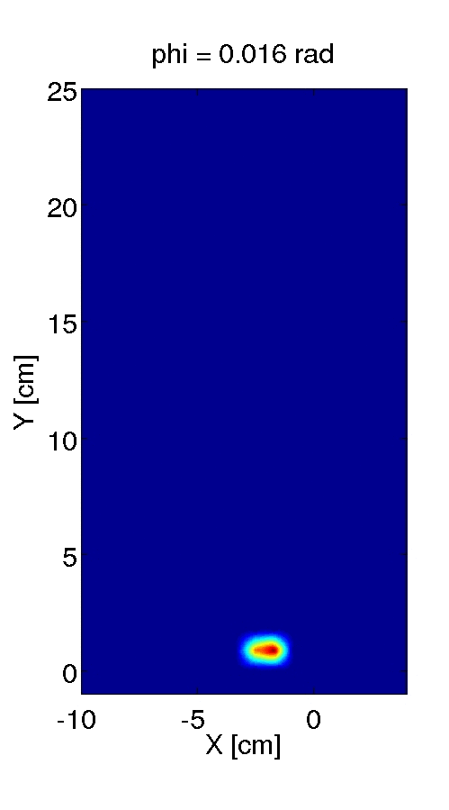
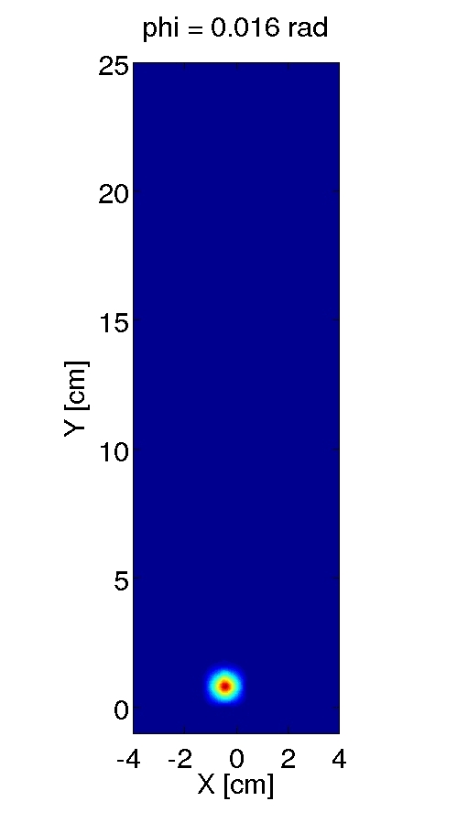
Synthetic profiles are reconstructed from simulations
E = 70 eV
E = 30 eV
Toroidal position

Slide 32
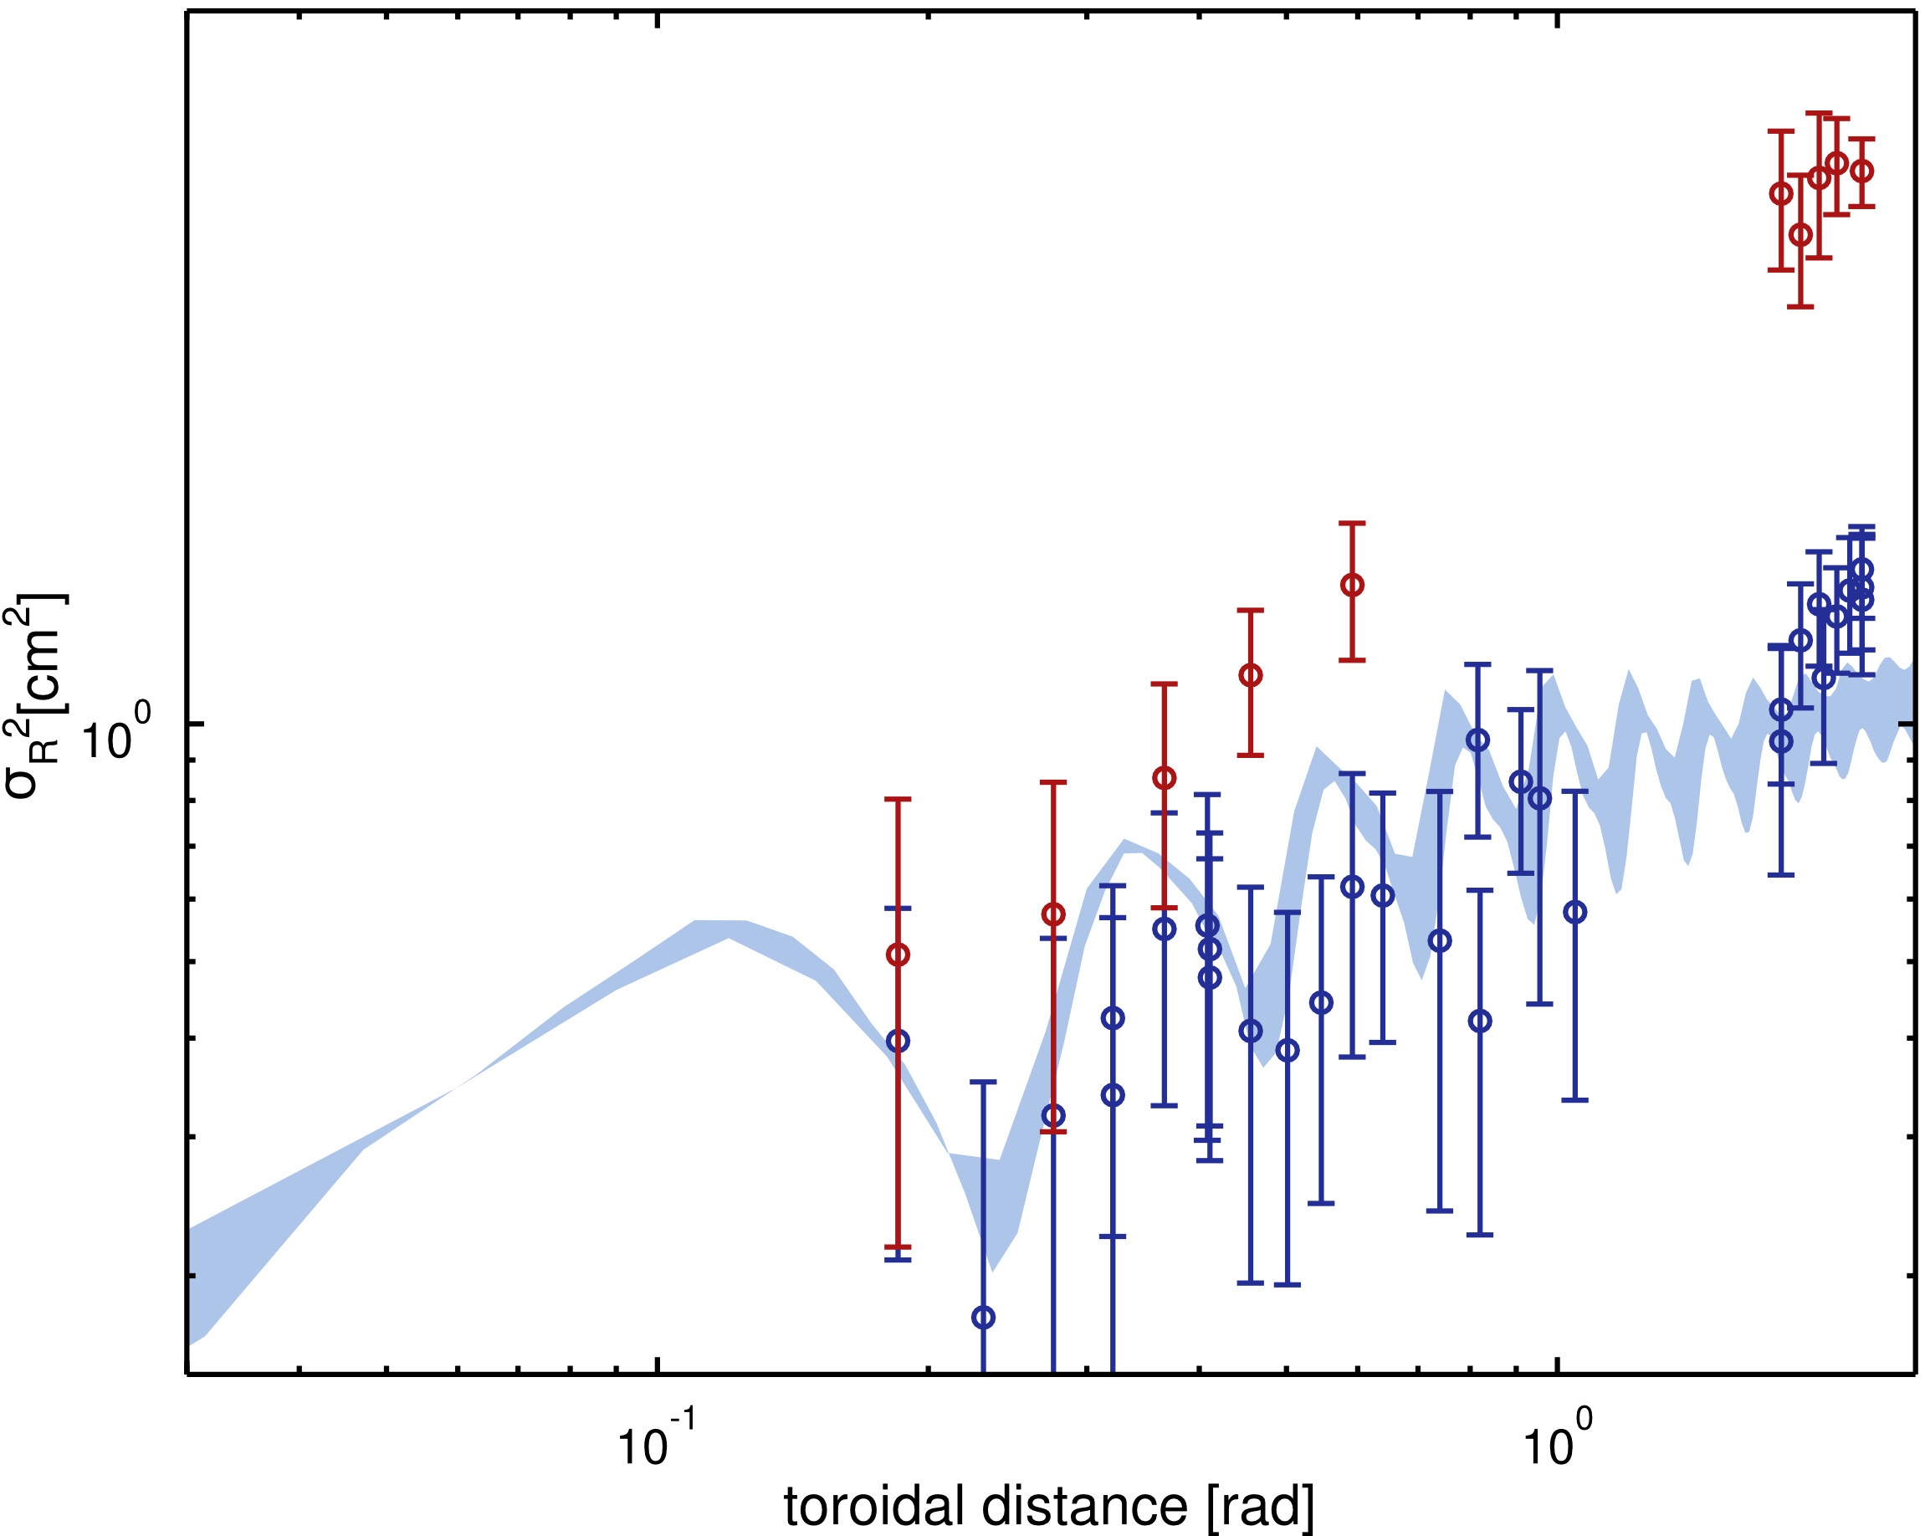
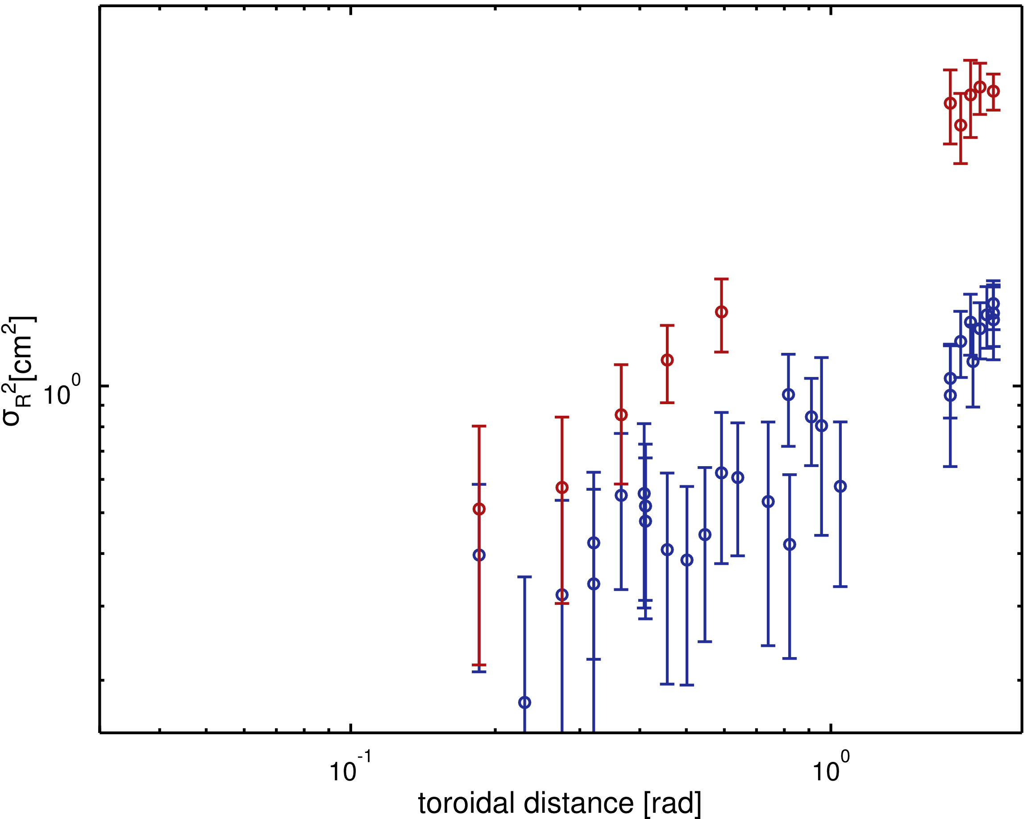
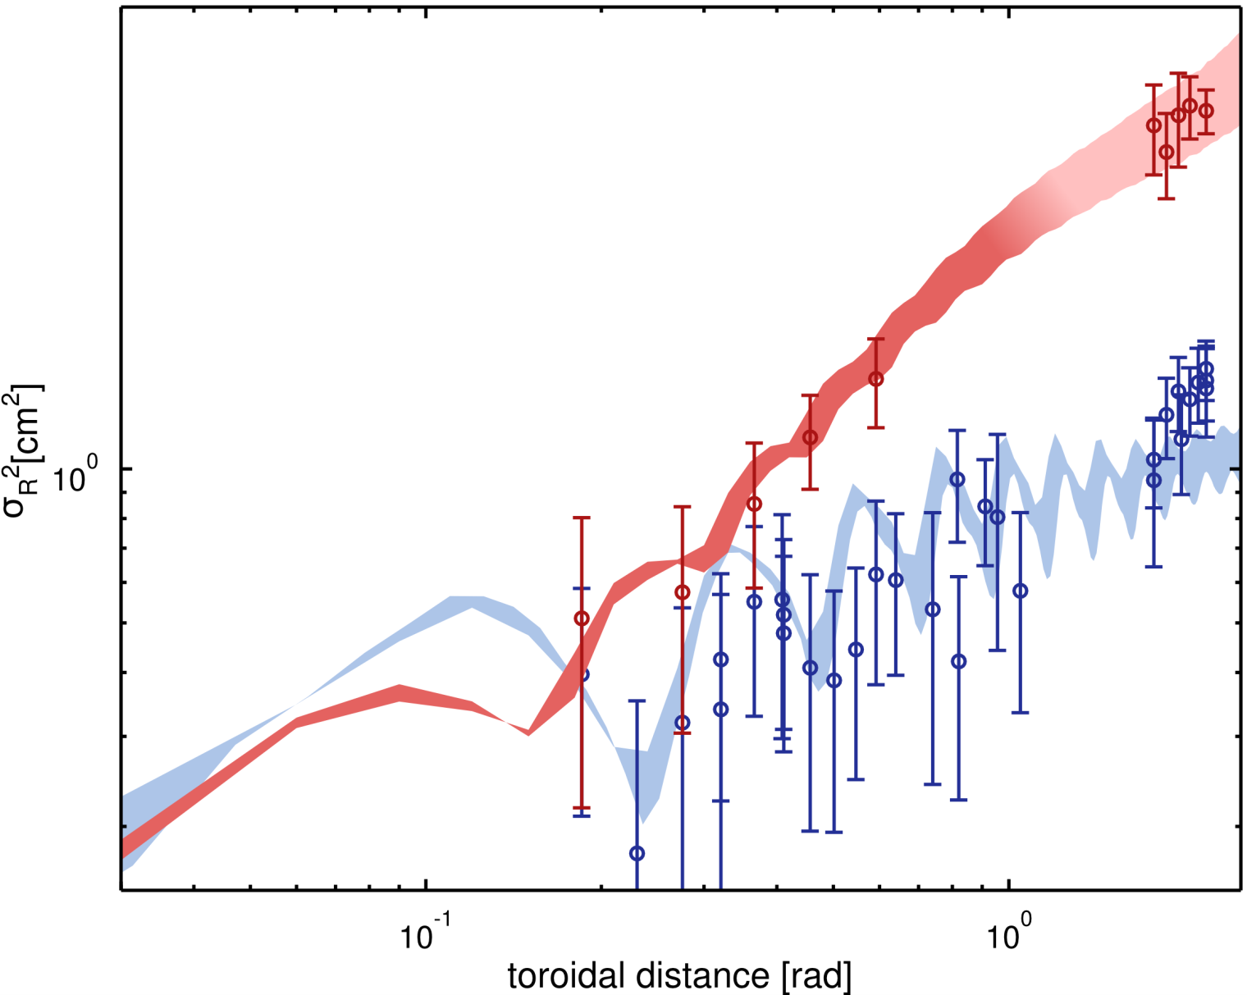
Simulations and experiments are in good agreement
Exp. E = 70 eV
Exp. E = 30 eV
Synthetic diagnostic 30 eV
Synthetic diagnostic 70 eV

Slide 33
Outline
  Motivations
  The TORPEX device and the diagnostics
  ideal interchange turbulence
  fast ions source and detector
Experimental measurements
  fast ion transport: energy dependence
Theoretical framework
  Fluid simulations
Comparison simulations – experiments
Transport regimes for fast ions
Outlook and conclusions

Slide 34
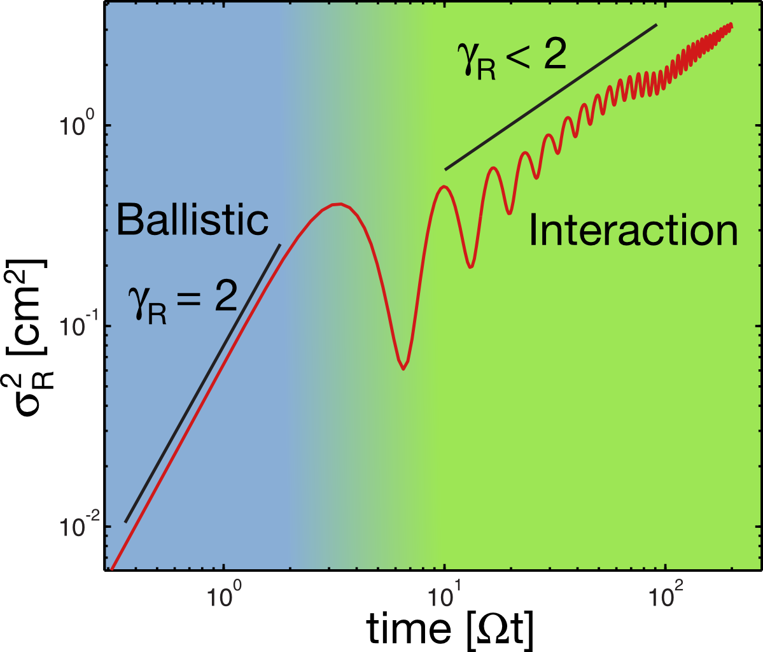
Transport is characterized by the radial variance

Slide 35
Different transport regimes are revealed
“super-diffusive”
E = 70 eV
E = 30 eV
γ_{R}~1.3
“sub-diffusive”
γ_{R}~0.38

Slide 36
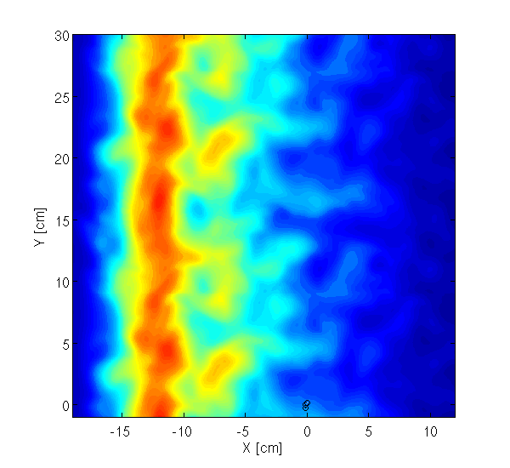
A look at trajectories suggests mechanisms for reducing transport
E = 20 EV
E = 70 EV
Parallel injection
E= 70 EV
45 deg. injection

Slide 37
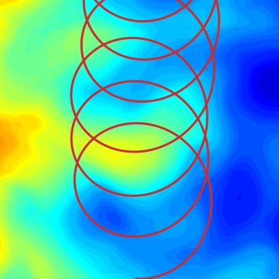
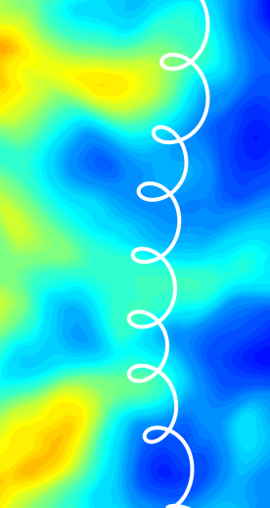


Gyro- and drift-averaging can reduce the radial transport
Gyroaveraging: large Larmor orbits smooth out electrostatic turbulence
k_{perp} ρ~2
Drift-orbit averaging: vertical motions smooth out electrostatic turbulence
τ_{x}\τ_{y}~5
K. Gustafson et al, PRL 2012

Slide 38
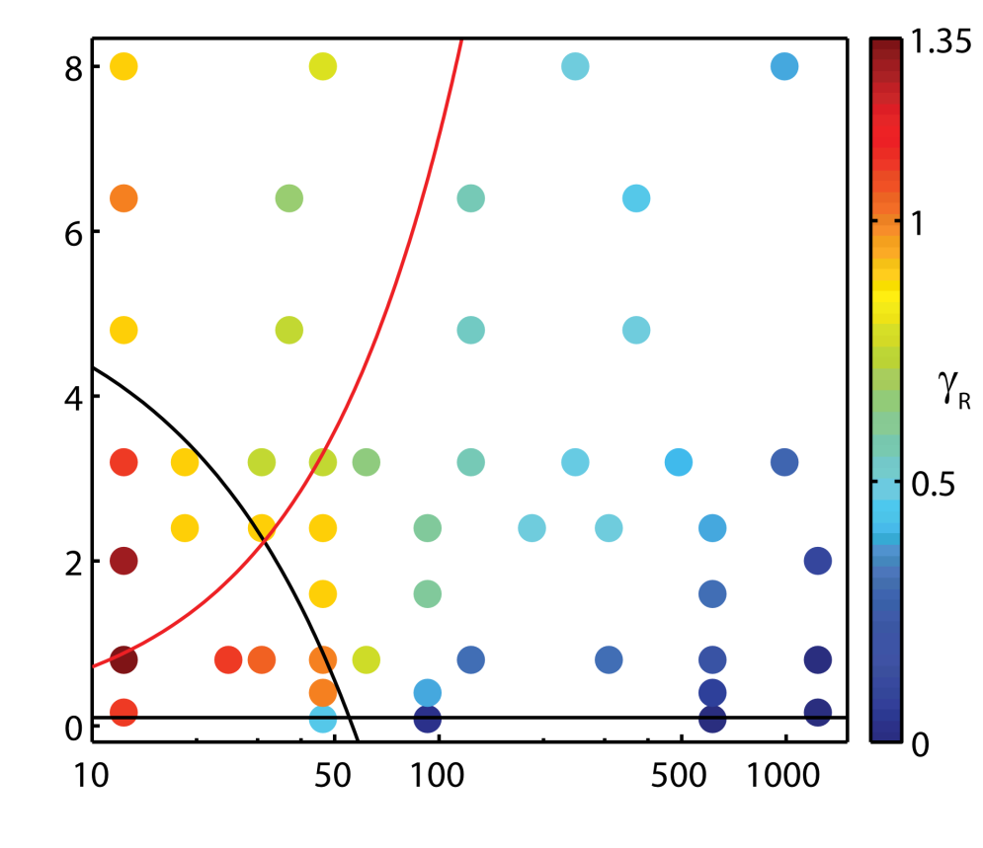
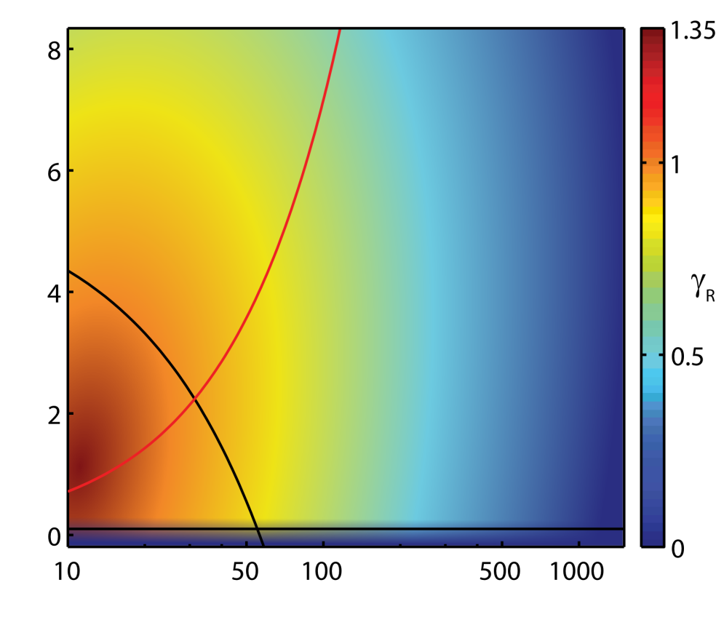

Transport regime is determined by E/T_{e} and turbulence amplitude
Drift-averaging
condition
Normalized fluctuations
amplitude (eΦ/T_{e})
τ_{x}/τ_{y} ∼ 5
Gyroaveraging
condition
k_{perp} ρ~2
Normalized energy (E/T_{e})

Slide 39
Outline
  Motivations
  The TORPEX device and the diagnostics
  ideal interchange turbulence
  fast ions source and detector
Experimental measurements
  fast ion transport: energy dependence
Theoretical framework
  Fluid simulations
Comparison simulations – experiments
Transport regimes for fast ions
Outlook and conclusions

Slide 40
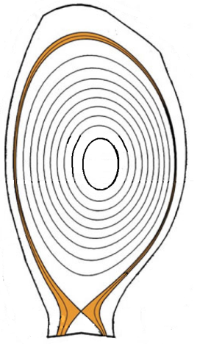
SMTs have similarities with tokamak SOLs
Scrape-Off Layer
open field lines
B and curvature
Plasma current
Last Closed Flux Surface
magnetic topology change

Slide 41
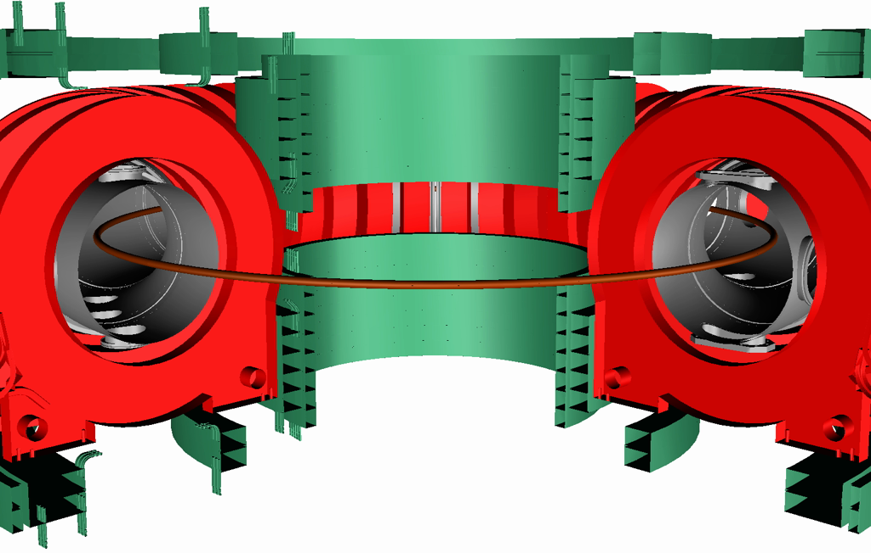
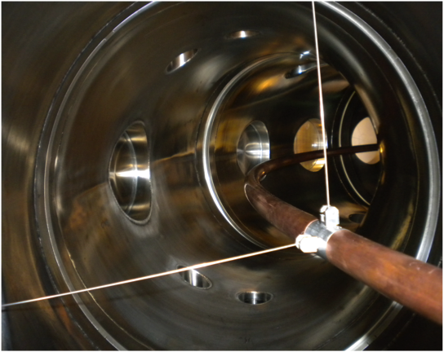
TORPEX 2013 and beyond (just getting started)
Current
1kA-10V supply; flat top ~1s, I_{conductor}~1kA; ~100 discharges/day

Slide 42
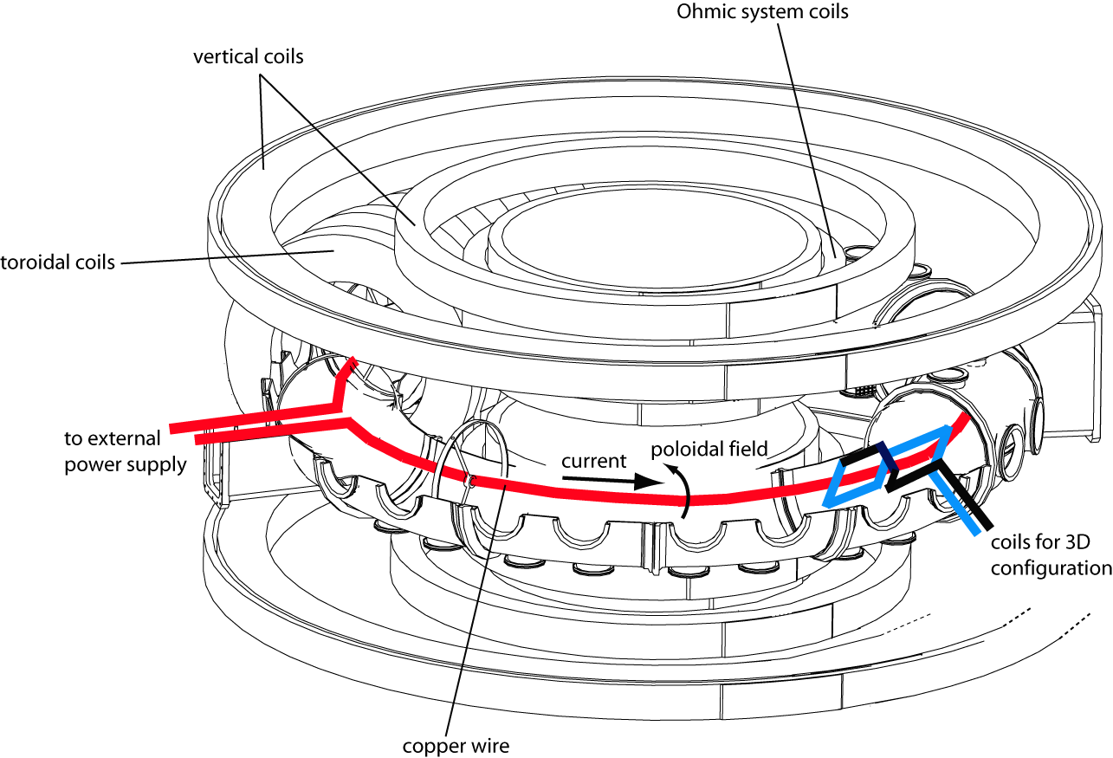
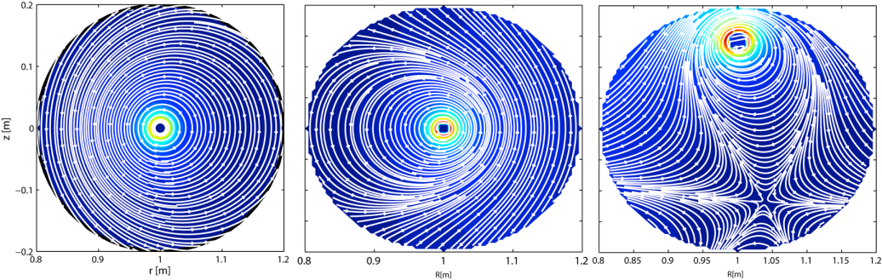
New exciting possibilities to study fast ion physics
Confined plasmas
Alfven wave
Snowflakes
X-point physics
Ripple, 3D, ergodic fields

Slide 43
Conclusions
  Simple plasma devices, such as TORPEX, offer great possibilities to investigate the fundamentals of fast ion – turbulence physics.
On TORPEX, numerical simulations and experiments reveal that different regimes for fast ion transport are possible depending on their energy and turbulence amplitude.
Gyro- and drift-averaging can effectively reduce turbulent transport.
Upcoming TORPEX experiments will explore more complex magnetic geometries of direct relevance to tokamaks.

