Slide 1
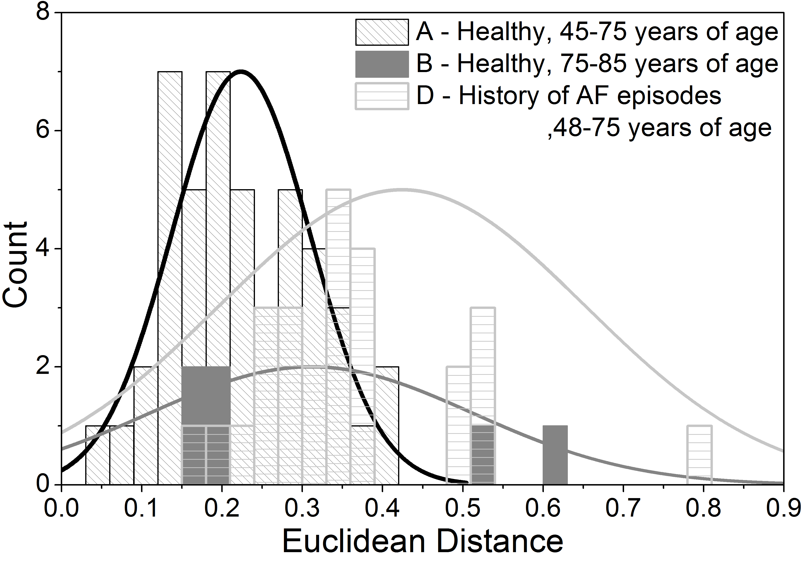
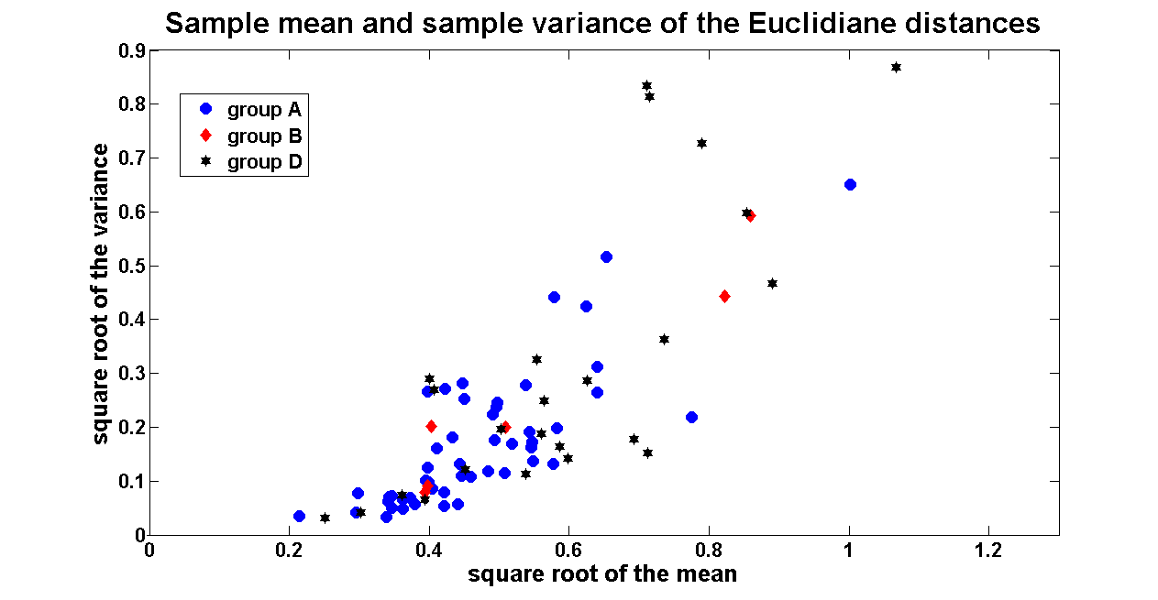
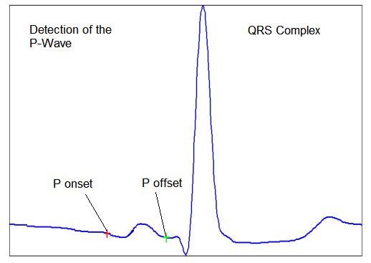
Markers for risk to develop atrial fibrillation based on a new electrocardiographic tool Alain Viso¹, Marta Aceña², Remo Leber³, Aline Cabasson⁴, Roger Abächerli³, Lukas Kappenberger⁵, Angelo Auricchio², Jean-Marc Vesin¹ ¹École Polytechnique Fédérale de Lausanne, ²Cardiocentro Ticino, ³SCHILLER AG, ⁴Université Nice Sophia Antipolis, ⁵Lausanne Heart Group, Lausanne, Switzerland
Goal
Early recognition of patients prone to atrial fibrillation
Analysis of P wave features on lead V1 during sinus rhythm
Results
Measurements | Group A | Group B | Group D
Heart rate (bpm) | 61 ± 9 | 58 ± 4 | 62 ± 10
P wave duration (ms) | 124 ± 18 | 132 ± 17 | 131 ± 25
P-R interval (ms) | 200 ± 22 | 230 ± 30 | 209 ± 49
Variance of the beat-to-beat Euclidean distance | 0.22 ± 0.09 | 0.31 ± 0.20 | 0.42 ± 0.22
Method
Analysis of 68 ECGs 5 minutes long recorded in sinus rhythm and at sampling frequency of 1 KHZ was performed
48 from group A are healthy patients aged between 45 and 75
6 from group B are healthy patients aged between 75 and 85
29 from group D are patients with history of AF aged between 48 to 72 (prone to AF)
Preprocessing
Baseline drift was removed by means of median filters
R waves were detected using a threshold technique
P waves were searched in a window of 200 ms starting 300 ms before the R wave.
P onsets and ends were obtained using first and second derivative estimates
P wave features extracted on V1
P onset
P wave offset
P width (P onset – end of P wave)
Summary of the results
Using P-R interval and the P width features, no significant differences between the groups were obtained
The variance of the beat-to-beat P-wave Euclidean distance was higher for the group D than for the other two groups (p<0.001). This may be indicative of disturbed conduction in the atrial tissue leading to differences in the electrical pathway used by the P-wave
Plotting the square root of the mean vs square root of the variance of the Euclidean distance we can identify 2 different clusters between healthy and prone to AF subjects
P-R interval (P onset – peak of R wave)
Euclidean distance between beat-to-beat resynchronized P waves
Conclusion
This study provides a valuable marker (beat-to-beat Euclidean distance) to perform a good detection of people prone to AF

