Slide 1
One-to-n Scrip Systems for Cooperative Privacy-Enhancing Technologies
EPFL - Laboratory for Communications and Applications (LCA1)
Allerton 2011
September 28
Mathias Humbert, Mohammad Hossein Manshaei, and Jean-Pierre Hubaux

Slide 2
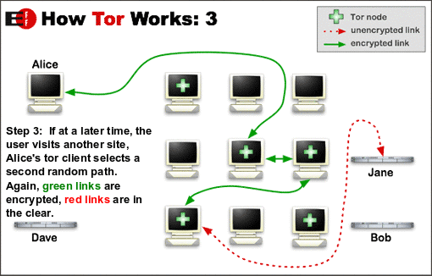
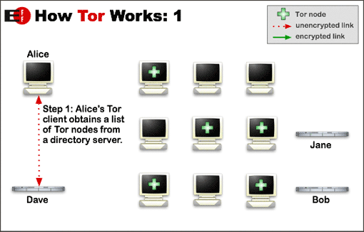
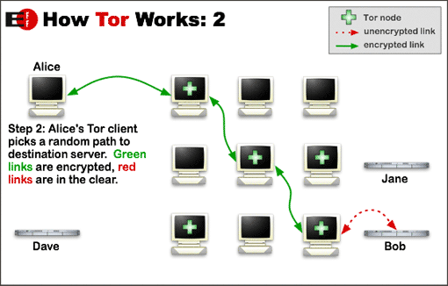
Privacy-Enhancing Technologies (PETs)
Tor/anonymity networks [1]
Client software + network of servers/relays
Protect users’ personal freedom and privacy by keeping their Internet activities from being monitored
E.g., used to circumvent censorship in dictatorial countries; dramatic increase in Tunisia during the Jasmine Revolution
[1] R. Dingledine et al., Tor: The second-generation onion router. USENIX’04
Notes:
Most famous example of PET currently used by hundred of thousands of users
Used to protect anonymity in general

Slide 3
Cooperation Problem in PETs
Running a relay node is not free
Investments to setup the software
Bandwidth
Processing power
Lack of relays remains one of the main challenges [2]
Only 2’500 Tor relays for 300k to 400k users [3]
Need of incentives!
One solution: reward users relaying other users’ anonymous traffic with a virtual currency
$3
+$1
$2
+$1
$1
+$1
[2] R. Dingledine et al., Challenges in deploying low-latency anonymity. Technical report (2005)
[3] Tor metrics portal. http://metrics.torproject.org, September 2011
Notes:
How easy is it to cheat by having a black hole (take all packets in order to earn money? Nodes taken uniformly at random, assuming no hoarders

Slide 4
Micropayments into Tor
Anonymous micropayment schemes
First payment-based incentive mechanism for P2P anonymity systems [4]
Online bank issuing coins to Tor clients while handling deposits from Tor relays [5, 6]
Monetary issues not covered so far
How much «money» shall we inject into the system in order to optimize its performance?
It should encourage users to work for others (i.e., relay traffic)
It should allow a large majority of people (if not all of them) to reward relays and thus use the anonymity network
[4] D. Figueiredo et al., Incentives to promote availability in peer-to-peer anonymity systems. ICNP’05
[5] E. Androulaki et al., PAR: Payment for Anonymous Routing. PET’08
[6] Y. Chen et al., Xpay: Pratical anonymous payments for Tor routing and other networked services. WPES’09
Notes:
Assuming a closed system, how much money do we have to put inside?

Slide 5
Scrip Systems
Scrip = non-governmental or virtual currency
Developed to prevent free-riding in P2P file sharing [7, 8]
First scrip system model [7, 8]
An agent (requester) pays $1 to another agent (volunteer) that satisfies his request
The requester gains a utility b for having his request satisfied
The volunteer has a cost c < b for fulfilling the request
$1
M₁ - 1
M₂ + 1
U₁ + b
U₂ - c
requester
volunteer
[7] E. J. Friedman et al., Efficiency and Nash equilibria in a scrip system for P2P networks. EC’06
[8] I. A. Kash et al., Optimizing scrip systems: efficiency, crashes, hoarders, and altruists. EC’07
Notes:
Free riding is prevented through the need to earn scrip in order to pay for service.
Explain better who does what in this example!

Slide 6
One-to-n Scrip Systems
One-to-one scrip systems not powerful enough to support micropayment distribution in anonymity networks or other types of PETs
One-to-n scrip systems
$1
$1
$1
n volunteers
…
…
What’s the value of n?
In current Tor implementation, n=3
Can be greater than 3 for other PETs
$1
Notes:
The requester has to own at least n dollars to pay for a service!

Slide 7
System Model
Closed system with N > n agents
At each round r, an agent is picked to make a request: this agent needs n other peers to fulfill his request
The agent’s type is characterized by a tuple t = (c_{t}, b_{t}, δ_{t}, β_{t}, α_{t}, γ_{t})
c_{t}: cost of satisfying a request
b_{t}: benefit of having a request satisfied (b_{t} > nc_{t})
δ_{t}: discount rate
β_{t}: probability of being able to satisfy a request
α_{t}: relative request rate
γ_{t}: likelihood to be chosen when an agent volunteers
payoff-related
parameters
Payoff-heterogeneous population → β_{t}=β, α_{t} =α & γ_{t}=γ for all t
Notes:
Capital N
If there are less than n volunteers, then the request can’t be satisfied

Slide 8
Strategic Choices
Each agent that is able to satisfy a request decides whether to cooperate/volunteer or not
Decision made based on his/her current amount of money
Using threshold strategies
S_{k}: agent cooperating if he has less than k dollars
S₀ : agent never volunteers
S∞ : agent always volunteers
Among the agents willing to cooperate, n are chosen uniformly at random to fulfill the request
cooperate
defect
M (= amount of money)
k= f(t)
Notes:
k is the comfort level of the agent; it represents how much money he is willing to save up for future requests
Who chooses the random agents? How do they synchronize?

Slide 9
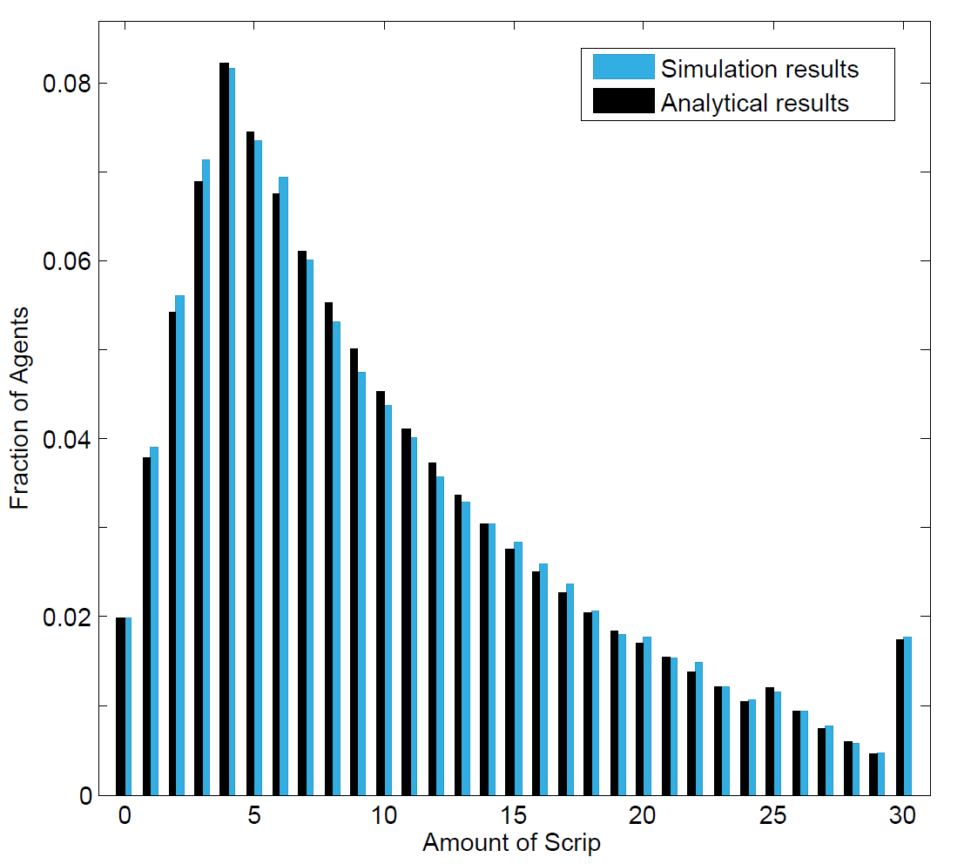
Distribution of money
Average amount of money in the system
Example with 1000 agents
Simulation results:
Averaged distribution of scrip after 10’000 steps
peak at i = 4= n-1
small peak at i = 25= k_{t}- n
concentration of agents at i = k_{t}

Slide 10
Nash Equilibrium
From the point of view of a single agent i, the game can be modeled as a Markov Decision Process (MDP)
There exists an optimal threshold policy for the MDP of agent i
This optimal threshold policy is an ε-best response for agent i
There exists an ε-Nash equilibrium where all agents play threshold strategies S_{k}, with k being a multiple of n
Notes:
If N is large and n reasonably small with respect to N, what agent i does has essentially no effect on the behavior of the system and no great impact on the scrip distribution
Explain in a few words the model so that people understand. What is an optimal policy in a MDP?
What does it mean to have a NE here?

Slide 11
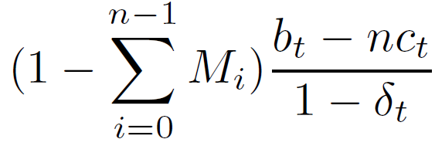
Social Welfare
Social welfare increases by b_{t} – nc_{t} only if a transaction happens (i.e., a request is satisfied)
The agent chosen to make a request must have $n; occuring with probability
There must be n volunteers able and willing to satisfy it; occuring with probability approximated by 1
Total expected social welfare:
Social welfare decreasing in n (for given values of b_{t}, c_{t}, δ_{t}, and average amount of money in the system m)
Social welfare increasing in m up to a certain point m* beyond which a monetary crash occurs (no agent willing to cooperate)
Fraction of agents owning less than $n
Notes:
A natural question arises when the system is at equilibrium: how good is it?
Social welfare represents the total utility of the system.
n = nb of volunteers needed to satisfy a service; m = average amount of money

Slide 12
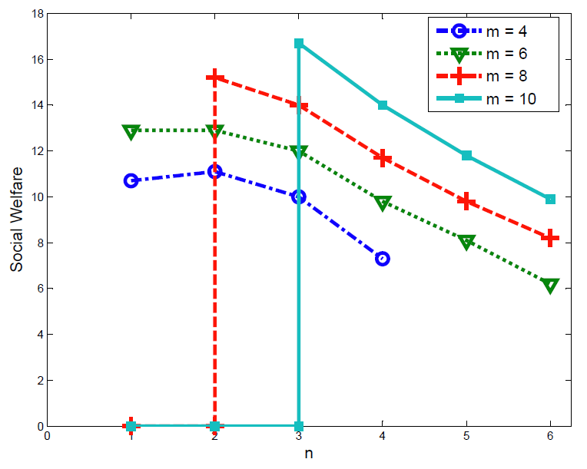
Social Welfare
m = average amount of money
n = number of volunteers needed
Monetary crash when m ≥ 8
Monetary crash when m ≥ 10

Slide 13
Two application examples
Anonymity networks (e.g., Tor)
Settings: N = 300’000 users, n = 3 relays
Social welfare maximized at m=10
Only 2.5% of agents cannot afford a service
Thus, 10 x 300’000 = 3’000’000$ should be allocated into the system
Privacy in participatory sensing systems
Settings: N = 1’000 users, n = 6
Social welfare maximized at m=16

Slide 14
Conclusion
Extended scrip systems to one-to-n
Existence of Nash equilibrium with threshold strategies
Finding optimal amount of scrip to maximize social welfare
First application of scrip systems to PETs
Encouraging cooperation in PETs
Improving fairness in PETs
Better performance of cooperative PETs
Future work
Rate of convergence towards the steady-state distribution
Investigate other strategies than thresholds
Open system with newcomers and variable prices
Notes:
Optimization of monetary incentives into PETs

