Slide 1

Privacy-Triggered Communications in Pervasive Social Networks
Murtuza Jadliwala, Julien Freudiger, Imad Aad, Jean-Pierre Hubaux and Valtteri Niemi

Slide 2
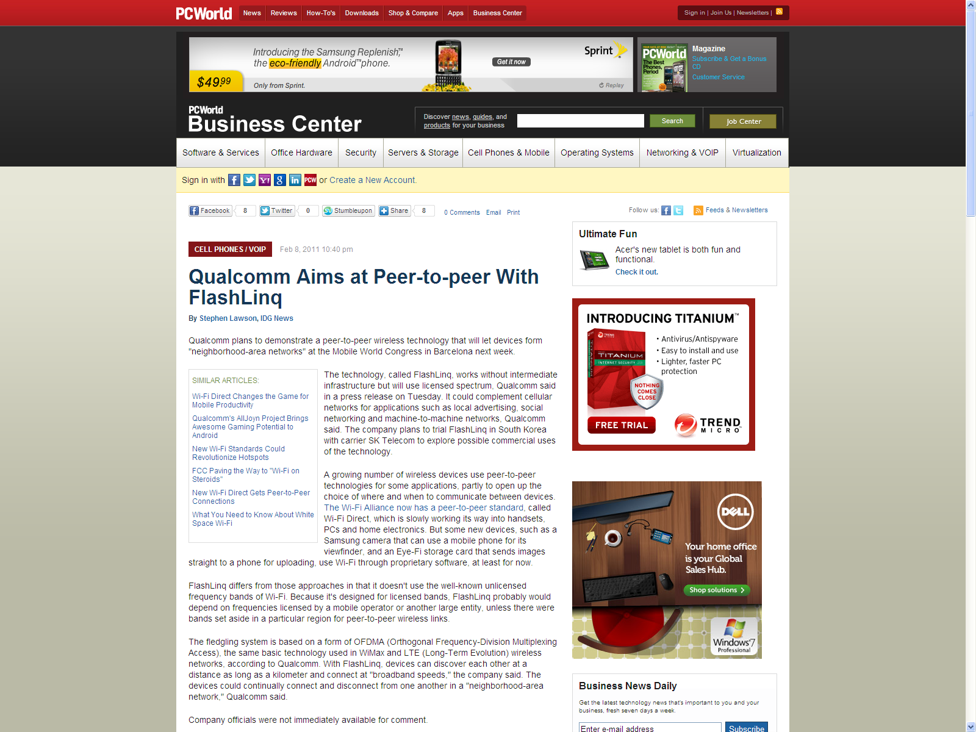
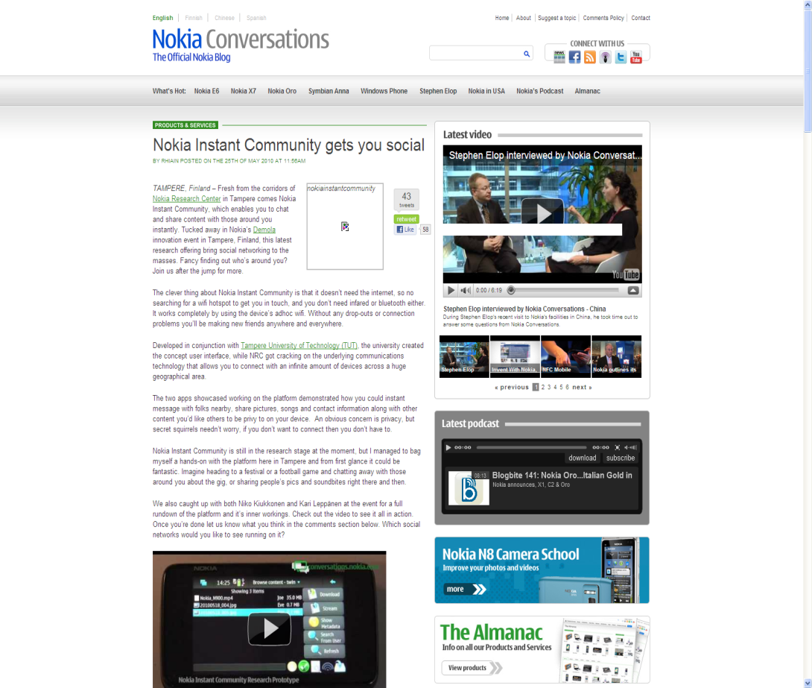
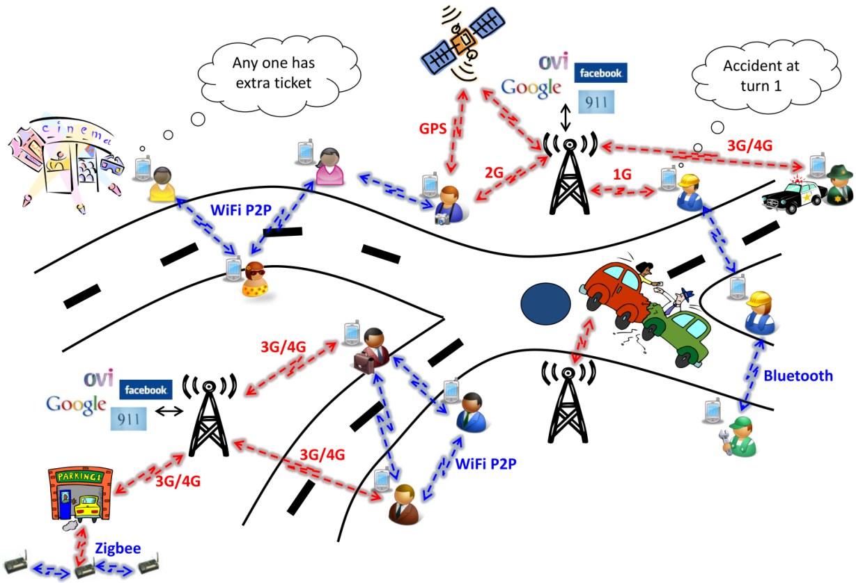

Rise of Wireless P2P Networks
Wireless P2P in smart phones and mobile devices
Complement infrastructure
Sharing local contextual data
User communities based on
  Common interest (Fans)
  Proximity (Neighbors)
  Social relations (Friends)
Pervasive Social Networks
Tourists
Workers
Office colleagues
Recent examples:
  Nokia Instant Community or NIC is based on WiFi
  Qualcomm’s FlashLinq on the licensed spectrum
  PeepWireless and NEC working on similar products
Notes:
Telecom device manufacturers rushing to take this technology out of the lab and into people’s mobile devices

Slide 3

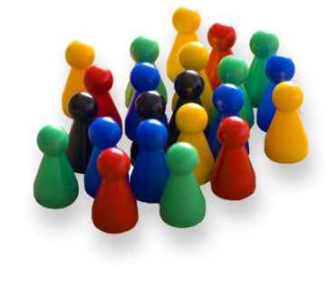
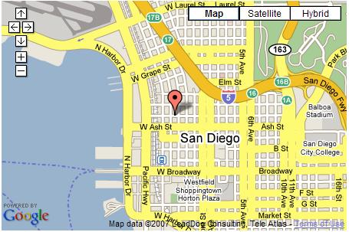

Advantages
Less dependence on infrastructure, always-on
Context-aware
Real-time
Limited sharing with third party
Free or low monetary cost
Works across existing social networks

Slide 4
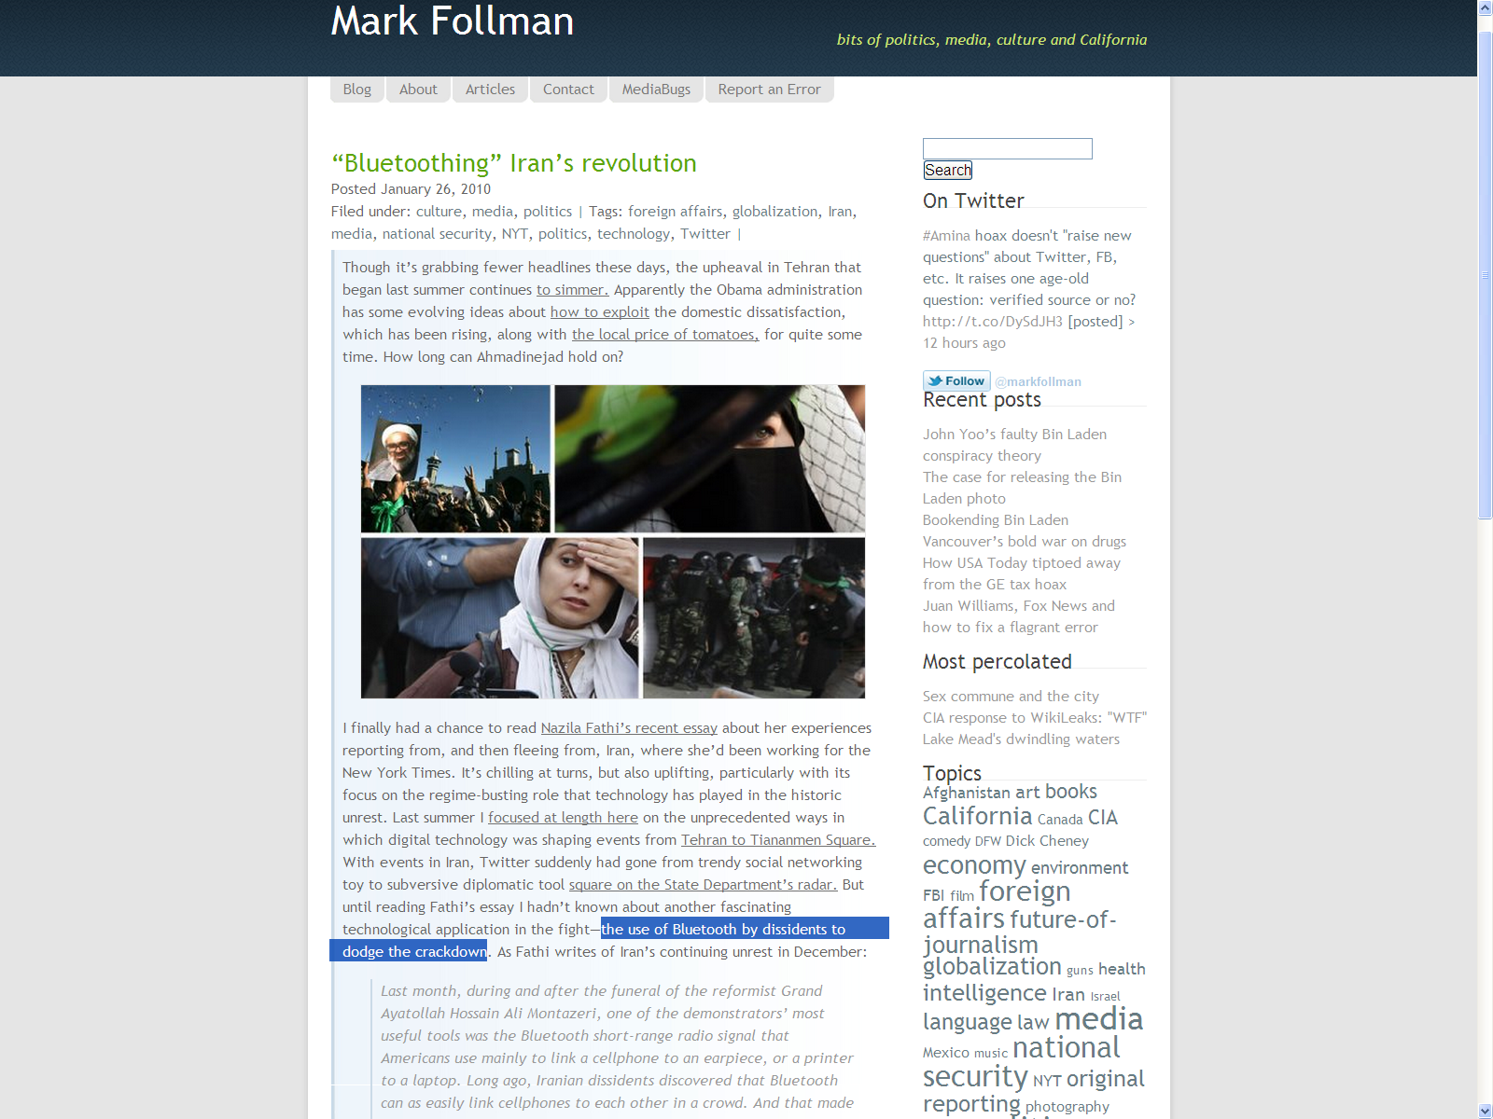
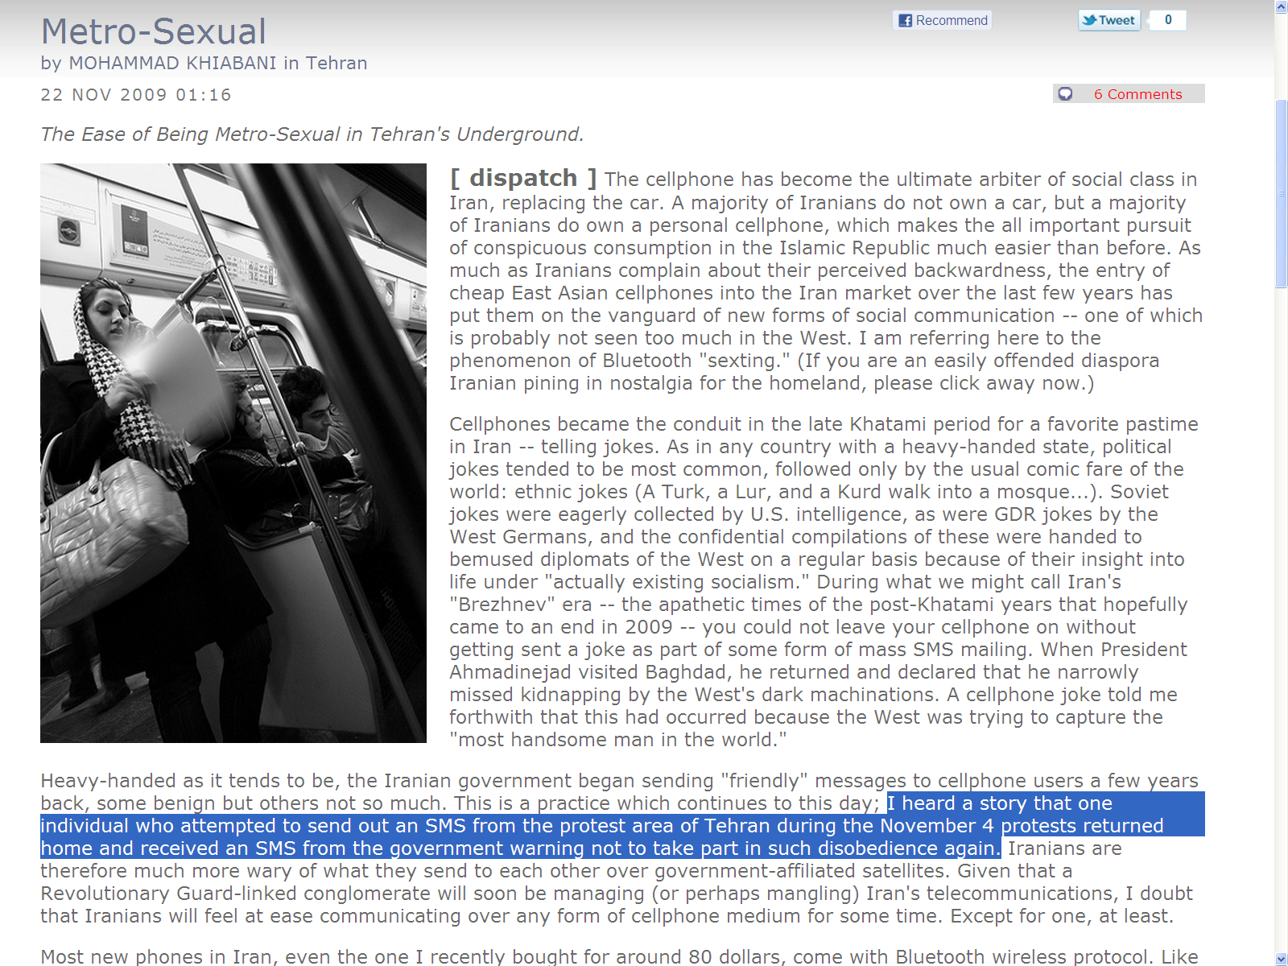
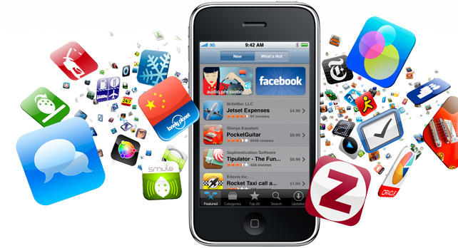
Applications
Dating
Friend Finding
Micro-blogging
Localized Advertising
Games and entertainment
Localized Social Networking
Notes:
Mark Follman is a famous San Francisco based writer and editor

Slide 5


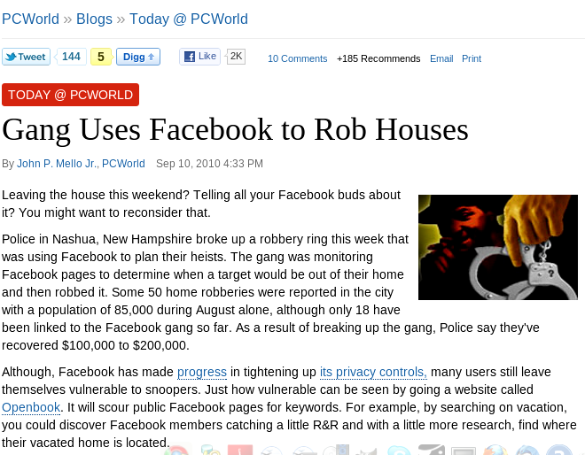

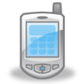

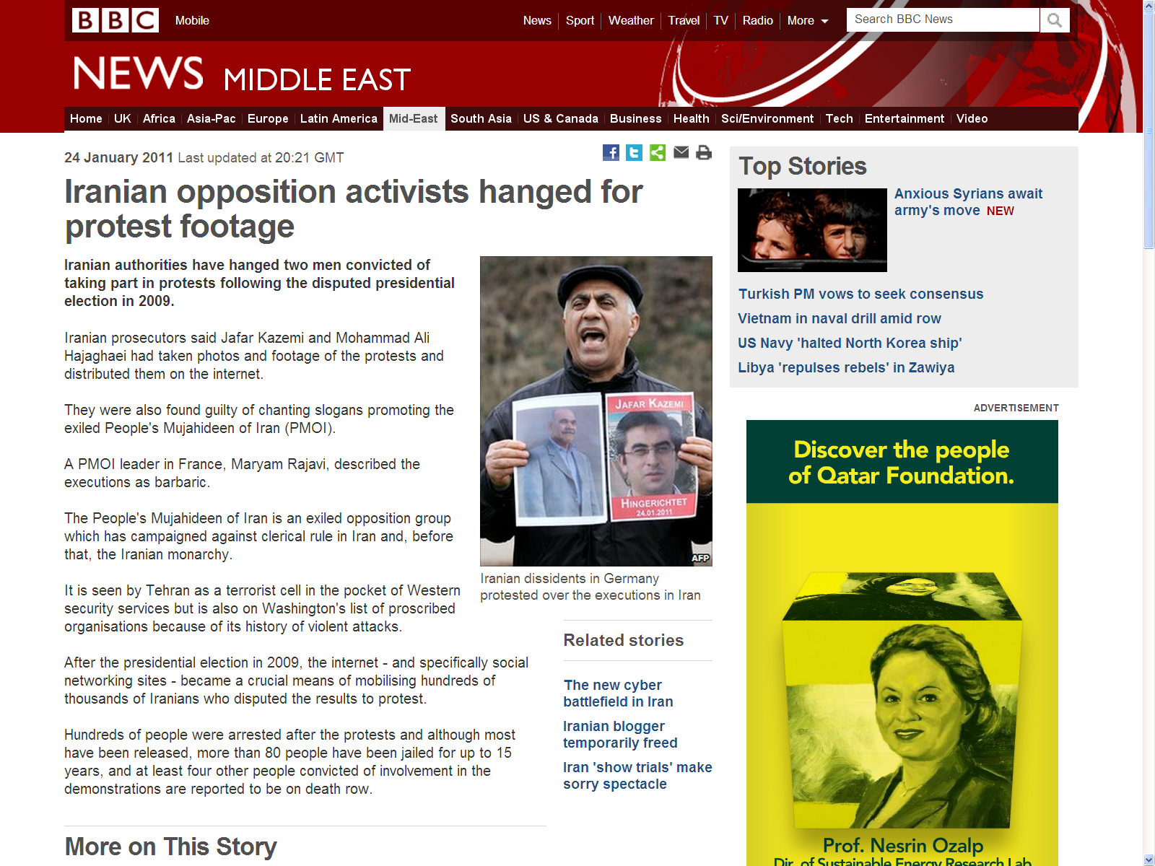
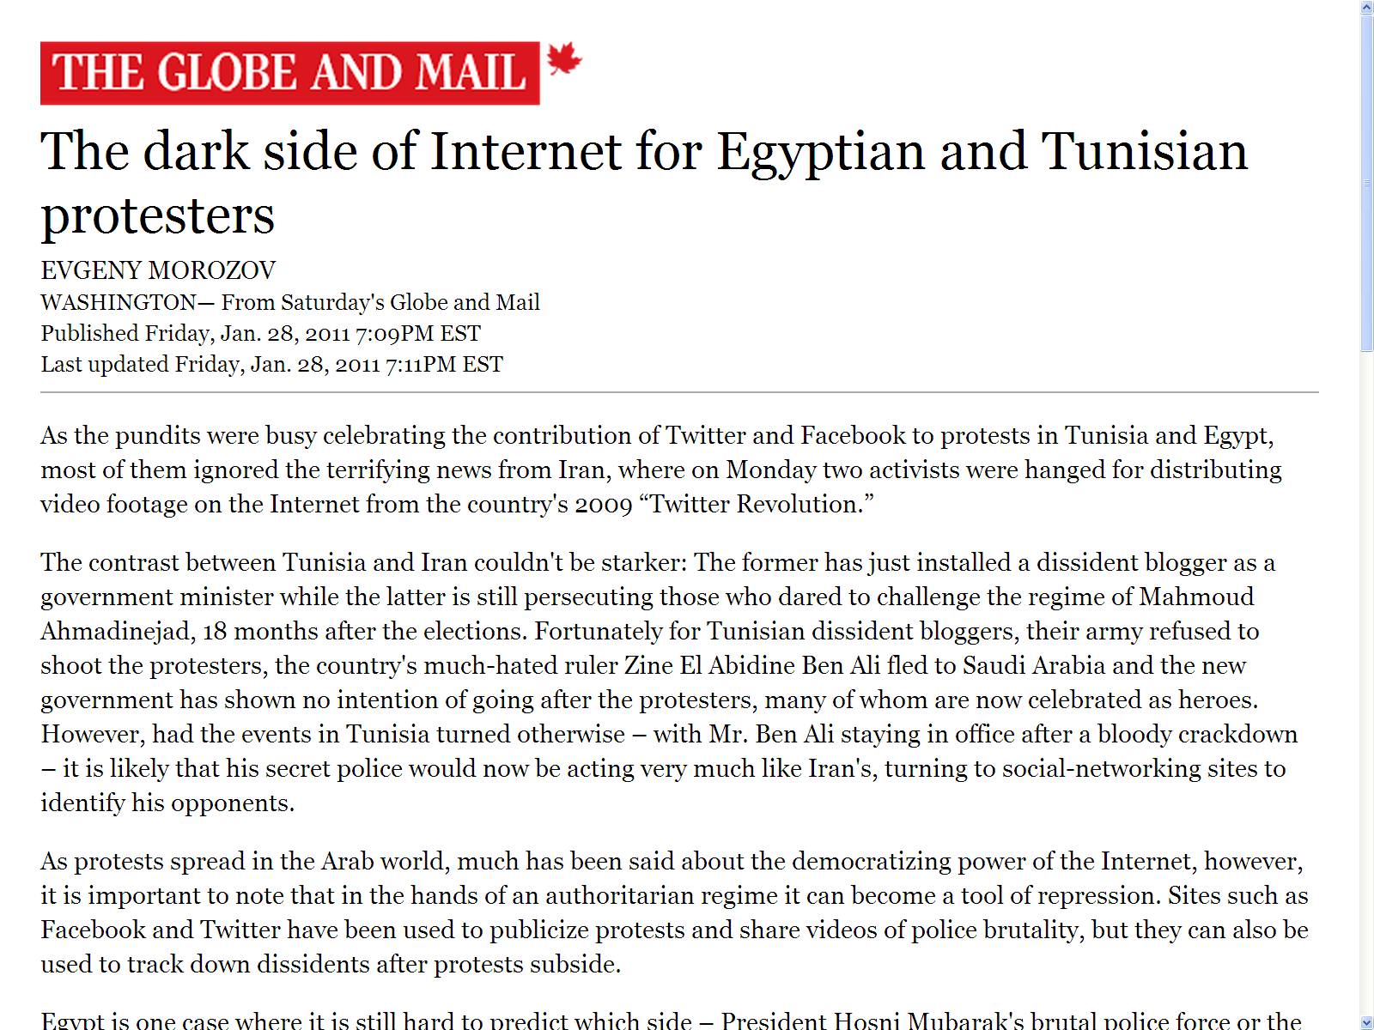

Privacy Concerns
Broadcast and localized communications → privacy threats
  Location privacy:
  Community privacy:
  Potentially grave implications of losing privacy
Problem: One wants to communicate (broadcast a message) without begin exposed → “Hiding in the crowd”
This Talk: Privacy-triggered communications
  Dynamic regulation of communications in pervasive environments based on privacy
t₂
t₃
t₄
t₁
A to C₁: Hello!
A
C₁
Notes:
All users, context, data may not require same level of privacy; current privacy-preserving mechanisms too rigid

Slide 6

Roadmap
Overview
System Model and Privacy Threats
Privacy-Triggered Communications
Evaluation
Initial Insights

Slide 7
















System Model
Any one has extra ticket
Accident at turn 1
Tourists
I have one
C
3G/4G
C
2G
1G
WiFi P2P
B
3G/4G
B
A
Bluetooth
A
3G/4G
WiFi P2P
Workers
Src
Dst
Message
Office-goers
Notes:
Exchange of context-based information between co-located mobile devices
Wireless peer-to-peer communications using WiFi or Bluetooth
Multi-hop communications possible
Communications complement infra-based communications (WLAN or cellular)
Two types of communications
Interactive: broadcast query, unicast reply
Non-Interactive: broadcast
Smart and efficient beaconing for neighborhood discovery
Current standards allow beaconing to be distributed within a group of co-located devices
Prevents trivial tracking through beacon packets
Each message contains an identifier (e.g., MAC address) for source and optionally for destination
Identifiers periodically changed to avoid trivial tracking
Message can be encrypted or un-encrypted based on type of communication

Slide 8



Privacy Threats and Adversary
Privacy requirement: Source anonymity (Hiding in the crowd)
Adversary type: Passive adversary or eavesdropper
  Legitimate (internal) or external
  Single or multiple coordinated sensing stations
Adversary goals:
  Track users
  Learn sensitive information, e.g., communities and preferences
Assumptions:
  Physical layer identification infeasible
t₂
t₄
Hmmm! A belongs to C₁
t₃
t₁
A to C₁: Hello!
A
C₁
Notes:
Enough radio signal uncertainty to prevent physical layer identification

Slide 9
Roadmap
Overview
System Model and Privacy Threats
Privacy-Triggered Communications
Evaluation
Initial Insights

Slide 10
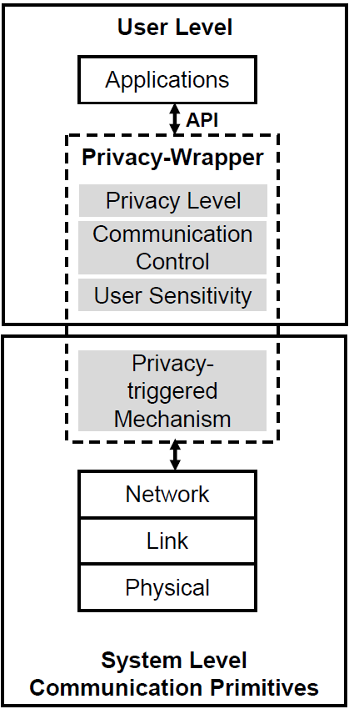
Privacy-Triggered Communications
Privacy-wrapper or middle-ware: Cross-layer libraries
Middle-ware consists tools for:
  Privacy measurement and visualization
  User sensitivity to privacy and messages
  Privacy-based communication triggering
Middle-ware monitors communications and context
  Dynamically triggers communication based on privacy
Notes:
Dynamically triggers communication based on the current privacy and the privacy requirement of the message

Slide 11
Related Research Efforts
User-friendly policy management tools¹
  Application specific
Operating system libraries²
  Enforces a system-wide policy in the OS
Our approach
  Dynamic
  Application independent
  Moves privacy controls from the system to the user
  Suitable for pervasive systems
[1] J. Cornwell, I. Fette, G. Hsieh, M. Prabaker, J. Rao, K. Tang, K. Vaniea, L. Bauer, L. Cranor, J. Hong, B. McLaren, M. Reiter, and N. Sadeh, “User-controllable security and privacy for pervasive computing,” in HotMobile, 2007
[2] S. Ioannidis, S. Sidiroglou, and A. Keromytis, “Privacy as an operating system service,” in HOTSEC, 2006

Slide 12
Privacy Measurement
Question: How to measure privacy?
Metrics
  Size of the anonymity set or k-anonymity¹
  Entropy of anonymity set²
  Probabilistic success of the adversary^{3,4}
Let us not restrict ourselves to any specific metric
Currently implemented the k-anonymity metric
  Anonymity set or k→ Neighborhood
  Confusion distance → Maximum distance between a device and its neighbors
  Dynamic k value
1m
1m
2m
5m
1m
k=5, Confusion distance=5m
[1] L. Sweeney, “Achieving k-anonymity privacy protection using generalization and suppression,” Int. Jour. on Uncertainty, Fuzziness and Knowledge-based Sys., 2002
[2] C. Diaz, S. Seys, J. Claessens, and B. Preneel, “Towards measuring anonymity,” in PET, 2002
[3] B. Hoh, M. Gruteser, H. Xiong, and A. Alrabady, “Preserving privacy in GPS traces via uncertainty-aware path cloaking,” in CCS, 2007
[4] R. Shokri, G. Theodorakopoulos, J-Y. Boudec, J-P. Hubaux, “Quantifying Location Privacy”, in IEEE S&P 2011

Slide 13

User Sensitivity
Current metrics do not capture users’ sensitivity
Users create and customize sensitivity profiles
  Contains location, time, privacy parameters (min. and max. anonymity set sizes)
  Expressed as preferred locations or points-of-interest¹
  Privacy measurements are accordingly scaled or adjusted
Selection of appropriate profiles
  Manual by users
  Automatic by system based on context
[1] L. T. Xu and Y. Cai, “Feeling-based location privacy protection for location-based services,” in ACM CCS, 2009
Notes:
User’s can either manually choose a sensitivity profile or the system can automatically choose one depending on the context

Slide 14
Threshold-based Triggering
Users assign
  Privacy threshold
  Time validity threshold
Communication buffered until privacy threshold met
Middle-ware periodically updates device privacy level
On each update, message delivered if still valid and privacy threshold met
Advantages: Simplicity
Drawbacks: Static thresholds
Notes:
Thresholds can change based on users past and future communications and contexts such as locations visited and time

Slide 15
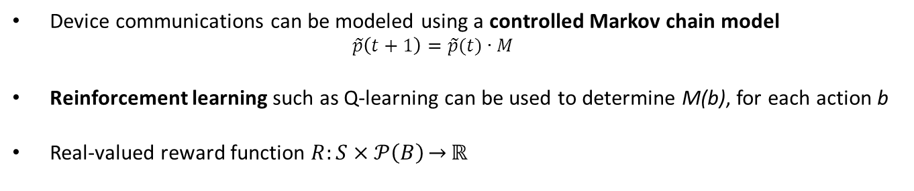
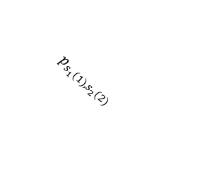

Probabilistic Triggering
S₁(1)
S₁(2)
S₁(3)
Privacy
  $$p_{s_{1}(1),s_{1}(2)}=$$
  $$P(s\left(t+1\right)=S_{1}(2)|s\left(t\right)=S_{1}\left(1\right))$$
0
max
0
max
0
max
  $$p_{s_{1}(1),s_{2}(2)}$$
1
2
3
S₂(2)
S₂(3)
:
Priv₃
0
max
0
max
Packet 3
Priv₂
Packet 2
Action b(1)
Action b(2)
Priv₁
Packet 1
Device communications can be modeled using a controlled Markov chain model
  $$\tilde{p}\left(t+1\right)=\tilde{p}(t)∙M$$
Reinforcement learning such as Q-learning can be used to determine M(b), for each action b
Real-valued reward function $R:S×𝒫\left(B\right)\overset{→}{}ℝ$
Notes:
Finite buffer, each slot holding messages with specific minimum privacy requirement
Device states can be defined at discrete time intervals by the current device privacy level and other factors (battery)
An action at a time instant is the message(s) forwarded in that time instant
Device communications can be modeled using a controlled Markov chain model
An action causes the device to transition from one state to another
$$p_{i,j}=P(s\left(t+1\right)=s_{j}|s\left(t\right)=s_{i})$$
$$\tilde{p}\left(t+1\right)=\tilde{p}(t)∙M$$
For an action b, M(b) represents the controlled Markov model (state transitions)
Reinforcement learning such as Q-learning can be used to determine M(b), for each action b

Slide 16
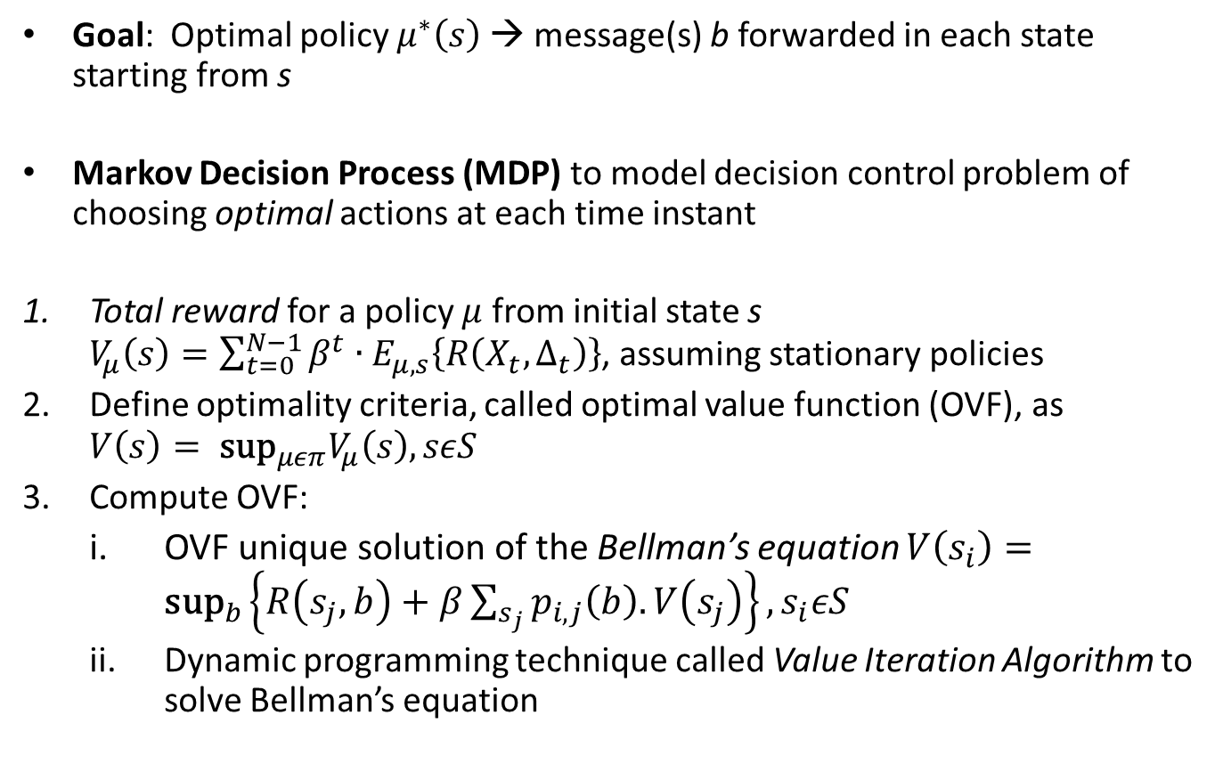
Probabilistic Triggering
Goal: Optimal policy $μ^{∗}\left(s\right)$→ message(s) b forwarded in each state starting from s
Markov Decision Process (MDP) to model decision control problem of choosing optimal actions at each time instant
Total reward for a policy $μ$ from initial state s $V_{μ}\left(s\right)=\sum_{t=0}^{N−1}{β^{t}∙E_{μ,s}\left\{R\left(X_{t},Δ_{t}\right)\right\}}$, assuming stationary policies
Define optimality criteria, called optimal value function (OVF), as $V\left(s\right)= {\text{sup}}_{μεπ}V_{μ}\left(s\right), sεS$
Compute OVF:
  OVF unique solution of the Bellman’s equation $V\left(s_{i}\right)={\text{sup}}_{b}\left\{R\left(s_{j},b\right)+β\sum_{s_{j}}{p_{i,j}\left(b\right).V\left(s_{j}\right)}\right\}, s_{i}εS$
  Dynamic programming technique called Value Iteration Algorithm to solve Bellman’s equation

Slide 17
Roadmap
Overview
System Model and Privacy Threats
Privacy-Triggered Communications
Evaluation
Initial Insights

Slide 18
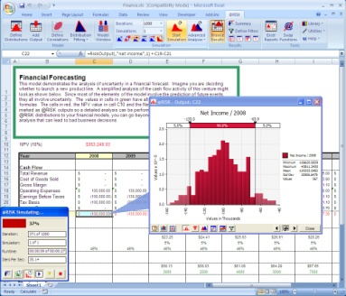
Will Privacy-triggered Communication Work?
How long would a user wait until a privacy-sensitive message gets transmitted?
If he/she is moving, would it still make sense to send it?
Two evaluation strategies:
  Large-scale network simulations
  Prototype implementation and evaluation in a live trial
  (On-going)

Slide 19
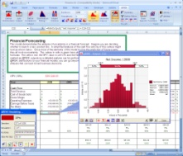
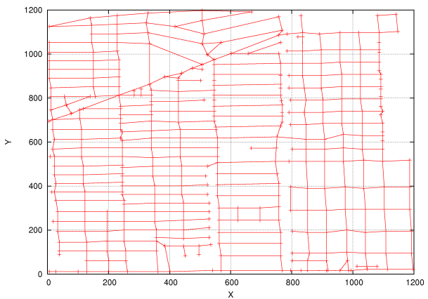
Simulation Experiments
Simulation (ns-2) setup
  RW and RWC mobility model
  100 devices, 914 MHz radio, pedestrian speed (< 3 km/h)
  Message size: 100 Bytes, Buffer: 50KB, Period: 15 sec
  Privacy metric: k-neighborhood
  User sensitivity: uniform
  Triggering technique: threshold-based (k=6)

Slide 20
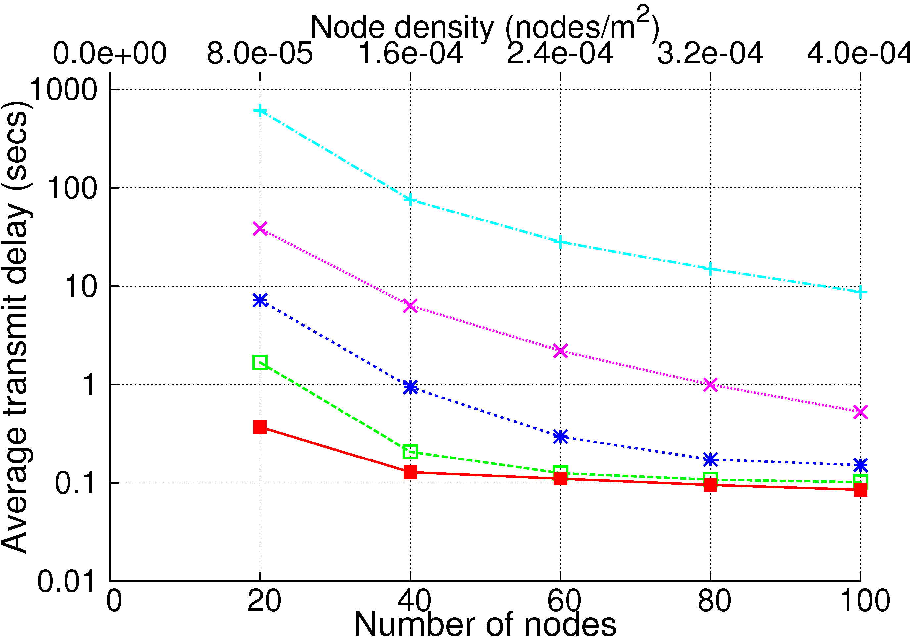
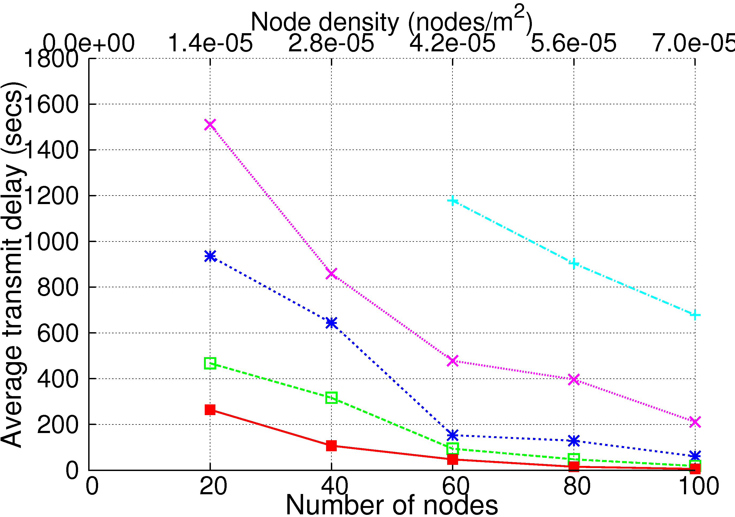
Results …
RW
RWC
RW has approximately 250000 meeting points, vs. 383 for RWC

Slide 21
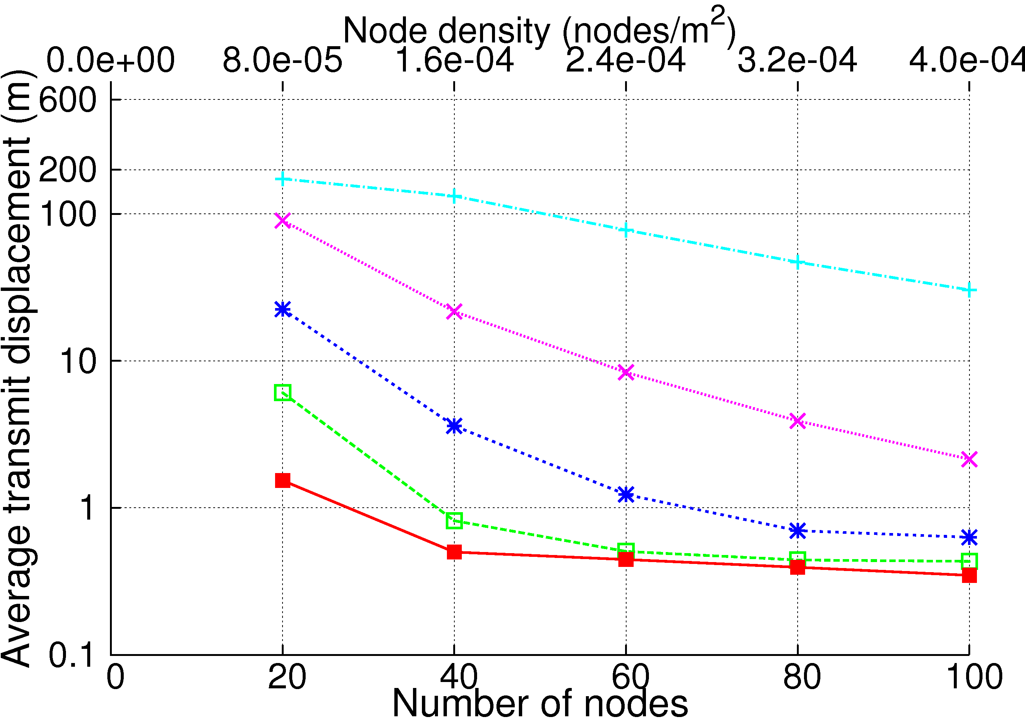
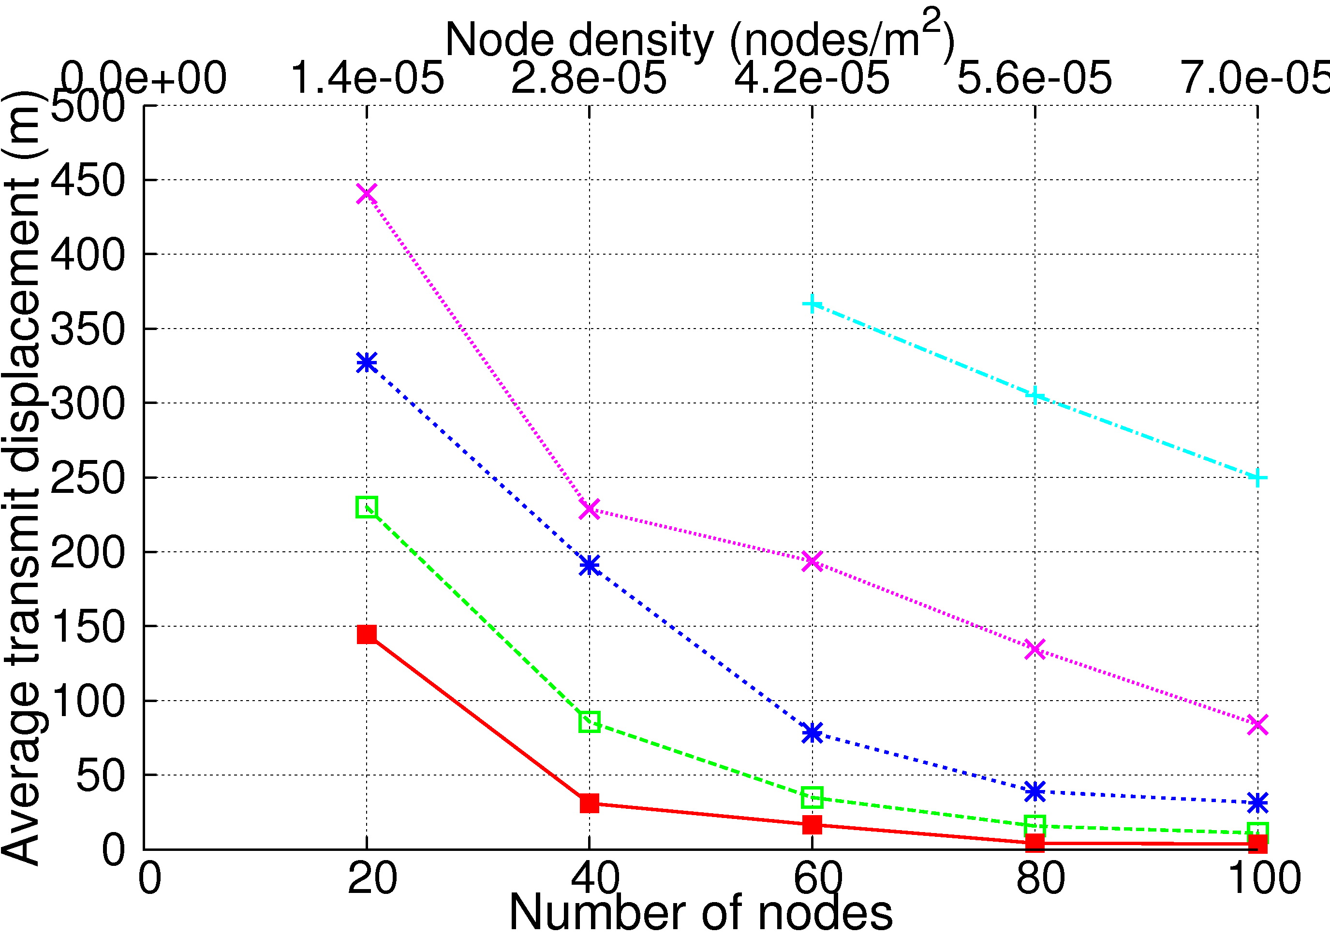
More Results …
RW
RWC

Slide 22
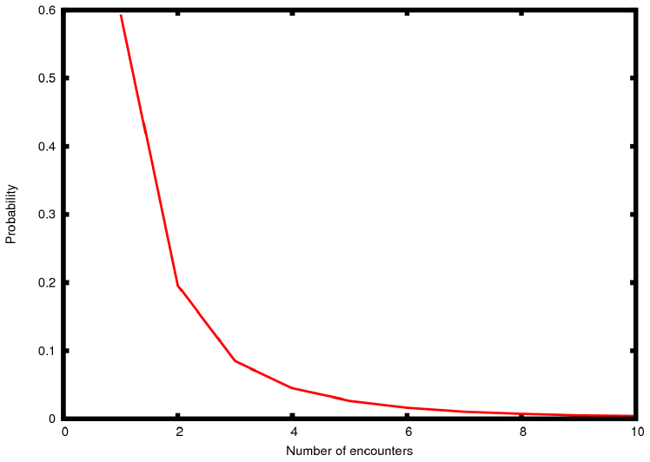
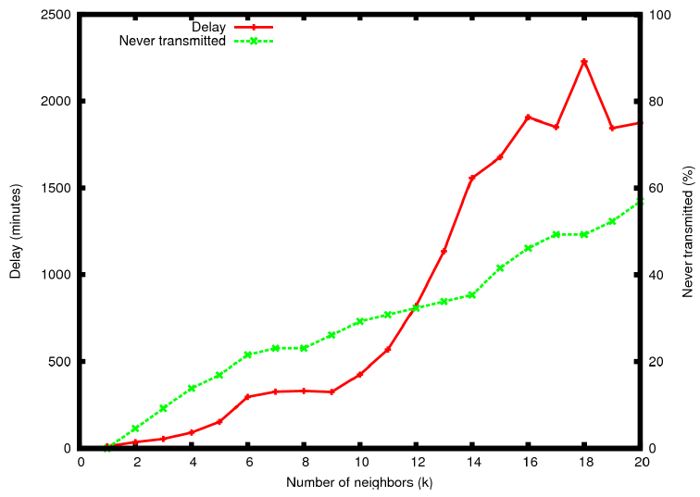
More Results
NRC data collection campaign: ~ 100 users in Lausanne area
Counting Bluetooth encounters

Slide 23
Discussion
From RW, to RWC, to real data: The more realistic we get, the worse is the network performance
  User density is low
  Counting only “turned on” BT devices
  Nights are included
We should fall somewhere in between RWC and the BT data
  In RWC, confusion distance of 100 m and k=6 results in delay of 3 min.
Delays are lower near intersections or POI’s → good for anonymous communications
  Side effect: Communications become bursty leading to higher congestion

Slide 24
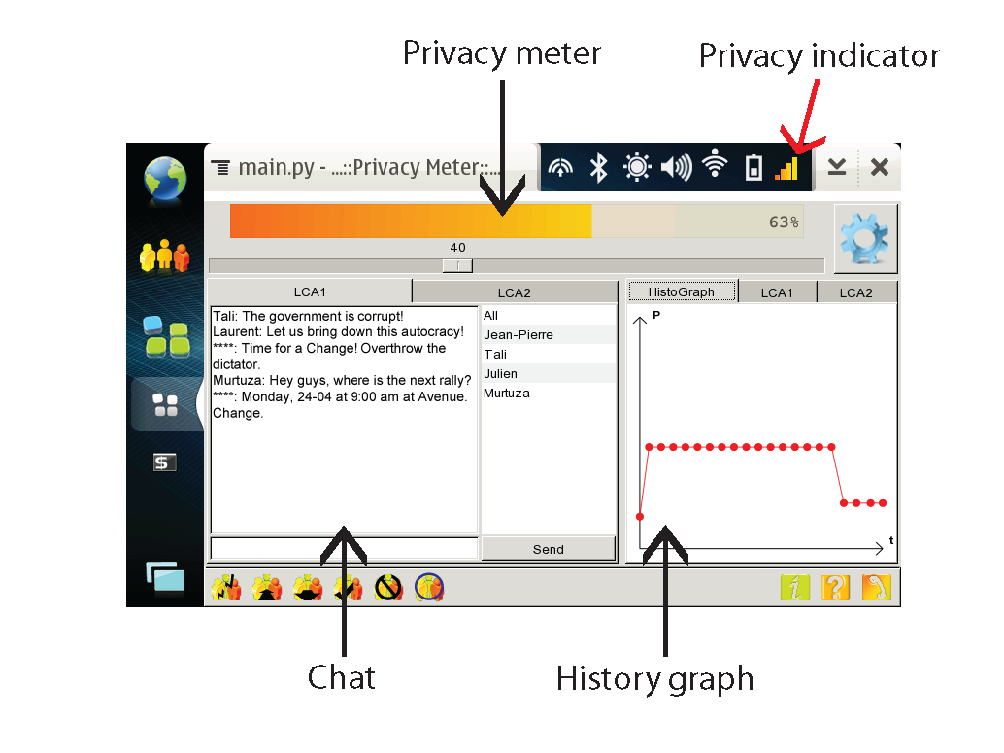
Implementation
Prototype for NIC enabled Nokia devices
  Binaries available for Maemo platform
  Coded using Nokia QT programming framework and python

Slide 25
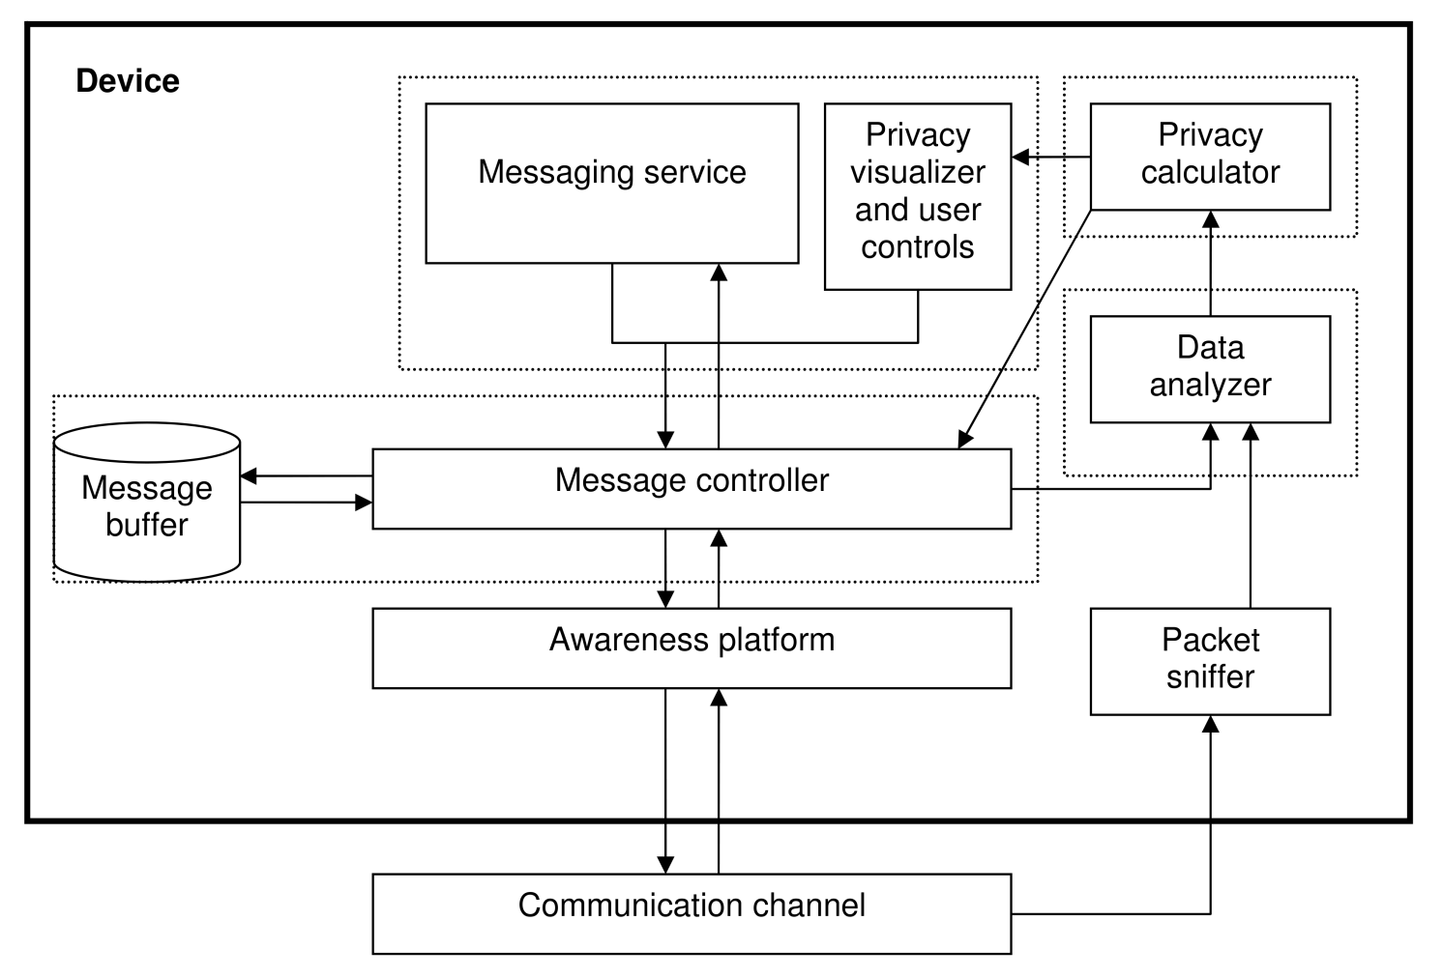
System Architecture

Slide 26
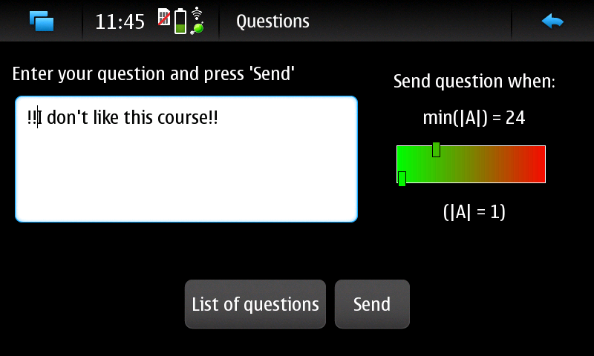
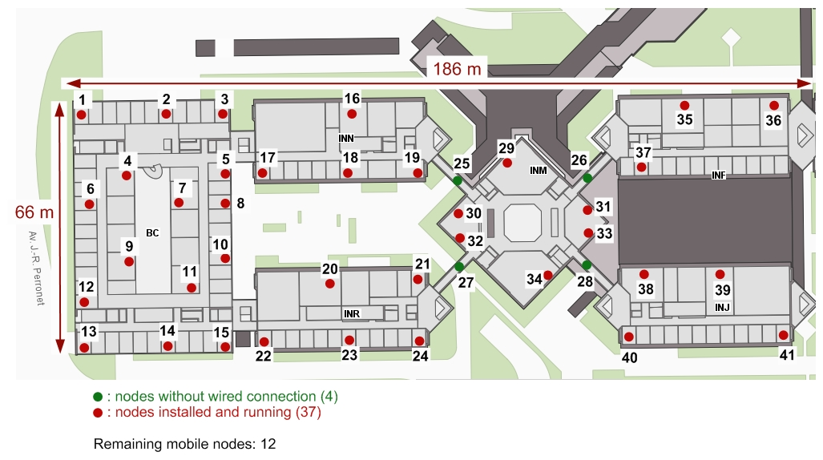
On-going Work
3 month NIC trial on EPFL campus
  100 students carrying NIC devices
  Privacy-triggered communications in Class-forum application
Adversary: 41 router wireless mesh network
Goal:
  Verify effectiveness
  Identify usability issues
Notes:
Continue development on latest Nokia hardware and NIC platform
Identify usability issues by studying usage patterns and student feedback

Slide 27
Roadmap
Overview
System Model and Privacy Threats
Privacy-Triggered Communications
Evaluation
Initial Insights

Slide 28
Initial Insights
Privacy tools and privacy-preserving mechanisms in pervasive environments need to consider the wireless context of the users
Privacy comes at the cost of lower QoS. Appropriate tools for users to make their own choice
Success of pervasive social networking technology will depend on such privacy-based communications
Notes:
Success of pervasive social networking technology will depend on the ability of the system to accurately capture and dynamically adapt to the users’ privacy requirements in different environments and contexts

