Slide 1
Integrity of the Web Content: The Case of Online Advertising
Nevena Vratonjic
Julien Freudiger
Jean-Pierre Hubaux
August 2010, Usenix CollSec’10

Slide 2
Internet Economy
Online Advertising:
The main Internet business model
Revenue in 2009 in the US is $22.4 billion
Sponsors free services and applications
What happens if one meddles with it?

Slide 3
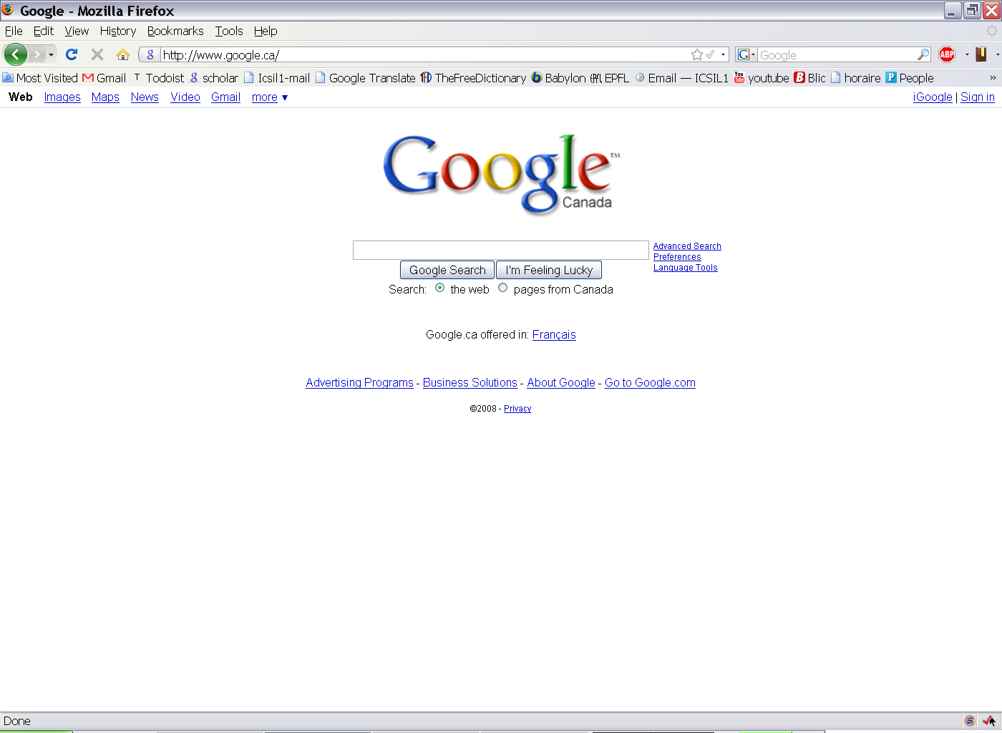
Rogers, Canadian ISP, injected content into web pages

Slide 4
Problem
Online advertising and Web browsing is not secured
Rely on the HTTP protocol
Advertisers, publishers and ad networks lose revenues
Threatens the Internet business model!
How to secure Online Advertising?

Slide 5
Outline
Online Advertising
Attacks on Online Advertising
Collaborative Approach to Securing Online Advertising

Slide 6
Online Advertising System
<script type=“text/javascript”><!--
google_ad_client = “pub-8494067626122848”;
google_ad_width = 728;
google_ad_height = 90;
google_ad_format = “728x90_as”;
google_ad_type = “text_image”;
google_ad_channel = “”;
//- -></script>
<script type = “text/javascript”
src = http://pagead2.googlesyndication.com/pagead/show_ads.js>
</script>
Ad Network
Website’s ID
Advertiser
Embedding ads
Ad Servers
(AS)
Websites
(WS)
Web page
Ad Server’s URL
Advertiser
User
(U)
Access Network
(ISP)
Advertiser
Placing ads
Ads

Slide 7
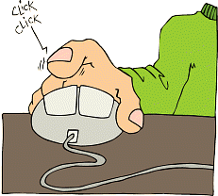
Revenue Model
Pay-per-click
Ad Network
Advertiser
Ad server
Website
User
User clicks on an ad:
Gets redirected to the advertised Website
Advertiser pays Ad Network (e.g., Google) for serving ads
Ad Network pays the Website for displaying ads on their web pages

Slide 8
Outline
Online Advertising
Attacks on Online Advertising
Collaborative Approach to Securing Online Advertising

Slide 9
Exploits against Online Advertising
Advertiser
Advertiser
Ad Server
Website
AN
User
Advertiser
Profiling and Tracking Users
Click Fraud
Man-in-the-Middle
Blocking Ads
Phishing Attacks
N. Daswani, C. Mysen, V. Rao, S. Weis, K. Gharachorloo, S. Ghosemajumder, and the Google Ad Traffic Quality Team, Online Advertising Fraud, from the book Crimeware, Symantec Press, 2008.
M. Jakobsson, Phishing and Counter-Measures: Understanding the Increasing Problem of Electronic Identity Theft, Wiley, 2006.
A. Rezgui, A. Bouguettaya, and M. Eltoweissy, Privacy on the Web: Facts, challenges, and solutions. IEEE Security and Privacy, 2003.
B. Krishnamurthy and C. E. Wills, Cat and mouse: content delivery tradeoffs in web access. WWW’06, Edinburgh, Scotland, 2006.

Slide 10
The Adversary
Advertiser 1
Advertiser 2
Ad servers
Web sites
AN
Users
Advertiser 3
Man-in-the-Middle
Wireless Access Point
Wireless Social Community Network (WSCN)
Internet Service Provider (ISP)
Power of the adversary: eavesdrop, alter, inject and delete messages

Slide 11
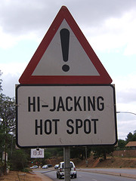
Recently Reported Cases
Growing number of ISPs injecting own content into web pages [1][2]
Third party ad companies partnering with ISPs
e.g., Adzilla, Phorm, NebuAd
Free ISPs [3]
[1] C. Reis, S.D. Gribble, T. Kohno and N.C. Weaver. Detecting In-flight Page Changes with Web Tripwires, NSDI 2008.
[2] B. April, F. Hacquebord and R. Link, A Cybercrime Hub, August 2009.
[3] thefreesite.com Free Internet Access Providers

Slide 12
Injecting Attack
Pollution Attack
Injecting ads not necessarily targeted to the content of the web page or users’ interests
Targeted Attack
Injecting ads into Search Engine Result Pages (SERPs)
Injecting ads into Location Based Services (LBS)

Slide 13
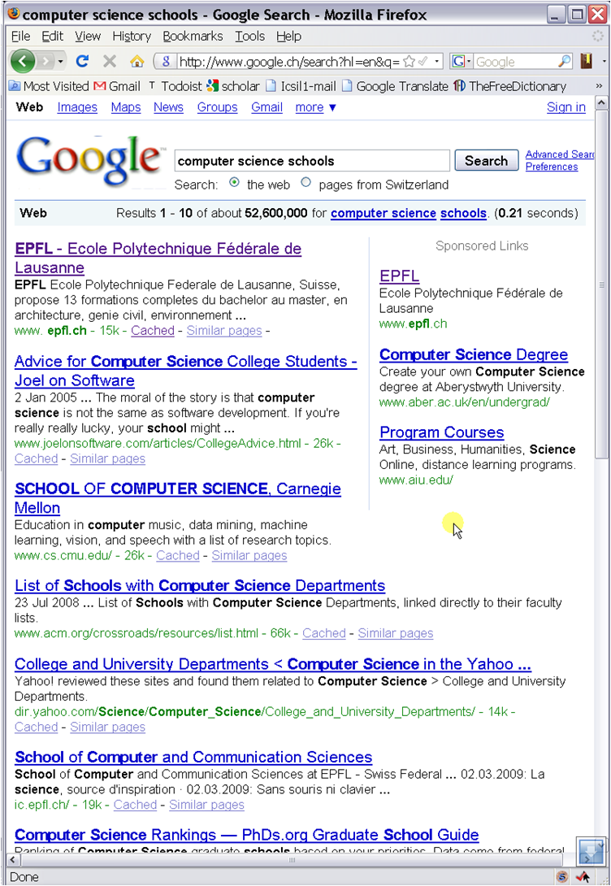
#1
#5

Slide 14
On-the-fly Ads Modifications
Advertisers
AN
Advertisers
Ad servers
Web sites
Users
Advertisers
Arbitrary Ad server
Redirect users to arbitrary Ad Servers (e.g., Yahoo!)
Consequence: Yahoo! earns money instead of Google

Slide 15
Ad Server Redirection
<script type=“text/javascript”><!--
google_ad_client = “pub-8494067626122848”;
google_ad_width = 728;
google_ad_height = 90;
google_ad_format = “728x90_as”;
google_ad_type = “text_image”;
google_ad_channel = “”;
//- -></script>
<script type = “text/javascript”
src = http://pagead2.googlesyndication.com/pagead/show_ads.js>
</script>
Website’s ID
Ad Server’s URL
src=“http://pagead2.arbitraryAdServer.com/pagead/show_ads.js”
HTTP requests to ad servers different from those that were referenced in the HTML of the original web page

Slide 16
Outline
Online Advertising
Attacks on Online Advertising
Collaborative Approach to Securing Online Advertising

Slide 17
Securing the Web: Traditional Approach
SSL/TLS (HTTPS)
Authenticity and data integrity
Only for sensitive information (e.g., e-banking…)
Two problems
Authentication failure (misaligned incentives)
Web sites expected to pay for certificates
Inefficiency of HTTPS
Computation and communication overhead

Slide 18
HTTPS to Secure the Web
Authentication problems
Costs
Annual cost $500
Websites tend to use self-signed certificates
Failure
Authentication can fail (MitM attacks against self-signed cert.)
Browser security warnings might deter users from visiting website
Not trivial to implement and deploy
Incentives
Websites buy certificates to help users and advertisers
Overhead Problems
Computation and communication overhead
Gradual deployment of HTTPS only by major companies
Most of the costs imposed on websites!

Slide 19
Collaborative Approach to Securing Online Advertising
Websites and ad servers share the costs!
Data Integrity in Advertising Services Protocol (DIASP)
Provides:
Authenticity
Ad servers with valid certificates as sources of trust
Data Integrity
Light-weight authenticated hash-chains

Slide 20
DIASP Primitive:
Authenticated Hash-chain (AH)
P₁
P₂
P_{i}
P_{k-1}
P_{k}
Web page split into k equally-sized packets
L_{k}
L_{k-1}
L₂
L₁
AH:
P_{k}
P_{k-1}
P₂
P₁
signed
H(L₁)
END
H(L_{k})
H(L₃)
H(L₂)
H – one way hash function
Verify the data integrity and authenticity of a message m:
Verify the signature and the hashes of the packets of AH(m)

Slide 21
DIASP v.1
L_{k}
L₁
L’_{k}
L’₁
P_{k}
P₁
H(L₁)
P’_{k}
P’₁
signed_{AS}
2.
H(L’₁)
7.
END
H(L₂)
END
H(L’₂)
Website
3.
H(L₁)
Ad Server
Cert
signed_{AS}
4.
H(L₁)
5. page, hash-chain
8.ads, hash-chain
1. Page Request
6. Ads Request
HTTP
User
HTTPS

Slide 22
DIASP v.1: Pros & Cons
Pros:
Users verify data integrity upon packet arrival
Browsers dynamically render a web page as soon as the first packet of the hash-chain is received
Allows to independently check the integrity of the two communication channels:
Between the user and the website
Between the user and the ad server
Cons:
Requires 2 signatures per web page hosting ads
Uses cross domain signatures
(incompatible with the current browser implementation)

Slide 23
DIASP v.2
L_{k}
L₁
L’_{k}
L’₁
P_{k}
P₁
H(L₁)
P’_{k}
P’₁
H(L’₁)
H(L₁)
2.
6.
END
H(L₂)
END
H(L’₂)
signed_{AS}
H(L₁)
Website
3.
H(L₁)
Ad Server
H(L’₁)
Cert
4. page, hash-chain
7.ads, hash-chain
1. Page Request
5. Ads Request
User
HTTP
HTTPS

Slide 24
DIASP v.2: Pros & Cons
Pros:
Requires only 1 signature per web page hosting ads
Solves the problem of cross domain signatures (compatible with the current browser implementation)
Cons:
May add some delay in rendering web pages
(cannot verify data integrity before receiving the signed element from the ad server)
Browsers make several requests in parallel
Links to ASs at the beginning of HTML pages
Requires AS to always be available

Slide 25
Evaluation of DIASP
Loading time of an average size .com web page [1]
250KB content from WS and 51KB ads from AS
Sequential requests
Apache benchmark software
Localhost server with HTTP and HTTPS
DIASP v.1 ~ 9 times faster than HTTPS
DIASP v.2 ~ 11 times faster than HTTPS
[1] B. Krishnamurthy and C. Wills, Cat and Mouse: Content delivery tradeoffs in web access, WWW 2006.

Slide 26
Conclusion
Man-in-the-Middle Attacks on Online Advertising
Easy to perform
Threaten the Internet business model
Provide incentives to secure online advertising
Collaborative Approach to Securing Online Advertising:
DIASP
Ad Servers protect the ad revenue
Publishers do not need to acquire valid certificates
Users benefit from the secure Web as a “side effect”

