Slide 1
On the Age of Pseudonyms in Mobile Ad Hoc Networks
Julien Freudiger, Mohammad Hossein Manshaei,
Jean-Yves Le Boudec and Jean-Pierre Hubaux
Infocom 2010

Slide 2

Location-based Applications
Get Location
  Cellular networks
  GPS
  Wifi
  IP
Share location
  Twitter
  Flickr
  Google search
  Foursquare
  Loopt
  Google Latitude
  Ovi
  …

Slide 3
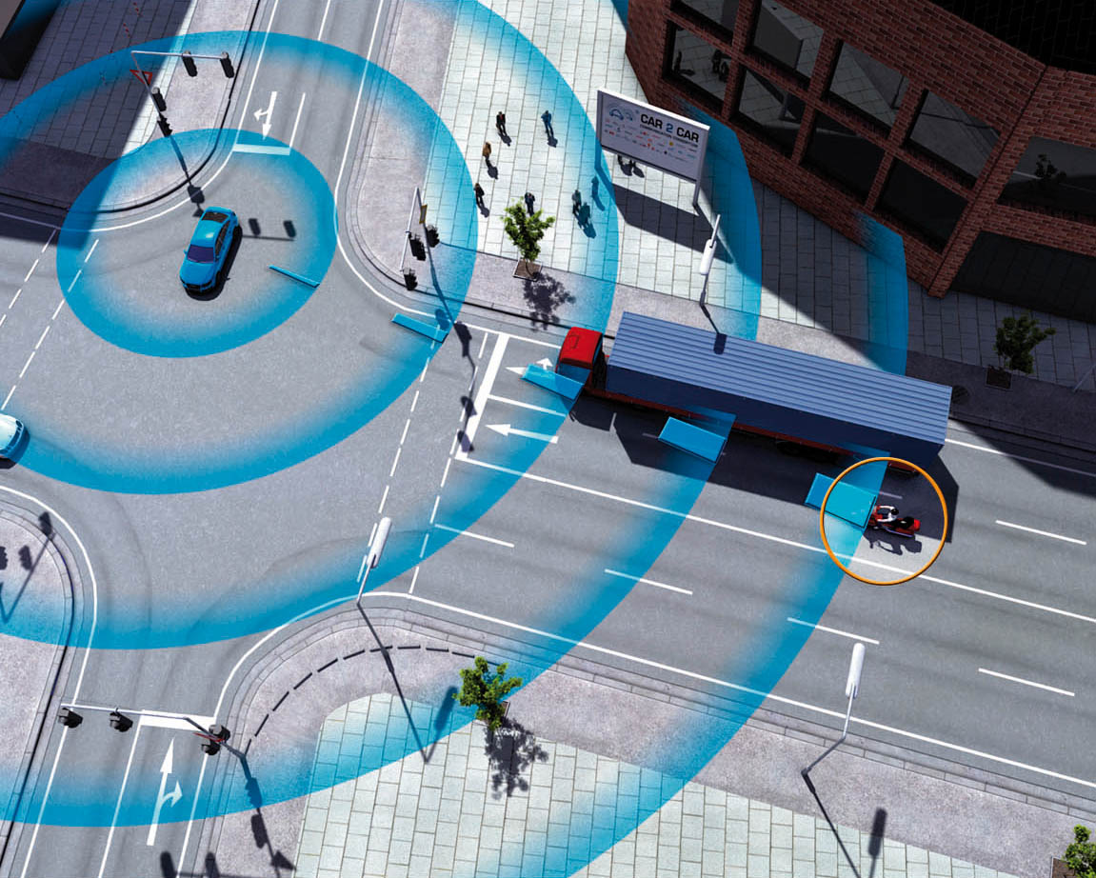
Context-based Applications
Sense neighborhood
  Ad hoc communications
  RFID
Communicate
  Vehicular Networks
  Proximity-based Social Networks
  Opportunistic communications
  Delay-tolerant networks
  …
Notes:
Proximity based => location is important

Slide 4
Hyper-connected World
Locality is one contextual information
most useful when combined with others
Notes:
Location alone is often useless, important to combine it with smth

Slide 5
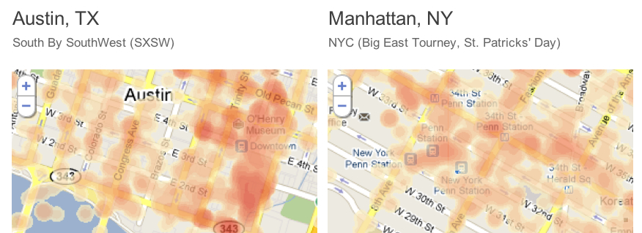
Location
Provides insight into human behavior
Enables localized services
Helps city planners
Spotrank by Skyhook wireless
Notes:
Mobile apps/ads.
I can also see it being used city planners and corporate real estate agents everywhere.
It will also give us great insights into human behavior.

Slide 6

You Are the City
“Understand urban construct
through the interaction of its parts”
Petra Kempf, Architect and Urban Designer
Notes:
Cities are an everyday invention.

Slide 7
Privacy Threat
Human movement is highly predictable and follows simple reproducible patterns
Visited locations reveal
  Personal activities
  Professional activities
  Social activities
C. Song, Z. Qu, N. Blumm and A.-L.Barabasi. Limits of Predictability in Human Mobility. Science 2010

Slide 8
Location is identity
Notes:
Spatio-temporal mobility traces are highly unique and correlated with our identity

Slide 9
“It’s not where you are,
it’s where you have been”
Gary Gale, Yahoo

Slide 10
Goal
Control location disclosure

Slide 11
This Paper
Consider
  Context-based applications
  Ad hoc wireless communications
  Mix zones to prevent tracking of users
Contribution
  Measure achieved location privacy
  using the distribution of age of pseudonyms
Notes:
Equivalently, we measure the ability of eavesdropper to track us and thus learn about us

Slide 12
Ad Hoc Networks
(Peer-to-Peer Wireless Communications)
1
2
Pseudonym
Identifier
Message
Signature + certificate
Notes:
Peer-to-Peer wireless network
WiFi, Bluetooth
Location privacy problem
Third party can track location of nodes by monitoring identifiers
Obtain location traces
MAC address, authentication credentials

Slide 13

Assumptions
N mobile nodes
WiFi/Bluetooth enabled
Ad hoc communications
1
5
2
Certification authority (CA)
6
4
3
Notes:
Independent of the communication protocol.
Give practical example with Google as CA, and distribute pseudonyms so that other users can check that you belong to Google network

Slide 14
Threat: Tracking
Global passive eavesdropper
tracks location of mobile nodes
1
2

Slide 15
Solution: Mix Zones
Spatial decorrelation: Remain silent
Temporal decorrelation: Change pseudonym
?
1
y
1
2
x
2
Mix zone
A. Beresford and F. Stajano. Mix Zones: user privacy in location aware services. Percom, 2004
M. Li et al. Swing and Swap: User-centric approaches towards maximizing location privacy . WPES, 2006

Slide 16
Gain and Cost
Gain
  Tracking uncertainty of adversary (entropy)
  Depends on number of nodes in mix zone and trajectory
Cost γ
  Obtain new pseudonym
  Update routing tables
  Silent period

Slide 17
Mix networks vs Mix zones
Mix network
Alice
source
Mix Zones
Mix
node
Mix
node
Alice
destination
Alice
Bob
Mix
node
Notes:
- Nodes move on road network
- Road network = restricted network
- Mix zones must be placed

Slide 18
The Problem
Can we measure the location privacy achieved with a network of mix zones?

Slide 19
Outline
Age of Pseudonym: A Metric for Location Privacy
Dynamical System: Mean Field Equations
Analytical Results
Numerical Results

Slide 20
Age of Pseudonym
Adversary can track nodes between mix zones
Mix zone = confusion point
Traceable
Mix zone 1
Mix zone 2
Age of Pseudonym
Location Privacy
Older age of pseudonym results in lower location privacy
Notes:
The more linkability is offered, the higher the chances of breaking anonymity => limit dtc

Slide 21
Evolution of Age of Pseudonym
E₁
E₂
3
E₃
A
2
1
Age:
E₁: Success
E₂ :Success
E₃:Failure

Slide 22
Outline
Age of Pseudonym: A Metric for Location Privacy
Dynamical System: Mean Field Equations
Analytical Results
Numerical Results

Slide 23
Mean Field Theory
Replace interactions between nodes
with average interaction
M. Benaım and J.-Y. Le Boudec. A class of mean field interaction models for computer and communication systems. Performance Evaluation, 65(11-12):823–838, 2008

Slide 24
Goal
Measure probability distribution of a certain state
  CDF of the age of pseudonym
Mean field theory says
“CDF is known to satisfy ordinary differential equations when N goes to infinity”

Slide 25
Model Parameters
Communication model
  λ: Communication rate
Mobility Model
  η: Rate of meetings
  : Average number of nodes in meetings
Cooperation model
  c(z): Probability of cooperation at age z

Slide 26
Mean Field Equations: Drift Process
At each time step, the age of pseudonym is incremented with rate λ
26

Slide 27
Mean Field Equations: Jump Process (1)
can successfully change its pseudonym
c(z): Probability of cooperation of node with age z
q(t): Probability of finding at least one cooperative node
η: Rate of meetings
27

Slide 28
Mean Field Equations: Jump Process (2)
cannot find a cooperative partner
28

Slide 29
Mean Field Equations

Slide 30
Outline
Age of Pseudonym: A Metric for Location Privacy
Dynamical System: Mean Field Equations
Analytical Results
Numerical Results

Slide 31
Stationary mode (t goes to infinity)
Cooperation is a threshold function

Slide 32
Mean Field Equation

Slide 33
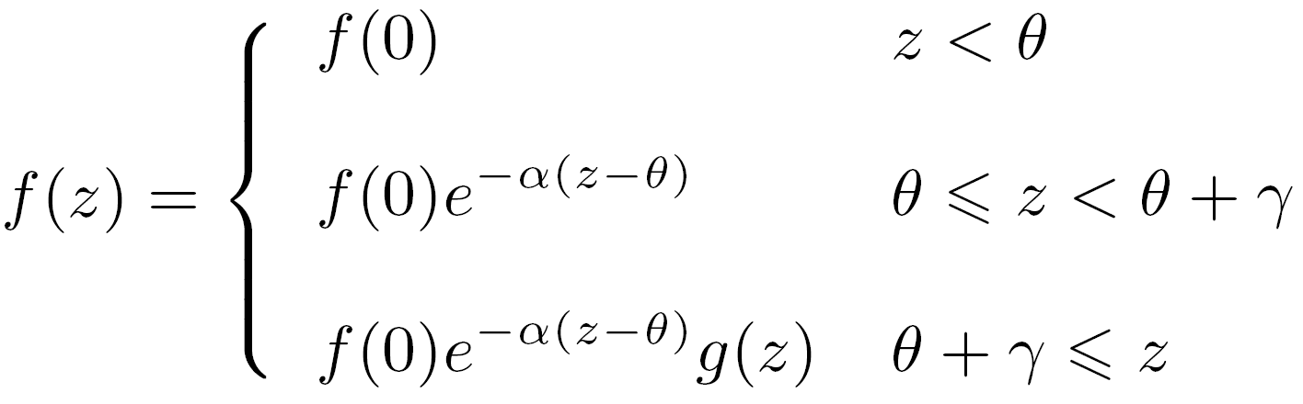
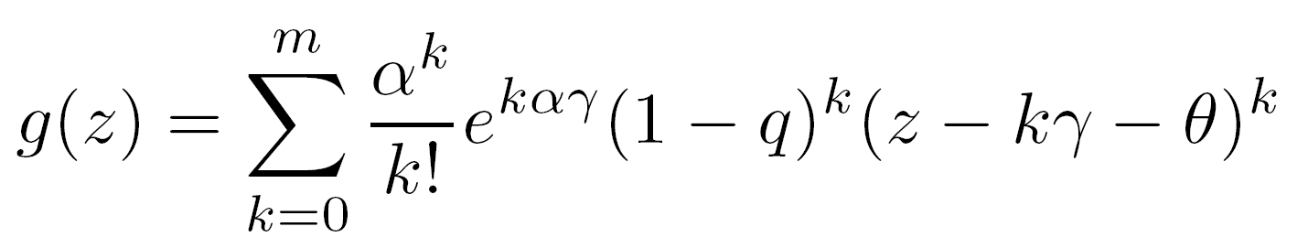
Solution: PDF of the Age of Pseudonyms

Slide 34
Outline
Age of Pseudonym: A Metric for Location Privacy
Dynamical System: Mean Field Equations
Analytical Results
Numerical Results

Slide 35
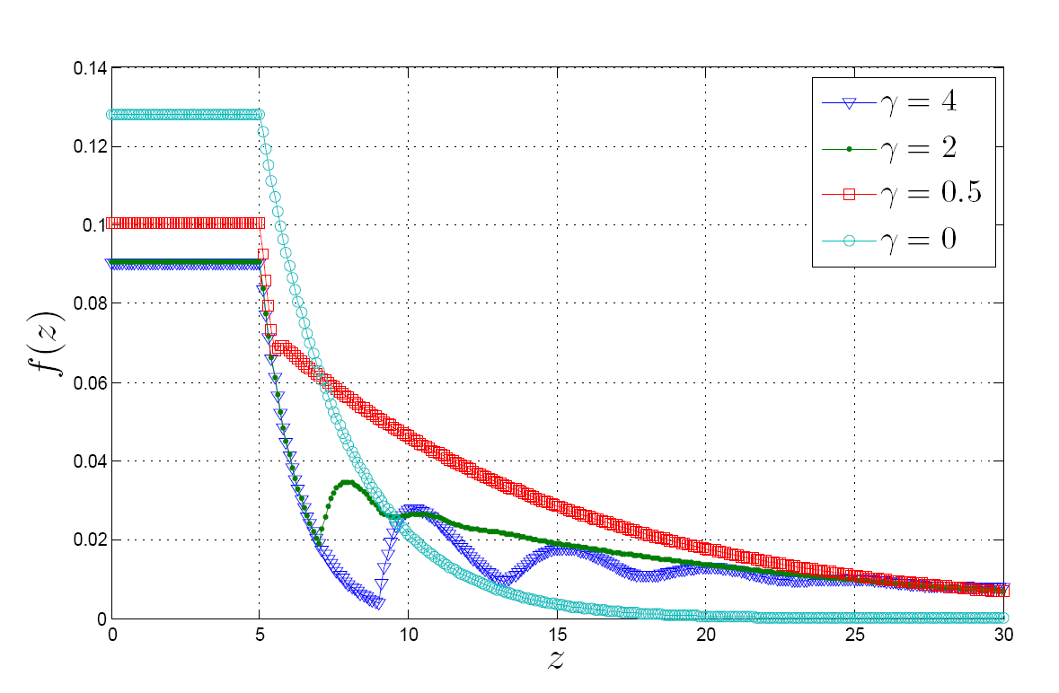
Gamma
Cost of Pseudonym change
θ = 5, λ=1, c₀=1
  Constant -- f(0)
  Exponential
  Exponential X Polynomial
Result 1: High γ results in older pseudonym distribution because of second jump process
Notes:
Surprising result: Oscillations depending on gamma.

Slide 36
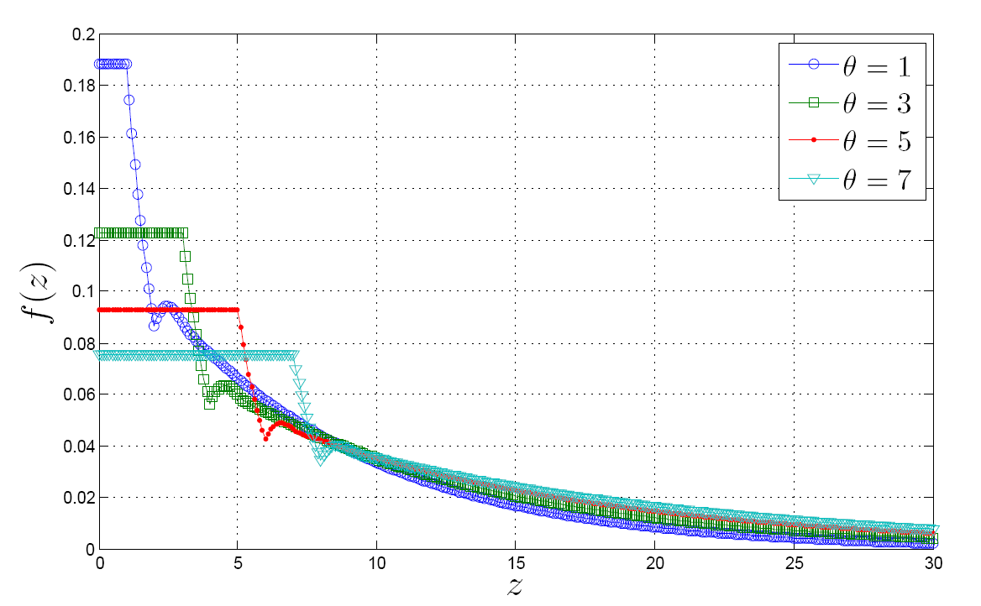
Theta
Cooperation Threshold
γ= 5, λ=1, c₀=1
Result 2: High θ results in older pseudonym distribution
because there is less cooperation.

Slide 37
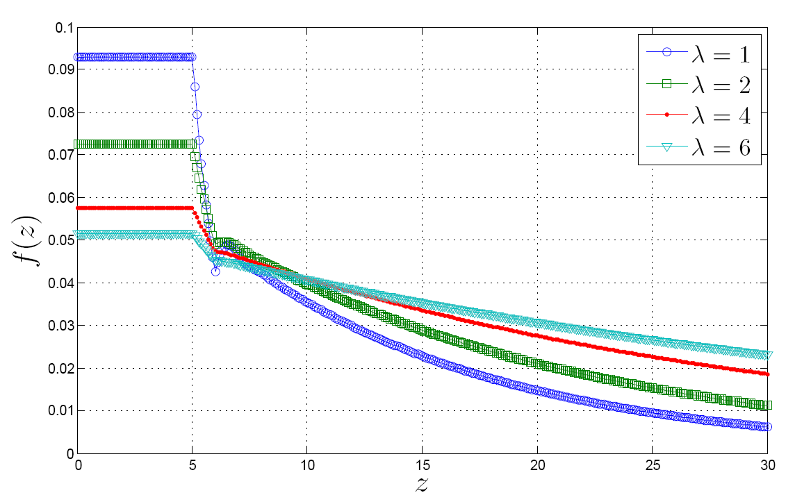
Lambda
Communication rate
γ= 1, θ =5, c₀=1
Result 3: High λ results in older pseudonym distribution because pseudonym ages faster.

Slide 38
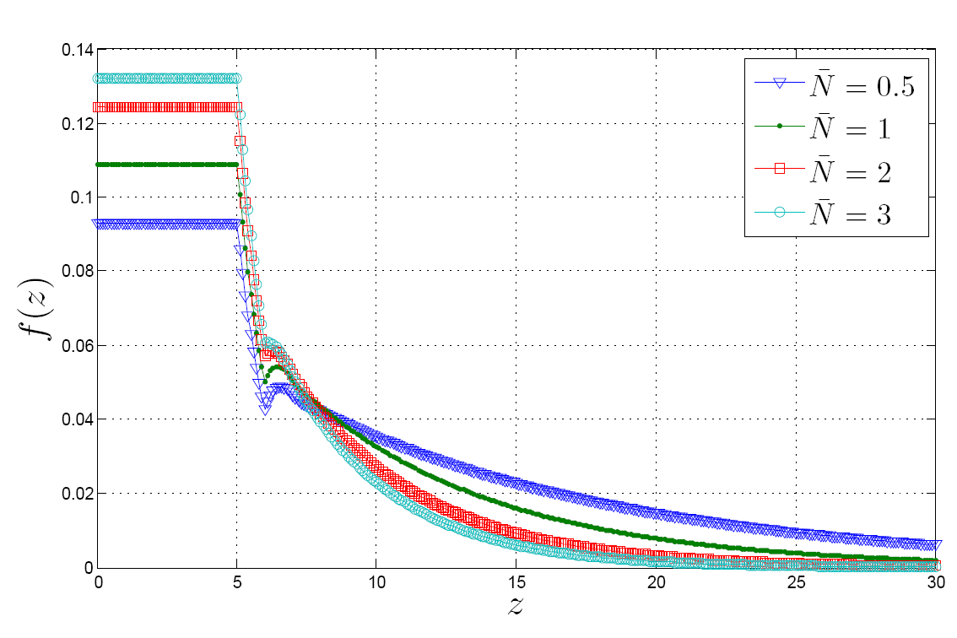
Average number of nodes in meeting
γ= 1, θ =5, c₀=1, λ=1
Result 4: High N results in younger pseudonym distribution
because it is easier to find cooperative nodes.

Slide 39
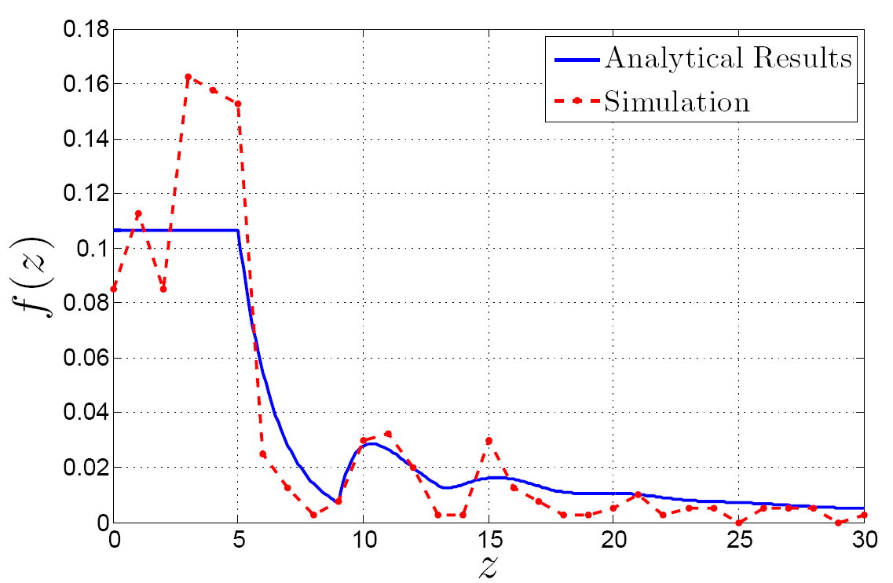
Model Validation
Random walk model
10km X 10km
Transmission range: 100 meters
Run simulation until convergence

Slide 40
Conclusion
Developed a framework to measure the distribution of age of pseudonyms
Main result: Possible to design system with low distribution of age of pseudonym
Obtained a fundamental building block of location-privacy-preserving systems
lca.epfl.ch/privacy
twitter.com/jfreudiger

