Slide 1
Towards Privacy-Friendly
Online Advertising
Julien Freudiger, Nevena Vratonjic, and Jean-Pierre Hubaux
May 2009, W2SP

Slide 2
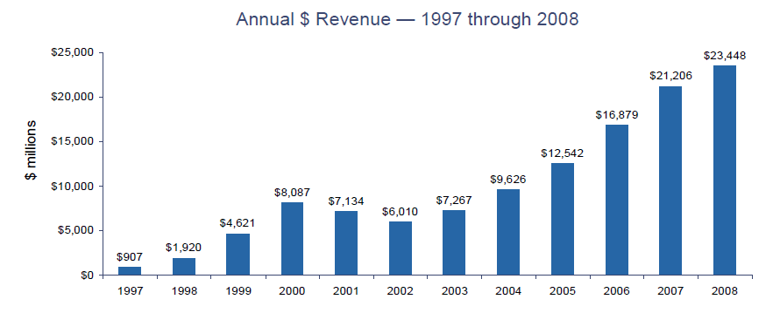
Motivation
Online advertising is at center of online economy
  Immediate and personalized
  Enables Behavioral targeting
Users benefit from relevance of ads
Website generate profit from ads
Notes:
Example: Google integrates user preferences to help improve relevance of ads.

Slide 3
Motivation (2)
But privacy concerns
  Track user activities online
Privacy/Traceability trade-off
Privacy
Block all
1
Trade-off
Allow all
0
Traceability
1
Provide a way to control amount of information shared
Notes:
With current solutions, we are completely embracing or disabling behavioral online advertising.
User centric solution at an acceptable price for users, web sites and advertisers.
Example: adblock + to allow websites to by pass ad blocking in some cases

Slide 4
Outline
Online Advertising
  Privacy Implications
  Existing Solutions
Proposed Solution
  Privacy friendly Cookie management
  User centric
Evaluation
  Firefox Extension

Slide 5
Online Advertising
Users
U
Visible servers
S
Hidden servers
D
u
s₁
d₁
s₂
Associated
web sites
u-> s₁: www.lemonde.fr
, TP-cookie
u-> s₂: www.google.ch
, TP-cookie
Notes:
Cookies: data-value pairs used to identify users
TP cookies : Used with third-party servers
Visible server = Web domain, i.e., can host several web sites.
We focus on this model of advertising as most of advertisement measured (measurable) online is with TP, rather than FP.
We ignore cooperative tracking (difficult to evaluate anyways).

Slide 6
Privacy Implications
Cookies enable
  Spatial tracking: Track over different domains
  Temporal tracking: Identify subsequent visits
Referrer reveals visited website
Advertisers learn browsing behavior of users
  Searches
  Consulted web pages
  Social graph
Notes:
Context
Behavior ads
Spatial & temporal tracking

Slide 7
Existing Solutions
All or nothing
  Block requests
  Block cookies
Same origin policy
  “Only the server that set cookie can access it”
  Prevents loss of data confidentiality or integrity
  But too permissive for online tracking

Slide 8
Proposed Solution
Trade-off privacy and traceability
  Limit spatial and temporal tracking
  User centric solution
Define policies for use of cookies
  User privacy/advertisement preferences
  Visited web site

Slide 9
Intuition
Maintain a collection of cookies in parallel
  Use cookie with an advertiser depending on the visited web site
  Similar to multiple pseudonym approach in mobile networks to achieve location privacy

Slide 10
Approach 1
Limit tracking based on web domain
u
s₁
d₁
s₂
u-> s₁: www.lemonde.fr, cookie(d1)
u-> s₁: www.lemonde.fr/technologie, cookie(d1)
u-> s₂: www.google.ch , cookie(d1,2)
One TP-cookie per domain
For a limited number of times
Notes:
On tp cookie per domain

Slide 11
Approach 2
Limit tracking based per web site categories
u
s₁
d₁
s₂
s₃
s₄
u-> s₁: www.lemonde.fr, cookie(d1)
u-> s₂: www.nyt.com, cookie(d1)
Same category
u-> s₃: www.ft.com, cookie(d1,2)
u-> s₄: www.google.ch , cookie(d1,3)
Different categories
u-> s₄: mail.google.ch , cookie(d1,4)
Limited use of TP-cookies per category
Use for a limited number of times

Slide 12
Approach 3
Limit tracking based on each web site category and URL
User preferences | URL
0.3 | 0.1
u-> s₁: www.google.com, cookie(d1)
0.3 | 0.9
u-> s₂: www.google.com/search?q=computers, cookie(d1)
1 | 0.1
u-> s₃: www.facebook.com, cookie(d1)
1 | 1
u-> s₄: www.facebook.com/search?q=nevena , cookie(d1,2)
Limited use of TP-cookies based on user preferences
Use for a limited number of times
Notes:
Third approach has higher granularity and control

Slide 13
Implementation
Firefox extension: PrivaCookie
  Proof of concept code
  Get it on http://icapeople.epfl.ch/freudiger
TP cookie detection
  Compare originating URL with current URL
Local cookie table
  Link cookies with hidden server that caused its assignment and visible server hosting ads
  ( Cookie, visible server, hidden server )

Slide 14
Study
Firefox extension pagestats
  Runs browser in batch mode with list of web sites
  We chose 10 pages from each of the top 20 domains
  A total of 200 pages

Slide 15
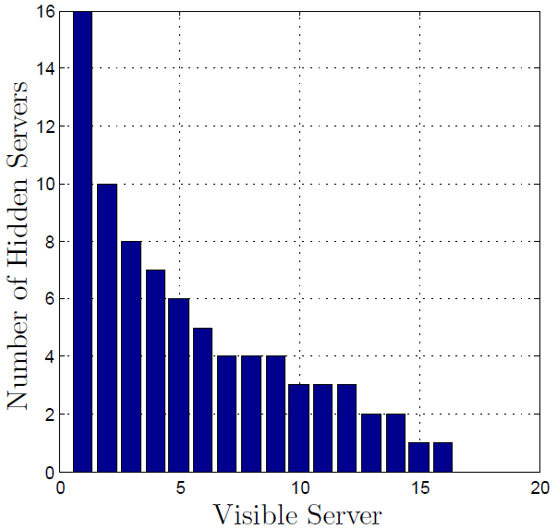
Number of hidden servers for each of the top 20 domains
Notes:
Half of the web domains are affiliated with at least 4 hidden servers => Significant tracking
AOL.com is connected with a total of 16 hidden servers
A total of 70 hidden servers.
Out of all hidden servers, a majority of online advertisers (72%)
Among the 20 visited web domains, 16 embedded advertisement.
Comply with related work results

Slide 16
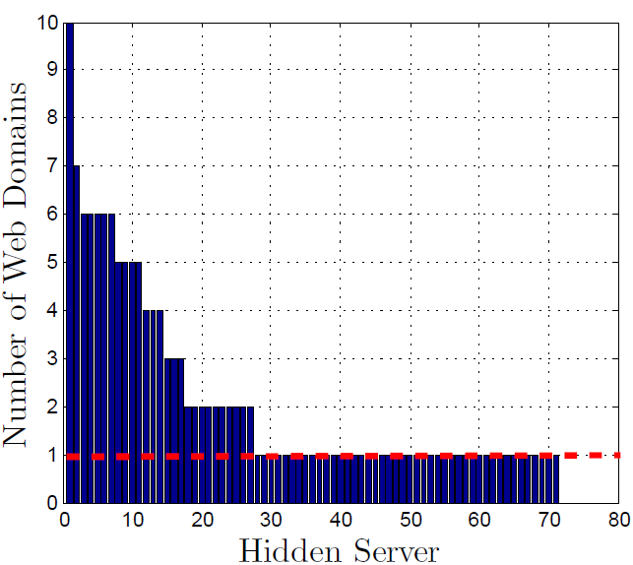
Number of visible servers for each hidden server
PrivaCookie
Notes:
Most popular hidden server is doubleclick.net
25 hidden servers are at least associated with 2 web domains.
PrivaCookie in its current form prevents tracking across domains

Slide 17
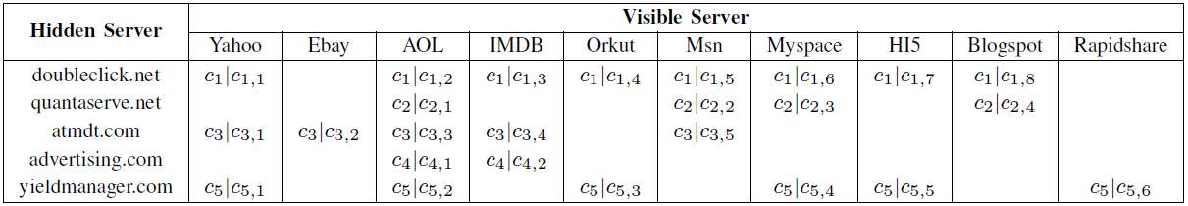

Top 10 associated visible servers connected with the most popular advertisers
c₁|c_{1,1}
c₁|c_{1,2}
c₁|c_{1,3}
c₁|c_{1,4}
c₁|c_{1,5}
c₁|c_{1,6}
c₁|c_{1,7}
c₁|c_{1,8}
Extension caused 81 additional cookies assignments

Slide 18
Advertisers Countermeasures
Online advertisers can still track users
  Based on IP
  With cache cookies
  By mining browser history
  Plugins (e.g., Flash cookies)
Proposed policies apply to those cases
Cooperative tracking?

Slide 19
Conclusion
No changes required from advertisers
Users are in control
Trade-off privacy/traceability
  Protect privacy
  Allow for targeted online advertising
Future Work:
  Implement third approach
  Implement Javascript support
  Consider other parameters
  Resistance to cooperative tracking

