Slide 1
Towards Provable Secure Neighbor Discovery in Wireless Networks
Marcin Poturalski
Panos Papadimitratos
Jean-Pierre Hubaux

Slide 2
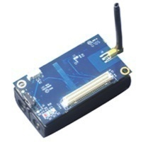
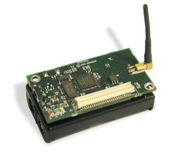
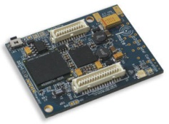
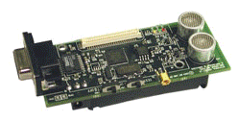
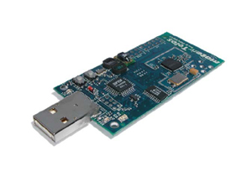
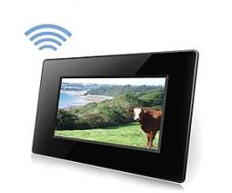


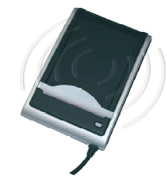

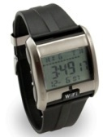

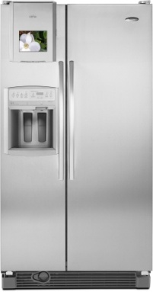


Proliferation of Wireless Networks
Wireless Sensor Networks
WiFi and Bluetooth enabled devices
RFID
Notes:
In recent years we are observing a rapid expansion of wireless devices:
- more and more familiar, every day use devices become wi-fi or bluetooth enabled
- we have RFID on price tags, in our passports, and various id cards (metro, …)
- on the more research side, wireless sensor networks constantly are developing

Slide 3
Proliferation of Wireless Networks
Strength of wireless networks:
  Any devices in range can communicate without additional infrastructure
Enables ad-hoc and mobile networking
  Devices do not know in advance with whom they can communicate
Neighbor Discovery becomes essential:
  Can wireless device A communicate directly with wireless device B?
Notes:
The strength of wireless, and one of the reasons we are observing this expansions, is the ease of communication that wireless enjoys: any two devices in range can communicate, without any infrastructure, like cables.
In other words, wireless enables ad-hoc and mobile communications, not really feasible before. (The example networks shown in the slide rely on this types of communication).
However, because in such networks you cannot know in advance with which other devices you will be able to communicate, neighbor discovery becomes a crucial problem
Neighbor discovery, that is, discovery which other devices are in range, or in other words, with which direct communication is possible.

Slide 4
Neighbor Discovery
How to achieve Neighbor Discovery?
Notes:
<Read>

Slide 5


Neighbor Discovery
How to achieve Neighbor Discovery?
Simple, widely used solution, but not secure
“Hello, I’m A”
A
B
B: “A is my neighbor”
Notes:
Naïve neighbor discovery is very easy:
Consider the following: a wireless device A sends beacon messages containing its identifier, e.g., “Hello, I’m A”. Any wireless device B that receives such a message will conclude that A is a neighbor…. As simple as that ;)
This is a very simple and widely used solution, but unfortunately, it is not secure…

Slide 6


Attacking Neighbor Discovery
“Relay” or “Wormhole” Attack
The adversary simply relays the message
A
“Hello, I’m A”
B: “A is my neighbor”
“Hello, I’m A”
M
Notes:
… which we can demonstrate with the following attack, called a relay or a wormhole attack
Consider two devices A and B which are *not* neighbors. Device A, however, will still send the beacon messages. Imagine an attacker M who overhears such a message, and replays it without any modification to device B. As a result, B will conclude that A is a neighbor, even though it is not. Correctness of ND is violated.
Why should we care? This simple attack can have devastating implications on protocols and applications that rely on ND as a building block.

Slide 7

Attacking ND:
Routing in Sensor Networks
[1] Y.-C. Hu, A. Perrig, and D. B. Johnson. Packet leashes: A defense against wormhole attacks
in wireless networks. INFOCOM 2003
Notes:
One classical example is routing in multihop wireless networks, such as a wireless sensor network.

Slide 8
Attacking ND:
Routing in Sensor Networks
The adversary sets up a wormhole, convincing remote nodes they are neighbors
[1] Y.-C. Hu, A. Perrig, and D. B. Johnson. Packet leashes: A defense against wormhole attacks
in wireless networks. INFOCOM 2003
Notes:
The attacker sets-up a wormhole: two devices connected via an out-of-bank link, relaying the traffic between these two devices
This disturbs ND and creates some false links. These links are significant “shortcuts” across the network: a routing protocol preferring shorter/’faster” routes will be attracted to these false links.

Slide 9
Attacking ND:
Routing in Sensor Networks
This “shortcut” attracts many routes
The adversary can eavesdrop, modify, or drop (DoS)
Local attack with global impact!
Notes:
As a result, all the traffic from the “left” side of the network to the “right” side of the network will go through the wormhole. With a local attack, the adversary gets global impact.
The adversary can eavesdrop, do traffic-analysis, modify, and (perhaps most significantly, as it cannot be stopped by cryptography) drop messages coming through the wormhole, e.g., messages critical to the system operation, such as a fire-alarm.

Slide 10
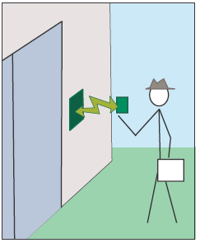
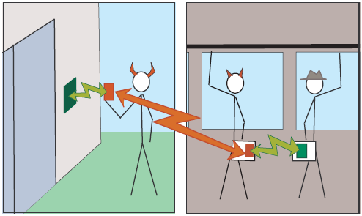
Attacking ND:
RFID Access Control
[2] Z. Kfir and A. Wool. Picking virtual pockets using relay attacks on contact-less smartcard.
SECURECOMM 2005
Notes:
There are other examples, such as RFID access control.

Slide 11
Attacking Neighbor Discovery
“Relay” or “Wormhole” Attack
The adversary does not modify any messages
Cryptography alone cannot help
A
“Hello, I’m A”
B: “A is my neighbor”
“Hello, I’m A”
M
Notes:
What is devious about this attack is that the adversary does not need to modify any messages. Hence, you can sprinkle your ND protocol with any kind of powerful crypto you want, it will not solve the problem. You need something more…

Slide 12
Securing Neighbor Discovery
Use message time-of-flight to measure distance
Reject “neighbors” who are too far away
  Distance Bounding [3]
  Temporal Packet Leashes [1]
  SECTOR [4]
Use node location to measure distance
  Geographical Packet Leashes [1]
[1] Y.-C. Hu, A. Perrig, and D. B. Johnson. Packet leashes: A defense against wormhole attacks
in wireless networks. INFOCOM 2003
[3] S. Brands and D. Chaum. Distance-bounding protocols. EUROCRYPT '93
[4] S. Capkun, L. Buttyan, and J.-P. Hubaux. SECTOR: secure tracking of node encounters in
multi-hop wireless networks. SASN '03
Notes:
… and various proposals exist in the literature.
First, one can relay on time: because the wireless signal propagates with a known, fixed velocity, one can measure message time-of-flight and from it derive the distance between the nodes. Knowing the distance, an ND protocol can reject fake neighbor who are too far away. A number of proposals uses this approach (first of which was not even designed for wireless).
Second, node location can also be used to derive the distance between nodes.
Other proposals exist, but in this work we focus on protocols which use time and location.

Slide 13

Our Contribution: “provable”
Model taking into account physical aspects of the wireless environment
Previously [5]: Impossibility result for time-based protocols
obstacle
A
B
A
M
B
No time-based protocol can distinguish these two situations
[5] M. Poturalski, P. Papadimitratos, and J.-P. Hubaux. Secure Neighbor Discovery in Wireless
Networks: Formal Investigation of Possibility. ASIACCS '08
Notes:
What is our contribution in this story? It is not the word “provable” – we want to prove things about neighbor discovery.
To this end, we have developed a mathematical model of the wireless environment, which takes into account physical aspects normally abstracted away from, but crucial for ND protocols, such as node location or propagation time.
In a previous piece of work, we have used our model to prove that in general, no protocol that uses only time measurements can provide secure ND. The fundamental reason is quite simple, as depicted in the slides: no protocol that uses only time-measurements can distinguish the “left-side” situation, where two close-by nodes are not neighbors, e.g., because of an obstacle, and an adversary is relaying all the communication with a very small added delay, and the “right-side” situation, where two further-away nodes are neighbors.

Slide 14
Our Contribution: “provable”
Model taking into account physical aspects of the wireless environment
This work: Proving the correctness of ND protocols
  Model extended and modified
    Closer representation of the wireless environment
  Stronger availability properties
  Composability
Notes:
In this piece of work, we focus the more “practical” side, i.e., proving things about specific ND protocols.
To this end, we needed to extend and modify our model. Some things were simply missing (e.g., nonces). In addition some of the abstractions that were perfectly fine in the case of the impossibility result, were not realistic and detailed enough when we wanted to reason about protocols (e.g, message temporal structure). In short, we needed to push the model closer to reality.
We have also used stronger, and thus much more practical availability properties, and, too a certain extend considered composability (i.e., executing the ND protocols with other protocols).
[NOTE: for the impossiblity result we used the weakest availability property possible. This was desired, because impossibility with respect too weaker properties is a stronger result. On the other hand, when talking about specific protocol, we want to prove properties which are as strong as possible.]

Slide 15
Outline
The model
ND properties
Example ND protocol
Skip proof
Limitations and possible extensions
Notes:
After this introduction, here’s the outline of the reminder of the talk.
First, I will present our model, for the sake of time a slightly simplified version.
Then, I will show our ND specification, i.e., the properties that we want ND protocols to satisfy.
Next, I will show how in our model we can define one example ND protocol.
I will omit the proof (that the example protocol satisfies our specificiation), as it is relatively straightforward.
Finally, I will briefly discuss some of the more interesting limitation of our model and directions for future work.

Slide 16
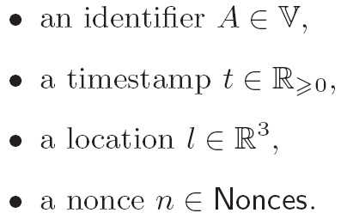



Messages
Any of the following is a message:
An authenticator is a message:
A concatenation is a message:
Message are essentially terms
  Subterm relation
Notes:
First, the model.
The first component of out model are the messages.
<read first bullet: any of the following…>
Then, if we take a message, and an identifier, we can create a new message: an authenticator, which corresponds to a digital signature.
And, if we take two messages, we can concatenate them to create a new message.
This is pretty standard: we can think of message as terms, and we will use the subterm relation as denote it as shown in the slide.

Slide 17


Messages: Temporal Structure
Message m has a duration |m|
  message transmission time (bit-rate dependant)
Duration is preserved by concatenation
m₁
m₂
m₃
m_{k}
Notes:
The more interesting part of the messages: the temporal structure.
Every message in our model has a duration, which corresponds to the time it takes to transmit it onto the medium (this depends on the bitrate).
Duration is preserved by concatenation: if we take a message m which is a concatenation of messages m_i, then it temporal structure looks like shown in the figure:
The duration of m is the sum of durations of m_i’s, and we can talk about the position of m_i within m.

Slide 18
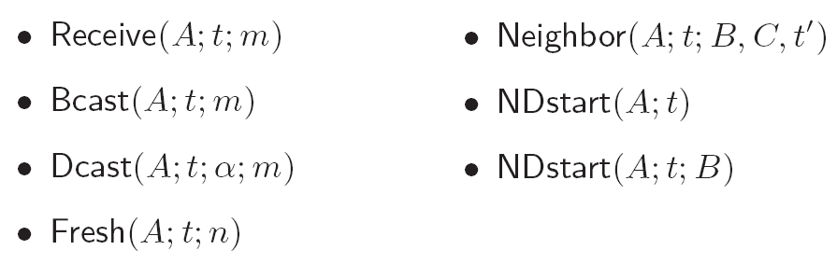
Events
Events temporal structure: inherited from m
t – start time
Notes:
Having messages, we can define events.
The first three model communication.
Node A can at time t receive a message m.
Node A can at time t broadcast a message m.
Node A can at time t D-cast a message m, where dcast stand for sending with a directional antenna, \alpha describes (what we call an antenna pattern, which is roughly) the direction in which the message is sent.
Then we have a nonce-related even:
4) Node A at time t generates a fresh nonce n
And finally, three events corresponding to ND.
5) Node A at time t declares that node B was a neighbor of C at time t’ [NOTE: the declaration is made at time t, t’ refers to the time then B and C were supposed to be neighbors).
6) Node A at time t start a ND protocol, either with a specific neighbor B, or with all node in the neighborhood.
Events also have temporal structure, which in case of the communication events is inherited from the message m. we assume the other events are instantaneous (duration is 0). t denotes the start time of the event

Slide 19

Events
Events temporal structure: inherited from m
t – start time
Useful notation:
m₁
t
Notes:
We will use the following convenient notation for communication events. When we write something like shown in the slide, we mean that node A boradcasts message m_2 (not m_1), but the time t actually corresponds to the position of m_1 inside m_2, as shown in the figure.

Slide 20






Traces
A trace model a system execution
A trace θ in Θ is a set of events
A
B
C
Notes:
Next, we define traces. A trace model a system execution. Formally, it is a set of event. (We do not use sequences, as is more traditionally done, because the order of the events is derived from the start time of the events.)
What is shown in the figure is a graphical representation of one example trace: just some nodes A,B,C sending receiving and making neighbor declarations….

Slide 21
Traces
A trace model a system execution
A trace θ in Θ is a set of events
A
B
A receives m₂ before B sends it…
C
Notes:
… However, if you look at it closer, you will notice a problem: node A receives message m_2 before B actually sends it.
This demonstrates that we need to add some constraints on the traces to make them meaningful. But before we can do that, we need one more notion…

Slide 22
Traces
A trace model a system execution
A trace θ in Θ is a set of events
A
We need to constrain traces
to make them meaningful
B
C
Notes:
… However, if you look at it closer, you will notice a problem: node A receives message m_2 before B actually sends it.
This demonstrates that we need to add some constraints on the traces to make them meaningful. But before we can do that, we need one more notion…

Slide 23
Setting
A setting models an instance of the environment
Formally: S = (nodes, loc, type, link, nlos)
Notes:
… that of a setting. A setting represent one particular instance of the wireless environment. Formally it is a tuple, which tell us….

Slide 24
Setting
S = (nodes, loc, type, link, nlos)
The nodes in the setting
Notation: V
{ A, B, C, D, E, F, G, H }
Notes:
… what node we have in the setting, or the identifiers of these nodes. We denote this by V

Slide 25
Setting
S = (nodes, loc, type, link, nlos)
Location of every node
Notation: dist
E
F
C
D
H
A
B
G
Notes:
The location of every node. We will also use the distance function dist that is straightforwardly derived from loc.
[NOTE: distance is symmetric.]

Slide 26
Setting
S = (nodes, loc, type, link, nlos)
Type of every node: correct/adversarial
Notation: V_{cor} / V_{adv}
E
F
C
D
H
A
B
G
Notes:
The type of every node: is it correct, or adversarial. In term of notation, this devides the set of nodes into Vcor and Vadv.

Slide 27



Setting
communication
possible not
S = (nodes, loc, type, link, nlos)
The link/neighbor function
Notation:
link A to B is up at time t
links A to B and B to A are up at time t
E
F
C
D
H
A
B
G
Notes:
The link relation, which can also be called the neighbor relation.
For every pair of nodes A, B, the link function tells us if at a given time instance this link (A,B) is up (meaning that B can receive messages from A), or down (meaning that it cannot).
In terms of notation, we use the thing shown on the slide to denote that the links is up at time t from A to B, or in both directions.
[NOTE: link relation is not symmetric.]

Slide 28
Setting
S = (nodes, loc, type, link, nlos)
Non-line-of-sight “delay” nlos(A,B) ≥ 0
The additional distance the signal needs to traverse
E
F
C
D
H
A
B
G
Notes:
Finally, nlos, which stand for non-line-of-sight tells us for every link, what is the additional distance compared to line-of-sight communication, which the wireless signal has to traverse when propagating from A to B (and in the reverse direction). This notion is necessary, because with wireless communication can sometime be possible even if the path that the signal has to traverse is not a straight line (e.g., there is an obstacle between the nodes, but the signal can reflect of a wall). Obviously, nlos >= 0.
[NOTE: nlos is symmetric]
[NOTE: why does link change over time but not the elements of a setting? Mostly for simplicity.
Nodes – adding or removing nodes can be expressed by links going up and down, hence it can be omited
Type – having node change type could model corruption: but we can just as well express that by having an adversarial node behave as correct one up to some point in time
Loc, Nlos – adding mobility and variable nlos would make the model more realistic; however, it would make the model quite more complex and less tractable. One can argue that the time scale at which ND protocols are run is such that mobility is negligible. But in general making this two time-dependant is something worth considering in the future]

Slide 29
Feasible Traces
A feasible trace θ in Θ_{S,P,A} satisfies constraints imposed by:
  a setting S
    Communication follows the laws of physics
  a protocol P
    Correct nodes follow protocol P
  adversary model A
    Adversarial nodes abide with adversary model
Notes:
Now we are ready to define the constrains that will make the traces *feasible*, i.e., correspond to actual system executions.
There are 3 aspects of feasibility:
A trace should be feasible wrt. a setting, which means that communication follows the laws of physics wrt. to that particular setting (i.e., communication is causal and timely).
Wrt. a protocol P, which means that correct nodes follow the protocol P
Wrt. the adversary model A, which means that the adversarial nodes behave as we expect them too (they do not do impossible things).
I will now show how we formally define these 3 aspects of feasibility…

Slide 30
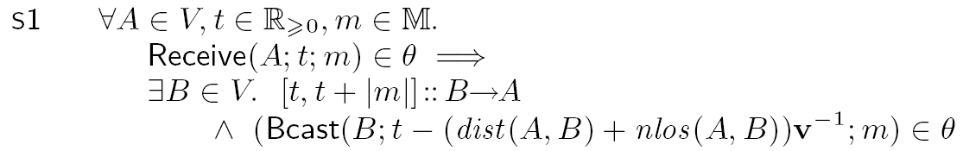
Setting-feasible Traces
A
B
v – wireless channel propagation speed
Notes:
… first with respect to a setting.
All the constraints are specified with formulas as the one shown in the slide. As it might look a bit complicated, let me read it out for you.

Slide 31

Setting-feasible Traces
A
B
v – wireless channel propagation speed
Notes:
So, whenever there is a receive event in a trace, A receives m at time t…

Slide 32
Setting-feasible Traces
A
B
v – wireless channel propagation speed
Notes:
… for some node B the link from B to A has to be up throughout the duration of the receive event…

Slide 33
Setting-feasible Traces
A
B
propagation delay
v – wireless channel propagation speed
Notes:
And node B has to sent message m, exactly propagation time before A receives it, where the propagation time is the distance between A and B, plus the non-line-of-sight component, divided by v, the wireless channel propagation speed.
This is a slightly simplified form, in the full form we also take Dcast into account. Then, we also have dual rules, which say that if a bcast/dcast occurs, and the links is up, there has to be a corresponding receive event in the trace.

Slide 34
Setting-feasible Traces
Full form of this rule includes the Dcast event
Dual rules:
  If there is a Bcast/Dcast event and a link is up, there will be an Receive event
Notes:
And node B has to sent message m, exactly propagation time before A receives it, where the propagation time is the distance between A and B, plus the non-line-of-sight component, divided by v, the wireless channel propagation speed.
This is a slightly simplified form, in the full form we also take Dcast into account. Then, we also have dual rules, which say that if a bcast/dcast occurs, and the links is up, there has to be a corresponding receive event in the trace.

Slide 35
Adversary-feasible Traces
Adversarial nodes can behave arbitrarily, except respecting:
  unforgability of authenticators
  freshness of nonces
Authenticators and nonces need to be relayed
Notes:
Next aspect of feasibility, wrt. to the adversary.
Intuitively, we allow the adversarial nodes to behave in an arbitrary fashion, but we require them to respect the unforgability of authenticatos and the freshness of nonces.
The rough idea is that authenticators and fresh nonces cannot be sent from thin air, they have to be relayed.
I will now show how do we define authenticators unforgability in our model…

Slide 36
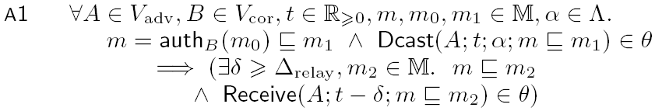
Adversary-feasible Traces
A
Notes:
...And this is node with this formula ….

Slide 37

Adversary-feasible Traces
A
auth_{B}(m₀)
Notes:
… which states: whenever an adversarial node Dcasts a message….
[NOTE: we assume that adversarial nodes use only dcast, and correct node use only bcast. This is not restricitive, as a Bcast is equvalent to a Dcast with a particular antenna patern.]

Slide 38
Adversary-feasible Traces
A
auth_{B}(m₀)
Notes:
… which contains an authenticator generated by a correct node, this HAS TO BE a relay, that is…

Slide 39

Adversary-feasible Traces
A
auth_{B}(m₀)
auth_{B}(m₀)
Notes:
… node A had to receive a message containing this authenticator….

Slide 40

Adversary-feasible Traces
A
auth_{B}(m₀)
auth_{B}(m₀)
Δ_{relay} – the minimum processing delay when relaying
Notes:
… and it had to receive it at least \Delta_relay before sending, with respect to the position of the authenticator in both messages (not the actual messages starting times).
Delta_relay is a parameter of the model which defines the minimum processing time when relaying a message, which applies to all nodes (adversarial or correct).

Slide 41
Adversary-feasible Traces
A
auth_{B}(m₀)
auth_{B}(m₀)
Adversarial nodes can communicate over an adversarial channel with information propagation speed v_{adv} ≥ v
Notes:
This rule is again slightly simplified: in the full version, we allow adversarial nodes to communicate using an adversarial channel not perceivable to correct nodes. Information propagates across this channel with the speed v_adv >= v (v is the wireless medium propagation speed).
The rule that guarantees nonce freshness is very similar.

Slide 42
Protocol-feasible Traces
Rules are protocol-specific
One general rule that requires correct nodes to respect the freshness of nonces
Notes:
Finally, the last aspect, feasilibty wrt. a protocol. In general, rules which define this are protocol specific, and I will shown you bunch of those when we get to our example protocol. However, there is also a general rule which applies to all protocol, and which says that correct nodes, as adversarial nodes, need to respect nonce freshness. This rule is very similar to the rule which we have just seen on authenticator unforgability….

Slide 43


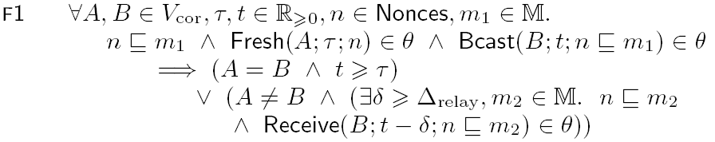
Protocol-feasible Traces
B
n
n
Notes:
Finally, the last aspect, feasilibty wrt. a protocol. In general, rules which define this are protocol specific, and I will shown you bunch of those when we get to our example protocol. However, there is also a general rule which applies to all protocol, and which says that correct nodes, as adversarial nodes, need to respect nonce freshness. This rule is very similar to the rule which we have just seen on authenticator unforgability….

Slide 44
Protocol-feasible Traces
B
n
n
Notes:
… one feature worth highlighting is the presence of the Fresh event: we only put restrictions on handling of freshly generated nonces.
This concludes the presentation of the model.

Slide 45
ND Properties
Correctness: “declared neighbors are actual neighbors”
Notes:
Now, our specification. We have two properties.
The first one, correctness, which we denote ND1, states that….

Slide 46
ND Properties
Correctness: “declared neighbors are actual neighbors”
Notes:
….For every setting and every feasible trace….

Slide 47
ND Properties
Correctness: “declared neighbors are actual neighbors”
Notes:
If node correct node A makes a neighbor declaration: B was a neighbor of C at time t’….

Slide 48
ND Properties
Correctness: “declared neighbors are actual neighbors”
Notes:
… then this link has to be up at time time.

Slide 49
ND Properties
Correctness: “declared neighbors are actual neighbors”
Notes:
Note here, that we assume that nodes B and C are both correct. This is a typical assumption, stemming from the fact that ND becomes much more difficult when we would like to consider internal adversaries.

Slide 50
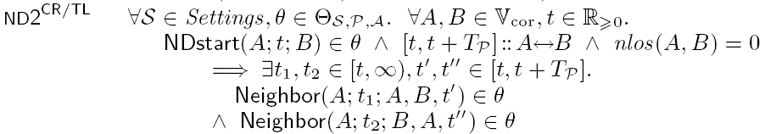
ND Properties
Correctness: “declared neighbors are actual neighbors”
Availability: “actual neighbor are declared neighbors”
T_{P} – protocol specific duration
Notes:
The 2nd property is availability, which we denote ND2. Note that this property has an index, which means that it correspond to a particular protocol.
We could have had one version of the availability property, but to have it general it would have to be weaker then what we can demand on a per-protocol basis. Hence we have protocol specific versions, but all state roughly the same: it is possible to discover neighbors who are actually neighbors.

Slide 51
ND Properties
Correctness: “declared neighbors are actual neighbors”
Availability: “actual neighbor are declared neighbors”
T_{P} – protocol specific duration
Notes:
Formally: for all settings and all feasible traces….

Slide 52
ND Properties
Correctness: “declared neighbors are actual neighbors”
Availability: “actual neighbor are declared neighbors”
T_{P} – protocol specific duration
Notes:
If node A start the ND protocol with B at time t…

Slide 53
ND Properties
Correctness: “declared neighbors are actual neighbors”
Availability: “actual neighbor are declared neighbors”
T_{P} – protocol specific duration
Notes:
… and link A,B is up in both directions from t until some protocol specific time T_P…

Slide 54
ND Properties
Correctness: “declared neighbors are actual neighbors”
Availability: “actual neighbor are declared neighbors”
T_{P} – protocol specific duration
Notes:
… and the non-line-of-sight penalty for this link is 0….

Slide 55
ND Properties
Correctness: “declared neighbors are actual neighbors”
Availability: “actual neighbor are declared neighbors”
T_{P} – protocol specific duration
Notes:
… then the protocol must be able to declare that A is a neighbor of B, and that B is a neighbor of A.
This concludes the specification.

Slide 56
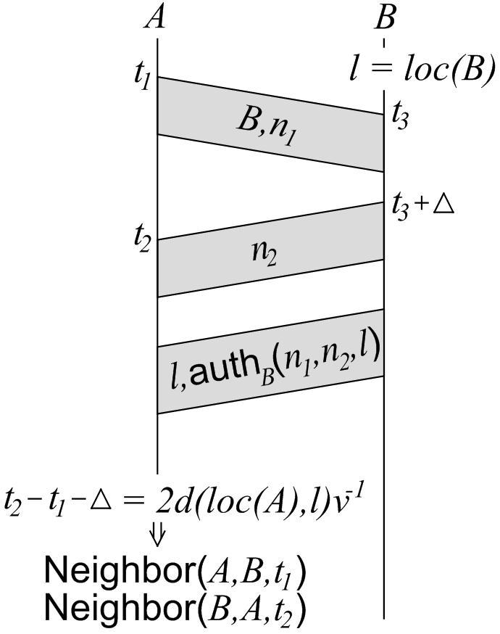
Protocol P^{CR/TL}:
Challenge-Response/Time-and-Location
challenge
message
response
message
authentication
message
Notes:
I now show you an example protocol.
We denote it P^CR/TL, which stands for challenge-response / time and location based
Intuitively, the protocol works as follows:
Node A sends a challenge message, which consists of an identifier of the nodes it wished to discover, B, and a fresh nonce.
Node B, having received the challenge, exactly after \Delta, which is a publicly known constant, replies with a response message, which consists of another fresh nonce.
Then, some times later, node B sends an authentication message, which consists of the location of B (l), and an authenticator on both nonces and the location.
Node A, having received the response message and the authenticator message computes two estimates of the distance:
Based on time (left-side of eq.)
Based on location (right-side of eq.)
Only if this two estimates are equal, the protocol makes appropriate neighbor declarations.
At this point, we got an interesting comment from the reviewers: it is hard to see the relation between this informal presentation, and the definition that we give in our model. It’s hard to see that this is the same protocol. To address this, we decided to use a different informal presentation, a intermediate level of sort…
[NOTE: the two estimates in the figure are actually round-trip-time estimates, but that’s a detail]
[NOTE: more importantly: in an actual implementation, you cannot have perfect location and time estimates, naturally, the equality of estimates would need to be replaces with an approximate equality, where the allowed difference is dictated by the expected location and time estimation errors]

Slide 57
Protocol P^{CR/TL}:
Challenge-Response/Time-and-Location
Comment:
“Hard to see the connection between this informal presentation and formal protocol definition”
Solution:
Intermediate form:
informal “implementation” is pseudo-code
challenge
message
response
message
authentication
message
Notes:
I now show you an example protocol.
We denote it P^CR/TL, which stands for challenge-response / time and location based
Intuitively, the protocol works as follows:
Node A sends a challenge message, which consists of an identifier of the nodes it wished to discover, B, and a fresh nonce.
Node B, having received the challenge, exactly after \Delta, which is a publicly known constant, replies with a response message, which consists of another fresh nonce.
Then, some times later, node B sends an authentication message, which consists of the location of B (l), and an authenticator on both nonces and the location.
Node A, having received the response message and the authenticator message computes two estimates of the distance:
Based on time (left-side of eq.)
Based on location (right-side of eq.)
Only if this two estimates are equal, the protocol makes appropriate neighbor declarations.
At this point, we got an interesting comment from the reviewers: it is hard to see the relation between this informal presentation, and the definition that we give in our model. It’s hard to see that this is the same protocol. To address this, we decided to use a different informal presentation, a intermediate level of sort…
[NOTE: the two estimates in the figure are actually round-trip-time estimates, but that’s a detail]
[NOTE: more importantly: in an actual implementation, you cannot have perfect location and time estimates, naturally, the equality of estimates would need to be replaces with an approximate equality, where the allowed difference is dictated by the expected location and time estimation errors]

Slide 58

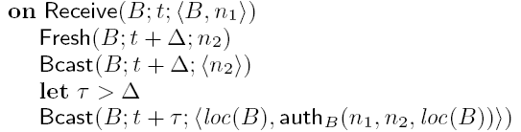
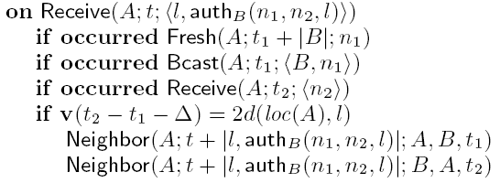
Protocol P^{CR/TL}: pseudo-code
block
block
block
A block states what events a node executes
when an event of interest occurs
Notes:
… we “implemented” the protocol, using pseudo code.
I emphasize, the pseudo-code is still an informal presentation, but it should be more clear from it why we define our rules the way we do.
How does this pseudo-code work (by example):
We have 3 blocks. Each block states how a node reacts to a particular event of interest: the events it execute are listed in the body of the block.
And so…

Slide 59
Protocol P^{CR/TL}: pseudo-code
Notes:
If an NDstart event occurs, triggered by a higher-layer protocol or application, the node will generate a fresh nonce and broadcast the challenge message

Slide 60
Protocol P^{CR/TL}: pseudo-code
Notes:
When then the node receives a challenge message, it will generate a fresh nonce, broadcast the response message, and later on the authentication message

Slide 61
Protocol P^{CR/TL}: pseudo-code
Notes:
Finally, when the node receives an authentication message, and it has also sent in the past a fresh challenge message and receives a response message (both corresponding to the authentication message, i.e., the nonces are the same), and the two estimates of the distance are equal, the node will make appropriate neighbor declarations.

Slide 62

Protocol P^{CR/TL}: rules
Notes:
Based on these 3 blocks, we can define 3 rules in a very straightforward manner.
First, whenever there is an NDstart event in the trace, there are also the corresponding fresh and bcast events

Slide 63
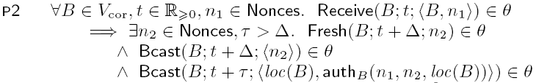
Protocol P^{CR/TL}: rules
Notes:
Second, whenver there is a Receive event for a challenge message in the trace, there is also a corresponding fresh, broadcast and another broadcast event

Slide 64

Protocol P^{CR/TL}: rules
Notes:
Third, if there is a receive event for an authentication message, and the fresh evenst, broadcast event and receive event are also in the trace, and the two distance estimates are equal, the two corresponding neighbor event are also in the trace

Slide 65
Protocol P^{CR/TL}: behavior restriction
With these rules we can prove availability
To prove correctness, we need to restrict nodes’ behavior wrt.
Bcast and Neighbor events
Notes:
These 3 rules provide half of the definition of the protocol.
They are sufficient to prove availability.
However, we cannot yet prove correctness. The basic reason for that is that the behavior of the node is not restricted enough with these 3 rules. In particular, a node is still allowed to make arbitrary neighbor declarations, and to braodcast arbitrary messages. We need to restrict that.

Slide 66
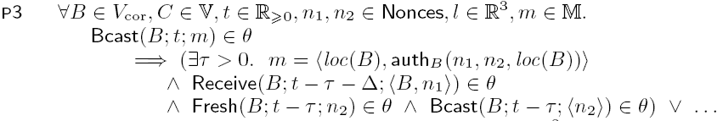
Protocol P^{CR/TL}:
Bcast restriction
First attempt:
Every Bcast is one
these three events
Notes:
Let’s first restrict broadcasting.
As a first attempt we could do the following:
Consider all the broadcasts that the protocol is doing, and then demand: whenever a broadcast event occurs, it has to be one of these 3 messages, and all the other events in a given block need to be in the trace.
This is in a way ok: with such a rule we could prove correctness. However, it is too restrictive: we are demanding that a correct node does not broadcast any other kind of message. If we would like to use our ND protocol with any other protocol (e.g. routing), the proof of correctness would no longer apply. Not because the protocol is flawed, but because the definition is too restrictive. We can do better.

Slide 67
Protocol P^{CR/TL}:
Bcast restriction
First attempt:
Every Bcast is one
these three events
Too restrictive!
No other protocol can be executed by the nodes
Notes:
Let’s first restrict broadcasting.
As a first attempt we could do the following:
Consider all the broadcasts that the protocol is doing, and then demand: whenever a broadcast event occurs, it has to be one of these 3 messages, and all the other events in a given block need to be in the trace.
This is in a way ok: with such a rule we could prove correctness. However, it is too restrictive: we are demanding that a correct node does not broadcast any other kind of message. If we would like to use our ND protocol with any other protocol (e.g. routing), the proof of correctness would no longer apply. Not because the protocol is flawed, but because the definition is too restrictive. We can do better.

Slide 68
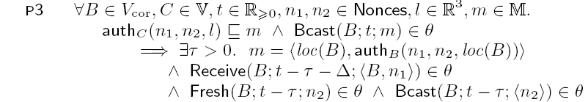
Protocol P^{CR/TL}: composability
Better solution:
Bcast of particular
authenticators
has to be the authentication message
Notes:
This is how we actually define the rule.
Whenever a node broadcast a message that contains an authenticator of the form used in the authentication message: <nonce, nonce, location> it has to be the authentication message and all the event in the block have to happen as well.
With this definition, we can use the protocol with any other protocol as long as it does not use authenticators of this form.
As for the other two broadcast event, we do not need to define any rules, the general freshness non-vialotion rule that we have seen before is enough.

Slide 69
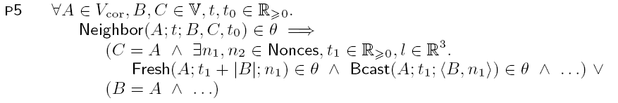
Protocol P^{CR/TL}:
Neighbor restriction
Every Neighbor event has to be one of these two
events
Notes:
Finally, a rule which states that if a neighbor event occurs it has to be one of the events in block 3 (and the other events in that block need to take place).
(This means that the node cannot run any other ND protocol, but we don’t see this as a relevant restriction).
This completes the definition of the protocol.

Slide 70
Result
Theorem: Protocol P^{CR/TL} satisfies the Neighbor Discovery Specification:
Correctness (ND1)
Availability (ND2^{CR/TL})
Under the assumptions:
Relaying processing delay Δ_{relay} > 0
Equality of maximum information propagation speed and wireless channel propagation speed v_{adv} = v
Notes:
We can now state that the protocol which we have just defined satisfies our ND specification (defined by the ND properties of correctness and availability we have seen a few slides back), under the following assumptions.
1) The minimum processing delay imposed by any correct or adversarial node when relaying a message is positive. [In practice, this would mean that this delay needs to be noticeable under the errors in location and time estimation.]
2) The speed with which the signal propagates over the wireless medium needs to be equal to the maximum information propagation speed over the adversarial channel [In practice, given that any reasonable adversary would use v_adv = c, it implies that the protocol can only work for RF communication, not ultra-sound.]

Slide 71
Future Work:
ND with adversarial nodes
P^{CR/TL} needs all nodes to be correct
Partial solution: Distance-Bounding protocols [3]
Cannot express DB in our model, as it uses:
  xor
  commitments
  rapid bit exchange: protocol sends single fresh bits
    Not compatible with our definition of freshness
[3] S. Brands and D. Chaum. Distance-bounding protocols. EUROCRYPT '93
Notes:
As we are approaching the end, a short word about interesting future directions. As mentioned before, in general we would be interested in having a ND protocol can be securely used to do ND with adversarial nodes (internal adversaries). The protocol that we have seen just now cannot do that.
However, there are actually some protocols which can do that to a certain extent, like DB protocols originally proposed bye Brands and Chaum.
At the moment, we cannot express this protocol in our model. For one thing, it uses xor and commitments, but this is not the biggest problem.
The protocol also uses a peculiar rapid bit exchange phase. In this phase, instead of exchanging “multiple bit” challenge and response messages, the nodes exchange *single bits*. What is more, these bits have to be fresh (in an intuitive sense). This poses a problem with the way freshness is treated in our model: we pretty much require that if a message (nonce) is fresh, it cannot have been sent before generation. In case of single bits, this cannot work: there are at most two bits that can be fresh in this sense (0 and 1). How to define freshness in this different manner remains an open issue for now.

Slide 72
Future Work:
ND with adversarial nodes
Can one do without the rapid bit exchange?
No: Bit level attack [6]:
Need to shift model to bit level to reason about ND with adversarial nodes
guess a few bits
R = f(C)
C
[6] J. Clulow, G. P. Hancke, M. G. Kuhn, and T. Moore. So near and yet so far:
Distance-bounding attacks in wireless networks. ESAS 2006.
Notes:
You might wander do we really need this strange rapid bit exchange. The answer is yes, as demonstrated by the following attack.
Consider a challenge-response protocol with multi-bit messages. The idea (shown on the left) is that the bottom node sends a challenge, and the top node replies if a response, which is a function of the challenge which only this node can calculate. However, if the top node is adversarial, it can decide to answer prematurely (as shown on the right). Granted, it will not know the first few bits of the response, because it does not know the whole challenge yet. However, it can guess them, and once it has received the whole challenge, it can continue with the correct bits of the response.
This way, we have an attack that can decrease the time-based distance estimate with a very good probability (1/8 in the example).
To summarize this, we claim that if we want to reason about ND protocols that can be executed with adversarial nodes, we need to be able to capture attacks like this, and protocols using rapid bit exchange. We need to move from the “message” level to “bit” level.

Slide 73
Conclusions
Proving the correctness of Secure Neighbor Discover protocols
A model or wireless networks
Secure Neighbor Discovery specification
Definition of a Secure Neighbor Discovery protocol
Highlighted interesting future directions
Notes:
To conclude:
In this work, we took on the problem of proving the correctness (and availability) of Secure ND protocols.
To this end, we have proposed a model of wireless networks, propose a specification for ND protocols, and demonstrated how we define an ND protocol within our model.
We have also highlighted what we consider an interesting direction for future work.

Slide 74
In the paper
Proofs
Other Secure Neighbor Discovery protocols
  P^{CR/T} - challenge-response / time-based protocol
  P^{B/T} - beacon / time-based protocol
  P^{B/TL} - beacon / time-and-location-based protocol
Our model captures the differences in their
  functionality
  assumptions / requirements
Notes:
What was omitted in the talk, and you can find in the paper. For one, there is the proof.
But we have also considered other SND protocols, and our model allowed us to explicitly state the differences in their functionality and (assumptions / requirements).
Thanks.

