Slide 1

First-principles theory-based scaling of the SOL width in limited tokamak plasmas, experimental validation, and implications for the ITER start-up
Paolo Ricci,
F.D. Halpern¹, J. Loizu¹, S. Jolliet¹, A. Mosetto¹, F. Riva¹, C. Wersal¹, A. Fasoli¹,
I. Furno¹, B. Labit¹, F. Nespoli¹, C. Theiler¹, G. Arnoux², J.P. Gunn³, J. Horacek⁴,
M. Kočan⁶, B. LaBombard⁷, C. Silva⁸
1) CRPP, EPFL, Switzerland; 2) CCFE, UK 3) CEA, France 4) Institute of Plasma Physics, Czech Republic 6) ITER Organization, 7) MIT, USA; 8) IPFN, IST, Portugal

Slide 2
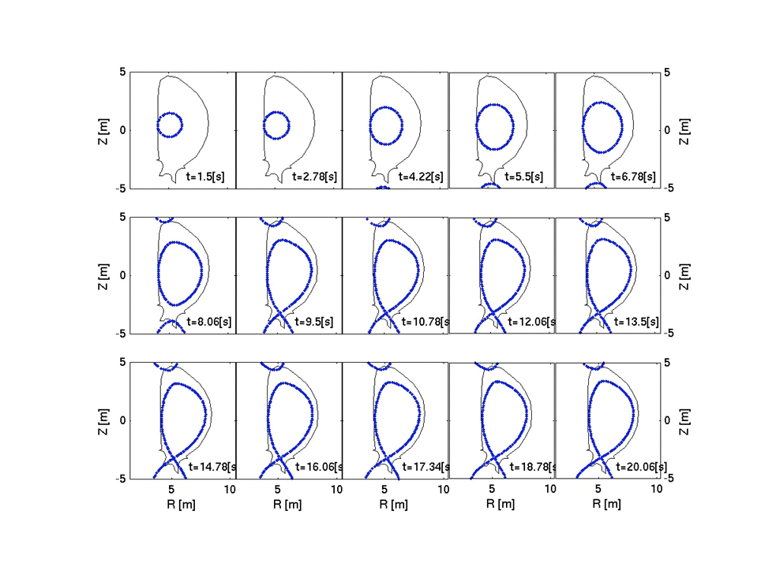
ITER start up and ramp down will be limited
SOL width?
First-principles analytical scaling of SOL width
Theory vs experimental observations
First-principles simulations
Predictions and implications for ITER

Slide 3
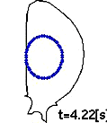
SOL width – first principles estimate
Ricci et al., PRL 2008; PoP 2013

Slide 4
SOL width – first principles estimate
Bohm’s
Ricci et al., PRL 2008; PoP 2013

Slide 5
SOL width – first principles estimate
Bohm’s
Ricci et al., PRL 2008; PoP 2013

Slide 6
SOL width – first principles estimate
Bohm’s
Removal of driving gradient
Ricci et al., PRL 2008; PoP 2013

Slide 7
SOL width – first principles estimate
Bohm’s
Ricci et al., PRL 2008; PoP 2013

Slide 8
SOL width – first principles estimate
Bohm’s
Nonlocal linear theory,
Ricci et al., PRL 2008; PoP 2013

Slide 9
SOL width – first principles estimate
Bohm’s
Ricci et al., PRL 2008; PoP 2013

Slide 10
SOL width – first principles estimate
Bohm’s
Ricci et al., PRL 2008; PoP 2013

Slide 11
SOL turbulent regimes
Instability driving turbulence depends mainly on q, , .
RESISTIVE BALLOONING MODE, with EM EFFECTS
RESISTIVE DRIFT WAVES
INERTIAL DRIFT WAVES
Mosetto et al., PoP 2013

Slide 12
SOL turbulent regimes
Instability driving turbulence depends mainly on q, , .
RESISTIVE BALLOONING MODE, with EM EFFECTS
TYPICAL LIMITED SOL OPERATIONAL
PARAMETERS
RESISTIVE DRIFT WAVES
INERTIAL DRIFT WAVES
Mosetto et al., PoP 2013

Slide 13
SOL turbulent regimes
Instability driving turbulence depends mainly on q, , .
RESISTIVE BALLOONING MODE, with EM EFFECTS
TYPICAL LIMITED SOL OPERATIONAL
PARAMETERS
RESISTIVE DRIFT WAVES
INERTIAL DRIFT WAVES
Mosetto et al., PoP 2013

Slide 14
SOL turbulent regimes
Instability driving turbulence depends mainly on q, , .
RESISTIVE BALLOONING MODE, with EM EFFECTS
TYPICAL LIMITED SOL OPERATIONAL
PARAMETERS
RESISTIVE DRIFT WAVES
INERTIAL DRIFT WAVES
BM
BM
Mosetto et al., PoP 2013

Slide 15
Ballooning scaling, good agreement with experiments
In SI units:
Halpern et al., NF 2013, NF 2014

Slide 16
Ballooning scaling, good agreement with experiments
In SI units:
Validation with
reciprocating probe
measurements
of n and T_{e}
Halpern et al., NF 2013, NF 2014

Slide 17
SOL width – comparison with ITPA database
[Experimental results: ITPA Divertor and SOL topical group, PPCF to be submitted, data courtesy of R.A. Pitts/J. Horacek; comparison with theoretical model: Halpern et al, PPCF, to be submitted]

Slide 18
SOL width – comparison with ITPA database
116 discharges
9 tokamaks
(EAST, TCV, Compass, HL-2A, DIII-D, TEXTOR, JET, Castor, ToreSupra)
[Experimental results: ITPA Divertor and SOL topical group, PPCF to be submitted, data courtesy of R.A. Pitts/J. Horacek; comparison with theoretical model: Halpern et al, PPCF, to be submitted]

Slide 19
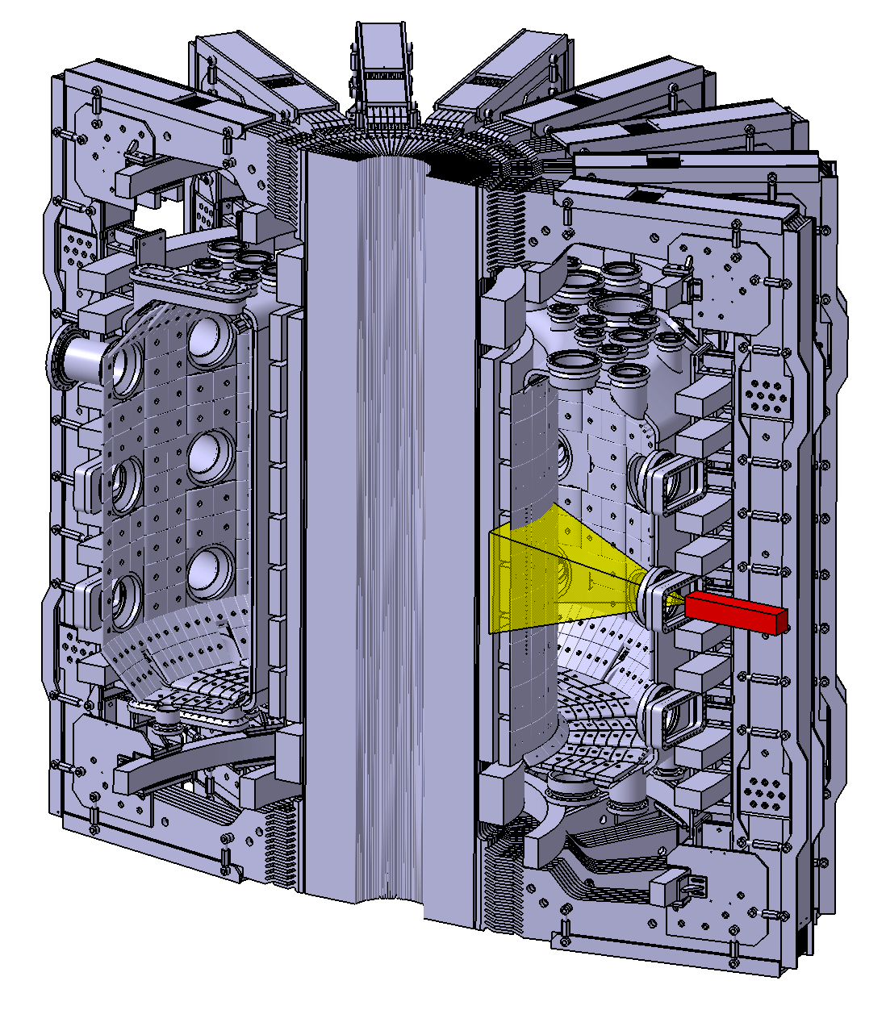
Recent measurements: 2 scale lengths
Infrared Measurement in TCV
Nespoli et al., JNM, submitted
Kocan et al., NF, submitted

Slide 20
Recent measurements: 2 scale lengths
Infrared Measurement in TCV
Nespoli et al., JNM, submitted
Kocan et al., NF, submitted

Slide 21
Recent measurements: 2 scale lengths
Infrared Measurement in TCV
Nespoli et al., JNM, submitted
Kocan et al., NF, submitted
Need nonlinear simulations…

Slide 22
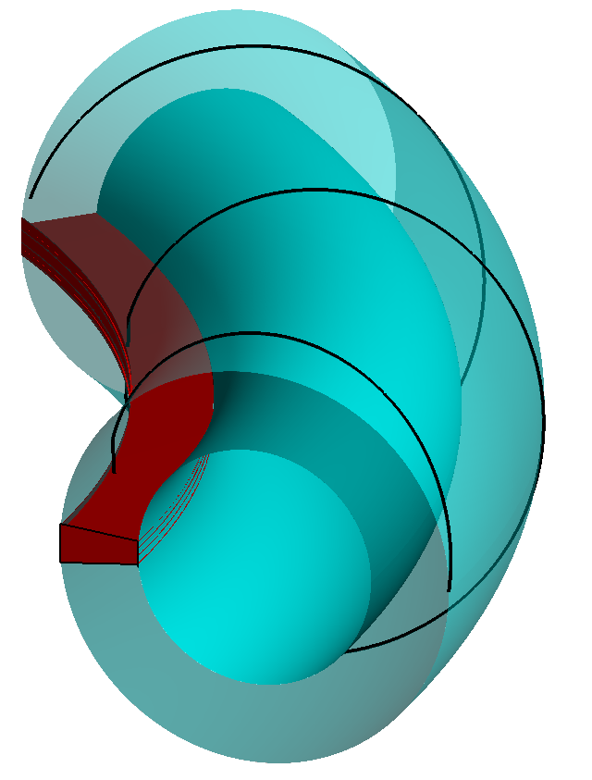
GBS code: a tool to simulate SOL plasmas
3D drift-reduced Braginskii equations,
no separation between equilibrium and fluctuating quantities
Flow
along B
Losses at the limiter
Radial transport
Plasma outflowing from the core
Ricci et al., PPCF 2012; Loizu et al., PoP 2012; Riva et al, PoP 2014

Slide 23
GBS code: a tool to simulate SOL plasmas

Slide 24
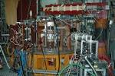
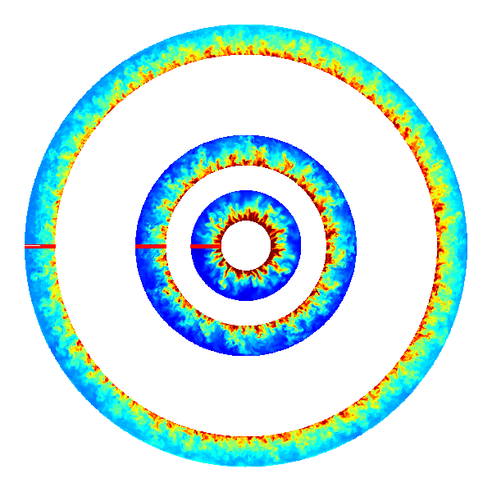
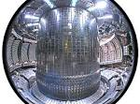
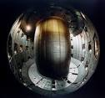
GBS code: a tool to simulate SOL plasmas
ISTTOK
C-Mod
TCV

Slide 25
GBS code: a tool to simulate SOL plasmas
ISTTOK
C-Mod
TCV

Slide 26
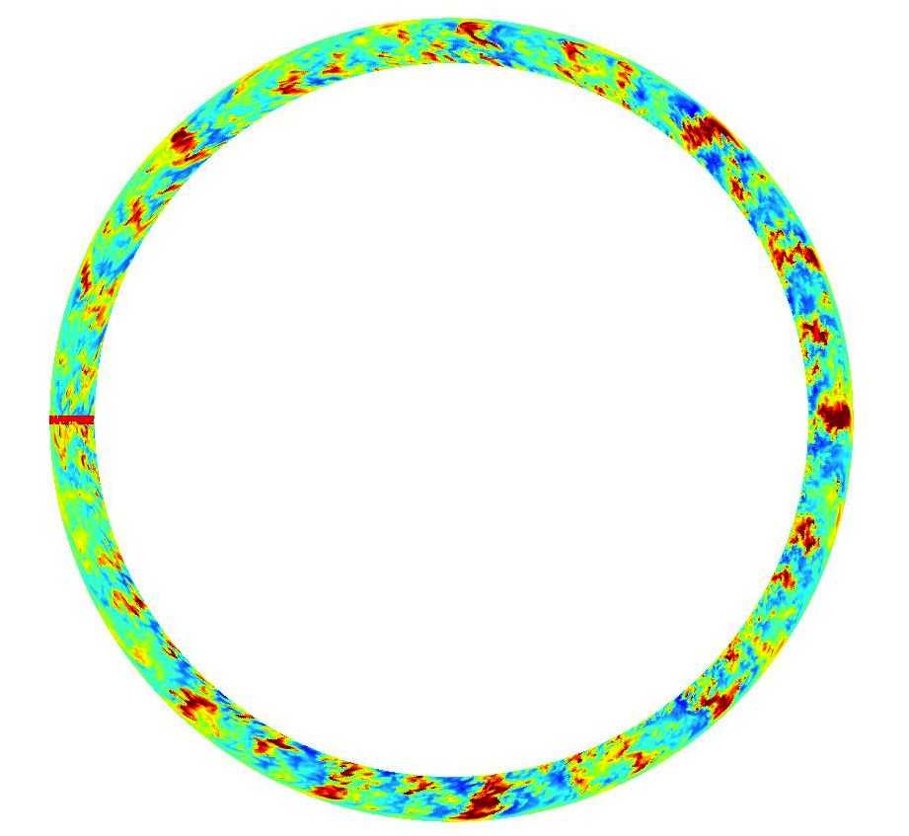
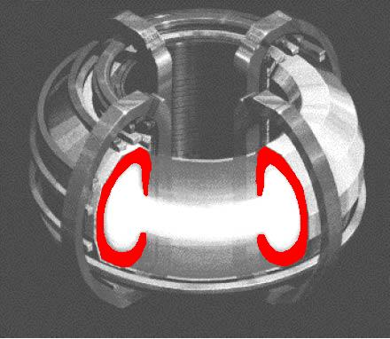

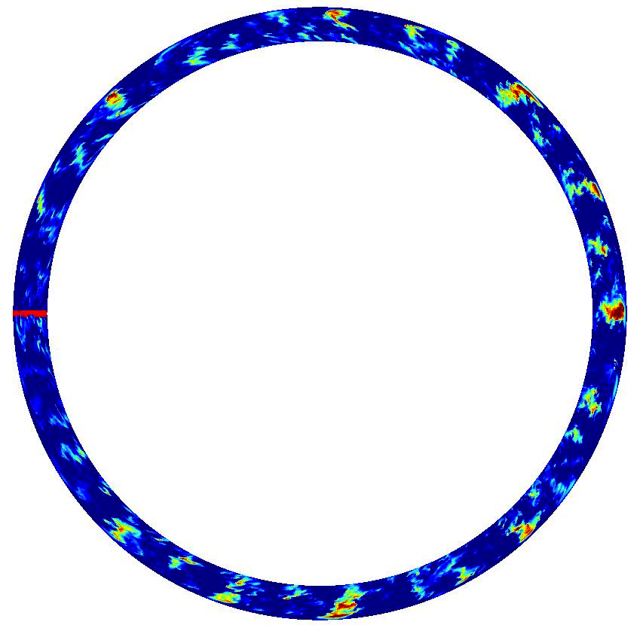
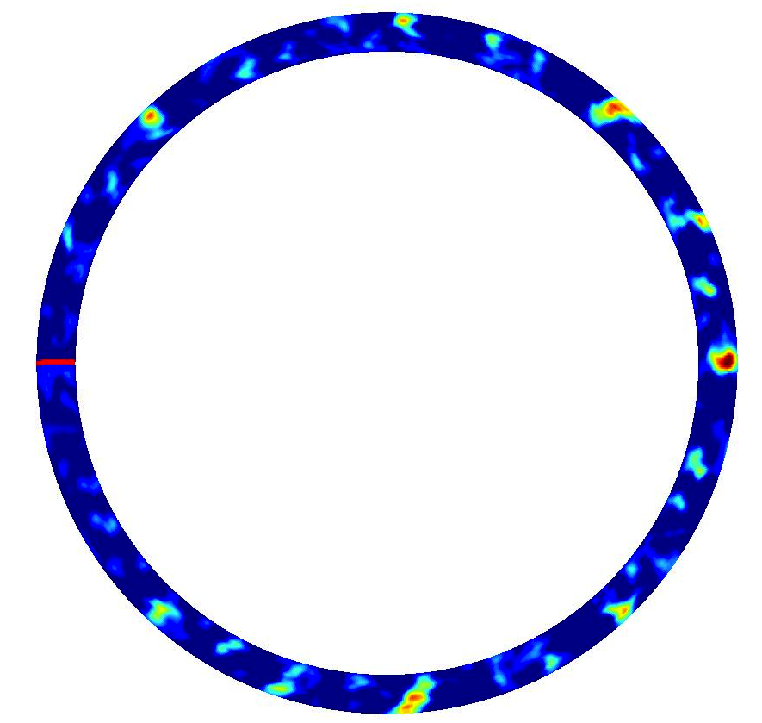
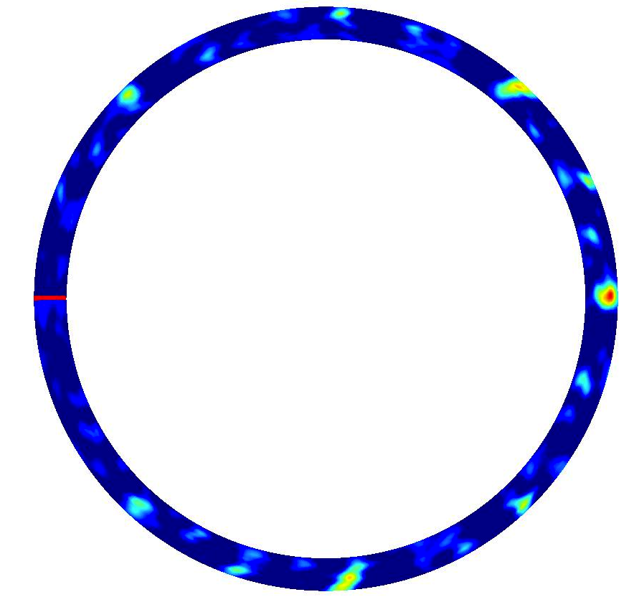
Gas puff imaging diagnostic
Emission
Photodiode
Geometry
Synthetic diagnostic
Experimental results provided by J. Terry, S. Zweben, B. LaBombard, and M. Podestà.

Slide 27
C-Mod fluctuation properties well captured
Alcator C-Mod,
B= 2.7 and 3.8 T, q=2.7,…
Halpern et al, PPCF, submitted

Slide 28
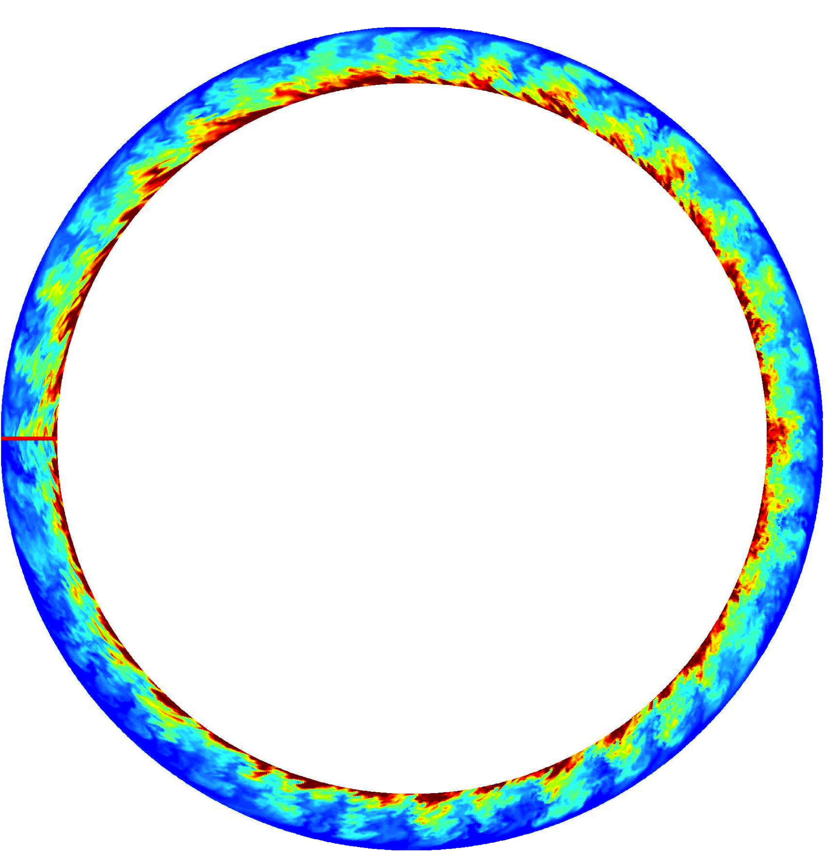
C-Mod simulations: pressure profile
Alcator C-Mod,
B= 2.7 and 3.8 T, q=2.7,…

Slide 29
C-Mod simulations: pressure profile
EXPONENTIAL FIT
Alcator C-Mod,
B= 2.7 and 3.8 T, q=2.7,…

Slide 30
Agreement between theory and simulations
By considering one scale length
EXPONENTIAL FIT
Alcator C-Mod,
B= 2.7 and 3.8 T, q=2.7,…
Halpern et al., NF 2013, NF 2014

Slide 31
C-Mod simulations: pressure profile
Alcator C-Mod,
B= 2.7 and 3.8 T, q=2.7,…

Slide 32
C-Mod simulations: 2 pressure scale lengths
2-EXPONENTIAL FIT
Alcator C-Mod,
B= 2.7 and 3.8 T, q=2.7,…

Slide 33
C-Mod simulations: 2 pressure scale lengths
Alcator C-Mod,
B= 2.7 and 3.8 T, q=2.7,…

Slide 34
Different turbulent properties in near and far SOL
Alcator C-Mod,
B= 2.7 and 3.8 T, q=2.7,…

Slide 35
Different turbulent properties in near and far SOL
Alcator C-Mod,
B= 2.7 and 3.8 T, q=2.7,…

Slide 36
Different turbulent properties in near and far SOL
BALLOONING MODE
Alcator C-Mod,
B= 2.7 and 3.8 T, q=2.7,…
DRIFT
WAVES

Slide 37
Different turbulent properties in near and far SOL
BALLOONING MODE
Alcator C-Mod,
B= 2.7 and 3.8 T, q=2.7,…
DRIFT
WAVES
2014 C-Mod campaign and other tokamaks will allow further progress

Slide 38
Predictions and implications for ITER
The ballooning scaling, in SI units:
One scale length fit of several centimeters; further analysis needed for narrow feature
ITER PREDICTION,
q = 5 – 8

Slide 39

SOL width?
Use of a first-principles approach
Analytical scaling derived, good agreement with one scale length fit of experiments and simulations
Narrow feature recovered in simulations
ITER prediction – one scale length fit of several centimeters; further analysis needed for narrow feature
Tools ready to investigate more
advanced SOL configurations
crpp.epfl.ch/research_theory_plasma_edge

Slide 40
The GBS code, a tool to simulate SOL turbulence
Collisional
Plasma
Braginskii model
ρ_{i}<<L, ω<<Ω_{ci}
Drift-reduced Braginskii equations
E×B
Convection
Magnetic curvature
Parallel dynamics
Outflow from core
T_{e}, T_{i} ,Ω (vorticity) similar equations
V_{||e}, V_{||i} parallel momentum balance
,
Solved in 3D, dynamics resulting from: plasma outflow, turbulent transport, and parallel losses

Slide 41
The GBS code, a tool to simulate SOL turbulence
Collisional
Plasma
Braginskii model
ρ_{i}<<L, ω<<Ω_{ci}
Drift-reduced Braginskii equations
E×B
Convection
Magnetic curvature
Parallel dynamics
Outflow from core
T_{e}, T_{i} ,Ω (vorticity) similar equations
V_{||e}, V_{||i} parallel momentum balance
,
Simulations contain physics of ballooning modes, drift waves,
Kelvin-Helmholtz, blobs, parallel flows, sheath losses…

Slide 42
RBM estimate works with ITPA database
RESISTIVE DRIFT WAVES
L_{p} (Full GR theory)
INERTIAL DRIFT WAVES
L_{p} (RBM scaling)

Slide 43
Limited SOL transport increases with and
(it is not possible to run GBS with yz4 and no filtering...)

Slide 44
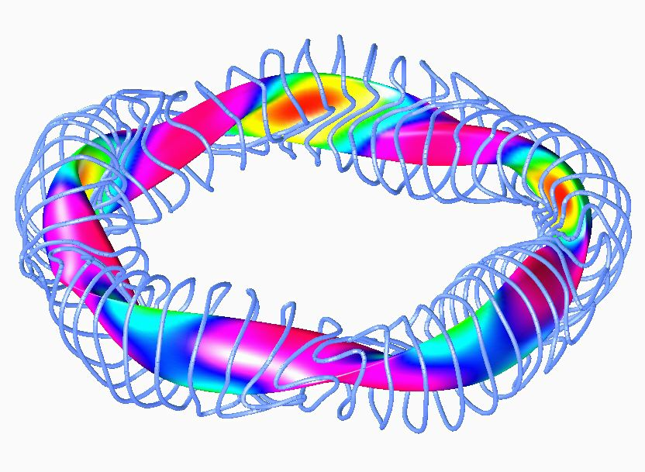
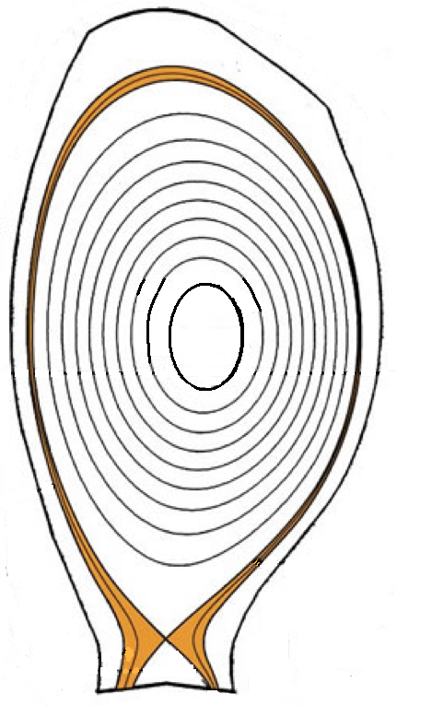
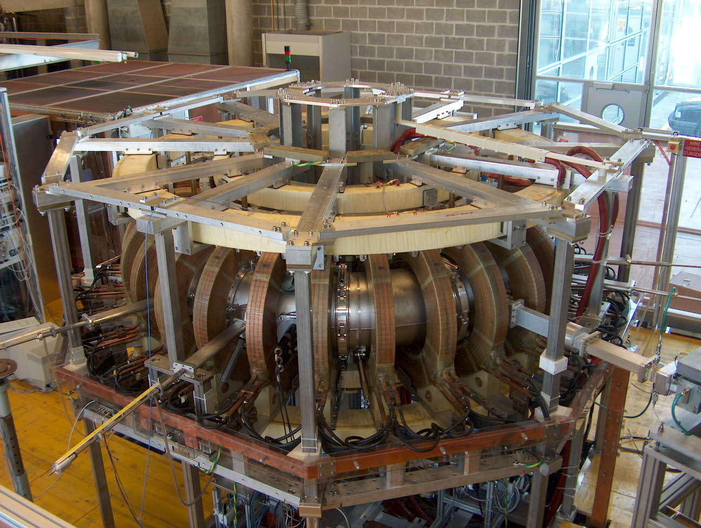
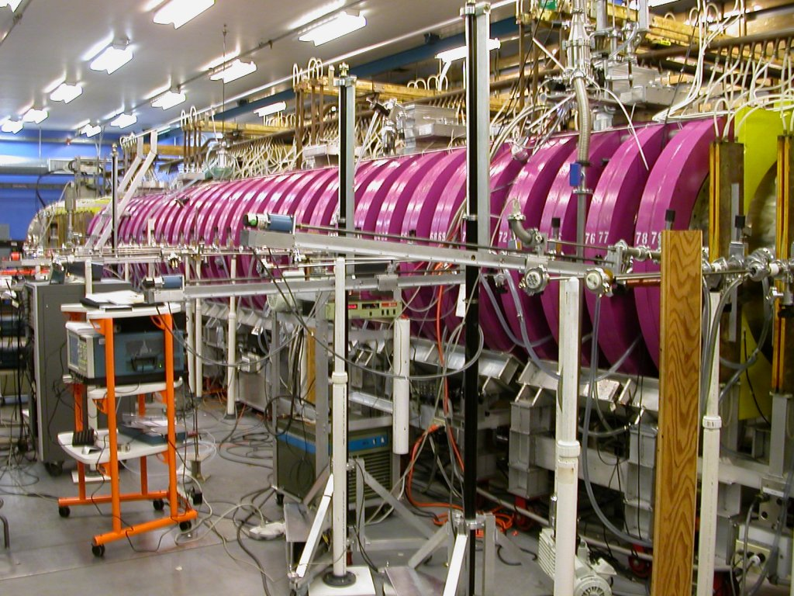
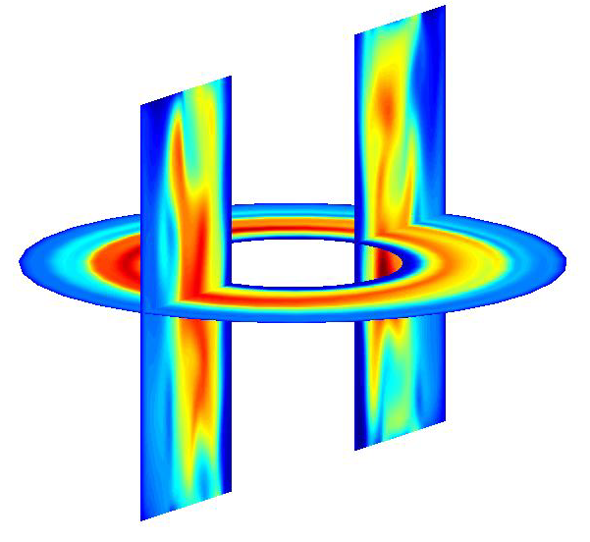
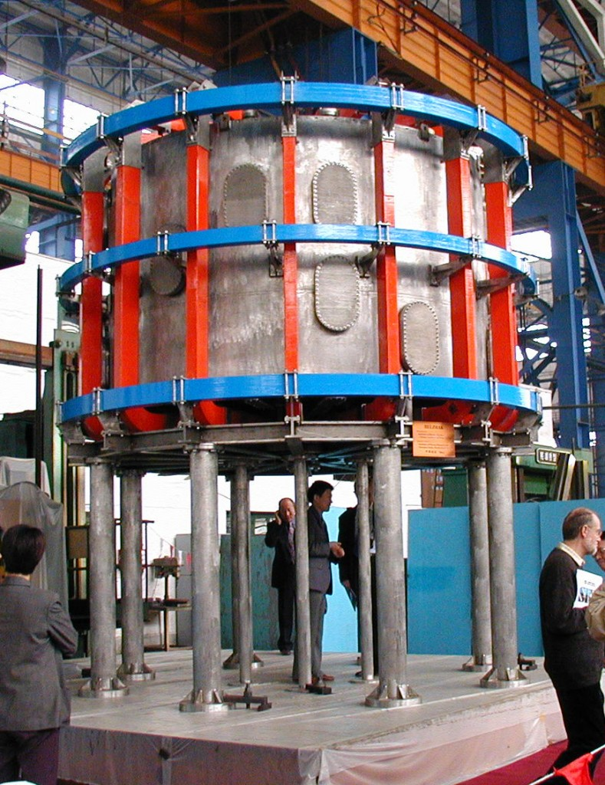
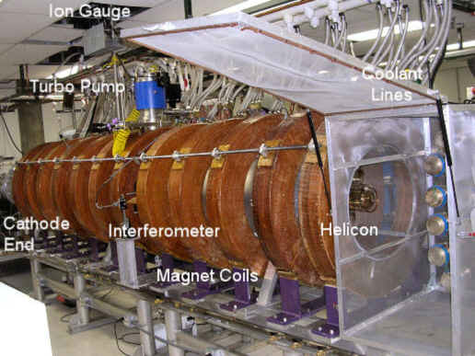
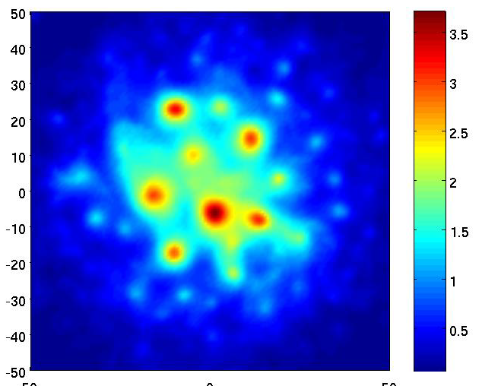
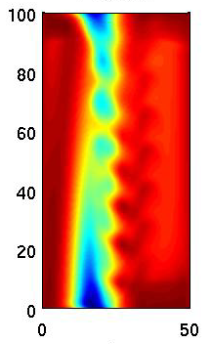
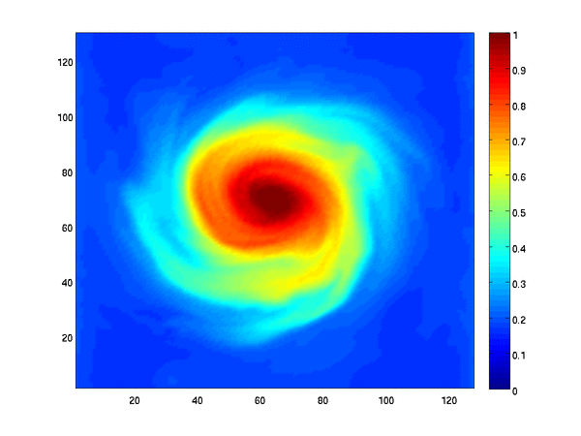
GBS code: a tool to simulate SOL-like plasmas
Limited
SOL
Stellarator
SOL
TORPEX, CRPP
Diverted
SOL
LAPD, UCLA
HelCat, UNM
Ricci et al, PPCF 2012
Helimak, UTexas

