Slide 1
Protecting Location Privacy: Optimal Strategy against Localization Attacks
Reza Shokri, George Theodorakopoulos, Carmela Troncoso,
Jean-Pierre Hubaux, Jean-Yves Le Boudec
EPFL
Cardiff University
K. U. Leuven
19th ACM Conference on Computer and Communications Security (CCS), October 2012

Slide 2

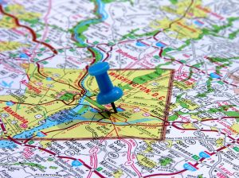
Location-based Services
Sharing Location with Friends
Sharing Location with Businesses
Uploading location, tagging documents, photos, messages, …
Asking for near-by services, finding near-by friends, …

Slide 3
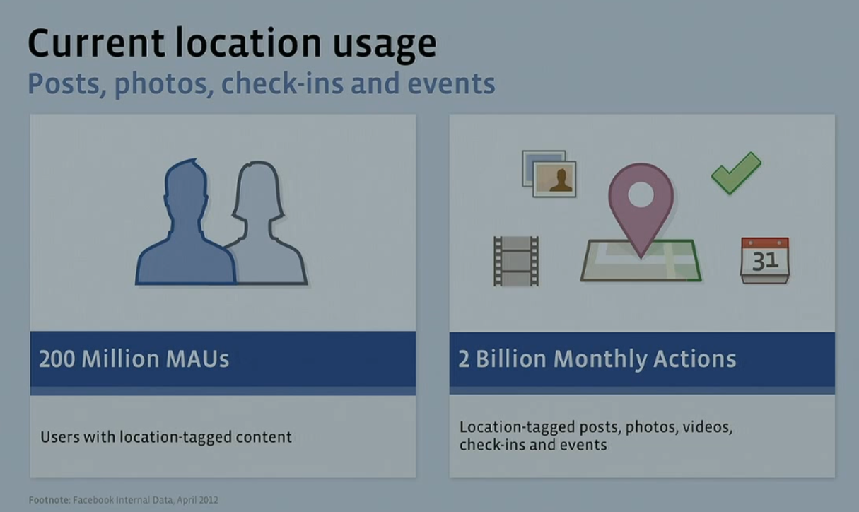
Example: Facebook Location-Tagging
>600M mobile users
Source: WHERE 2012, Josh Williams, "New Lines on the Horizon“, Justin Moore, "Ignite - Facebook's Data"

Slide 4
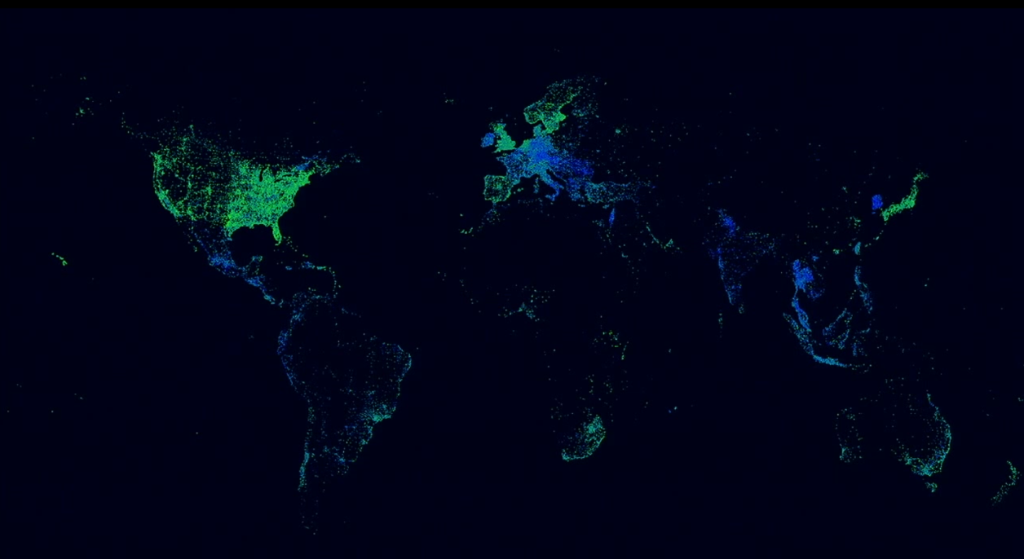
Check-ins at Facebook, one-day
Source: Where 2012, Josh Williams, "New Lines on the Horizon“, Justin Moore, "Ignite - Facebook's Data"

Slide 5

Threat
A location trace is not only a set of positions on a map
The contextual information attached to a trace tells much about our habits, interests, activities, and relationships

Slide 6
Location-Privacy Protection Mechanisms
Anonymization (removing the user’s identity)
It has been shown inadequate, as a single defense
The traces can be de-anonymized, given an adversary with some knowledge on the users
Obfuscation (reporting a fake location)
Service Quality?
Users share their locations to receive some services back. Obfuscation degrades the service quality in favor of location privacy

Slide 7
Designing a Protection Mechanism
Challenges
Respect users’ required service quality
User-based protection
Real-time protection
Common Pitfall
Ignor adversary knowledge
Adversary can invert the obfuscation mechanism
Disregard optimal attack
Given a protection mechanism, attacker designs an attack to minimize his estimation error in his inference attack

Slide 8
Our Objective: Design Optimal Protection Strategy
A defense mechanism that
anticipates the attacks that can happen against it,
and maximizes the users’ location privacy against the most effective attack,
and respects the users’ service quality constraint.

Slide 9
Outline
Assumptions
Model
User’s Profile
Protection Mechanism
Inference Attack
Problem Statement
Solution: Optimal strategy for user and adversary
Evaluation

Slide 10
Assumptions
LBS: Sporadic Location Exposure
Location check-in, search for nearby services, …
Adversary: Service provider
Or any entity who eavesdrops on the users’ LBS accesses
Attack: Localization
What is the user’s location when accessing LBS?
Protection: User-centric obfuscation mechanism
So, we focus on a single user
Privacy Metric:
Adversary’s expected error in estimating the user’s true location, given the user’s profile and her observed location

Slide 11
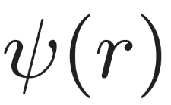
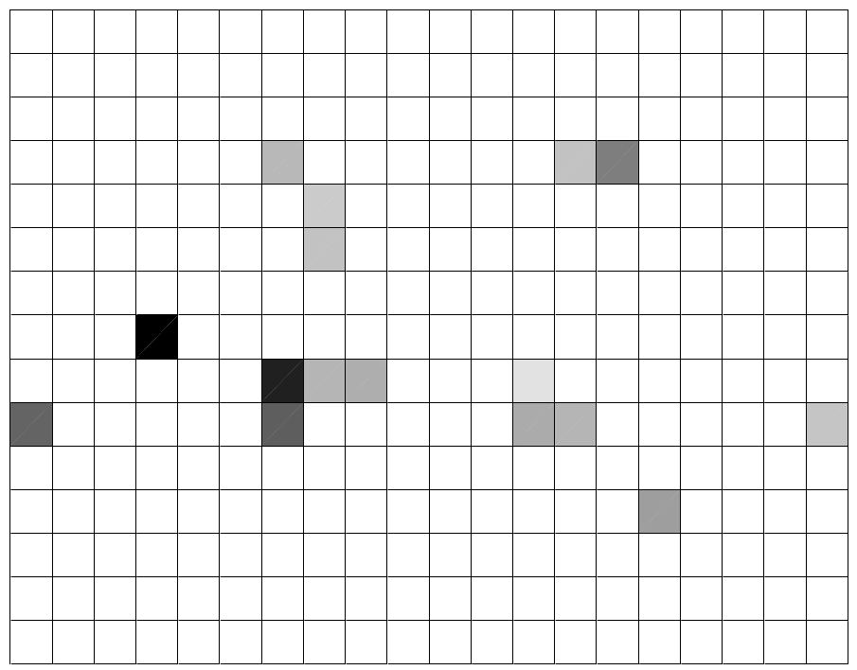
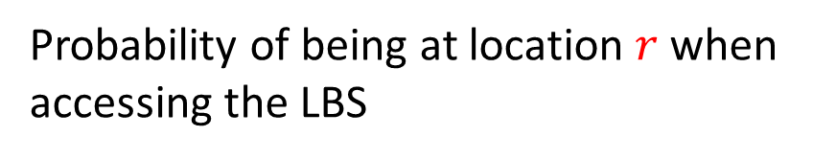
Adversary Knowledge: User’s “Location Access Profile”
Probability of being at location $r$ when accessing the LBS
Data source: Location traces collected by Nokia Lausanne (Lausanne Data Collection Campaign)

Slide 12
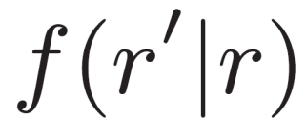
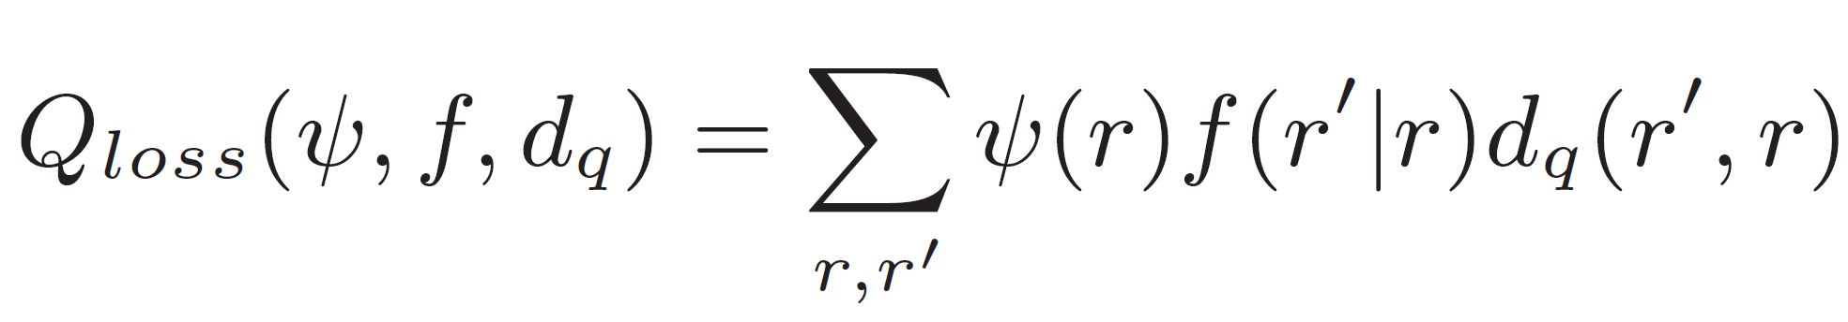
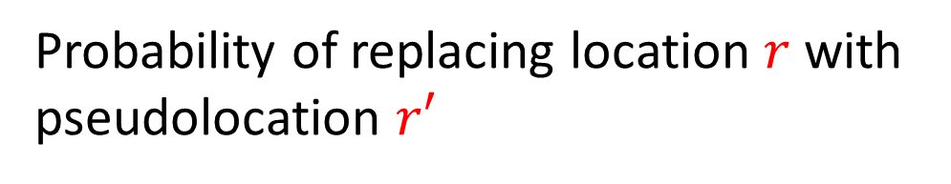
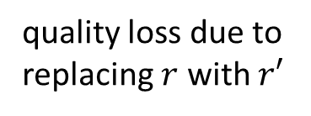
Location Obfuscation Mechanism
Probability of replacing location $r$ with pseudolocation $r′$
Consequence: “Service Quality Loss”
quality loss due to replacing $r$ with $r′$

Slide 13
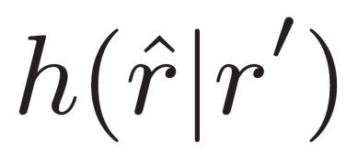
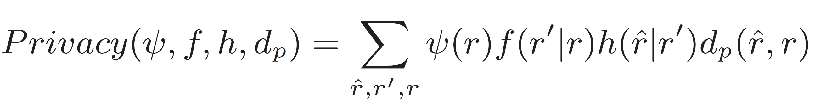
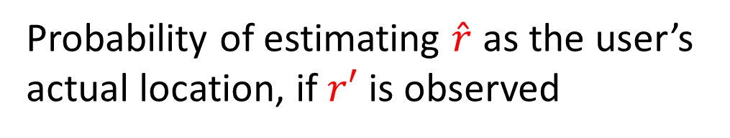
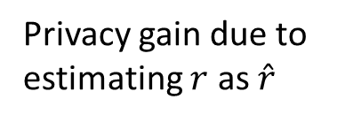
Location Inference Attack
Probability of estimating $\hat{r}$ as the user’s actual location, if $r′$ is observed
Estimation Error: “Location Privacy”
Privacy gain due to estimating $r$ as $\hat{r}$

Slide 14
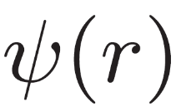

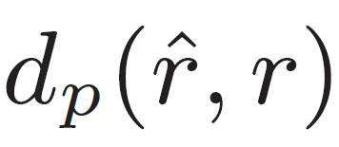

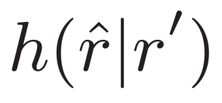

Problem Statement
Given, the user’s profile known to adversary
Find obfuscation function that
Maximizes privacy, according to distortion
Respects a maximum tolerable service quality loss
Adversary observes $r′$, and finds optimal to minimize the user’s privacy who uses

Slide 15
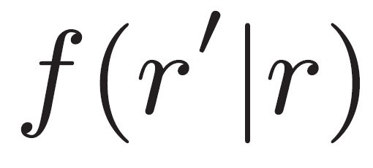





Zero-sum Bayesian Stackelberg Game
Game
User accesses LBS from location $r \sim ψ\left(r\right)$ known to adversary
User Adversary
(leader) (follower)
LBS message
$$r$$
$$r′$$
$$\hat{r}$$
user gain / adversary loss
Chooses $f$ to maximize it
Chooses $h$ to minimize it

Slide 16
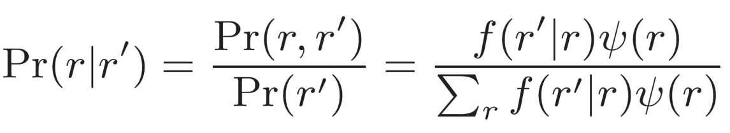
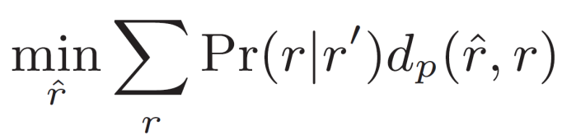
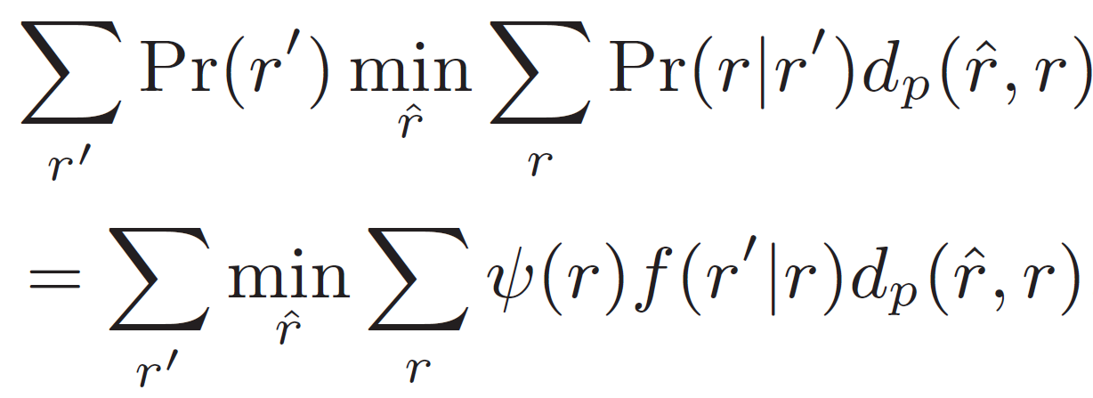

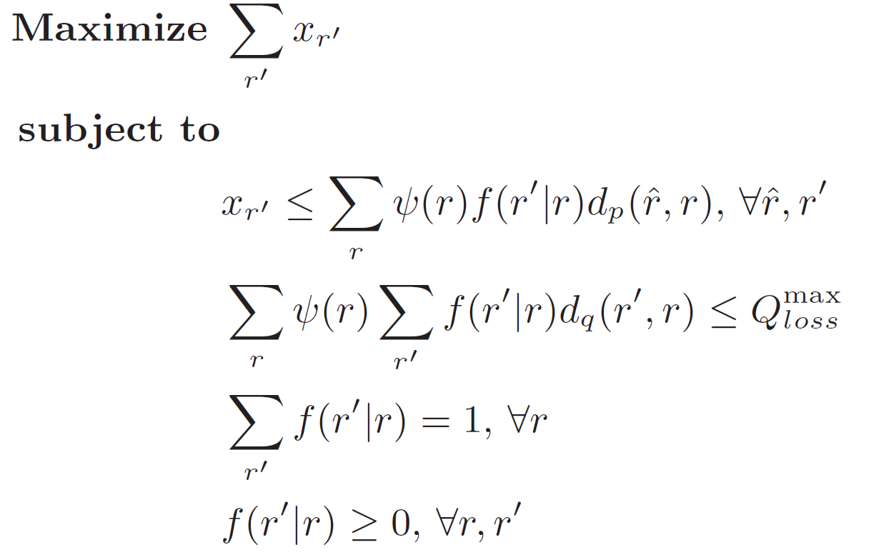
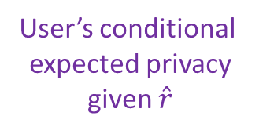
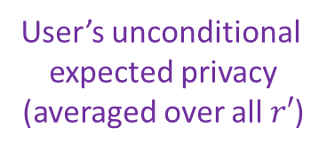

Optimal Strategy for the User
User’s unconditional
expected privacy
(averaged over all $r′$)
User’s conditional
expected privacy
given $\hat{r}$
Posterior probability, given observed pseudolocation $r′$
User maximizes it by choosing the optimal obfuscation $f$
Adversary chooses $\hat{r}$ to
minimize user’s privacy
Respect service quality
constraint
Proper probability
distribution

Slide 17
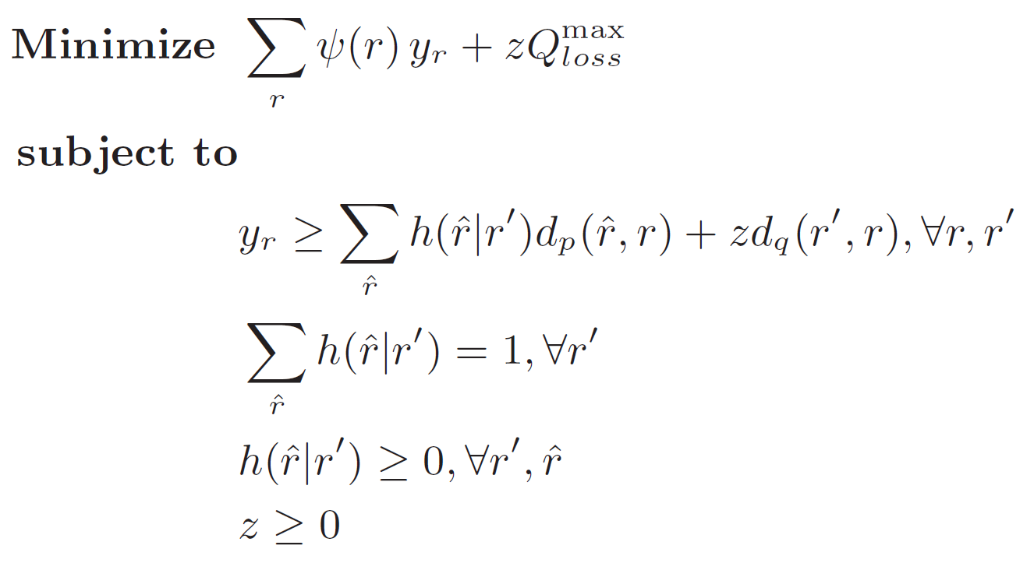
Optimal Strategy for the Adversary
Minimizing the user’s maximum
privacy under the service quality
constraint
Proper probability distribution
Shadow price of the service quality constraint .
(exchange rate between service quality and privacy)
Note: This is the dual of the previous optimization problem

Slide 18
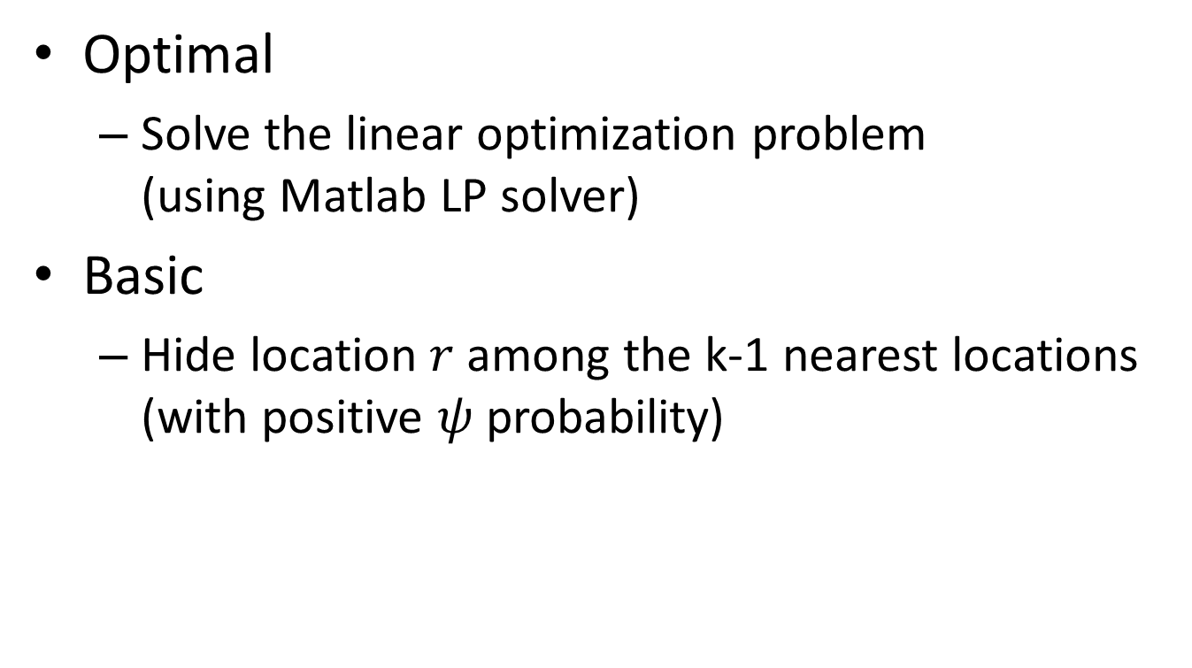
Evaluation: Obfuscation Function
Optimal
Solve the linear optimization problem (using Matlab LP solver)
Basic
Hide location $r$ among the k-1 nearest locations (with positive $ψ$ probability)

Slide 19
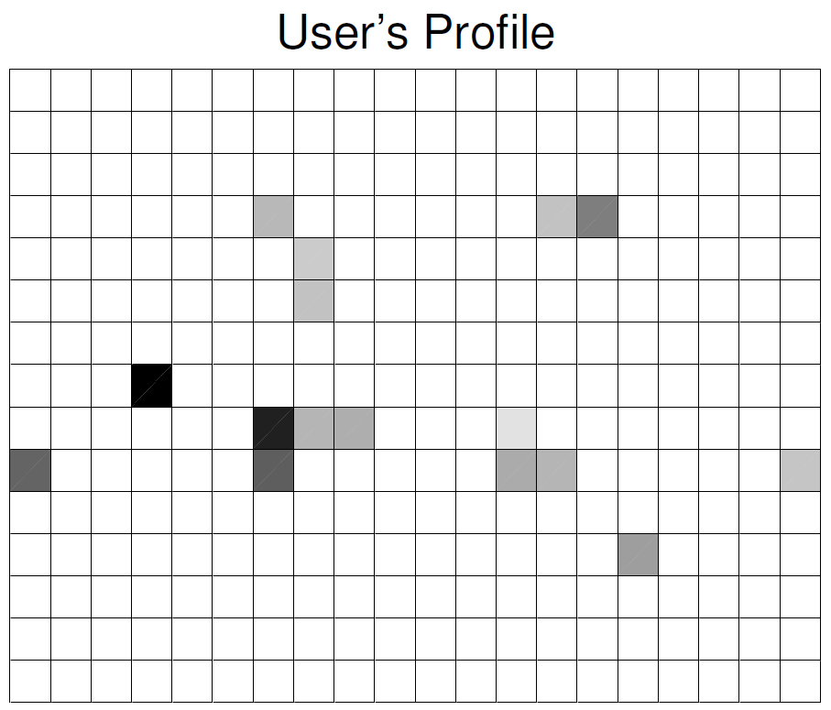
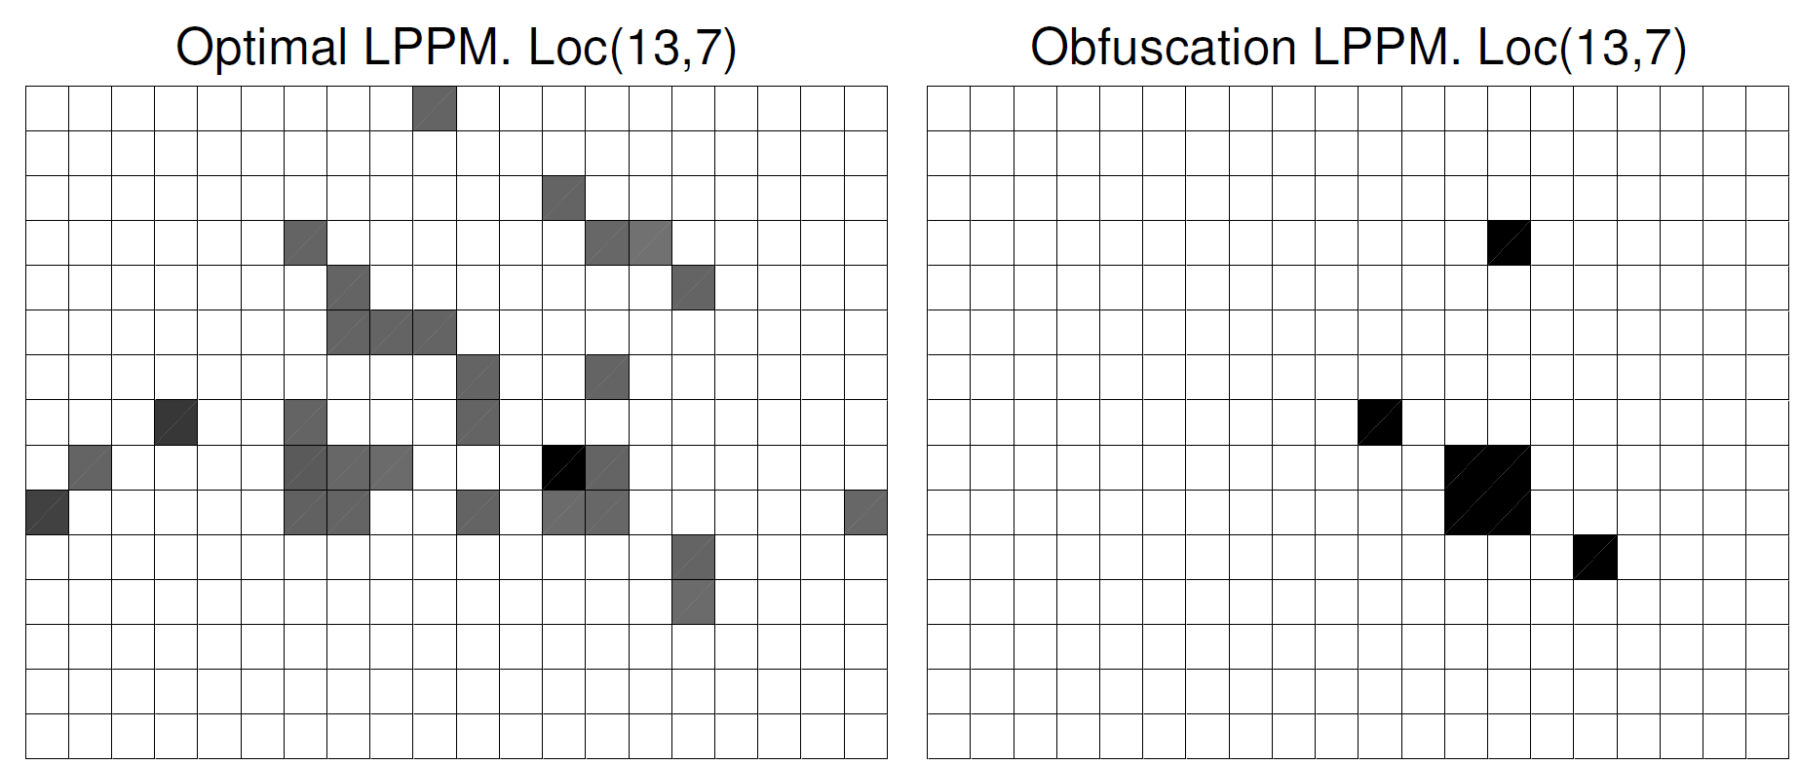
Output Visualization of Obfuscation Mechanisms
Optimal Obfuscation
Basic Obfuscation
(k = 7)

Slide 20
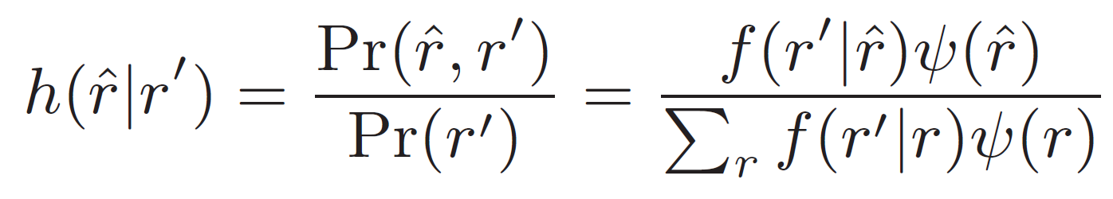
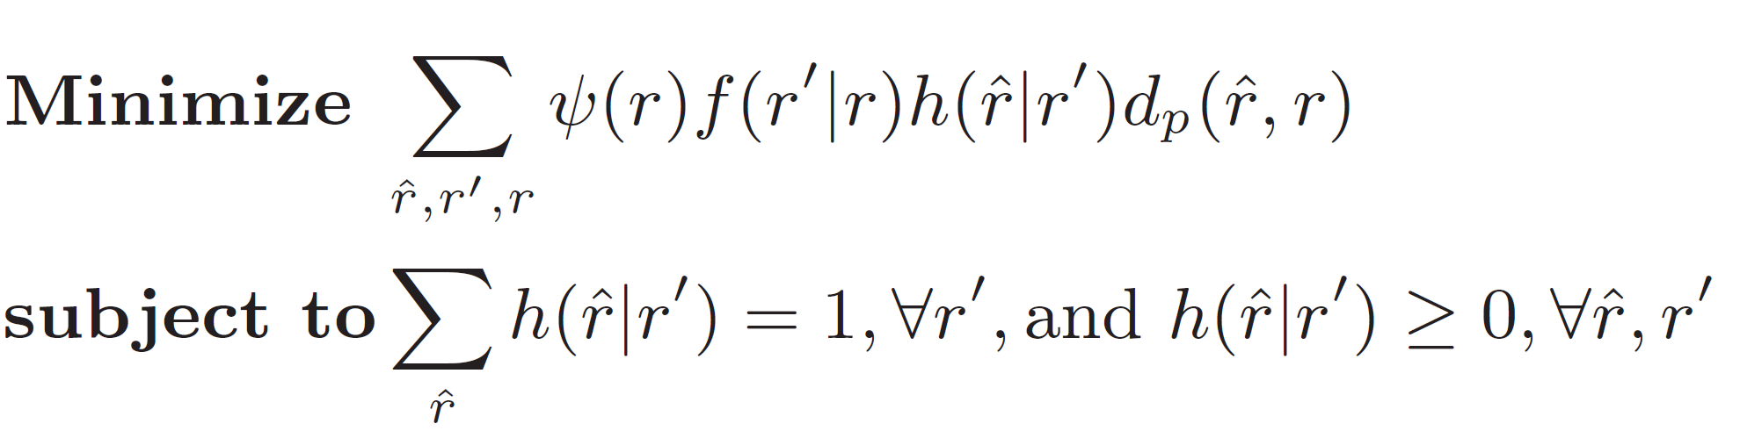
Evaluation: Localization Attack
Optimal attack against optimal obfuscation
Given the service quality constraint
Bayesian attack against any obfuscation
Optimal attack against any obfuscation
Regardless of any service quality constraint

Slide 21
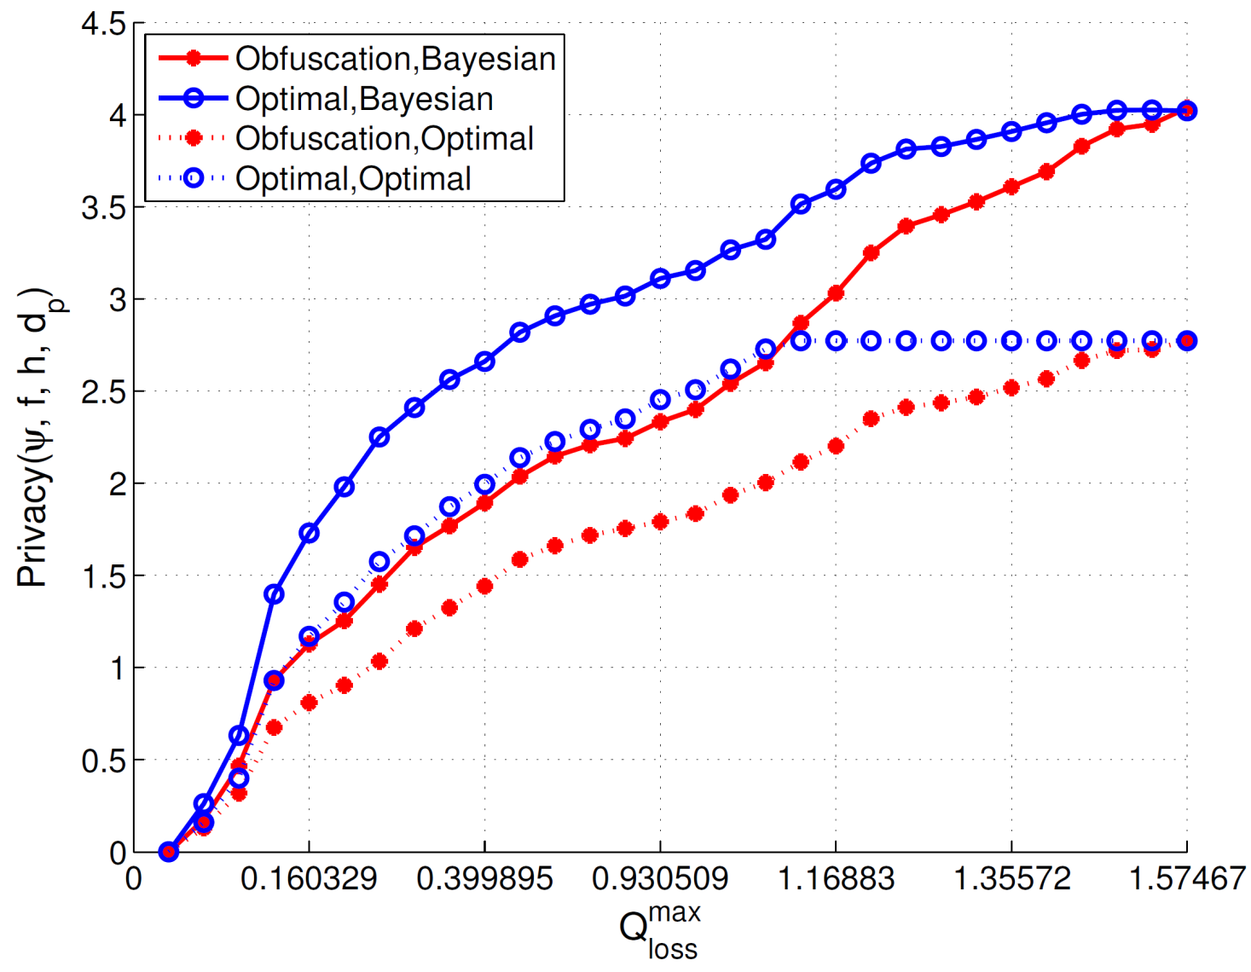
Optimal vs. non-Optimal
k=1
k=30
Service quality threshold is set to the service quality loss incurred by basic obfuscation.

Slide 22
Conclusion
(Location) Privacy is an undisputable issue, with more people uploading their location more regularly
Privacy (similar to any security property) is adversarial-dependent. Disregarding adversary’s strategy and knowledge limits the privacy protection
Our game theoretic analysis helps solving optimal attack and optimal defense simultaneously
Given the service quality constraint
Our methodology can be applied in other privacy domains

Slide 23
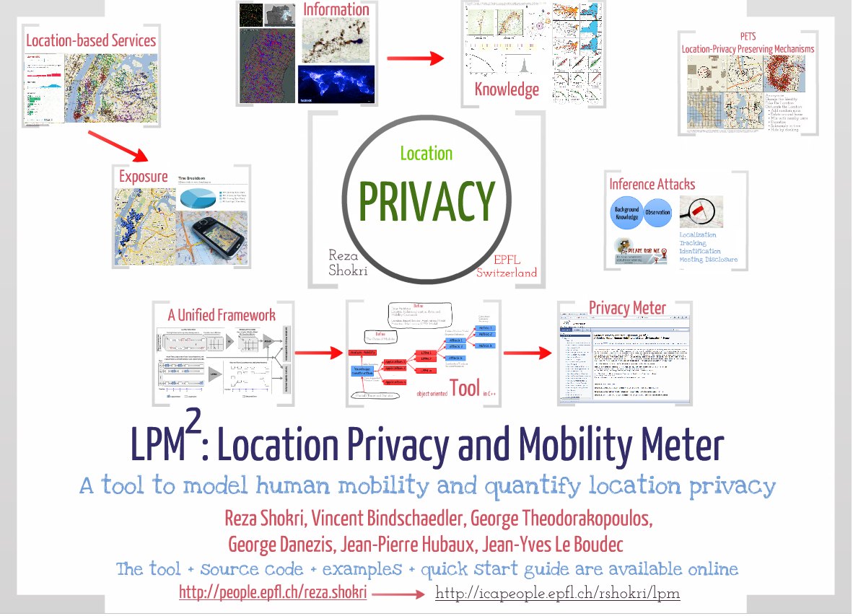

Slide 25
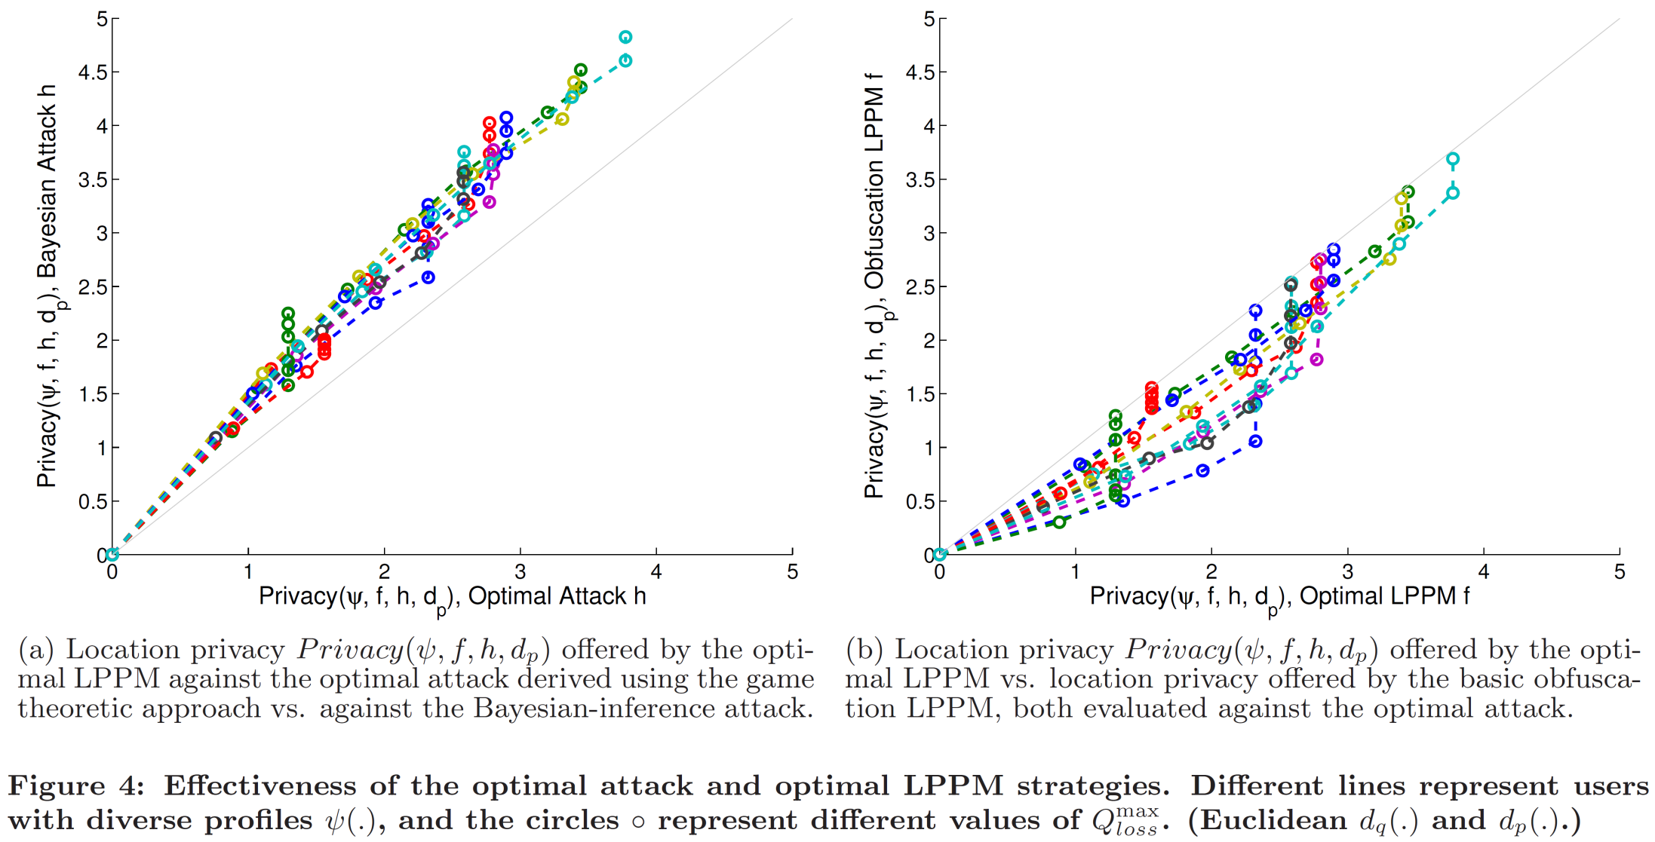
Optimal Attack & Optimal Defense
Service quality threshold is set to the service quality loss incurred by basic obfuscation.

Slide 26
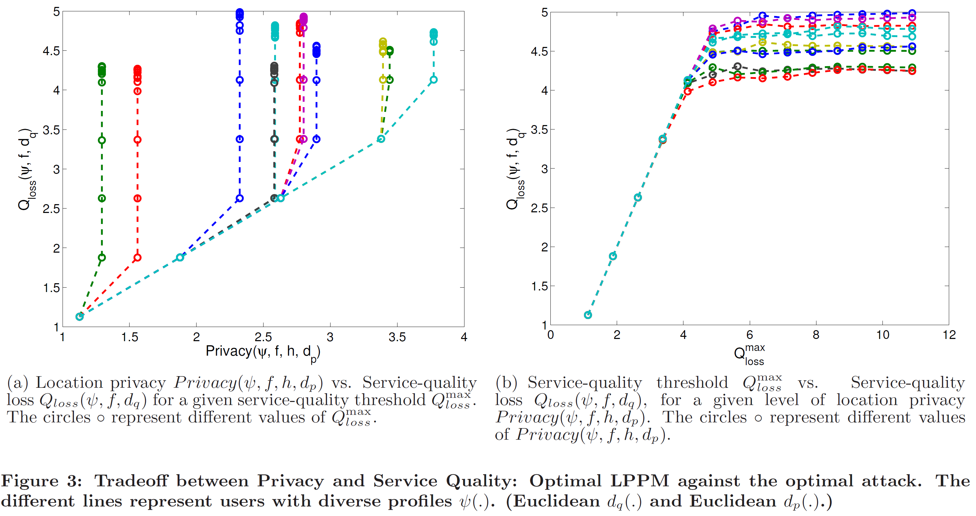
“Optimal Strategies” Tradeoff between Privacy and Service Quality

