Slide 1
Passive/Active Acoustic metamaterials
Dr. Hervé Lissek
EPFL - Laboratoire d’ElectroMagnétisme et d’Acoustique

Slide 2
Introduction
Acoustic Metamaterials
increasing research topic in the Physical Acoustics community
design accessible through straightforward concepts (electroacoustic analogies)
Ongoing research at LEMA-EPFL
Dual Transmission-Line based acoustic/mechanical metamaterials
Theoretical/Experimental validation of 1D prototype
Theoretical assessement of 2D configurations
Electroacoustic absorbers:
Shunt a loudspeaker with active electric networks = active control of acoustic impedance
Bongard F., Lissek H., Mosig J.R., Acoustic transmission line metamaterial with negative/zero/positive refractive index, PRB 82(9), september 2010
Gouraud B., Métamatériaux acoustiques type ligne de transmission, Rapport de stage long de recherche FIP-M1, ENS, juillet 2010
Lissek H., Boulandet R., Fleury R., Electroacoustic absorbers: bridging the gap between shunt loudspeakers and active sound absorption, JASA 129(5), 2011

Slide 3
Introduction
K : Bulk modulus
ρ : Mass density
γ : Propagation constant
Fields variation in exp(-γz)
Acoustic metamaterials
Negative refraction

Slide 4
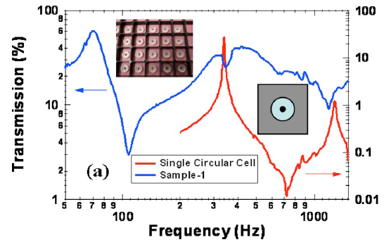
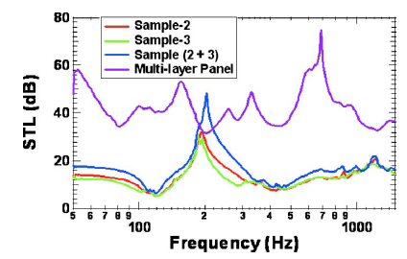
Introduction - Applications
Low frequency noise absorption
Yang Z., Dai H. M., Chan N. H., Ma G. C., Sheng P., Acoustic metamaterial panels for sound attenuation in the 50–1000 Hz regime, APL 96, January 2010

Slide 5

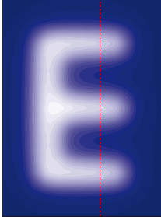
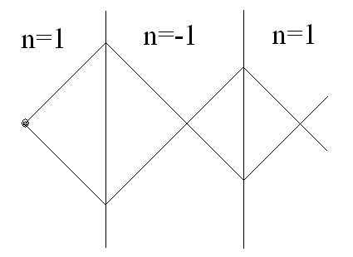
Introduction - Applications
Low frequency noise absorption
Superlenses, subwavelength imaging
Zhu J., Christensen J., Jung J., Martin-Moreno L., Yin X., Fok L., Zhang X.,.Garcia-Vidal F. J, A holey-structured metamaterial for acoustic deep-subwavelength imaging, NPL 7, January 2011

Slide 6
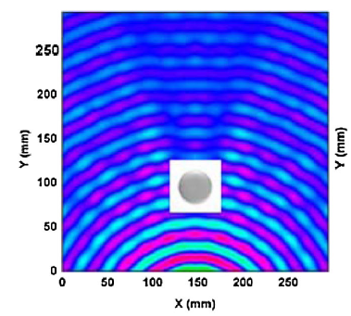
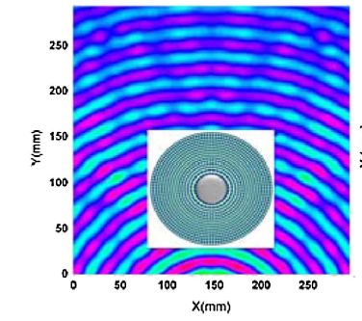
Introduction - Applications
Low frequency noise absorption
Superlenses, subwavelength imaging
Acoustic cloaking
Zhang S., Xia C., Fang N., Broadband Acoustic Cloak for Ultrasound Waves, PRL 106, January 2011

Slide 7
Dual TL-based Acoustic metamaterials
Dual Transmission Line
Analogies with Electromagnetics
Transmission-Line approach
Waveguides periodically loaded with “inclusions”
Only K < 0
Only K < 0
Side holes [Lee, JPCM 21, 2009]
Helmholtz resonators [Fang, NM 51, 2006]

Slide 8
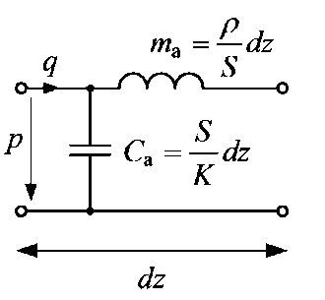
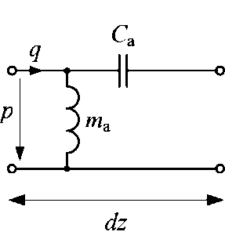
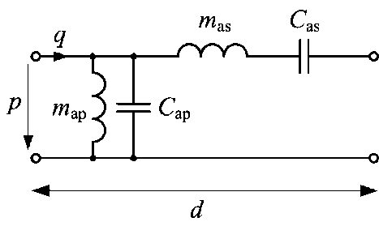
Dual TL-based Acoustic metamaterials
Implementation of a “double negative acoustic medium” based on a transmission line approach
⇒ Dual Transmission Line!
Conventional medium
Negative refraction medium
Generally: Composite Right/Left-Handed (CRLH) medium
In practice:
⇒ Implementation of series acoustic compliances + shunt masses …

Slide 9
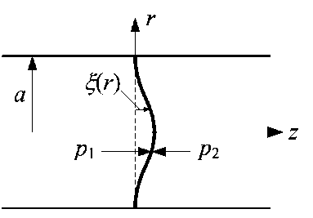
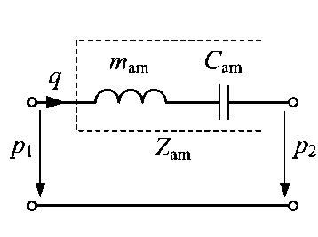
Dual TL-based Acoustic metamaterials series compliances
How to implement such elements?
E : Young’s modulus
ν : Poisson’s ratio
ρ_{m} : mass density
h : thickness
mass-compliance approximation
Clamped thin plate
Equivalent acoustic circuit
Thin plates theory:
Exact mechanical impedance
Acoustic impedance

Slide 10
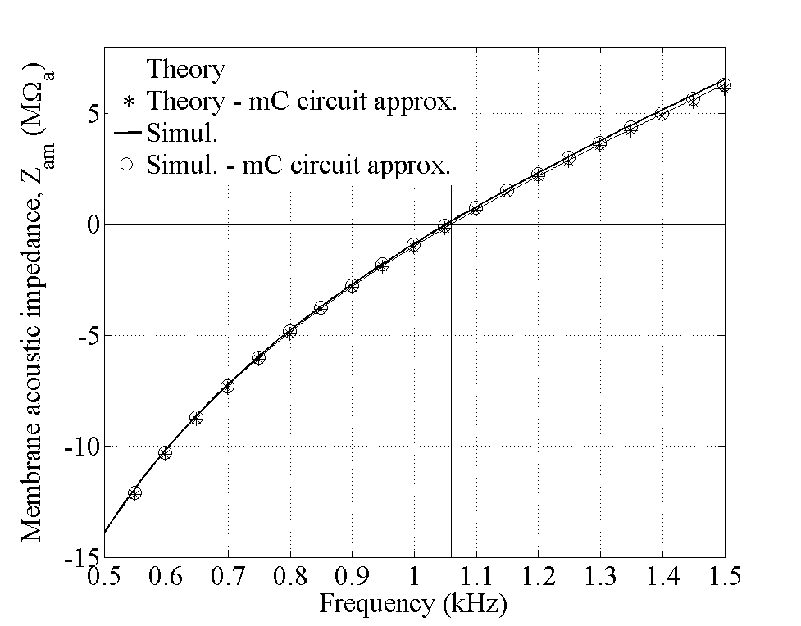

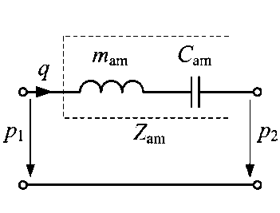
Dual TL-based Acoustic metamaterials series compliances
Validation
Kapton® FPC membrane, h = 125 μm, a = 9.06 mm
simulations with COMSOL MULTIPHYSICS (Application mode: “Stress-Strain with Acoustic Interaction”)
Computing reflection and transmission coefficients under plane waves ⇒ series equivalent impedance Z_{am}:
Dominated by m_{am}
(Imaginary part)
Dominated by C_{am}

Slide 11
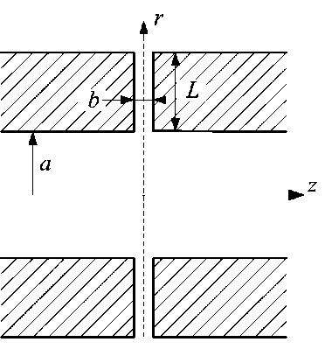
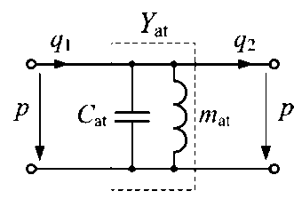
Dual TL-based Acoustic metamaterials Shunt masses
How to implement such elements?
Shunt masses can be achieved with small open ducts (“stubs”).
≈ p = 0 ⇒ small “shunt” duct ⇒ ≈ shunt acoustic mass m_{at} (+ parasitic C_{at})
m_{at} can be approx. by
Equivalent acoustic circuit
Open radial stub
Radial duct theory ⇒ exact expression of Y_{at} ⇒ mass-compliance approximation (m_{at}, C_{at})…

Slide 12
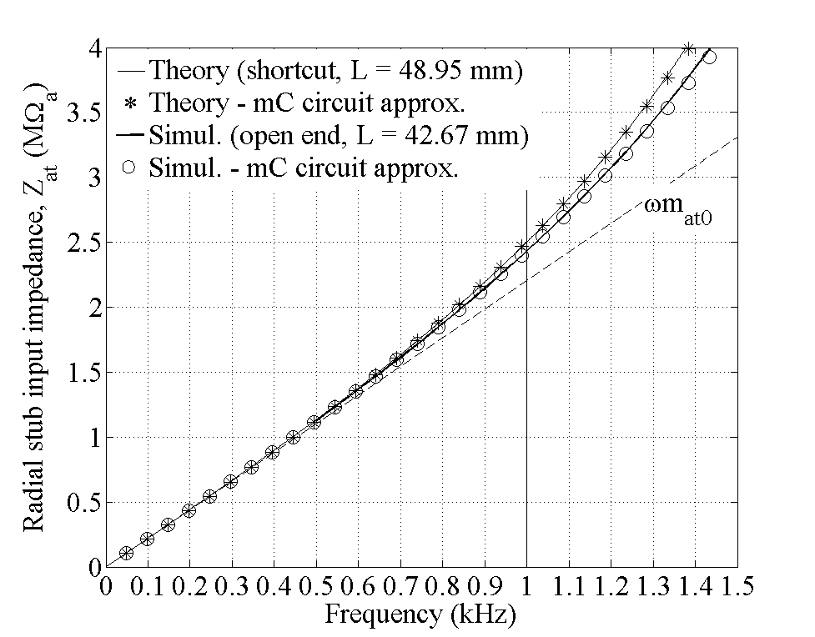
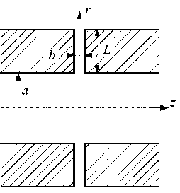
Dual TL-based Acoustic metamaterials Shunt masses
Validation
Open radial duct with b = 1 mm and a = 9.06 mm
Simulations with COMSOL MULTIPHYSICS
Computing reflection and transmission coefficients under plane waves ⇒ extraction of shunt impedance Z_{at} = 1/Y_{at}:

Slide 13
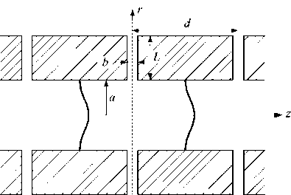
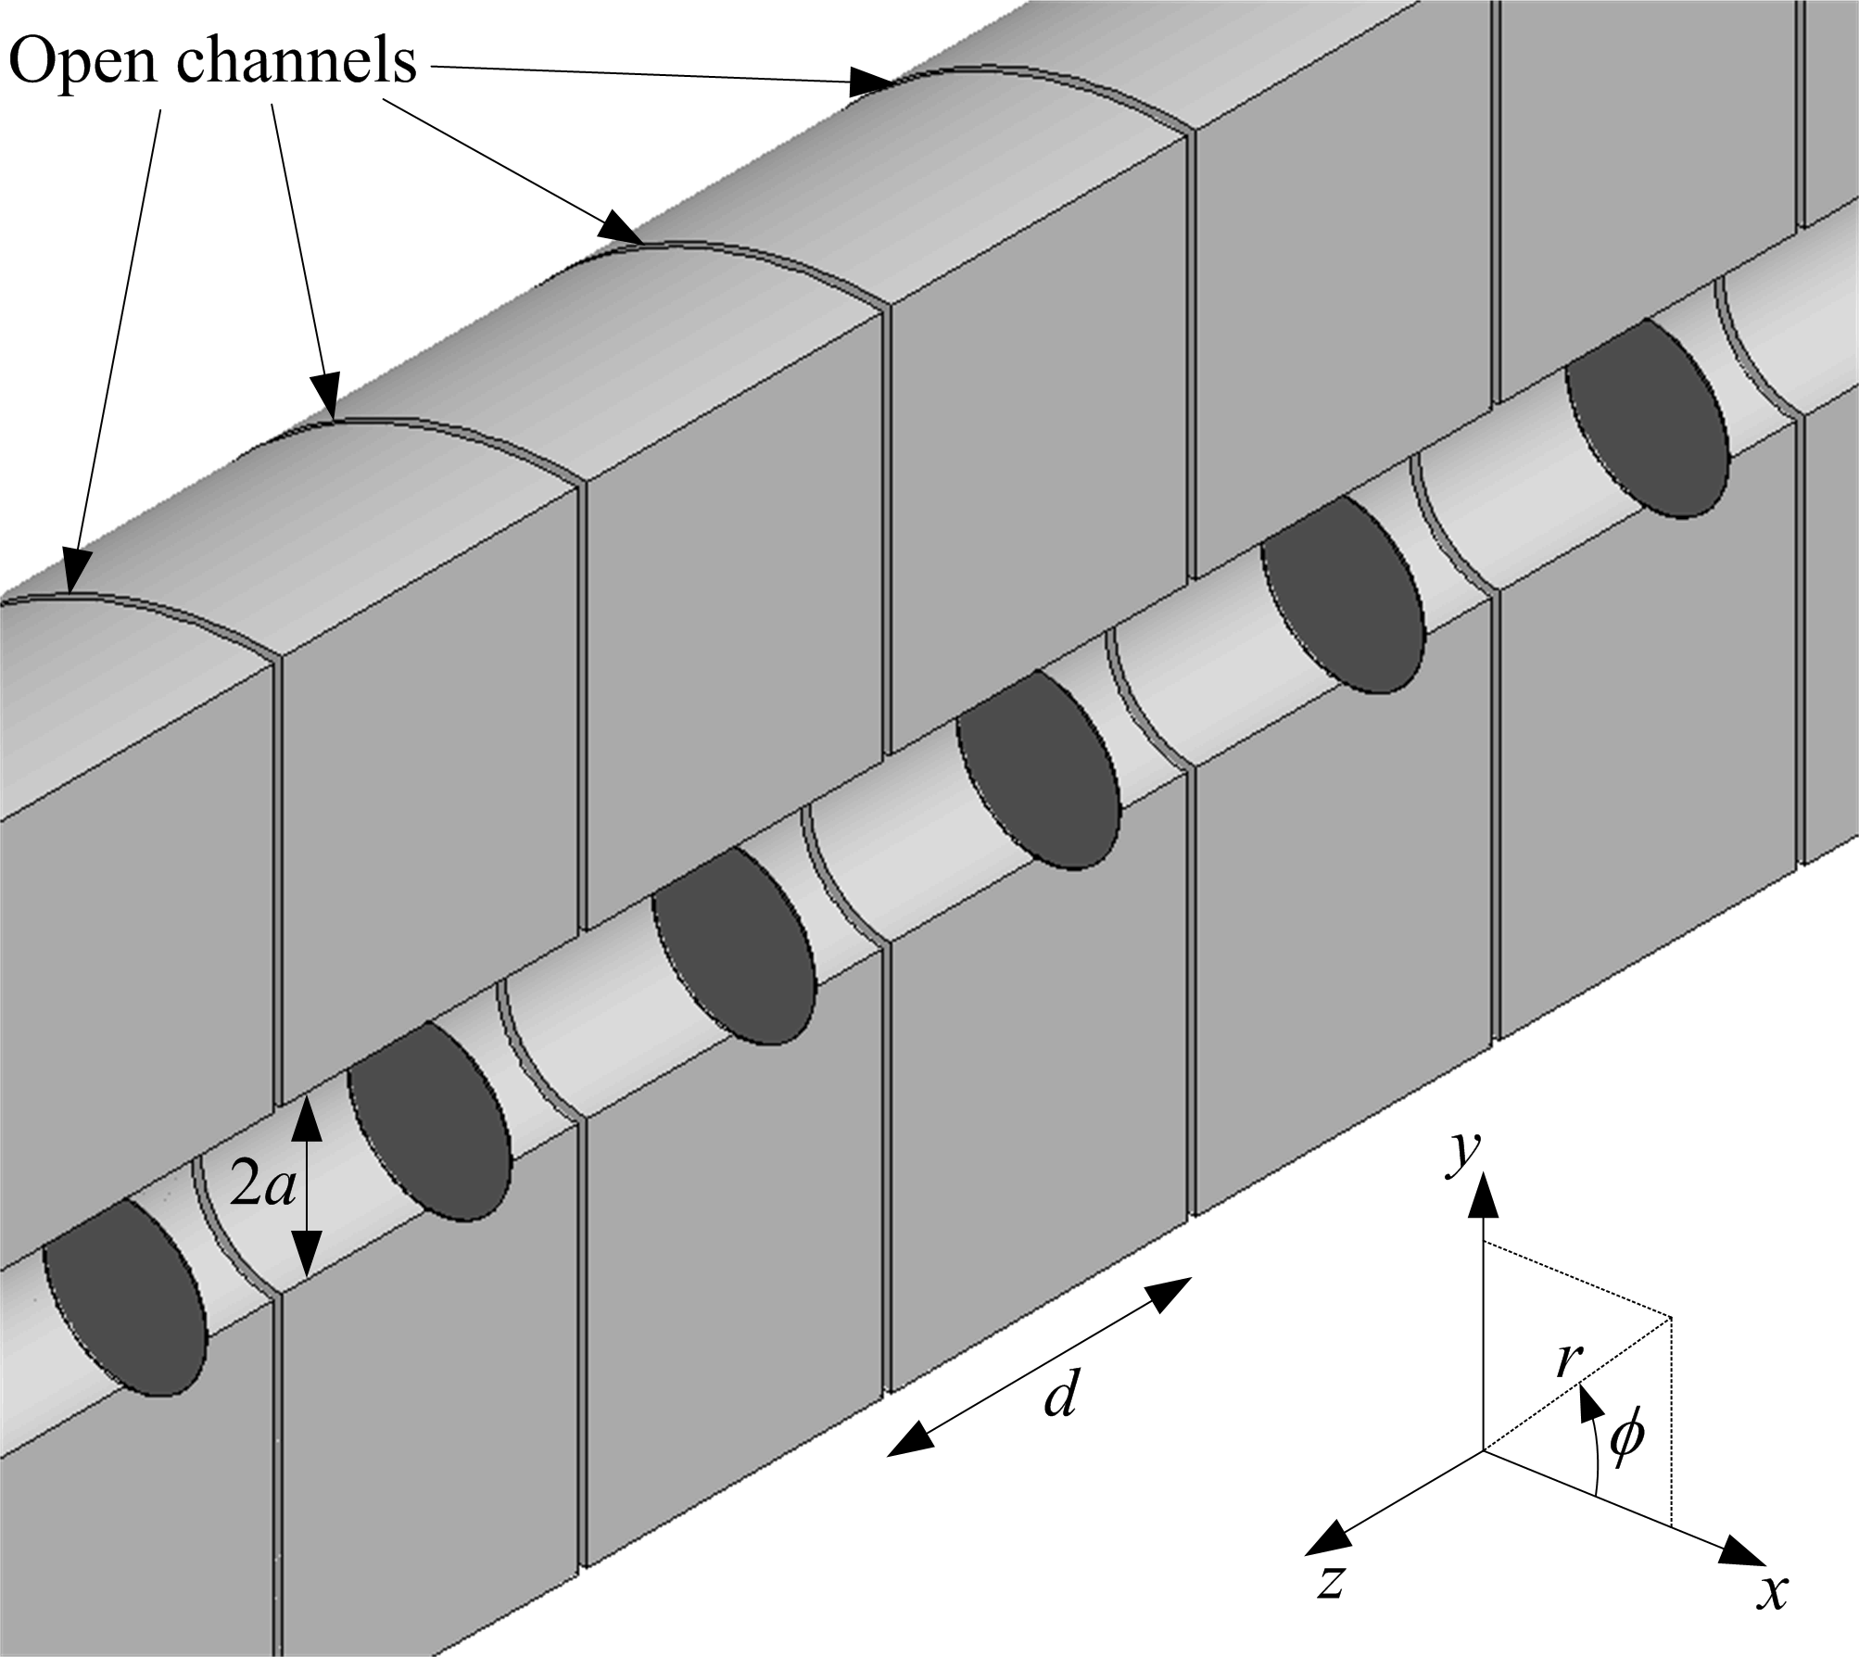
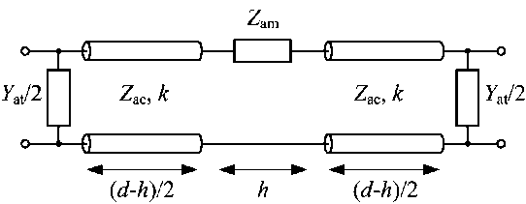
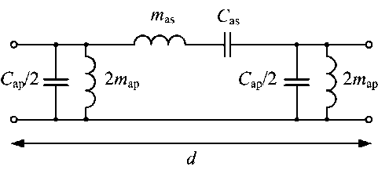
Dual TL – Model and Design
Structure proposée:
Symmetric unit-cell
“detailed model”
“lumped-elements model”
d = 34 mm = λ/10 @ 1 kHz ⇒ subwavelength unit-cell ⇒ effective medium characteristics

Slide 14
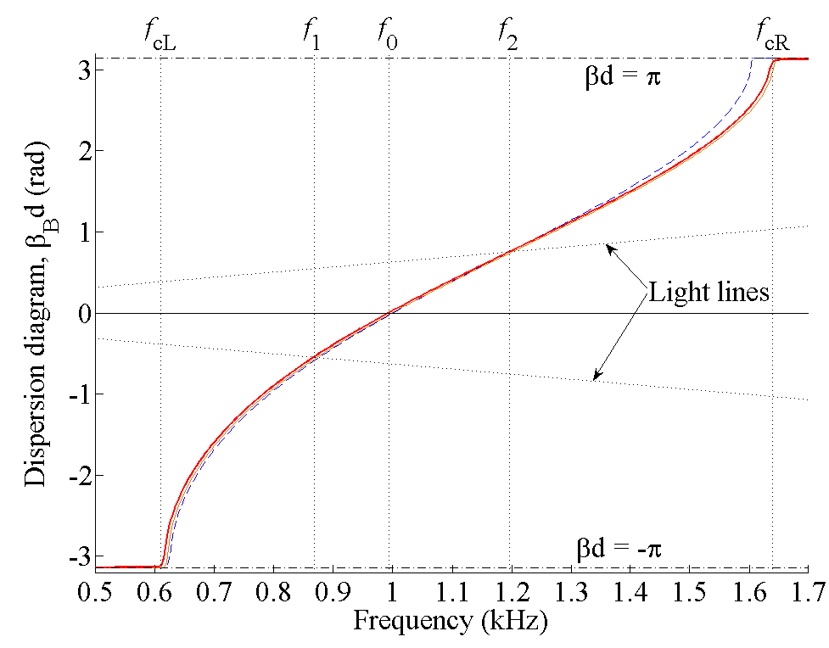
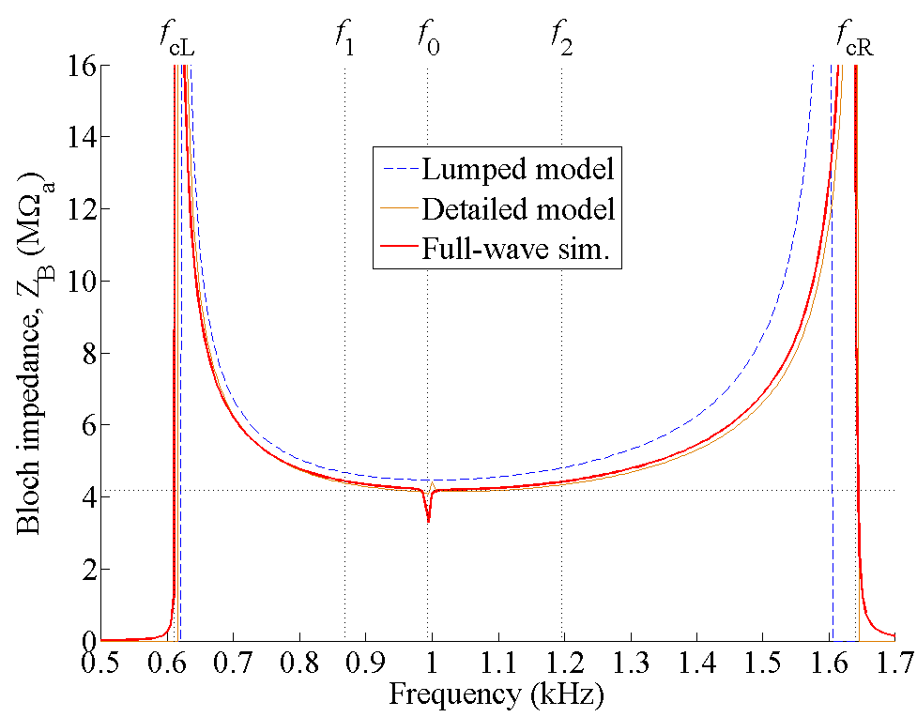

duAL TL – Performances (1/2)
dispersion diagram β_{B} (refraction index: n = β_{B}/k)
Bloch impedance Z_{B}
n < 0 band (backward waves)
≈ 1 octave !!
n > 0 band (forward waves)
Bloch parameters =
scattering parameters of a TL equivalent to the periodic structure
Bongard F., Contribution to characterization techniques for practical metamaterials and microwave applications., PhD Dissertation n° 4407 , EPFL, 2009

Slide 15
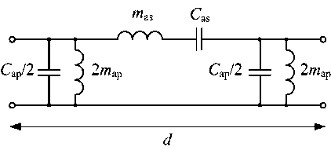
duAL TL – Performances (1/2)
dispersion diagram β_{B} (refraction index: n = β_{B}/k)
Bloch impedance Z_{B}
n < 0 band (backward waves)
≈ 1 octave !!
n > 0 band (forward waves)
Smooth impedance ⇒ wideband matching
n = 0 @ f₀ = 1 kHz : transition frequency
No band gap ⇒ “matched conditions” ! It is possible to match the resonance frequencies of the series and shunt branches
=
Bongard F., Contribution to characterization techniques for practical metamaterials and microwave applications., PhD Dissertation n° 4407 , EPFL, 2009

Slide 16
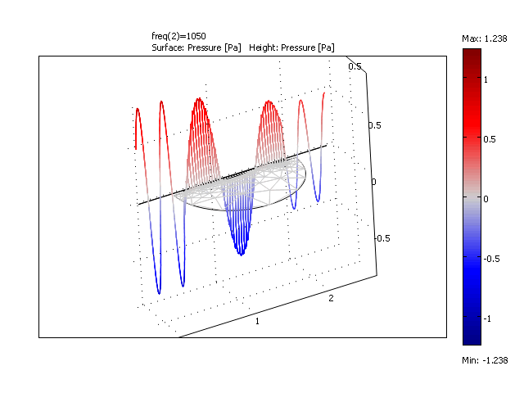
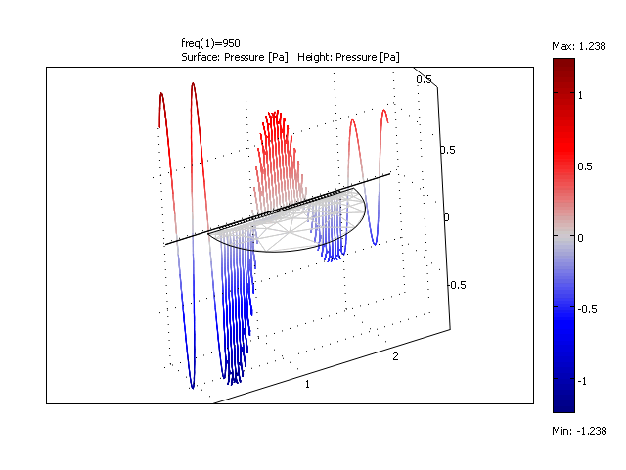
duAL TL – Performances (1/2)
dispersion diagram β_{B} (refraction index: n = β_{B}/k)
n < 0 band (backward waves)
≈ 1 octave !!
n > 0 band (forward waves)
Bongard F., Contribution to characterization techniques for practical metamaterials and microwave applications., PhD Dissertation n° 4407 , EPFL, 2009

Slide 17
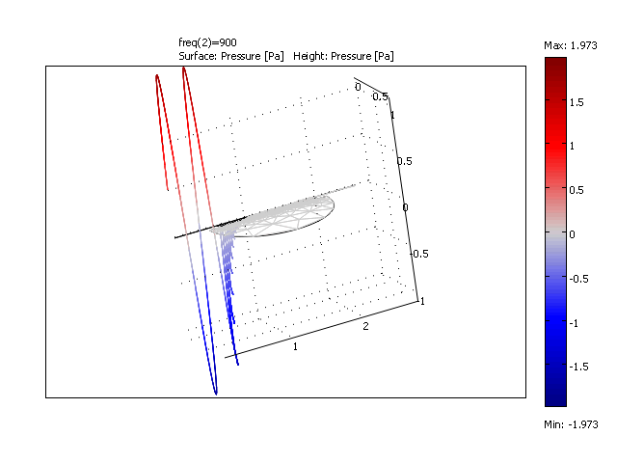
Example of mismatched resonators

Slide 18
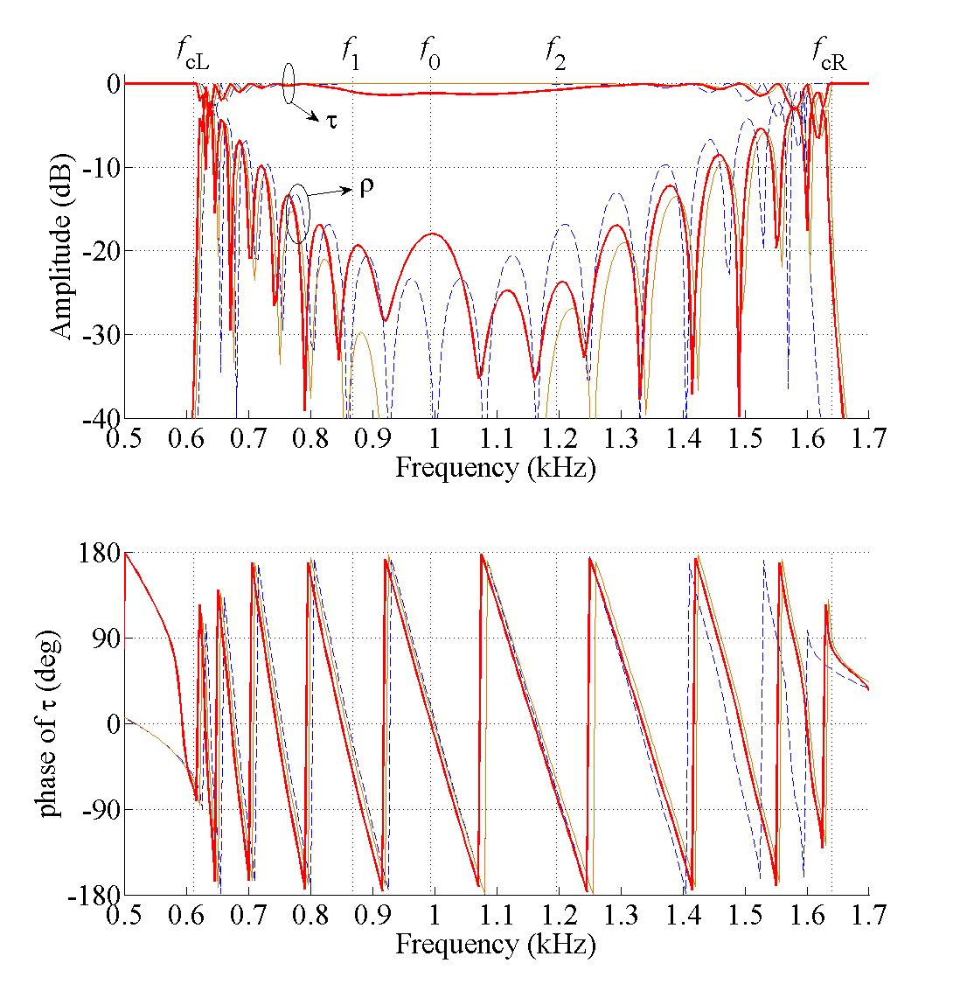
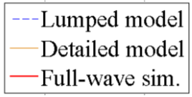
duAL TL – Performances (2/2)
10 cells structure :scattering parameters
ρ : Reflection coeff.
τ : Transmission coeff.
wideband -10 dB matching
0° transmission phase

Slide 19
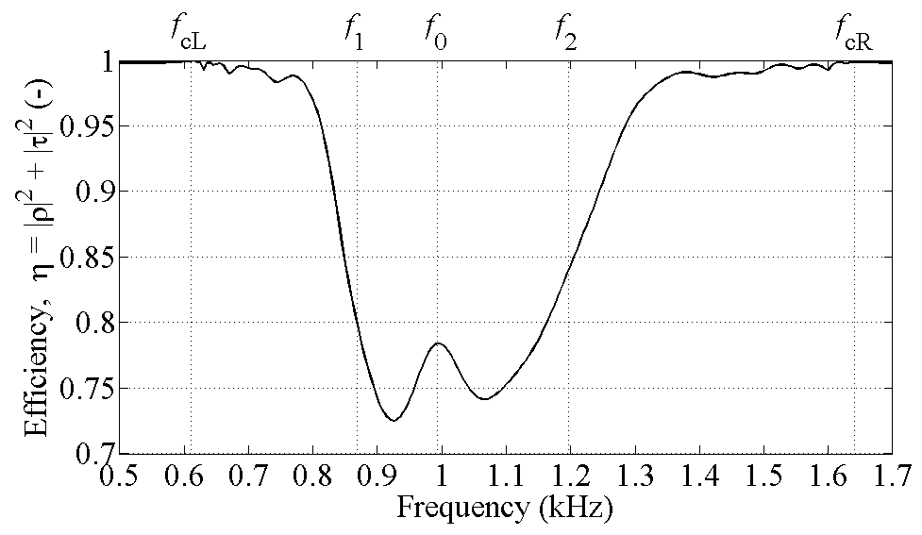
Dual TL – Radiation properties (1/2)
Radiation of open stubs
fast-wave radiation band
“Efficiency” : (η = 1 for lossless structure)
fast-wave radiation band

Slide 20
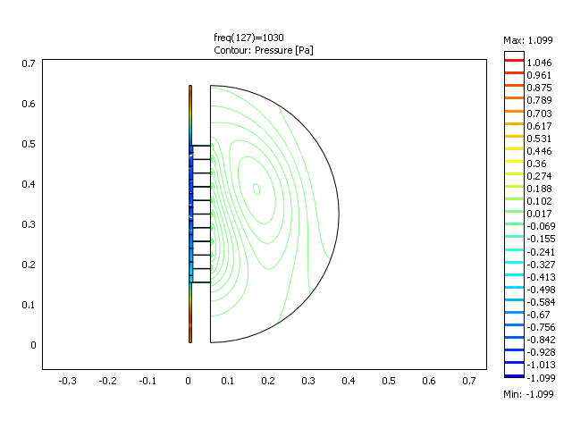
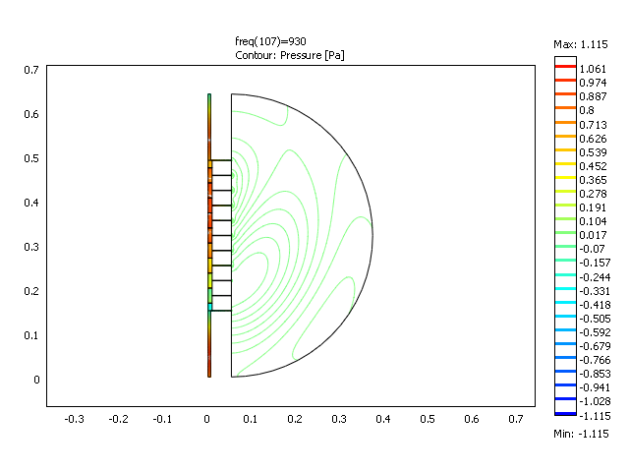
Dual TL – Radiation properties (2/2)
fast-wave radiation band
1030 Hz
fast-wave radiation band
930 Hz

Slide 21
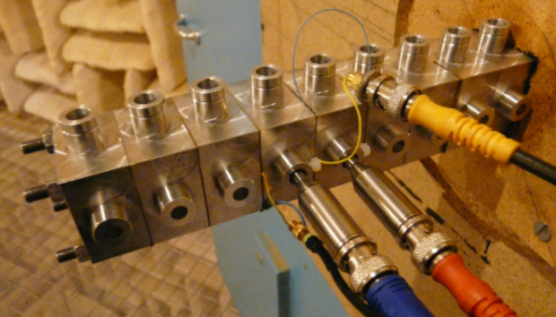
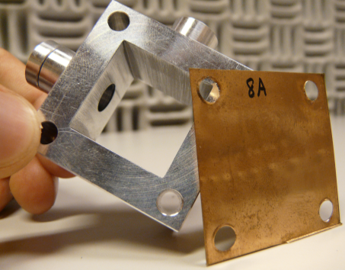
expErimental study
1D dual TL prototype
Rectangular waveguide: section 23mm x 23mm
Membranes = 50μm Bronze-Beryllium plates clamped between two adjacent cells
Stubs = cylindrical ducts (radius 4mm, length 20mm)

Slide 22
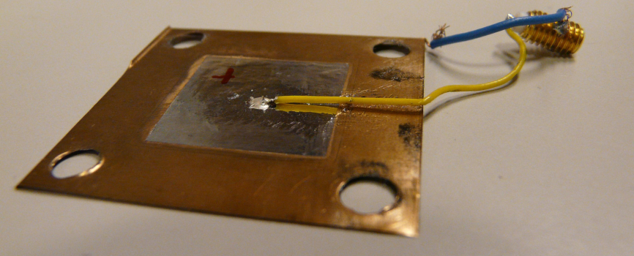
expErimental study
Characterization (series + shunt impedances)
Plates vibratory velocity v_{i}:
PVDF film (9μm) glued on one face
Acoustic pressure p_{i} in each connecting cavity
v₁
p₁
p₂

Slide 23
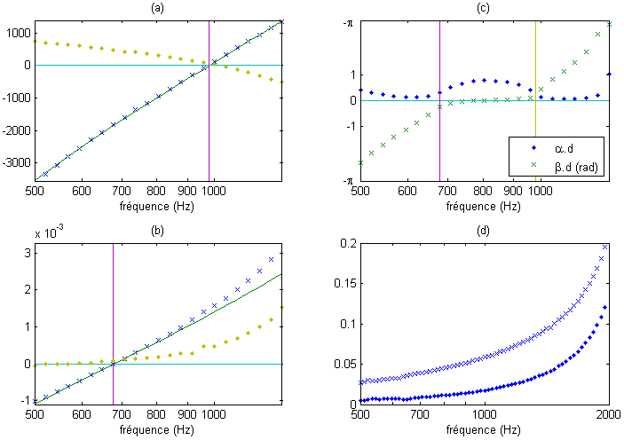
expErimental study
Characterization (series + shunt impedances)
Plate series impedance
+ Im(Z_{as})
. Re(Z_{as})
with m_{as}=0.4 kg.m⁻² and C_{as}=6.6.10⁻⁸ m.Pa⁻¹
Stub admittance
+ Im(Y_{ap})
. Re(Y_{ap})
with C_{ap}=41.10⁻⁸ Pa⁻¹ and m_{ap}=0.13 kg.m⁻²

Slide 24
expErimental study
Characterization: dispersion diagram
Dispersion diagram processed according to Z_{as} and Y_{ap}

Slide 25
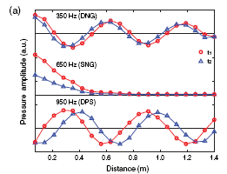
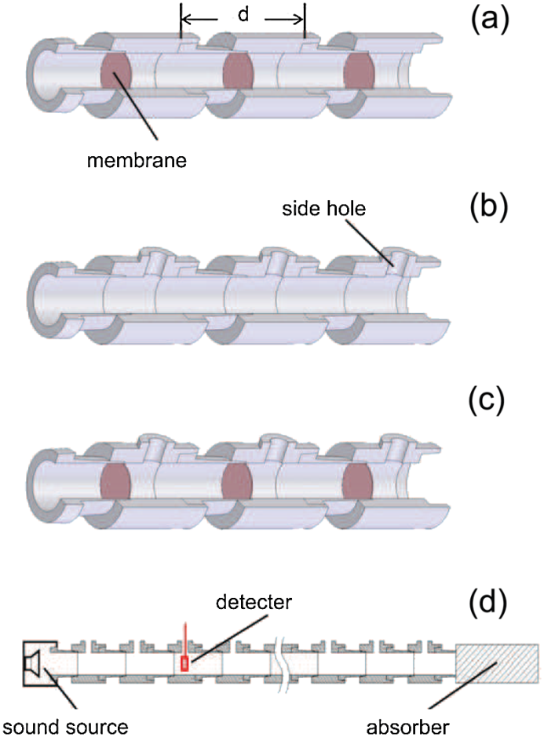
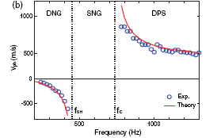
expErimental study (Lee et al)
Characterization: phase velocity
Visualization of the three typical waves (t₂ =t₁+Δt).
At 350 Hz the wave propagates backwards,
At 650 Hz the wave is evanescent,
At 950 Hz the wave travels forward.
Phase velocity as a function of frequency.
Lee S.H., Park C.M., Seo Y.M. et al, Composite Acoustic Medium with Simultaneously Negative Density and Modulus, PRL 104, 2010

Slide 26
Experimental study
Experimental issues:
Design discrepancies: building the structure induces heterogeneous tension on the plates
Resonance frequencies hardly tuneable in practice!
Only local measurements for now
Experimental assessment to be optimized:
measurement of coefficients α and β in TL-impedance tube

Slide 27
Active acoustic metamaterials Active Control of acoustic impedance

Slide 28
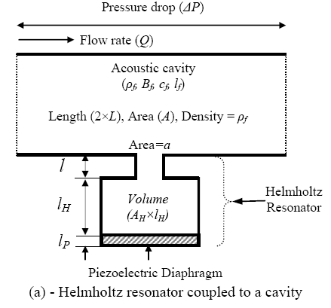
Rationale for turning into active
Possibility to tune acoustic properties hardly achievable with passive structures
In 2010, Akl et al proposed a configuration with active HRs
piezo-transducer at the back of the cavities
direct pressure feedback
➔ Programmable bulk modulus
Variable mass density also
achievable with active membranes
Akl W., Baz A.., Configurations of Active Acoustic Metamaterial with Programmable Bulk Modulus, Proc. SPIE, 2010

Slide 29
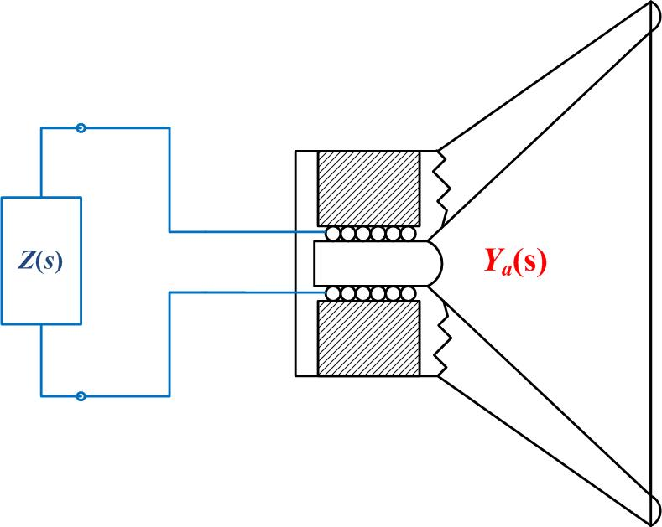
Active control of acoustic impedance
An electroacoustic transducer can be used as a variable acoustic impedance
Concept of "electroacoustic absorber"
Applied in FP7-OPENAIR
Mechanical resonator
- mech. resistance R_{ms}
mass M_{ms}
mech. compliance C_{ms}
β_{n}(s)
V_{n}(s)
P(s)
Lissek H., Boulandet R., Fleury R., Electroacoustic absorbers: bridging the gap between shunt loudspeakers and active sound absorption, JASA 129(5), 2011

Slide 30
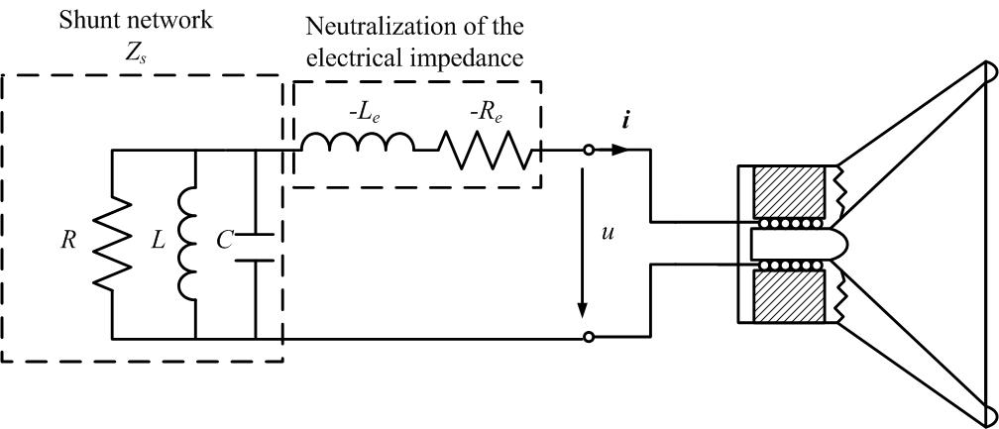
Active control of acoustic impedance
In the case of an electrodynamic loudspeaker + shunt R//L//C electric resonator
Variable R modifies R_{mEA}
Variable L modifies C_{mEA}
Variable C modifies M_{mEA}
β_{n}(s)

Slide 31
Active control of acoustic impedance
Natural resonator

Slide 32
Active control of acoustic impedance
Positive shunt resistance

Slide 33
Active control of acoustic impedance
Negative shunt resistance

Slide 34
Active control of acoustic impedance
Positive R and negative L and C

Slide 35
Active control of acoustic impedance
Negative C
Positive C

Slide 36
Active control of acoustic impedance
Negative L

Slide 37
Active control of acoustic impedance
Theoretically, an electroacoustic resonator parameters can be modified to a large extent
Reduction of mass // compliance (negative inductance // capacitance)
increases resonance frequency of membranes
possible alignement of plates in a multi-cell metamaterial
Reduction of resistance (negative resistance)
reduces losses in the metamaterial

Slide 38
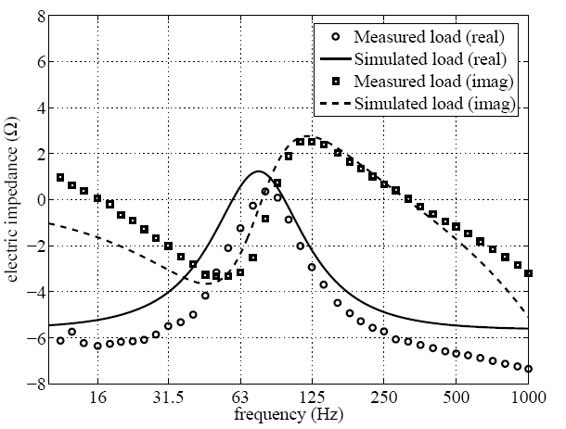
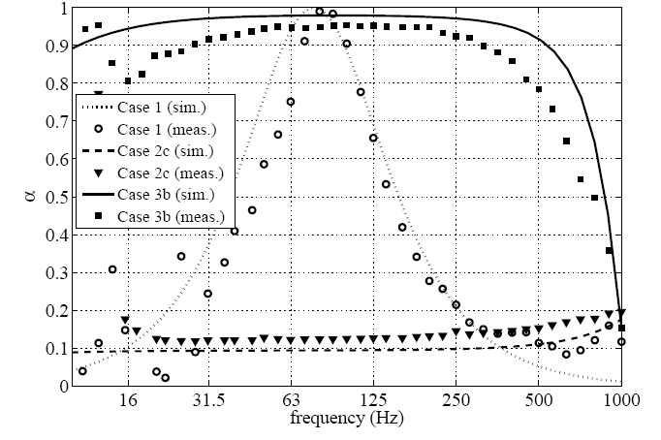
Experimental assessment
Absorption coefficient
Active electric load

Slide 39
CONCLUSIONS

Slide 40
Conclusions – perspectives
1D dual TL concept validated
Series compliance achieved with membranes
Shunt masses achieved with open derivation ducts
Effective properties assessed numerically
Local properties assessed experimentally
In parallel, several applications assessed:
Sound absorption in the LF range
Subwavelength imaging
Acoustic cloaking

Slide 41
Conclusions – perspectives
Active control of acoustic impedance
Variable acoustic resonator parameters
reduce losses in the resonator
stiffen the resonator
lighten the resonator
No need to use sensor for fedbacks
But pressure feedback (combined with active electric load) can improve the stability

Slide 42
Conclusions – perspectives
Active acoustic metamaterials
Could take advantages of actuated membranes
Vary negative mass
Vary negative bulk modulus
Set, by electric control, the bandwidths of work
possibility to overcome practical issues
Lossless mechanical systems
Alignement of membranes

Slide 43
Thank you for your attention time for questions…
Collaborators:
Dr. Frédéric Bongard, Baptiste Gouraud
Romain Boulandet, Romain Fleury, Anne-Sophie Moreau

