Slide 1
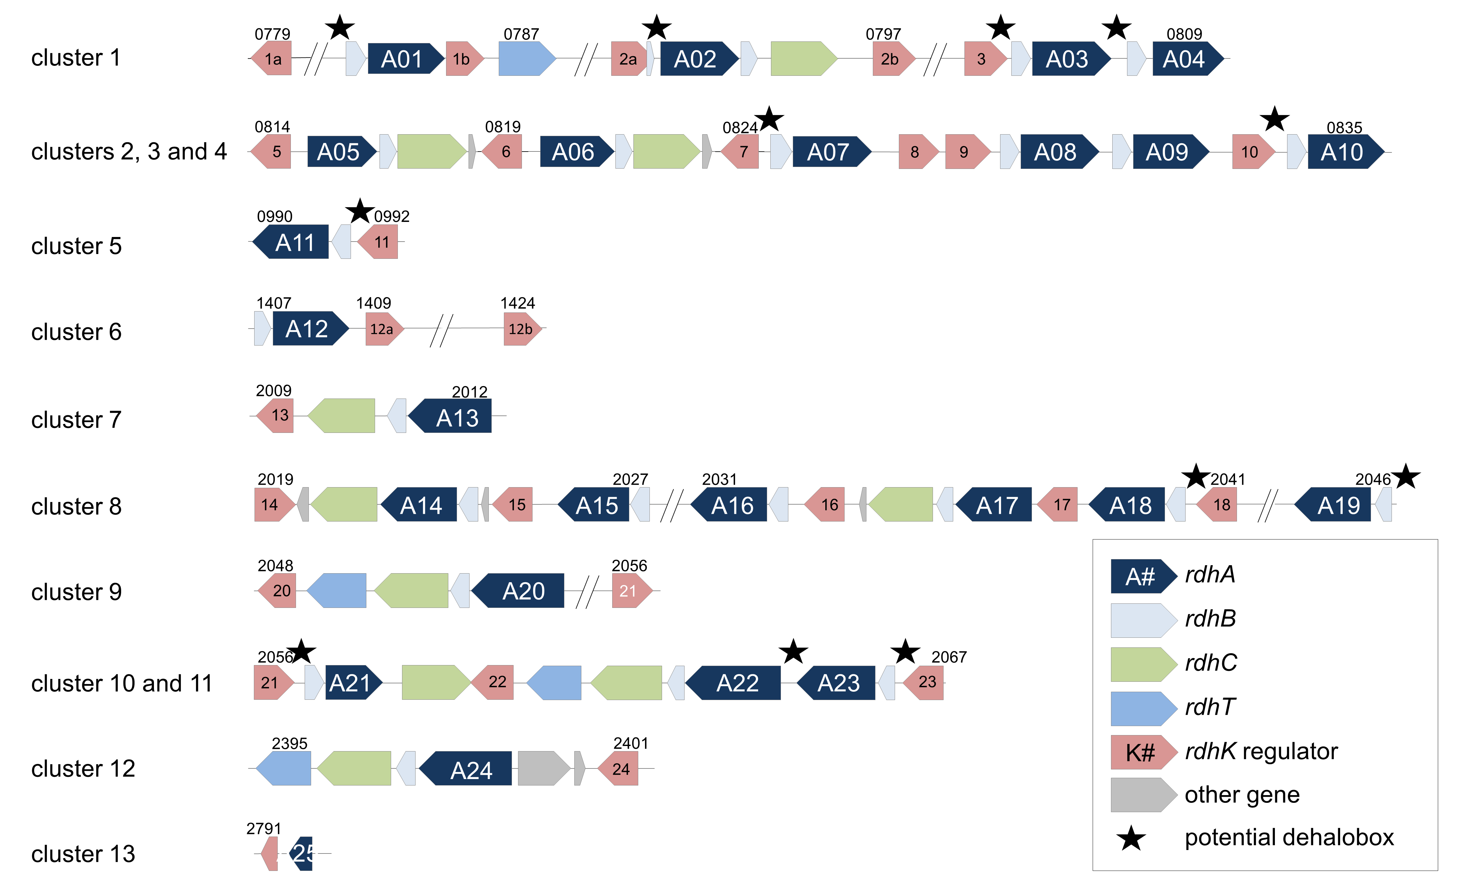

Explore RdhK based regulatory network of organohalide respiration using a hybrid proteins strategy
Mathilde Willemin#, Christof Holliger and Julien Maillard
Laboratory for Environmental Biotechnology (ENAC-IIE-LBE), Swiss federal institute of technology, Lausanne, Switzerland
II. Main goal
I. context
III. Challenge
Dehalobacter restrictus PERK-23 gene organization
Rdh gene clusters encode proteins involved in organohalide respiration and their transcription is regulated by protein of the CRP/FNR family, called RdhK.
Identification of RdhK binding partners
Visualization of the tripartite complex requires the presence of the interdependent effector and dehalobox partners.
Characterization of new RdhK protein (i.e. identification of both binding partners)
An indirect way to discover new substrate for organohalide
Decoupling the screenings using an hybrid RdhK strategy.
Come and disscuss with me ☺

