Slide 1


Security Games in Online Advertising: Can Ads Help Secure the Web?
Nevena Vratonjic
Maxim Raya
Jean-Pierre Hubaux
David C. Parkes
June 2010, WEIS’10

Slide 2
Internet Economy
Online Advertising:
  The main Internet business model
  Revenue in 2009 in the US is $22.4 billion
  Sponsors free services and applications
What happens if one meddles with it?

Slide 3
Online Advertising System
Ad Network
Advertiser
Embedding ads
Advertiser
Ad Servers
(AS)
Websites
(WS)
Web page
User
(U)
Access Network
(ISP)
Advertiser
Placing ads
Ads

Slide 4
Role of ISPs
Traditional role:
  Provide Internet access to end users
  Forward the communication in compliance with
  Network Neutrality Policy
New requirements
  Data retention legislations
  Increase costs and require investing into new technologies
How will ISPs obtain a return on investment?

Slide 5

Recently Reported Cases
Growing number of ISPs injecting own content into web pages [1][2]
Third party ad companies partnering with ISPs
  e.g., Adzilla, Phorm, NebuAd
[1] C. Reis et al. Detecting In-flight Page Changes with Web Tripwires, NSDI 2008.
[2] B. April, F. Hacquebord and R. Link, A Cybercrime Hub, August 2009.
[3] C. Kreibich and N. Weaver, US internet providers hijacking users' search queries, August 2011.

Slide 6
ISPs in Online Advertising Business
Non-cooperative ISP – diverts part of online ad revenue by performing attacks on online advertising
  E.g., injecting ads into the content of web pages on-the-fly
Cooperative ISP – collects and provides information about users’ online behavior with the goal of improving ad targeting
  Generates revenue by charging for users’ profiles

Slide 7
Problem Statement
Study the effect of strategic ISPs on the Web
  Model the behavior of ISPs and
  economic incentives in online advertising systems
  Analyze mutually dependent actions of
  ISPs and Ad Servers (AS)

Slide 8
Related Work
Online advertising fraud
  The best strategy for ad networks is to fight click fraud [1]
Incentives to increase the security of the Web
  Users’ choice: Investment in security or insurance mechanisms [2]
Our model introduces a new strategic player – the ISP
[1] B. Mungamuru, S. Weis, H. Garcia-Molina, Should Ad Networks Bother Fighting Click Fraud? (Yes, they should.), Stanford Technical Report, July 2008.
[2] J. Grossklags, N. Christin, J. Chuang, Secure or insure?: a game-theoretic analysis of information security games, WWW 2008.

Slide 9
Outline
Strategic behavior of ISPs
Game-theoretic Model
Analysis and Results

Slide 10
Nominal Mode
ISP: Abstain (A) – forwards users’ communication
AS: Abstain (A) – serves online ads upon users’ requests
Ad Network
Embedding ads
ISP
Advertisers
(AV)
Ad Servers
(AS)
Websites
(WS)
Web page
User
(U)
Placing ads
Ads

Slide 11

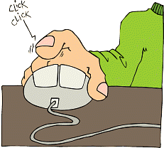



Cooperative Mode
ISP: Cooperate (C) – shares the collected users’ profiles to help AS improve ad targeting
AS: Cooperate (C) – shares a part of its revenue with the ISP
Ad Network
Placing ads
Embedding ads
ISP
Advertisers
(AV)
Ad Servers
(AS)
Websites
(WS)
Web page
User
(U)
Ads
Improved ad targeting
Users’ profiles

Slide 12


Non-Cooperative Mode
ISP: Divert (D) – diverts a fraction of the ad revenue from the AS
AS: Abstain (A) – serves online ads upon users’ requests
Secure (S) – secures the website
Ad Network
Placing ads
Embedding ads
ISP
Advertisers
(AV)
Ad Servers
(AS)
Websites
(WS)
Web page
User
(U)
Advertisers
(AV)
Ads
Users’ profiles
Ad Servers
(AS)
Improved ad targeting

Slide 13
Non-Cooperative Mode
ISP: Divert (D) – diverts a fraction of the ad revenue from the AS
AS: Secure (S) – secures the website
Ad Network
Placing ads
Embedding ads
ISP
Advertisers
(AV)
Ad Servers
(AS)
Websites
(WS)
Web page
User
(U)
Ads

Slide 14
Game-theoretic Model
Behavior of ISPs:
  Abstain (A) – forwards users’ communication
  Cooperate (C) – shares the collected users’ private info to help improve ad targeting
  Divert (D) – diverts a fraction of ad revenue from the AS
Behavior of Ad Servers (AS):
  Abstain (A) – serves online ads upon users’ requests
  Cooperate (C) – shares a part of its revenue with the ISP
  Secure (S) – secures a website to prevent loss of ad revenue

Slide 15
The Game
Dynamic, finite multi-stage game G={P,S_{A},U}
Set of players: P={ISP, AS}
Multi-stage game: Single stage game played for n stages
Total payoffs over n stages= Σ(payoffs at each stage)
Complete and perfect information
Game is modeled for a single website
Identify Subgame Perfect Nash Equilibrium (SPNE)

Slide 16
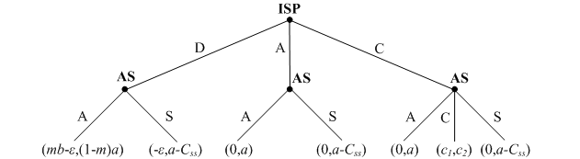
Single Stage Game
If a website is not secured
Payoffs = (U_{ISP},U_{AS})
Non-coop Mode
Non-coop Mode
Nominal Mode
Non-coop Mode
Nominal Mode
Coop
Mode
Non-coop Mode
a – AS’s total payoff in the nominal mode
c₁ , c₂ – ISP’s and AS’s total payoff in the coop mode
m – Fraction of clicks ISP diverts
ε – Cost of diverting clicks
b – ISP’s per fraction revenue when diverting clicks
C_{ss} – One-time cost of securing a website

Slide 17
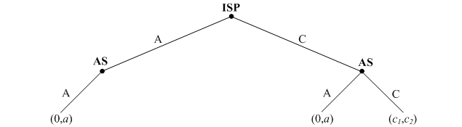
Single Stage Game (cont’d)
If a website is secured
Payoffs = (U_{ISP},U_{AS})
Nominal Mode
Nominal Mode
Coop
Mode
a – AS’s total payoff in the nominal mode
c₁ , c₂ – ISP’s and AS’s total payoff in the coop mode
m – Fraction of clicks ISP diverts
b – ISP’s per fraction revenue when diverting clicks
ε – Cost of diverting clicks
C_{ss} – One-time cost of securing a website

Slide 18
Outline
Strategic behavior of ISPs
Game-theoretic Model
Analysis and Results

Slide 19
Solving the Game
Example: n=1
Payoffs = (U_{ISP},U_{AS})
Case 1: ma≥C_{ss} , c₂>a outcome: (C,C)
Case 2: ma≥ C_{ss} , c₂≤a
Case 3: ma< C_{ss} , c₂≤ a
Case 4: ma< C_{ss} , c₂>a , c₁≥mb-ε
Case 5: ma< C_{ss} , c₂>a , c₁<mb-ε
outcome: (A,A),(C,A)
outcome: (D,A)
outcome: (C,C)
outcome: (D,A)

Slide 20
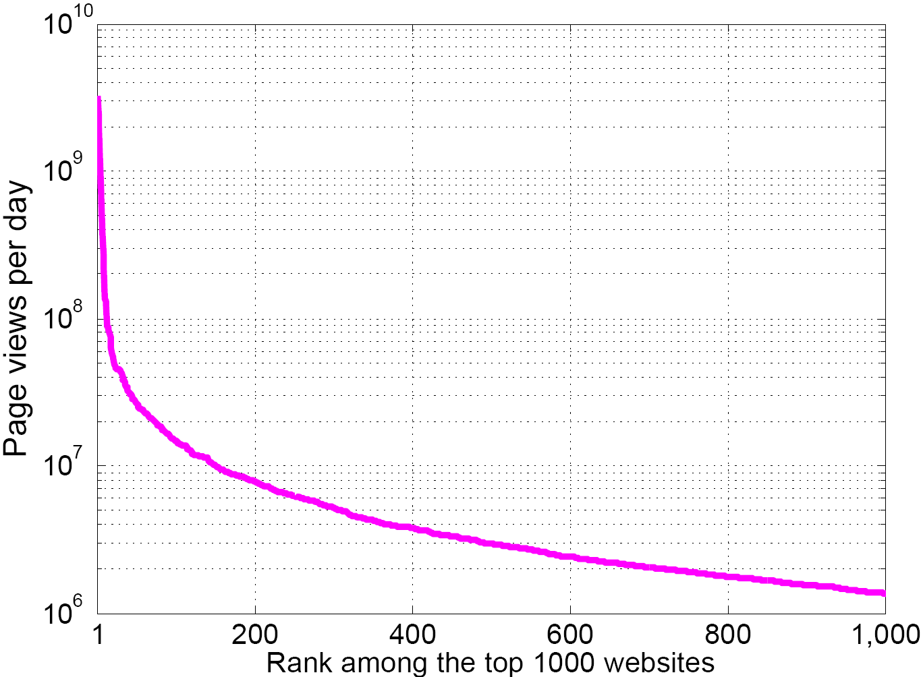
Evaluations on a Real Data Set
Top 1000 most popular websites in June 2009
  based on the data of page views [Compete.com]
Parameters:
  Fraction of revenue diverted by non-cooperative ISP (m)
  Fraction of shared revenue when cooperating (l)
  Improvement of ad targeting (β₂/β₁)
Assumption:
  C_{ss}– the cost of deploying a X.509 certificate and HTTPS at the web server

Slide 21
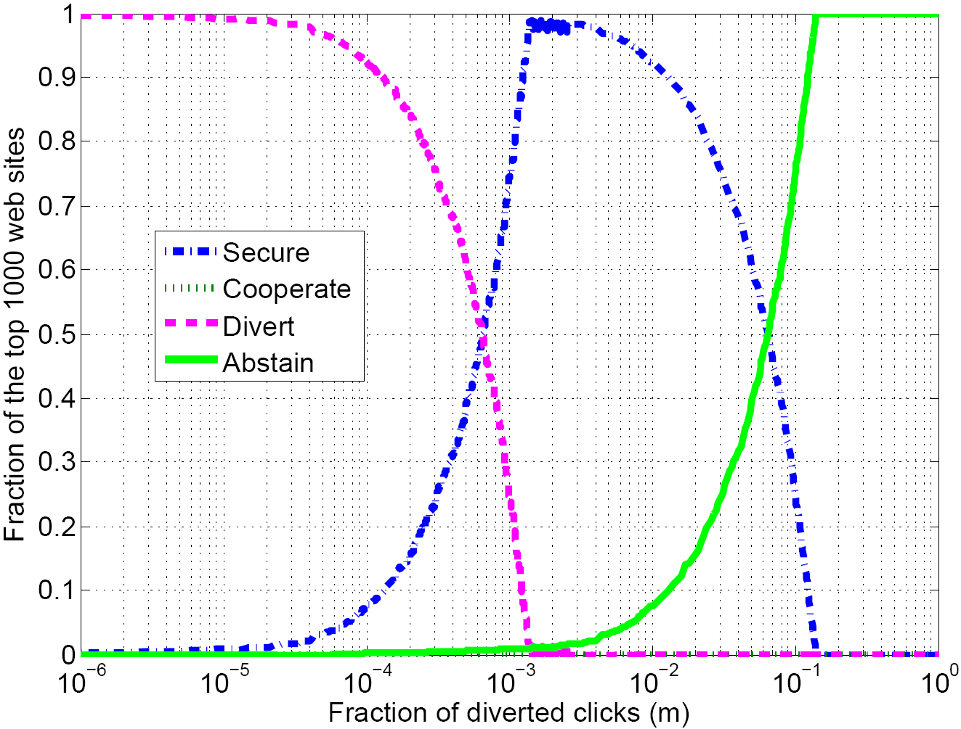
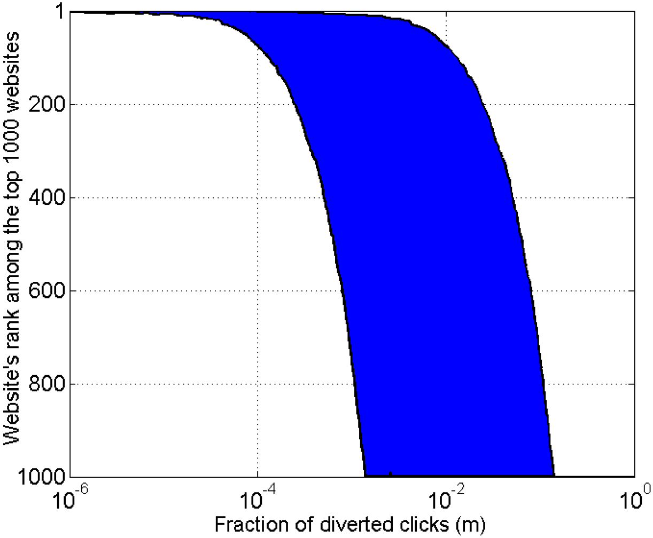
Non-cooperative Scenario
Outcomes of the multi-stage game for the top 1000 websites
Secured websites
(secure if ma>C_{ss})

Slide 22
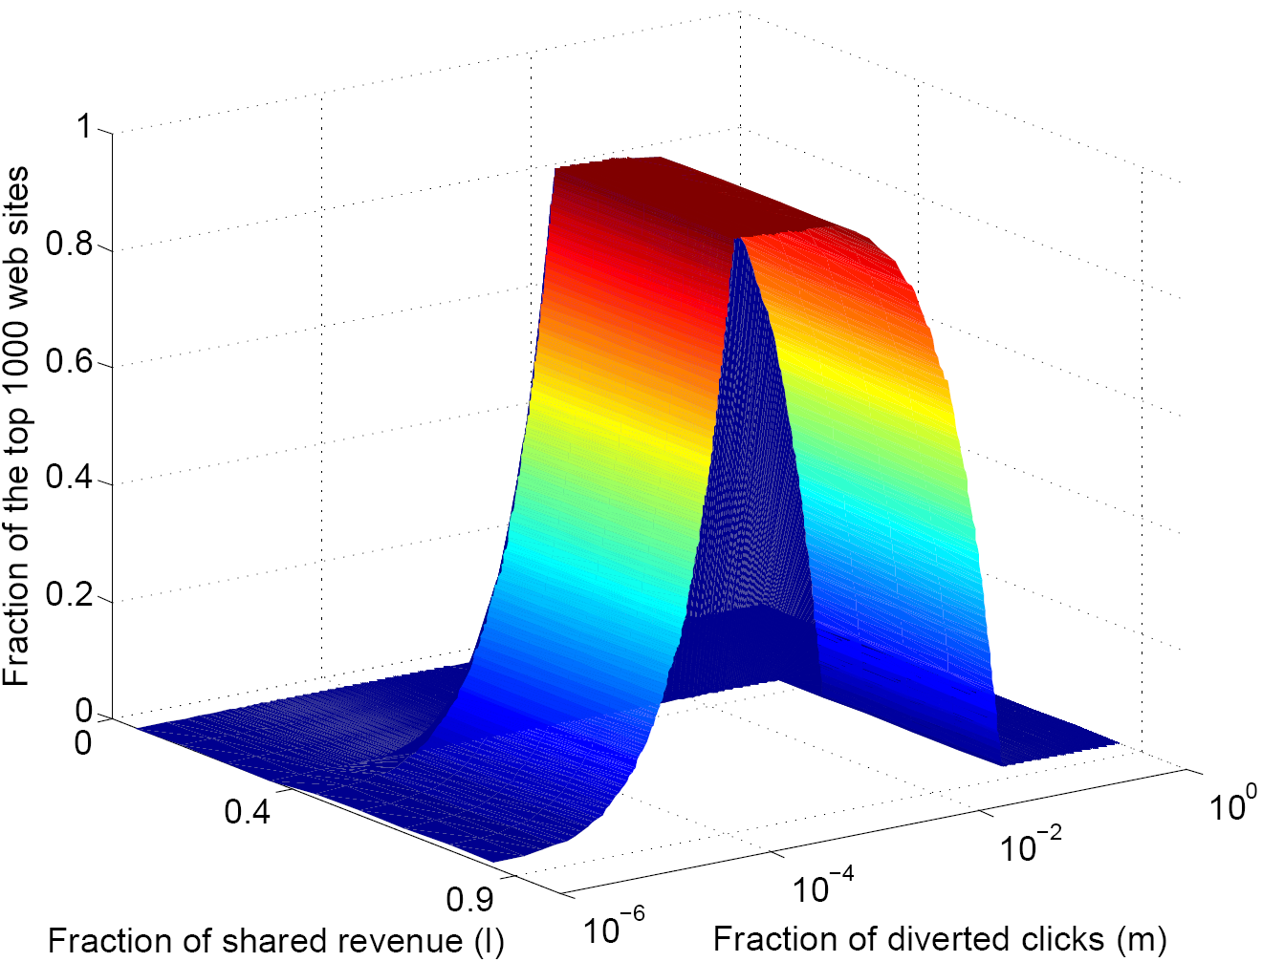
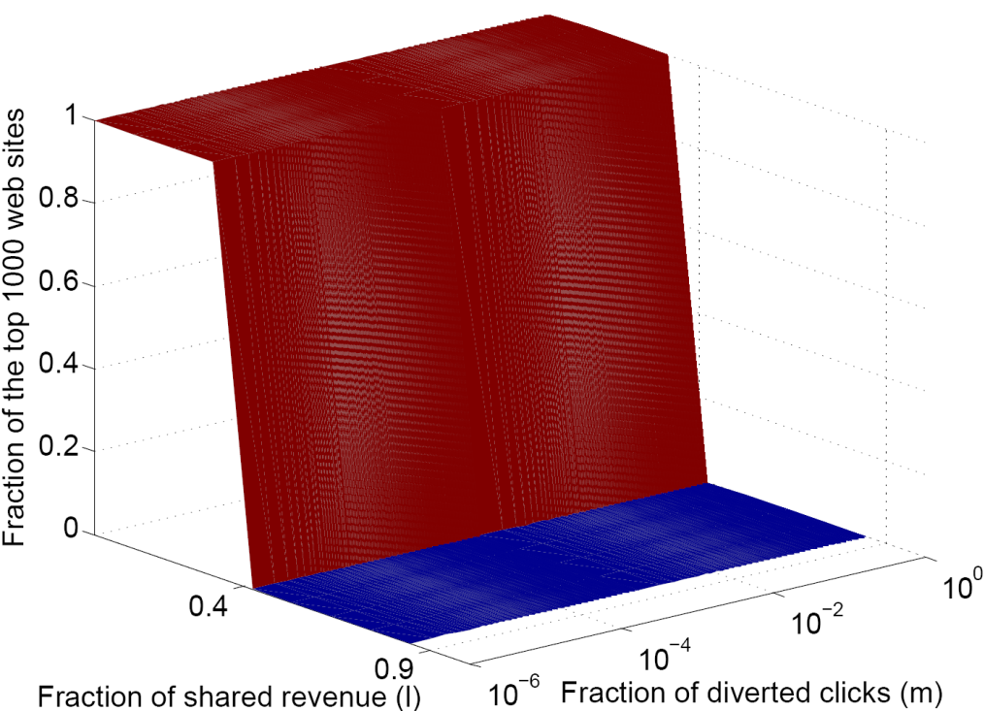
Effect of the Parameters
  Fraction of shared revenue when cooperating (l)
  Cooperative
  Cooperative
  Non-cooperative
  Non-cooperative
Secured websites
Cooperation achieved

Slide 23
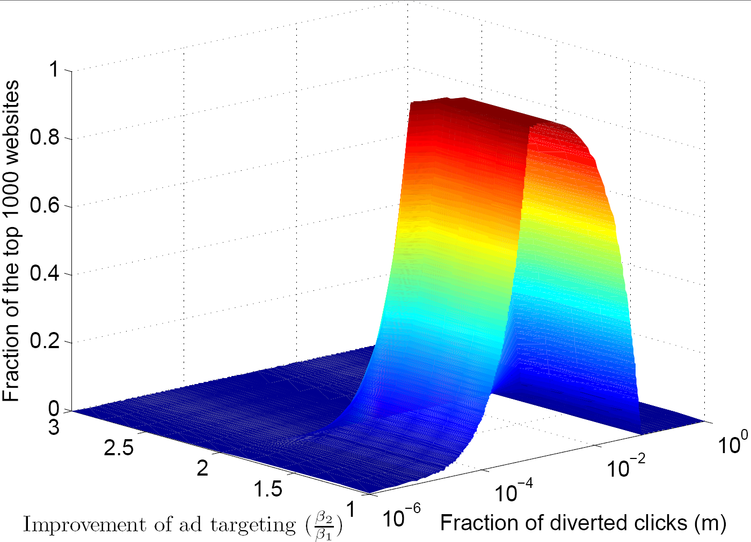
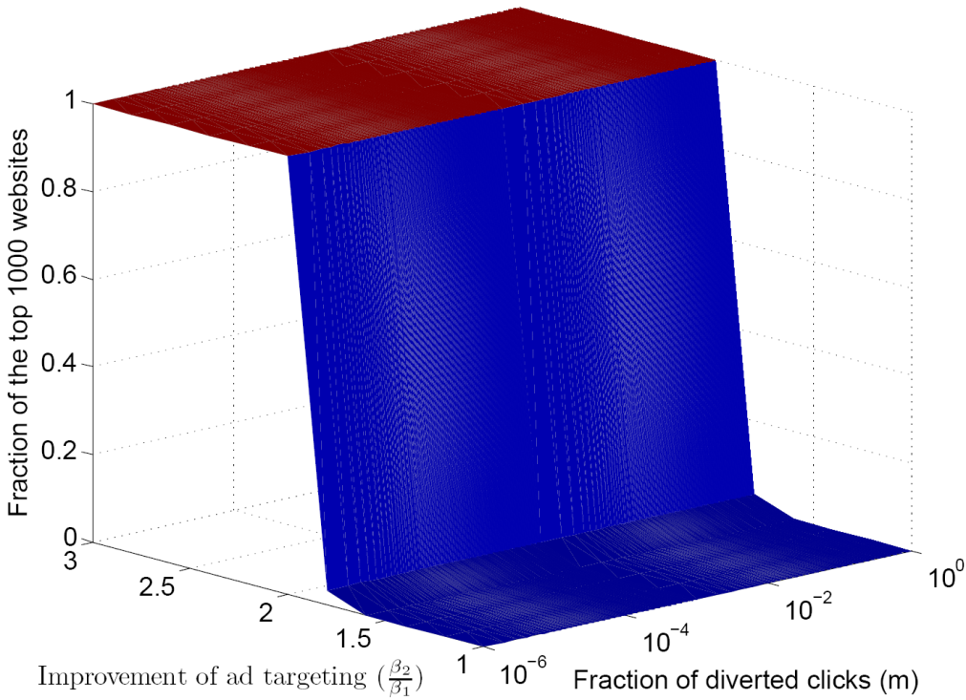
Effect of the Parameters (cont’d)
  Improvement of ad targeting (β₂/β₁)
  Cooperative
  Cooperative
  Non-cooperative
  Non-cooperative
Secured websites
Cooperation achieved

Slide 24
Conclusion
Novel problem of ISPs becoming strategic participants
in the online advertising business
Studied the behavior and interactions of the ISPs and ad networks
Applied game-theoretic model to the real data
Effect on the Web is positive in both cases:
  Cooperative ISPs: - users receive better targeted ads - ISPs and ad networks earn more
  Non-cooperative ISPs: - improved Web security
  - the most important websites secured first

