Slide 1
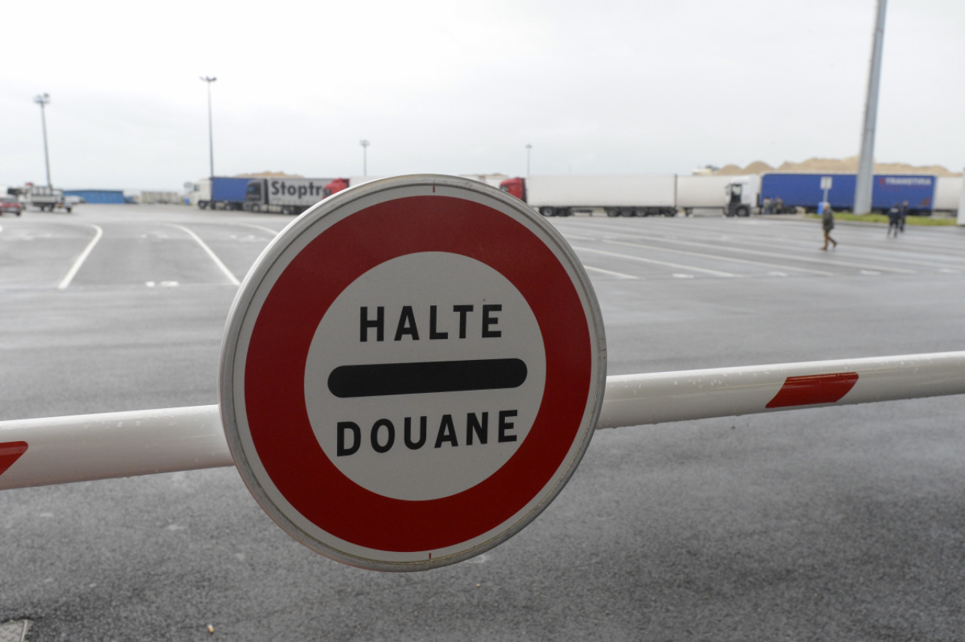
Making the EU Carbon Border Adjustment Mechanism (CBAM) Acceptable and Climate Friendly for Least Developed Countries
Paper co-authored by:
Dr. Sigit Perdana & Dr. Marc Vielle
Presented in 27th Annual Conference of the European Association of Environmental and Resource Economists (EAERE)
28 June – 1 July 2022
Rimini, Italy

Slide 2
Research Background
EU ‘Fit for 55’ : reducing GHG by at least 55% compared to levels in 1990; climate neutrality in 2050;
CBAM supports the transition to stop free allowances under the EU-ETS;
CBAM address risks of carbon leakage as a result of the increased Union climate ambition;
CBAM is implemented through carbon-based import tariffs on certain goods to the EU, based on Direct Emissions (Scope 1);
Power Sector and EII (cement, steel, aluminium, and fertilizers);
Nothing on Exports.

Slide 3
Research Background
CBAM Concern
Developing Economies →EU CBAM will come with a high cost, especially for Least Developing Countries (LDC);
LDC → High Exposures and Vulnerability Risks (European Commission, 2021) ;
Exports to the EU are the primary sources of foreign income and represent a significant share of LDC GNI;
There have been calls to support a smooth transition to help countries to adapt to the effects of the EU’s climate change mitigation policies;
Exemption of CBAM for countries with specific conditions of unilateral agreement with the EU (such as GSP, GSP+ and EBA).
Notes:
Although LDCs currently account for a minimal share of EU-external trade in the CBAM commodities,

Slide 4
Research Background
This Research:
Address these options on the exemption and revenue allocation of the EU CBAM → implications on climate and economic indicators;
The magnitude of changes on leakage, sectoral competitiveness, and welfare is quantified, and compared to baseline projections of pure CBAM implementation;
The analysis is based on the development of 8 different scenarios of CBAM exemptions and revenue redistributions on targeted countries/ regions.
Exemption
OR
Revenue Allocation
Notes:
Or redistribution of revenue generated to address climate justice concerns and support countries in the decarbonization process?

Slide 5
Research Methods
GEMINI E-3 model (Bernard & Vielle,2008) ;
GTAP 10 Database (Aguilar et al. 2019); CD-Link (MCCollum et al. 2018; Roelfsema et al. 2020); IEA (2020) ;
The baseline is constructed based on the EU current policy (Giarola et al. 2021; Sognaes et al.2021) ;
Then moves to the Fit 55 target without and with CBAM;
Examine 8 Different scenarios.

Slide 6
The Fit for 55 package without CBAM
(changes w.r.t current policies scenario): Year 2040
Leakage rate = 17%
Results comparable to JRC GEM-E3 and GTAP-E
*CO2 emissions refer to CO2 from energy, industrial processes and product use
**without LULUCF

Slide 7
The Fit for 55 package with CBAM
(changes w.r.t current policies scenario): Year 2040
Scope 1 (Direct Emissions)
Leakage rate: 17% → 12.6%
EU EII output loss: 13.8% → 11.6%
EU welfare gain: 47 billion US$
LDC welfare loss: 37 billion US$
*CO2 emissions refer to CO2 from energy, industrial processes and product use
**without LULUCF

Slide 8
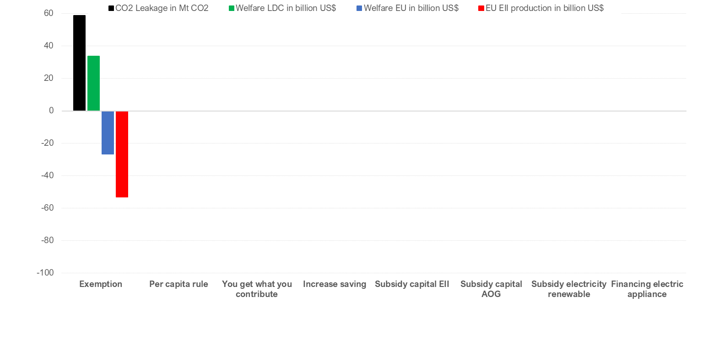

LDC exemption
(changes w.r.t Fit for 55 with CBAM): Year 2040
Able to limit LDCs Burden
but
Costly option for EU
Not effective for limiting leakage
Not effective for reducing EU EII output
IEW, Freiburg Germany / 27 May 2022

Slide 9
Lump sum transfer to LDCs
CBAM revenue rebated to LDCs trough lump-sum transfer to each government (Sovereignty principle)
As government budget is balanced → revenue goes to Households
Two scenarios:
All the CBAM revenue (including the ones from non-LDCs) redistributed with a per capita rule.
Only the CBAM revenue collected from the LDC exports is rebated to it, you get what you contribute.

Slide 10
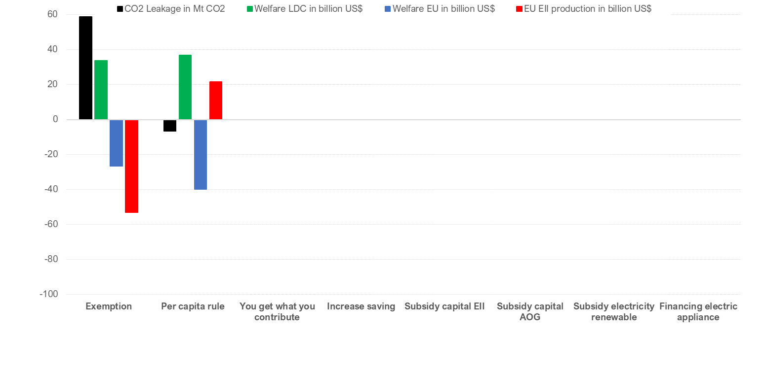
Lump sum transfer: per capita rule
(changes w.r.t Fit for 55 with CBAM): Year 2040
Able to limit LDC Burden
Keep CBAM incentive
but
Costly option for EU
IEW, Freiburg Germany / 27 May 2022
EU transfer = 29 billion US$ = 2/3 of the estimated EU contribution to 100 billion aid

Slide 11
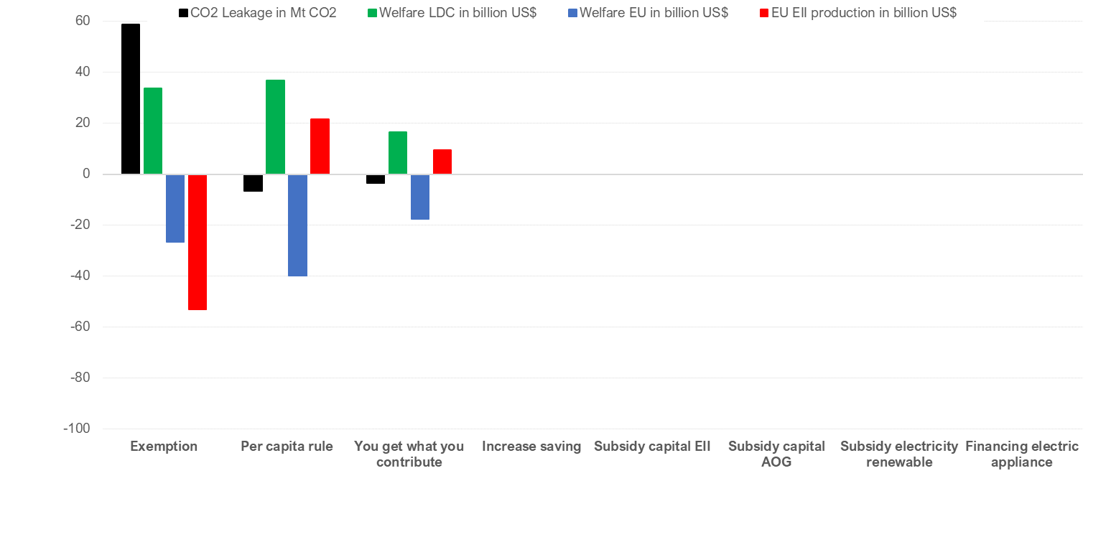
Lump sum transfer: you get what you contribute
(changes w.r.t Fit for 55 with CBAM): Year 2040
Less able to limit LDC Burden
Keep CBAM incentive
and
Less costly option for EU
IEW, Freiburg Germany / 27 May 2022

Slide 12
Increasing saving LDCs
Lump sum transfer increase consumption and saving
But we can use the money to invest in LDCs
Without targeting any sector, any technology nor economic agent
In this scenario and the following ones, we use the revenue coming from LDCs exports and rebate them to the respective region

Slide 13
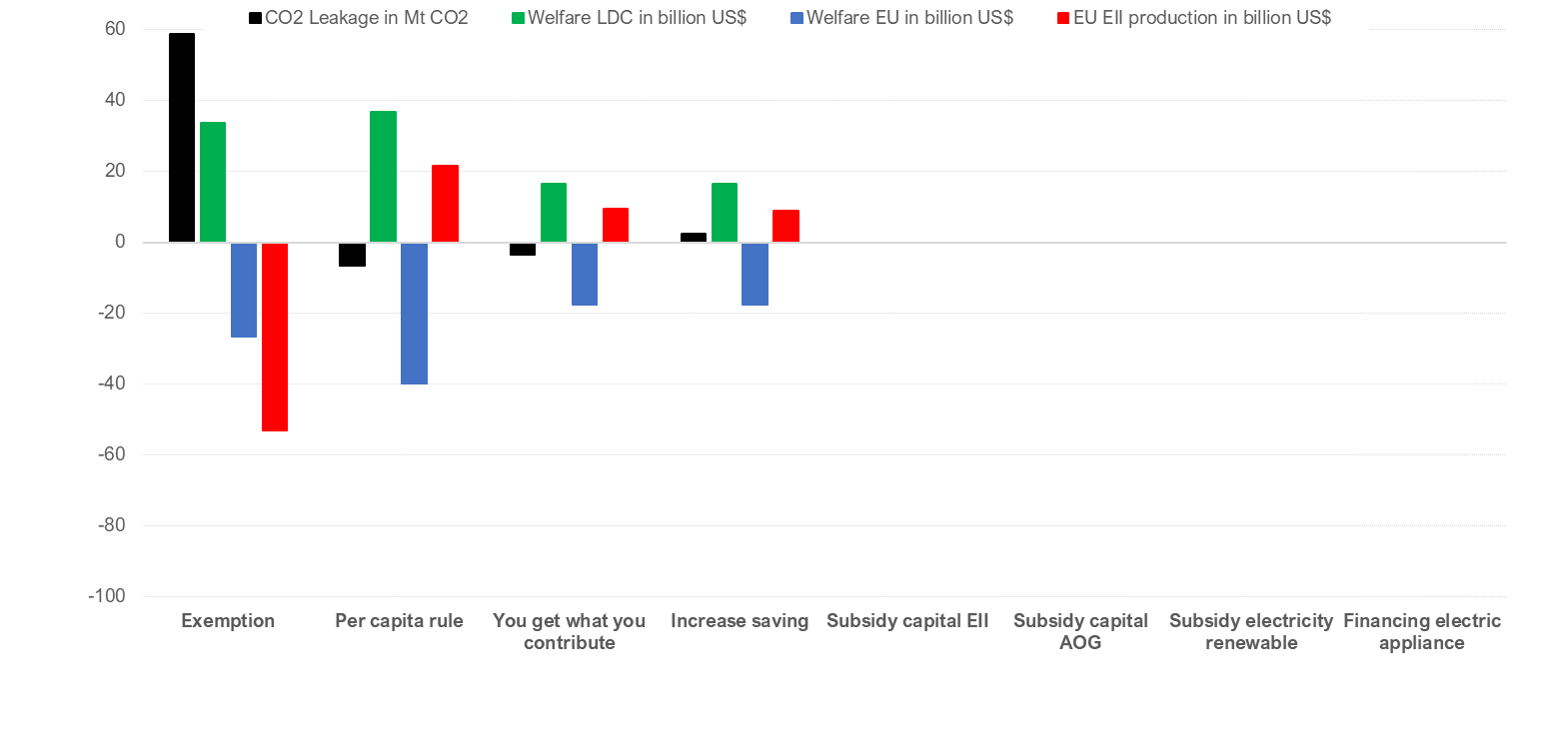
Increase Saving
(changes w.r.t current policies with CBAM): Year 2040
limit LDC Burden
Keep CBAM incentive
and
Increase slightly emissions
Less costly option for EU
IEW, Freiburg Germany / 27 May 2022

Slide 14
Financing investment in specific sectors
Aim: financing clean investment in LDCs
We implement a subsidy on investment, 2 scenarios:
In energy intensive industries, facilitating the decarbonization of the sectors that are faced to CBAM and by the way to limit the impact of the CBAM
In other industries and services (AOG), promoting diversification in non energy intensive goods

Slide 15
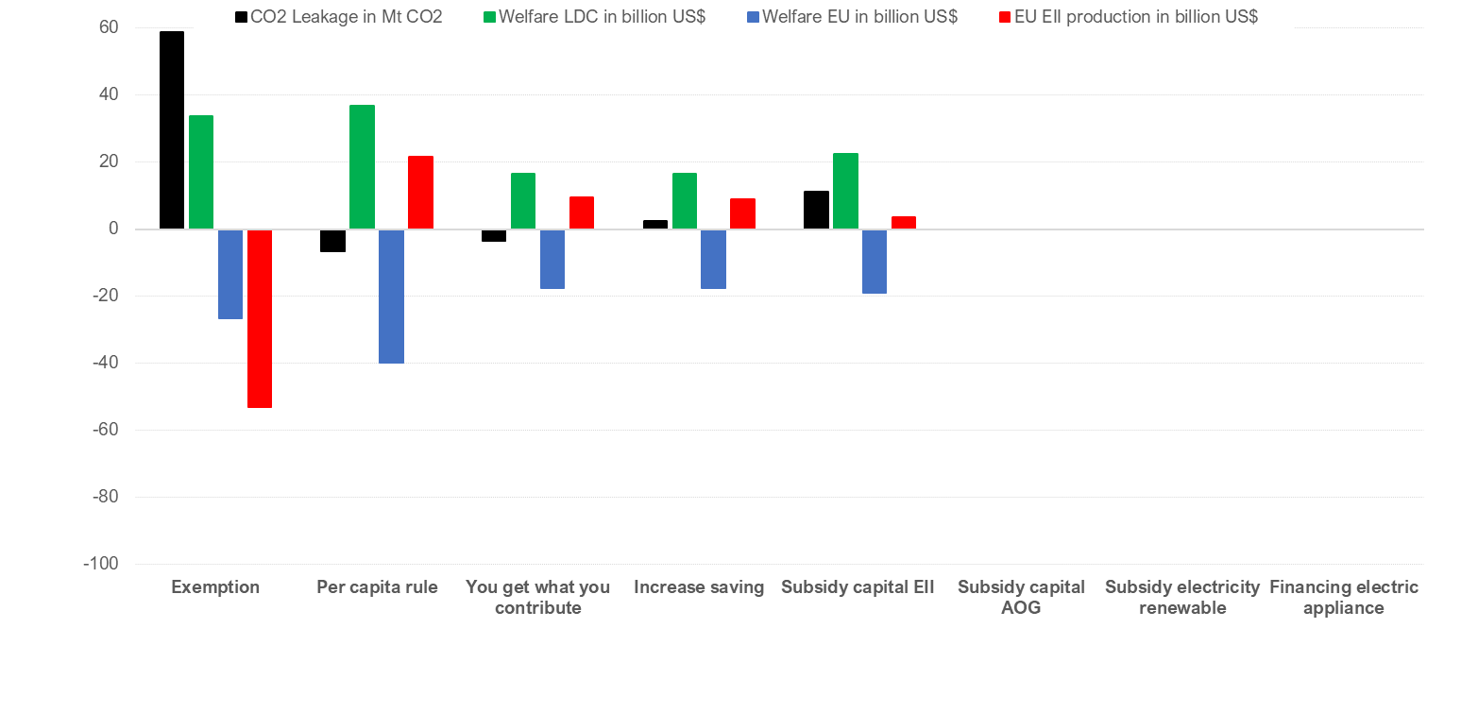

Subsidy Capital of EII
(changes w.r.t Fit for 55 with CBAM): Year 2040
No significant change with respect to you get what you contribute
Limit of our model no specific capital dedicated to energy consumption as in Zimmermann et al. (2021)
→ Underestimate the impact
IEW, Freiburg Germany / 27 May 2022

Slide 16
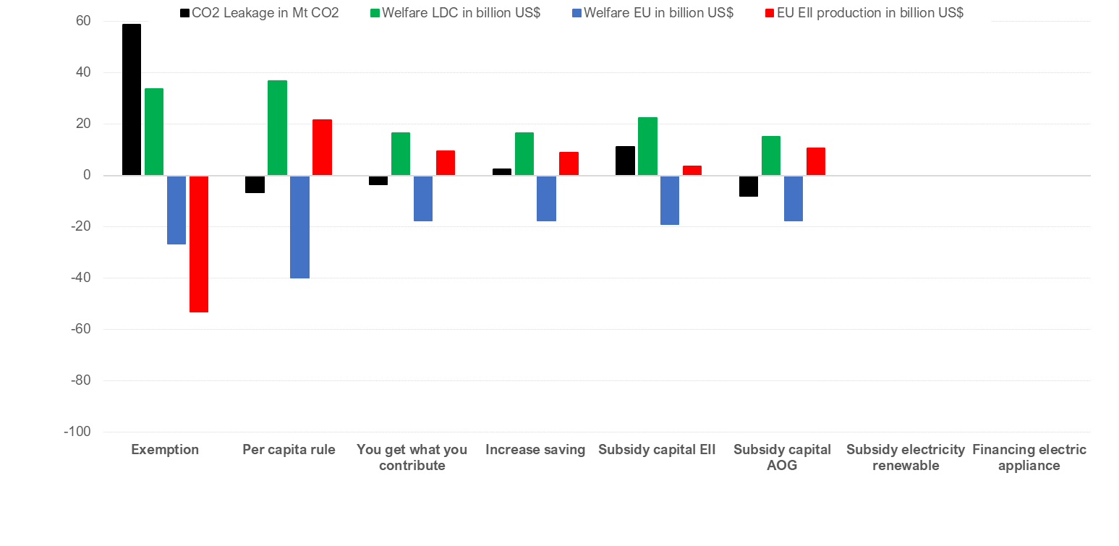
Subsidy Capital of AOG
(changes w.r.t Fit for 55 with CBAM): Year 2040
No significant change with respect to you get what you contribute
Limit of our model no specific capital dedicated to energy consumption as in Zimmermann et al. (2021)
→ Underestimate the impact
IEW, Freiburg Germany / 27 May 2022

Slide 17
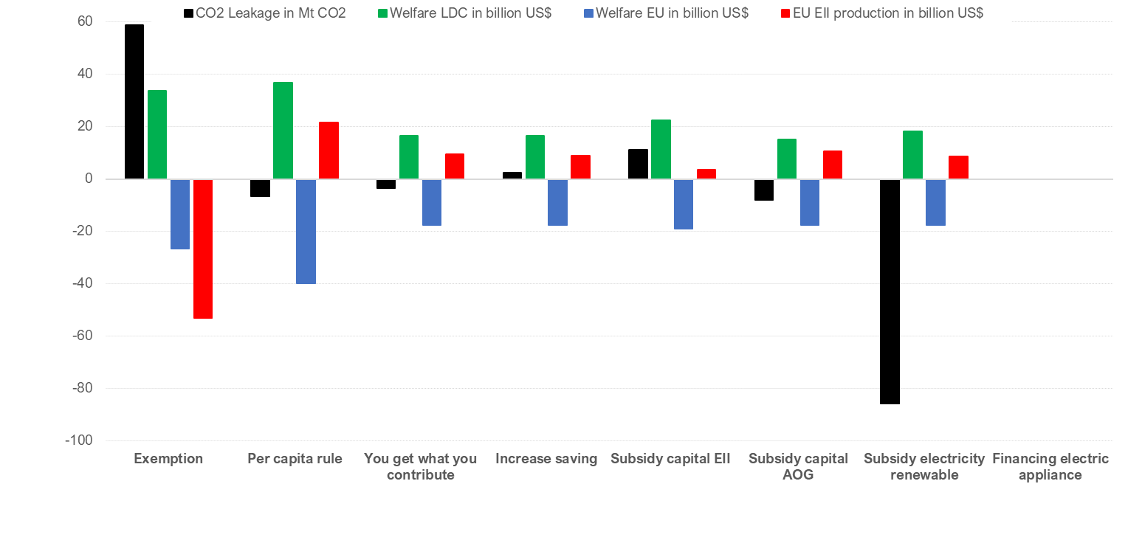
Subsidy electricity renewable
(changes w.r.t Fit for 55 with CBAM): Year 2040
Decrease emissions in LDCs
Improve welfare in LDCs
and
Less costly option for EU
IEW, Freiburg Germany / 27 May 2022
+237 TWh renewable: 107 TWh wind, 168 TWh solar

Slide 18
Promoting efficiency measures in residential energy consumption
Aim: limit energy poverty
TIAM Database: 1% efficiency improvement in electric appliances (refrigerator, dishwashers, …) costs 1$ to 4$, we retain 3$
Refrigerator (300 liters) = 400 KWh per year, we give 100 US$ per refrigerator → -133 KWh

Slide 19
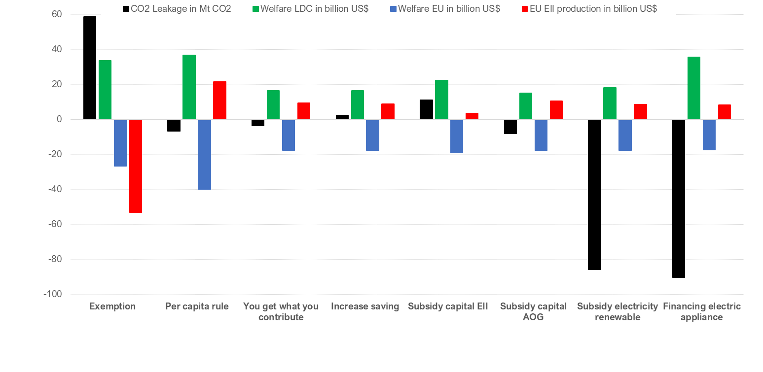
Financing electric appliance
(changes w.r.t Fit for 55 with CBAM): Year 2040
Decrease emissions in LDCs
Improve welfare in LDCs
and
Less costly option for EU
IEW, Freiburg Germany / 27 May 2022
Decrease of electricity consumption = 209 TWh

Slide 20
Conclusion
EU CBAM reduces leakage by one-third, from 17% to 12.6% by 2040;
Implementation is detrimental to LDCs causing declines in EIIs, thus leading to significant welfare loss;
Exemptions improve LDCs’ welfare, yet the environmental implications and EU costs are too significant. It results in higher leakage compared to other complementary scenarios;
Redistribution to promote clean energy or improve energy efficiency substantially reduces leakage with relatively the same costs for the EU.

Slide 21
Thank You
Sigit Perdana
Laboratory of Urban And Environmental Economics
Ecole Polytehnique Federal de Lausanne (EPFL)
Sigit.perdana@epfl.ch

Slide 22
Additional Slides

Slide 23
Research Background
CBAM Concern
EU’s trading partners exporting carbon-intensive goods → CBAM would substantially curtail their exports and competitiveness.
Source: Estimated from GTAP 10 Database
Notes:
The EU imports on EII it is still dominated by the developed countries

Slide 24
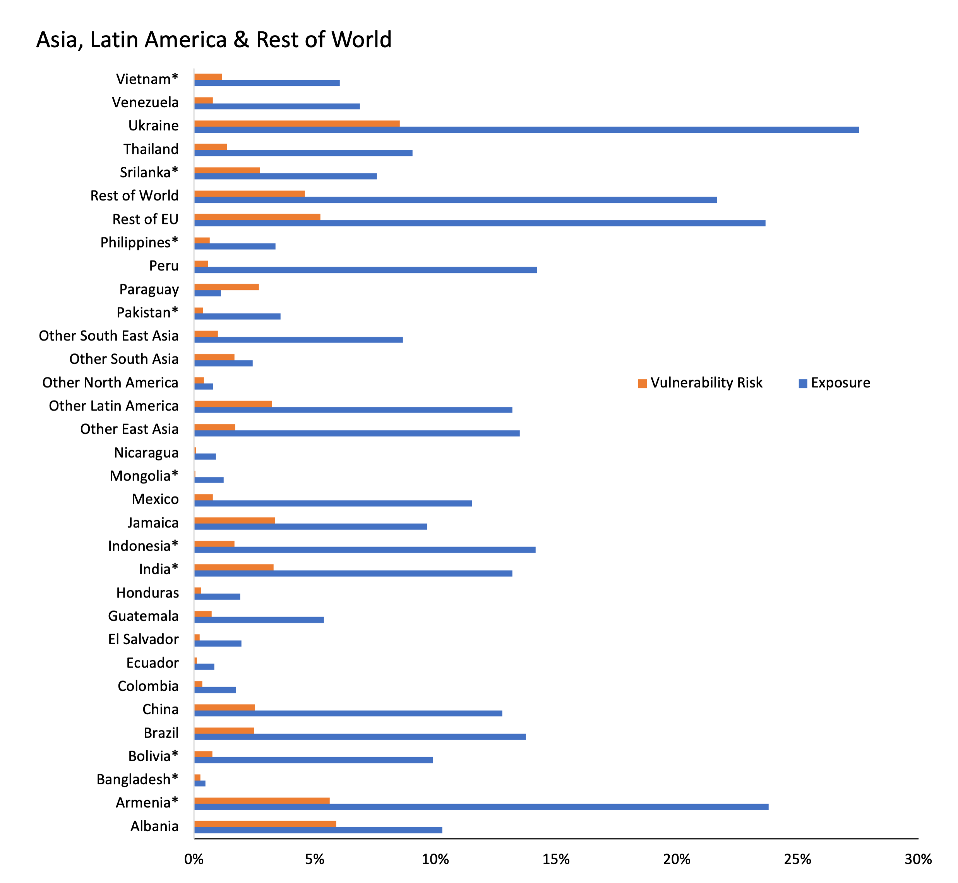
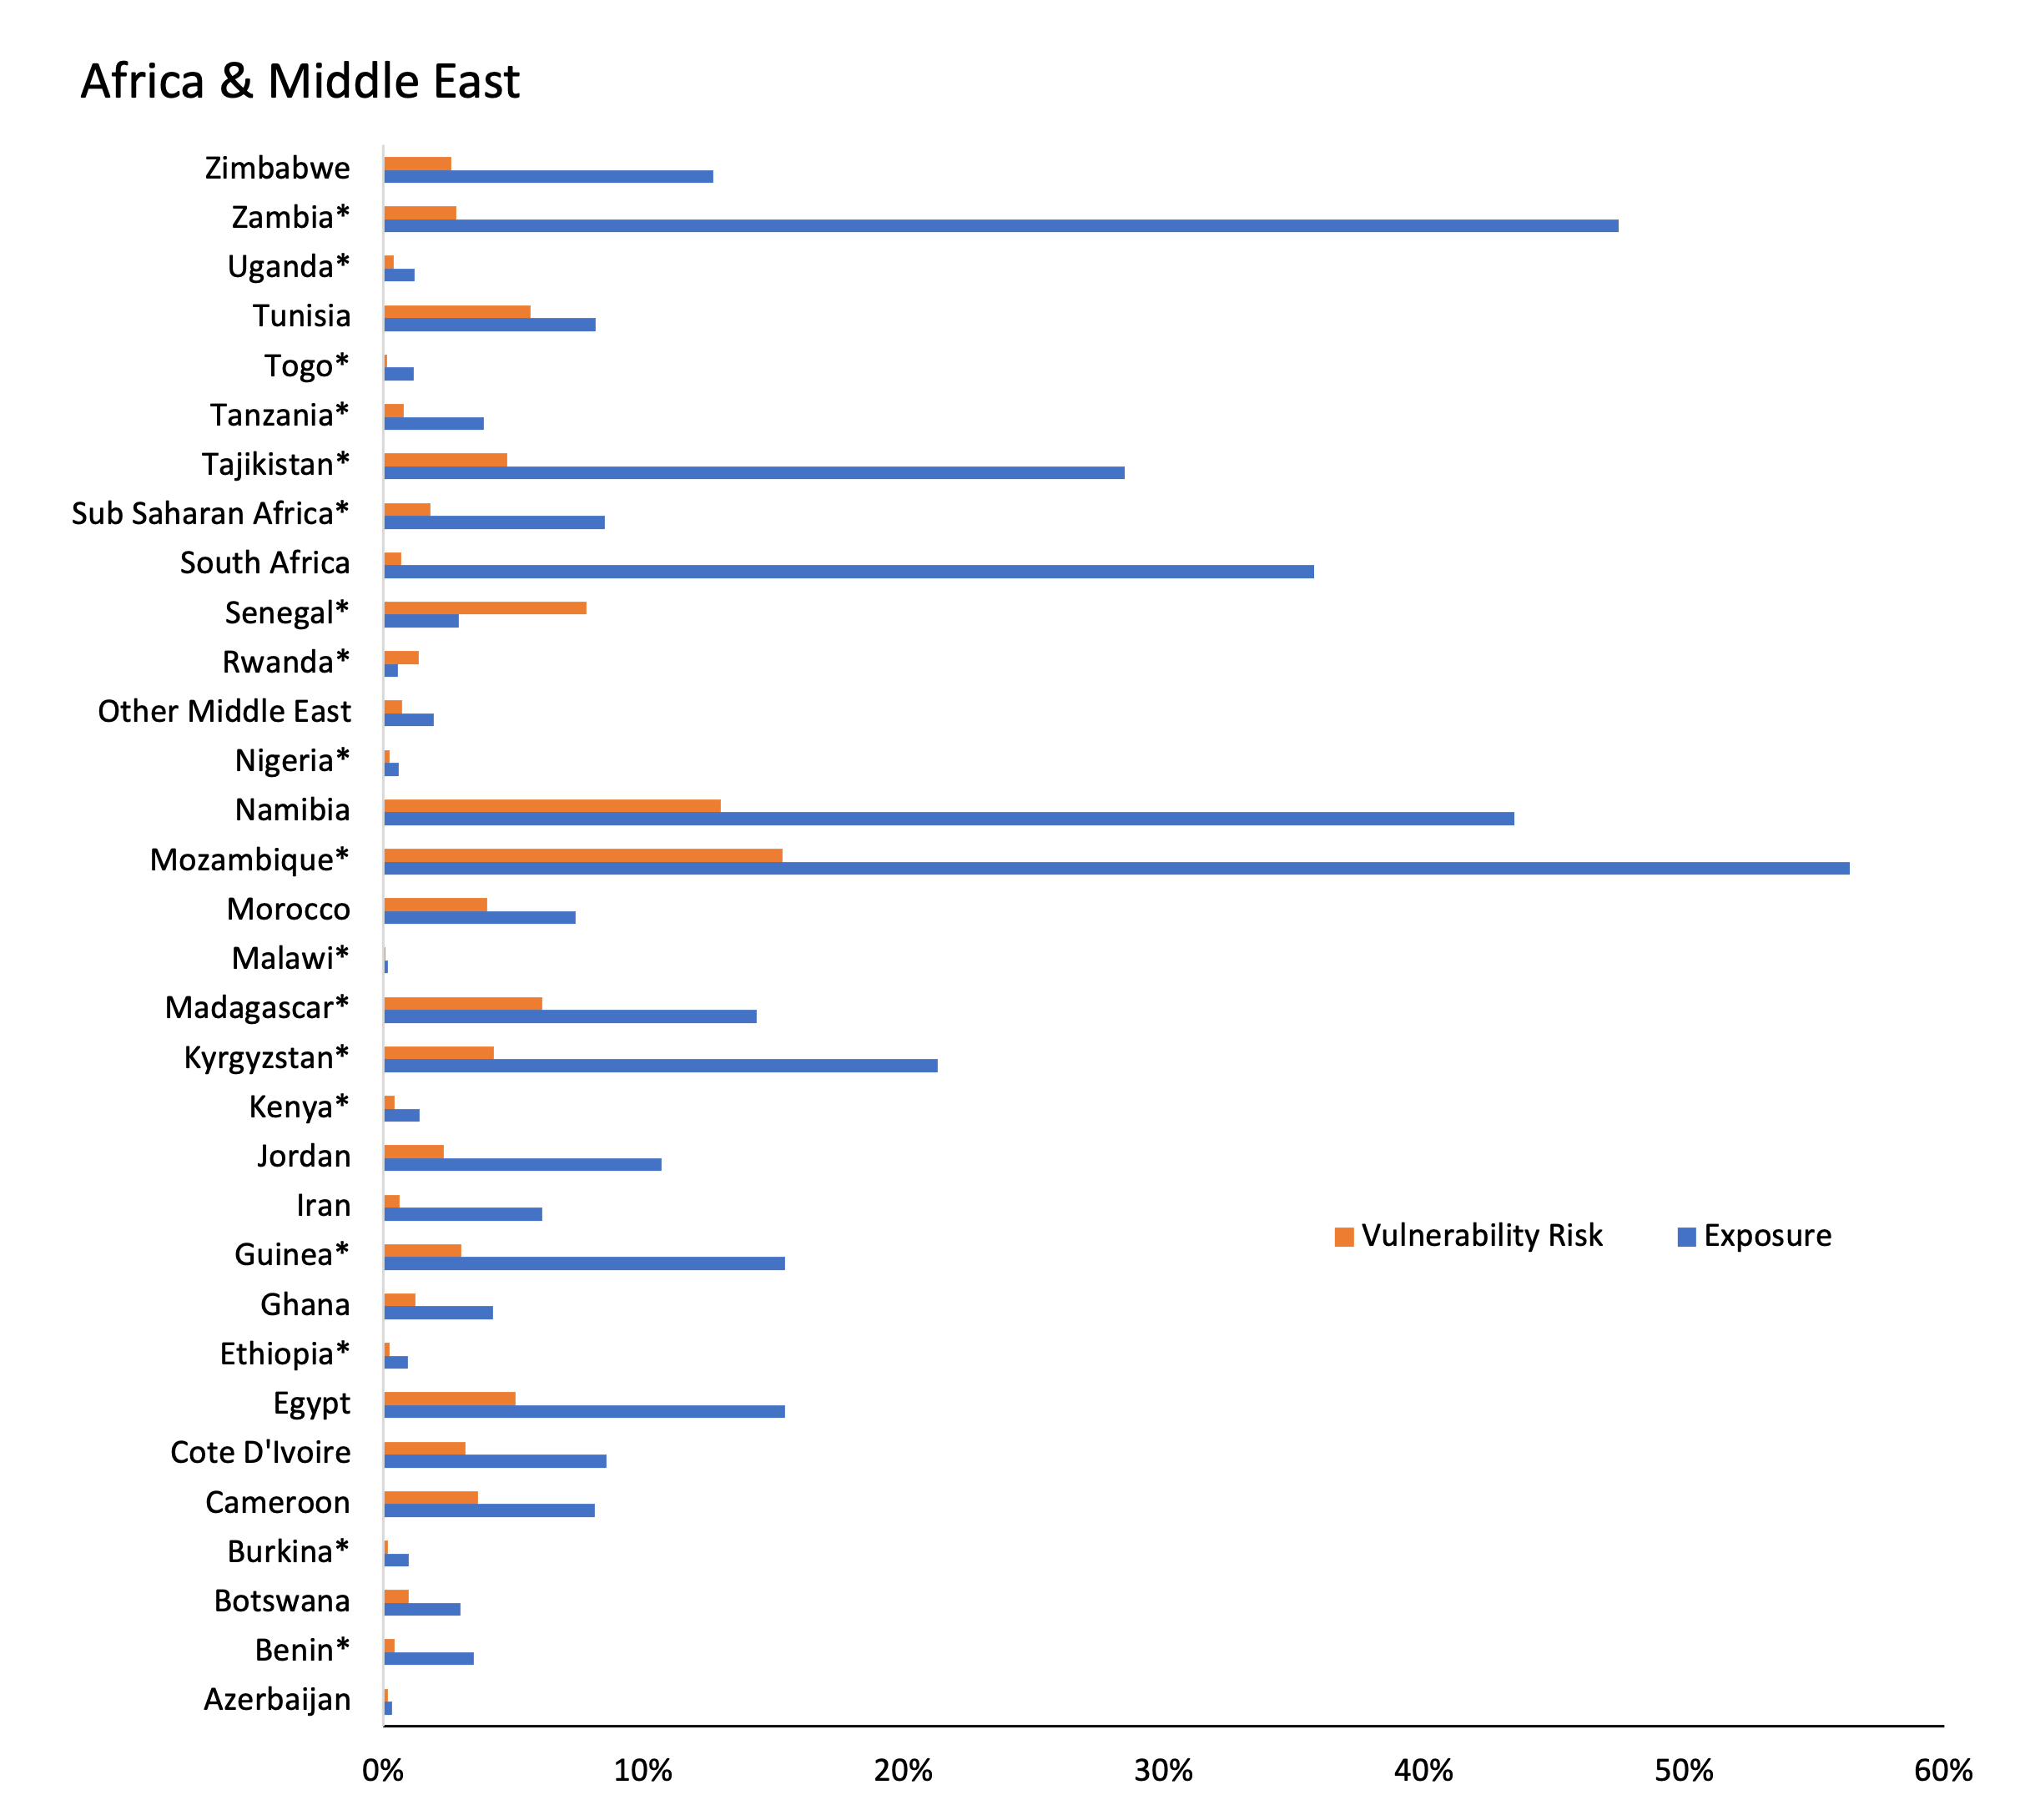
Exposure and Vulnerability Risk

Slide 25
Scenario Development
Exempt Developing Countries from CBAM
Revenue collected is redistributed to developing countries based on per capita rule.
Revenue collected is redistributed to developing countries based on their contribution (what you paid is what you get).
Revenue collected is redistributed to developing countries to increase saving
Revenue collected is redistributed to developing countries as subsidy of capital on EII sector
Revenue collected is redistributed to developing countries as subsidy of capital on non-EII sectors
Revenue collected is redistributed to developing countries as subsidy of capital on EII sector as subsidy of renewable electricity
Revenue collected is redistributed to developing countries as subsidy to finance electric appliances

Slide 26
CBAM with Support Measure to LDCs
(changes w.r.t current policies with CBAM): Year 2040

Slide 27
CBAM with Support Measure to LDCs
(changes w.r.t current policies with CBAM): Year 2040

Slide 28
CBAM with Support Measure to LDCs
(changes w.r.t current policies with CBAM): Year 2040

Slide 29
The Fit for 55 package with CBAM (Scope 2)
(changes w.r.t current policies scenario): Year 2040
*CO2 emissions refer to CO2 from energy, industrial processes and product use
**without LULUCF

Slide 30
The Fit for 55 package with CBAM (Scope 3)
(changes w.r.t current policies scenario): Year 2040
*CO2 emissions refer to CO2 from energy, industrial processes and product use
**without LULUCF

Slide 31
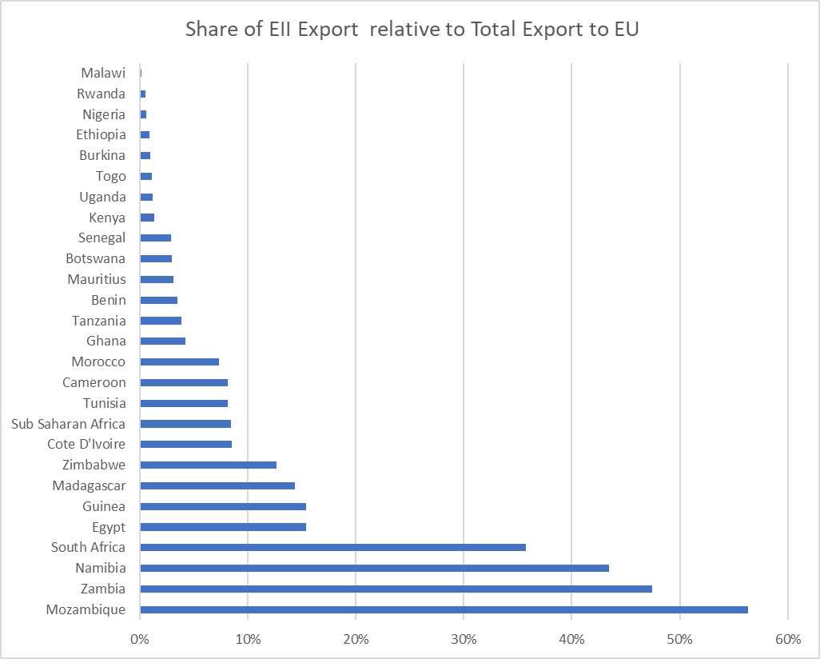
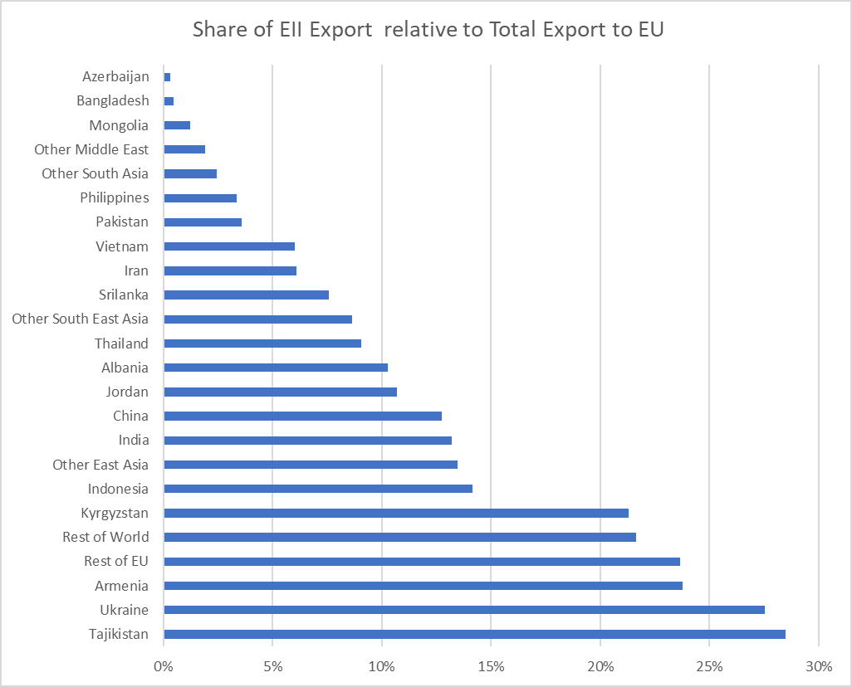
Exposure on EU CBAM
Developing Countries - Africa
Developing Countries – Asia & ROW

Slide 32
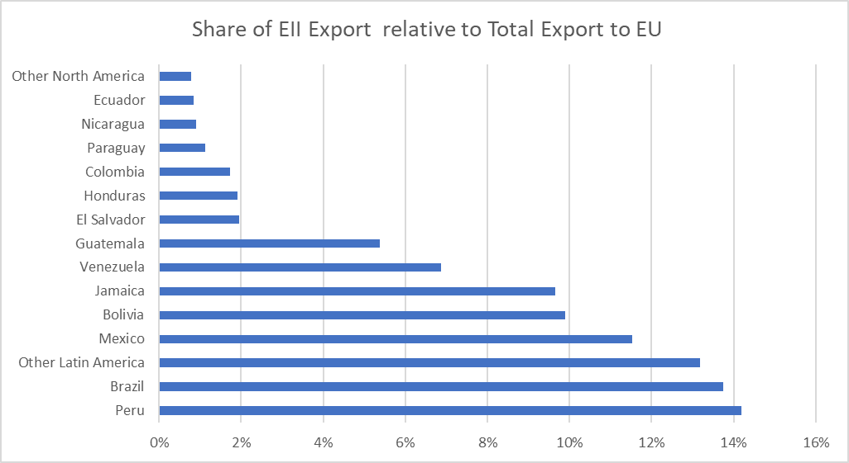
Exposure on EU CBAM
Developing Countries – Latin America

Slide 33
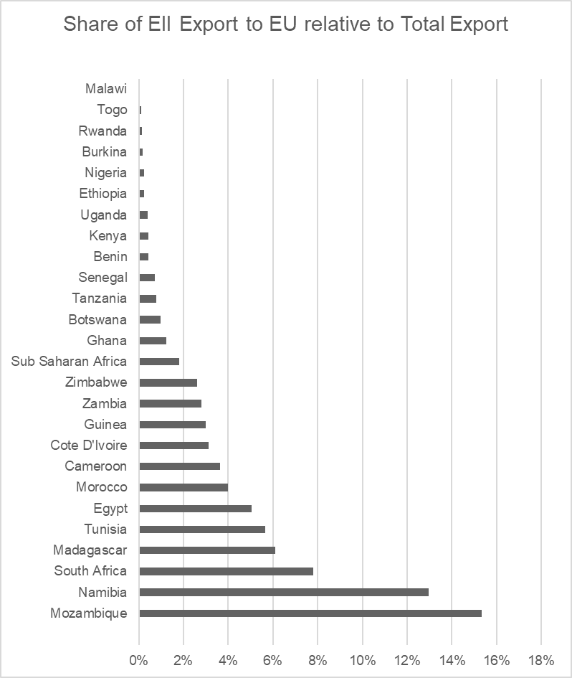
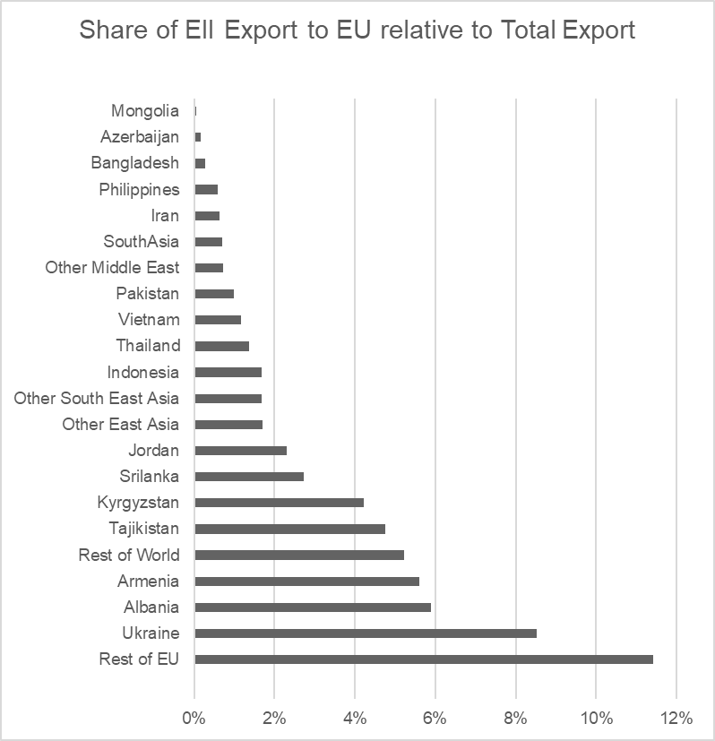
Vulnerability Risk on EU CBAM
Developing Countries - Africa
Developing Countries – Asia & ROW

Slide 34
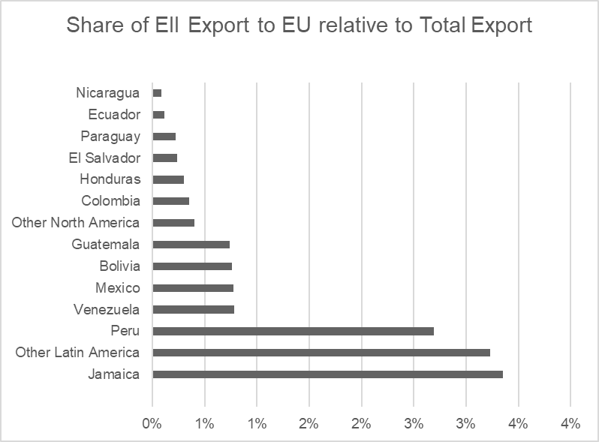
Vulnerability Risk on EU CBAM
Developing Countries – Latin America
Although LDCs currently account for a minimal share of EU-external trade in the CBAM commodities, exports to the EU are the primary sources of foreign income and represent a significant share of their GNI.

Slide 35
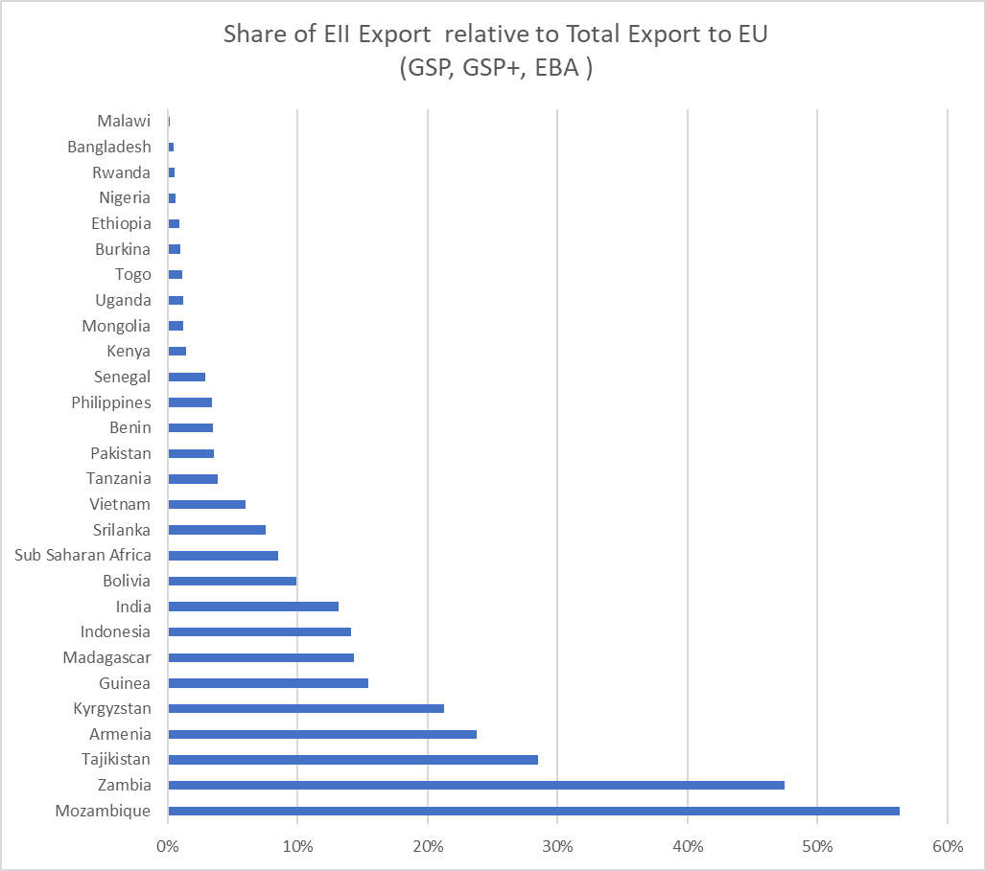
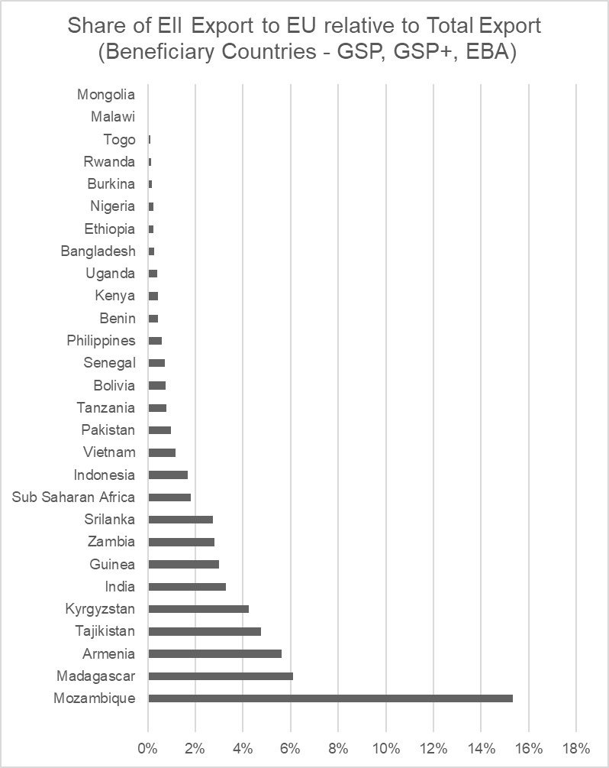
Exposure on EU CBAM
Vulnerability Risk on EU CBAM

Slide 36
The Fit for 55 package without CBAM
Exposure on EU CBAM
European Carbon Prices US$2014
 | 2025 | 2030 | 2040
EU ETS price | 48 | 75 | 132
EU ESD price | 146 | 764 | 3,312

Slide 37
Conclusion
The other seven complementary measures with revenue redistribution scenarios also improve LDCs’ welfare, however implications on leakage reduction vary;
Assigning the investment (as a capital subsidy) to EII sectors increases LDCs’ comparative advantage, further triggering production reallocation with a higher potential of emission leakage.
Promoting efficiency measures in residential energy consumption significantly improves LDCs’ welfare with an equal rate of leakage reduction as the complimentary scenario promoting renewable electricity.

