Slide 1
Casting States of Matter the construction of thermodynamic 3D-models at the end of the 19th century
Ion Gabriel Mihailescu
Laboratory for the History of Science and Technology, EPFL

Slide 2
2D representation, 2D surface (representation on a 2D medium)
Marks or traces on a given surface (mainly plane or regular).
3D representation, 3D model (representation on a 3D medium)
The carving or molding of a solid whose surface can afterwards be also marked or traced.

Slide 3
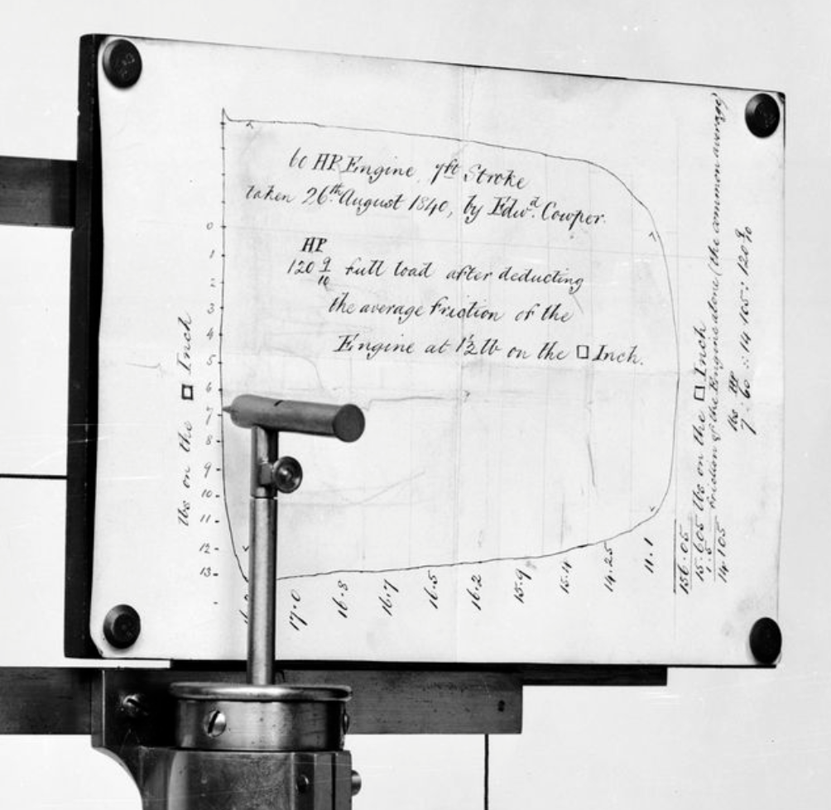
Watt's steam engine indicator
Amsler integrator

Slide 4
Haüy, Crystal Model (1802)
Brill, Geometrical Model (1892)

Slide 5
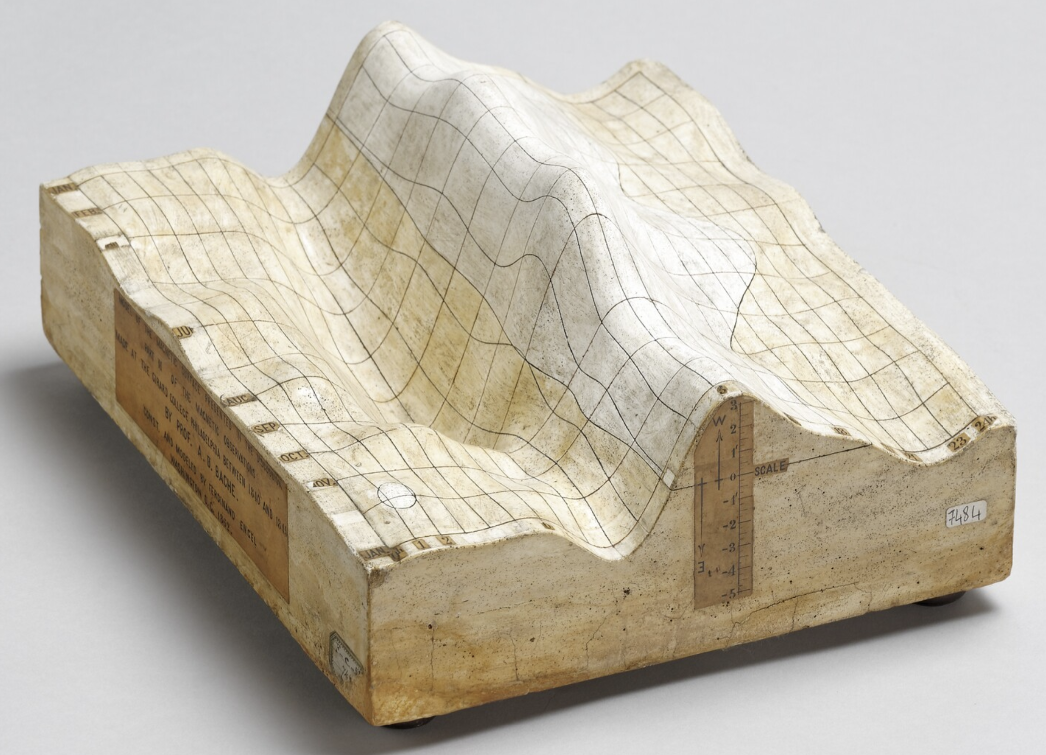
T. Sopwith, Geological Model (1841)
F. Engel, Model of Magnetic Surface (1862)

Slide 6
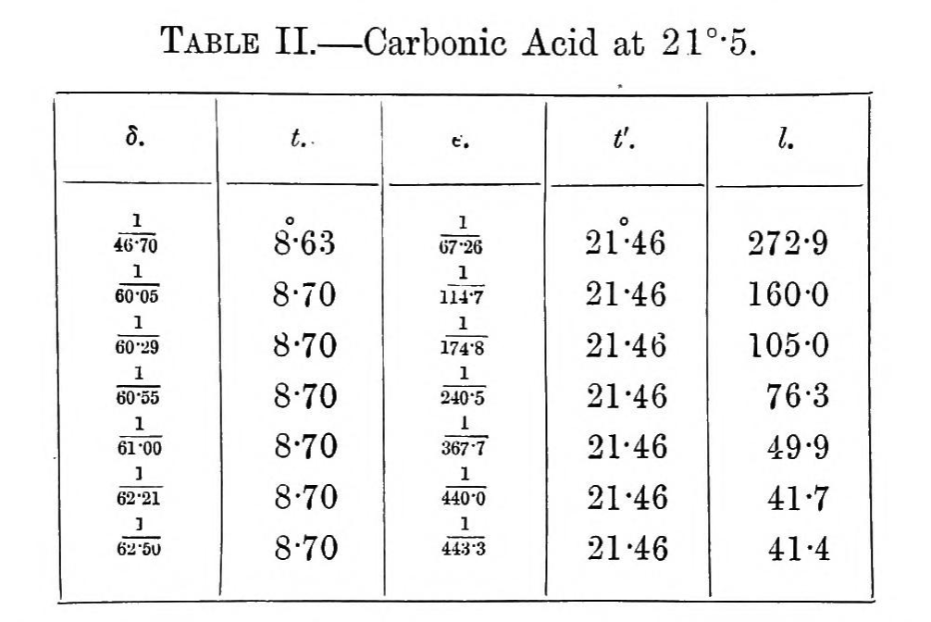
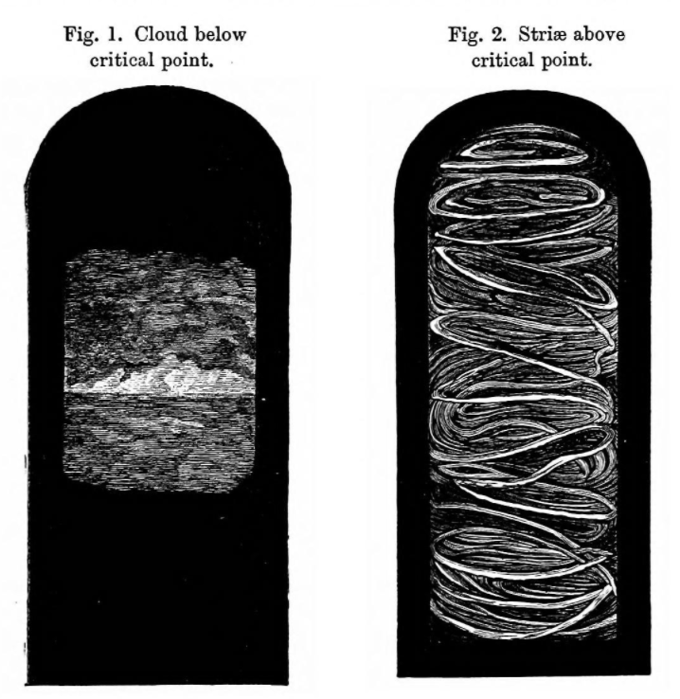
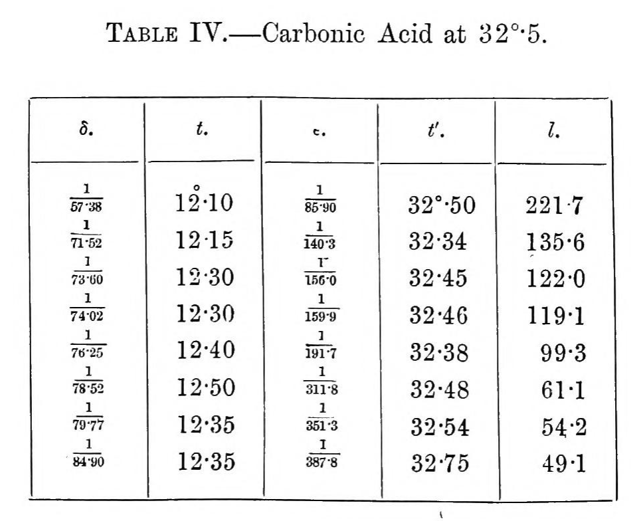
Below Critical Point
Above Critical Point

Slide 7
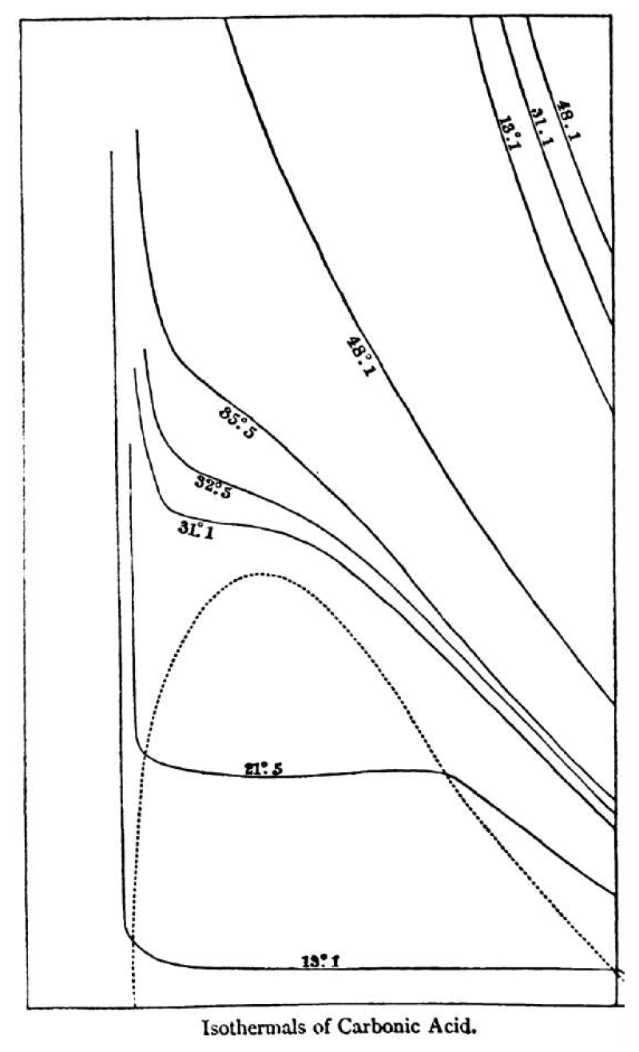
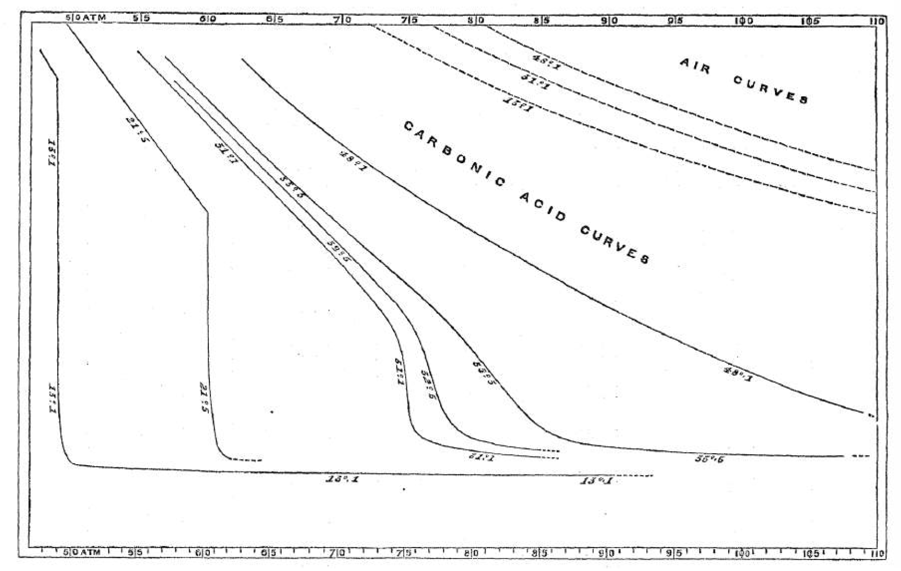
Thomas Andrews (1869)
Single state (liquid-gas indistinguishable)
Critical Point
Liquid state mixed with gas state
Clerk Maxwell (1871)

Slide 8
J. Thomson, Thermodynamic Model (1869-1871?)
Hunterian Museum, Glasgow
National Museums Scotland

Slide 10
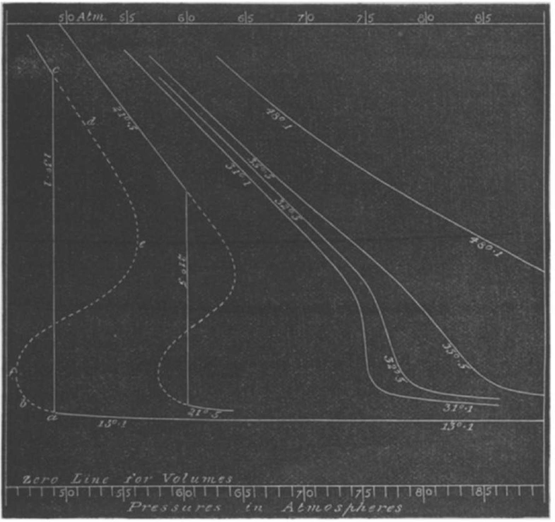
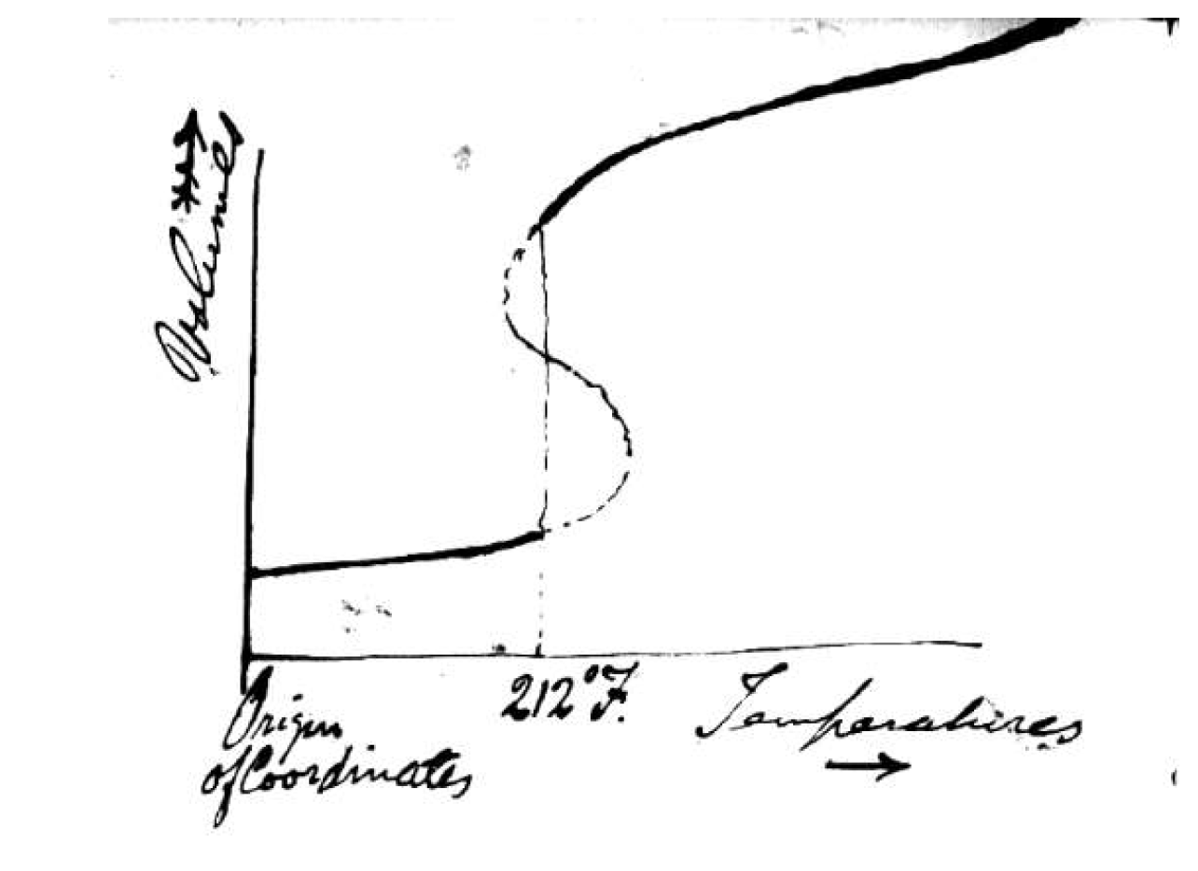

Slide 11
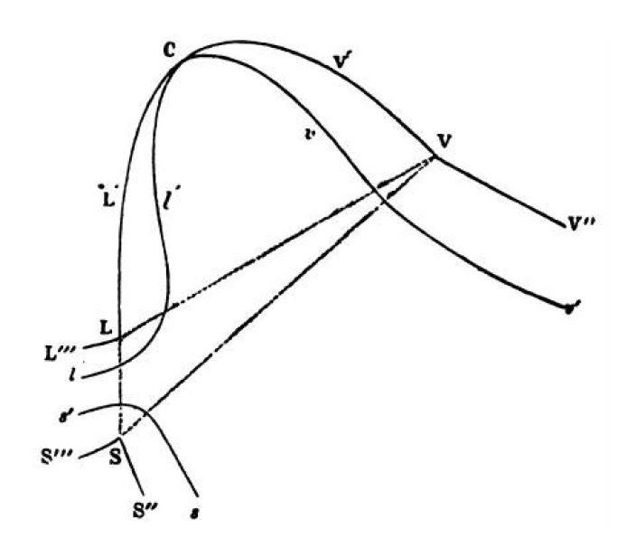
Josiah Willard Gibbs (1873)

Slide 12
Maxwell, Thermodynamic Model (1875)
Yale Peabody Museum

Slide 13
The numerical data about entropy can only be obtained by integration from data which are for most bodies very insufficient, and besides it would require a very unwieldy model to get all the features, say of CO₂, well represented, so I made no attempt at accuracy, but modelled a fictitious substance…
Maxwell to Thomas Andrews, 1875

Slide 14
I think such graphical methods are better fitted for purely conjectural applications of the principle of continuity beyond the range of experiment than any empirical formulae…
Maxwell to Thomas Andrews, 1875

Slide 15
Mathematical
Theory
(Integral &
Differential Eqs.)
Experimental
Measurements

Slide 16
Mathematical
Theory
(Integral &
Differential Eqs.)
Experimental
Measurements
Empirical Formula
Derived Numerical Quantities

Slide 17
Mathematical
Theory
(Integral &
Differential Eqs.)
Graphical Methods
(2D or 3D)
Experimental
Measurements
Derived Numerical Quantities

Slide 18
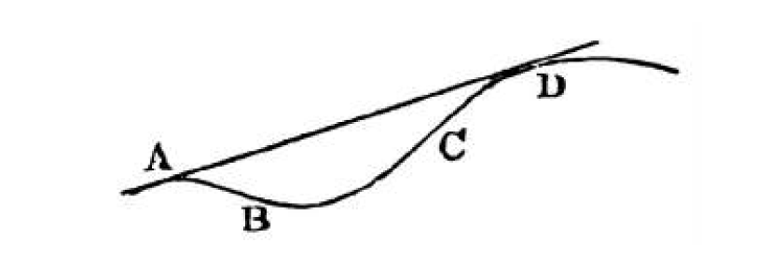
Maxwell, Theory of Heat (1875)

Slide 19
To construct it [the surface corresponding to the mixture of states or AD], spread a film of grease on a sheet of glass and cause the sheet of glass to roll without slipping on the model, always touching it in two points at least. The grease will be partly transferred from the glass to the model at the points of contact, and there will be traces on the model of the node-couple curves, and on the glass of corresponding plane curves.
If we now copy on paper the curve traced out on the glass and cut it out, we may bend the paper so that the cut edges shall coincide with the two node-couple curves, and the paper between these curves will form the derived surface representing the state of the body when part is in one physical state and part in another….
Maxwell, Theory of Heat (1875)

Slide 20
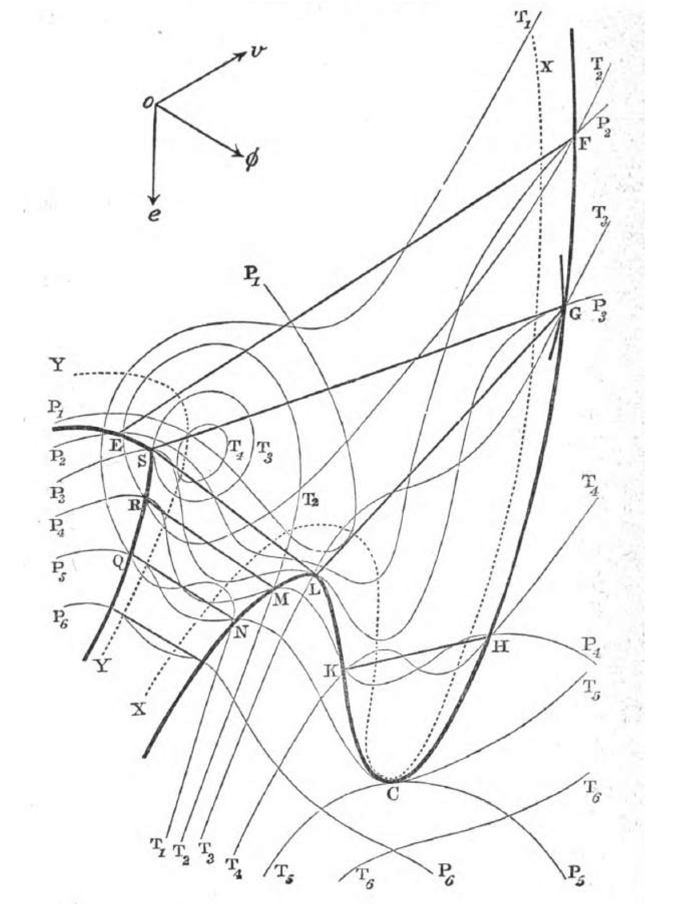

Slide 21
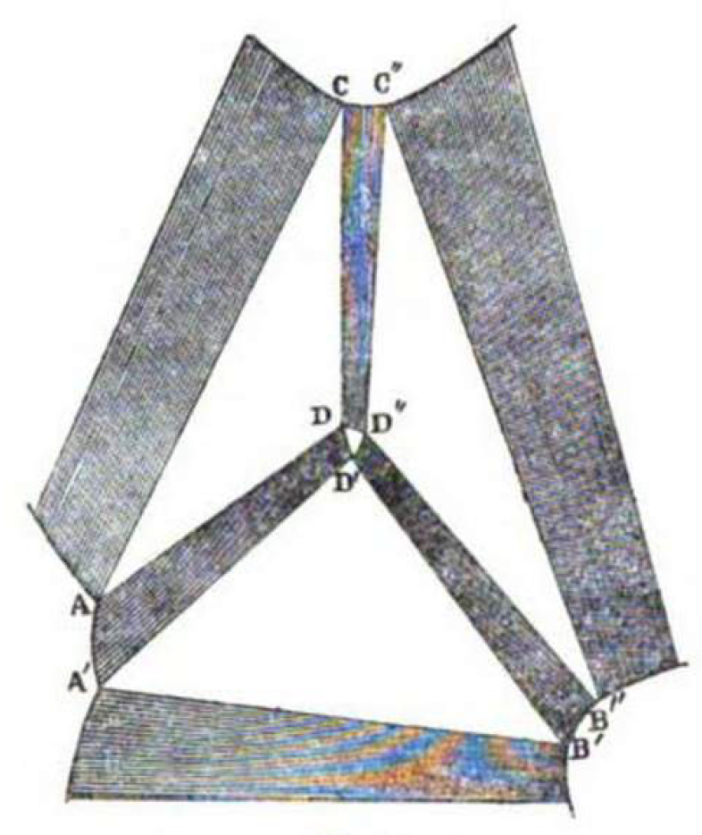
Josiah Willard Gibbs (1876)

Slide 22
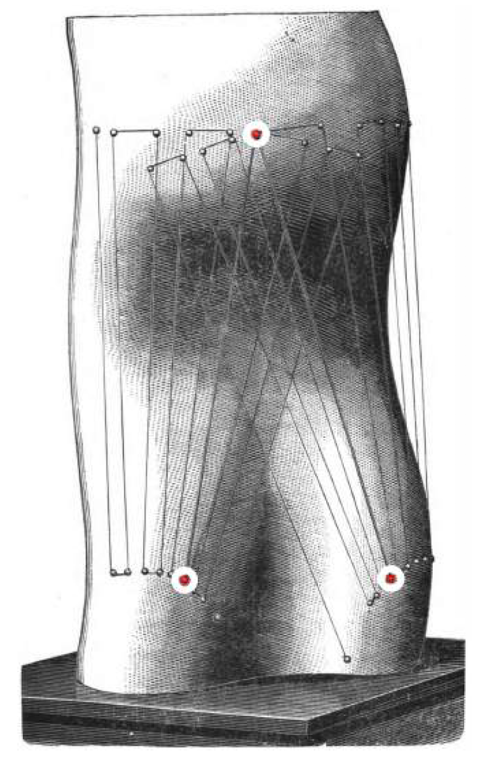
Van der Waals, Model of a Psi-Surface (1891)

Slide 23
Kamerlingh Onnes Laboratorium, Leiden (1902)

Slide 24
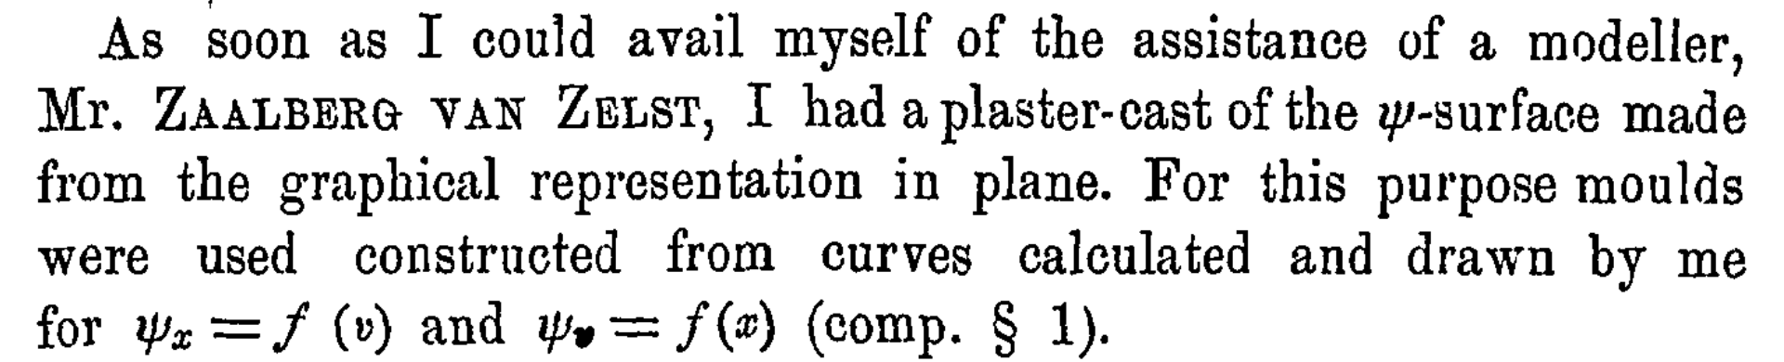
Kamerlingh Onnes (1900)

Slide 25
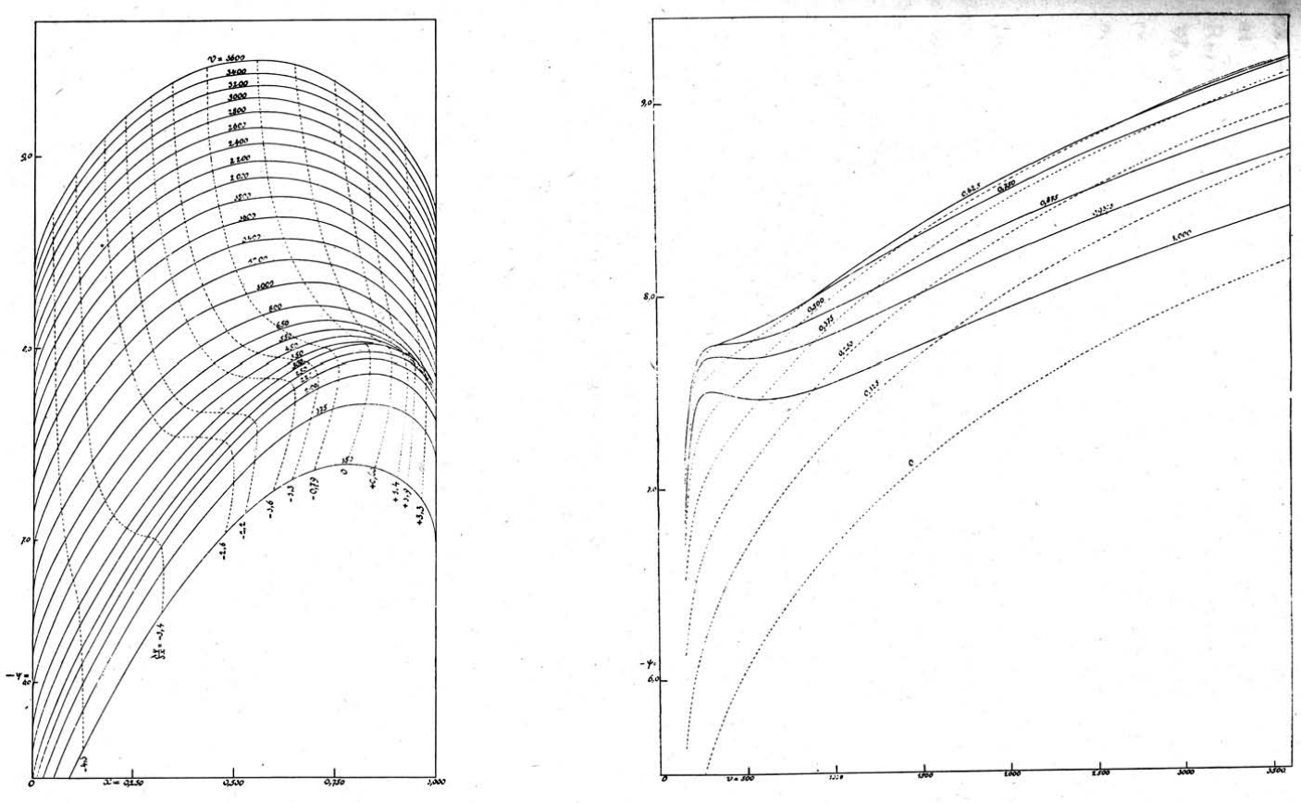

Slide 26
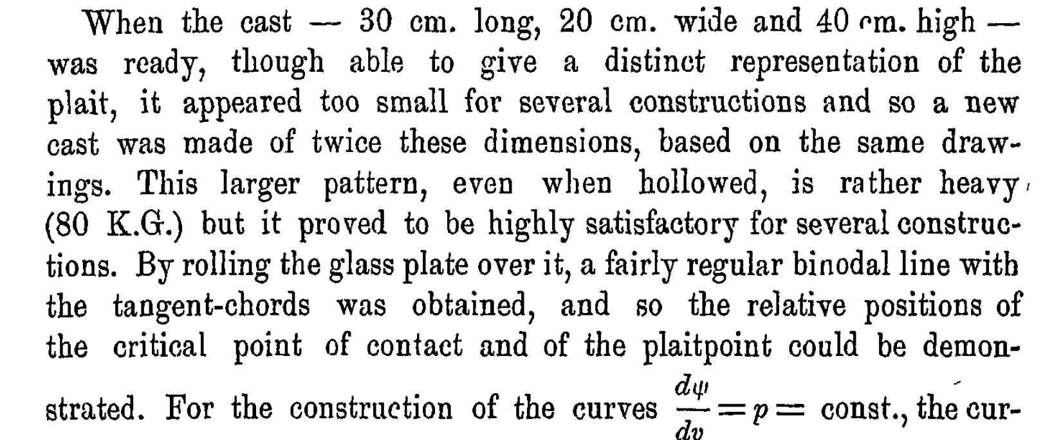

Slide 27
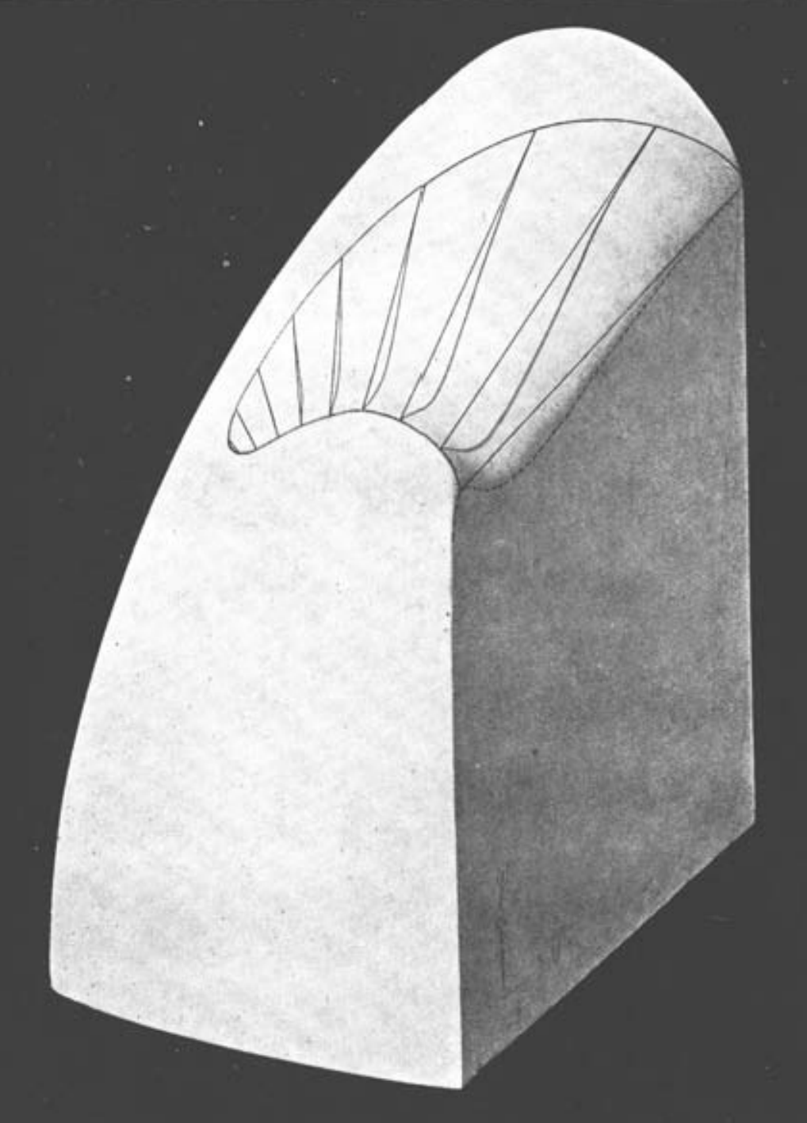
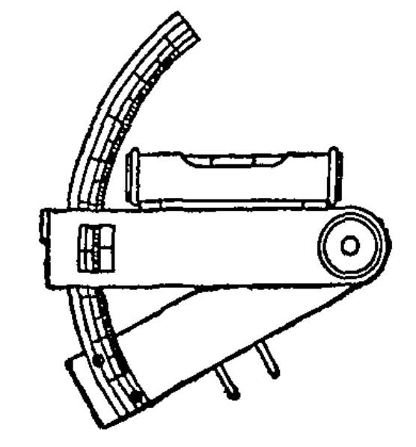
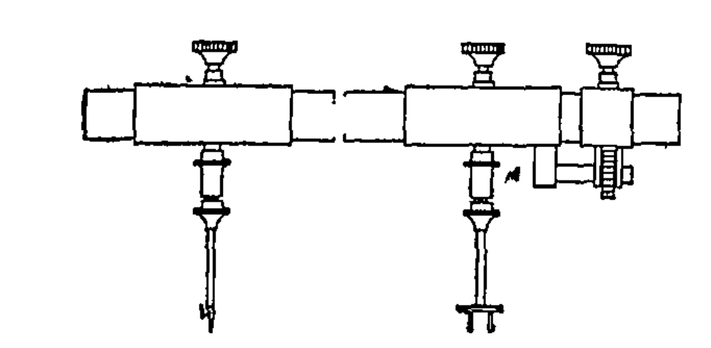

Slide 28
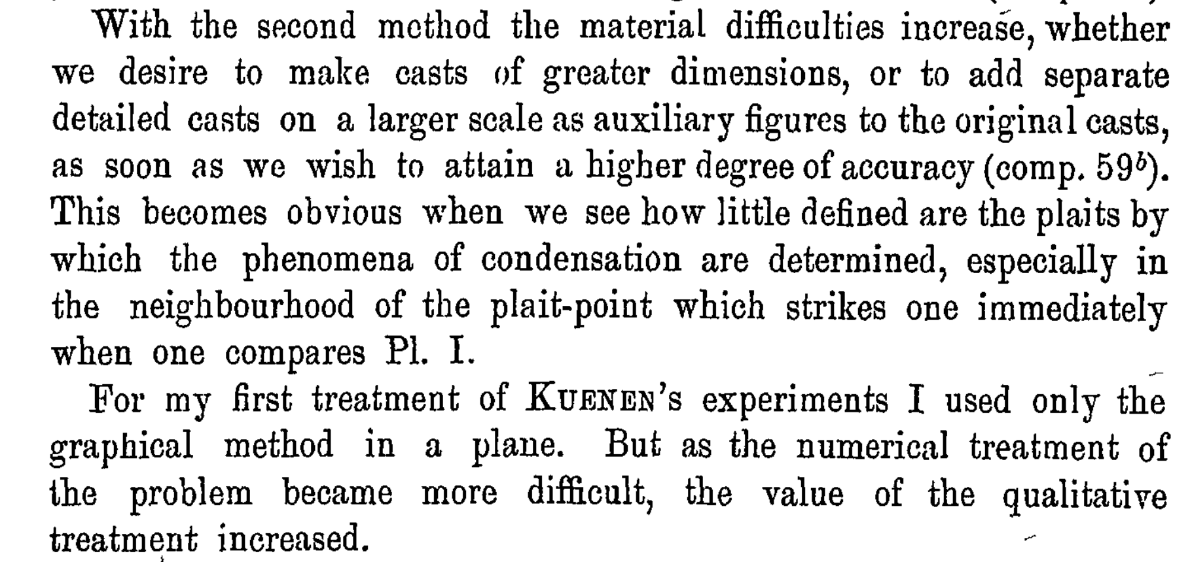

Slide 29
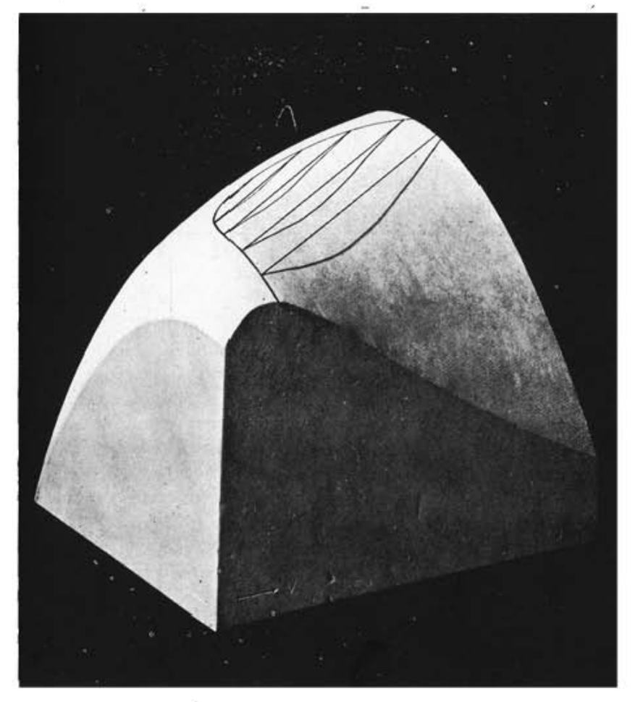
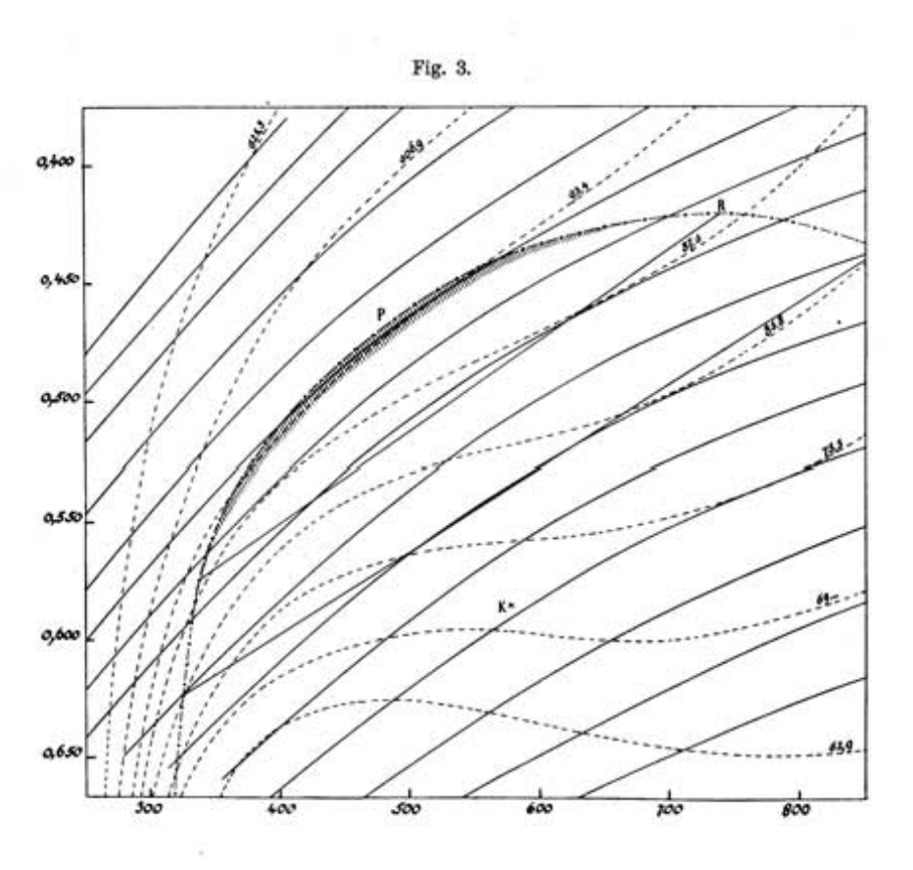

Slide 30
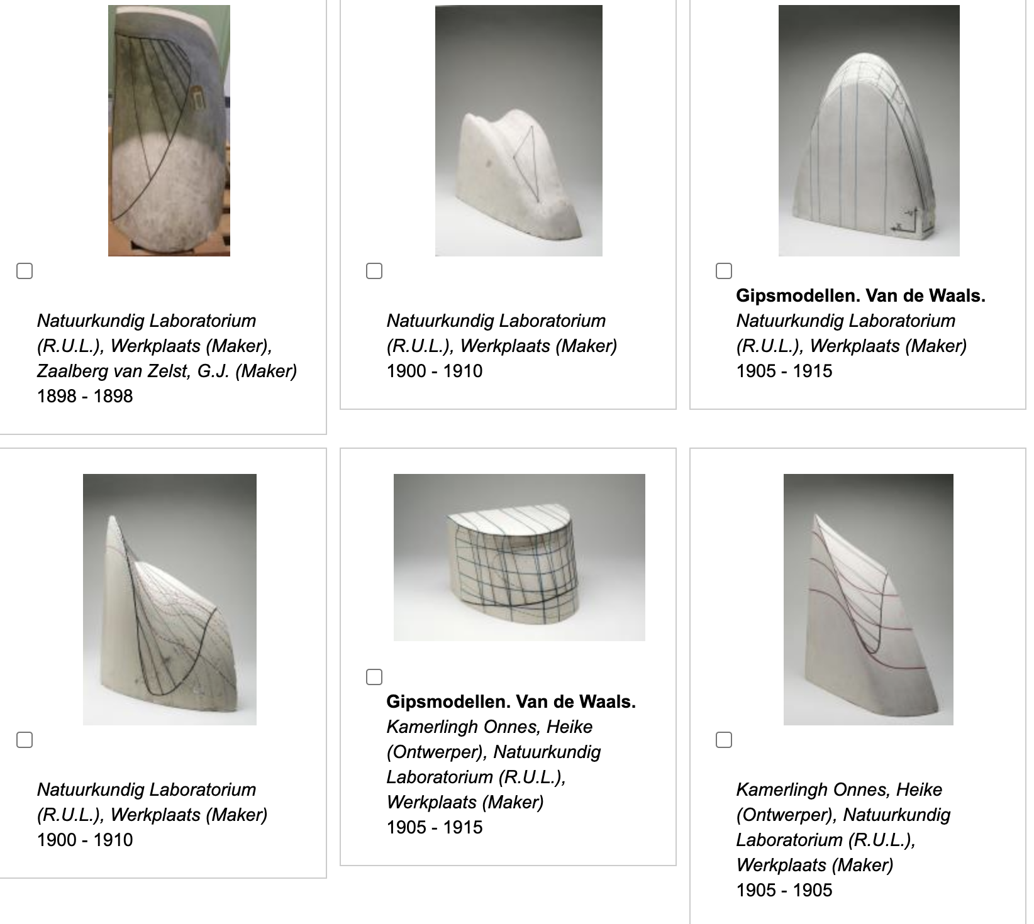
Rijksmuseum Boerhaave Museum

Slide 31
Experimental Culture
Graphical Culture
Modelling Culture
Numerical Quantities
2D Surfaces
Thomson’s Graphs
3D Models
Thomson’s Model
Van der Waals’ Model
Mathematical Models
? Culture
3D Models
Onnes’ Models

Slide 32
Experimental Culture
Graphical Culture
Modelling Culture
Numerical Quantities
2D Surfaces
Thomson’s Graphs
3D Models
Thomson’s Model
Van der Waals’ Model
Mathematical Models
A Computational Culture
An Epistemological Culture
Empirical Formulas
Empirical Formulas
Numerical Quantities
2D Surfaces
Graphs
Numerical Quantities
Extrapolation
2D Surfaces
Graphs
Numerical Quantities
3D Models
Maxwell’s Models
Onnes’ Models
3D Models
Maxwell’s Models
Onnes’ Models

