Slide 1


RUBIK: Efficient Threshold Queries on Massive Time Series
Anastasia Ailamaki‡
Thomas Heinis*
Eleni Tzirita Zacharatou‡
Farhan Tauheed§
§Oracle Labs, Zurich
*Imperial College London
‡École Polytechnique
Fédérale de Lausanne

Slide 2
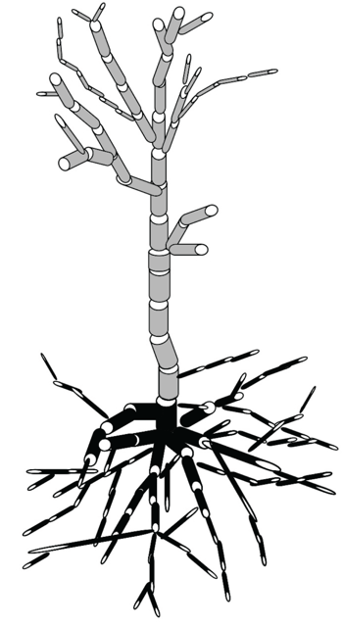
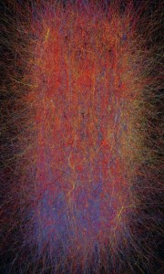
Scaling up Brain Simulations
voltage
time
Model Resolution
voltage
time
Temporal Resolution
time
3D Neuron Model
Time Series Analysis: key to neuroscientific discovery

Slide 3
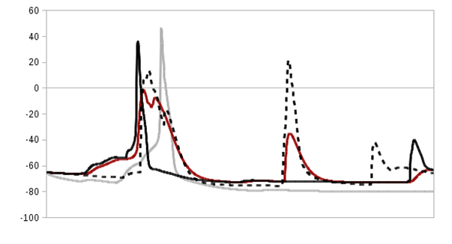


Neuron firing: which and when
Exploration
Hypothesis Testing
Identify subsets of interest:
  time series where voltage > -40 and time step ∈ [300,400]
Threshold
Query
voltage
time
Threshold queries fuel efficient data analysis

Slide 4
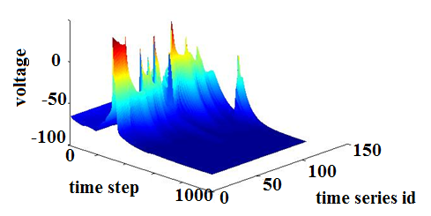
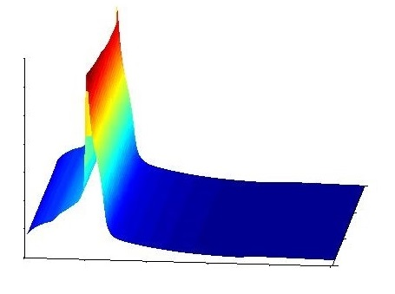
Time Series Correlation…
time series id
voltage
time step
Trends | Correlation | Opportunity to scale with
Increased simulation duration | Across time | increase in temporal resolution
Increasingly detailed models | Across time series | increase in spatial resolution
…enables efficient time series-specific compression

Slide 5
Time Series Data Discretization
Binning:
Partition the values into bins
Range encoding:
Set bin to ‘1’ if condition satisfied, ‘0’ otherwise
 |  | 17
9 | 5
 |  |  | 2
3: [15-20)
0 | 0 | 0 | 0
0 | 0 | 1 | 0
0 | 0 | 1 | 0
1 | 1 | 1 | 0
≥ 20
2: [10-15)
≥ 15
Value
Bin
≥ 10
1: [5-10)
0: [0-5)
≥ 5
Timestep
Timestep
Increased similarity across time series
Precomputed answers stored as a bitmap

Slide 6
Bitmap Compression Today
Run-Length-Encoding compresses each bitvector
  Word-Aligned Hybrid Code (WAH) [SSDBM ’02]
0 | 0 | 0 | 0
0 | 0 | 1 | 0
0 | 0 | 1 | 0
1 | 1 | 1 | 0
4×’0’
2×’0’, 1×’1’, 1×‘0’
Bin
2×’0’, 1×’1’, 1×‘0’
3×’1’, 1×‘0’
Timestep
Compression prevents direct access
  Timesteps don’t correspond to bit positions
Values filtered independently of timesteps
Similarities across time series are not exploited

Slide 7
Our Approach: RUBIK
0 | 0 | 0 | 0
0 | 0 | 1 | 0
1 | 1 | 1 | 1
1 | 1 | 1 | 1
0 | 0 | 0 | 0
0 | 0 | 1 | 0
1 | 1 | 1 | 1
1 | 1 | 1 | 1
0 | 0 | 0 | 0
0 | 0 | 1 | 0
1 | 1 | 1 | 1
1 | 1 | 1 | 1
0 | 0 | 0 | 0
0 | 1 | 0 | 0
1 | 1 | 1 | 1
1 | 1 | 1 | 1
0 | 0 | 0 | 0
0 | 1 | 0 | 0
1 | 1 | 1 | 1
1 | 1 | 1 | 1
0 | 0 | 0 | 0
0 | 1 | 0 | 0
1 | 1 | 1 | 1
1 | 1 | 1 | 1
Bitmap index
creation
Quadtree-based bitmap decomposition
Bitmap stacking
Access specific timesteps
Exploit similarities

Slide 8
Quadtree-based 3D Bitmap Decomposition
Timestep
Start
0
0
0
0
0
0
0
1
1
1
0
1
0
Bins
0
1
1
1
1
1
1
Time series
0
0
1
1
1
1
1
0
0
1
1
Mix
0
1
1
1
1
1
1
1
1
1
1
1
1
0
1
1
1
1
1
1
1
1
1
1
1
First Split
All 0
All 1
1
1
1
All 1
Mix
1
1
1
1
1
1
1
1
1
1
1
1
0
0
1
1
1
1
0
0
1
1
0
0
0
1
1
1
1
1
0
0
1
0
0
0
1
1
1
1
1
1
0
0
1
0
1
0
0
0
0
1
1
1
0
0
1
0
0
1
0
0
1
1
0
0
0
1
1
0
0
1
0
0
1
1
1
0
0
1
1
0
1
1
0
0
0
1
1
1
0
0
1
Second Split
All 0
All 1
Mix
All 0
0
0
1
1
0
0
0
0
0
0
1
1
0
0
0
0
0
1
1
0
0
0
0
0
0
1
1
1
0
0
0
0
0
1
1
0
1
0
0
0
1
0
0
0

Slide 9
Quadtree-based 3D Bitmap Decomposition
Start
Mix
First Split
All 0
All 1
All 1
Mix
Second Split
All 0
All 1
Mix
All 0
0
0
0
0
0
0
Apply WAH
1
0
0
1
0

Slide 10
Query Execution
Query:
voltage > 11 in time steps 1 and 2
Mix
All 0
All 1
All 1
Mix
1
1
1
Bin
1
1
1
1
1
1
1
1
1
1
1
1
1
1
1
1
1
1
1
1
1
Timestep
All 0
All 1
Mix
All 0
1
1
0
0
1
1
0
0
1
0
Transformation into a 2D bitmap problem
1
1
0
0
1
1
1
1
1
1
0
0
One tree traversal to retrieve multiple bitmaps

Slide 11
Stacking Time Series Bitmaps
Goal: Maximize size and number of common squares
bitmap 1
bitmap 3
0 | 0 | 0 | 0
0 | 1 | 1 | 0
1 | 1 | 1 | 1
1 | 1 | 1 | 1
0 | 0 | 0 | 0
1 | 1 | 0 | 0
1 | 1 | 1 | 1
1 | 1 | 1 | 1
bitmap 2
0 | 0 | 0 | 0
0 | 1 | 0 | 0
1 | 1 | 1 | 1
1 | 1 | 1 | 1
Mix | Mix
All 1 | All 1
Mix | All 0
All 1 | All 1
cluster 1
cluster 2
⇒ Maximize compression across time series

Slide 12
Scaling with Data Volume
In-memory indexes: FastBitF (WAH-compressed bitmap index), FastBit 2.0.1 API and RUBIK
Configuration: 128 bins
Datasets: 300K – 1.2M time series, 1000 time steps, 1.2GB – 4.8GB
Benchmark: 60 threshold queries,
random thresholds, up to 11% selectivity
RUBIK index size scales sublinearly
The speedup is increased from 9 to 23
Hardware: AMD Opteron, 2.7GHz, 32GB RAM

Slide 13
RUBIK Sensitivity Analysis
Configuration: 128 bins
Datasets: 500K – 2M time series, 1024 time steps, 2.1GB – 8.4GB
Benchmark: 60 threshold queries,
random thresholds, up to 15% selectivity
7.5X
6.7X
5.8X
Increased similarity ⇒ Increased compression
~80% of the time is spent on filtering
Hardware: AMD Opteron, 2.7GHz, 32GB RAM

Slide 14
Threshold Queries on Time Series
Subsets of interest in neuroscience simulations
RUBIK outperforms state-of-the-art by using:
  Quadtree decomposition
    ⇒ Transformation into a 2D bitmap problem
  Time series clustering
    ⇒ Similarities across time series are exploited
RUBIK scales particularly well with time series from increasingly detailed simulation models
Thank you!

Slide 15
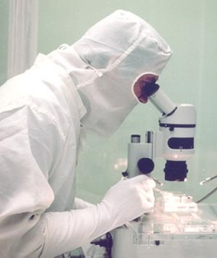
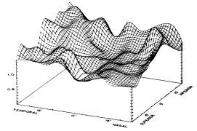

Scientific Simulations
Experimental measurement
Model
Simulation
Analysis
time

Slide 16
Stacking Time Series Bitmaps
0 | 0 | 0 | 0
0 | 0 | 1 | 0
0 | 0 | 1 | 0
1 | 1 | 1 | 0
All 0
Mix
Mix
Mix
All 0 | Mix
Mix | Mix
All 0 | Mix
All 1 | Mix
Mix | All 0
Mix | All 1
cluster 1
cluster 2
cluster 3

Slide 17
Experimental Methodology
Datasets:
  Neuroscience: 300K – 1.2M time series, 1000 time steps, 1.2GB – 4.8GB on disk
  Synthetic: 500K - 2M time series, 1024 time steps, 2.1GB – 8.4 GB on disk
Benchmark: 60 threshold queries, random thresholds, selectivity up to 15%
Software:
  RUBIK
  FastBitF (WAH-compressed bitmap index), FastBit 2.0.1 API
Hardware: AMD Opteron, 2.7GHz, 32GB RAM

Slide 18
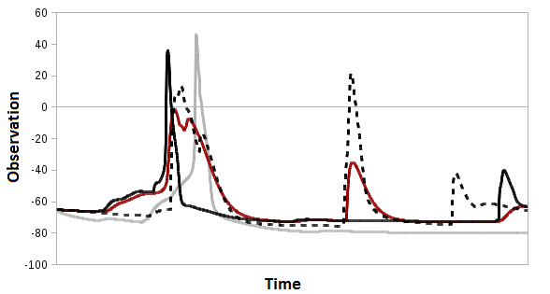
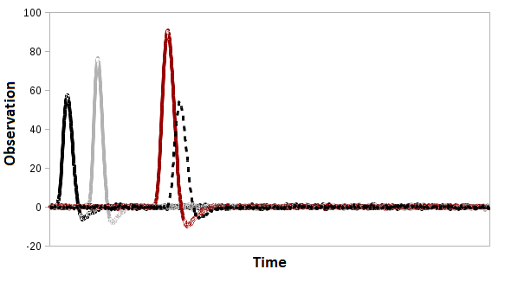
Datasets
Neuroscience Dataset
Synthetic Data Generation
Impulse response
Spike excitation
Parameters:
time offset of the excitation
time constant of the model
sensitivity factor of the model (amplitude of the response)
Additional Gaussian noise (activity independent of the excitation)
Synthetic Dataset
Notes:
TODO: Slide explaining how we obtained the synthetic dataset

Slide 19
Bitmap Compression: FastBit Approach
Indexing software for scientific applications
Key innovation: Word-Aligned Hybrid (WAH) compression
  Variation of Run-Length Encoding
  Encode/decode bitmaps in word size chunks
  Minimal decoding to gain speed
FastBitF:
One-dimensional indexing on the observation value
Filtering according to queried time boundaries

Slide 20
Impact of Binning
In-memory indexes: FastBitF (WAH-compressed bitmap index), FastBit 2.0.1 API and RUBIK
Datasets: 300K time series, 1000 time steps, 1.2GB
FastBitF-128 bins almost as big as RUBIK-256 bins
Higher resolution binning for higher indexing precision
FastBitF-512 bins bigger than the indexed data
Hardware: AMD Opteron, 2.7GHz, 32GB RAM
Notes:
TODO: beautify, fix graphs

Slide 21
Scaling with Temporal Resolution
In-memory indexes: FastBitF (WAH-compressed bitmap index), FastBit 2.0.1 API and RUBIK
Configuration: 128 bins
Datasets: 300K time series, 1000 - 4000 time steps, 1.2GB – 4.8GB
Benchmark: 60 threshold queries,
random thresholds, stretched time ranges
FastBitF compresses efficiently along time dimension
Speedup decreases from 9x to 6x
Hardware: AMD Opteron, 2.7GHz, 32GB RAM
Notes:
TODO: beautify, fix graphs

Slide 22
Comparative Analysis
In-memory indexes: FastBit10, FastBit25, FastBitF and RUBIK
Fixed space budget: 150MB
Benchmark: 60 threshold queries
Dataset: 300K time series, 1000 time steps, 1.2GB
Hardware: AMD Opteron, 2.7GHz, 32GB RAM
Notes:
39, 14, 54, 128 bins

Slide 23
Comparative Analysis
In-memory indexes: FastBitF and RUBIK
Configuration: 128 bins
Benchmark: 60 threshold queries
Dataset: 2M time series, 1024 time steps, 8.4GB
Hardware: AMD Opteron, 2.7GHz, 32GB RAM

