Slide 1
ON THE USE OF HISTORICAL PATTERNS OF ECOSYSTEM SERVICES IN SWITZERLAND TO INFORM SPATIAL PLANNING
Rémi JALIGOT, Jérôme CHENAL, Martí BOSCH
Ecole Polytechnique Fédérale de Lausanne
remi.jaligot@epfl.ch
24.10.2019
Jaligot, R., Chenal, J., & Bosch, M. (2019). Assessing spatial temporal patterns of ecosystem services in Switzerland. Landscape Ecology, 1-16.

Slide 2
Content
1. Introduction
Historical and change-overtime approach
Spatial planning in Vaud (Switzerland)
2. Methods
Mapping of historical ES supply
ES associations / clustering
Drivers of change
3. Results and discussion
ES associations over time
ES clustering and drivers
Spatio-temporal patterns of ES
Implications for planning
4. Conclusion

Slide 3
Introduction – Historical and change-overtime
We know that:
Not all ES can be maximized simultaneously other than by trade-offs
ES vary over space AND time, and history is critical in their current provision
Research focusing on the historical dynamics of ES remains limited to:
Static assessments:
Do not reflect if ES has been degraded / recovered from a prior unfavourable state
Lack of spatially explicit quantification of ES, accounting for changes in land-use and landscape configuration
“Space-for-time” approach: contribute to define spatial priorities,
but captures only snapshots of ES associations at different phases of LU transitions
Using a ‘‘change-overtime approach’’ (i.e., ES associations determined from a map difference) may moderate these issues

Slide 4
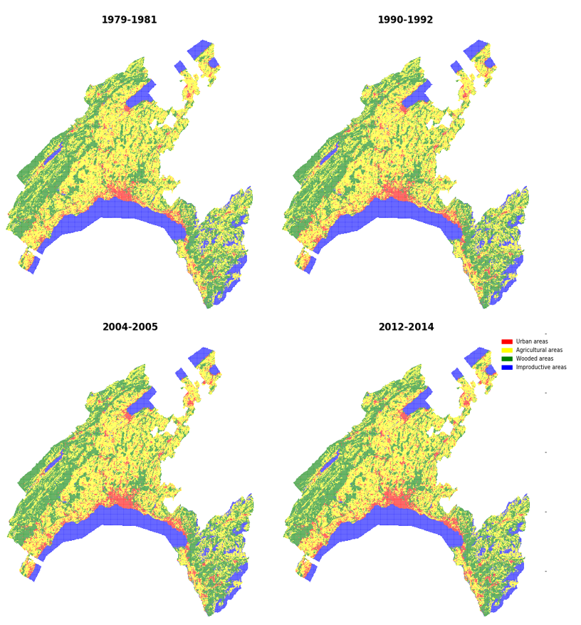
Introduction – Spatial planning in Vaud
About 777,000 inhabitants and total area 3,210 km2
Between 1979 and 2014:
Urban areas = + more than 8,000 ha
Agricultural areas = - 9,858 ha (mostly arable land)
Wooded areas = + 2,656 ha, mainly in mountainous regions in the eastern and western parts at the expense of pastures

Slide 5
Methodology – Mapping of historical ES supply
1 PES, 5 RES, and 5 CES were assessed
Annual supply of ES at four time steps: 1979–1981 (period 1), 1990–1992 (period 2), 2004–2005 (period 3), and 2012–2014 (period 4)
Combination of participatory mapping for cultural ES (e.g., public participatory GIS), process-based (e.g., STREAM model for flood regulation) and proxy-based models (e.g. InVEST tool for pollination, carbon stock)
Indicators ranging from potential capacity to actual supply
ES category | Ecosystem service | Type
Regulating | Carbon stock | Potential/Actual
 | Flood regulation | Actual
 | Erosion control | Actual
 | Water purification | Actual
 | Pollination | Potential
Provisioning | Food production | Actual
Cultural | Heritage | Potential
 | Landscape aesthetics | Potential
 | Outdoor activities | Potential
 | Inspiration, spiritual and religious | Potential
 | Simple nature value | Potential

Slide 6
Methodology – ES associations / clustering
Our analysis was conducted at the municipal scale, as it is one of the most important for spatial planning in Switzerland
Variations of each ES between two consecutive time steps (period 1–period 2, period 2–period 3, period 3–period 4), and between the start and the end of the entire study period (period 1–period 4)
Spearman’s rank correlation - values were not transformed in order to preserve directionality in the data
Identify co-occurrence of ES changes in bundles in a spatially explicit manner =
k-means cluster analysis over the entire study period

Slide 7
Methodology – Drivers of change
Potential driver | Description | Unit
Agricultural areas | Municipality land area occupied by agricultural areas | %
Arable land areas | Municipality land area occupied by arable land | %
Urban areas | Municipality land area occupied by urban areas | %
Wooded areas | Municipality land area occupied by wooded areas | %
Population density | Population density as the number of inhabitants divided municipal surface area | Inhab / km²
Protected areas | Municipality land area occupied by protected areas | %
Economic density | Total municipal tax revenues divided by the number of inhabitants | CHF / per capita
Elevation | Mean derived from DHM25 global digital elevation model | Meters
Slope | Mean derived from DHM25 global digital elevation model | Degrees

Slide 8
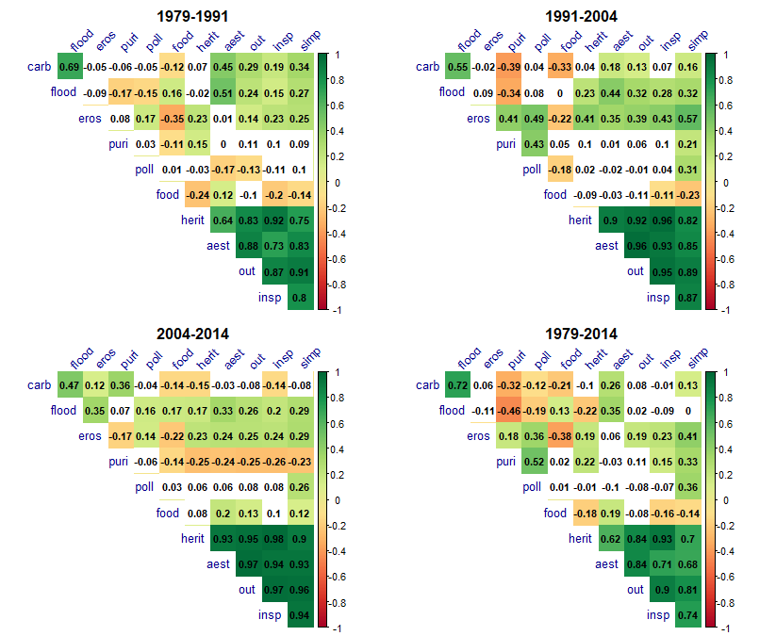
Results – ES association over time
Notes:
CES are synergetic through time
Food production vs Erosion control
Flood regulation vs Water purification
Pollination and food production but this depends on the location as we will see later

Slide 9
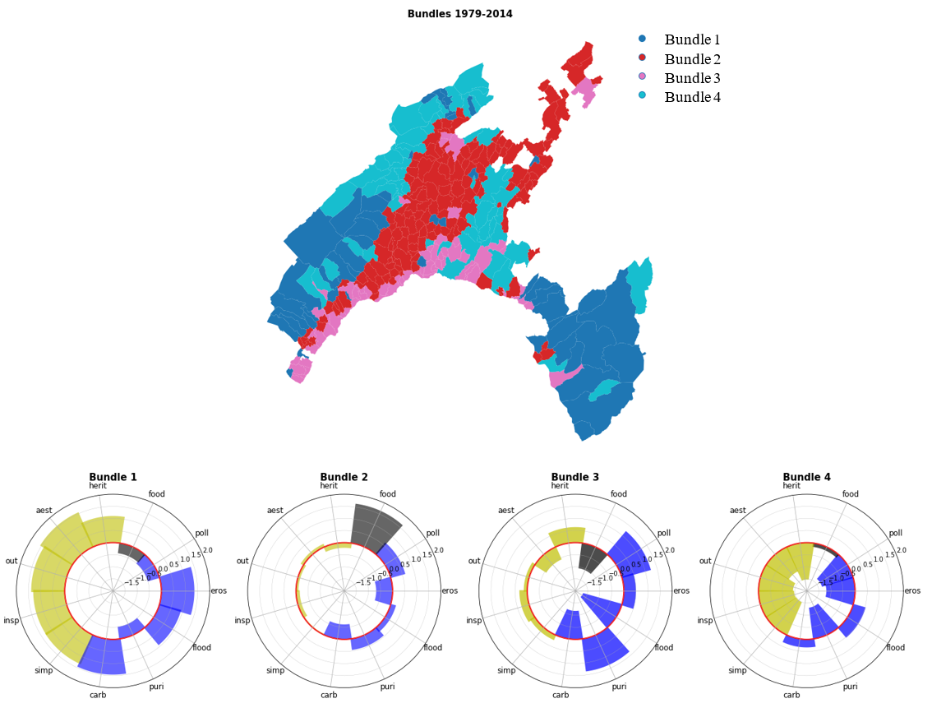
Results – ES clustering and drivers
Bundle 1 - dominated by cultural ES, carbon stock, erosion control and flood regulation in wooded areas
Bundle 2 – high change in food production, slight changes in pollination, flood regulation and water purification
Bundle 3 – largest change in
pollination and water purification,
lowest change in food production
Bundle 4 - lowest, below-average,
change in all ES except carbon stock
and flood regulation

Slide 10
Results – ES clustering and drivers
Bundle 1:
Changes in cultural ES = population density
Most RES = altitude / protected areas
Water purification, pollination, food production = agricultural areas
Bundle 2:
Flood regulation and carbon stock = slope, altitude, protected areas
Pollination = population density, forest cover and protected areas.
Bundle 3:
RES = slope and forest cover
Pollination = urban areas
Heritage and inspiration = urban areas
Bundle 4:
Carbon stock = altitude, protected areas, slope
Food production and water purification = altitude
Notes:
Some ES are synergetic but driven but different factors
Similar ES can be driven by different factors depending on the bundle, say the example of pollinators

Slide 11
Discussion - Spatio-temporal patterns of ES
Persisting negative relationships between food production and RES/CES
Dichotomy in bundle types: ES trade-offs tended to arise from a specific land use providing a service (e.g., forests in bundle 1) OR conflicting land uses (e.g. food production vs. erosion control in bundle 2).
Landscape multifunctionality was the highest where urbanization and crop production were the lowest (Bundle 1)
As in bundle 2, most trade-offs could appear when a
service is maximized (food production)
Urban municipalities provide multiple services (bundle 3)
Notes:
Swiss urban areas are relatively green, with patches of wooded areas acting as protection against erosion, or parks that are adequate for the activity of pollinators

Slide 12
Discussion - Implications for planning
How to integrate multiple services while minimizing trade-offs?
Overall, municipalities supply ES BUT none showed an increase in all ES - Municipalities that favoured a land sparing management policy fail to ensure landscape multifunctionality (bundle 2)
Regions prone to supply cultural ES were located mostly in areas distant from urban municipalities with low population density
Unrealistic for each municipality to have a multifunctional territory in this context Two different perspectives for spatial planning:
Land sparing = landscape multifunctionality at the supra-municipal level
Land sharing = municipalities adopt land sharing practices by merging sectoral policies
Notes:
Speak about surfaces d’assolement in bundle 2
landscape multifunctionality at the supra-municipal level to facilitate the planning process and alleviate the challenge for municipalities to provide a multifunctional landscape if current policy remain

Slide 13
Conclusion
Bundling captured key patterns of ES driven by past socio-ecological dynamics
Contrast between productive/highly populated region VS not productive/low density
ES can be synergetic in one bundle, but antagonistic in another
Different processes can cause change in the same ES depending on the location
BUT there are some limitations to this work
Potential vs Actual supply = ES bundles delineated by cluster analysis are not entirely generalizable to other regions/countries
Scale = Smallest administrative units are good to identify shared ES supply and trade-offs between it is arbitrary for some ES
Notes:
Pollination vs crop production

Slide 14
Conclusion
Thank you for listening
Any questions?

