Slide 1


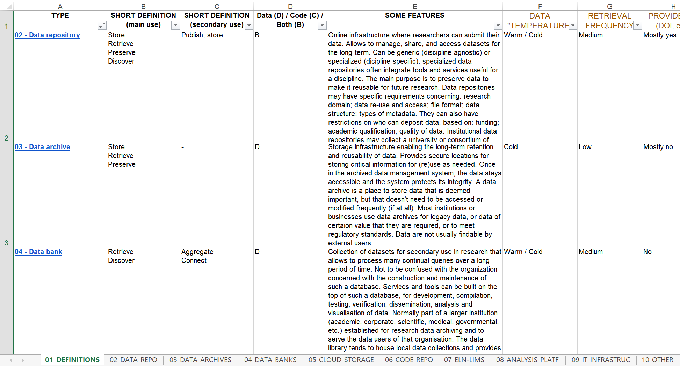
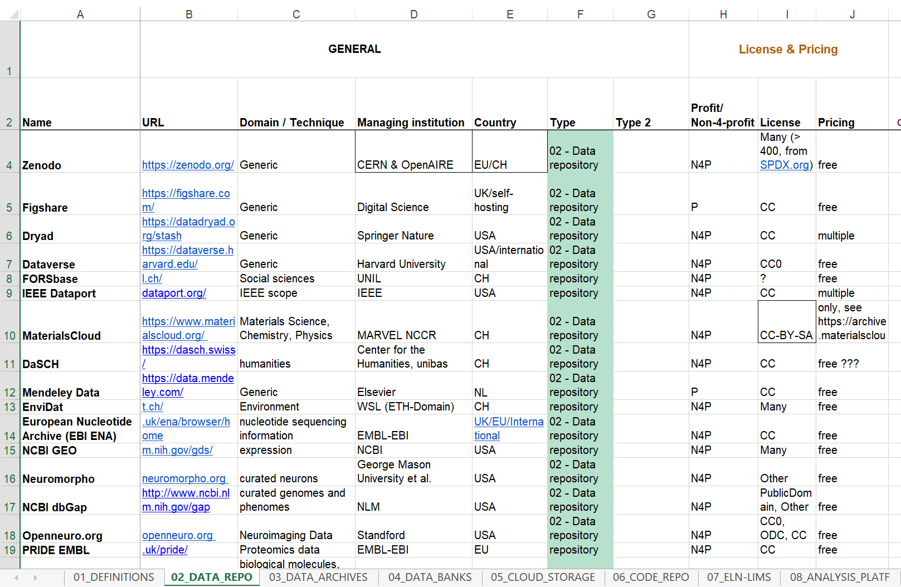








Landscape of data repositories & platforms
The quest for guiding researchers in choosing data dissemination platforms
At researchers’ service
Beyond data repos
Open Data, but where?
University services act in the continuous effort of supporting students and researchers, providing them with guidance and tools, and anticipating their needs. All while aligning with the services' mission.
We aim to help researchers in streamlining datasets publication: shorten the time to dissemination, create awareness, guide them in choosing the ones the best fit their needs.
The work towards the current version involved: 3 university services, 4 people, 2 collaborative platforms, 4 major versions of the table, ~60 total work hours, ~6 meetings, lot of coffee.
We started from a list of data repositories used by a specific faculty, then expanded the scope to include other forms of data dissemination (code repositories, databanks, etc.), more faculties and eventually addressed 3 major blurred lines:
  Between platforms
  Between content
  Between scientific domains of their users
While the fragmented landscape of tools for Open Data and Open-Source imposes to look beyond data repositories, the large variety of practices among researchers implies a combined approach by research domain and by service.
Scholarly communication is slowly shifting from papers to richer content, as for instance research data and code. Data dissemination has a crucial role and yet it is in its infancy, with visible fragmentation of practices and tools, and too many unknowns for researchers to get onboard.
With our work, we want to mitigate this situation and help researchers decide which platforms would be best suited to disseminate their data and code.
The table we elaborated is based on precious feedback from EPFL researchers, and its purpose is both to capture a variety of use-cases, and to guide researchers in making their choice.
Comparative table WIP
Based on EPFL researchers’ input and on our experience, we divide the data dissemination solutions in 8 categories:
The table is composed by:
  10 tabs: the 1st tab contains the 8 definitions of data dissemination solutions, plus 8 tabs corresponding to each data dissemination type, and finally a tab for uncategorized platforms.
  22 columns or more for each category tab: ranging from general information (ex. research domain, managing institution, country), to information about pricing, handling of private data, findability, sharing, etc.
  Data repositories
  Data archives
  Data banks
  Cloud storage
  Code repositories
  ELN / LIMS
  Data analysis platforms
  IT infrastructure
Because it is still work in progress and because of two main challenges, voids are a natural component of the table.
As next steps, we will explore these ideas for improvement:
Streamline the information and fill the voids!
Publish it as a filtrable table and collaborative spreadsheet
Create a short guide to accompany the researchers
Make it evolve as a Decision tree or Chatbot or other form
This poster and a static version of the Data Dissemination table in their current form are freely available at
go.epfl.ch/FORCE21epfl
WHO PUT THE HANDS ON THIS PROJECT
Miriam Braskova
Scientific advisor
@ EPFL School of Engineering
Eliane Blumer
Coordinator or the EPFL RDM team
@ EPFL Library
Francesco Varrato
Data Librarian and RDM trainer
@ EPFL Library
Charlotte Weil
Data Scientist
@ EPFL School of Architecture, Civil
and Environmental Engineering
Contributors
Collecting information
INFORMATION IS POWER, TO EMPOWER
As our own knowledge of platforms for data and code dissemination is limited, we surveyed EPFL researchers, asking for the platforms they use. Once we listed the used platforms, we did the online due diligence to get information for each platform.
Ideally, the table should be self-explanatory, however the fragmented landscape for data dissemination exacerbates this challenge.
For ex., while re3data.org is a great resource for data repositories, it leaves out basic information as pricing, max allowed size of datasets, physical servers' location, etc. We also contacted directly some platform providers to get the information.
Main challenges
Categorization
YOUR MINDMAP IS NOT MY MINDMAP
Once we collected the list of platforms and their specifics, we needed to align our perspectives (basic vocabulary + collaborative online tools + etc.), integrating our different backgrounds, different tasks, different service goals and expectations.
To make sure to be on the same page we tackled this complexity by structuring the information with categorization of the Data Dissemination platforms that would make sense both for us (the services’ representatives) and of course for the researchers.
Such a categorization is not unique. To anyone wanting to tackle a similar project, we suggest that you engage and leverage on different stakeholders, in particular: RDM experts, researchers, faculty representatives and central services.
FORCE11 online conference: FORCE2021, 7-9 December 2021
“Joining Forces to Advance the Future of Research Communications”
Photos and poster : CC-BY-NC-SA, EPFL Library
Notes:
Landscape of Data repositories & platforms
The quest for guiding researchers in choosing data dissemination platforms
Miriam Braskova¹, Charlotte Weil², Eliane Blumer³, and Francesco Varrato³
miriam.braskova@epfl.ch, charlotte.weil@epfl.ch, eliane.blumer@epfl.ch, francesco.varrato@epfl.ch
¹ EPFL School of Engineering
² EPFL School of Architecture, Civil and Environmental Engineering
³ EPFL Library
Abstract
Scholarly Communication is still shifting from papers to richer content, as for instance research data and code.
Data dissemination has a crucial role and yet it is in its infancy, with visible fragmentation and too many
unknowns for researchers to get onboard. With our work, we want to mitigate this situation and help researchers
decide which platform/s is/are best suited to disseminate their data and code. The table we elaborated is based
on multiple feedback from EPFL researchers, and its purpose is both to capture the variety of use-cases, and to
guide researchers to make their choice.

