Slide 1


The validation project for the TORPEX basic plasma physics experiment
Paolo Ricci
F. Avino, A. Bovet, A. Fasoli, I. Furno, S. Jolliet, F. Halpern,
J. Loizu, A. Mosetto, C. Theiler
Centre de Recherches en Physique des Plasmas
École Polytechnique Fédérale de Lausanne, Switzerland
What is TORPEX? And the simulation code?
What validation methodology did we use?
What have we learned from the validation?

Slide 2
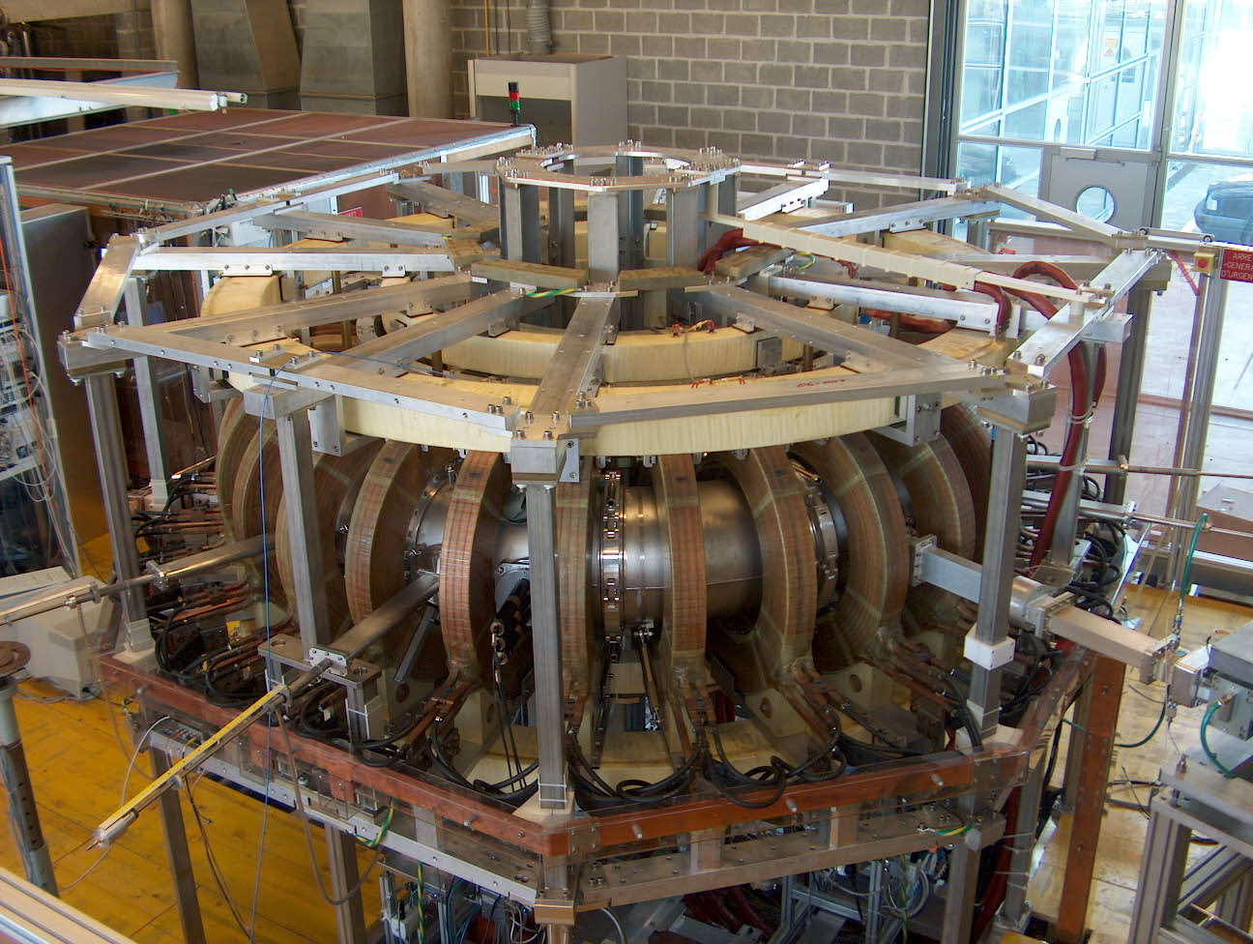
The TORPEX device

Slide 3
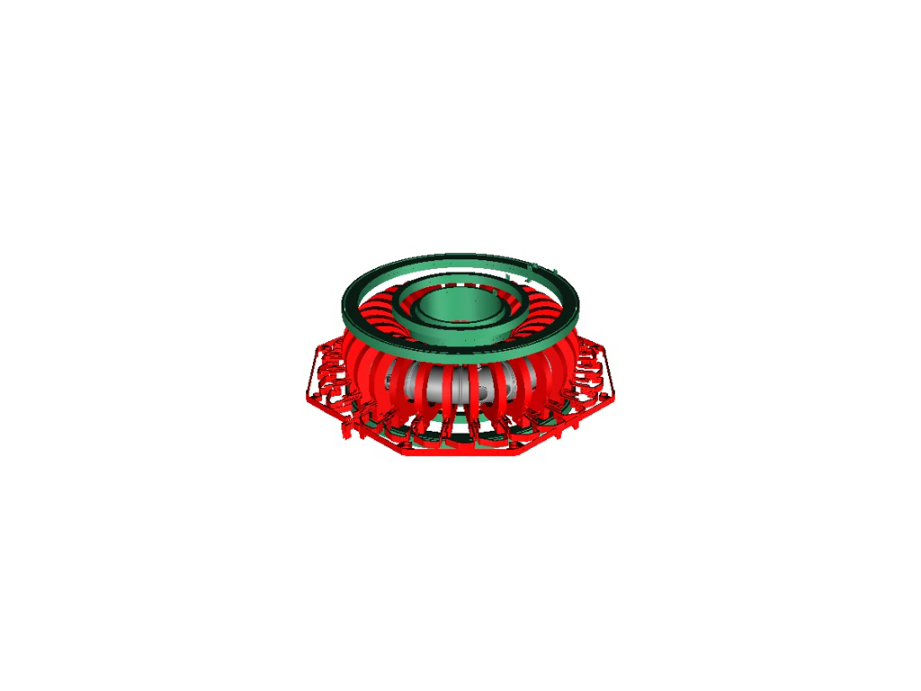
The TORPEX device

Slide 4
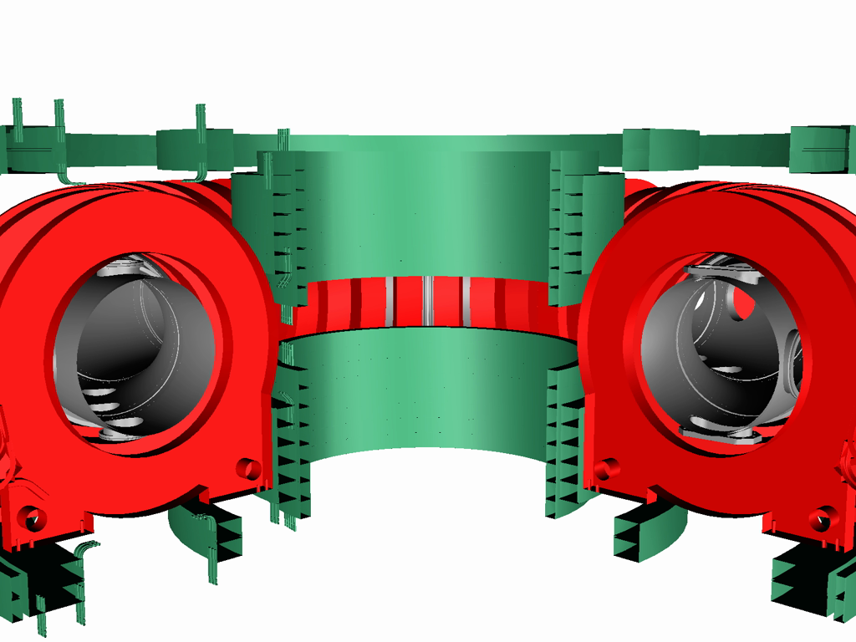
The TORPEX device

Slide 5
The TORPEX device

Slide 6
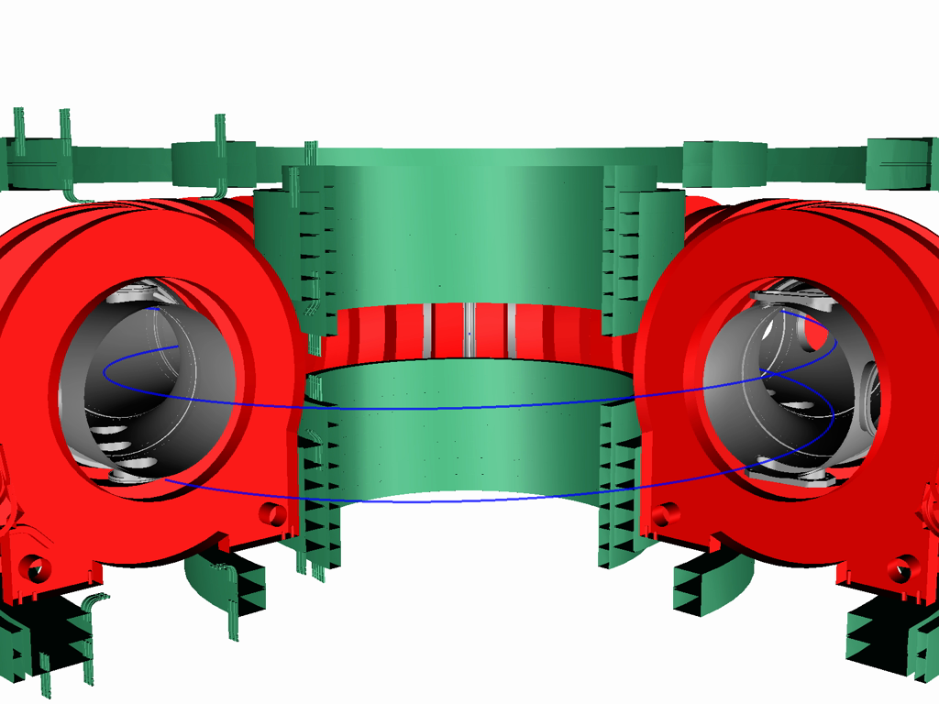
The TORPEX device

Slide 7
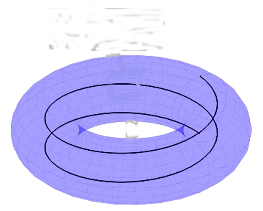
Key elements of the TORPEX device
Source (EC and UH resonance)
Parallel losses
Plasma gradients
Magnetic curvature

Slide 8
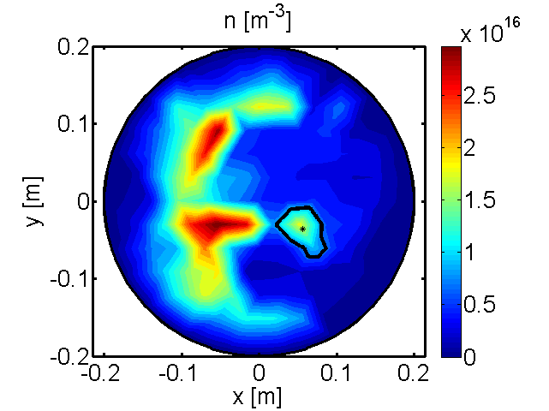
TORPEX, the main research avenues
Basic plasma turbulence physics studies
Generation, propagation, control of blobs
Interaction of fast particles with turbulence

Slide 9
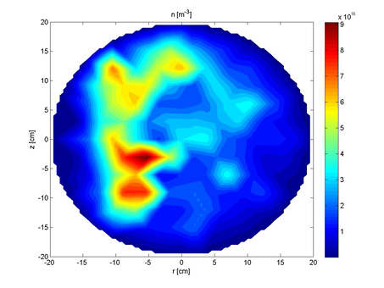
TORPEX: an ideal validation testbed
Complete set of diagnostics, full plasma imaging possible
Parameter scan, N – number of field line turns
Example: N=2

Slide 10
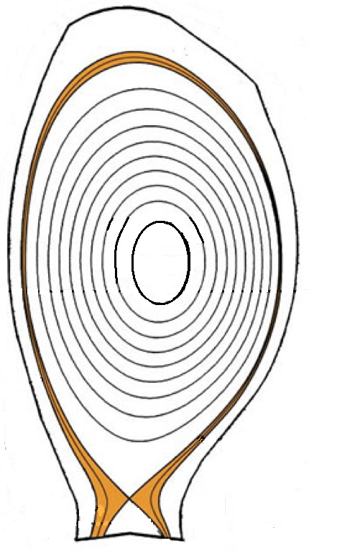
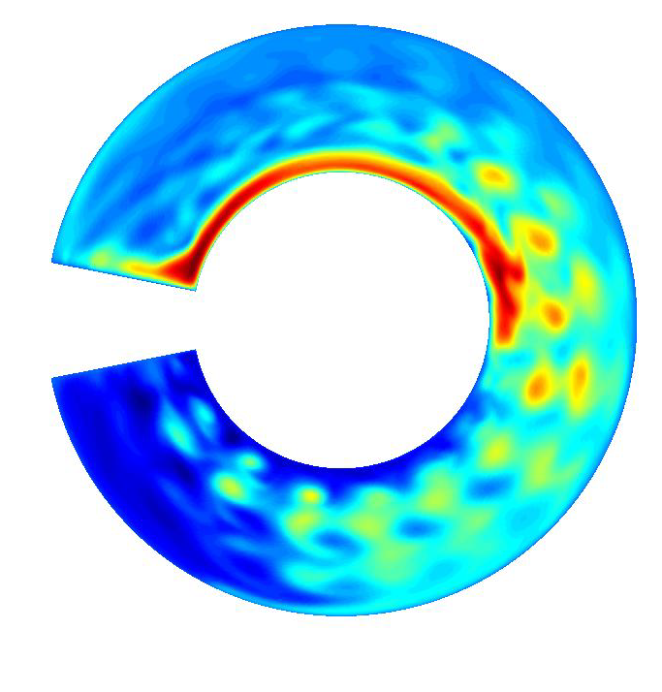
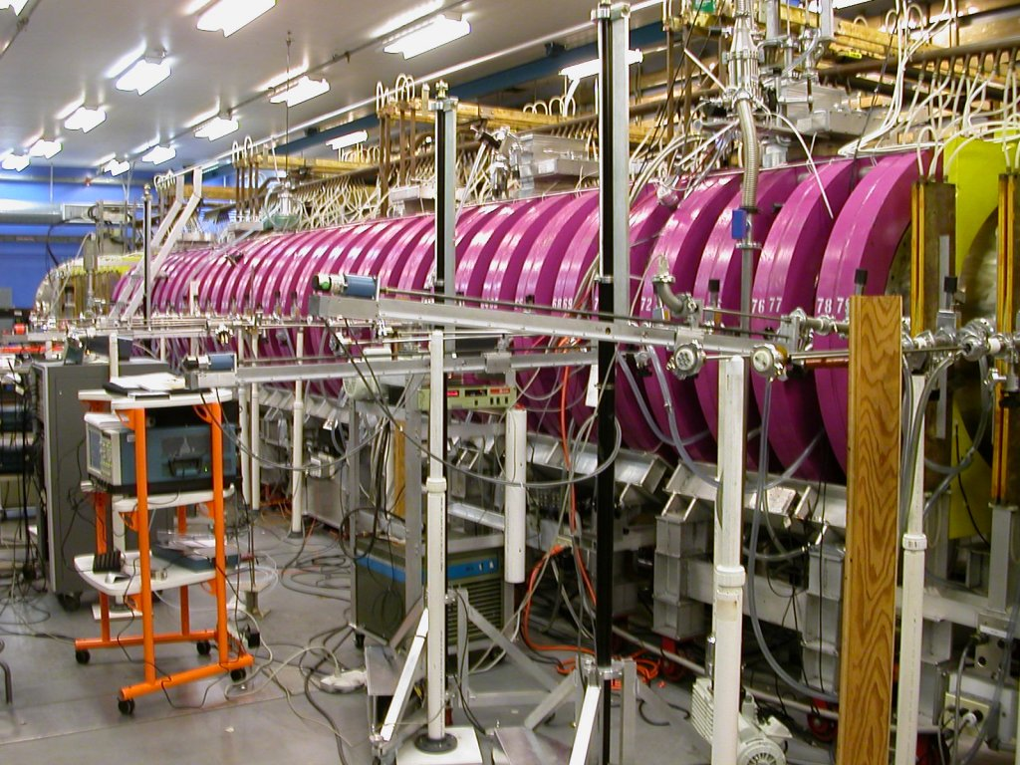
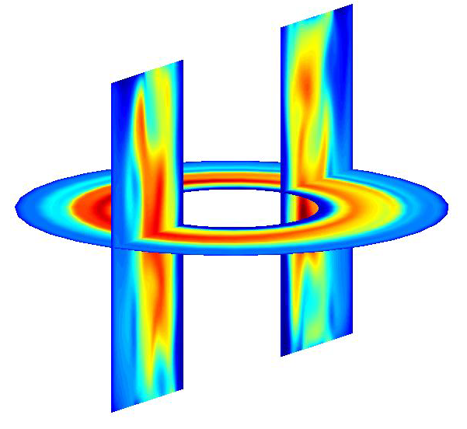
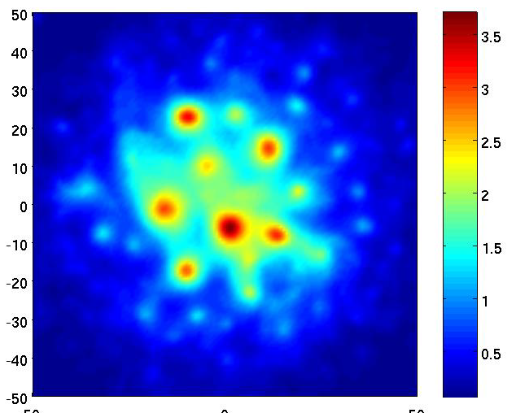
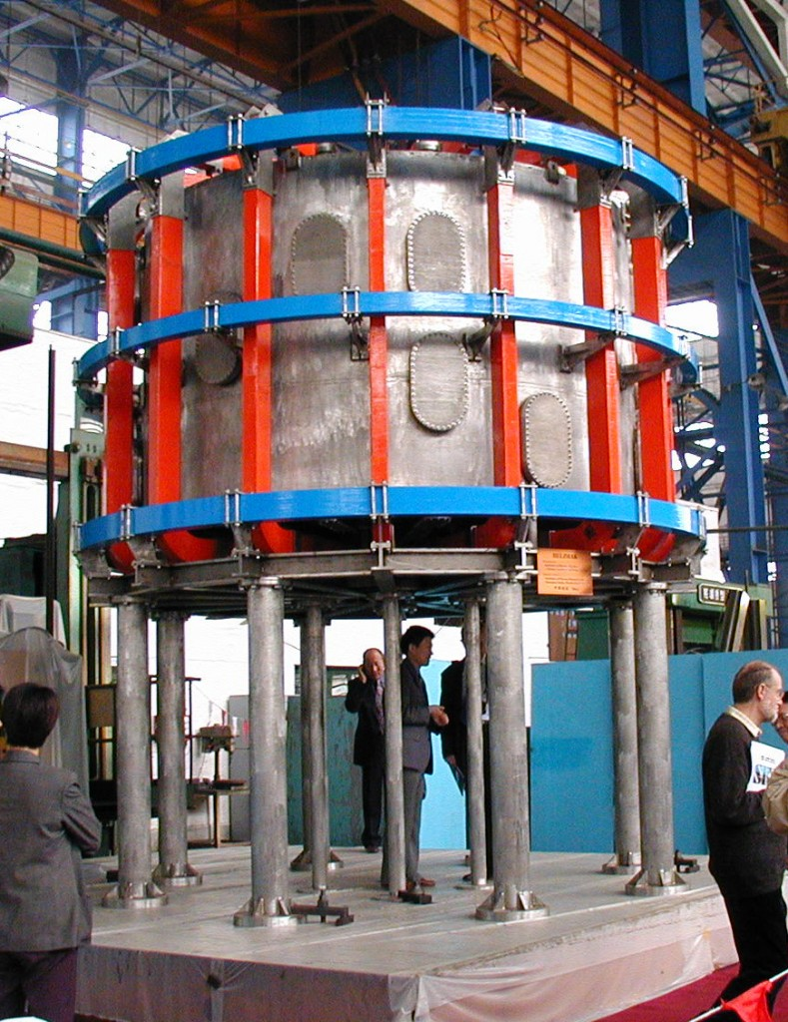
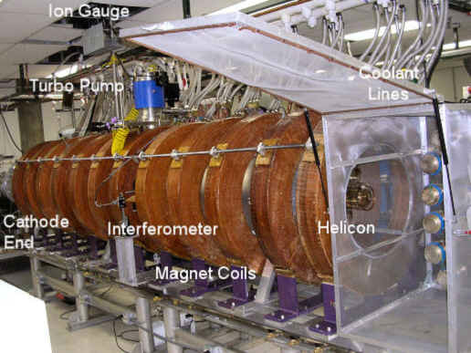
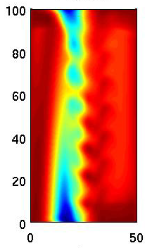
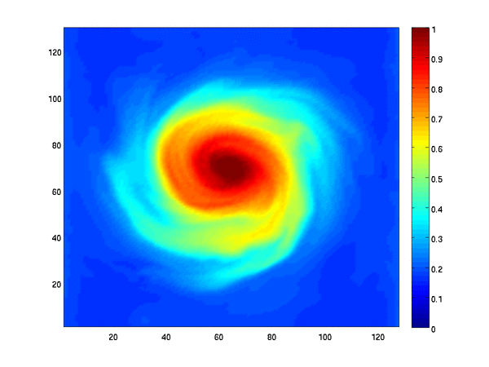
GBS: simulation of plasma turbulence in edge conditions
From linear devices, to Simple Magnetized Tori (SMT), and
to SOL
ITER-like
SOL
Limited
SOL
TORPEX,
CRPP
LAPD,
UCLA
HelCat, UNM
Helimak, UTexas

Slide 11
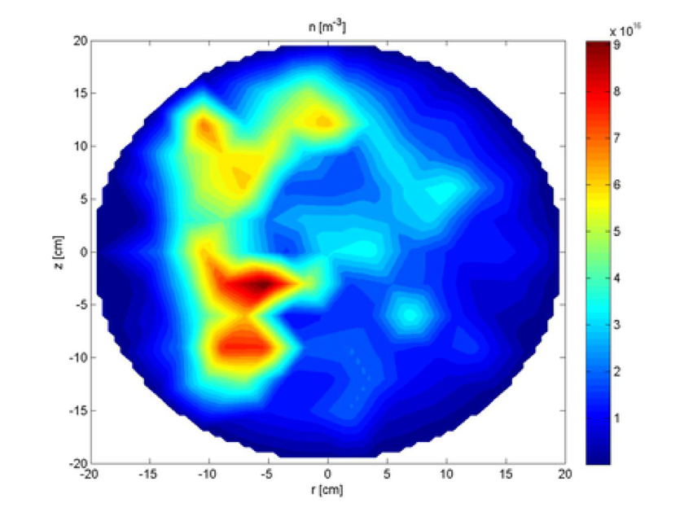
Properties of TORPEX turbulence
Collisional

Slide 12
The GBS model
Collisional
Plasma
ρ_{i}<<L, β<<1,
ω<<Ω_{ci}
Electrostatic
Drift-reduced Braginskii equations
Braginskii model
Convection
Magnetic curvature
Parallel dynamics
Source
T_{e}, Ω (vorticity) similar equations
V_{||e}, V_{||i} parallel momentum balance
Quasi steady state – balance between:
plasma source, perpendicular transport, and parallel losses

Slide 13
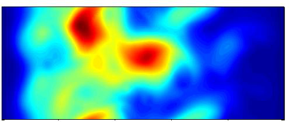
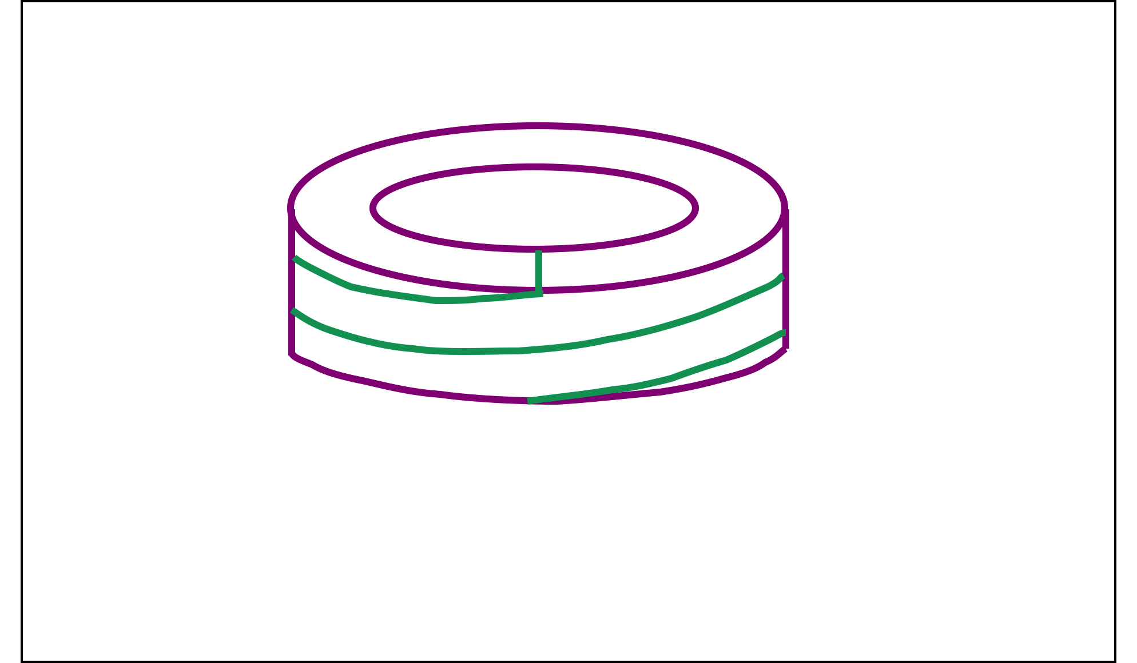
3D and 2D GBS simulations
Fully 3D version
2D version (k||=0 hypothesis)
z
r
z
r
Notes:
TORPEX plasma has been simulated with the GBS code, which is based on the following model.
GBS evolves 5 quantities in space and time. No equilibrium profile is imposed. Self-consistent evolution of equilibrium + fluctuations. Steady-state balance.
Here a snapshot of n in global 3D simulations, N=2.There is also a 2D reduced model which integrates parallel dynamics assuming kpar=0.

Slide 14
Our project,
paradigm of turbulence code validation
?
3D GBS model
TORPEX
2D reduced model
What is the agreement of experiment and simulations as a function of N? Is 3D necessary?
What can we learn on TORPEX physics from the validation?
Notes:
So the validation project in TORPEX consists of
a comparison between 3D-exp and 2D-exp,
considering a set of observables and
making a scan in N.

Slide 15
The validation methodology
[Based on ideas of Terry et al., PoP 2008; Greenwald, PoP 2010]
  What quantities can we use for validation? The more, the better…
  Definition & evaluation of the validation observables
What are the uncertainties affecting measured and simulation data?
  Uncertainty analysis
For one observable, within its uncertainties, what is the level of agreement?
  Level of agreement for an individual observable
How directly can an observable be extracted from simulation and experimental data? How worthy is it, i.e. what should be its weight in a composite metric?
  The observable hierarchy
How to evaluate the global agreement and how to interpret it
  - Composite metric
Notes:
We have both theory and experiment so we can consider a code validation.
Based on Terry ideas, we adopt the following procedure.

Slide 16

Definition of the validation observables
?
Common quantities
n
I_{sat}
T_{e}
V_{float}
Probe model, assumptions
Validation
observables
φ
Probe model, assumptions
V_{||i}
I-V
V_{||e}
to be compared
Examples:
A validation observable should not be a function of the others
Quantities to predict should be included among the observables
Notes:
First: what are the observables?
Direct from…
We can then consider interesting validation observables.
Examples with n and Isat. Different N cases. Qualitative agreements.

Slide 17
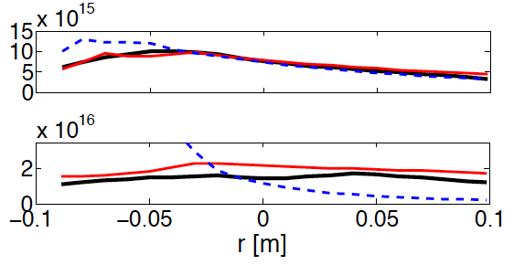
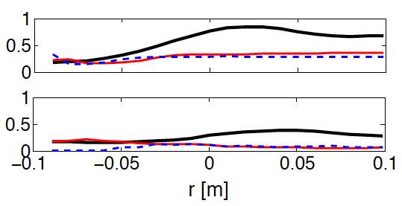
Evaluation of the validation observables
Examples
We evaluate 11 observables:
n [m⁻³]
low N
high N
δI_{sat}/I_{sat}
low N
high N
experiment
3D
2D
Notes:
First: what are the observables?
Direct from…
We can then consider interesting validation observables.
Examples with n and Isat. Different N cases. Qualitative agreements.

Slide 18
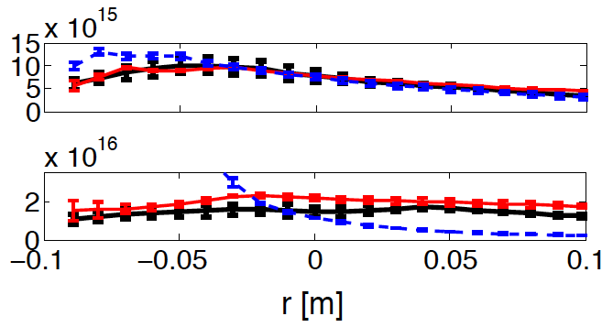
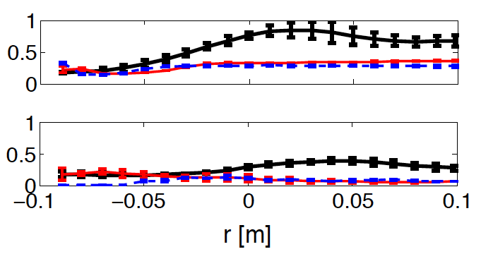
Uncertainty analysis
Experiment:
Examples
n [m⁻³]
I-V Fitting
low N
Plasma reproducibility
Probe properties,
measurement errors
Finite statistics
high N
δI_{sat}/I_{sat}
Simulation:
low N
high N
Numerics
Finite statistics
Input parameters -
scan in resistivity and boundary conditions
experiment
3D
2D
Notes:
Now we would like to quantify the uncertainties present in both exp/sim.
For the exp, we have contributions from (1)fiting (2)probe properties (3)reproducible plasma (4)finite statistics time
For the sim, we have (1)numerics (2)input (3)finite statistics time
Apply this to our examples.

Slide 19
Exp/Sim distance for an individual observable
Examples
Experimental measurements
Simulation results
n [m⁻³]
d_{2D}=1.3
low N
d_{3D}=0.8
d_{2D}=7.8
high N
d_{3D}=2.0
δI_{sat}/I_{sat}
d_{2D}=4.5
d_{3D}=3.9
low N
Average over all points
Normalization to uncertainty
d_{2D}=5.5
high N
d_{3D}=4.0
experiment
3D
2D
Notes:
Now we can try to quantify the distance between exp. and sim (2D or 3D) for each observable.
It appears that the most suitable way to define such distance is to say d=geometric distance in units of error bars. Formula.
Apply to our examples. Quantitative agreements.

Slide 20
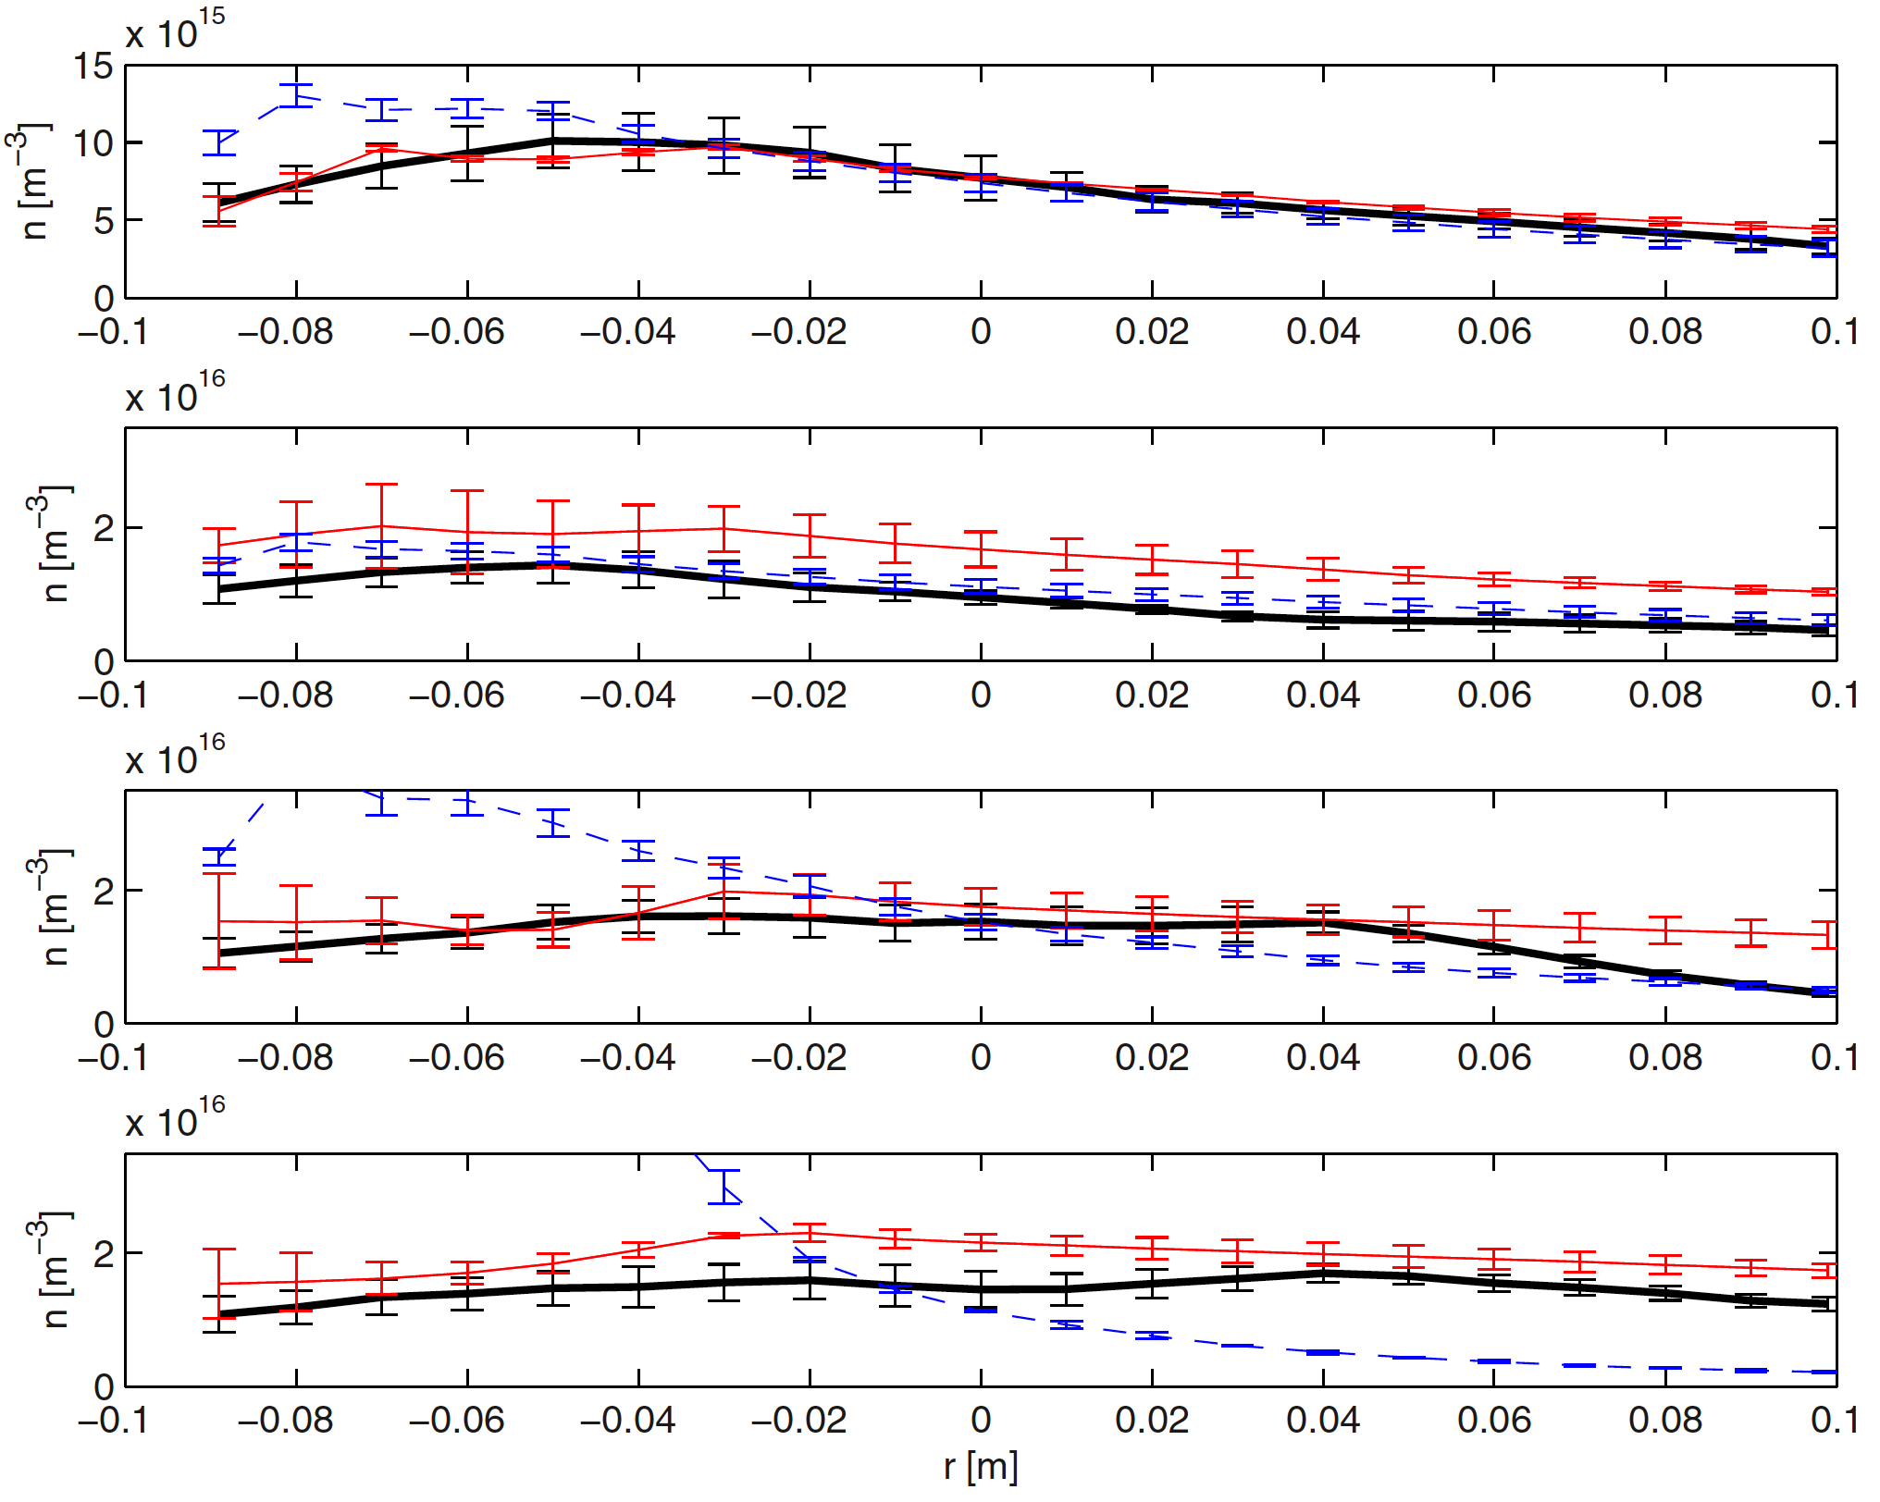
Agreement with respect to an individual observable
Examples
Level of agreement:
n [m⁻³]
R_{2D}=0.35
low N
R_{3D}=0.06
DISAGREEMENT
AGREEMENT WITHIN UNCERTAINTY
R_{2D}≈1
high N
R_{3D}=0.88
AGREEMENT
δI_{sat}/I_{sat}
R_{2D}≈1
R_{3D}≈1
low N
R_{2D}≈1
high N
R_{3D}≈1
experiment
3D
2D
Notes:
Apply to our examples. Quantitative level of agreement.

Slide 21
Observable hierarchy
Not all the observables are equally worth…
The hierarchy assesses the assumptions used for their deduction
Examples
n [m⁻³]
h^{exp}=1, h^{sim}=0, h=1
 | h^{exp} | h^{sim} | h
I_{sat}, V_{fl} | 0 | 1 | 1
n, T_{e}, ϕ equilibrium profiles | 1 | 0 | 1
T_{e} time trace | 2 | 0 | 2
Structure analysis, CAS | 1 | 2 | 3
Γ | 2 | 1 | 3
…
low N
# of assumptions to get the observable from experimental data
high N
δI_{sat}/I_{sat}
h^{exp}=0, h^{sim}=1, h=1
same for simulation results
low N
high N
experiment
3D
2D
Notes:
Now we need to classify observables, with a so-called primacy hierarchy level. Level 1 corresponds to…
We can then define the hierarchy level h=… and apply to our 2 examples.
By repeating this exercise for all observables it is possible to generate a table with observables classified by their h_tot

Slide 22
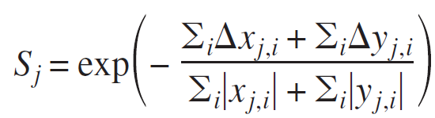
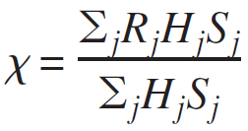
Definition of the composite metric
Hierarchy level
Level of agreement
Sensitivity
Sum over all the observables
Quality of the comparison, in our case
Normalization:
- χ=0: perfect agreement
- χ=0.5: agreement within uncertainty
- χ=1: total disagreement
22
Notes:
Finally we can define a global agreement with a composite metric chi = sum(R) with h and s weights.
Applying this to a set of 11 observables, we get a single chi value for the global agreement, and we do this for different N. Plot. 2D and 3D.

Slide 23
Composite metric: the validation results
Complete disagreement
2D simulations
Agreement within uncertainty
3D simulations
Perfect agreement
Why 2D and 3D work equally well at low N and 2D fails at high N?
What can we learn on the TORPEX physics?
Notes:
Finally we can define a global agreement with a composite metric chi = sum(R) with h and s weights.
Applying this to a set of 11 observables, we get a single chi value for the global agreement, and we do this for different N. Plot. 2D and 3D.

Slide 24
Flute instabilities - ideal interchange mode
n + T_{e} eqs.
Vorticity eq.
Compressibility stabilizes the mode at

Slide 25
Anatomy of a perturbation
longest possible vertical wavelength of a perturbation
If then

Slide 26
TORPEX shows turbulence at low N
Ideal interchange regime

Slide 27
For N~1-6, ideal interchange modes dominant
N=2

Slide 28
A different turbulent regime at N>7
WHY?

Slide 29
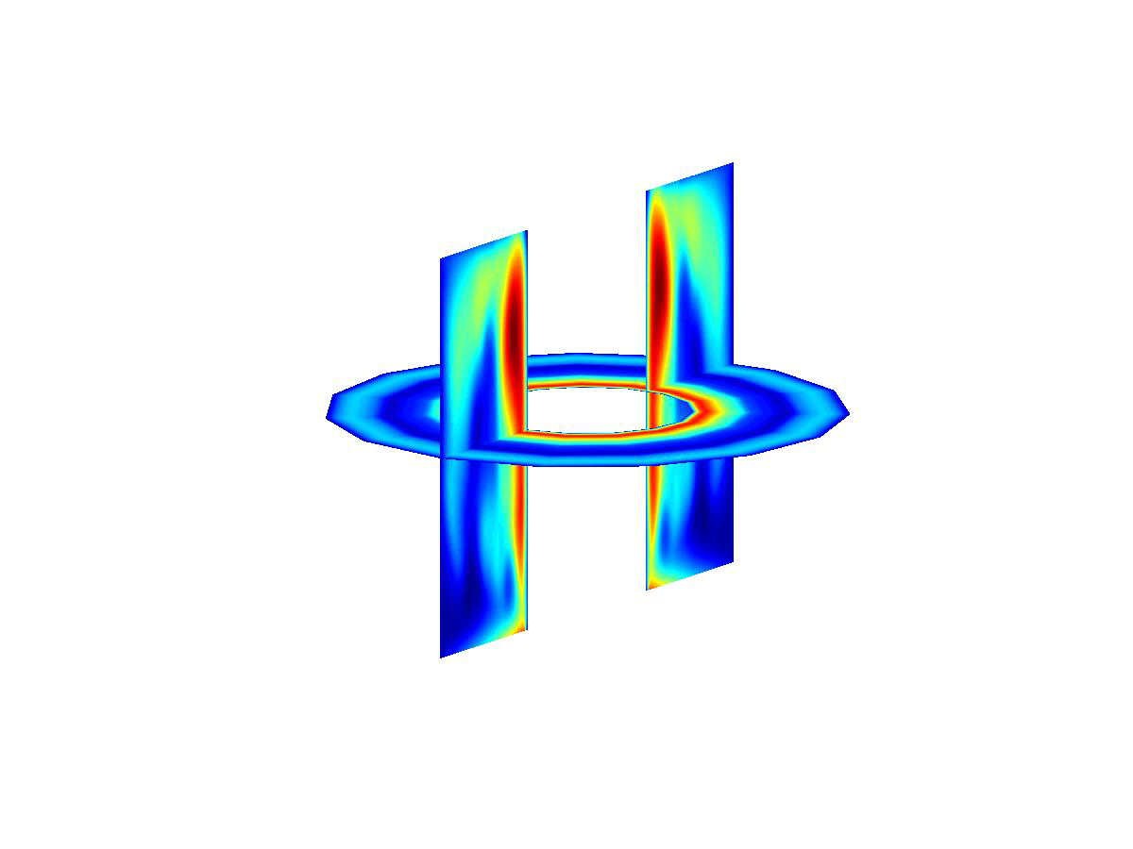
At high N > 7, toroidal symmetric turbulence
N=16

Slide 30
Resistive interchange modes
n + T_{e} eqs.
Vorticity eq.
Ohm’s law
Two cases:
Ideal interchange mode
Resistive interchange mode (requires )
Resistive interchange

Slide 31
Why does TORPEX transition from ideal to resistive interchange for large N?
N
Resistive interchange requires high N:
Ideal interchange requires low N:
thus
stable:
Threshold: N~10 TORPEX

Slide 32
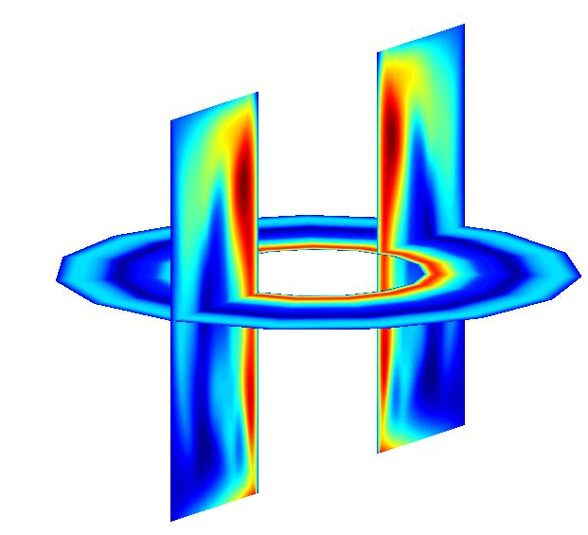
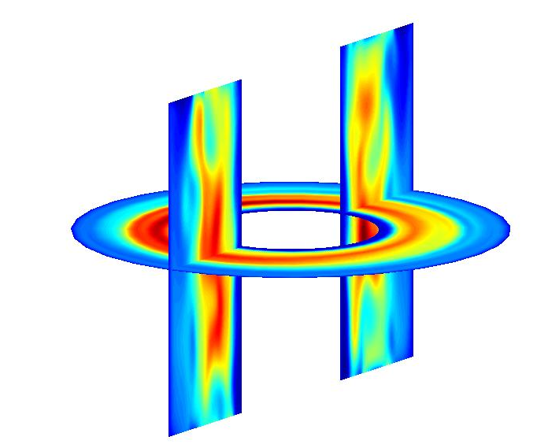
Interpretation of the validation results
2D
3D
Ideal interchange turbulence
2D model appropriate
Resistive interchange turbulence
2D model not appropriate
Notes:
We have to look at 2 regimes of N:
low N shows kpar=0 modes (ideal Int), with ktor not zero, and kver = N
high N shows transition to kpar non zero modes (res Int), with ktor=0 and kver = 1/Lver small
Conclusion: high N needs kpar not zeros so 2D is not good => chi captures this

Slide 33
Where can a validation exercise help?
1. Compare codes
2D and 3D simulations agree with experimental measurements similarly at low N.
Global 3D simulations are needed to describe the plasma dynamics at high N.
2. Let the physics emerge
Two turbulent regimes: ideal interchange mode at low N and non-flute modes at high N.
Parameter scans have a crucial role
3. Assess the predictive capabilities of a code
3D simulations predict (within uncertainty) profiles of n but not of I_{sat}
Notes:
----- Meeting Notes (07-02-2013 15:17) -----
- parameter scan (impprtance)
- robusteness
- huge number of points
- Independence (should be calculated independently – Isat vs n)
- choice
rubustness
Smaller d_0
Diffusion

Slide 34
What comes next?
Validation at each code refinement
Considering more observables
Involving more codes
ITER-like
SOL
Limited
SOL
TORPEX,
CRPP
LAPD,
UCLA
HelCat, UNM
Helimak, UTexas

Slide 35
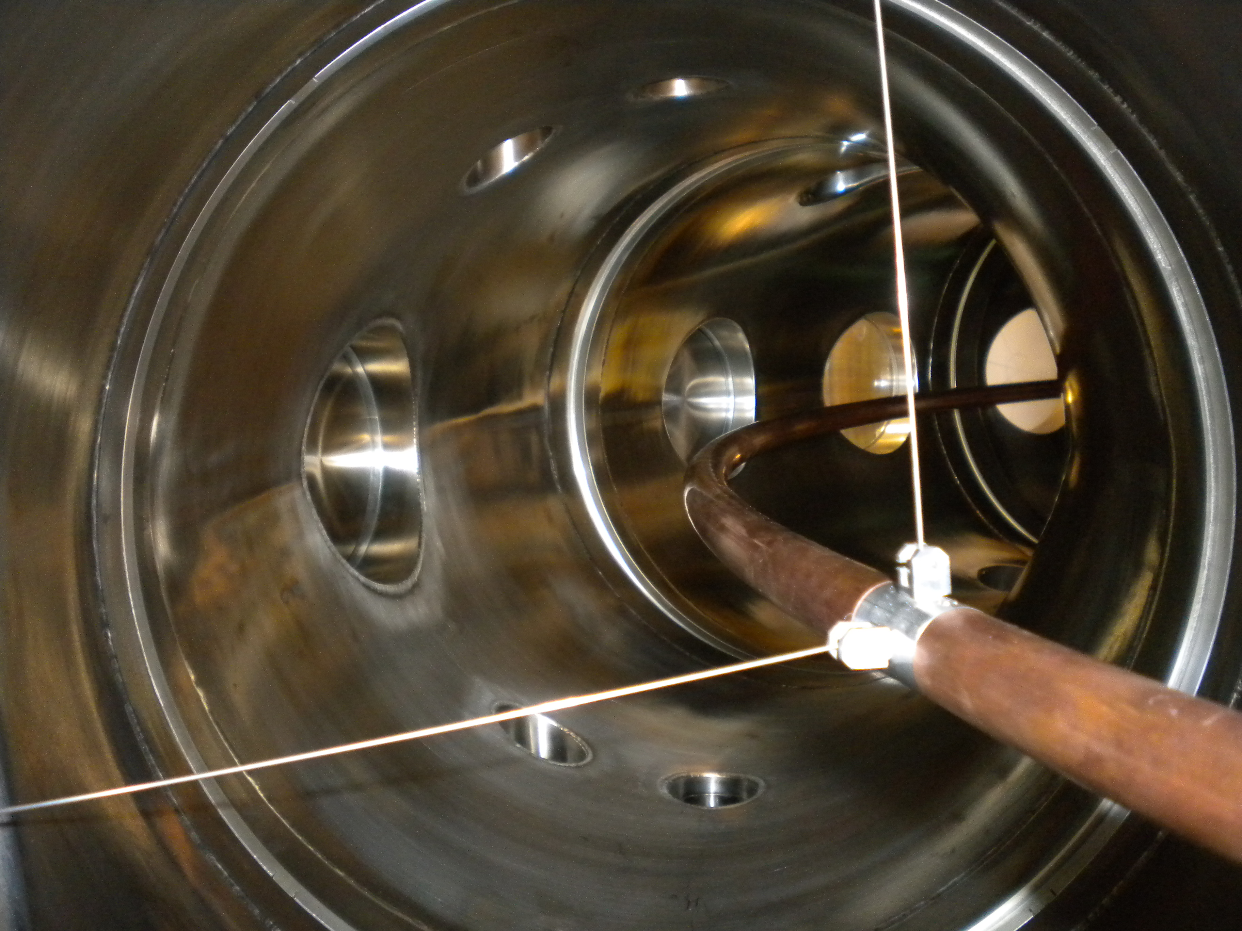
What comes next?
Validation on a recently achieved SOL-like configuration in TORPEX
ITER-like
SOL
Limited
SOL
TORPEX,
CRPP
LAPD,
UCLA
HelCat, UNM
Helimak, UTexas

Slide 36
Where can a validation exercise help?
1. Compare codes
2D and 3D simulations agree with experimental measurements similarly at low N.
Global 3D simulations are needed to describe the plasma dynamics at high N.
2. Let the physics emerge
Two turbulent regimes: ideal interchange mode at low N and non-flute modes at high N.
Parameter scans have a crucial role
3. Assess the predictive capabilities of a code
3D simulations predict (within uncertainty) profiles of n but not of I_{sat}
Notes:
----- Meeting Notes (07-02-2013 15:17) -----
- parameter scan (impprtance)
- robusteness
- huge number of points
- Independence (should be calculated independently – Isat vs n)
- choice
rubustness
Smaller d_0
Diffusion

Slide 37
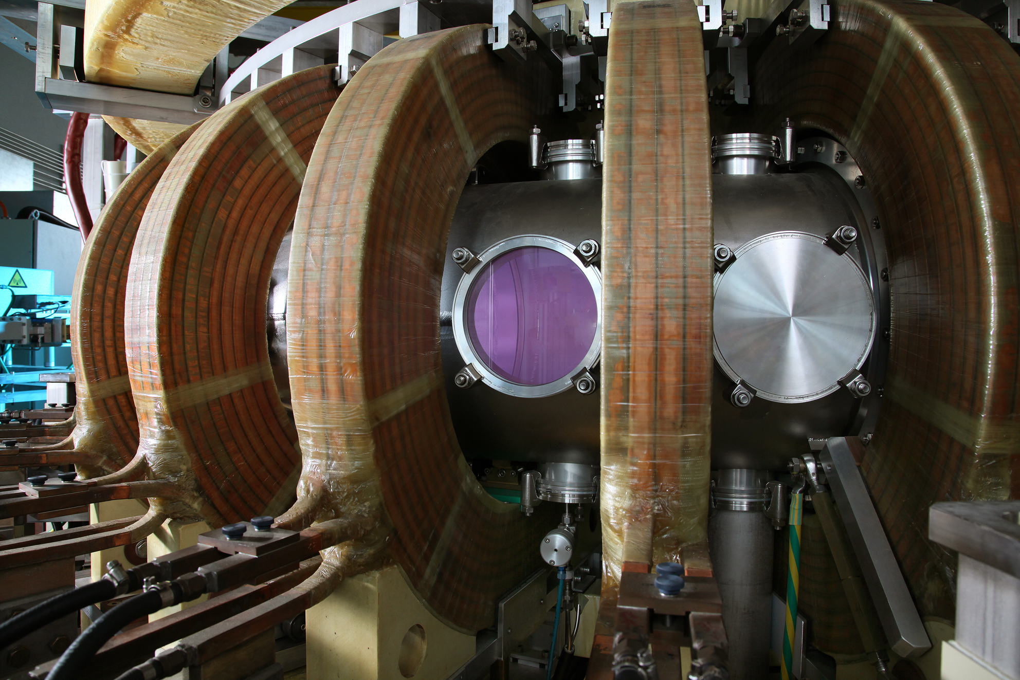
Future work
Missing ingredients for a complete description of plasma dynamics in TORPEX:
Use of more diagnostics: Mach probes, Triple probes or Bdot probes to compare other interesting observables.
Better source
modeling
Physics of neutrals
Better boundary conditions

Slide 38
V&V
A validation project requires a four step procedure:
(i) Model qualification
(ii) Code verification
(iii) Definition and classification of observables
(iv) Quantification of agreement

Slide 39
