Slide 1



Analysis of functional groups in atmospheric aerosols by infrared spectroscopy: ElnetPLS model
Matteo Reggente
Giulia Ruggeri
Adele Kuzmiakova
Satoshi Takahama
Swiss Federal Institute of Technology Lausanne
Ann Dillner
University of California, Davis

Slide 2
Nutshell
What: FT-IR analysis of ambient sample collected on Teflon filters.
Why:
Reduce the operating costs of large air quality monitoring networks and field campaigns.
Associate molecular structure to other aerosol measurements.
How: Statistical modeling, to retrieve relevant information.
ElnetPLS model.
Results from the IMPROVE network (US).
Nutshell
1/1

Slide 3
Background

Slide 4
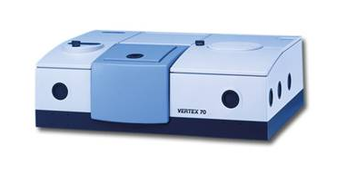
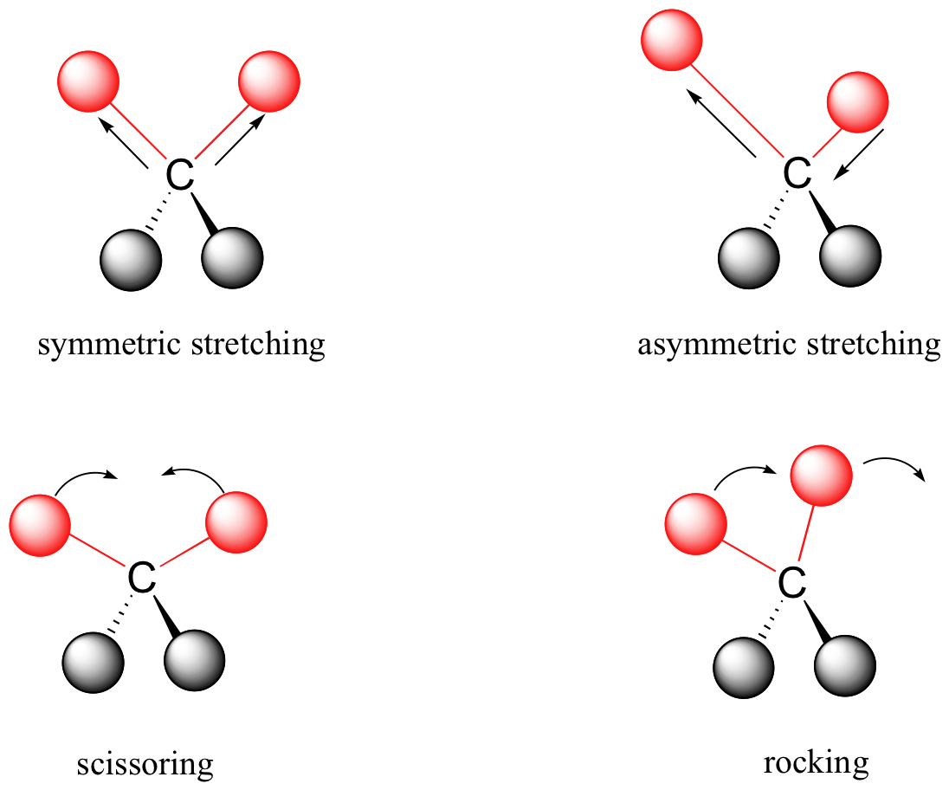
FT-IR spectroscopy
Measures absorption due to net change in dipole moment of vibrating/rotating molecules
Absorption is linearly related to abundance of a substance
Relatively inexpensive to own and operate
Requires advanced algorithms to process spectral information
FTIR spectrometer
Background
1/7

Slide 5
Data: Teflon/quartz filters collected in the IMPROVE network
3136 collocated ambient PM_{2.5} samples:
PTFE filters for FT-IR spectra analysis
Quartz filters for TOR OC
18 sites:
7 sites 2011
17 sites 2013
Dillner A. M. and Takahama S., AMT, 8, 1097-1109, 2015
Dillner A. M. and Takahama S., AMT, 8, 4013-4023, 2015
Reggente et al., AMT, 9, 441-454, 2016
Takahama et al., AMT, 9, 3429-3454, 2016
Kuzmiakova et al. AMT, 9, 2615-2631
Background
2/7

Slide 6
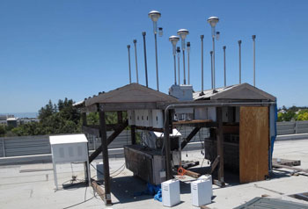

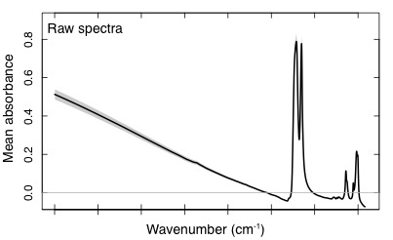
Data - Collection
Background
3/7

Slide 7
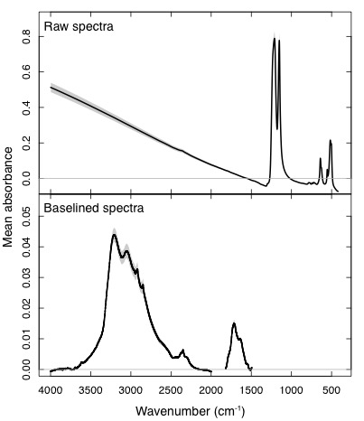
Data – Baseline correction
Teflon
scattering
Teflon
peak absorbance
Background
4/7

Slide 8
Data – Baseline correction
Teflon
scattering
Teflon
peak absorbance
Kuzmiakova et al. AMT, 9, 2615-2631
Background
4/7

Slide 9
Organic aerosols
Organic aerosols have many different sources
Complex mixtures of 10,000+ compounds
Carbon content commonly analyzed by thermal optical methods
Background
5/7

Slide 10
Organic aerosols
quantification
Background
6/7

Slide 11
ElnetPLS algorithm
GOAL: identify the most relevant infrared absorption bands that allow us to make quantitative predictions of TOR OC using FT-IR spectra
HOW: ?
Background
7/7

Slide 12
ElnetPLS algorithm
GOAL: identify the most relevant infrared absorption bands that allow us to make quantitative predictions of TOR OC using FT-IR spectra
HOW: Elastic net regularization
Background
7/7
Notes:
RSS: least square problem. Residual sum of squares
Lasso: sparseness constraints
Ridge: restrictions on the overall size of the regression vector

Slide 13
ElnetPLS algorithm
GOAL: identify the most relevant infrared absorption bands that allow us to make quantitative predictions of TOR OC using FT-IR spectra
HOW: Elastic net regularization and partial least square (PLS) regression
Background
7/7
Notes:
RSS: least square problem. Residual sum of squares
Lasso: sparseness constraints
Ridge: restrictions on the overall size of the regression vector

Slide 14
Results

Slide 15
TOR OC prediction, Full Spectra
Dillner A. M. and Takahama S., AMT, 8, 1097-1109, 2015
Reggente et al., AMT, 9, 441-454, 2016
Results
1/11

Slide 16
ElnetPLS model – Wavenumbers selected
10 Wavenumbers selected (blue vertical lines)
anhydride
carboxylic acid
aldehyde
ketone
Results
2/11

Slide 17
TOR OC prediction, Full Spectra Vs. ElnetPLS model
Full Spectra
10 wavenumbers
Results
3/11

Slide 18
TOR OC prediction, Full Spectra Vs. ElnetPLS model
Full Spectra
10 wavenumbers
Results
3/11

Slide 19
TOR OC prediction, Full Spectra Vs. ElnetPLS model
Full Spectra
10 wavenumbers
Results
3/11

Slide 20
TOR OC prediction, Calibration 2011 – Test 2013 Addl
Full spectra
10 wavenumbers
(box denotes
calibration range)
Using only the original set of samples, eliminate uninformative wavelengths that interfere with predictions.
Results
4/11

Slide 21
Past studies: aCH
Past studies (e.g. ) show that alkane CH (aCH) should contribute a significant amount of OM mass fraction
IMPROVE 2011, 6 sites
Ruthenburg et al. , Atmos. Environ., 86, 46-57, 2014
Results
6/11

Slide 22
aCH Vs. ElnetPLS wavenumbers
aCH
aCH
carbonyl
Results
7/11

Slide 23
Why can we predict aCH?
Why can we predict aCH without using absorption bands associated with it?
Hypothesis:
Mass is explained by several polyfunctional molecules.
We are able to predict aCH and other mass in the same polyfunctional molecule by their association with carbonyl.
Results
8/11

Slide 24
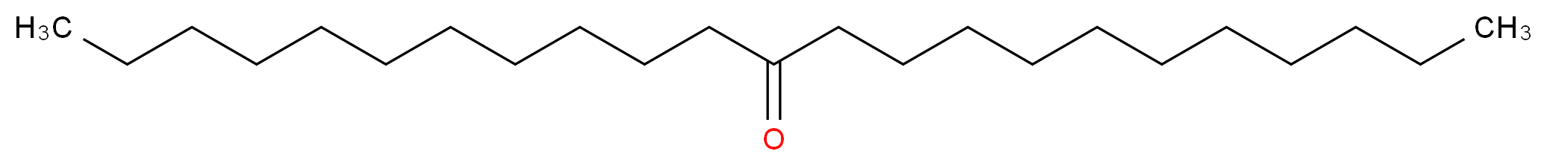
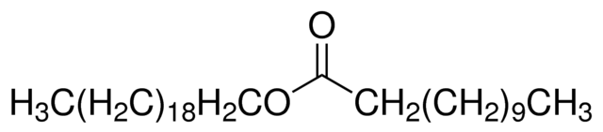
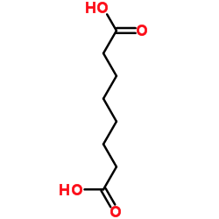
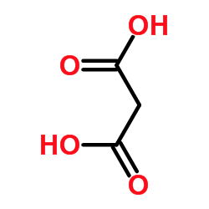
Prediction of aCH in polyfunctional compounds (laboratory standards)
12-Tricosanone (Ketone): 1 carbonyl and 44 CH
Arachidyl dodecanoate (Ester): 1 carbonyl and 62 CH
Suberic acid: 12 carbonyl and 2 CH
Malonic acid: 2 carbonyl 2 CH
Results
9/11

Slide 25
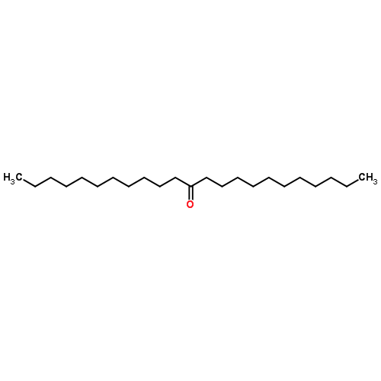
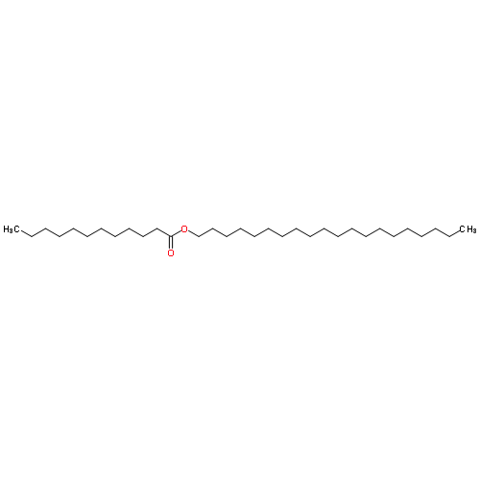
Prediction of aCH in lab standards
Ketone and ester
12-Tricosanone (Ketone): 1 carbonyl
44 CH
Arachidyl dodecanoate (Ester):
1 carbonyl
62 CH

Slide 26
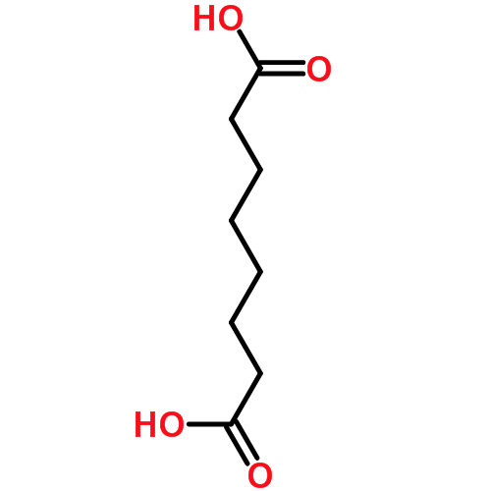
Prediction of aCH in lab standards
Dicarboxylic acids
Suberic acid:
2 carbonyl
12 CH
Malonic acid:
2 carbonyl
2 CH

Slide 27
Prediction of aCH in polyfunctional compounds (laboratory standards)
Results
11/11

Slide 28
Summary
We predict accurately TOR OC measurements by FTIR spectra of ambient samples collected on Teflon filters (18 sites, 3136 samples).
Predictions based on only 10 wavenumbers (0.5% of the whole spectra) have similar or better performance of model that uses the whole spectra 2784 wavenumbers.
The ElnetPLS model has the potentiality to eliminate uninformative wavelengths that interfere with predictions.
Mass of PM_{2.5} OM in these samples are dominated by a few polyfunctional molecules.
We are able to predict aCH and other mass in the same polyfunctional molecule by their association with carbonyl.
The 10 wavenumbers selected are in carbonyl region of the spectra and they seems to be informative enough to predict masses from different compounds.
Summary
1

Slide 29

Presentations
O45-BAP-AC-17: Computational tools for functional group analysis of organic aerosols.
Friday 09/09/2016 14:40, Room 3
P3-BAP-AC-007 An Automated Baseline Correction Method for Atmospheric Aerosol Infrared Spectra Collected on Polytetrafluoroethylene (Teflon) Filters.
Thursday 08/09/2016. Poster session: Basic Aerosol Processes - Aerosol Chemistry.
Thank you

Slide 30
Prediction of aCH in polyfunctional compounds (laboratory standards)
12-Tricosanone (Ketone): 1 carbonyl and 44 CH
Arachidyl dodecanoate (Ester): 1 carbonyl and 62 CH
Suberic acid: 2 carbonyl and 2 CH
Malonic acid: 2 carbonyl 2 CH
Results
10/11

Slide 31
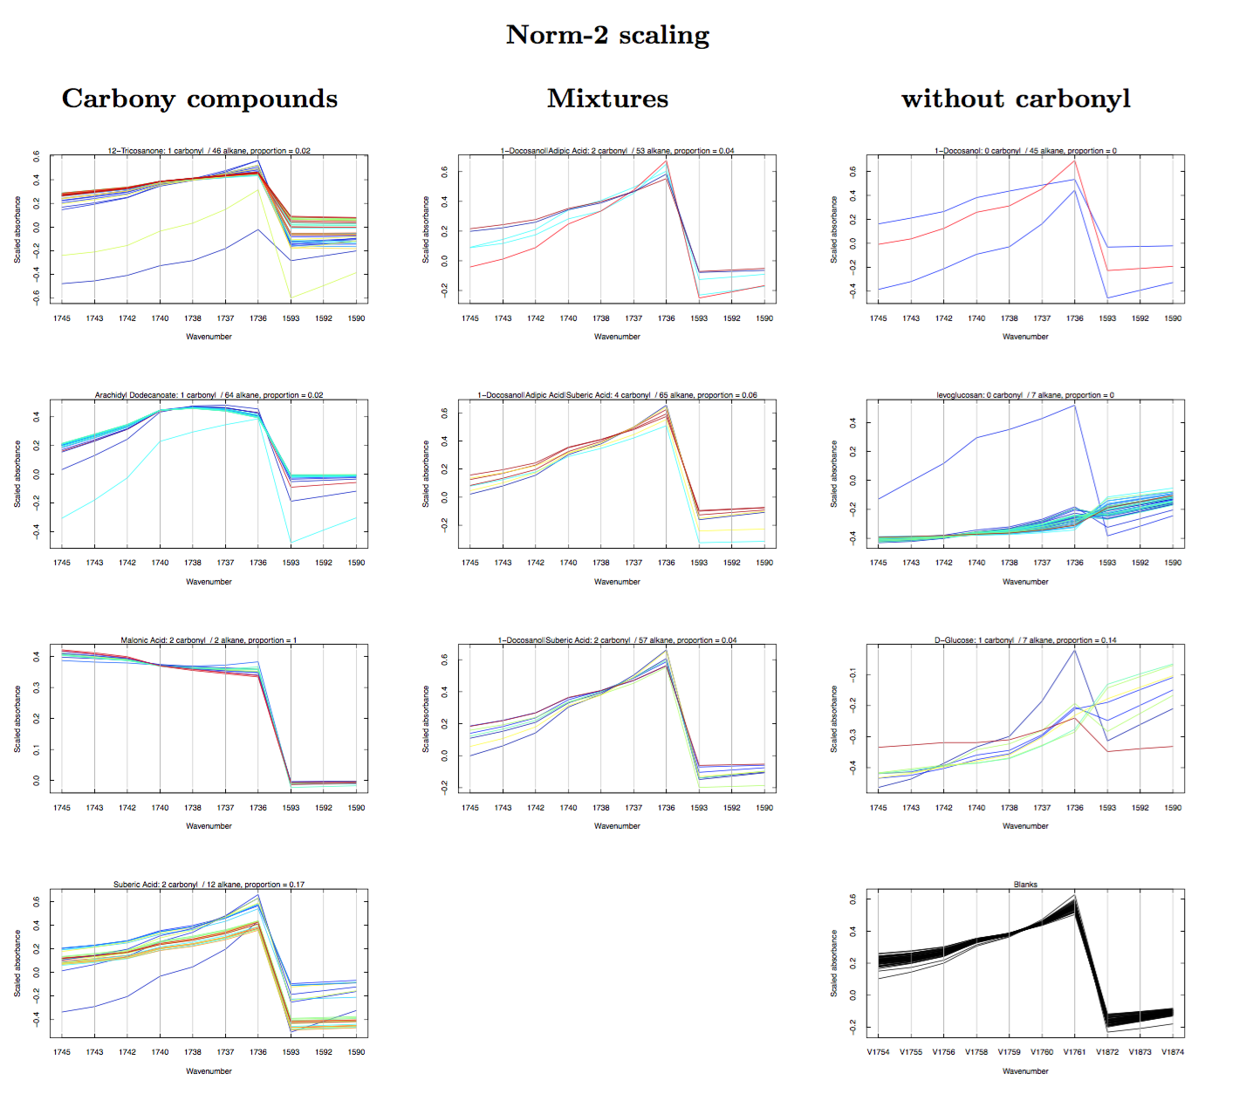
Lab standards – aCH – Parrcoord Plot

Slide 32
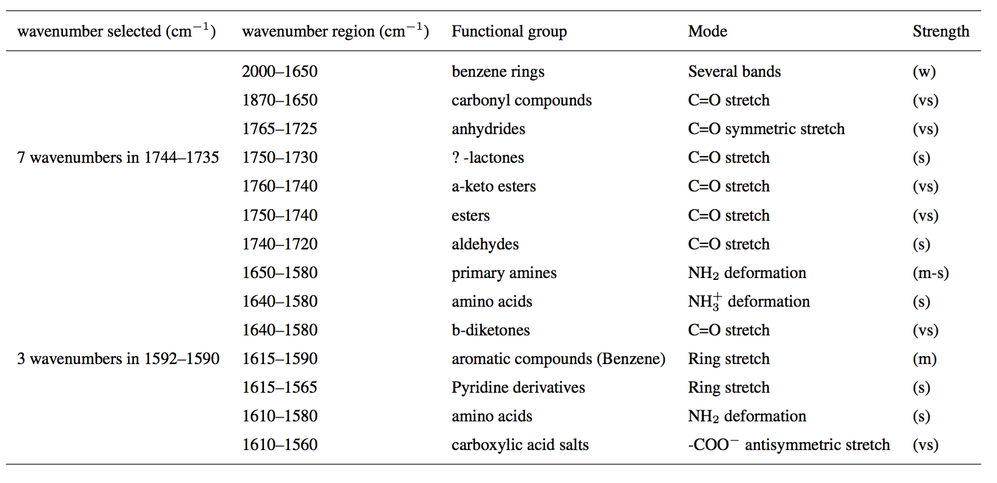
10 wavenumbers → simpler interpretation
Shurvell, H.: Spectra–Structure Correlations in the Mid-and Far-Infrared, Handbook of vibrational spectroscopy, 2002

Slide 33
TOR OC prediction – Rural Samples
Results
1/2

Slide 34
TOR OC prediction – Urban Samples
Results
1/2

Slide 35
TOR OC prediction – 14 wavenumbers model
Results
1/2

