Slide 1


Scrape-off-layer turbulence and flows in different limiter configurations
Joaquim Loizu
joaquim.loizu@ipp.mpg.de
P. Ricci, F. Halpern, S. Jolliet, A. Mosetto
EPS conference, Lisbon, Portugal, June 23rd 2015

Slide 2
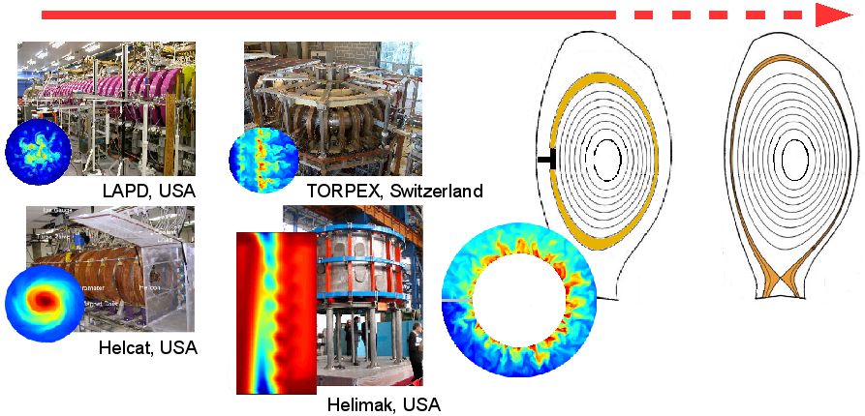
GBS: a tool to simulate open-field-line turbulence
The Global Braginskii Solver [1] is a 3D, global, flux-driven, turbulence code that solves the electromagnetic drift-reduced Braginskii equations with magnetic presheath boundary conditions [2].
[1] Ricci et al, Plasma Physics and Controlled Fusion 54, 124047 (2012)
[2] Loizu et al, Physics of Plasmas 19, 122307 (2012)

Slide 3
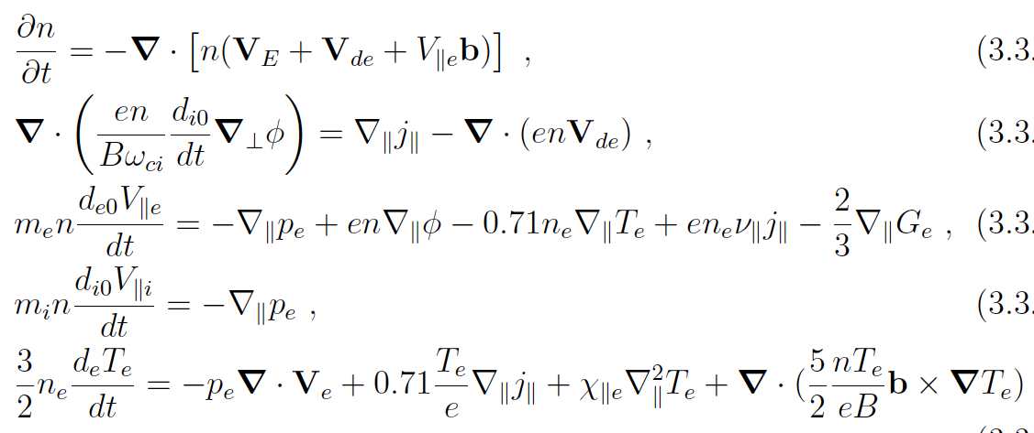

Example: electrostatic DRB equations with cold ions
continuity
. j = 0
Δ
Ohm’s law
momentum
heat
with boundary conditions for at the magnetic presheath entrance,
where the ion-drift-approximation, , breaks down.
[Loizu et al, PoP 2012]

Slide 4
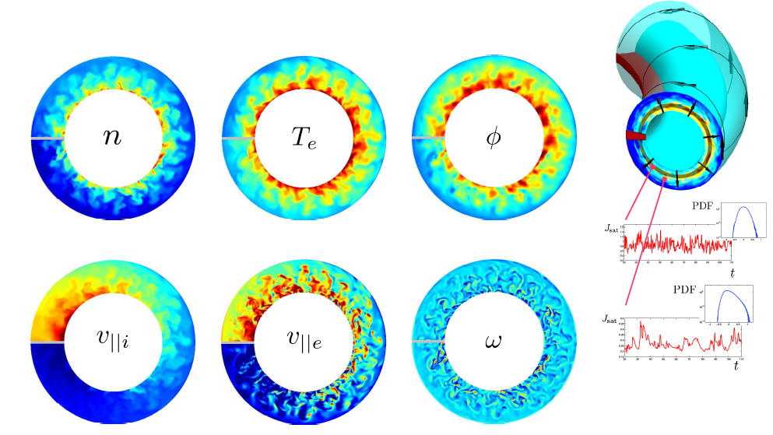
3D scrape-off-layer turbulence simulations
Quasi-steady state is reached as a balance between plasma
source from the core, cross-field transport, and parallel losses.

Slide 5
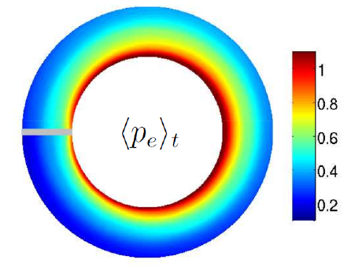
The SOL width is not poloidally symmetric
L_{p}
L_{p}
A sign of ballooning-dominated turbulence

Slide 6
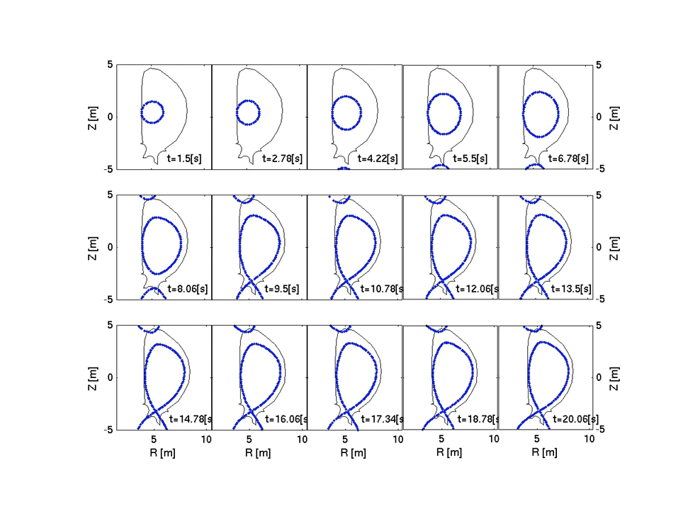
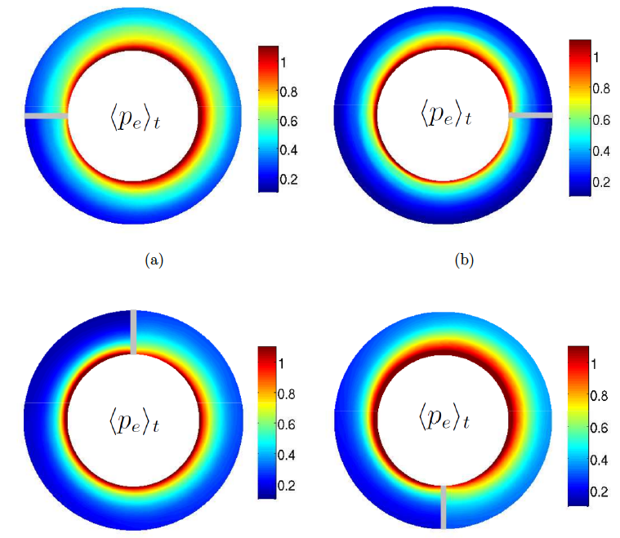
The limiter position substantially modifies the SOL width
Important for ITER start-up
HFS- or LFS-limited?

Slide 7
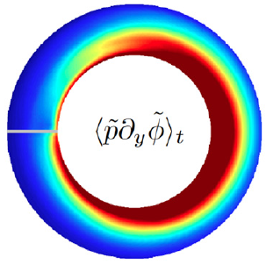
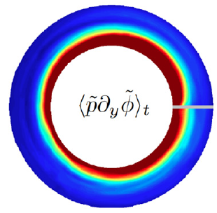
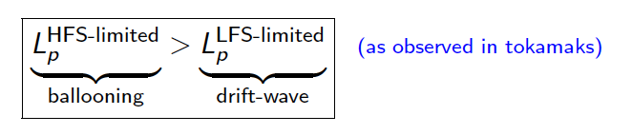
The limiter position substantially modifies the SOL width
HFS
LFS
HFS
Turbulent flux
Turbulent flux
Phase difference
(n, φ) ≈ 90° (ballooning)
Phase difference
(n, φ) ≈ 0° (drift-wave)
[Loizu et al, Nuclear Fusion 2014]

Slide 8
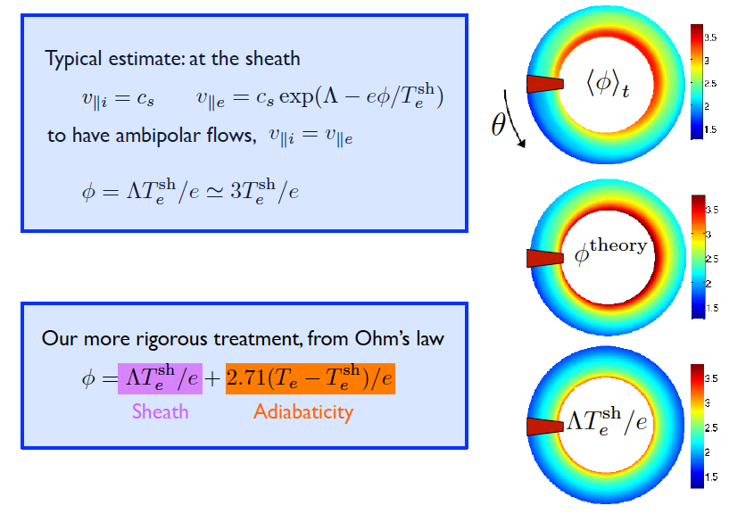
Which mechanism determines E_{r} ?
dominates in
convection-limited regimes
dominates in
conduction-limited
regimes
[Loizu et al, PPCF 2013]

Slide 9
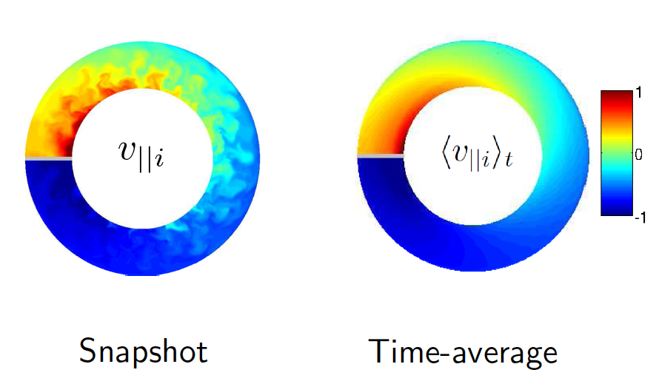
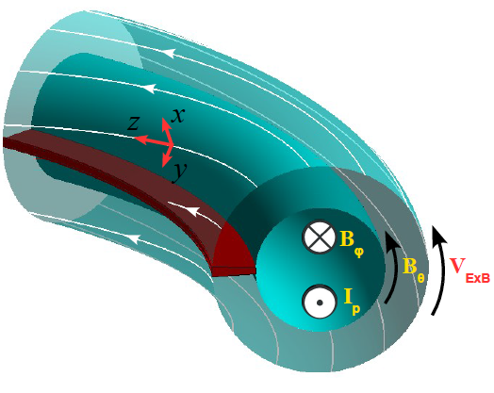

Intrinsic flows are estabished in the SOL
Magnetic presheath explains
co-current rotation
There is a volume-averaged co-current toroidal rotation

Slide 10
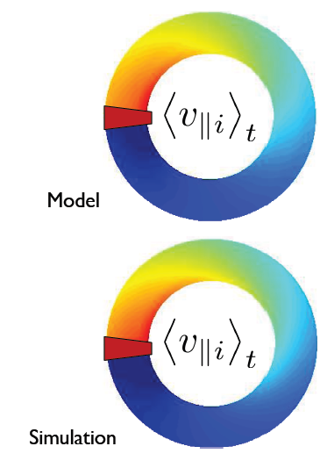
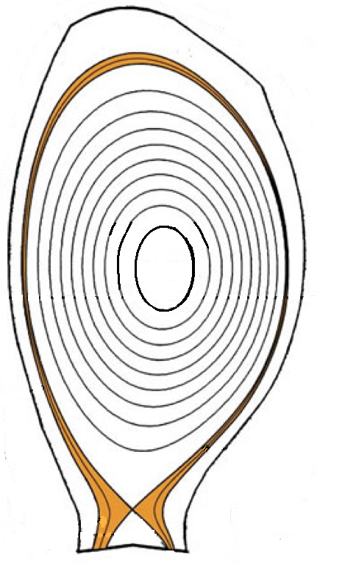
A theory of SOL rotation
From the momentum equation:
Time
derivative
Parallel
convection
ExB transport
Pressure gradient
Express mean ExB transport:
Can be estimated from
first-principles using
gradient-removal
saturation of the mode
[Loizu et al, PoP 2014]
B_{ϕ} = σ_{ϕ}|B_{ϕ}|ϕ
2D equation for mean flow:
(assuming are known)

Slide 11

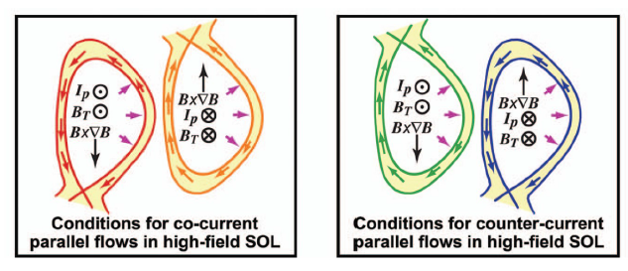

Analytical solution consistent with observed trends
Mach number far from the limiter/divertor:
Core coupling
Sheath contribution
Pressure poloidal asymmetry due to ballooning transport
Sheath term
always co-current
Asymmetry term
reverses with
- toroidal field B_{ϕ}
- limiter/X-point position
[LaBombard et al, PoP 2008]
[Loizu et al, NF 2014]

Slide 12
A bird’s eye view
The SOL width can be substantially modified by the limiter position due to a change in the turbulence regime.
HFS-limited plasmas: BM dominate, larger width
LFS-limited plasmas: DW dominate, smaller width
The SOL electrostatic potential results from a combined effect of sheath physics and electron adiabaticity. We expect that:
Sheath dominates in convection-limited regimes
Adiabaticity dominates in conduction-limited regimes
SOL intrinsic toroidal rotation is driven by the sheath and pressure asymmetries, and transported by turbulence.
Sheath: always co-current rotation
Pressure asymmetries: co/counter current and explain flow reversals

Slide 13
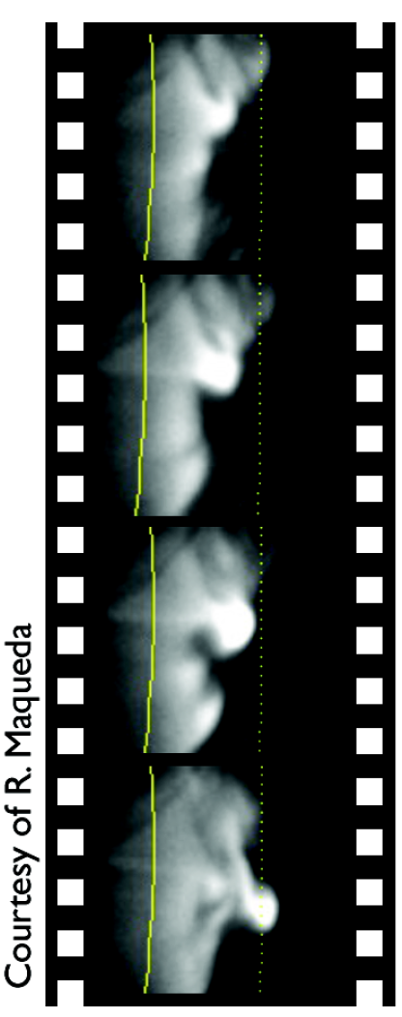
Typical properties of open-field-line plasmas
Collisional magnetized plasma.
n_{fluc} ~ n_{eq}
L_{fluc} ~ L_{eq}
Low-frequency modes ω << ω_{ci} .
Plasma losses at the sheaths.

Slide 14
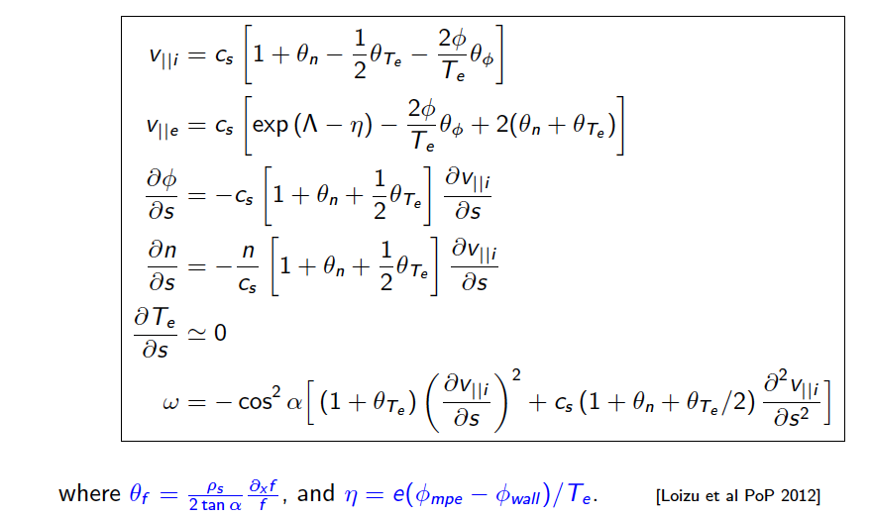
Summary of the boundary conditions

Slide 15

Magnetized plasma turbulence via drift-fluid models
Starting from the Braginskii equations…
Quasi-neutrality n_{e} ≈ n_{i} is assumed.
The limit of a strongly magnetized plasma is taken, ω_{ce} τ_{e} >> 1 .
A drift ordering is adopted, d/dt << ω_{ci} , leading to the ion-drift-approximation.
e.g. for cold ions:
…the Drift-Reduced-Braginskii (DRB) equations are derived.

Slide 16
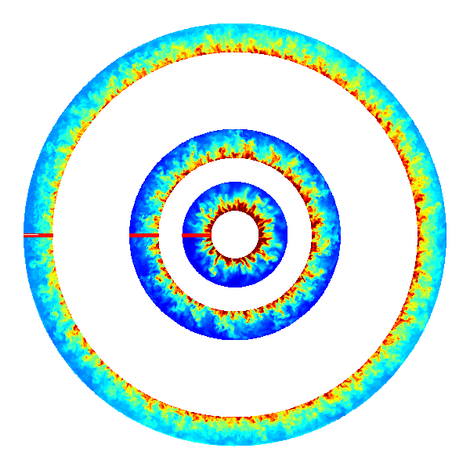



GBS has been used to simulate real-size tokamaks
ISTTOK
C-Mod
TCV

Slide 17
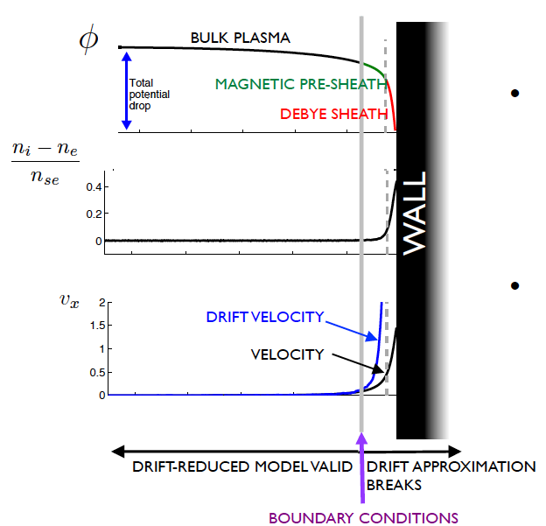

Boundary conditions at the plasma-wall interface
Kinetic simulations of the plasma-wall transition [1,2] reveal that the DRB equations breakdown at the entrance of the magnetic presheath.
Boundary conditions at the magnetic presheath entrance have been derived analytically for all the fluid quantities [2].
ρ_{s}
[1] Loizu et al, Physical Review E 83, 016406 (2011)
[2] Loizu et al, Physics of Plasmas 19, 122307 (2012)

Slide 18
The SOL width can be estimated theoretically
L_{p}
Bohm’s
BM
Removal of driving gradient
Nonlocal linear theory,
[Ricci and Rogers, Physics of Plasmas 16, 062303 (2009)]
BM

Slide 19
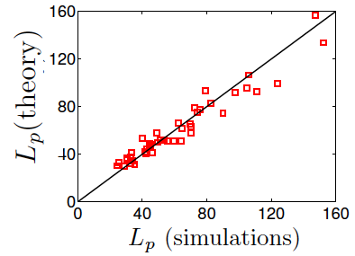
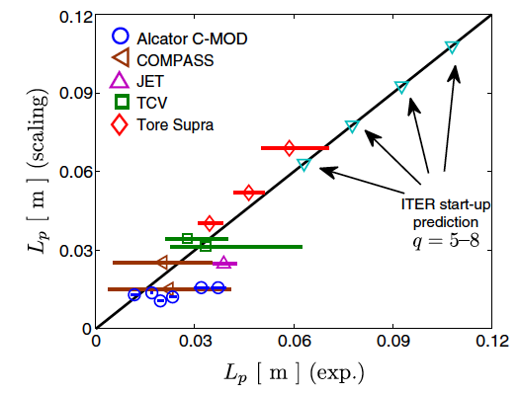
The SOL width can be estimated theoretically
In SI units:
[Halpern et al, Nuclear Fusion 2013; Nuclear Fusion 2014]

Slide 20
The limiter position substantially modifies the SOL width
HFS
LFS
HFS

Slide 21
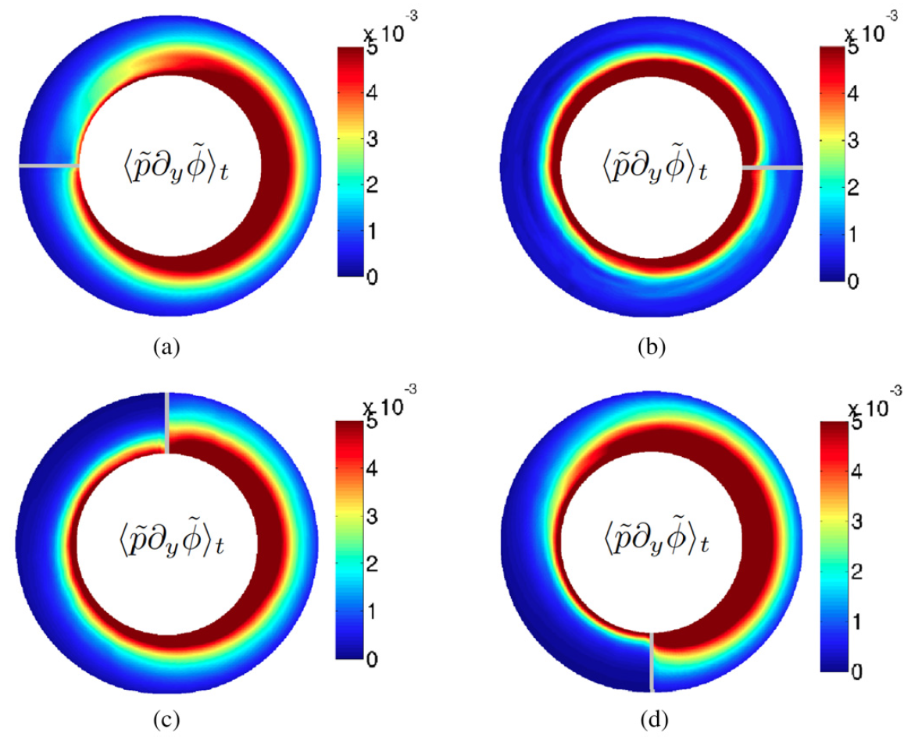
The limiter position can modify the turbulent regime
Phase difference
between n and φ
is ≈ 90° (ballooning)
Phase difference
between n and φ
is ≈ 0° (drift wave)
Phase difference
between n and φ
is ≈ 90° (ballooning)
Phase difference
between n and φ
is ≈ 90° (ballooning)

Slide 22
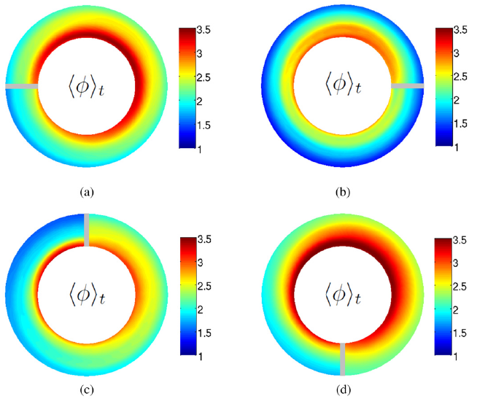
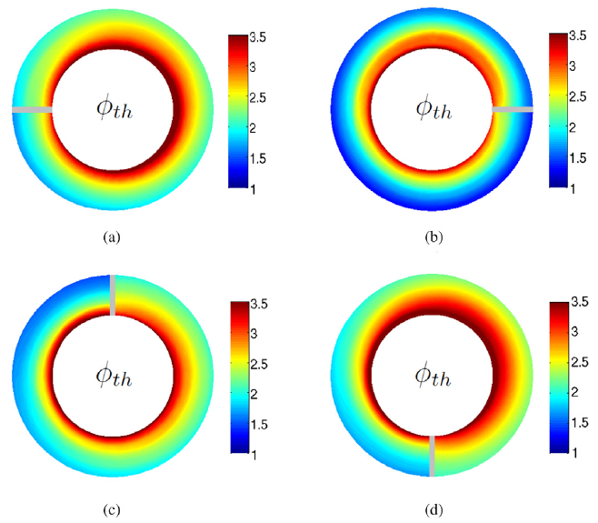
The limiter position affects poloidal structure of E_{r}
GBS simulations
Analytical model
[Loizu et al, Nuclear Fusion 2014]

