Slide 1
(a)
(b)
(c)
Fig.S1. Plot of c(I_{y}) projection as function of θ_{tot} at the end of D¹⁰_{N} scheme for N = 2 (a), 3 (b) and 4 (c). The other simulation parameters are identical to those of Fig.4.

Slide 2
(a)
(b)
(c)
(d)
(e)
Fig.S2. Plot of c(I_{y}) and c(I_{z}) projections as well as ||⟨σ(t)⟩|| norm as function of θ_{tot} at the end of D¹⁰_{N} scheme for ν₁ = 227 kHz and N = 1 (a,b), 2 (c), 3 (d), and 4 (e). The other parameters are identical to those of Fig.4. The D¹⁰_{N} pulses are rotor-synchronized, except in (a), where the period of the D¹⁰₁ pulse train is 16.722 μs = 1/59.8 kHz, a delay which is slightly longer than one rotor period (16.667 μs).

Slide 3
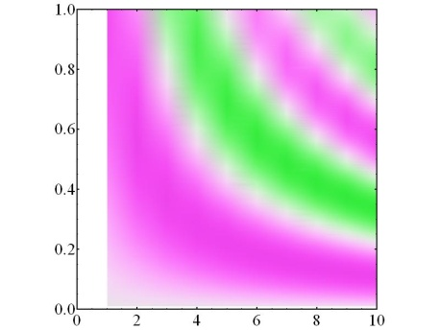
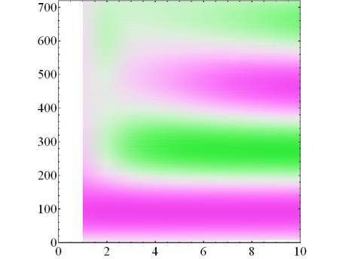
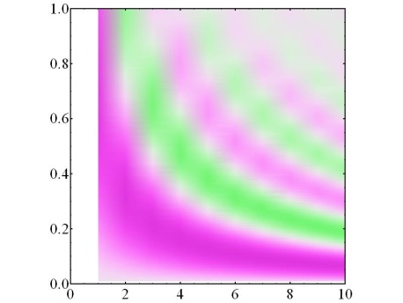
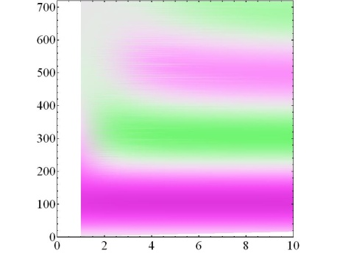
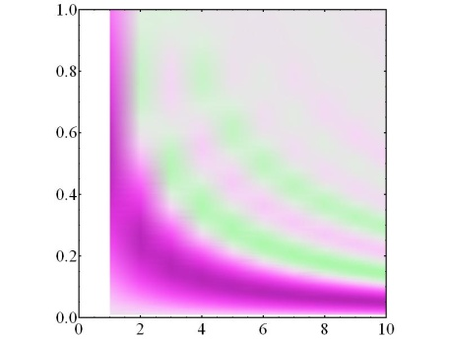
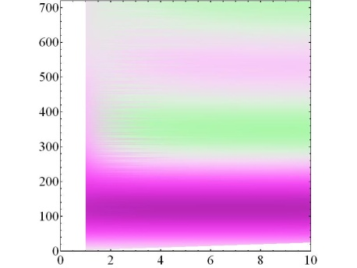
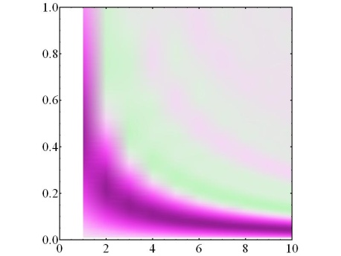
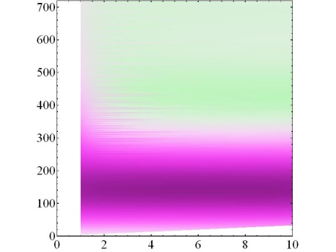
Int*1
Int*2
Int*3
Int*4
Int*1
Int*2
Int*3
Int*4
(a)
(b)
(c)
(d)
(e)
(f)
(g)
(h)
+
2
1
0
-1
-2
+
τ_{P}(μs)
+
θ_{tot}(º)
+
k
k
Fig.S3. Plot of NII_{norm} as function of K and τ_{p} (a-d) or K and θ_{tot} (e-h) at the end of D^{K}_{N} scheme for ν₁ = 227 kHz and N = 1 (a,e), 2 (b,f), 3 (c,g), and 4 (d,h). II_{norm} was calculated according to Eq.4. The other simulation parameters are identical to those of Fig.2.

Slide 4
D⁵₁
(a)
α = 1.21
(b)
α = 1.21
(c)
α = 1.16
(d)
-1000 -480 -240 0 240 480 1000 (kHz)
Fig.S4. Comparison between the ¹⁹F simulated spectra excited by D⁵_{N} sequence (in black) and (b-d) the Σ⁵_{N} sum (in red) of the N individual trains of D⁵_{N} sequence. B₀ = 18.8 T, ν_{R} = 60 kHz, ν₁ = 29 kHz, θ_{tot} = 90°,and (N, τ_{p} (μs)) = (1, 1.72) (a), (2, 0.86) (b), (3, 0.573) (c) and (4, 0.43) (d). To facilitate the comparison, the D⁵_{N} spectra are shifted to the left in (b-d) and are multiplied by the scaling factor, α, as indicated above the spectra.

Slide 5
(a)
α = 1
(b)
α = 1
(c)
α = 1
(d)
-1000 -480 -240 0 240 480 1000 (kHz)
Fig.S5. Comparison between the ¹⁹F simulated spectra excited by D⁵_{N} sequence (in black) and (b-d) the Σ⁵_{N} sum (in red) of the N individual trains of D⁵_{N} sequence. B₀ = 18.8 T, ν_{R} = 60 kHz, ν₁ = 29 kHz, θ_{tot} = 15°, and (N, τ_{p} (ns)) = (1, 290) (a), (2, 145) (b), (3, 96) (c) and (4, 72) (d). The D⁵_{N} spectra are shifted to the left in (b-d) and scaled by the factor α indicated above the spectra.

Slide 6
D⁵₁
(a)
α = 1.24
(b)
α = 1.22
(c)
α = 1.17
(d)
-1000 -480 -240 0 240 480 1000 (kHz)
Fig.S6. Comparison between the ¹⁹F simulated spectra excited by D⁵_{N} sequence (in black) and (b-d) the Σ⁵_{N} sum (in red) of the N individual trains of D⁵_{N} sequence. B₀ = 18.8 T, ν_{R} = 60 kHz, ν₁ = 227 kHz, θ_{tot} = 90°, and (N, τ_{p} (ns)) = (1, 220) (a), (2, 110) (b), (3, 73) (c) and (4, 55) (d). The D⁵_{N} spectra are shifted to the left in (b-d) and scaled by the factor α indicated above the spectra.

Slide 7
D⁵₁
(a)
α = 1.14
(b)
α = 1.12
(c)
α = 1.12
(d)
-1000 -480 -240 0 240 480 1000 (kHz)
Fig.S7. Comparison between the ¹⁹F simulated spectra excited by D⁵_{N} sequence (in black) and (b-d) the Σ⁵_{N} sum (in red) of the N individual trains of D⁵_{N} sequence. B₀ = 18.8 T, ν_{R} = 60 kHz, ν₁ = 7.5 kHz, θ_{tot} = 90°, and (N, τ_{p} (μs)) = (1, 6.66) (a), (2, 3.33) (b), (3, 2.22) (c) and (4, 1.66) (d). The D⁵_{N} spectra are shifted to the left in (b-d) and scaled by the factor α indicated above the spectra.

Slide 8
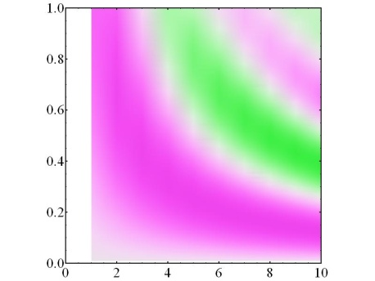
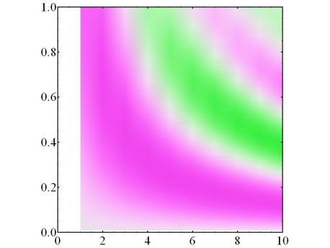
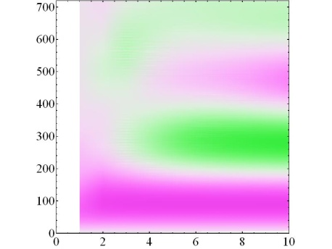
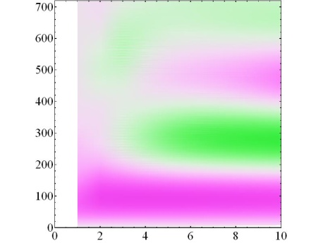
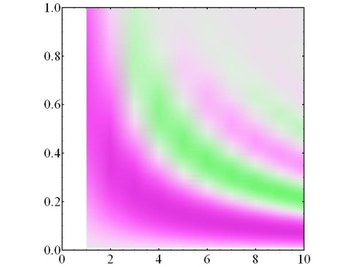

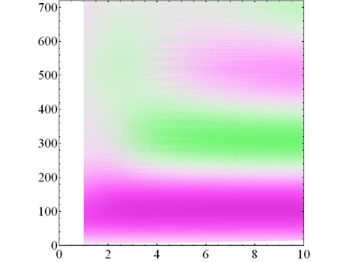

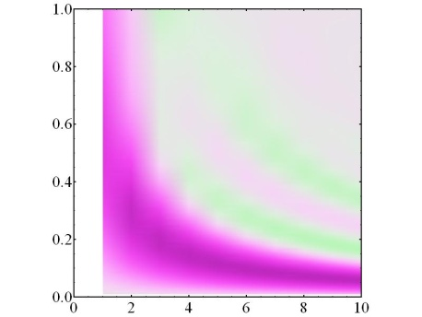

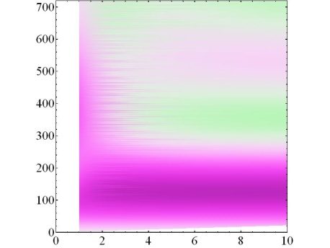
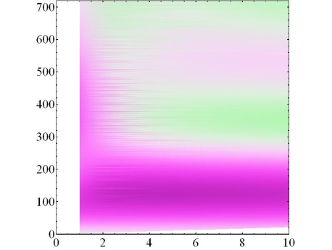

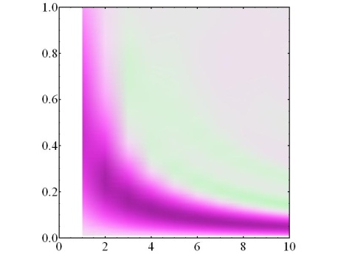
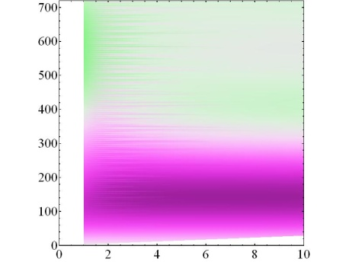

Int*1
Int*2
Int*3
Int*4
Int*1
Int*2
Int*3
Int*4
Int*1
Int*2
Int*3
Int*4
Int*1
Int*2
Int*3
Int*4
(a)
(b)
(c)
(d)
(e)
(f)
(g)
(h)
(i)
(j)
(k)
(l)
(m)
(n)
(o)
(p)
+
+
2
1
0
-1
-2
+
+
τ_{p} (μs)
+
+
θ_{tot} (º)
+
K
+
K
K
K
Fig.S8. Plot of NII_{norm} as function of (a-h) K and τ_{p} or (i-p) K and θ_{tot} at the end of D^{K}_{N} scheme for ν₁ = 200 kHz and N = (a,e,i,m) 1, (b,f, j,n) 2, (c,g,k,o) 3, (d,h,l,p) and 4. II_{norm} was calculated according to Eq.4. In (a-d) and (i-l), only 1st-order quadrupole interaction is considered, whereas in (e-h) and (m-p), both 1st- and 2nd-order quadrupole interactions are considered. The other simulation parameters are identical to those of Fig.8. In (a-d) the crosses correspond to K = 5, τ_{p} = 0.25, 0.15, 0.13, 0.11 for N = 1, 2, 3, 4, respectively.

Slide 9
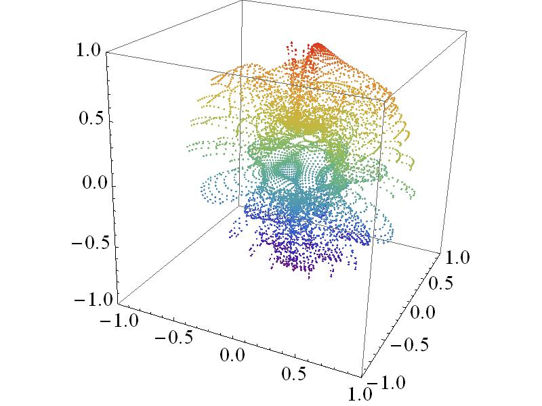

B⁰
(a)
(b)
β
α
Fig.S9. Plot of II_{norm} for a D₂¹¹ sequence as function of the polar angles {α_{PL}, β_{PL}}. The simulations are performed for an isolated ¹⁴N nucleus subject to 1st- and 2nd-order quadrupole interaction with C_{Q} = 1.18 MHz, η_{Q} = 0.5, ν₁ = 50 kHz, θ_{tot} =110°, and (τ_{p} (ns), B₀ (T)) = (277, 18.8) (a), (277, ∝) (b). The other simulation parameters are identical to those of Fig.11. The colors in the figures come from the “Rainbow” function in Mathematica software. They have no real physical meaning, but are used to help the reader to have an easy 3D interpretation.

