Slide 1
www.climate-diamond.eu
SESTEF 2024
11-13 December 2024
Paris
Trade War to Cooperation:
Scrutinizing China’s Strategies to the EU Carbon Border Adjustment Mechanism
Sigit Perdana*, Marc Vielle*, Ru Li**
*Ecole Polytechnique Fédérale de Lausanne (EPFL), Switzerland
** Chengdu University of Technology, China

Slide 2

Background & Research Aims
EU Fit 55 & Climate Neutrality
Critics:
Potential Barrier to Global Trade;
An unequal Burden on Non-EU;
Unfairly Disadvantage Developing Economies.
Carbon Border Adjustment Mechanism (CBAM)
Iron, steels and aluminum are vitals;
Hard to Abate Sectors;
Challenges in Meeting Mitigation Target:
Coal Dominated Energy Structure
Alignment with Economic Growth
Focus on China
Notes:
… vitals: 2020, China produce 57% of global steel productions and 60% of global aluminum production.
…hard to abate: re: survey tech to abate: iron ore electrolysis
Coal: Coal is difficult to replace in SR. Consumption decline 70 to 50% but production reaching its peak in 2022
Alignment: China still emerging and energy demand are still in growth period
All these factors : potential repercussion of CBAM to their export

Slide 3
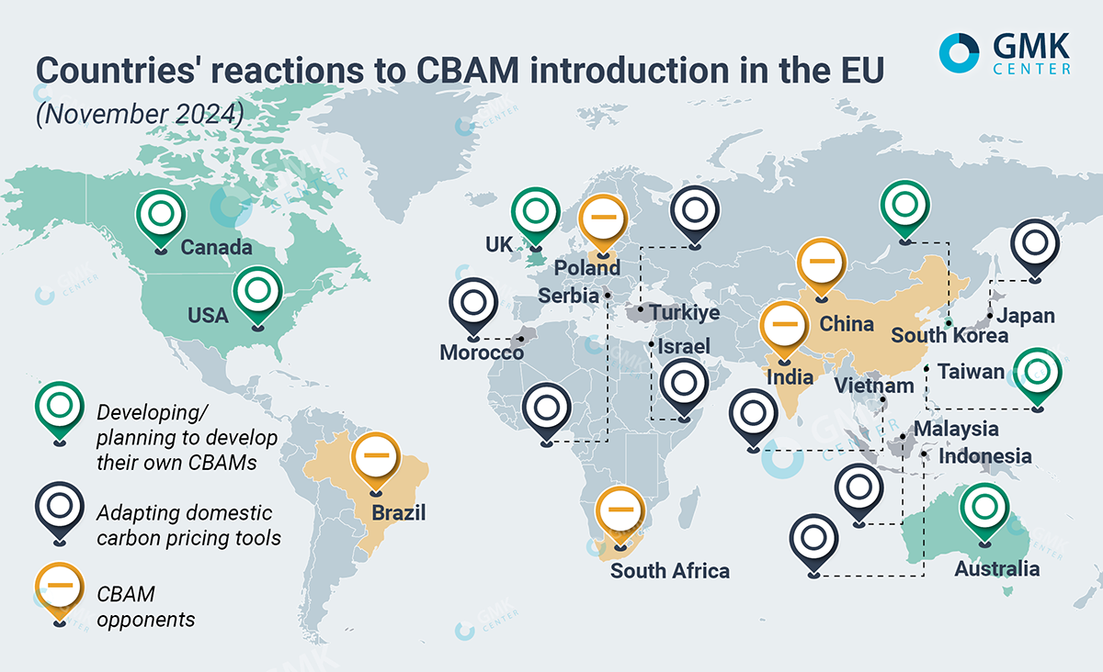
CBAM the Day After

Slide 4
Background & Research Aims
CBAM
China
EU
Potential Trade Retaliation
Trade Gap : EU Import > EU Export
EU CBAM increases cost → straining trade relation;
Security Related Friction → control services & tech;
US vs China Trade War → EU vs China ?
Analysis on EU CBAM to China
Scrutinizing China’s potential counter-policies
Retaliatory Measures
Cooperative Measures
Notes:
CBAM: increase trade complexity EU – China
Why: Because of historical trade imbalance : EU M > EU X
Two elements cause EU China Trade war – Unfair Trade Practice and Constraint Market Access
Cooperative Measure: comply and do green

Slide 5
Methods
China Export to the EU – CBAM Related Products
GEMINI-E3 Model
(Bernard & Vielle, 2008)
Database:
GTAP 10 (Aguilar et al. 2019);
CD-Link (McCollum et al. 2018; Roelfsema et al. 2020);
IEA (2020) ;
Isolating CBAM Sectors essential for China:
Ferrous Metal, Metal Nec.
Baseline is constructed based on the current policy
EU: Prior to Fit for 55
China: Some Updates (Recent Development)
Source: General Administration of Customs of People's Republic of China
Notes:
90% of CBAM related commodity from China Export to EU are iron stell & aluminum

Slide 6
Reference Scenario
China Update!
CO₂ emissions in Mt - Current policies scenario
Ding (2022) and Liu et al. (2022):
25% share of non-fossil energy in total primary energy consumption by 2030;
29% electric vehicles of the overall vehicular landscape by 2030;
39% share of non-fossil energy for electricity generation by 2025;
Wei et al., 2022
GDP growth:
5.3% from 2021 to 2025,
4.9% from 2026 to 2030
4.5% from 2030 to 2040
Notes:
GDP assumption higher that current WEO projection
Implementation of ETS on ely at national scale since 2021
CO2 decline before 2030, inline with NDC

Slide 7
EU Fit 55 Scenarios
Main results of the fit for 55 scenarios without and with CBAM – Year 2040*
EU CBAM:
alleviates negative impact of EU Steel & Aluminum production;
China Production decline: 14 Billion USD relative to Fit for 55 Scenario
* relative to the Reference Scenario
** Household Consumption
Notes:
Fit for 55
EU Cost 1.72% of GDP
Prod decline 4.64%
For China: Impact rather limited
When CBAM implemented: EU production alleviated
China export fall

Slide 8
China Counter Policy Action: (1) Retaliation
Trade Retaliation Scenarios
(Million USD– Year 2040)*
Target: restore the production to the level prior to EU CBAM
Duties on Import from EU: China Imports fall, mostly from EU
Subsidizing Export: Export rise-up, advantages for Non-EU, costly for China
Subsidizing Production: limited effect to foreign trade, mostly for domestic demand.
* relative to the fit for 55 CBAM Scope 2
Notes:
Import fall, export fall but far less, production restored, welfare positive

Slide 9
China Counter Policy Action: (2) Cooperation
CO₂ Emissions Compensation Scenarios
(Million USD– Year 2040)*
Target: Exempted by EU: Buying credits from ETS
Compensating Direct CO2:
ETS price goes up (20 USD in 2040),
Production substantially fall
Partial exemption increases China Exports to EU, but higher market price reduce competitiveness
Compensating Direct CO2 but only to EU:
Non-penalizing Non –EU and Domestic: Export to EU increases
Minimum effects to abatement
Compensating Full CO2 but only to EU : Stronger impacts than previous option
China Remittance of EU CBAM dues
Producers incorporate this into selling price, avert price escalation within EU Market
* relative to the fit for 55 CBAM Scope 2

Slide 10
China Counter Policy Action: (2) Cooperation
Green Electricity Scenarios
(Million USD– Year 2040)*
Target: Exempted by EU: Use Renewable in Power Generation
Green Electricity:
Exports to EU goes up, but competitiveness loss
Production fall, mostly from the decrease in domestic demand.
Fall in Coal price induces demand, improves welfare
Green Electricity but only to EU:
No competitiveness issue: both production and export increase
Insignificant Emission reduction
* relative to the fit for 55 CBAM Scope 2
Notes:
Try to capture China Deep decarbonization strategy for Steel
For this we use LCOE from China Nuclear Agency 2020. LCOE Renewable > Coal
Green Ely only to EU? Is it Feasible? Yeah, EU only need green certificate.

Slide 11
Main Findings
Notes:
Focusing retaliatory measures to EU by imposing duties on import from EU → max welfare

Slide 12
Main Findings
Two potential strategic reactions from China
Resource Shuffling ➔ reallocation of global trade
Trade Retaliation ➔ going to a Trade War with EU
Options for limiting such reactions
Collective CBAM ( UK will implement CBAM, Canada, Australia countries regions)
Mutual agreement on carbon pricing ⇨ Extending & merging ETS
Initiate discussion and cooperation at the industrial level, e.g.: “Global arrangement on sustainable steel and aluminum”
Notes:
In line with Nordhaus Study 2015 about climate club, and also our paper for collective implementation of CBAM
As more country join coalition, incentives to reduce resources shuffling goes down.

Slide 13



Sigit Perdana
sigit.perdana@epfl.ch
Marc Vielle
marc.vielle@epfl.ch
Ru Li
liru@cdut.edu.cn
climatediamond
climatediamond
climatediamond

Slide 14
Policy Recommendation
1
Resources Shuffling
Collective CBAM
Coordination & Harmonization
A
TCA with UK
CAI with China
Leveraging Trade Agreement (TA):
Platform Integrating CBAM
Current TA
On Going TA
US, Australia, India, Singapore
B
Enhance Collaboration
International Forum such as Carbon Pricing Leadership Coalition – Promote Adoption of Carbon Pricing, including CBAM
Notes:
TCA: Trade & Corporation Agreement
CAI: Comprehensive Agreement on Investment

Slide 15
Policy Recommendation
2
Trade Retaliation
Mutual Agreement on Carbon Pricing
Transparency
A
Intensive Dialog
Use High-Level Trade Dialog
B
Consistent & Reliable Accounting Methods for Carbon
EU Commission
C
Global Arrangement on Sustainable Steel & Aluminum to Foster Green Steel
Complementary Policy Tools
D
Intensify Dispute Resolution Framework
EU Commission
E
For EU: Diversify Trades!
Notes:
High Level Trade Dialog EU China Sept 2023
Accounting: highly challenging: comprehensive understanding of value chain, environmental standard & production costly
CBAM encompass all of activity: Rationalization of Secondary Products such as Bolt in addition to emissions for steels
Diversify Trade Horizons: Expanding Markets, Strengthening Resilient !

Slide 16
Appendix

Slide 18
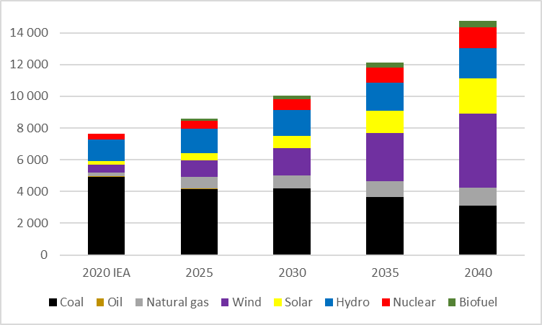
Reference Scenario
China Update!
Electricity generation in TWh -Current policies scenario
Strengthening its Emissions Trading System (ETS): 4000 Mt CO₂ reduction by 2030 for electricity generation.
The Chinese ETS price reaches 16 US$ in 2030, from the current average price of 9 US$
The share of electricity generated by non-fossil energy reaches 50% in 2030 and 69% in 2040
Source: Year 2020: IEA (2020) statistics, Other Years: Authors’ estimation.
Notes:
Share of non fossil 50% in 2030
69% in 2040

Slide 19
Counter Policy Action: BRIC
Target: Capture Trade Dynamics & Political Consideration
EU Significant decline in both steel and aluminum production
Russia worse off
Other countries including China better off
 | Production | Exports | Imports | Welfare | GHG emissions in Mt CO2-eq
EU27+UK | -10,809 | -12,872 | -5,622 | -4843 | 0
China | 13,981 | -5,859 | -13,836 | 3237 | 2.6
India | 4,282 | -1,241 | -3,645 | 1028 | 4.4
Russia | 11,830 | -4,726 | -12,759 | -3336 | 6.2
Brazil | 1,618 | -908 | -2,310 | 370 | 0.4

Slide 20
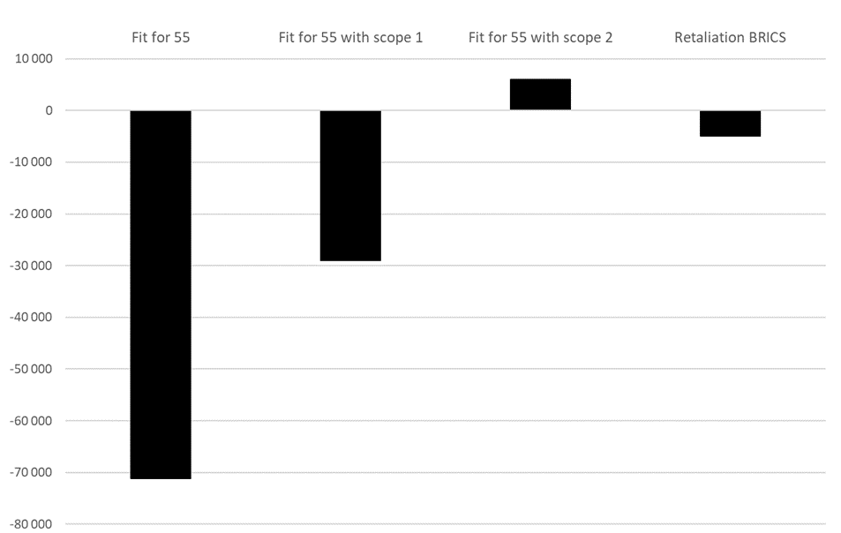

Slide 21
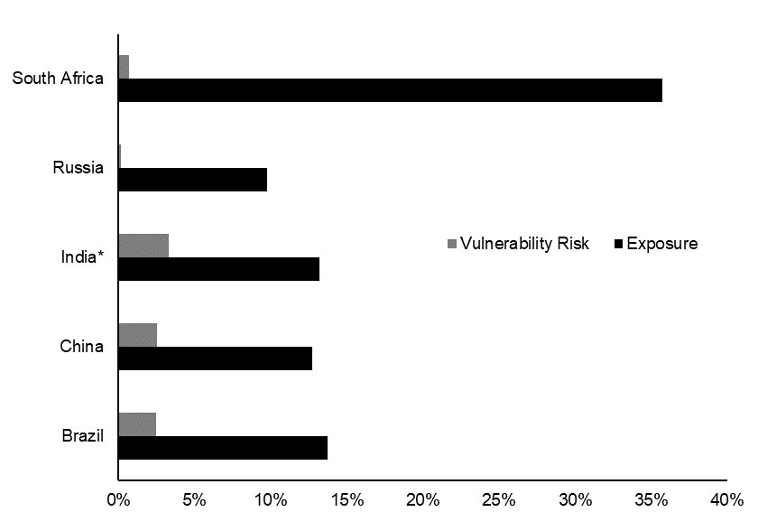

Slide 22
Main Findings
 | China |  |  | EU27+UK
 | Production | Welfare | Environment | Production | Welfare
Duties on European imports | 13,981 | 3,841 | -3.0 | -4,413 | -1,628
Export subsidies | 13,981 | -2,880 | -2.7 | -774 | 706
Subsidies on production | 13,981 | 1,099 | -4.7 | -684 | -35
Chinese Government pays CBAM | 5,087 | 1,533 | -1.2 | -6,560 | -1,852
CO2 Compensation | -65,126 | -59,343 | 838.9 | -1,264 | -1,363
Full CO2 Compensation on EU export | ,416 | 595 | 2.8 | -3,297 | -1,028
Chinese full CO2 Compensation on export to EU | 4,617 | 1,248 | 2.4 | -6,067 | -1,849
Green electricity | -13,436 | 14,991 | 489.2 | -1,616 | -571
Green electricity only on export to EU | 1,974 | 879 | 1.2 | -2,550 | -695
Increase of BRIC duties on European imports | 13,981 | 3,237 | -2.6 | -10,809 | -4,843
Notes:
Focusing retaliatory measures to EU by imposing duties on import from EU → max welfare

