Slide 1

The Inconvenient Truth about Web Certificates
Nevena Vratonjic
Julien Freudiger
Vincent Bindschaedler
Jean-Pierre Hubaux
June 2011, WEIS’11

Slide 2








HTTPS
Secure communication
  e-banking, e-commerce, Web email, etc.
  Authentication,
  Confidentiality
  and Integrity
https://www.bankofamerica.com
HTTPS
Impersonation
Authentication
Modifications
Eavesdropping
Integrity
Confidentiality

Slide 3
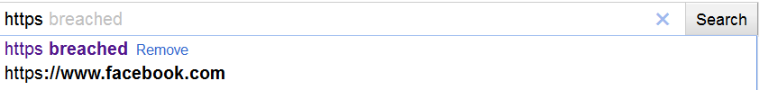
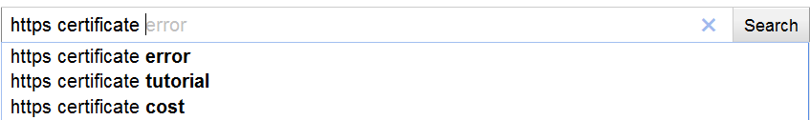
HTTPS in practice
HTTPS is at the core of online businesses
Provided security is dubious
  Notably due to obscure certificate management

Slide 4
Research Questions
Q1: At which scale is HTTPS currently deployed?
Q2: What are the problems with current HTTPS deployment?
Q3: What are the underlying reasons that led to these problems?
Large-scale empirical analysis of the current deployment of HTTPS on the top 1 million websites

Slide 5
Methodology
1 million most popular websites (Alexa’s ranking)
Connect to each website with HTTP and HTTPS
Store:
  URLs
  Content of Web pages
  Certificates

Slide 6
Q1: At which scale is HTTPS deployed?
1/3 of websites can be browsed via HTTPS
Is this too much or too little?

Slide 7
Login Pages: HTTP vs. HTTPS
77.4% of websites may compromise users’ credentials!
More Web pages should be served via HTTPS!

Slide 8

Q2: What are the problems with current HTTPS deployment?
HTTPS may fail due to:
Server certificate-based authentication
Cipher suites
  The majority ( 70%) of websites use DHE-RSA-AES256-SHA cipher suite
?

Slide 9
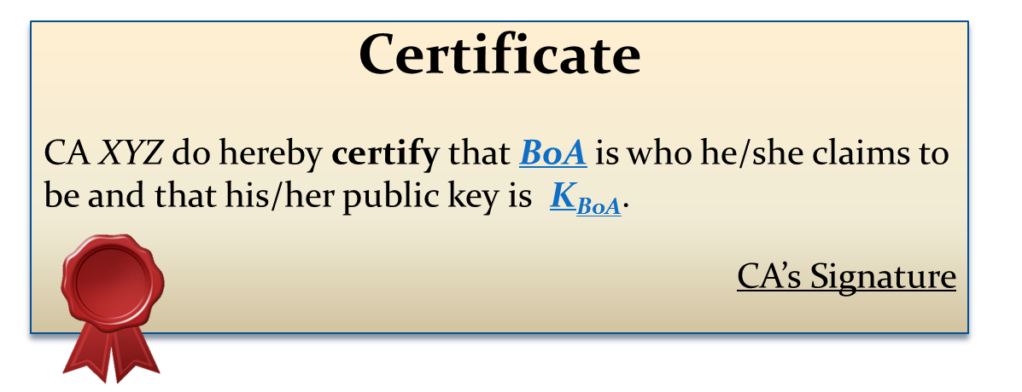
Certificates
X.509 Certificates: Bind a public key with an identity
Certificates issued by trusted Certification Authorities (CAs)
  To issue a certificate, CAs should validate:
  The applicant owns the domain name
  The applicant is a legitimate and legally accountable entity
  Organization Validated (OV) certificates
BoA’s
public
key
CA XYZ
K_{BoA}
Two-step validation
BoA’s
identifying information & domain name
www.bankofamerica.com

Slide 10
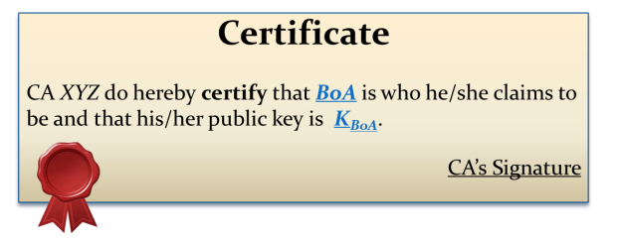
Certificate-based Authentication
  Chain of trust
    Public keys of trusted CAs pre-installed in Web browsers
https://www.bankofamerica.com
HTTPS
Browser: K_{CA}
Authentication

Slide 11

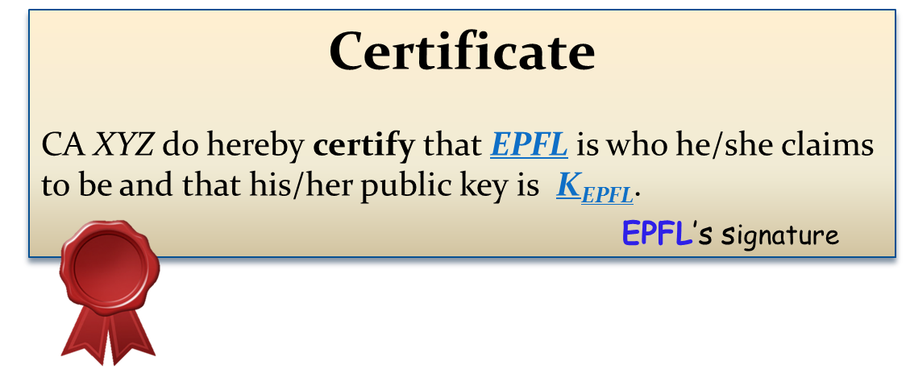
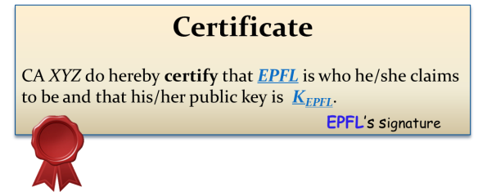
Self-signed Certificates
  Chain of trust cannot be verified by Web browsers
https://icsil1mail.epfl.ch
?
?
Browser: K _{EPFL} ?
Authentication

Slide 12
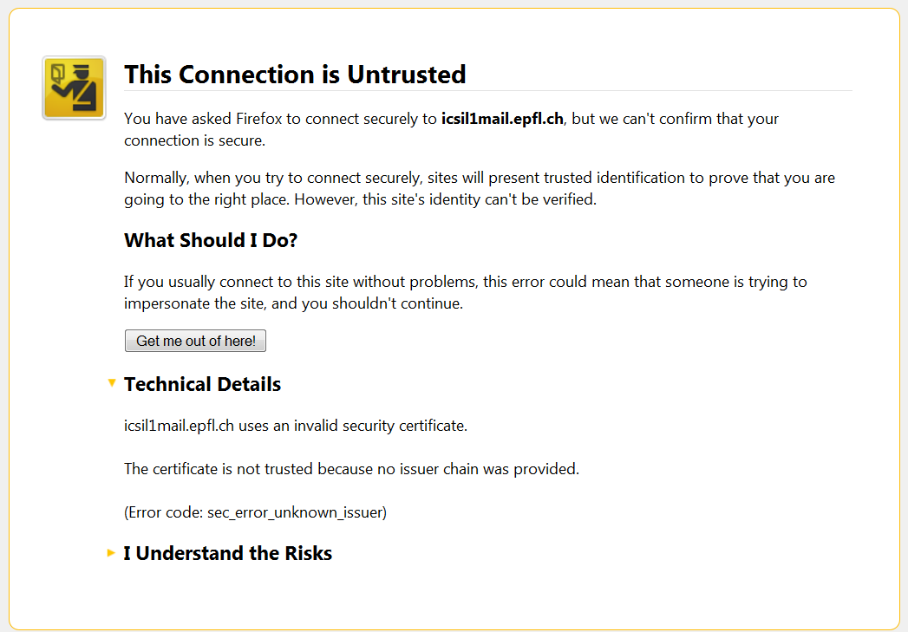
Self-signed Certificates

Slide 13
Verifying X.509 Certificates
Trusted CA
Not expired
Domain match
Successful
authentication

Slide 14
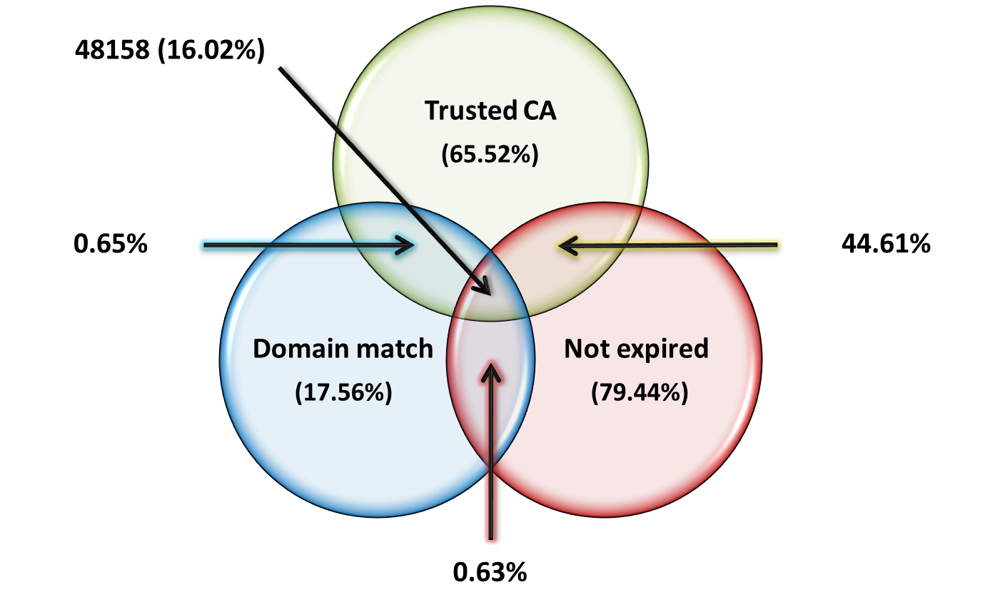
Authentication Success
  Total of 300’582 certificates

Slide 15
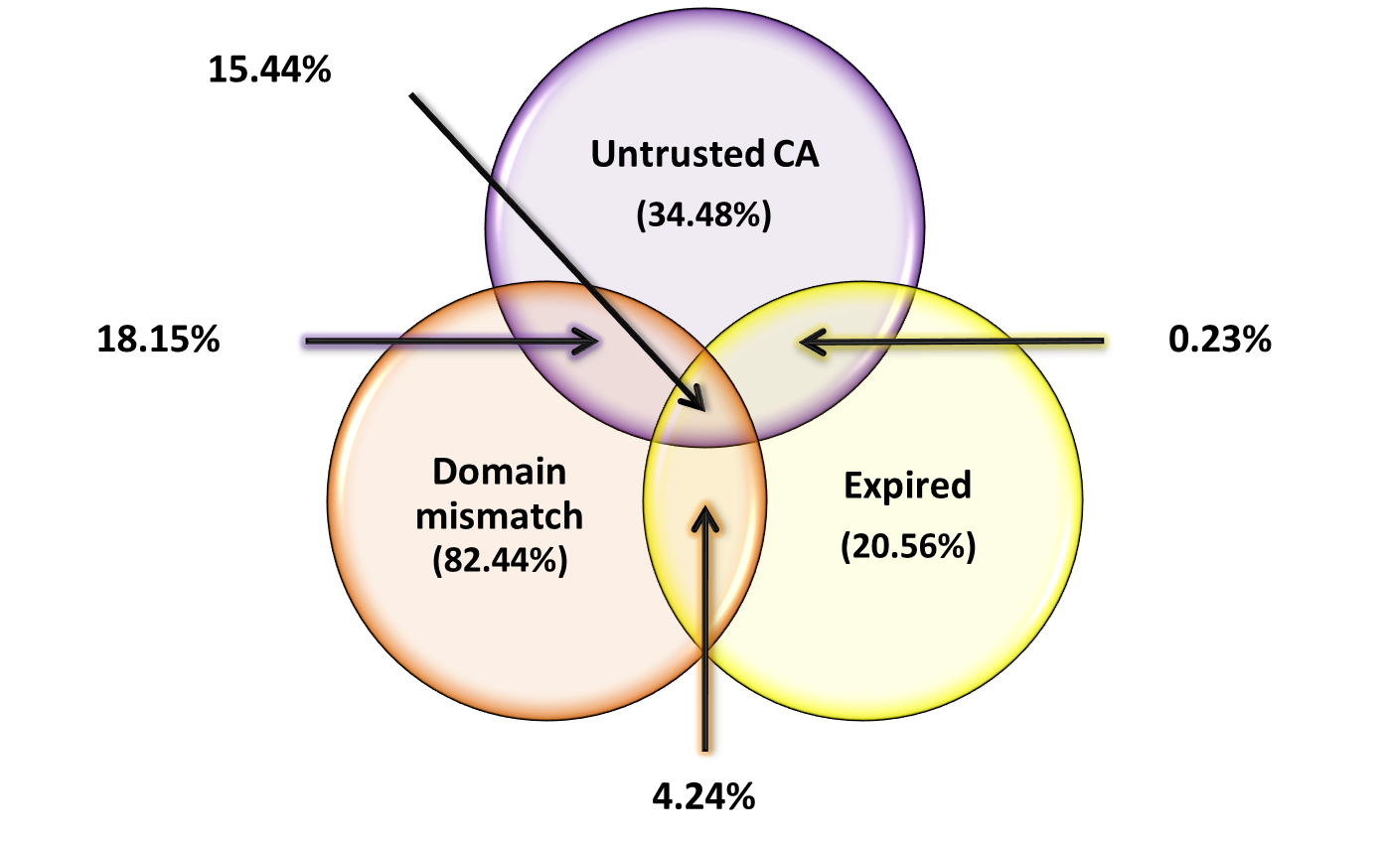
Authentication Failures
  Total of 300’582 certificates

Slide 16
Certificate Reuse Across Multiple Domains
Mostly due to Internet virtual hosting
Certificate Validity Domain | Number of virtual hosts
*.bluehost.com | 10’075
*.hostgator.com | 9’148
*hostmonster.com | 4’954
Serving providers’ certs results in Domain Mismatch
Solution: Server Name Indication (SNI) – TLS extension
47.6% of collected certificates are unique

Slide 17
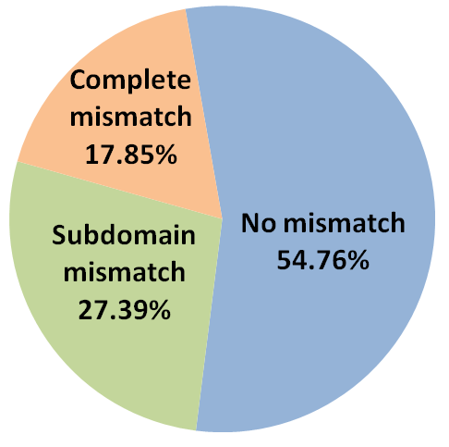
Domain Mismatch: Unique Trusted Certificates
45.24% of unique trusted certs cause Domain Mismatch
Subdomain mismatch: cert valid for subdomain.host deployed on host and vice versa

Slide 18
Authentication Success
  Total of 300’582 certificates

Slide 19
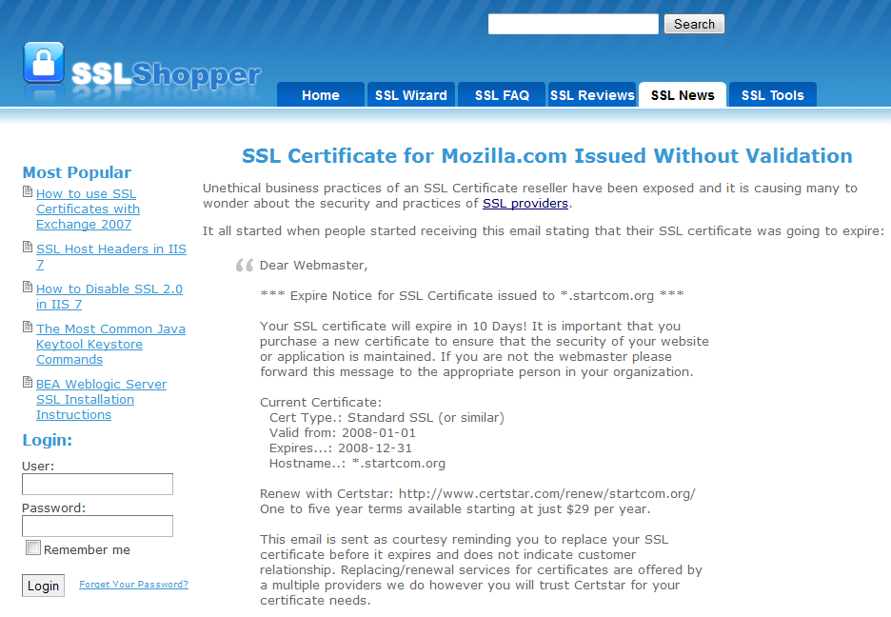
Trusted DVO Certificates
Domain-validated only (DVO) certificates
  The applicant owns the domain name
  The applicant is a legitimate and legally accountable entity
  Based on Domain Name Registrars and email verification
Problem: Domain Name Registrars are untrustworthy
Legitimacy of the certificate owner cannot be trusted!

Slide 20
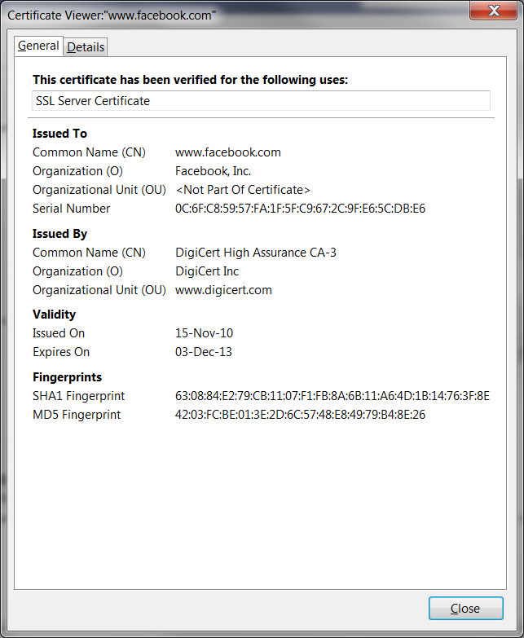
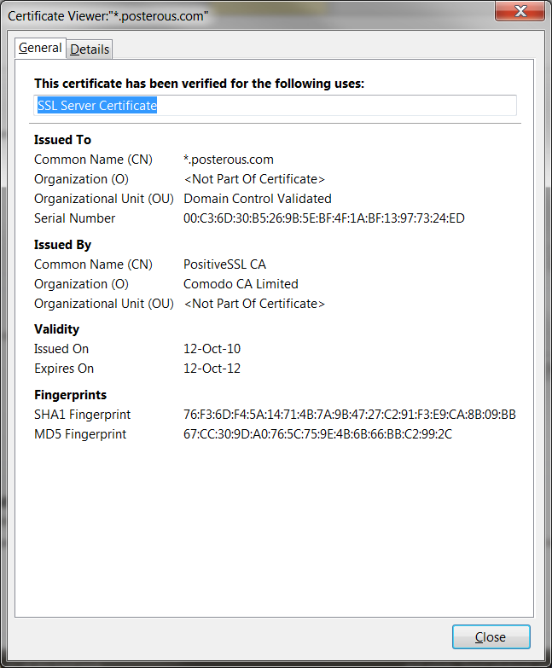
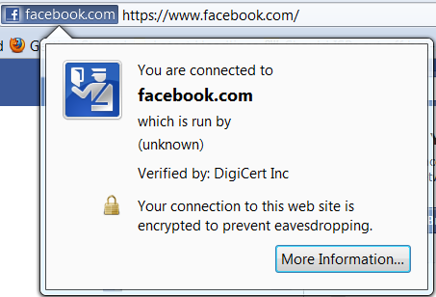
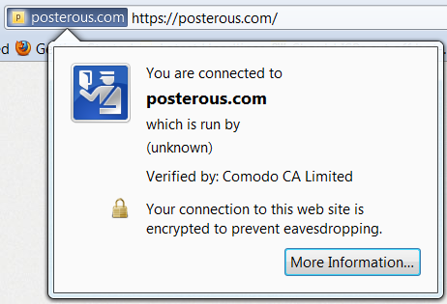
Domain-validated Only (DVO)
Organization Validated
(OV)
Organization Validated
Organization NOT Validated
Trusted
Trusted

Slide 21
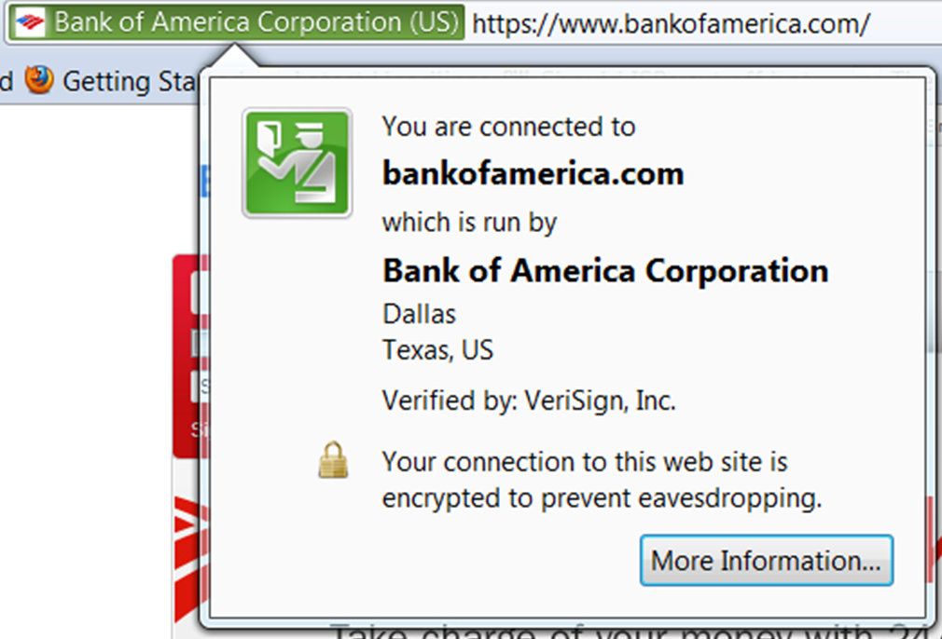
Trusted EV Certificates
Extended Validation (EV)
  Rigorous extended validation of the applicant [ref]
  Special browser interface

Slide 22
DVO vs. OV vs. EV Certificates
Certs with successful authentication
(48’158 certs)
61% of certs trusted by browsers are DVO
5.7% of certs (OV+EV) provide organization validation
22

Slide 23
Research Questions
Q1: How is HTTPS currently deployed?
  1/3 of websites can be browsed via HTTPS
  77.4% of login pages may compromise users’ credentials
Q2: What are the problems with current HTTPS deployment?
  Authentication failures mostly due to domain mismatch
  Weak authentication with DVO certificates

Slide 24
Q3: What are the underlying reasons that led to these problems?
Economics
  Misaligned incentives
    Most website operators have an incentive to obtain cheap certs
    CAs have an incentive to distribute as many certs as possible
  Consequence: cheap certs for cheap security
Liability
  No or limited liability of involved stakeholders
Reputation
  Rely on subsidiaries to issue certs less rigorously
Usability
  More interruptions users experience, more they learn to ignore security warnings
  Web browsers have little incentive to limit access to websites

Slide 25
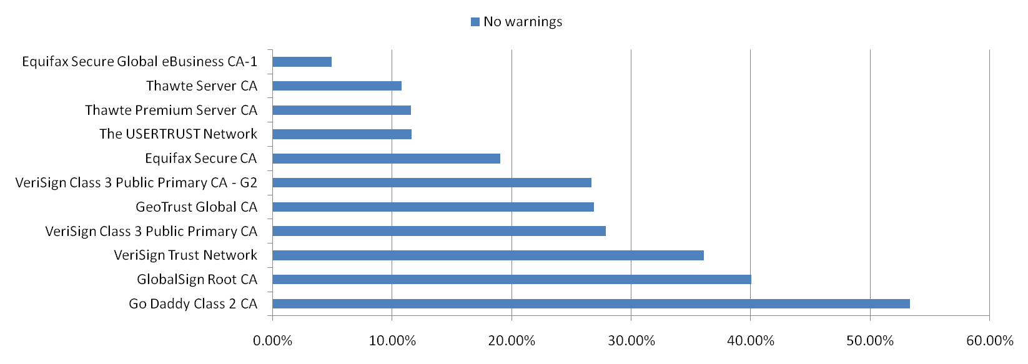
Countermeasures
New Third-Parties:
  Open websites managed by users, CAs or browser vendors
  Introduce information related to performances of CAs and websites
New Policies:
  Legal aspects
    CAs responsible for cert-based auth.
    Websites responsible for cert deployment
  Web browser vendors limiting the number of root CAs
    Selection based on quality of certs
Authentication Success Rate wrt. CAs

Slide 26
Conclusion
Large-scale empirical study of HTTPS and certificate-based authentication on 1 million websites
5.7% (18’785) implement cert-based authentication properly
  No browser warnings
  Legitimacy of the certificate owner verified
Market for lemons
  Information asymmetry between CAs and website operators
  Most websites acquire cheap certs leading to cheap security
Change policies to align incentives

Slide 27
Data available at:
http://icapeople.epfl.ch/freudiger/SSLSurvey

