Slide 1
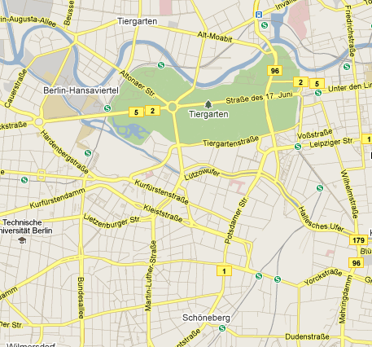



Private Sharing of User Location over Online Social Networks
Julien Freudiger, Raoul Neu and Jean-Pierre Hubaux - EPFL, Switzerland
HotPETs, Berlin, July 2010

Slide 2








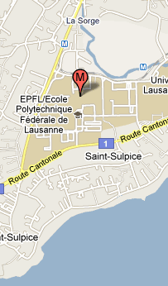

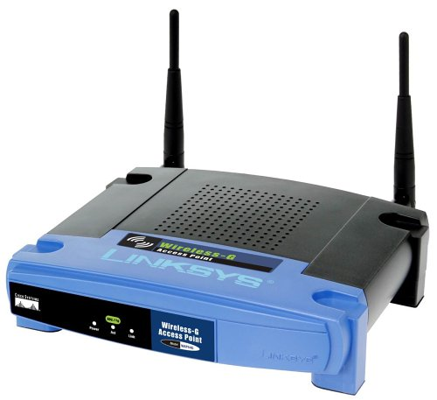
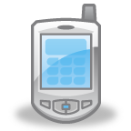
1. Localization
2. Visualization
3. Sharing
Alice: 46.651,6.561
Bob: 46.652,6.562
Chris: 46.653,6.563
GPS
Lat: 46.65
Lon: 6.561
WiFi
Notes:
Use localization capability of mobile devices.
We are not considering pure location based services. Instead location sharing services over online social networks. So PIR, PSI, and cloaking don’t work.
Contact three types of location servers.

Slide 3













Online Social Networks with
Location Sharing Services (LSS)
LBS Coordinator
Notes:
Location sharing control problems: misconfiguration, permanently stored on server, API to spread info more easily. Hard to share only with subgroup (ala community detection)
How to control spread of location information?
Users are linkable.

Slide 4
Privacy Threats
Location Sharing Services and passive eavesdroppers can collect user locations
Localization attack
Profiling attack
Retroactive attack
Notes:
Location is Identity

Slide 5
Goal
Design application for private sharing of user Location
CLIENT SERVERS
Application PrivL
  Client-side application
  Works with existing location sharing services
  Privacy by design

Slide 6

Privl description
privl.sourceforge.net

Slide 7
Privacy-Preserving Mechanisms
Localization & Visualization
  Cache
  Dummy Queries
Sharing
  Encryption
  Ephemeral Storage
Notes:
Idea of using dummies not new. Used in gps traces. Results show that it is hard to do in a realistic fashion. We test and measure cost. Since done on mobile cell phone.

Slide 8
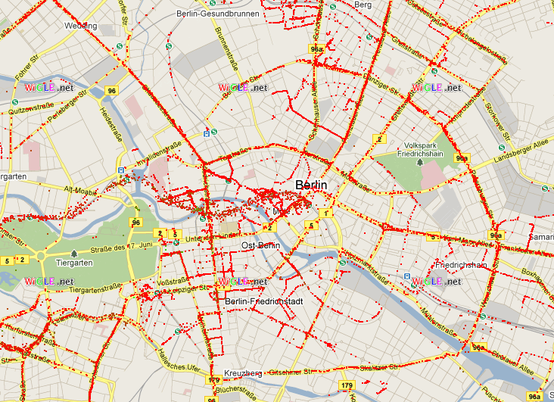
Privacy-Preserving Localization
Caching
Internet
        dummy queries
MAC1
SIGNAL: -62 dB
QUERY: (MAC1, -62dB; MAC2, -80dB; MAC3, -70dB)
SIGNAL: -70dB
RECEIVE: (Lat: 46.653, Lon: 6.561)
MAC2
SIGNAL: -80 dB
QUERY: (MAC1, -62dB; MAC2, -80dB; MAC3, -70dB)
Local
RECEIVE: (Lat: 46.653, Lon: 6.561)
Cache from Wigle.net
MAC3
Notes:
GPS provides good privacy
Ask user where he’s mainly located to cache Access point database.
How do we put db values in dummy requests.
Add image of wigle.net
PROBLEM -> service knows location

Slide 9
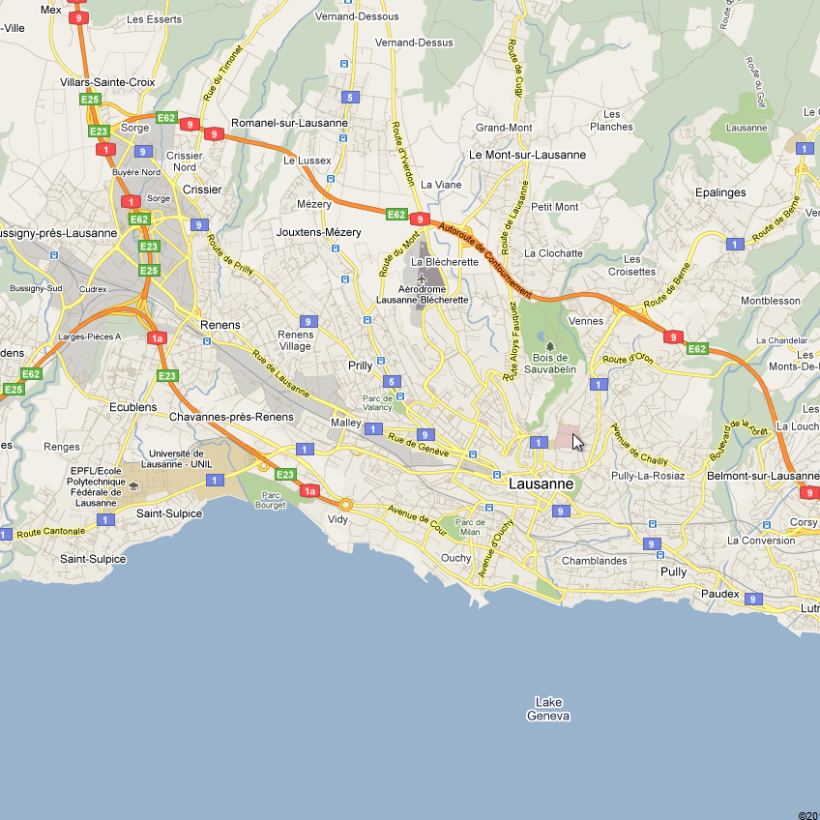
Privacy-Preserving Localization
Query Obfuscation with Dummies
14h10
14h12
14h15
Notes:
Learn from dummies => improve local database.

Slide 10

Clever Dummy Queries
Constraints
  Spatial
  Temporal
  Statistical
Generate virtual identities
TH You, WC Peng, WC Lee. Protecting moving trajectories with dummies. In PALMS 2007
MC González, CA Hidalgo, AL Barabási. Understanding individual human mobility patterns. Nature. 2008
Notes:
Trackmenot
What should we do? We can follow statistic of users mobility => leak something. But we need to follow human mobility statistics.

Slide 11
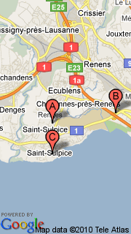
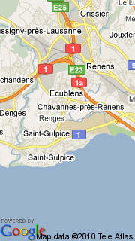
Privacy-Preserving Visualization
Attribute Obfuscation
User: 46.52, 6.55
A: 46.52,6.56
B: 46.52,6.59
C: 46.51,6.56
Center: 46.51, 6.57
Local
Javascript
Notes:
PROBLEM -> SOLUTION
Google Maps: by center
Bing Maps: by Bounding Box

Slide 12
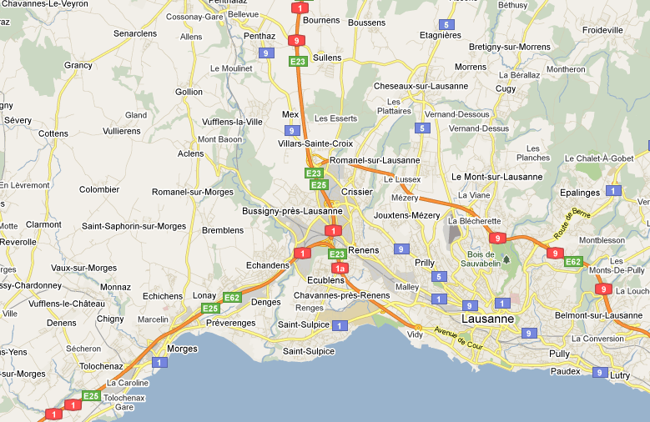
Privacy-Preserving Visualization
Query Obfuscation & Caching
Notes:
Ask user where he’s mainly located to cache map database.
Fifo cache and virtual identity of friends.
Social virtual identities.

Slide 13
Privacy-Preserving Sharing
Security Association
A
B
Side channel for secret sharing
  Bluetooth
  SMS (trust in cellular operator)
  Phone Call
Obtain pairwise secret K_{i}
Notes:
Could use PKI in future

Slide 14
Privacy-Preserving Sharing
Ephemeral Storage
LSS
Standard
username: (lat, lon)
Location Format
(lat, lon) ⊂ ([-90,90], [-180,180])
Private
username: AES_{Ki}(lat, lon)
DHT
Ephemeral Private
username: (reference1, reference2)
reference1_reference2 : AES_{Ki} (lat, lon)
R Geambasu, T Kohno, A Levy, HM Levy. Vanish: Increasing data privacy with self-destructing data. USENIX. 2009
Notes:
PROBLEM: cleartext -> SOLUTION: aes
PROBLEM: format -> SOLUTION: dht
AES 265 CBC (cipher block chaining) mode, 5 rounds
key size is currently set to 128 bytes

Slide 15
Implementation
QT Framework: Cross platform (Symbian, MeeGo)
Generic Client: Works with any LSS operator
Privacy by Design: Build in privacy
Open Source: PrivL.sourceforge.net
Notes:
LOC: 2822 lines of C++
Garnter (Feb’10): Smybian 46.9%, RIM 19.9, iPhone 14.4%

Slide 16
Demo

Slide 17

Application Performances
Privacy, ok, but at what cost?

Slide 18
Localization Overhead
Localization method

Slide 19
Sharing Overhead
Mode

Slide 20
Conclusion
Localization, Visualization & Sharing
  Cache: Fast, not always scalable
  Dummy Queries: Little computation overhead, hard to fake
  Broadcast Encryption: Little overhead
  Ephemeral Storage: 5x slower than standard storage
PrivL: First implementation of client-side PET
for user location sharing
Future work
  Privacy evaluation of clever dummy queries
  Interface to other LSSs
  Enhance GUI
Notes:
Enhance Privacy -> Possible

Slide 21

Private Sharing of User Location over Online Social Networks
Julien Freudiger, Raoul Neu and Jean-Pierre Hubaux – EPFL, Switzerland
Lca.epfl.ch/privacy - julien.freudiger@epfl.ch - twitter.com/jfreudiger

Slide 22
Backup SLides
Just in case

Slide 23
Memory Usage
MBytes

Slide 24
Communication Overhead
Bytes
# of dummies

Slide 25
Scalability
# of friends

Slide 26
Details of Sharing Architecture
LSS (3rd party server)
DHT (ephemeral storage)
Account of User A
My Friends
Key
Value
2
Friend1
UserA:Friend1:Lat’:Lon’ AES_{key1}(Lat, Lon)
Friend2
UserA:Friend2:Lat’:Lon’ AES_{key2}(Lat, Lon)
Friend3
UserA:Friend3:Lat’:Lon’ AES_{key3}(Lat, Lon)
My Position:
(Lat’, Lon’)
UserA:UserA:Lat’:Lon’ AES_{key0}(Lat, Lon)
6
5
PrivL (client)
encrypt
4
3
1
DHT Reference
(Lat’ ,Lon’) = RNG([-90,90], [-90,90])
SA
AES Session Key
WiFi / GPS
Position of UserA : (Lat, Lon)

Slide 27
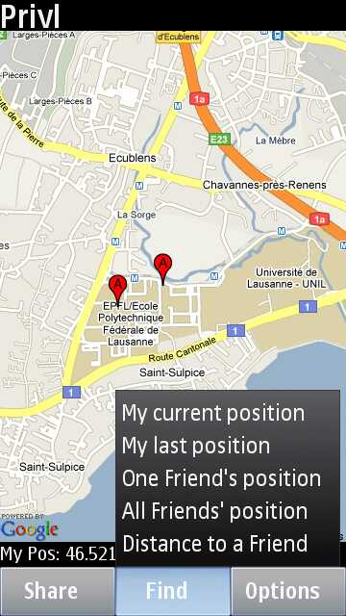
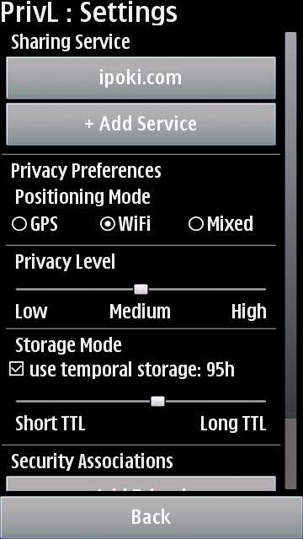
ScreenShots
        PrivL.sourceforge.net

Slide 28
Related Work
Information Sharing
Social Networks
  Noyb (Firefox Plugin): “dictionaries” to convert ciphertext into proper format
  Flybynight (Facebook App): Encrypt free-text data in Facebook
  Access Control (Firefox Plug-in by Beato et al.): Access control in social networks
Location Sharing
  Locaccino (Platform): User-defined rules to control location sharing
  Tsai (Survey): Analysis of privacy policies in LBS
Notes:
Sharing based on these ideas (+location_format +mobile_ressources +vanish_retroactive)
New: location/map retrieval
Flybynight: ELGamal, only fixed fields
Noyb: AES
Beato: hide all information from SNS

Slide 29
Related Work
Broadcast Encryption
n = number of Users
r = number of revoked Users
s = ciphertext size
s = O(r)
s = O(sqrt(n))
s = O(n-r)
r
r = 0
NNL
BWG
trivial
C. Delerablée, P. Pailler and D. Pointcheval. Fully collusion secure dynamic broadcast encryption with constant size ciphertexts or decryption keys. In Pairing, 2007
Notes:
No implementation

Slide 30
Caching Wireless Access Points
Cache access points in user-defined Area of Interest
  Select a city (e.g. Lausanne)
  City name => GPS coordinates
    Lausanne -> (46.5196168, 6.6322095)
  Area is a square centered on this point
      46.5296168 , 46.5296168
      66.6422095, 6.6222095
  Query WiGLE.net
Notes:
Area = current city eg

Slide 31
Wireless Triangulation API
{ "version": "1.1.0",
"host": "maps.google.com",
"request_address": true,
"cell_towers": [ { "cell_id": 42
"location_area_code": 415
"mobile_country_code": 310
"mobile_network_code": 410],
"wifi_towers": [ { "mac_address": "01-23-45-67-89-ab",
  "signal_strength": 8]
}

Slide 32
Ipoki.com API
Users should be authenticated using the Ipoki plugin.
/signin.php?user=[username]&pass=[password]&ver=[optional plugin version]
'CODIGO$$$'.[session id].'$$$'.[server URL].'$$$'.[0=no update, 1=optional update, 2=must update].'$$$‘
Set the user's location.
/ear.php?iduser=[session id]&lat=[latitude]&lon=[logintude]&h=[altitude]&speed=[speed]&
to=[to]&comment=[comment]&action=[action]&change=[status change]
if ($alert) {echo 'ALERT$$$' . [alert text] . '$$$' . [URL] . '$$$' . [latitud] . '$$$' . [longitude] . '$$$' . [radio] . '$$$' . [username] . '$$$'; } else if ($comment) {echo 'COMMENT$$$' . [user] . '$$$' . [comment] . '$$$' . [action].'$$$';} else {echo 'OK'; }
Get the location of a user.
/readposition.php?iduser=" + [session id]
(-999.999999,-999.999999)
Get a list of friends for the calling user and their location.
/myfriends.php?iduser=" + [session id]
"$$$".[username]."$$$".[latitude]."$$$".[longitude]."$$$".[session key];

