Slide 1
Secure Neighbor Discovery in Wireless Networks
Marcin Poturalski, Panos Papadimitratos, Jean-Pierre Hubaux

Slide 2
Neighbor Discovery (ND)
“Who are my neighbors?”
In wireless networks:
“Can I communicate directly with B?”
Fundamental Building Block

Slide 3
Neighbor Discovery:
Routing in ad-hoc networks
C
A
B

Slide 4
Naïve Neighbor Discovery
“A: Hello”
A
B
A is a neighbor

Slide 5
Naïve ND: relay attack
A
B
“A: Hello”
“A: Hello”
A is a neighbor
C
PHY preamble
PHY preamble
… MAC A …
… MAC A …
… IP A …
… IP A …
…
…
“A:Hello”
“A:Hello”
…
…

Slide 6
Routing in ad-hoc networks:
Violation of ND
D
B
A
C
M

Slide 7
Routing in ad-hoc networks:
Violation of ND

Slide 8
ND is an important and fragile building block
Secure ND protocols have been proposed
  Distance Bounding
Does not quite solve the problem…
To what extent is secure ND possible?

Slide 9
Outline
Model of wireless networks
  language: set theory, 1st order logic
Specification of ND
Investigate two classes of protocols:
  Time-based (T-protocols)
  Time- and Location-based (TL-protocols)
Results:
  T-protocol ND impossibility (general case)
  T-protocol solving ND (restricted case)
  TL-protocol solving ND (general case)

Slide 10
Model

Slide 11

Traces and events
Trace is a set of events
A
B
C

Slide 12
Feasible traces
System execution: feasible trace
Traces feasible with respect to:
- setting S
- protocol P
- adversary A
Θ
Θ_{S}
Θ_{S,P}
Θ_{S,P,A}

Slide 13


Setting
…
…
…
E
F
{ A, B, C, D, E, F, G, H }
C
D
H
A
B
G

Slide 14



Trace θ feasible wrt setting S
Causal and timely message exchange
v – signal propagation speed
A
B

Slide 15
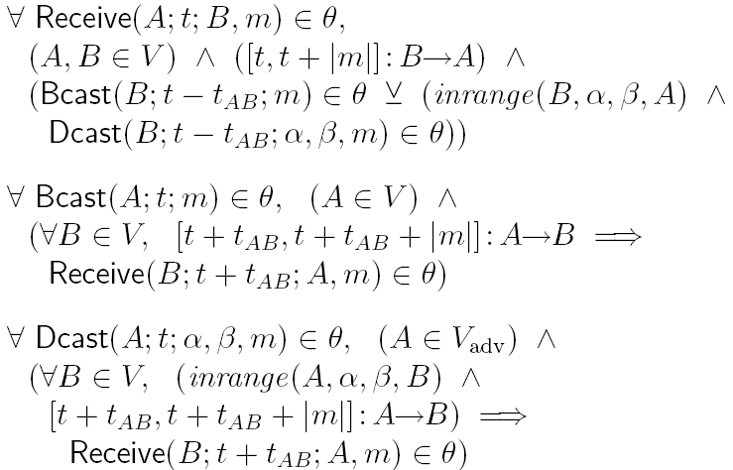
Trace θ feasible wrt setting S
Causal and timely message exchange

Slide 16





Local trace
A
B

Slide 17

Local view

Slide 18



Protocol
Actions:

Slide 19
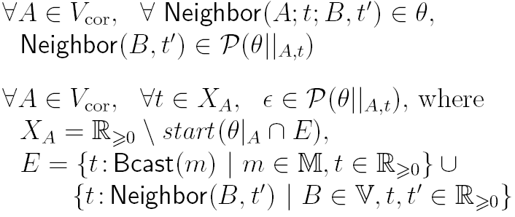
Trace θ feasible wrt protocol
Correct nodes follow the protocol

Slide 20




Trace θ feasible wrt adversary
Adversarial nodes can only relay messages,
with minimum delay
A

Slide 21
Neighbor Discovery Specification

Slide 22

Neighbor Discovery specification
Protocol P solves Neighbor Discovery for adversary A if
Discovered neighbors are actual neighbors
It is possible to discover neighbors

Slide 23



Neighbor Discovery specification
Protocol P solves Neighbor Discovery for adversary A if
2-party ND
Discovered neighbors are actual neighbors
It is possible to discover neighbors
in the ND range R
…

Slide 24
Results
T-protocol ND impossibility (general case)
T-protocol solving ND (restricted case)
TL-protocol solving ND (general case)

Slide 25
Results
T-protocol ND impossibility (general case)
T-protocol solving ND (restricted case)
TL-protocol solving ND (general case)

Slide 26

T-protocol impossibility
No T-protocol can solve Neighbor Discovery
for adversary if
Proof (sketch):
Any T-protocol P which satisfies ND2 cannot satisfy ND1

Slide 27



T-protocol impossibility
A
B
A
B
C

Slide 28
T-protocol impossibility
A
B

Slide 29


T-protocol impossibility
A
B
A
C
B

Slide 30
T-protocol impossibility
A
C
B
Trace θ ^{b} is feasible in S^{b}
A declares B a neighbor in θ ^{b}
A and B are not neighbors in S^{b}
ND1 is violated
A
B
C

Slide 31
Results
T-protocol ND impossibility (general case)
T-protocol solving ND (restricted case)
TL-protocol solving ND (general case)

Slide 32

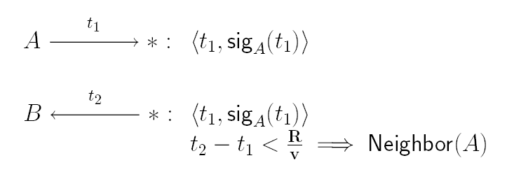
T-protocol solving ND
Temporal packet leash:

Slide 33
Results
T-protocol ND impossibility (general case)
T-protocol solving ND (restricted case)
TL-protocol solving ND (general case)

Slide 34
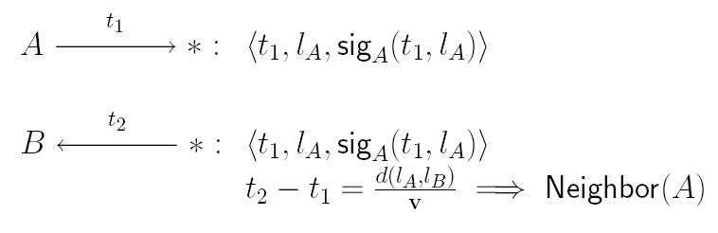
TL-protocol solving ND
“Geo-Temporal” packet leash:

Slide 35
Conclusion
Investigation of Neighbor Discovery in wireless networks for two general classes of protocols
T-protocols can solve ND iff
TL-protocols can solve ND if

Slide 36
Conclusion
Problems with proposed protocols:
  require synchronized clocks
  require very accurate time measurements
  require line-of-sight communication (TL)
  require secure location (TL)

Slide 37
Future work
Reasoning about a wider range of protocols
  e.g. Challenge-Response schemes
Multi-party ND?
Moving closer to the physical layer
  ?

